Slide 1
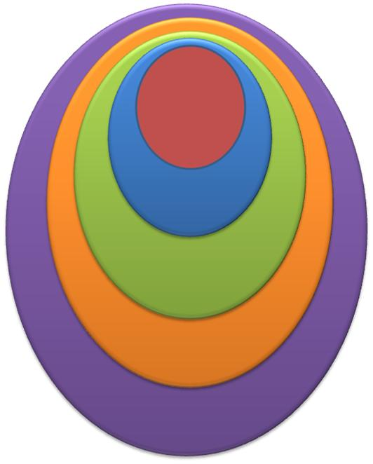
Systems Based Practice
American Society of Hematology
Atlanta, GA
December 7, 2012
http://www.screencast.com/t/CuChNEvh04
Notes:
Welcome to this lecture on Systems-Based Practice. This is the ACGME competence that is arguably the most difficult to teach and evaluate. It may be difficult because it is part of everything we do to deliver care. We take it for granted. We see it as something outside of our control. I hope to change that view in this lecture.

Slide 2

Objectives
Teach Systems Based Practice by having learners work in the specialty’s various microsystems
Teach the anatomy and physiology of clinical microsystems for quality, safety, and joy in work
Use coordination of care across microsystems to teach the importance of competence SBP
Structure teaching and evaluation to assure learners can do the EPAs for an SBP Milestone
Notes:
At the completion of this lecture you will have some good ideas about how to
Teach systems Based Practice by having learners work in the specialty’s various microsystems.
Teach the anatomy and physiology of clinical microsystems for quality, safety, and joy in work
Use coordination of care across microsystems to teach the importance of competence in SBP.
Structure teaching and evaluation to assure that learners can do the EPAs of an SBP Milestones

Slide 3
ACGME Systems-Based Practice
Demonstrate awareness & responsiveness to system of health care.
Work in various health care settings
Coordinate patient care
Use cost/benefit analysis in patient and population-based care
Advocate for quality patient care
Work in interprofessional teams to improve safety and quality
Identify system errors & implement systems solutions
Internal Medicine adds:
Transmit clinical information in transitions of care
Pediatrics adds:
Show how systems control cost, assure quality, & allocate resources
Advocate for population health promotion & disease prevention
Notes:
The ACGME Competence in systems based practice has 6 elements with one added by internal medicine and two by pediatrics.
This lecture will focus on four:
First, work in various health care settings
Second, coordinate patient care
Next, work in interprofessional teams to improve safety and quality,
And transmit clinical information in transitions of care.

Slide 4
Health Care Systems
Patient Self-Care
Patient-Physician
Clinical Microsystem
Macro- Organization
Policy, Finances, Market, Community
Notes:
First, lets develop the concept of systems in health care,
Paul Batalden from Dartmouth Medical School describes the health care system as embedded subsystems
beginning with the patient self care system, which includes the patient’s family and home caregivers.
Next is the Patient-Provider system which is the focus of most of our medical education.
The Clinical Microsystem is a new concept. Batalden describes it as the frontline organization where care is delivered, outcomes achieved, and patient expectations are met. This lecture will focus on the anatomy and physisiology of the clinical microsystem. This concept is essential for understanding systems-based practice and practice-based learning and improvement.
When several microsystems are organized into a Macro-organization, we call that a health system. It is created by microsystems agreeing to follow common rules of practice and usually use the same medical record keeping system.
The outer layer is the policies, finances, market, and community which sets the economic and cultural context and regulations for health care. This is the layer we usually think of as being “the health care system” and will not be a part of this lecture.

Slide 5
ACGME Competencies and Systems
Medical Knowledge
Patient Self-Care
Communication & Interpersonal Skills
Professionalism
Patient-Physician
Clinical Microsystem
Patient Care
Macro- Organization
System Based Practice
Policy, Finances, Market, Community
Practice-Based Learning & Improvement
Notes:
Each of the ACGME competencies are learned and evaluated in one or more of these systems levels.
For example, Medical Knowledge is solidified at the provider-patient level,
As is communication and interpersonal skills, although the communication involved in team work is important at the clinical microsystem layer.
Professionalism also is learned in both the patient-provider and clinical microsystem levels.
As we will soon learn, Patient Care is a product of the clinical microsystem and can only be learned and evaluated in the context of real or simulated microsystems.
System-Based Practice is taught and learned by working in a variety of microsystems and understanding their individual roles in the larger macro-organization. Residents and fellows can gain a broader understanding of the ring of community context of care as it impacts on the care provided in the clinical microsystem.
I think of Practice-Based Learning and Improvement as being the twin competency to Systems-Based Practice. In addition to learning answers to clinical questions in practice, PBLI is learned through evaluating measures of care and participating in cycles of change aiming to improve the process and outcomes of care.

Slide 6
Milestones for SBP
System Based Practice
Patient Self-Care
6 MO- Describe the specialty’s microsystems
Patient-Physician
12 MO- Perform physician role in microsystem’s team
Clinical Microsystem
Macro- Organization
30 MO- Assures quality & safety of care provided by microsystems
Policy, Finances, Market, Community

Slide 7
Entrustable Professional Activities
System Based Practice
Patient Self-Care
6 MO- Describe the specialty’s Microsystems
Patient-Physician
Perform orientation to microsystem
Clinical Microsystem
Explain “metrics-that-matter” for microsystem
Macro- Organization
Policy, Finances, Market, Community
Diagram the work flow processes for microsystem
Notes:
The six month milestone might document that the resident understands systems based practice.
The EPA’s might be entrusted to perform an orientation to the microsystem
A second to explain “metrics-that-matter” for the microsystem
A third might be diagram the work flow processes used in microsystem.

Slide 8
Entrustable Professional Activities
System Based Practice
Patient Self-Care
12 MO- Performs physician jobs in microsystems
Patient-Physician
Performs consults, co-management, procedures, & team-based care for specialty patients
Clinical Microsystem
Macro- Organization
Adjusts team’s work flow to finish schedule of patient care on time
Policy, Finances, Market, Community
Notes:
The EPAs for the 12 month milestone might be
X the resident performs consults, co-management, procedures, and team-based care for specialty patients.
X a second might be adjusts work flow to finish scheduled patient care on time.

Slide 9
Systems-Based Practice
Competence To…
  Perform physician role in the healthcare team
  Perform microsystem processes , including improvement
Learned By…
  Working in multiple real microsystems
  Faculty observing and giving feedback on SBP to deliver and improve healthcare
Notes:
Simply stated system-based practice is competence to perform the physician role in a health care team and perform microsystem processes, including improvement in quality and safety of care.
SBP is learned through first-hand experience as a team member working in multiple in multiple real clinical settings, with faculty observing and giving corrective feedback on how the learner applies systems based practice to deliver and improve healthcare.

Slide 10
Paradigm Shift in Medical Work
Profession-Based
Systems-Based
Quality & safety result from Individual knowledge and skill
Quality & safety are system characteristics
Professional education improves outcomes of care
Improving system processes improves outcomes
Boards & memberships are evidence for quality outcomes
Objective measures are evidence of quality outcomes
Physician is craftsman who uses assistants to practice craft
Team of professionals work at the top of their licenses
Notes:
We are in a paradigm shift in the way we think about medical work.
X 50 years ago we were in the work model I call “Profession-Based.” Advances in information technology, organizational science, and quality in manufacturing and service have pushed medicine into system-based practice.
X In profession-based medicine, quality and safety are thought to result from the physician’s knowledge and skill. While in system-based practice, quality and safety are thought to be system characteristics.
X In the profession-based model, professional education is though to improve care, while systems-based practice shows that individual education is important, but to reliably improve outcomes we must improve the system processes that produce them.
X In profession-based medicine, board certification and society memberships are evidence for quality of care, while system-based practice requires objective measures for evidence of quality outcomes.
X In profession-based medicine, the physician is a craftsman who uses assistants to produce care, in system-based practice, a team of professionals working at the top of each license delivers care.

Slide 11
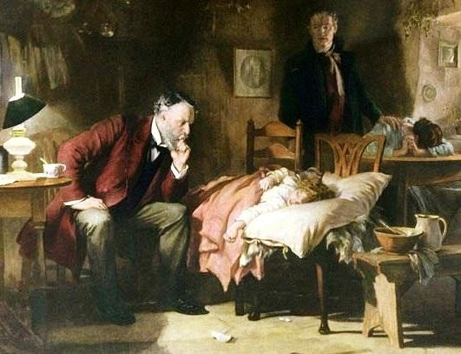
One Professional to One Patient
Notes:
The profession based approach has a dangerous nostalgia for an all knowing, personal physician who helped in the time of crisis He (and it was almost always he) did everything himself, carrying his tools in a black bag. Unfortunately, he had little to offer other than professional caring and comfort.

Slide 12
From Doctor to Practice System
Social Work
Specialist Consultant
One Doctor
One Patient
Drug Store
Lab or X-ray
Hospital
Notes:
The systems-based approach moves us from the one doctor to a practice system.
X For over 100 years we have relied on the professionals who compound medications and run drug stores, and on laboratory or x-ray services. The hospital has evolved to a highly technical center that provide complex life-saving care.
X The physician role has separated into over 150 subspecialties, and we have added a multitude of allied health professionals.

Slide 13
From Doctor to Practice System
Social Work
PSR
Specialist Consultant
MA
One Doctor
One Patient
Nurse
Drug Store
Business Office
Lab or X-ray
Medical Information & Records
Hospital
Health Insurance
Notes:
Even the doctor’s office, whether the primary care or specialist office, has changed. The doctor’s wife has been replaced by a professional nurse, medical assistant, receptionist or patient service representative.
X In the mid 60s when Medicare, Medicaid and office-based private insurance became the norm, business office professionals were needed to assure third-party payment for services.
X The Harrison’s textbook and PDR were replaced by internet-based medical information systems, and the paper medical record gives way to an Electronic Health Record.

Slide 14
From Doctor to Practice System
Social Work
We have failed to design roles & accountabilities that assure safe, high value care and joy in work
PSR
Specialist Consultant
MA
One Doctor
One Patient
Nurse
Drug Store
Business Office
This is Systems-Based Practice
Lab or X-ray
Medical Information & Records
Hospital
Health Insurance
Notes:
As this complex system has grown, we have failed to design roles and accountabilities that assure safe, high value care and joy in the work. We’ve relied on the individual professionals to do their job, without thoroughly understanding and designing how the systems-based practice differs from profession based care.

Slide 15

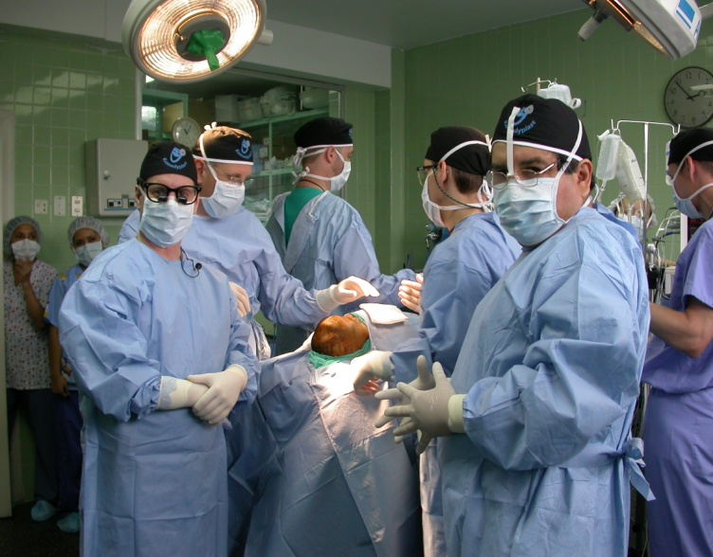
What makes Human Systems Work?
Frequent Communication
Timely Communication
Accurate Communication
Blameless Problem Solving
Shared Goals
Shared Knowledge
Mutual Respect
Jody Hoffer-Gittell – Relational Coordination Brandeis University
Notes:
What makes human systems work?
Jody Hoffer-Gittel partially answered this question by studying Southwest Airlines flight turnaround teams. She found it takes extraordinary competence in what we call communication and interpersonal skills. She calls it Relational Coordination
She identified seven characteristics of a Relational Coordination Index. None are surprising. Four deal with how we talk with each other: frequent, timely, accurate, and blameless problem-solving communication.
Three elements, shared goals, shared knowledge, and mutual respect, are components of teamwork described by others. Heffner-Gitell and Suchman have demonstrated that the relational coordination index identifies high and low performing medical microsystems and provides a language for guiding their improvement.

Slide 16
Promises Glue Systems Together
Make promises to one another
  Truth about the performance of the system
  Know our role in the interdependent processes that produce the work
Seek forgiveness when our promises are not kept and patients are misled or harmed by
  Inaccurate understanding of how the system performs,
  Failing to do our part in the interdependent work
Baltadin & Leach, 2009 JGME
Notes:
What holds human systems together?
It’s the promises we make to one another according to David Leach and Paul Batalden.
To keep our promises we must know the truth about how our system performs and our role in the processes that produce health care.
They warn that with imperfect knowledge about our systems and our interdependent roles we must also become skilled in seeking forgiveness when our promises are not kept and patients are misled or harmed.

Slide 17
Clinical Microsystem
Purpose
www.clinicalmicrosystem.org
Notes:
Let’s begin to understand the “black box” of system-based practice by unpacking the concept of the clinical microsystem.
This is the frontline people who engage patients. It is smallest replicable part of the health care system. It is where health care is delivered.

Slide 18
Clinical Microsystem
Purpose
The promises that hold the microsystem together
Quality Care
Quality Education
Sustainable Business
Joy in Work
www.clinicalmicrosystem.org
Notes:
The boundaries of the clinical microsystem are shown by the dashed rectangle.
The first of the 5 Ps will explore is the Purpose of the microsystem.
Baltaden and Leach describe the Purpose Statement as the shared assumptions and promises that hold people together in their work.
The purpose of a teaching microsystem might include quality care for a particular group of patients, quality education for students, residents, and fellows, sustainable business, and joy in work for those who commit their careers to the microsystem’.

Slide 19
Clinical Microsystem
Purpose
Needs
Patients
www.clinicalmicrosystem.org
Notes:
The second of the 5 Ps is the Patients who come to the clinical microsystem with needs to be diagnosed and treated. Understanding these needs from the patient’s’ perspective guides the design care processes to meet them.

Slide 20
Clinical Microsystem
Purpose
Needs
Met
Patients
www.clinicalmicrosystem.org
Notes:
As patients pass through our clinical microsystem, their needs are met and they leave satisfied with the experience of care and return to healthy or at least comforted life.

Slide 21
Clinical Microsystem
Purpose
Patients
Patients
Professionals
MDDO
PA NP
RN LPN
PSR MA
Social Work
Technician
Call/Web
Pharm D
www.clinicalmicrosystem.org
Notes:
The third P is the Professionals or People who work with the patients to meet their needs. The types and number of professional roles vary across microsystems.
The professional roles are the physicians, PA or Nurse Practitioners, Nurses, Patient Service Representatives, Medical Assistants,
Social workers, Technicians, phone or web-based person who makes appointments, answers calls, and arrange referrals, and some lucky practices have a Doctor of Pharmacy as a full-time or shared position.
Many learners working in a teaching clinical microsystems do not know the other member of the team. How could they possibly practice Relational Coordination?
In a workshop at the OU School of Community Medicine, we developed an orientation to rotations that includes the picture, name, role, and personal bio for each professional working in the clinical microsystem. We expect that residents and students rotating on the service will get to know who they will be working with in the microsystem.
1:25.2

Slide 22
Clinical Microsystem
Purpose
Processes
Patients
Patients
Professionals
www.clinicalmicrosystem.org
Notes:
The fourth P is the Processes that organize the work of the Professionals to deliver care.
A process is a standardized set of tasks. The process map shows the sequence of processes with internal hand-offs from one process to another. At the end of the train of processes, the diagram shows a stack of four processes designed to meet needs of specific groups of patients.
We can teach system-based practice by giving learners a microsystem process map and instructing them to walk through the processes from a patient’s perspective. The learner sees first hand the multiple steps, the waits, the handoffs, and the coordination needed for care. This walk-through should be completed before the learner begins to perform the physician role in the process train.

Slide 23
Clinical Microsystem
Purpose
Processes
Patients
Patients
Professionals
Registration &
Orientation to Practice
Rooming, Screening & Reconciliation
Diagnosis & Treatment Plan
www.clinicalmicrosystem.org
Notes:
Here are common processes that describe how we do our work to deliver care:
X The first process registers and orients the patient to the practice.
X the next, usually after a waiting room stop, is Rooming in which a nurse or medical assistant asks screening questions, records vital signs and updates problem, medication, and allergy lists,
X The third process is done by the physician to make a diagnosis, and develop a treatment plan.

Slide 24
Clinical Microsystem
Purpose
Prevention Care
Processes
Acute New Illness Care
Patients
Patients
Professionals
Chronic Care Management
High Risk Coordination
Registration &
Orientation to Practice
Rooming, Screening & Reconciliation
Diagnosis & Treatment Plan
www.clinicalmicrosystem.org
Notes:
Clinical microsystem have different processes for managing the between visit care for different types of patients.
X For example, one process assures that every patient receives Prevention Care.
X Another process assures patient access to acute new illness care by phone or today appointment,
X Some practices need a chronic care management process and professional role to provide lots of between visit care and follow-up, and
X Most practices need to develop processes for a few high risk patients who need nearly constant coordination of care, office visits, home visits, or communication with a nursing home staff to avoid hospitalizations or emergency department visits.

Slide 25
Clinical Microsystem
Purpose
Processes
Patients
Patients
Professionals
Measures That Matter
Patterns
www.clinicalmicrosystem.org
Notes:
The fifth “P” are the Patterns that define the microsystem’s culture.
X These patterns include the formal and informal team meetings and huddles throughout the day and week. It is how the team practices relationship coordination, teamwork, and how the team works on its work to improve it.
X The compass symbol on either side of the pattern field represent the “Measures-That-Matter” which measure and report patients’ needs and expectations, and indicators of outcome and process quality, patient satisfaction with the experience, and the cost of care for the benefit achieved.

Slide 26
Notes:
The Patient-Centered Medical Home is a model of care that applies the 5Ps of a clinical microsystem.
This model has been written into the Affordable Care Act as the basis for achieving better health and better care.
Ideally, all patients should have 24/7 access to people who know them and engage them in their care. All practices need a robust clinical information system to support the professionals to provide care coordination, team care, receive patient feedback, and be accountable for its quality.

Slide 27
Medical Neighborhood
Notes:
(Click) Now lets look at how the system-based care replaces the nostalgic one-professional to one-patient approach to care. I’ll show you a system map for the care of a 67 year old woman, Betty Armstrong. She has been well all her life, hard working and hasn’t seen a doctor for more than 25 years. Accompanied by her husband she goes to a primary care doctor for pain in her hip.
(Click) She finds a primary care practice, but not one that functions as a medical home..
(Click) She is given a prescription for pain medication for her hip and agrees to have some lab and x-ray tests, and return for follow-up.
(Click) She complained of shortness of breath climbing stairs and was found to have a systolic ejection murmur, so she was referred to cardiology for evaluation, where she was seen and given a return appointment for testing.
(Click) She has frequency of urination and stress incontinence, so she was referred to gynecology.
(Click) She was due for colon cancer screening so she was referred to GI.
(Click) Oh yes, the hip pain, she was referred to orthopedics for evaluation and possible hip replacement, where she was seen and given a follow-up appointment after imaging studies.
(Click) The gynecologist referred her to urology for urodynamic testing and a cystoscopy.
(Click) GI found malignancy on colonoscopy so she was referred to Oncology for evaluation. In turn Oncology performed an evaluation with follow-up visit and referred the patient to Hematology or Radiation Oncology and to Surgery
(Click) In preparation for surgery, she was referred to urology for evaluation of the incontinence,
(Click) and to pulmonary for evaluation of her shortness of breath. Pulmonary scheduled tests and a follow-up visit.
(Click) After these she was admitted to the hospital for colon surgery and the cancer was reported to be cured.
(Click) One Saturday shortly thereafter, her hip pain had become worse, so she went to the ED where she received a prescription for a narcotic and was referred back to her PCP
(Click) She continued to have hip pain and returned to the ED where she was referred to Orthopedics for evaluation.
(Click) One evening she experienced chest pain and shortness of breath, called here PCP who sent her directly to be admitted for a chest pain evaluation, she did not have a cardiac event.
(Click) She returned to the ED with shortness of breath and was given a tranquilizer.
(Click) She returned to the ED and was referred to psychiatry who performed an evaluation and assumed care for management of depression.
3:02.8

Slide 28
Medical Neighborhood
Each provider acts as if he or she has a 1:1 relationship with each patient
Patients must sort out conflicting priorities and the meaning of all the tests and recommendations
Physicians cling to autonomy & professional identity – Payment is for 1:1 fee-for service, not for coordination of care
Notes:
Each of the individual providers clings to his or her autonomy and professional identity behaving as if he or she were the only physician providing care and someone else will do the coordination. Unfortunately the current fee-for-service payment structure reinforces this situation by paying for independent services rather than care coordination.

Slide 29
Accountable Care Organization
Community of Individuals & Families
Adapted from Premier Healthcare Alliance PCPCC 3/11
Notes:
Is there a better way? One answer is an integrated health system in which a patient receives all the care from providers who belong to a single health system operating under a single set of policies and procedures and communicating seamlessly through a single electronic medical record. A VA, Kaiser Permanente or Geissinger health system are examples of such organizations
The Affordable Care Act provides funding for experiments in payment reform that aim to stimulate formation of high value systems of care. This diagram shows the system concepts of an Accountable Care Organization, or ACO.
The ACO begins in the center with a community of individuals and families who need health care.

Slide 30
Accountable Care Organization
Health Information Exchange
PCMH
PCMH
Community of Individuals & Families
PCMH
PCMH
PCMH
PCMH
PCMH
PCMH
PCHM
Health Access Network
Adapted from Premier Healthcare Alliance PCPCC 3/11
Notes:
Ideally, each individual enters the system through a practice organized along the Patient Centered Medical Home model providing pro-active coordinated system-based care.
A Health Information Exchange connects all of the PCMHs with each other and with the specialty and service microsystems needed for modern health care. The Health Information Exchange operates within a Health Access Network which establishes rules and standards for cross boundary referrals, information sharing, and coordination of care.

Slide 31
Accountable Care Organization
Participation Agreements
$
Health Information Exchange
Social Agencies
Public Health
Mental Health
DME
PCMH
PCMH
Community of Individuals & Families
Specialist
PCMH
PCMH
Hospice
Pharmacy
PCMH
PCMH
Long term care
Labs & Path
PCMH
PCMH
Home Health
PCHM
Q
Imaging
Health Access Network
Rehab
EMS
Hospital
Emergency Care
Adapted from Premier Healthcare Alliance PCPCC 3/11
Notes:
X A myriad of specialty and service providers are then connected through the HIE and the Health Access Network by an overarching membership agreement that creates the ACO.
X The ACO becomes an agent of its member providers and patients to distribute the resources of money for health care and human capital to deliver the highest quality at the most affordable cost for the community.
X And provide accountability for the overall quality of care provided by the ACO.

Slide 32
Consultation
Referral
Co-Management
Transfer of Care
Pediatrics
Primary Care
Specialty Care
Tertiary Care
Notes:
Now let’s turn to a common activity that we can use to teach systems-based practice. It is working across microsystem boundaries through consultation, referral, co-management, and transfer of care.
In this example we show three separate microsystems that provide care for patients with hemophilia or another consuming illness.
X There is a primary care microsystem, a secondary care one, and a tertiary care Regional Center for Hemophilia.

Slide 33
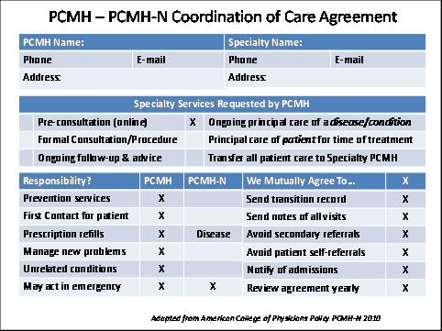
Our Promises
Pediatrics
PCMH-N Agreement
PCMH-N Agreement
Notes:
Remember that the glue that holds a system together is the promises we keep to each other across microsystems.
These promises ought to be recorded in written agreements that we call PCMH N or Neighbor agreements.
In some cases the entire PCMH function for persons with hemophilia will be handled by the pediatric hematology microsystem, and it will not have a relationship with a separate PCMH for this subset of patients. In these cases, patients could expect that the Hematology PCMH will meet all of the same standards as another PCMH.
A comparable management agreement is also reasonable in the consultation and referral between the pediatric hematology microsystem and a regional or national Hemophilia Center of Excellence.

Slide 34
Coordination of Care Agreement
PCMH Name:
Phone | E-mail
Address:
Specialty Name:
Phone | E-mail
Address:
Specialty Services Requested by PCMH
 | Pre-consultation (online) | X | Ongoing principal care of a disease/condition
 | Formal Consultation/Procedure |  | Principal care of patient for time of treatment
 | Ongoing follow-up & advice |  | Transfer all patient care to Specialty PCMH
Responsibility? | PCMH | PCMH-N
Prevention services | X
First Contact for patient | X
Prescription refills | X | Disease
Manage new problems | X | Disease
Unrelated conditions | X
May act in emergency | X | X
We Mutually Agree To… | X
Send transition record | X
Send notes of all visits | X
Avoid secondary referrals | X
Avoid patient self-referrals | X
Notify of admissions | X
Review agreement yearly | X
Adapted from American College of Physicians Policy PCMH-N 2010
Notes:
Here is a sample coordination of care agreement. The American College of Physicians published recommendations for such an agreement in 2010.

Slide 35
Coordination of Care Agreement
PCMH Name:
Phone | E-mail
Address:
Specialty Name:
Phone | E-mail
Address:
Specialty Services Requested by PCMH
 | Pre-consultation (online) | X | Ongoing principal care of a disease/condition
 | Formal Consultation/Procedure |  | Principal care of patient for time of treatment
 | Ongoing follow-up & advice |  | Transfer all patient care to Specialty PCMH
Responsibility? | PCMH | PCMH-N
Prevention services | X
First Contact for patient | X
Prescription refills | X | Disease
Manage new problems | X | Disease
Unrelated conditions | X
May act in emergency | X | X
We Mutually Agree To… | X
Send transition record | X
Send notes of all visits | X
Avoid secondary referrals | X
Avoid patient self-referrals | X
Notify of admissions | X
Review agreement yearly | X
Adapted from American College of Physicians Policy PCMH-N 2010
Notes:
Here is a sample coordination of care agreement. The American College of Physicians published recommendations for such an agreement in 2010.
(Click) It includes contact information between microsystems.
(Click) It identifies the type of specialty service requested by the PCMH. Let’s look at these in more detail.
(Click) in Pre-Consultation , the specialty practice provides a curbside or online opinion to the PCMH about the necessity of a referral or makes recommendations to try first.
(Click) In a Formal Consultation/Procedure request, the specialty practice sees the patient and performs an evaluation or a procedure and makes recommendations for the PCMH to follow rather than personally treating the patient’s problem.
Ongoing follow-up and advice (Shared Co-Management) - the specialty/subspecialty practice provides expert advice and guidance to the PCMH to manage the problem and provides periodic follow-up visits to chart the progress, but does not manage the illness on a day to day basis.
Principal care for a disease—Both the PCMH and specialty practices co-manage the treatment of a discrete set of problems, while the PCMH maintains responsibility for all other aspects of patient care, including first contact for new problems.
Time-limited Principal care of the patient for a consuming illness —the specialty/subspecialty practice temporarily becomes the primary care giver and first contact for the patient with a serious disorder or complex treatment; the PCMH receives on-going treatment information, retains input on secondary referrals, and may provide certain, well-defined areas of care.
Transfer all care to a Specialty PCMH —is the situation in which the specialty practice assumes the role of the PCMH after consultation with the patient’s current PCMH and approval by the patient.
Once the Roles in patient care have been clarified in the agreement, it is valuable to define specific responsibilities. (Click) For example, in this case of an agreement that the hematologist will have ongoing primcipal care for the hemophilia, the PCMH will continue to provide preventive services, be the first contact for new problems, refill prescriptions with the exception of the factor replacement, diagnose and treat new problems and conditions unrelated to the hemophilia, and either may act in an amergency
(Click) The Coordination of Care Agreement also includes mutual promises to send transition of care records, send notes on all visits, avoid secondary referrals, discourage patient self-referral, notify each other of admissions, review the agreement yearly and evaluate the effectiveness of the care coordination.
2:51.5

Slide 36
Pediatrics
Adult Care
Transition of Care Record
Transition of Care Record
PCMH-N Agreement
Notes:
Let’s consider a transition of care in which a pediatric hemophilia patient ages into adult medical care. We will practice this situation in the workshop later today.
X Both the pediatric PCMH and the hematology microsystem need to conduct a transition of care with a record of the process to their adult medicine counterparts. Let’s imagine how this transition of care might look if it took place in a meeting with the patient and key members of pediatric, adult, and regional center microsystems.

Slide 37
Transition of Care Record
Patient: DOB: Address: Phone: Insurance
Sender
Phone #
E-mail
Patient Goals
Self-Care Capacity
Problems
Medications
Receiver
Phone #
E-mail
Emergency Contact
Phone #
E-mail
Prognosis
Goals of Care
Diagnostic Tests or Treatment to be Done Next
Care Giver Name
Phone #
Capacity
Recent Tests Results Pending?
Directives
Power of Attorney:
Phone #
Consultants/Co-Manager/Equipment Appointment
Notes:
This sample Transition of Care Record comes from the Stepping Up to the Plate conference from the ABIM Foundation.

Slide 38
Transition of Care Record
Patient: DOB: Address: Phone: Insurance
Sender
Phone #
E-mail
Patient Goals
Self-Care Capacity
Problems
Medications
Receiver
Phone #
E-mail
Emergency Contact
Phone #
E-mail
Prognosis
Goals of Care
Diagnostic Tests or Treatment to be Done Next
Care Giver Name
Phone #
Capacity
Recent Tests Results Pending?
Directives
Power of Attorney:
Phone #
Consultants/Co-Manager/Equipment Appointment
Notes:
It is helpful to record the transition of care information in a care record that may be used by the sending microsystem to communicate clearly the most important elements of the patient’s care plan.
This sample comes from the Stepping Up to the Plate conference from the ABIM Foundation. It includes demographic date and key contact information.
Patient Goals for care drive the plan and an assessment of the patient’s self-care capacity focuses home care assistance that might be needed.
The problem list and medication list, ideally matched with medications for a specific problem summarize the treatment plan.
A statement of prognosis or what to look out for or prevent and the clinician’s goals for care based on this prognosis.
A list of tests and treatments that are suggested to be done next is listed as are the results of recent tests or any tests whose results are currently pending and where they might be found.
Lastly, the sending microsystem lists the other microsystems that collaborate in the patients care providing co-management or equipment and any appointments that may have been scheduled.
Ideally this transition of care record will be completed with both the sending and receiving microsystems present at the same time either in person or by teleconference. The patient and the patient’s family caregiver might be a very valuable member of the transition team.
1:37.6

Slide 39
Take Home Message
SBP transforms profession-based practice
  The microsystem is the source of all care
  Each microsystem is defined by its purpose, patients, professionals, processes, and patterns
We teach SBP to residents and fellows by:
  Orienting to microsystem’s 5 Ps on each rotation
  Assigning residents to perform the physician role and work on improvement in each microsystem
  Observing and giving corrective feedback about learner performance as a team member and the quality of their work in the processes of care
Notes:
What are the take home messages?
First, we are in the middle of a shift in perspective on our work with system-based practice partially replacing profession- based care.
Recall that the microsystem, not the physician, is the source of all care. The microsystem is defined by its purpose, patients, professionals, processes, and patterns.
The second message is that we teach SBP to residents and fellows by orienting them to the microsystem’s 5 Ps for each rotation.
We assign residents and fellows to perform the physician’s role and participate in microsystem process improvement.
Faculty teach SBP by observing and giving corrective feedback about learner performance as a team member and quality of work process.

