Slide 1
ASH Training Directors’ Workshop
“Milestones in Graduate Medical Education”
Dec 7. 2012
Lee Berkowitz, MD
UNC – Chapel Hill

Slide 2
Lee Berkowitz
No financial conflicts of interest to disclose
Board of Directors- ABIM

Slide 3
Goals
Be familiar with the Internal Medicine Milestones
Understand the utility of Entrustable Professional Activities in trainee assessment
Understand the ACGME Next Accreditation System

Slide 4
Case History
You have just completed a rotation as the attending on an inpatient service. You worked with a first-year fellow who performed well. She was well-informed about all of the patients and seemed to have a good understanding of disease pathophysiology and management.
You are asked to fill out an evaluation.

Slide 5
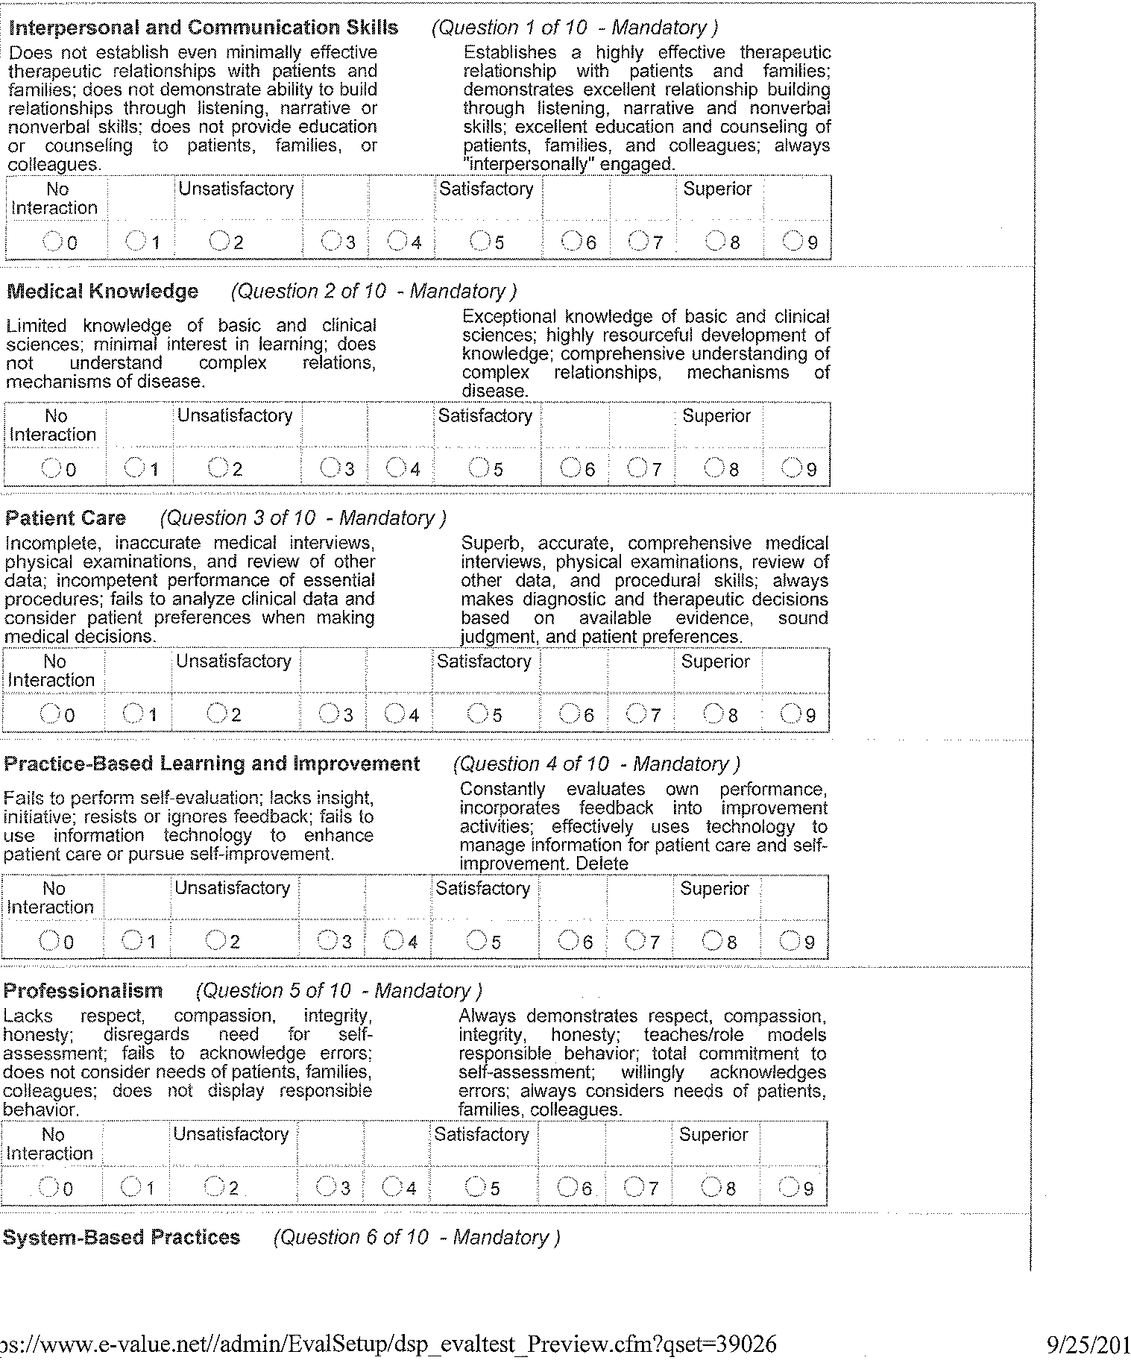
Evaluation System

Slide 6
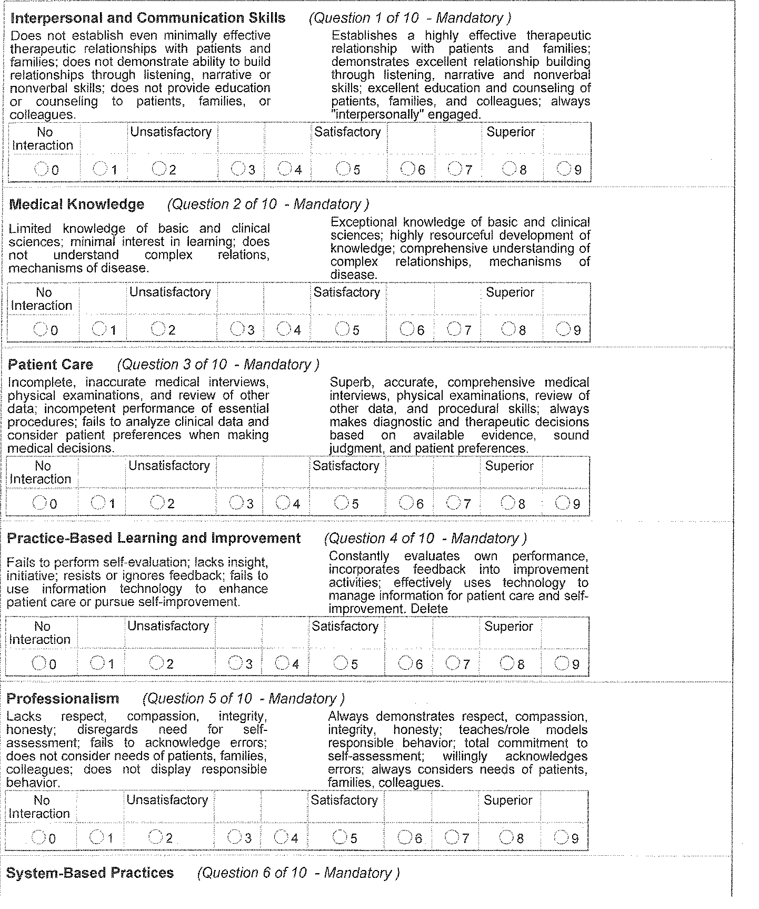

Slide 7


ABIM and ACGME

Slide 8
ABIM FasTrack
Patient Care
Unsatisfactory- incomplete, inaccurate medical interviews, physical examination, and review of other data; incompetent performance of essential procedures; fails to analyze clinical data and consider patient preferences when making medical decisions
Superior – Superb, accurate, comprehensive medical interviews, physical examinations, review of other data, and procedural skills; always makes diagnostic and therapeutic decisions based on available evidence, sound judgment, and patient preferences
Unsatisfactory – 1,2,3
Satisfactory – 4,5,6
Superior – 7,8,9

Slide 9
ABIM Fastrack
Systems- Based Practice
Unsatisfactory – Unable to access/mobilize outside resource; resists efforts to improve systems of care; does not use systematic approaches to reduce error and improve patient care
Superior – Effectively accesses/utilizes outside resources; effectively uses systematic approaches to reduce errors and improve patient care; enthusiastically assists in developing systems improvement

Slide 10
ACGME
Program Information form – PIF
Residency survey

Slide 11
Problems/Issues
Misunderstanding of terms
Generalization of evaluations
Not relevant to faculty and residents

Slide 12
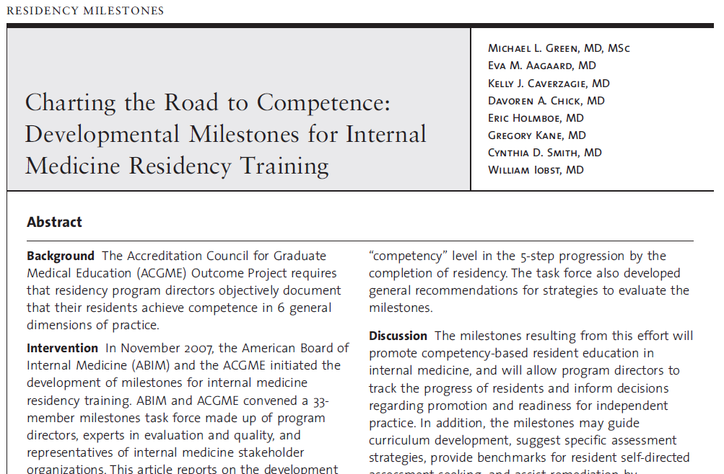
J Grad Med Educ. 2009; 1: 5-20.

Slide 13
IM Milestones
“ The milestones would explicate the 6 ACGME general competencies by describing a developmental progression of observable behaviors. Programs would use the milestones to provide more specific feedback and evaluation to residents and ensure that they acquire the necessary knowledge, skills, and attitudes for advancing in the program and entering the next phase of their careers.”

Slide 14
IM Milestones - Methods
“The ABIM and ACGME convened a 33 member milestones task force composed of program directors, experts in evaluation and quality, and representatives of internal medicine stakeholder organizations…”
“ Calibrated the milestones to achieve competency”

Slide 15
Internal Medicine Milestones
142 Milestones under 6 ACGME Core Competencies

Slide 16
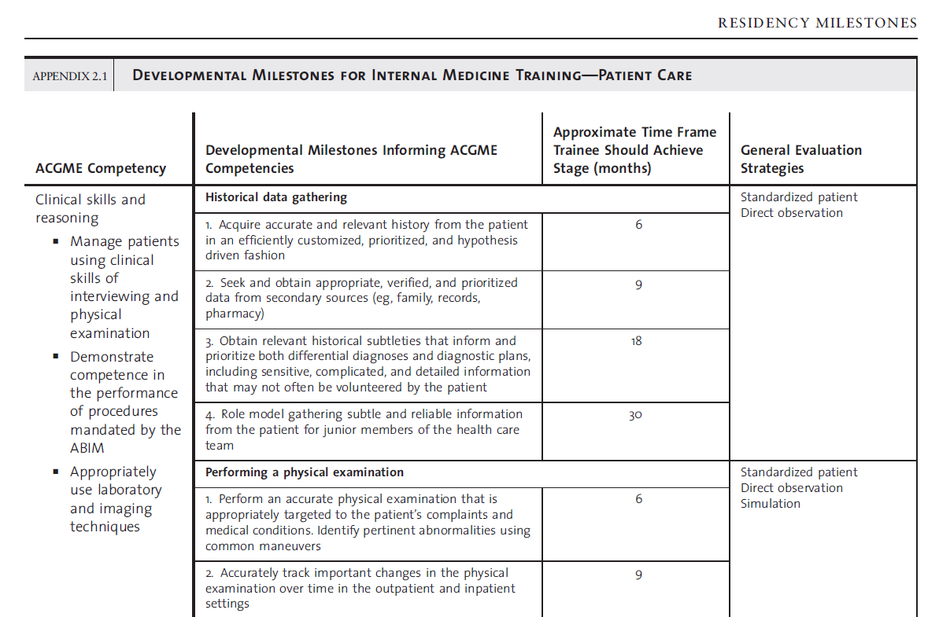

Slide 17
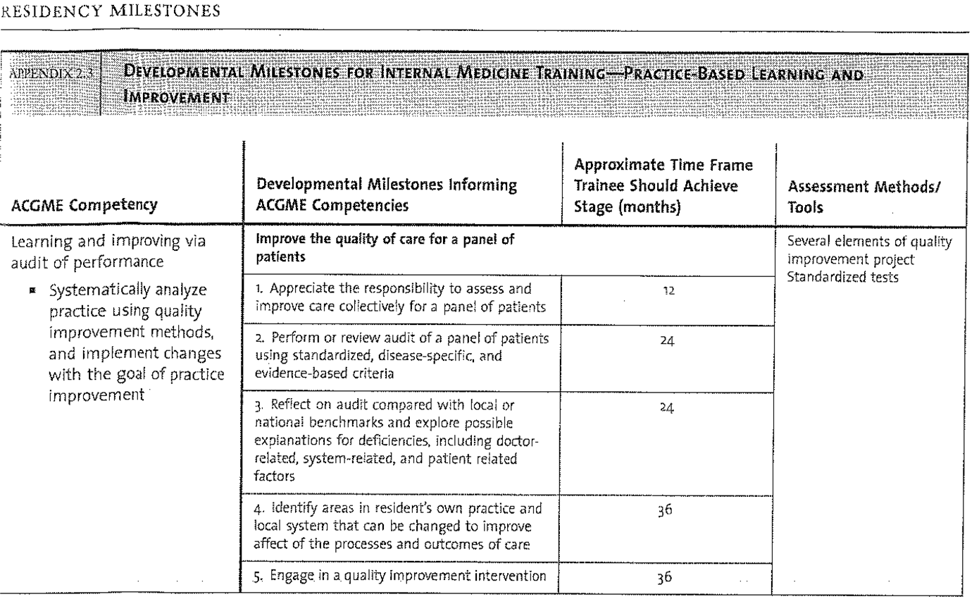

Slide 18
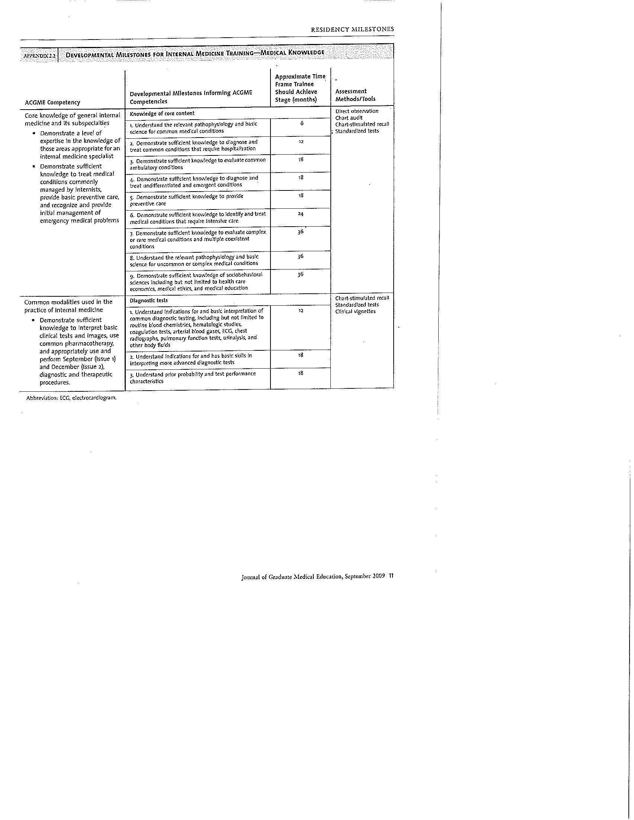

Slide 19
Shortcomings of Milestones
Too Many
More check box than synthetic
Time frames
Evaluation strategies

Slide 20

AAIM Education Redesign
Other IM stakeholders in education community have similar structures and initiatives
Educate membership regarding CBME especially external activities
Assist membership to achieve necessary and meaningful change in relation to changing educational landscape

Slide 21
Entrustable Educational Activities
Aka EPA’s

Slide 22
An Entrustable Professional Activity
Part of essential work for a qualified professional
Requires specific knowledge, skill, attitude
Acquired through training
Leads to recognized output
Observable and measureable, leading to a conclusion
Reflects the competencies expected
EPA’s together constitute the core of the profession
ten Cate et al.
Acad Med 2007; 82: 542-47
Notes:
More concretely, they …
Part of the essential work for qualified professional
Requires specific knowledge, skill, attitude
Acquired though training
Leads to a recognized output
Observable and measurable
Reflects the competencies expected (competencies – the things that they are able to do)
Remember back to Daisy’s slides … the Milestones link to the EPA’s using these last two bullets which we will talk about in just a little bit.
Also important to note that the EPA’s together constitute the core of the profession – emphasize together
Consider these criteria when reviewing some examples of what I think are EPA’s.

Slide 23
AAIM Education Redesign Committee
End-of-Training EPAs
July 2012
Written from perspective of a resident who is ready to enter into unsupervised practice
  “EPA’s together constitute the core of the profession”
Intentionally broad
  Manageable number
  Flexibility in assessment
Meaningful assessment strategy
  Pick and choose / alter as necessary
  Intended to be a starting point for PD’s
Not mandatory and not reported to ACGME

Slide 24
AAIM Education Redesign Committee
End-of-Training EPAs
July 2012
Manage care of patients with acute common diseases across multiple care settings
Manage care of patients with acute complex diseases across multiple care settings
Manage care of patients with chronic diseases across multiple care settings
Provide age-appropriate screening and preventive care
Resuscitate, stabilize, and care for unstable or critically ill patients
Provide perioperative assessment and care
Provide general internal medicine consultation to nonmedical specialties
Manage transitions of care
Facilitate family meetings
Lead and work within inter-professional health care teams
Facilitate the learning of patients, families, and members of the interdisciplinary team
Enhance patient safety
Improve the quality of health care at both the individual and systems level
Advocate for individual patients
Demonstrate personal habits of lifelong learning
Demonstrate professional behavior

Slide 25
Manage transitions of care
End-of-Training EPA | Related Curricular Milestones
Manage Transitions of Care (Page 2) | Patient Care (PC) | F1, F2
 | Medical Knowledge (MK) | A8, B2
 | Practice-Based Learning & Improvement (PBLI) | E1, E2, F1, G2
 | Interpersonal & Communication Skills (ICS) | B3, C1, C2, D1, D2, D3
 | Professionalism (P) | B4, C1, G1, G2, J1, K3
 | Systems-Based Practice (SBP) | A2, A3, B1, B2, B3, B4, C1, C2, C3, C4, C5, C6, E2

Slide 26
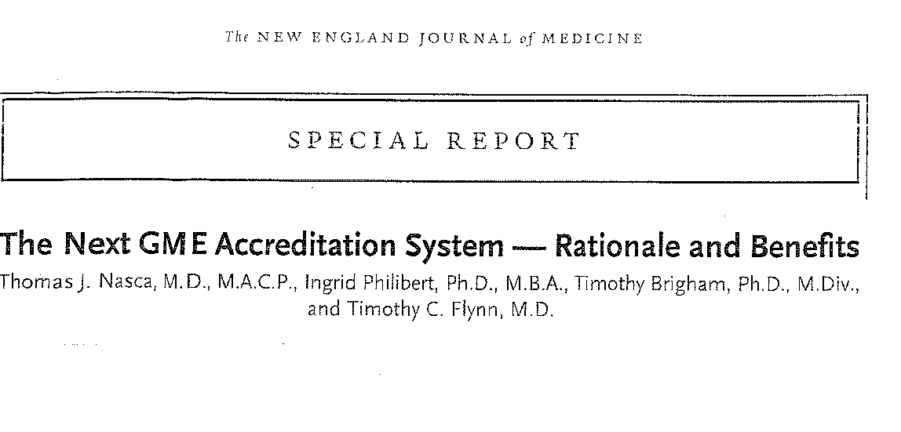

Slide 27
Next Accreditation System - Aims
Enhance the ability of our peer-review system to prepare physicians for practice in the 21st century
Reduce the burden associated with the current structure and process-based approach to accreditation
Accelerate the ACGME’s movement towards accreditation on the basis of educational outcomes

Slide 28
9 Components of the NAS
ADS Update
Resident Survey
Board Pass Rate
Clinical Experience Log
Program Self Study
Faculty Survey
CLER Visit
Core Faculty Scholarly Activity
Milestones
Next
Accreditation
System

Slide 29
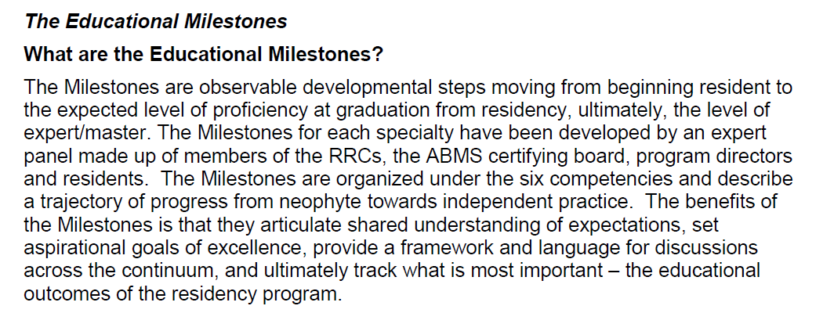
NAS
Milestones
ACGME NAS-FAQ
http://www.acgme-nas.org
Accessed: Sept 20, 2012

Slide 30
Reporting Structure to RRC
NAS
Milestones
Crosswalk between NAS Milestones and Outcomes as defined in IM Program Requirements
Feasibility study completed
Active rewrite in process with planned release in December 2012
Note: Curricular Milestones provided foundation for this document – they are inherently linked

Slide 31
Milestones Writing Group – v2.0
Extension of group that developed and authored original Milestones published in 2009
Used original Milestones to develop a structure for reporting Milestones to IM-RRC in accordance with NAS

Slide 32
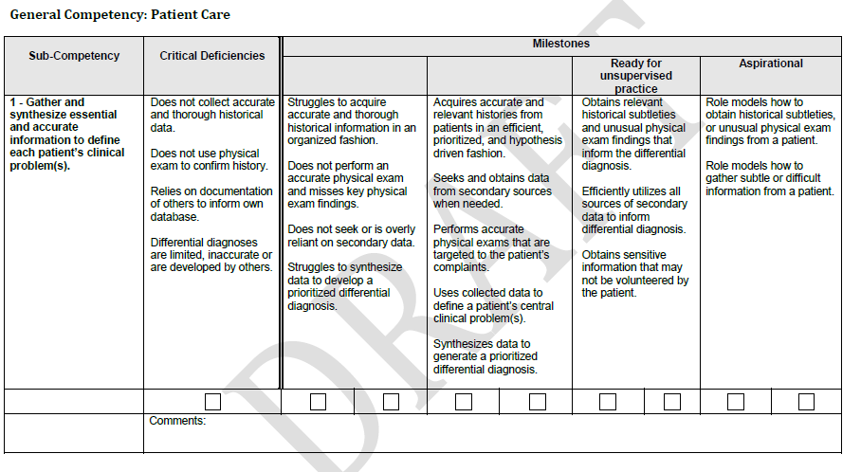

Slide 33
NAS Milestones
Clinical Competency Committee
Assessment System
ADS Update | Self Study
Resident Survey | Faculty Survey
Board Pass Rate | CLER Visit
Clinical Experience Log | Core Faculty Scholarly Activity
Next Accreditation System

