Slide 1
Disclosures for Christopher R. Cogle
In compliance with ACCME policy, ASH requires the following disclosures to the session audience:
Employment | University of Florida
Consultancy
Equity Ownership
Research Funding
Honoraria
Patents & Royalties
Speakers Bureau
Membership on Board of Directors/Advisory Committee
Other
Presentation includes a description of the following off-label use of a drug or medical device
52nd ASH Annual Meeting ♦ Orlando, FL

Slide 2
Impact of an Annual Hematology/Oncology Fellow Wet Laboratory Program on Fund of Biomedical Knowledge
Christopher R. Cogle, M.D.
Associate Professor of Medicine
University of Florida, Division of Hematology & Oncology
c@ufl.edu

Slide 3
Background: Hem/Onc Training
Clinical Care,
Research
Hematology/Oncology
Wet Laboratory
Volume of knowledge
Educational
Need
ACGME
Work Hours
Limits
Outsourced
Lab Assays

Slide 4
Needs Assessment
Competent
Self Assessed
Competency
Incompetent
*2 year cumulative data (2004-2006; 88% participation)
Notes:
SAKs and Former Fellow Surveys showing lack of knowledge in biomedical aspects of hematology & oncology.
Faculty also recognized deficiency in clinical problem solving and laboratory-based interpretative skills during clinical consults and conference discussions.
Curriculum already included didactic lectures and elective rotations. Thus, novel strategy needed to increase knowledge in fundamental and clinical lab sciences.

Slide 5
Potential Solutions
Require Laboratory Research
Intense exposure
Narrow focus
May miss clinical lab procedures
Relevance to fellow’s career goals?
Simulation Training / Wet Laboratory
Brief exposure
Requires institutional investment
Effective?

Slide 6
Hypothesis
An active training method providing hands-on participation will increase fund of biomedical knowledge in hematology and oncology.

Slide 7
Aims
Develop an annual laboratory-based event
Didactics
Hands-on assay performance
Interpretative skills
Develop an evaluation system
Pre & post wetlab objective knowledge tests
Self-assessments of knowledge
In-training exams (ASH, ASCO)
ABIM board certifications
Evaluation of event and impact on curriculum

Slide 8
Endpoints
Primary
Quantify biomedical knowledge gained
Secondary
Feasibility
Impact on overall fellowship curriculum
Perceived utility

Slide 9
Methods: Wet Lab Events
Year | Morning | Afternoon
2007 | ELISA for heparin-PF4 IHC for ER, PR, HER2/neu | FISH for BCR/ABL PCR for BCR/ABL
2008 | Blood smears (Wright Giemsa) SPEP for immunoglobulins PCR for Factor V Leiden (part I) | PCR for FVL (part II) PT, PTT, TT Heparin (Anti-FXa Activity)
2009 | Blood smears (Wright Giemsa) Automated cytometers Hemoglobin electrophoresis DNA sequencing PFA-100 | Platelet aggregometer FACS for leukemias Cytogenetics in AML FISH in AML
2010 | PT, PTT, TT Heparin (Anti-FXa Activity) Factor VIII assay | HLA B genotyping ELISA for anticardiolipin

Slide 10
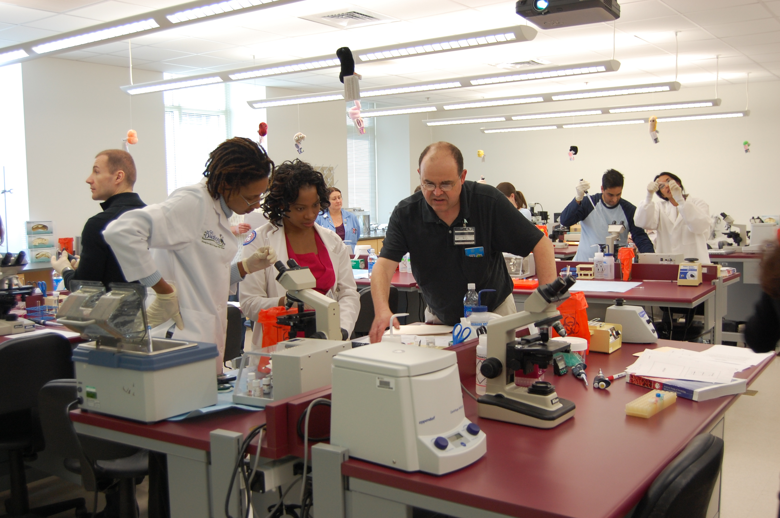
Methods: Wet Lab Events
Notes:
Discuss Resource Utilization here:
Medium-sized combined HemOnc Fellowship Program (n=9; 3-3-3)
Academic hospital-based practice
Team of key faculty/staff to generate Wetlab curriculum
n=3 including Director
Utilized Interdisciplinary Center for Biotechnology Research (ICBR) core laboratory
Monthly planning sessions x 4 to refine schedule, speakers, assays
Budget for supplies and core lab fees
$375/fellow
Light breakfast/lunch
Small industry-sponsored unrestricted educational grant → Divisional
16 unique fellows participated over a 3 year period
Fellows randomized to attend the all day event or not in 2007 (n=5 vs. 3)
Subsequently, all attended

Slide 11
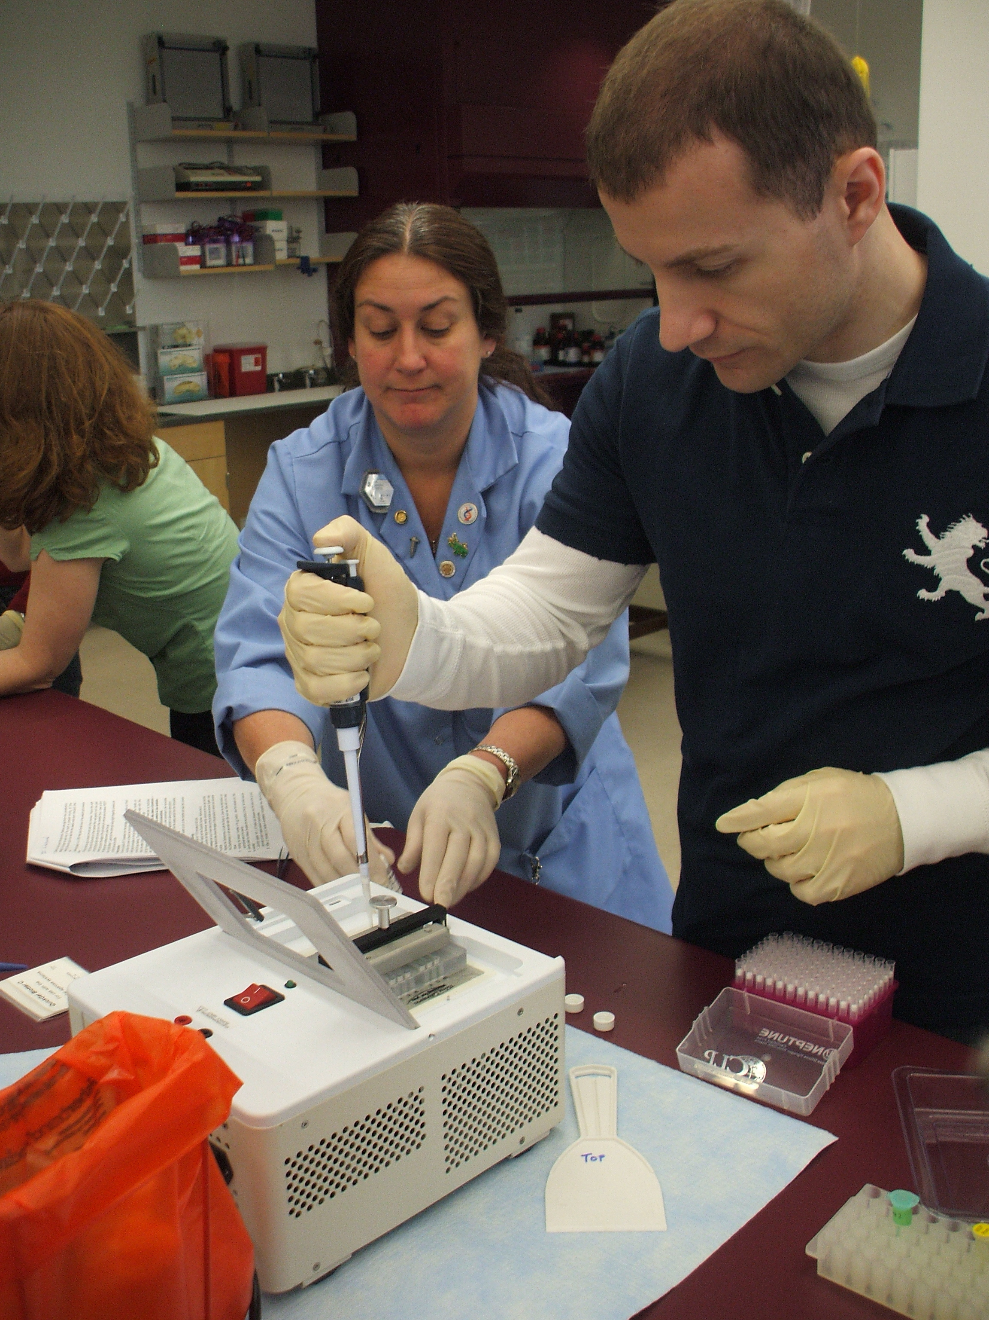
Methods: Wet Lab Events
Time | Activity
2 – 5 minutes | Case Presentation
5 – 10 minutes | Didactic
30 – 45 minutes | Hands-on
2 – 5 minutes | Comparing Results
15 – 30 minutes | Interpretations

Slide 12
Methods: Wet Lab Evolution

Slide 13
Results: Objective Knowledge
*
Test Score (%)
* P < 0.014
Notes:
Multiple-choice test on laboratory technique, interpretive skills, and core concepts (6-10 questions)
Modified from ASH-SAP and ASCO-MKSAP

Slide 14
Results: Self Assessed Knowledge
Competent
Self Assessed Knowledge
Incompetent

Slide 15
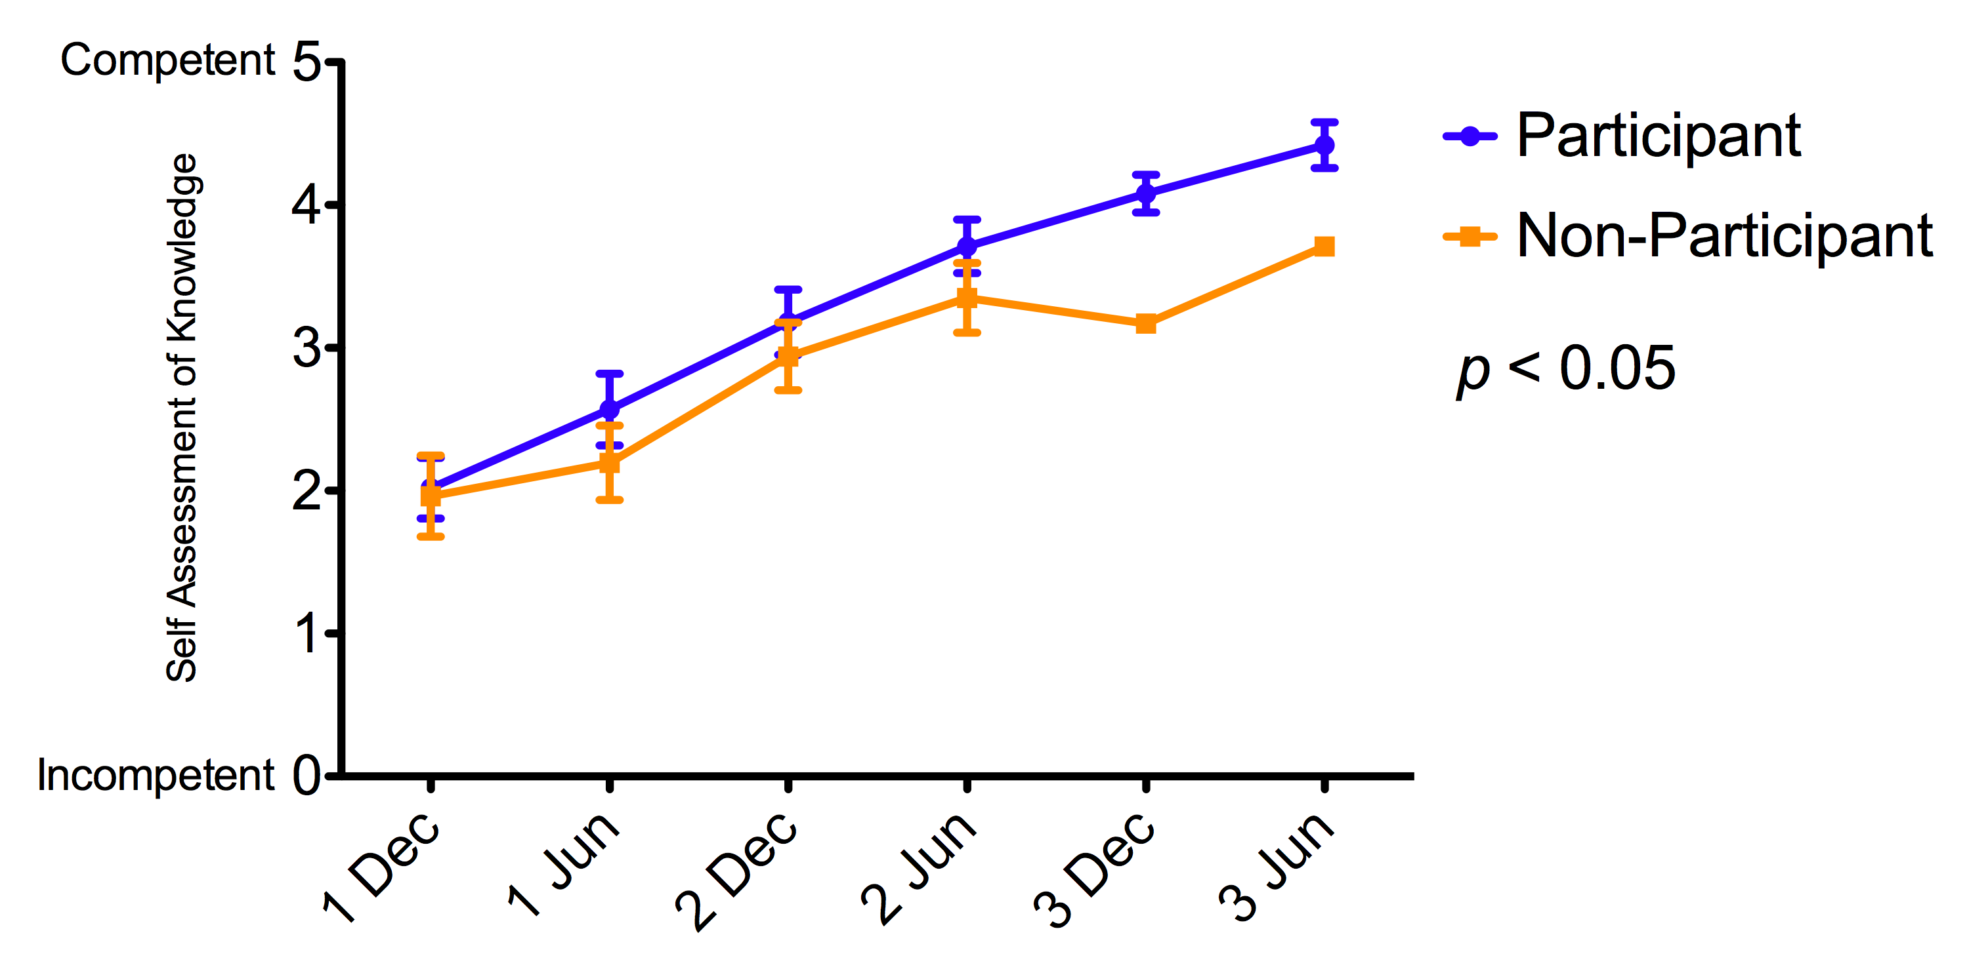
Results: Self Assessed Knowledge
Biomedical / Lab Science

Slide 16
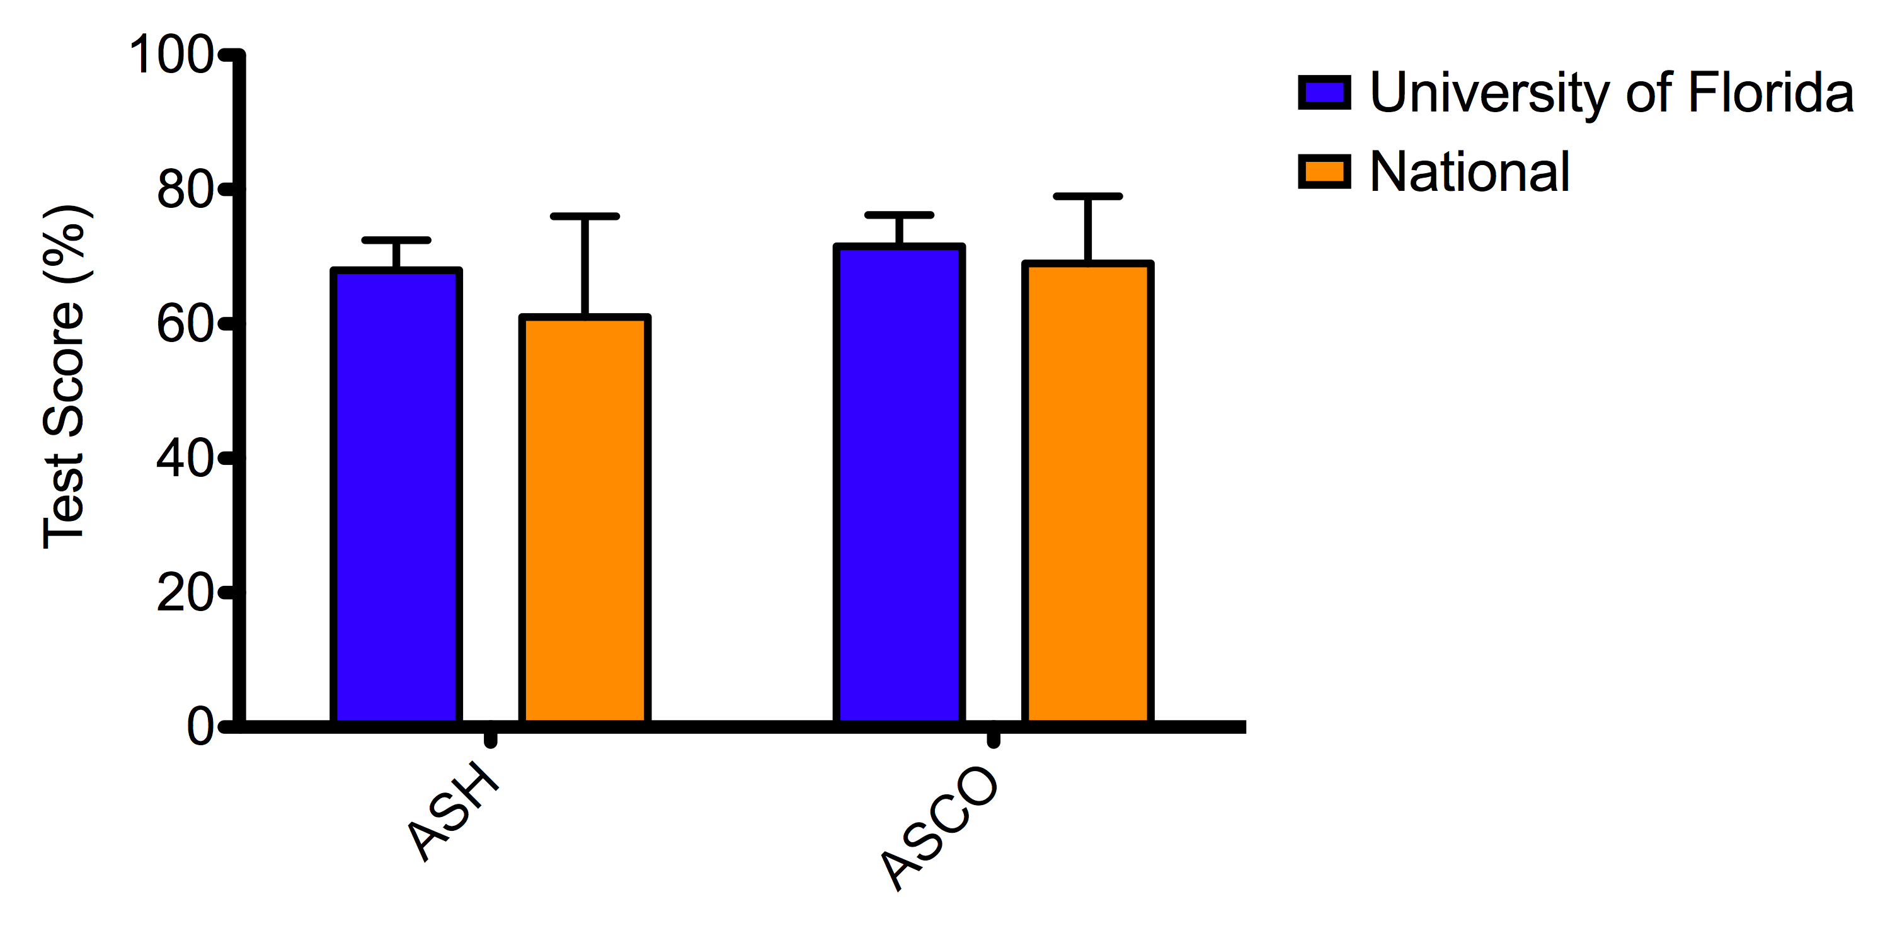
Results: In-Training Exams
Basic Science Subsections
Notes:
Change this slide into graphical format.

Slide 17
Results: Board Certification
ABIM Certifications
Hematology: 100% pass rate
Medical Oncology: 100% pass rate
No Basic Science subsection reporting available
Notes:
Change this slide into graphical format.

Slide 18
Results: Utility
Poor/No
Outstanding/Yes

Slide 19
Conclusions
Wetlab is feasible and well received.
Controlled environment.
Mistakes permissible.
Opportunities to measure and document performance.
Improvements in
Objective, and
Self assessed knowledge.
Annual event permits evaluations for growth.

Slide 20
Future Directions
Durability of knowledge gained?
Objective measures of knowledge and skill?
Create export for other programs.
Notes:
Limited validated, objective measures available for monitoring fellow progress.
Few standardized resources for TP directors.

Slide 21
Acknowledgements
Wetlab Planning Committee
Sharon Norton, M.S.
Neil Harris, M.D.
William Winter, M.D.
Richard Lottenberg, M.D.
UF Hematology/Oncology Fellowship Program
Thom George, M.D.
Julia Close, M.D.
Carmen Allegra, M.D.

