Slide 1
Enhancing Fellows’ Communication Skills
ASH Program Directors’ Workshop
Mark Heaney MD PhD

Slide 2
Disclosures for Mark Heaney, MD
In compliance with ACCME policy, ASH requires the following disclosures to the session audience:
Employment | None
Consultancy | Novartis, Incyte
Equity Ownership | None
Research Funding | Novartis, Synta
Honoraria | None
Patents & Royalties | None
Speakers Bureau | None
Membership on Board of Directors/Advisory Committee | Medco
Other | None
Presentation includes a description of the following off-label use of a drug or medical device | None
52nd ASH Annual Meeting ♦ Orlando, FL

Slide 3
Doctor-patient communication is not always optimal
Our patients sometimes have unmet information needs regarding:
  Extent of disease and prognosis
  Treatment options
  Side effects
Observational research shows room for improvement in physician communication, e.g.:
  Recognizing and responding to patient cues
  Soliciting patient agendas
  Empathic responses

Slide 4
Development of Comskils Program
Concept developed by Department of Psychiatry (David Kissane, Richard Brown, Carma Bylund)
Modules reviewed in collaboration with Heme-Med Onc Fellowship Program
Program was reviewed in an iterative fashion and refined

Slide 5
Impact of Comskils on Core Competencies
Patient Care
Medical Knowledge
Practice-based Learning and Improvement
Interpersonal and Communication Skills
Professionalism
Systems-based Practice

Slide 6
Impact of Comskils on Core Competencies
Patient Care
Medical Knowledge
Practice-based Learning and Improvement
Interpersonal and Communication Skills
Professionalism
Systems-based Practice

Slide 7
Challenges and Barriers to Comskils Implementation
Lack of training, resulting in suboptimal skills and lower confidence
Emotional vulnerability
Conforming to traditional doctor-patient roles
Time constraints

Slide 8
Exploring the evidence for Comskil training
Maguire, Fairburn & Fletcher. BMJ 1986

Slide 9

Comskils Curriculum
Applied
1. Cutting edge concepts
2. Breaking bad news
3. Prognosis
4. Shared decisions / clinical trials
5. Response to anger
6. DNR/Transition to palliative care
Elective
Working with interpreters
Conducting Family Meetings
Discussing Phase I Trials
Discussing Internet Information
Promoting Adherence

Slide 10
Comskils Curriculum
Applied
1. Cutting edge concepts
2. Breaking bad news
3. Prognosis
4. Shared decisions / clinical trials
5. Response to anger
6. DNR/Transition to palliative care
Elective
Working with interpreters
Conducting Family Meetings
Discussing Phase I Trials
Discussing Internet Information
Promoting Adherence

Slide 11
MSKCC Comskil Lab Structure
641 Lexington Ave @ East 54th St.
Teaching Theater
6 Role-play Training Rooms with 2 cameras
Software platform for video playback

Slide 12
Comskils Format
Videotape of fellow interview with a new patient
Booklets
Didactic teaching presentation
  Evidence, Group discussion, Communications Strategies, Exemplary Video
Small group role play
  Actors, Facilitators matched with learners’ discipline
Follow up videotape of fellow interview with a new patient

Slide 13
Importance of Role Play
Practice using new skills
Receive feedback from peers and facilitators
Use video playback
Observe peers
Learn self-reflection
Chance to ‘try again’

Slide 14
Faculty Development
Engage leadership of institution through Train-the-Trainer programs
  Participation in Comskil Training as learners
  Facilitator Training Programs
Currently 47 facilitators from diverse disciplines
  Medical Oncology/Hematology
  Surgery
  Radiation Oncology
  Neurology
  Pediatrics
Currently, 21 psychosocial facilitators
Assessment and Feedback

Slide 15
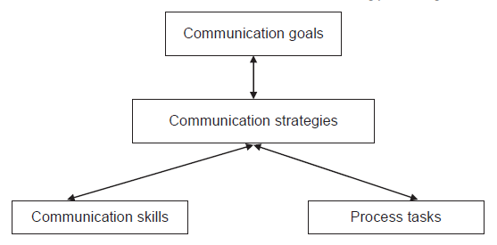
Comskils Training Approach
Brown et al. Communication Education 59; 235-248, 2010

Slide 16
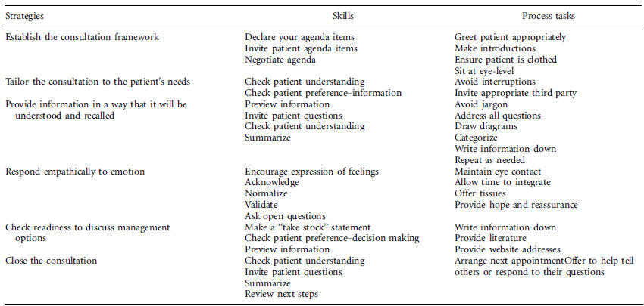
Comskils Example:
“Breaking Bad News”
Brown et al. Communication Education 59; 235-248, 2010

Slide 17
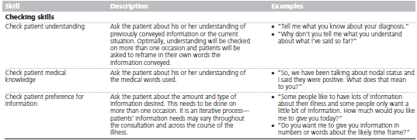
Comskils Process example
Brown and Bylund Acad Med 83:37-44, 2008

Slide 18
Model for Evaluation
Kirkpatrick Triangle
Level 4: Evaluation of Results
Patient Outcomes
Level 3: Evaluation of Behavior
Clinic Consultation Recordings
Level 2: Evaluation of Learning
Level 2A: Pre-Post Training Self-efficacy
Level 2B: Pre-Post training Standardized Patient Assessments
Level 1: Evaluation of Reaction
Course Evaluations

Slide 19
Comskils Course Evaluations
The skills I learned in this module will allow me to provide better patient care. (all means between 4-5)
The module prompted me to critically evaluate my own communication skills. (all means between 4-5)
The facilitators were effective. (all means between 4-5)
Pre-Post self-efficacy:
  Significant changes across all modules and all participants.
    Pre-training scores generally @ 3.5
    Post-training scores generally @4.5

Slide 20
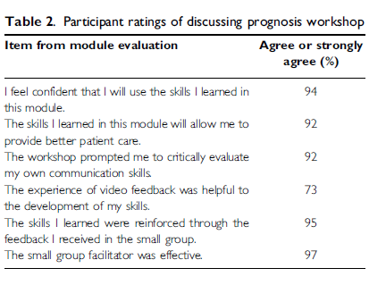
Comskils Feedback
Brown et al. Psycho-Oncology 19:408-414, 2010

Slide 21
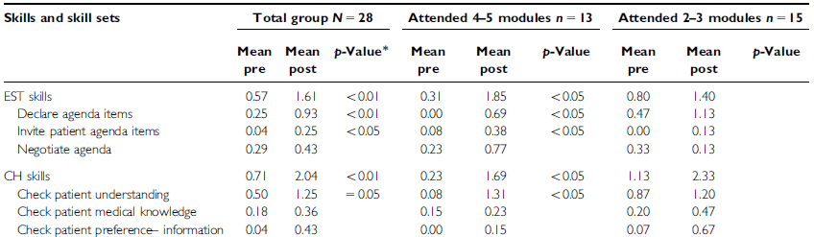
Comskils Outcomes
Bylund et al. Psycho-Oncology 19: 583-593, 2010

Slide 22
Fellows’ Feedback
Didactic component repetitive of booklets
  Presentations were shortened
Some modules substantially overlapped
  “Discussing Prognosis” module was eliminated
Role playing portion was felt to be especially helpful due to real time feedback
  Actors kept their jobs

Slide 23
Conclusion
Advanced cancer communication training can be integrated into an institution’s regular practice.
Balance between “top-down” and “bottom-up” approaches.
Facilitators from each discipline key to success of program.
Training Program feedback led to a more tailored program and improved trainee satisfaction
Future work will include rigorous evaluation of the effects of the Comskil Training Program on clinician and patient outcomes.

Slide 24
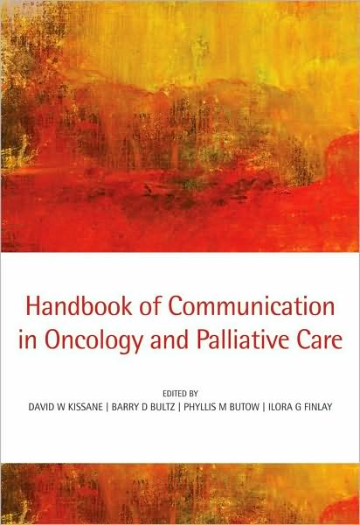
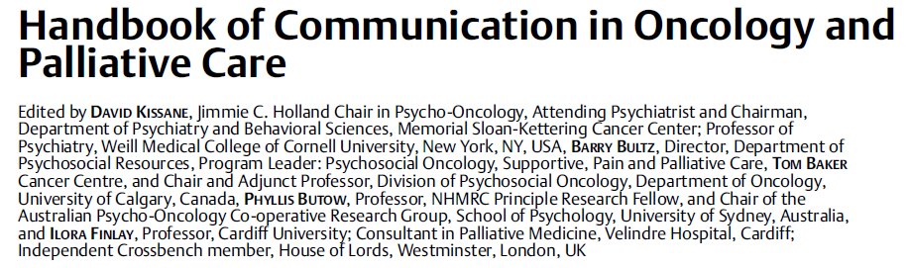

Slide 25
Acknowledgements
David Kissane, MD
Richard Brown, PhD
Carma Bylund, PhD
Chief Fellows, 2006-present
Dean Bajorin, MD
Jedd Wolchok MD PhD
Cheryl James

