Slide 1
Effective Interview Strategies: Separating the Wheat from the Chaff,
Patrick Leavey, MD
Pediatric Hematology/Oncology PD
UT Southwestern Medical Center Dallas

Slide 2
Disclosures for Patrick Leavey, M.D.
In compliance with ACCME policy, ASH requires the following disclosures to the session audience:
Employment
Consultancy | Pfizer
Equity Ownership
Research Funding | Pfizer
Honoraria
Patents & Royalties
Speakers Bureau
Membership on Board of Directors/Advisory Committee
Other
Presentation includes a description of the following off-label use of a drug or medical device
52nd ASH Annual Meeting ♦ Orlando, FL

Slide 3
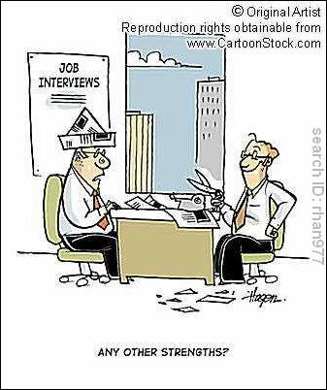
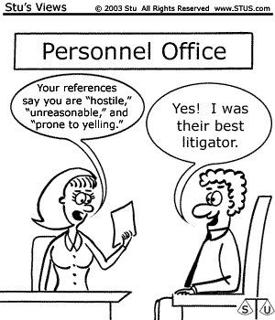
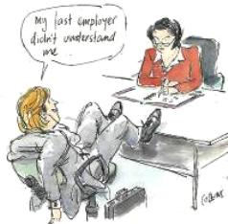

Slide 4
Outline
NRMP results 2006-2010
Survey results
Interview strategies
  Pediatric residency recruitment – experience at one large program
  Interview questions
Program improvement

Slide 5
NRMP results 2006 – 2010:
# positions offered

Slide 6
NRMP results 2010
Specialty | # Applicants |  | # matches |  | % programs filled |  | # Unfilled programs
 | US | Total | US | Total | US | Total
H/O | 283 | 700 | 234 | 435 | 52 | 97 | 10
Heme | 67 | 163 | 11 | 21 | 52 | 100 | 0
PHO | 95 | 149 | 88 | 132 | 60 | 90 | 10

Slide 7
NRMP results 2010
Specialty | # Applicants who ranked specialty | # Matched applicants | % matched (by choice) |  |  |  | % not matched
 |  |  | 1st | 2nd | 3rd | >3rd
H/O | 700 | 435 | 37 | 9 | 7 | 10 | 30 (7% matched another specialty)
Heme | 163 (only 44 noted as preferred specialty) | 21 | 7 | 2 | 1 | 3 | 25 (62% matched another specialty)
PHO | 149 | 132 | 54 | 14 | 8 | 12 | 11

Slide 8
Successful Recruitment: pre-workshop survey
APPD survey
  N=23 respondents
ASPHO survey
  N=42 respondents
ASH survey
  N=22 respondents

Slide 9
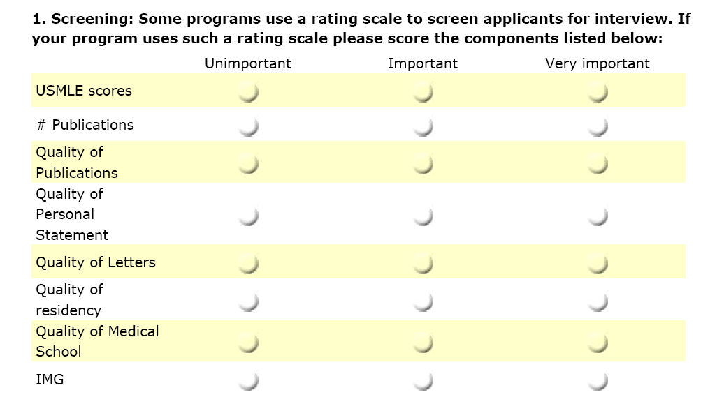
Successful Recruitment: pre-workshop survey

Slide 10
Successful Recruitment: pre-workshop survey

Slide 11
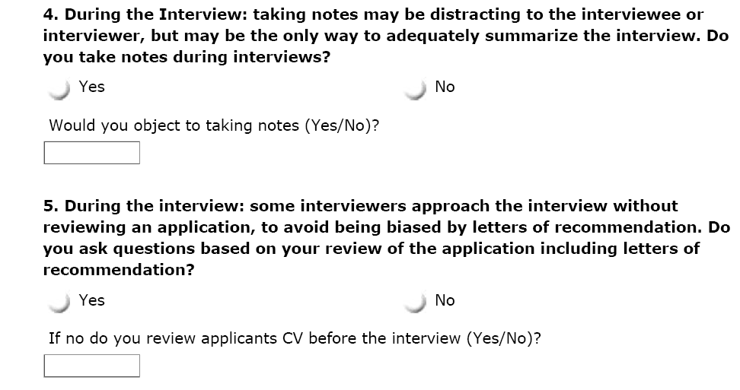
Successful Recruitment: pre-workshop survey

Slide 12
Successful Recruitment: pre-workshop survey

Slide 13
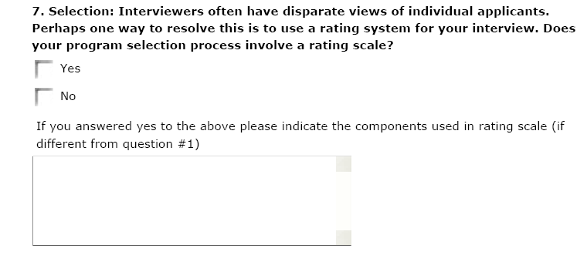
Successful Recruitment: pre-workshop survey

Slide 14
APPD/PAS_What are the most important traits you would like to see in fellows? Please indicate the level of importance of the following suggested traits (or add to the list as appropriate)

Slide 15
ASPHO_What are the most important traits you would like to see in fellows? Please indicate the level of importance of the following suggested traits (or add to the list as appropriate)

Slide 16
ASH_What are the most important traits you would like to see in fellows? Please indicate the level of importance of the following suggested traits (or add to the list as appropriate)

Slide 17
Surveys
3 most consistent and important traits
  Team orientated
  Communication skills
  Good fit

Slide 18
Outline
NRMP results 2006-2010
Survey results
Interview strategies
  Pediatric residency recruitment – experience at one large program
  Interview questions
Program improvement

Slide 19
The impact of the interview in Pediatric Residency Selection
Pediatric residency selection at CHOP
  n = 935; Years = 1999-2002; ~ 300 interviews/year
  Selection
    Academic record; Deans letter; USMLE; CV; LOR
      Notes of significant research or extracurricular activities
  Interview
    2 faculty, one blinded (CV and PS only)
    Interview score based on
      Personal characteristics (communication, attention to detail, emotional stability), maturity, warmth, enthusiasm and conscientiousness;
      unique positives and negatives
  Ranking
    Applicant presented by non-blinded interviewer
      House staff feedback solicited

Slide 20
The impact of the interview in Pediatric Residency Selection
 | Correlation to USMLE Step I
Blinded interviewer score | No correlation seen
Non-blinded interviewer score | r = -0.17 | P < 0.0005
 | Correlation to final score
Step I scores and final score | r = -0.26 | P < 0.0005
Negative correlation – higher USLME score correlates with better interview and final score
Interview score was the most significant
predictor of the final ranking score

Slide 21
The impact of the interview in Pediatric Residency Selection -- Take home points:
USMLE scores may introduce BIAS in selection and interview
  No other consistent measure of academic merit across medical schools
  We like data and will continue to use as long as it is available (e.g. requests for in-training examination scores)
  Fallacy that higher scores imply higher clinical competence

Slide 22
The impact of the interview in Pediatric Residency Selection -- Take home points:
Interview score is the most significant indicatory for final rank
    Interview is a controlled environment with applicant and interviewer with ‘best-face’
    Many (perhaps most) interviewers gain an instinctive impression only
    Halo Effect
    Expectations are high for a non-blinded interviewer preparing for an interview with an AOA applicant – interview only to confirm already held beliefs
    Expectations are low for a non-blinded interviewer preparing for an interview with an applicant with poor scores – interview only to confirm already held beliefs

Slide 23
Common Selection Problems!
Interviewers miss important information
  Focus on areas critical to job success
Biases and stereotypes affect judgment
  Typical fellow!
No note taking
  Remember the first and last
Misinterpret information
  Amateur psychologist
Snap decisions
  Great handshake!
Pressure to fill

Slide 24
Suggestions
Blinded, behavioral-based interviews and evaluations based on identified traits that are important to program:
  Survey: communication; team; organization; coping skills; goal orientated
  Fit
Structured scoring system
Interviewer training

Slide 25
One programs experience ☹
Committee thought we got better data
Failed to fill in 2003– 1st and only time
Post-match survey – interview ranked as -
  Same question asked by multiple interviewers
  “Awkward interviews” “Interviews seemed scripted”
  Interviews viewed by some as “high pressure”
Regrouped
Continued blinding

Slide 26
Lessons Learned ☺
Method is valid and can work well
Students need to be prepared
Additional faculty development is needed
  Use select faculty
  Perform some standardized interviews
  Set anchors – OK, better, best answers
  Add real-time debriefing process after first few interviews

Slide 27


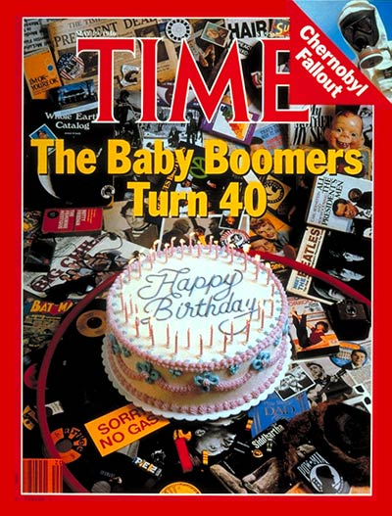
Generation gap!

Slide 28
Millenials (1981 – 1999)
Prefer to work in teams
Want frequent (even daily) feedback about performance
Want leadership and structure, but also want their ideas respected
Desire flexibility in schedules and a life away from work
Seek a challenge and a career path

Slide 29
Types of interview questions
Behavioral -- Past behavior predicts future behavior
  What would you do if….
  Examples questions … tell me about a time when..
Comparison questions
  can the candidate differentiate between sets of skills or compare themselves across time
Evaluation questions – strengths and weakness
  Research experience – what was easy/difficult and why?

Slide 30
Interview
Do your homework
Ask follow-up questions
  What makes for a good fellow?
    Give me an example of an activity as a resident where you demonstrated ….
Follow-up questions
  Complete picture
    (STAR: Situation/Task, Action, Result)
  I was involved in the team… (incomplete!)
    What did you do; what was your role etc

Slide 31
Example Questions
Communication skills
  Give me an example of a difficult situation in which you were able to demonstrate effective communication skills.
    Difficulties with a parent; challenging consult;
    What did you do, learn, etc..
  How have your communication skills changed over the course of your residency thus far
    Colleagues; patients….

Slide 32
Example Questions
Team oriented working relationships
  If you have a major disagreement over treatment with your attending, how do you resolve this conflict? With your peers?
  Describe a stressful situation you've had with a coworker. What made it stressful? How did you handle it?
  Describe how you adjusted when you first took on a supervisory role in residency. How has your leadership style changed as you have progressed through residency training?

Slide 33
Motivational Fit – will do questions..
Job; Organization; Location
Job fit facets (include but are not limited to)
  Achievement
  Challenging work
  Continuous learning
  Details
  High responsibility
  Relationship building
  ….

Slide 34
Motivational Fit – will do questions..
Organization fit facets (include but not limited to)
  Bench research vs. clinical
  Educational changes
  Continuous improvement activities
  Fun and family friendly
  High-tech
  Lean and mean
  Management structure
  Prestige
  ….

Slide 35
Motivational Fit – will do questions..
Matches
  Motivate
  Happy to avoid
Discrepancies
  Annoy
  Would miss

Slide 36
Motivational Fit – will do questions..
Likes and dislikes questions
  What do you consider least interesting when it comes to ….?
  What areas of study have you enjoyed the most and why?
  What do you hope to accomplish during your fellowship?
  What would you find intolerable in an fellowship program?

Slide 37
The Interview
What to ask and What not to ask!
Don’t initiate a conversation on the following topics:
  marital status - age
  race/ethnicity - height or weight
  national origin - sexual orientation
  religion or creed
NEVER divulge to the applicant information contained in their letters of recommendation
Don’t make negative comments about other medical schools
NRMP rules of communication

Slide 38
Can you interview for other traits?
Intelligence
  High-dive interview
  Anything on the PS is fair game
Superior clinical skills
  what volume of patients are you used to handling
  Challenging clinical scenario and how the candidate managed it

Slide 39
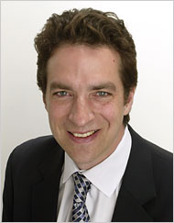
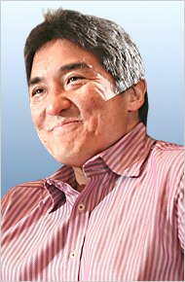
NY Times : Corner Office
Adam Bryant
Deputy Editor NYT Sunday Business Section
Guy Kawasaki,
Co-founder of Alltop, a news aggregation site, and
Managing Director of Garage Technology Ventures
Q. How do you hire?
A. The most important thing is that you hire people who complement you and are better than you in specific areas.
Good people hire people better than themselves. In a perfect world, you would take pride in the fact that you hired someone who is better than you. Hardly anybody has that attitude, though.
Notes:
39

Slide 40
Operating Curves: Selection
Desired
Quality:
Better
than you
in specific
areas
Selection Feature:“?????”
Notes:
40

Slide 41
Operating Curves: Selection
Desired
Quality:
Better
than you
in specific
areas
Selection Feature:“High Dive Questions”
Notes:
41

Slide 42
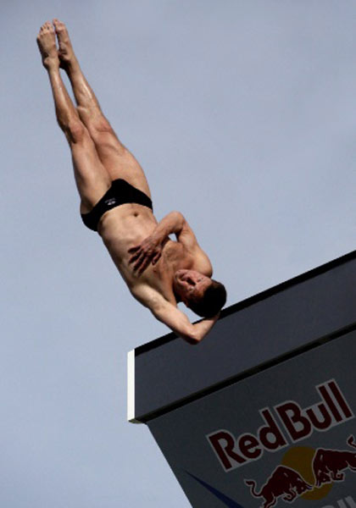
Operating Curves: Selection
Performance
Level of Difficulty
http://www.funsporting.com/pics/585_custom_1.jpg
Selection Feature:“High Dive Questions”
Notes:
42

Slide 43
Operating Curves: Selection
Performance
Level of Difficulty
http://www.funsporting.com/pics/585_custom_1.jpg
Selection Feature:“High Dive Questions”
Notes:
The best days of interview season for me are when I feel I can facilitate an applicant doing a great job on the most difficult question they can handle. I suspect this is the best operating curve performance possible.
43

Slide 44
Operating Curves: Selection
Performance
Level of Difficulty
Desired
Quality:
Better
than you
in specific
areas
http://www.funsporting.com/pics/585_custom_1.jpg
Selection Feature:“High Dive Questions”
Notes:
44

Slide 45
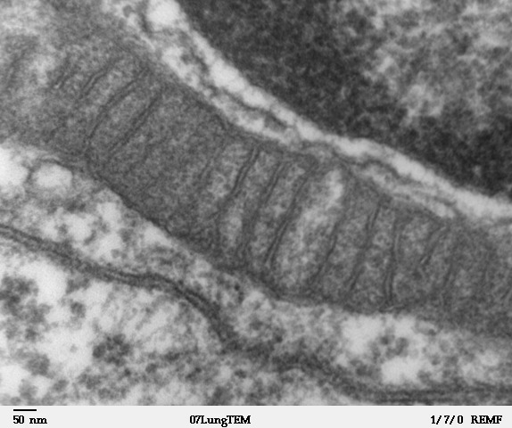
Operating Curves: Selection
Performance
Level of Difficulty
Desired
Quality:
Better
than you
in specific
areas
Louisa Howard: http://remf.dartmouth.edu/imagesindex.html
Selection Feature:“High Dive Questions”
Notes:
45

Slide 46
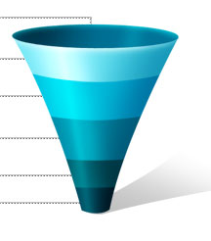
Selection Funnel
ERAS
Intelligence
Screening
Systems practice (Advocacy);
Written Communication (PS)
Communications Skills
Organizational skills
Working with teams
Motivation/Goals
Interviews
Ranking
All the above

Slide 48
Students performance Percentile | Descriptor
99 | Magnificent
98 | Superlative
93 | Extraordinarily strong
88 | Notable
….. | …..
20 | Punctual
15 | Imminently about to blossom
12 | Present and full of all excreta
8 | Claudicative
0 | Eukaryotic and possibly diploid

Slide 49
Letters of recommendation

Slide 50
Outline
NRMP results 2006-2010
Survey results
Interview strategies
  Pediatric residency recruitment – experience at one large program
  Interview questions
Program improvement

Slide 51
Operating Curves: Training
Desired
Quality:
Success
in
Profession
Coaching Efforts
Notes:
If I focus on the specifics of how I might be able to coach a given applicant, I find this offers me actionable information for another aspect of the selection process, that I find very challenging:
Appropriate Interview Etiquette and Post Interview Communications
51

Slide 52
Selection Funnel
Interview Etiquette &
Post Interview Communication
ERAS
Screening
Interviews
Interview Etiquette
&
Post Interview
Communication
Ranking
Notes:
I was worried that maybe I was pushing too hard during interviews, but of my interviews that I intentionally made more demanding of applicants, I instead had particularly meaningful follow up. Emails to clarify a point, or to refer me to other literature. Follow up explorations of certain nuances of the discussion. The more “push-back” I sensed in interview, the more engaged interviewees seemed to become.
52

Slide 53
Success in
Profession
ERAS
Screening
Coaching
Interviews
Interview Etiquette
&
Post Interview
Communication
Ranking
Notes:
This also allowed me to have post interview communications remain what I consider ethical and appropriate.
Rather than committing a spot to someone, I committed to connect them with resources and specific people on campus.
Post interview communications were focused on joint problem solving and planning, rather than very inexact – and perhaps misleading – exchanges of how much we liked each other. Now that we are post match, people have expressed particular appreciation for that.
It also lets me use my time to focus on efforts at specific program improvements and initiatives; using these as a designated vehicle tuned to the ongoing development of particular trainees.
The goal is honesty, transparency, and a genuine desire to see someone do well. If someone sees that I’m working particularly intensely to mentor them that level of interest and investment speaks for itself.
53

Slide 54
Post Interview survey
Why you listed your program above ours | 2008 - Yes | 2009 - Yes | 2010 - Yes
Overall better program | 43% | 46.3% | 33%
Elective or international opportunities | 35% | 25.6% | 27%
More welcoming atmosphere | 37% | 45.1% | 24%
Location | 82% | 80.2% | 79%

Slide 55
Post Interview survey
Why you listed your program above ours | 2008 - Yes | 2009 - Yes | 2010 – yes
Opportunities for spouse or SO | 44% | 38.3% | 50%
Residents seemed happier | 37% | 37.5% | 30%
Program leadership seemed interested in me | 58% | 45.7% | 38%
I was recruited strongly & encouraged by program | 38% | 28.4% | 40%

Slide 56
Post Interview survey
Why you chose NOT to list our program higher | 2008 - Yes | 2009 - Yes | 2010 - Yes
Educational opportunities | 15% | 12.7% | 20%
Evaluation system | 0% | 2.5% | 0%
Workload | 12% | 7.6% | 15%
Leadership | 11% | 12.7% | 4%
Recruitment | 21% | 13.9% | 6%
Mentorship | 7% | 10.1% | 9%

Slide 57
Summary
NRMP results 2006-2010
Survey results
Interview strategies
  Pediatric residency recruitment – experience at one large program
  Interview questions
Program improvement

Slide 58
Questions?

