Slide 1
Disclosures for Marc Kahn, MD
In compliance with ACCME policy, ASH requires the following disclosures to the session audience:
Research Support/P.I. | Not applicable
Employee | Not applicable
Consultant | Not applicable
Major Stockholder | Not applicable
Speakers Bureau | Not applicable
Honoraria | Not applicable
Membership in Advisory Board | Not applicable
Presentation includes a description of the following off-label use of a drug or medical device | Not applicable
51st ASH Annual Meeting ♦ New Orleans, LA

Slide 2
Using Team Based Learning (TBL) to Teach Coagulation
Marc J. Kahn, MD
Professor of Medicine
Sr. Associate Dean, Tulane

Slide 3
Educational Methods
Passive: Lecture, reading
Just in Time Teaching
Audience response
More Active: Problem Based Learning
Interactive: Team Based Learning

Slide 4
Team Based Learning
Take home readings
Individual Readiness Assessment Test
Group Readiness Assessment Test
Group Application Exercise

Slide 5
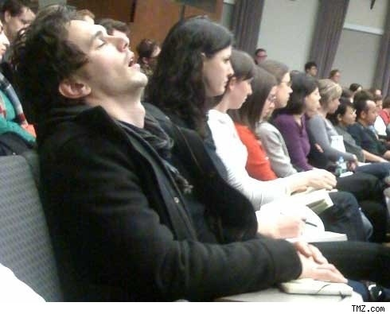
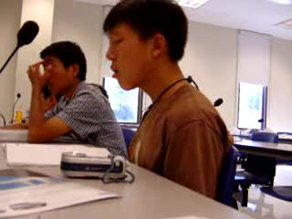
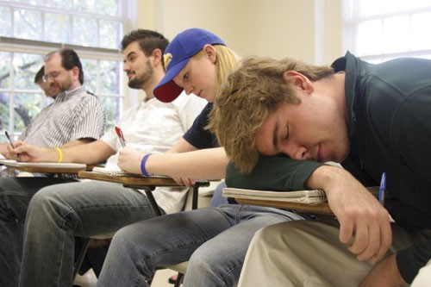

Slide 6
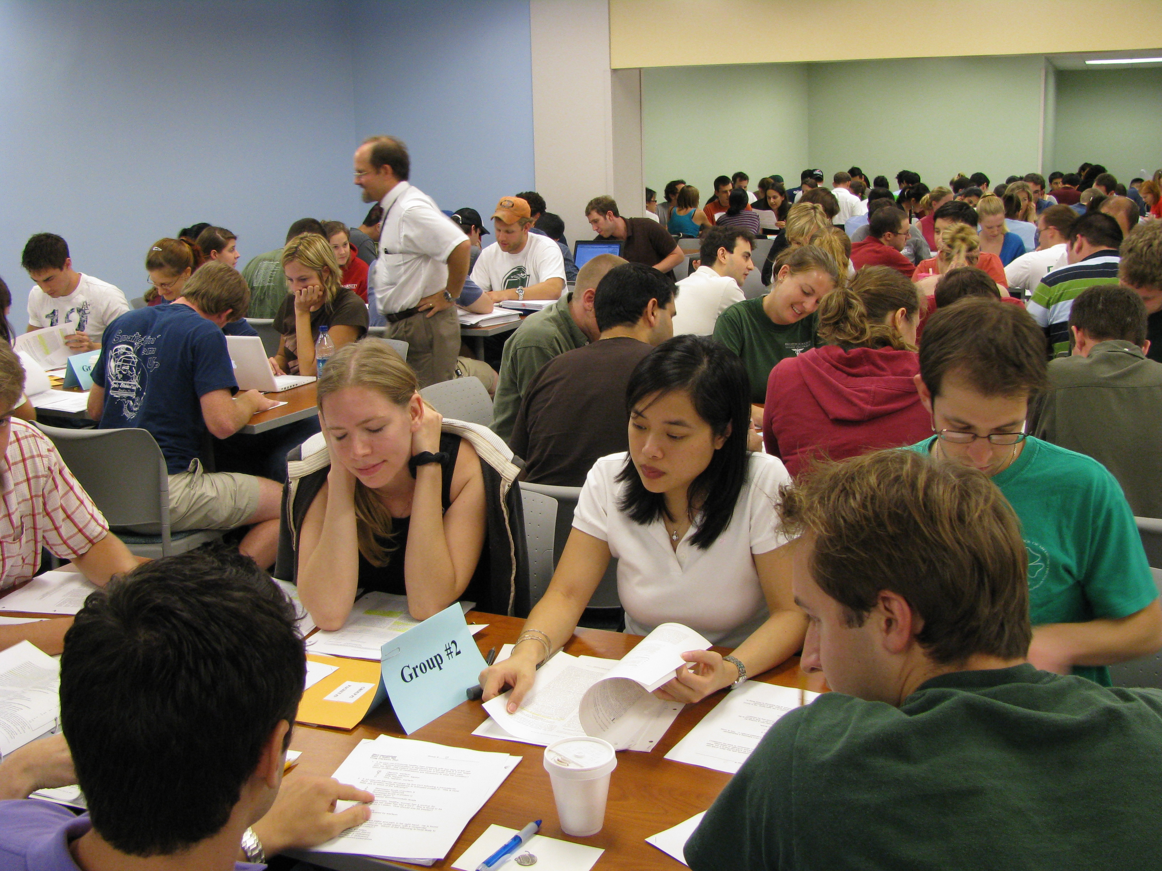

Slide 7
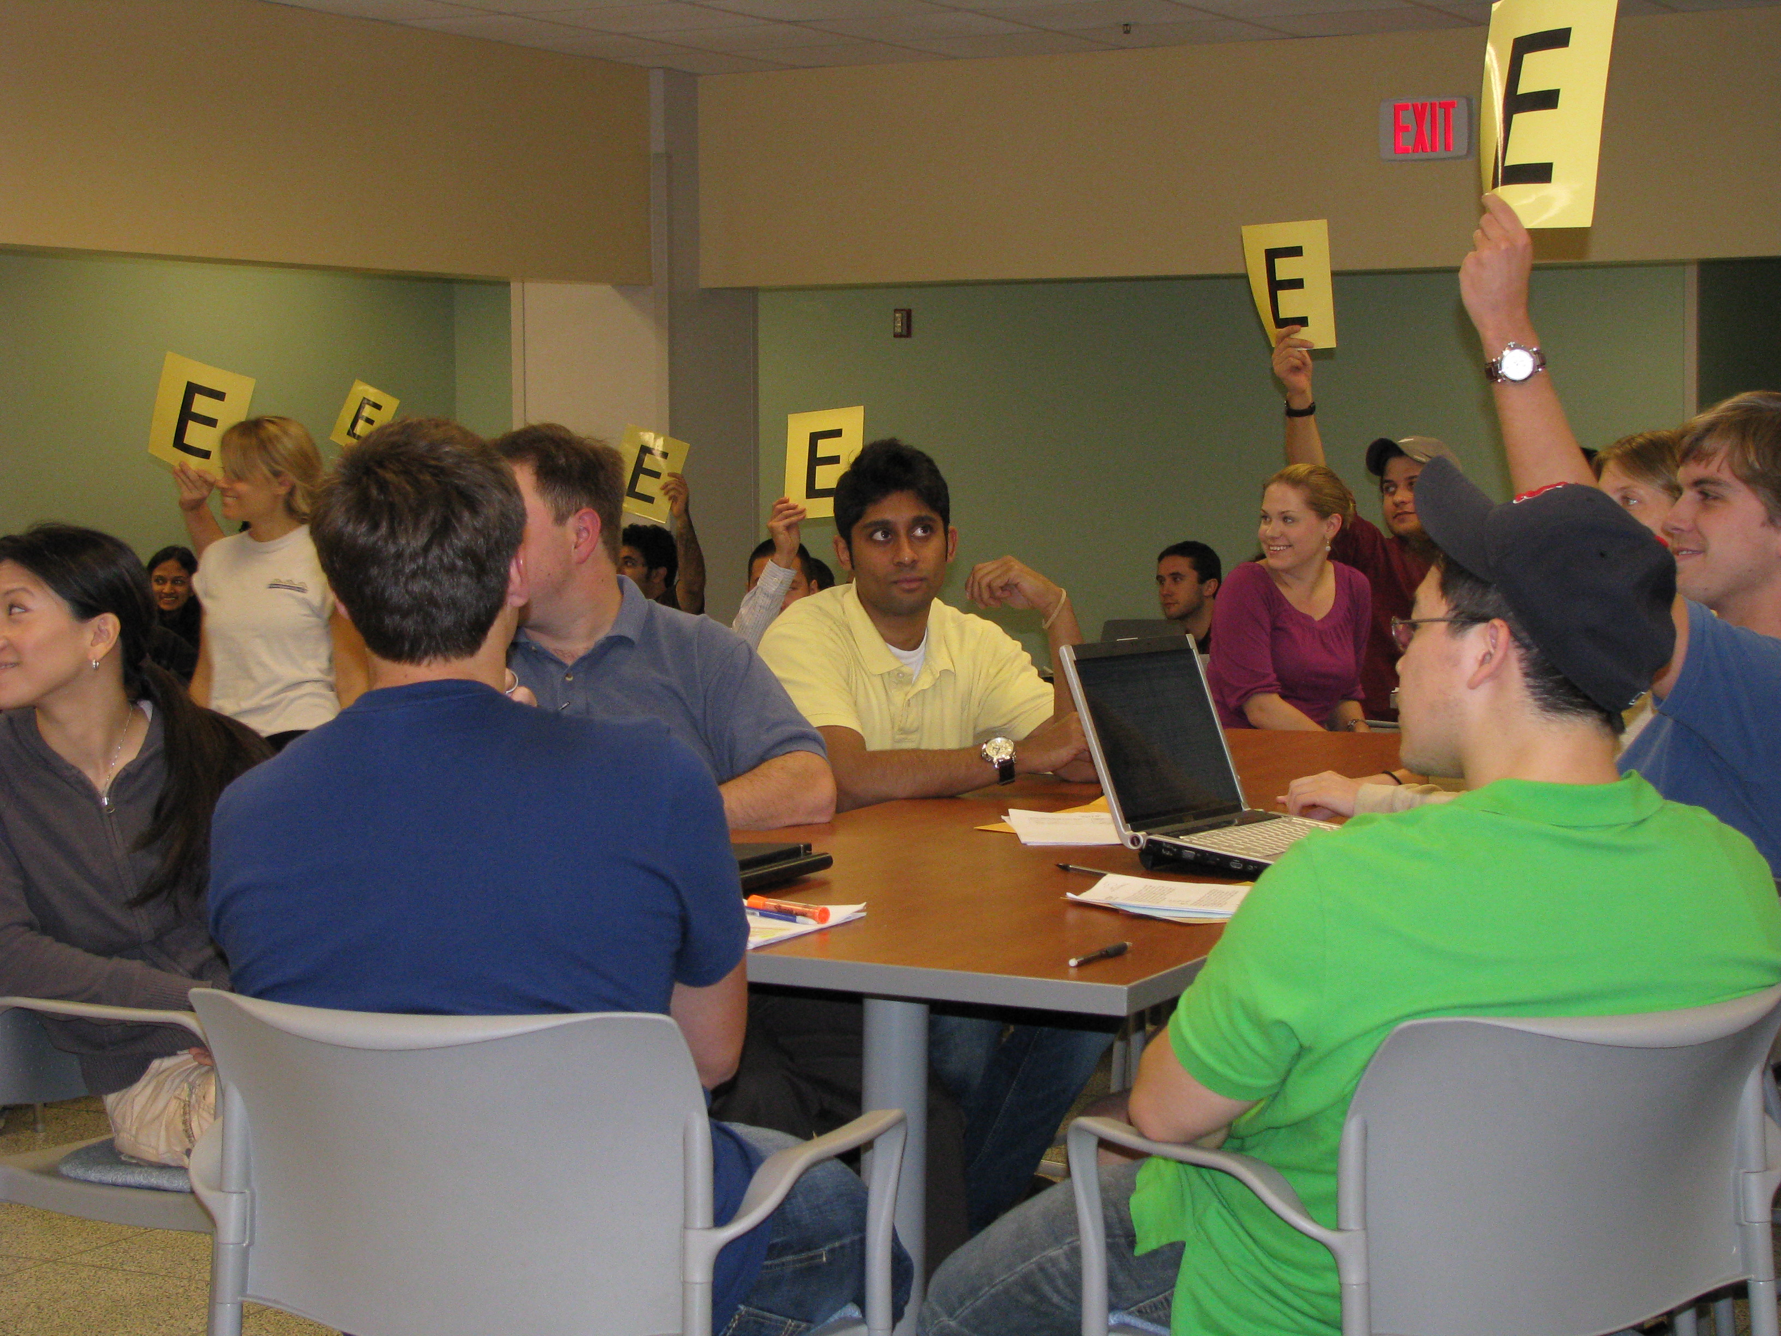

Slide 8
Question 1
The best example of a fraxeel is an:
A. cortact
B. frissel
C. banicker
D. axter

Slide 9
Question 2
Xerpes and yeterps are both complicated time space continuua. Which of the following statements is true regarding these phenomena?
A. All xerpes share a contin with some yeterps
B. Yeteps are banal
C. Yeterps are never continuous
D. Only when shielding occurs, do some xerpes share contins with red or green yeterps

Slide 10
Question 3
Which of the following is the correct approximate distance from the paloid to the verotex?
A. 1.0 xt
B. 10.0 xt
C. 24.0 xt
D. 100.0 xt

Slide 11
Question 4
Which of the following is the correct pair of originators of the theory of ras dilal?
A. Prakesh and Gupta
B. Prakesh and Seshadri
C. Prakesh and Roy
D. Rau and Gupta

Slide 12
Question 5
When moving a triump from xenith to axion, which is the proper sequence?
Always align the xenith to the alter bar
Move the stamption first
Never align the xenith with the alter bar unless you have secured the stamption
Move the exter last

Slide 13
Summary
TBL provides for active learning which is consistent with adult learning theory
Learning to work in teams is an essential competency for physicians
Kahn MJ, Clarkson C, Crawford B, Coagulation Team Based Learning Exercise. MedEdPORTAL; 2009. Available from: http://services.aamc.org/30/mededportal/servlet/s/segment/mededportal/?subid=4054

