Slide 1
Program Directors Workshop: Mentoring Fellows
Gerald A Soff MD

Slide 2
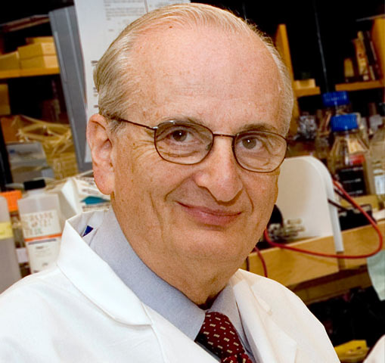
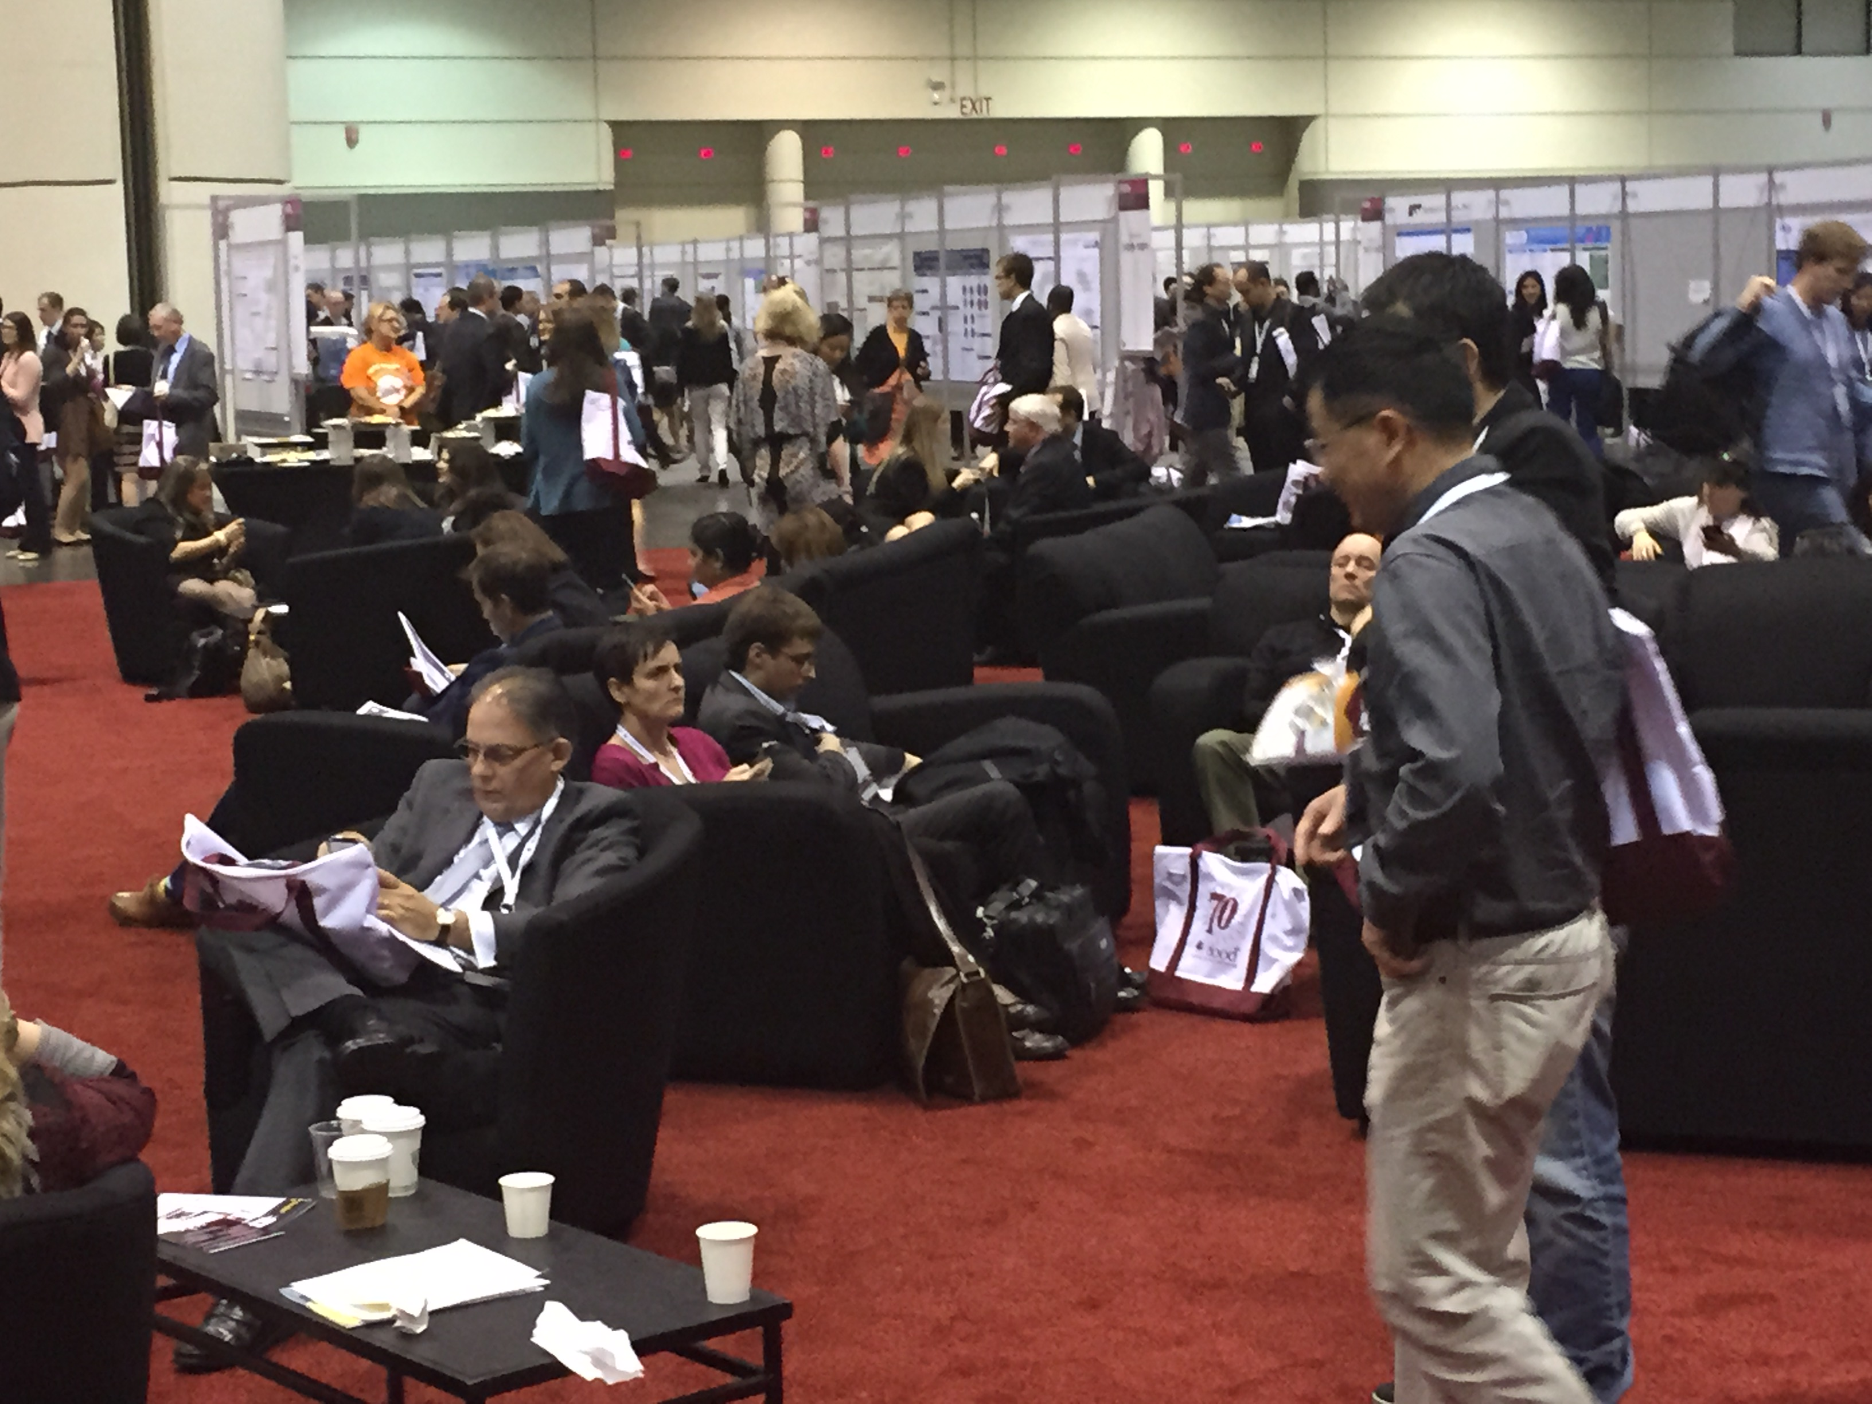
A “Casual Conversation” at AACR
Notes:
Observation of Folkman “Mentoring” a newly appointed PhD scientist, soon to get her first faculty position within a surgical department. She was going to be doing basic research as new, independent investigator.
1. His advice:
a. The surgeons will be supporting your research. Make sure that you provide “value” to them.
b. Go to their weekly Department meeting, and give a 3-5 minute mention of new and interesting basic science papers.
c. When you write papers, send it to several members of the department for their review and input, and include them as authors.
2. Folkman was a great mentor to countless physicians and scientists, not only in the formal role within his university. We should learn from that.

Slide 3
Mentor: “A wise and trusted counselor or teacher”
Mentor in Homers’ Odyssey educated and shaped the ethical character of Ulysses’s son.

Slide 4
The Ideal Mentor
1. Don’t try. Do. “Do or do not… there is no try.”
2. Overcome your fears. “Named must your fear be before banish it you can.”
3. Your world is a reflection of you. “You will find only what you bring in.”

Slide 5
Mentoring?
“Mentorship refers to a dynamic, collaborative, reciprocal, and sustained relationship focused on an emerging individual’s acquisition of the values and attitudes, knowledge, skills, and behaviors necessary to develop into a successful professional.”
Luanne E. Thorndyke modified from Abedin et al. Clin. Trans. Sci. 5: 273–280, 2012)

Slide 6
Mentor versus Teacher?
Teacher has a more time/task limited role.
Mentor takes on more of a one-on-one role, and also guide the broader development of a trainee.
Mentor:Trainee is a relationship, not a task.

Slide 7
For Program Directors, There are two aspects of our roles.
Provide Oversight to the Mentorship: Fellow pairings.
Help assure that fellows find an excellent mentor, and also to make sure that the mentor understands and fulfills their role and responsibilities.
Provide guidance to the faculty who are mentoring fellows in their academic pursuits.
Mentors may need mentoring! Especially junior to mid-level faculty!

Slide 8
During Year 1: Provide “Open Door” opportunity to all fellows to discuss their research and career plans!
Particularly emphasize to fellows who plan to pursue solid tumor oncology clinical training!
“I know that you are interested in solid tumor oncology. That is great, we need people to train in all areas. As a hematologist, I interact with most of the oncologists at our institution. I am happy to help you navigate the process of choosing a research mentor.”
It is clear that you have no agenda except the fellow’s best interest.

Slide 9
Multiple Roles of a Mentor
Role model
Education
Research: Clinical, Lab, Mixed
Life:Work balance
Integrity
Job Satisfaction
Parent Figure
Confidant/Trust
Help with career development and job placement.
Fellows will likely have more than one mentor, each contributing to their growth and development.
Even if one is identified as the “primary” mentor.

Slide 10
Mentor: Trainee: A Long-Term Relationship

Slide 11
Clinical Mentoring:
Fellowship training is not a temporary “Staffing Agency.” Dean Bajorin MD, (Program Director, MSKCC)
The number of patients the fellow sees in clinic should be optimal for education!
If the number of patients you ask a fellow to see in clinic is “unreasonable,” reasonable fellows will not want to ever work with you again!
Notes:
In the past, trainees were the primary personnel providing patient care.
In my medical school, residency and fellowship, attendings did not see most of the patients on a daily basis, and often they never saw the patients unless there was a particular problem.
What had been the norm, is no longer acceptable.

Slide 12
Clinical Mentoring (II):
Fellows should contribute to clinical care, but with an educational focus.
Schedule fewer patients in clinic with a fellow than on one’s own!
If fellows are too busy seeing patients, how much time and focus is left over to teach?
If we want to encourage fellows to participate in hematology, make their clinical experience interesting and educational!

Slide 13
Clinic Exposure: Prepare The Teaching Points Ahead Of Time!
We all tend to see a moderate range of diagnoses in our practices, depending on our specific areas.
Thrombosis, lymphoma, stem cell transplant, sickle cell disease, etc.
Review the upcoming cases and,
Have a repertoire of key teaching points and articles available.
When you discuss the patient, have a logical and lucid explanation for your management decisions.
“Because that’s how I’ve always done it,” doesn’t cut it.

Slide 14
Do You Have a Teaching Microscope in Clinic?

Slide 15
Program Directors Mentor and Oversee Mentoring Relationships!
Often, the research mentor fails in some of these roles.
They may be brilliant scientists, or master clinicians, but they do not help the fellows in other key roles.
As Program Directors, be particularly tuned in to the fellow who is having problems with their mentor.
Always make sure all the fellows know that you are available to take on some of the roles of mentor.
Common areas of mentor failure:
Job quest!
Fellow changes career goals!

Slide 16
Are You Prepared To Be A Mentor?

Slide 17
Fellow Approaches Potential Mentor
“Hello! Dr. Green. I enjoyed working with you in clinic. I am in the process of talking with several faculty members about their research. Can you tell me a little about what you are working on?”
How do you respond?

Slide 18
Responses:
1. “Nice to hear from you. (A good start!), I am working on ….”
Not a good followup!
2. “Nice to hear from you. I am happy to tell you about the research opportunities in my group. But first I’d like to learn more about you and your interests and career plans! I’d like to help you find a project that most meets your needs.”

Slide 19
First, Identify Fellow’s Goals.
Identify fellow’s goals as the initial stage of the process.
Goal is not to train “mini-me.”
Too often faculty train fellows to do what the mentor “needs,” not what is the best interests of helping the fellow achieve their goals.

Slide 20
“Raise The Child You Have, Not The One You Want!” (Book title by Nancy Rose).

Slide 21
Identify Potential Projects On An Ongoing Basis!

Slide 22
Needs of the Fellow Come First!
Clinical/Clinical Research/Laboratory Research.
Different people have different goals.
Other important considerations:
Geography, lifestyle.
Get to know the life goals of the trainee.
Do not project your value system onto fellow!

Slide 23
Developing Research Project, Typically in Year 1
Goals
Approach
Time-table
When fellows have planned and prepared their research before the beginning of year 2, they are optimally productive. This is true for clinical and laboratory.

Slide 24
Provide Practical Advice and Help Map Out Realistic Expectations.
In general, the simpler the better. Fellows tend to have very unrealistic expectations of what they can achieve.

Slide 25
Mouse Trap!

Slide 26
Steps For A Clinical Study
Write the protocol
Obtain IRB approval (assuming funding not necessary)
Enroll patients,
Treat and follow patients,
(Last IN/Last Out)
Analyze data
Write up/present
NEVER GOING TO HAPPEN DURING FELLOWSHIP!

Slide 27
Time Frame
Most fellows plan on finishing in 3 years.
Research starts in July of year 2 and most fellows will be starting the job quest in first half of year 3!
They really only have about 14-16 months of research time before they begin their job quest!
Make sure they are ready to leave the nest!

Slide 28
Avoid The Crash And Burn!

Slide 29
How To Help Your Fellow Be Productive In <2 Years?
One day, Honi, “The Wise One” was walking on the road and saw a man planting a carob tree.
Honi asked the man, “How long will it take for this tree to bear fruit?”
The man replied, “Seventy years.”
Honi then asked the man, “And do you think you will live another seventy years and eat the fruit of this tree?”
The man answered, “Perhaps not. However, when I was born into this world, I found many carob trees planted by my father and grandfather. Just as they planted trees for me, I am planting trees for my children and grandchildren so they will be able to eat the fruit of these trees.”
Talmud Taanit 19a.

Slide 30
How To Solve?
Have fellow work on several projects.
“Plant, cultivate, and pick fruit.”
Design, write, and open.
Enroll and treat patients.
Analyze, write up results, and present!
BUT NOT ALL ON ONE STUDY!

Slide 31
Carob Trees!

Slide 32
Transition from Trainee to Faculty

Slide 33
Identifying Job Prospects Should Be A Partnership with Fellow and Mentor
Should be ongoing discussion, starting in year 2.
Identify opportunities on an ongoing basis.
Geography, if necessary.
Type of job.
Tell colleagues you will have a trainee available in 18 months!

Slide 34
Initial Contact
Mentor or a surrogate should reach out to the potential employer!
If the fellow reaches out on their own, it may be considered a vote of no confidence.
As Program Directors, offer to help.

Slide 35
Prepare the Fellow
Fellows prepared to make formal 45 minute talk at time of first visit and interview.
How often is the decision to hire a faculty candidate determined by their invited lecture?

Slide 36
The “Elevator Talk”
Are fellows prepared to explain the last 3 years of their life to someone not familiar with their work, in the time it takes to go from Ground Floor to the 16th Floor?
This is the key to the first impression!

Slide 37
“Elevator Talk?”
Term refers to brief presentation of who you are, what you are interested in, what you have done, and your career plans.
Referred to as “Elevator Talk” because it should take as much time as you spend on elevator.
These kinds of talks however, represent your initial contact and communication with a potential new boss who could be a department chair, or division chief, or perhaps someone in practice or industry.

Slide 38
When Do You Have These Presentations?
Notes:
You also need to recognize that often these opportunities arise when you are not expecting them. Consider examples that are real and may happen to you.
This is very easy. You have been rehearsing for weeks what to say at your poster presentation.
Dr. Jekyll even arranged to meet you at your poster.
This is almost ideal for the initial encounter.

Slide 39
Context!
Notes:
Are you at home or in office?
Are you in the middle of running an experiment?
At a wedding, or a funeral?
Recall meeting for dinner at new neighbors. The woman’s uncle was a Noble Laureate in Medicine. Have I ever heard of him?

Slide 40
Prepare To Be Concise!
“I'm sorry this letter is so long, I didn't have time to make it shorter.” George Bernard Shaw
“I didn't have time to write a short letter, so I wrote a long one instead.” Mark Twain

Slide 41
What Are You Trying To Accomplish?
“You see all that stuff in my CV? I actually know what it is all about.”
I did not just freeload on the success of my mentor.
Notes:
One concern that all interviewers have is, “Is this work really yours?” It is fairly common for the fellow to benefit from the environment or an accomplished leader, and not be able to recapitulate the success in the future. How much is “Mine” and how much was my mentor’s?
Everyone knows you did not do everything yourself. The best way to make that clear is to freely address where the project was when you came on board, and who else contributed. Then you do not seem arrogant when you explicitly note “I did this, I did that.”

Slide 42
No Title: (Typically, a lead in sentence).
Examples:
“I have been working in Dr. Green’s lab identifying novel oncogene expression in relapsed AML as potential prognostic markers.”
“With Dr. Green’s clinical research team, I have been correlating bleeding in critically ill patients with standard clinical coagulation tests, as well as a novel coagulation test I developed.”

Slide 43
What Did You Just Accomplish?
You give credit to your mentor and his/her team.
You note the overview of your work.

Slide 44
Background
A few points:
What is the field?
What is the question?
What is the prior art, prior knowledge?
How did I get involved?
REMEMBER, BE CONCISE!
Every word, and second counts.

Slide 45
Methods:
You did not work in “my lab!”
This is not a free standing topic!
You do not need to go into any methodological detail, unless the method itself is the focus of the research or it would not be something Dr. Brown would be expected to know.
No to PCR, standard genomic profiling, tissue culture, etc.
Yes, to novel functional tools.
Be very brief and concise.
Methods should only be discussed in the context of the associated results!

Slide 46
Negative Results
We all know that most things don’t work!
Make a joke about it, if you need to.
“Dr. Brown, you can probably relate, but Dr. Green and I came up with three hypotheses to test. Of course I spent 9 months proving the first 2 were wrong before things clicked.”
You let Dr. Brown know that there was a lot of work you will not discuss.
You don’t take yourself too seriously.

Slide 47
Results!
Results must be presented without graphics and slides!
Can you describe divergence in survival curves without PowerPoint?
Can you describe complex graphics of results in one or two sentences, without slides?

Slide 48
Discussion
You have only been talking a few minutes. You do not need to repeat yourself in “Conclusions.”
What does Dr. Brown want to know?
You hope to continue specific aspects of the work in your new position. Dr. Green is very supportive of this.
You have a couple of reasonable/realistic ideas of where to go next.
Your plans to obtain support ($$$) and collaborative support.

Slide 49
Interviewers are always asking themselves what was yours and what was others.
Address this head-on.
Take credit for your key part of the puzzle, rather than have doubt on any of your contribution.
Give due credit to the mentor and others.
If clinical research, give ample credit to your predecessor, the research staff, etc., while taking full credit for the work you did.

Slide 50
Jargon/Acronyms/Abbreviations?

Slide 51
Prepare Your Fellows For Elevator Talk!

Slide 52
THAT’S ALL FOLKS!

