Slide 1
Hematology/oncology milestones
Elaine A. Muchmore, MD
University of CA, San Diego
Laura Edgar, EdD
ACGME Milestones Group

Slide 2
Disclosures
Elaine A. Muchmore, MD
ACGME: Membership on an entity's Board of Directors or advisory committees.
Laura Edgar, EdD
Nothing to disclose.

Slide 3
FIGURE 1. Development of the Internal Medicine Subspecialty Milestones Document as Part of the Next Accreditation System
Published in: Frances Collichio; Elaine A. Muchmore; American Society of Clinical Oncology Educational Book 38, 887-893.
DOI: 10.1200/EDBK_201773
Copyright © 2018 American Society of Clinical Oncology

Slide 4
Subspecialty Reporting Milestones
Launched July, 2014 with similar language as IM residency reporting milestones
Combined project with AAIM/ABIM/ACGME
IM had 22, subspecialties had 24 (procedures and MK3 (Scholarship)

Slide 5
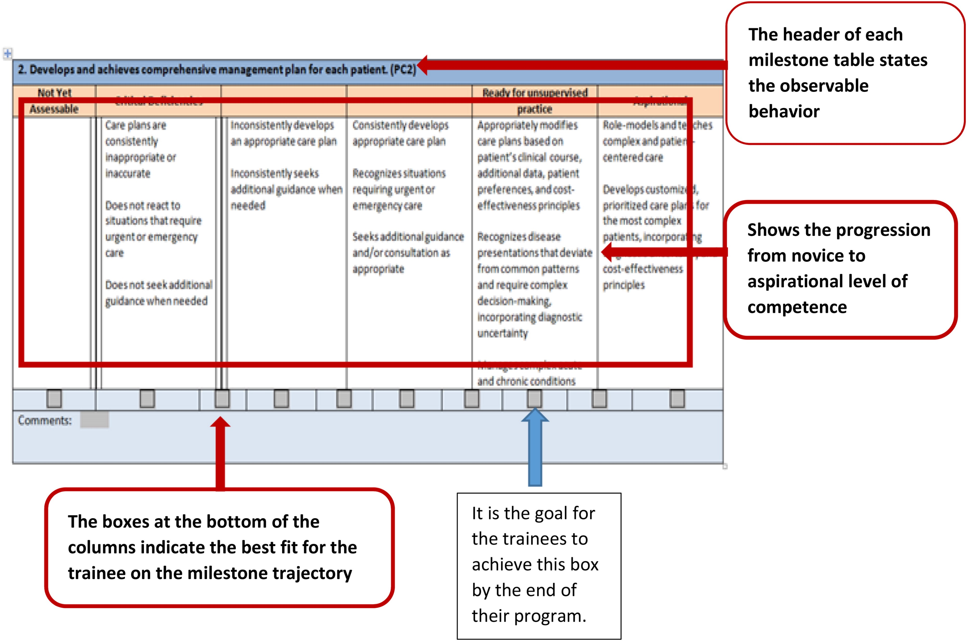
A sample format for a subcompetency, showing the format for submission of this information to the ACGME. This is one subcompetency in Patient Care.
Published in: Frances Collichio; Elaine A. Muchmore; American Society of Clinical Oncology Educational Book 38, 887-893.
DOI: 10.1200/EDBK_201773
Copyright © 2018 American Society of Clinical Oncology

Slide 6
Subspecialty Reporting Milestones
Major issues
Language relatively non-specific
Levels 1-5 were not always consistent between subcompetencies
Some subcompetencies overlapped
SBP1 (works effectively in a team) = ICS2 (communicates effectively in teams)
PBL1 (monitors practice) = PBL2 (learns and improves via performance audits)
PROF1(has professional and respectful interactions) = PROF4 (exhibits integrity in conduct).

Slide 7
Hematology/Oncology Curricular Milestones
Also launched July 2014
Developed by ASH CT and ASCO OTP collaboration
Introduced specialty-specific concepts
Issues included:
Had to include non-PC, non-MK subcompetencies not targeted to fellows
Sum of PC and MK subcompetencies PLUS others totaled 39
Some subcompetencies were too wordy
Subsequent evaluation forms were lengthy

Slide 8
Outcomes
Since launch of Subspecialty Reporting Milestones in 2014
Fellowships have formed CCCs for evaluation
Most fellowships have developed some form of curricular milestones
IM fellowships have reported fellow progression during training, with very little programmatic “straight-lining”
ACGME Milestones Group recognized redundancy of non-PC, non-MK milestones, and created harmonized milestones

Slide 9
December, 2017
ACGME Milestones group convened a summit of IM fellowship leaders to query them about moving forward with “Subspecialty-Specific Reporting Milestones 2.0”
ALL AGREED

Slide 10
What are “Subspecialty-Specific Milestones 2.0”?
For Hematology/Oncology:
Blend of curricular and harmonized milestones
Five columns, but without headers such as “critical deficiency” or ‘aspirational”
Language clear and consistent in each of the subcompetency columns
Evaluations will require fewer questions to cover the subcompetencies
Goal: greater internal consistency will facilitate CCC discussions
These will serve as reporting milestones!

Slide 11
Progress on “Hematology/Oncology Subspecialty-Specific Milestones 2.0”
ACGME Milestones Group has gathered representatives from ASH, ASCO and ABIM
Meeting 1 discussed PC and MK subcompetencies
Meeting 2 (next week) will address the rest
After Meeting 3, the document will be posted for comments
Hopefully implementation will be AY19-20

Slide 12
MILESTONES

Slide 13
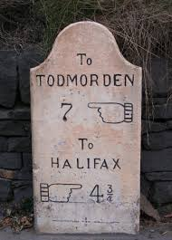
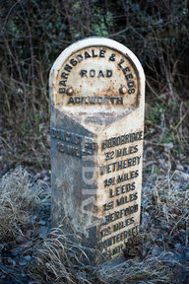
Milestones
By definition a milestone is simply a significant point in development.
Milestones should enable the learner and training program to know an individual’s trajectory of competency development.

Slide 14
Dreyfus Developmental Model Stages
Dreyfus Stage | Description
Novice | Rule driven; analytic thinking; little ability to prioritize information
Advanced beginner | Able to sort through rules based on experience; analytic and non-analytic for some common problems
Competent | Embraces appropriate level of responsibility; dual processing of reasoning for most common problems; can see big picture; Complex problems default to analytic reasoning. Performance can be exhausting.
Proficient | More fully developed non-analytic and dual process thinking; comfortable with evolving situations; able to extrapolate; situational discrimination; can live with ambiguity
Expert | Experience in subtle variations; distinguishes situations

Slide 15
Milestones Guiding: Professional Development
Curriculum
MILESTONES
Expert/
Master
Assessment
Proficient
Competent
Development is a
non-linear phenomenon
Advanced Beginner
Novice
Time, Practice, Experience
Notes:
Reality is skills develop over time and training. We expect different levels of competence for different skills. The Milestones were heavily influenced by developmental models of expertise, such as the work of the Dreyfus brothers and Anders Ericsson. This slide is based on the Dreyfus brothers. We also make the point that curriculum and assessment must be integrated: assessment drives learning but the “right learning” (curriculum) should also guide the appropriate choice of assessment.

Slide 16
Purposes and Implications
Milestones
ACGME
Training Programs
Certification Boards
Residents and Fellows
Accreditation – continuous quality improvement (CQI)
Community of practice for evaluation and research, with focus on continuous improvement
Guide curriculum development
More explicit expectations of trainees
Support better assessment
Enhanced opportunities for early identification of under-performers
Framework for CCC
Not intended for SMB use
Research ONLY
Public Accountability – focus nationally on important competency outcomes
Increased transparency of expectations
Encourage informed self-assessment and self-directed learning
Better feedback
Facilitate individualized learning plans
Milestones are a Formative Assessment Framework
Notes:
There are four primary stakeholders in the Milestone Project: ACGME, Residency Programs, Residents, and Certification Boards. The CAGME will primarily use milestones for accreditation of GME programs. They will also use them for reporting to nation al interests and for research purposes. Residency programs may use the milestones to help guide curriculum and to aid residents. For residents that are not performing at expectation, the milestones become a clear means of explanation as to where the problems lie. Residents can use the milestones to do more self-assessment and to prepare for future learning. The results of a milestone evaluation will help the resident to understand their strengths and weaknesses. Each certification board will decide for themselves what they will do with this information. They may use it as a requirement for sitting for the board exams or as a launching point for maintenance of certification.

Slide 17
Resident Reports in ADS
Resident reports demonstrate the evaluation numerically, narratively, and as trends
You are able to download and edit these pdfs
Add in comments or other information that could be valuable to the resident

Slide 18
Resident Reports in ADS

Slide 19
Resident Reports in ADS

Slide 20
Resident Reports in ADS

Slide 21
Program Reports in ADS
Quartiles
Range
Specialty mean
Specialty median

Slide 22
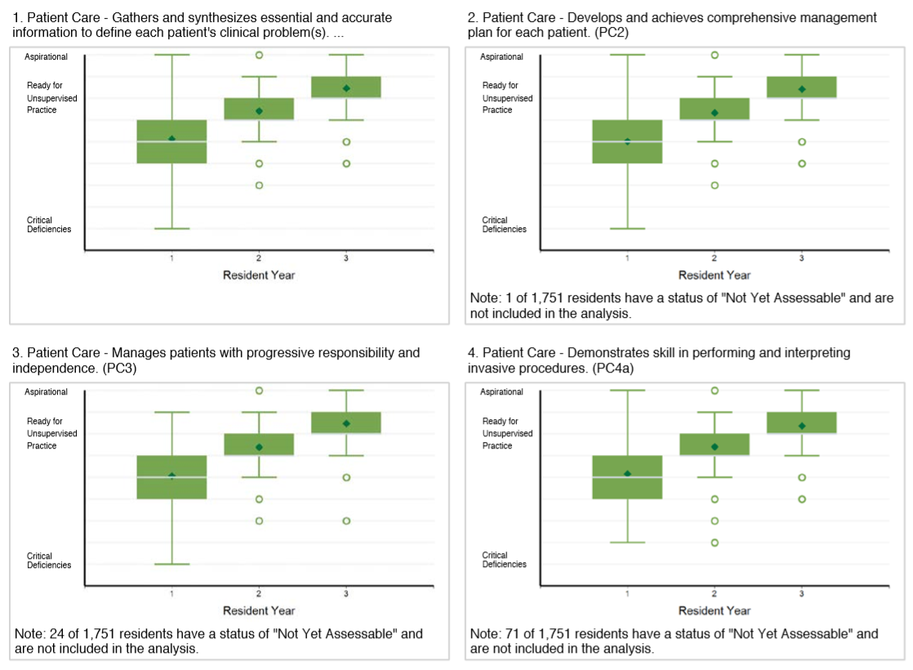

Slide 23
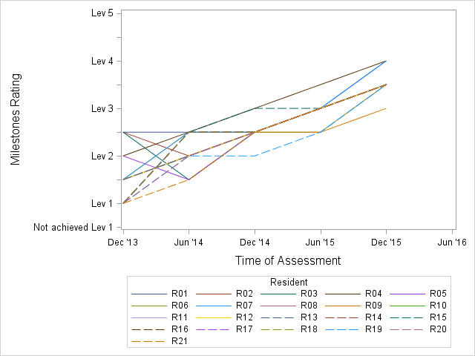
Getting Started: Track Progression Over Time
Within Program example - PC1 (Emergency Medicine)
Was this an important trend?
Notes:
From a program of EM (3yr) for residents who are graduating from the program in June 2016

Slide 24
Mapping Individual Trajectories
Residents’ Milestones trajectories over time (e.g., Wound Management)
N=1336
1st year
2nd year
3rd year
Jul ‘13
Entrance
1st Assessment
Graduation
Notes:
All residents were assessed six times over three years until their graduation.

Slide 25
Results – EM Wound Management
Milestones trajectories for those who attained Level 4 and those who did not
n = 1066
(80%)
N=1336
n = 270
(20%)
Jul ‘13
Entrance
1st Assessment
Graduation
Notes:
When all residents were grouped depending on whether or not they attained Level 4, 80% of them reached the target, whereas 20% did not.
As you can see, this grouping seems to show two distinctive tendencies over time.
(office use: ST30)

Slide 26
Results – EM Wound Management
Milestones trajectories for those who attained Level 4 and those who did not
n = 1066
N=1336
n = 270
Jul ‘13
Entrance
1st Assessment
Graduation
Notes:
Now, dots are added to the graph. One dot represents the number of residents who were rated on the Milestones level at the time of assessment.
The larger the dot is, the more residents are rated at the level and time.
ST50

Slide 27
Milestone Level Thresholds
Odds ratio (OR) for residents not attaining Level 4 under the threshold over time
n = 1066
Lev 3.0
n = 270
Lev 2.5
Lev 2.0
Lev 2.0
OR=4.05****
(2.63,6.23)
Lev 1.5
OR=1.43*
(1.06,1.94)
OR=1.85**
(1.25,2.74)
OR=2.64****
(1.81,3.83)
OR=1.02
(0.78,1.33)
Jul ‘13
Entrance
1st Assessment
Graduation
Notes:
…the rest of the assessment (except for the last). The Odds Ratio increased as the time of observation approached the time of graduation.

Slide 28
Number of Residents by Resident Year
 | Year 1 |  | Year 2 |  | Year 3
 | Dec 2015 | Jun 2016 | Dec 2016 | Jun 2017 | Dec 2017 | Jun 2018
N of residents | 508 | 508 | 508 | 507 | 507 | 508
Notes:
Done

Slide 29
Sub-competencies
PC01 | Gathers and synthesizes essential and accurate information to define each patient’s clinical problem(s)
PC02 | Develops and achieves comprehensive management plan for each patient
PC03 | Manages patients with progressive responsibility and independence
PC04a | Demonstrates skill in performing and interpreting invasive procedures.
PC04b | Demonstrates skill in performing and interpreting non-invasive procedures and/or testing
PC05 | Requests and provides consultative care
MK01 | Possesses Clinical knowledge
MK02 | Knowledge of diagnostic testing and procedures
MK03 | Scholarship
Notes:
Done

Slide 30
Resident-Level Trajectories of Milestones Ratings PC01
Notes:
Done

Slide 31
Resident-Level Trajectories of Milestones Ratings PC02
Notes:
Done

Slide 32
Resident-Level Trajectories of Milestones Ratings PC03
Notes:
Done

Slide 33
Resident-Level Trajectories of Milestones Ratings PC04a
Notes:
Done

Slide 34
Resident-Level Trajectories of Milestones Ratings PC04b
Notes:
Done

Slide 35
Resident-Level Trajectories of Milestones Ratings PC05
Notes:
Done

Slide 36
Resident-Level Trajectories of Milestones Ratings MK01
Notes:
Done

Slide 37
Resident-Level Trajectories of Milestones Ratings MK02
Notes:
Done

Slide 38
Resident-Level Trajectories of Milestones Ratings MK03
Notes:
Done

Slide 39
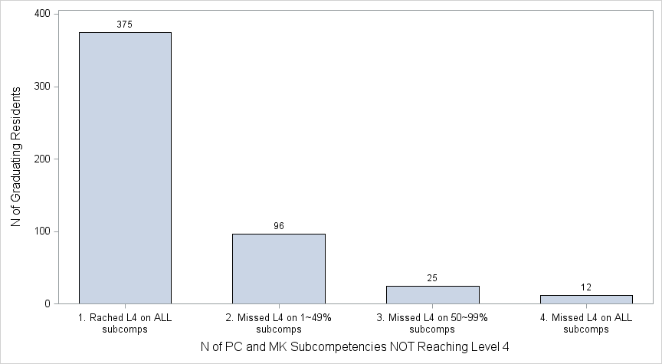
Distribution of Graduating Residents Not Achieving Level 4 by number of PC and MK Subcompetencies (June 2018)

Slide 40
Where do I find...?

Slide 41
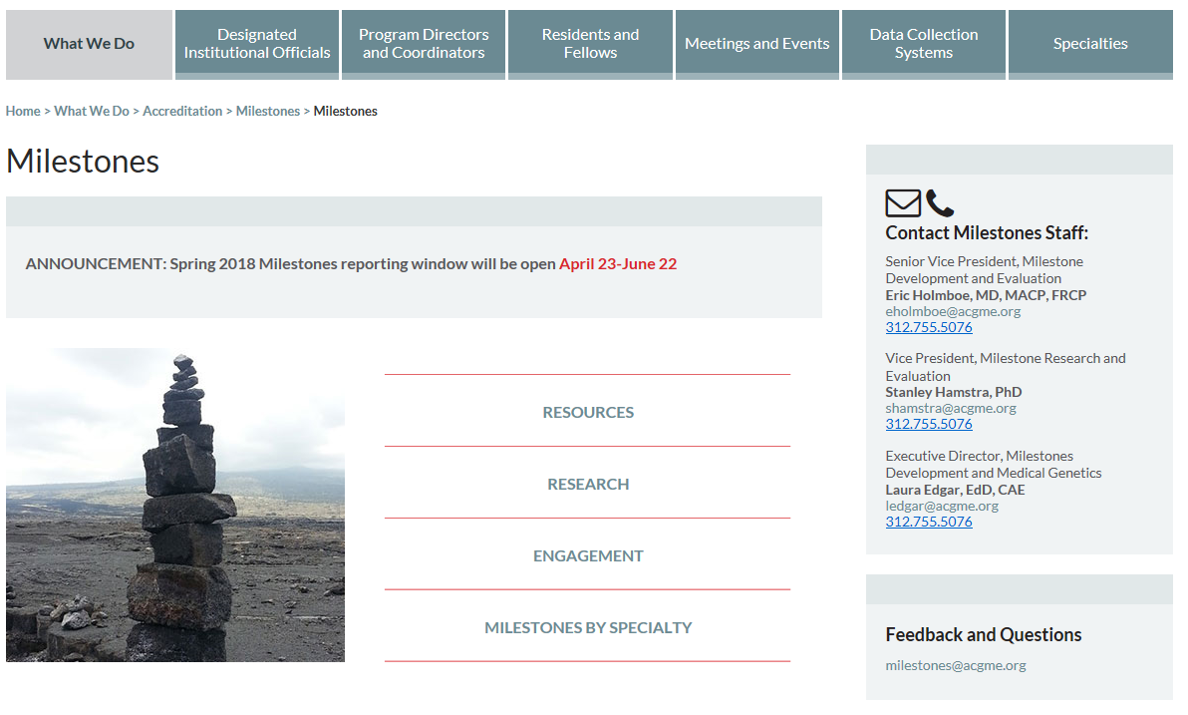

Slide 42
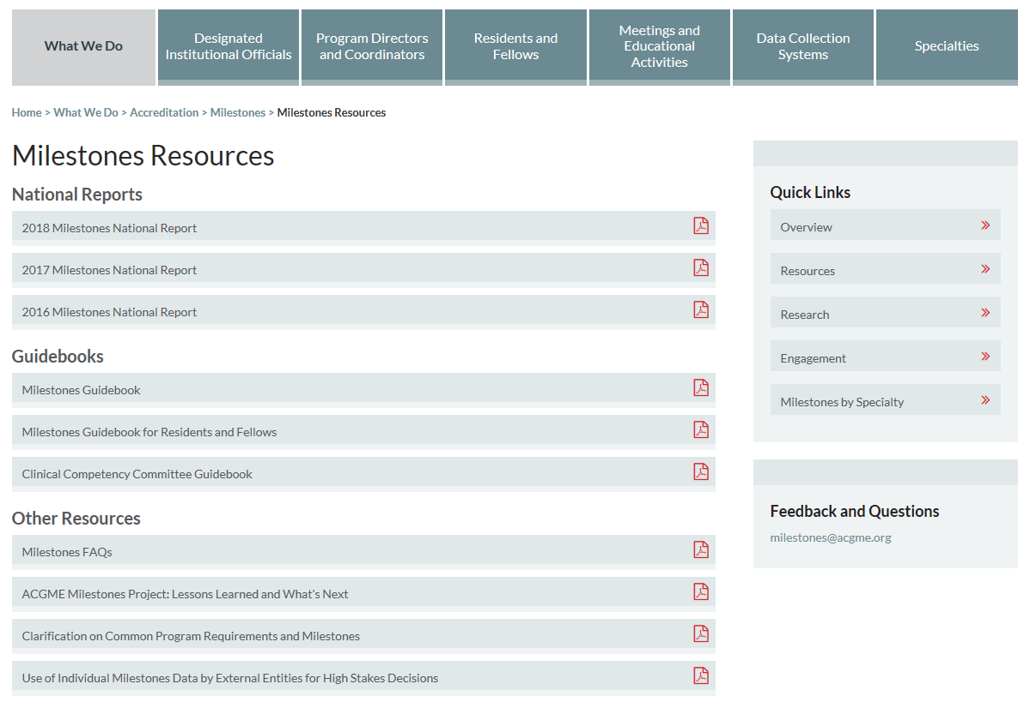

Slide 43
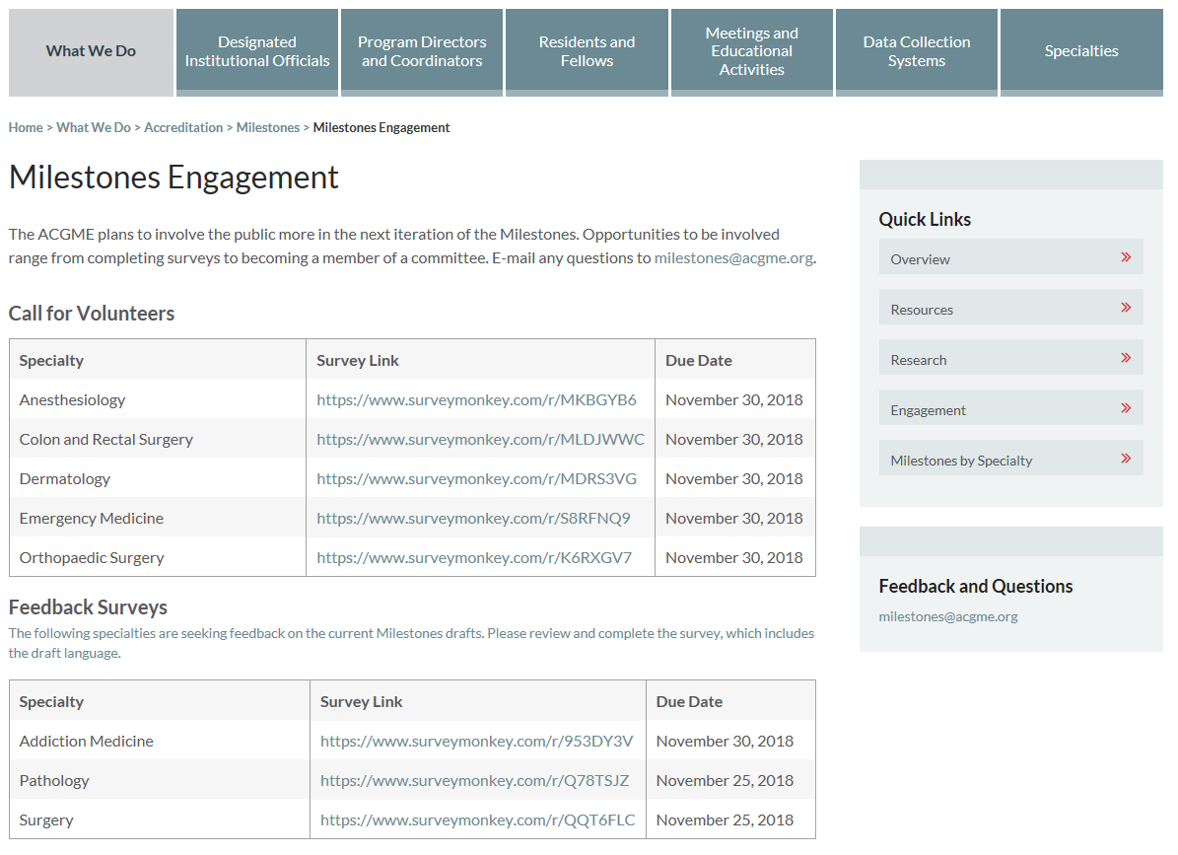

Slide 44
Courses Available
Developing Faculty Competencies in Assessment
6-day workshop in Chicago 3 times per year
3-day workshop at regional hubs
Vanderbilt, UCLA, Philadelphia Consortium, Cleveland Clinic, and more are being developed

Slide 45
Distance Learning in Development
Creating short modules for Milestones Education
Assessment 101
Milestones 101
CCC 101
CCC’s and Group Process

Slide 46
Other Resources

Slide 47
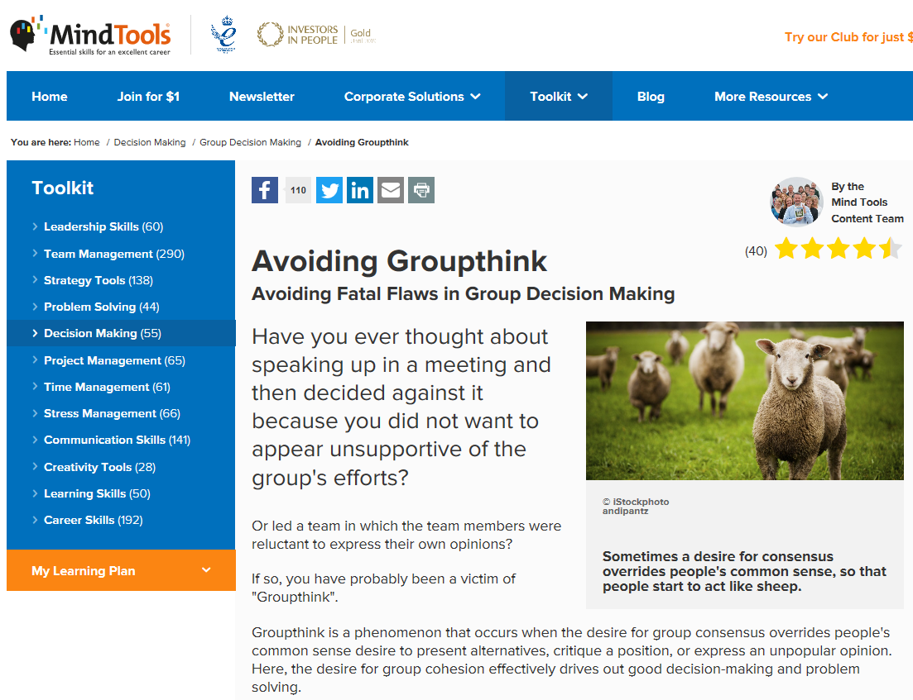
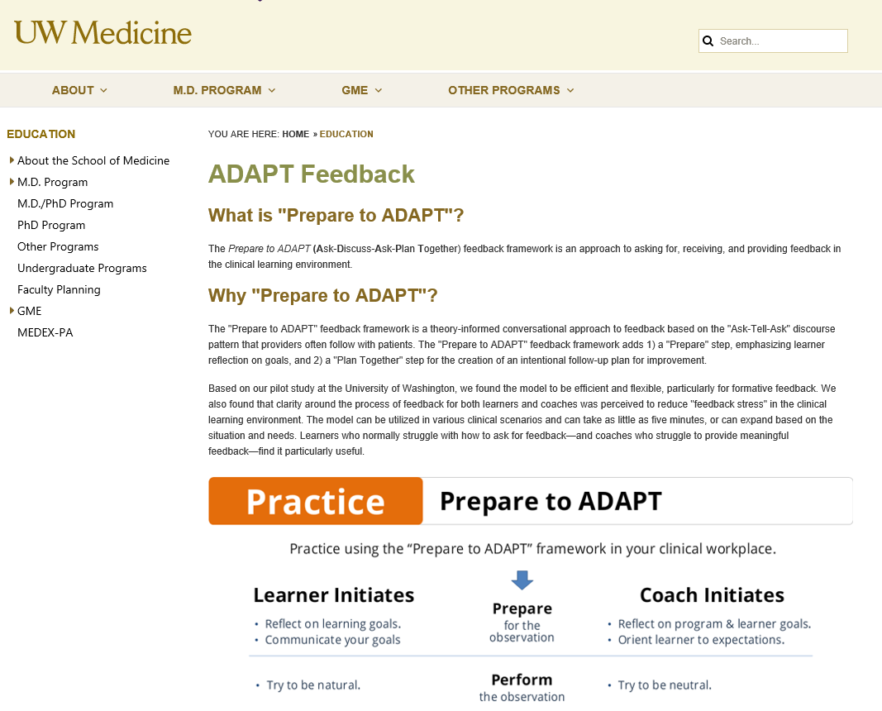
Other Resources

Slide 49
We are here to help
Milestones:
milestones@acgme.org
Laura Edgar
ledgar@acgme.org

Slide 50
PERSPECTIVE

Slide 51
Milestones Team
Lisa Conforti
Laura Edgar
Stanley Hamstra
Eric Holmboe
Landyn Jordan
Sydney Roberts
Chandra Ross
Sonia Sangha
Nicholas Yaghmour
Kenji Yamazaki

