Slide 1
Top Ten Pearls & Pitfalls of Fellowship Program Directorship
Annie Im, MD
University of Pittsburgh
Ann LaCasce, MD, MMSc
Dana-Farber Cancer Institute
Alice Ma, MD
University of North Carolina, Chapel Hill

Slide 2
American Society of Hematology 60th ASH Annual Meeting Disclosure Statement
Ann LaCasce, MD, MMSc
BMS, Humanigen, Seattle Genetics Consultancy
Discussion of off-label drug use: Not applicable

Slide 3
American Society of Hematology 60th ASH Annual Meeting Disclosure Statement
Annie Im, MD
Nothing to disclose
Discussion of off-label drug use: Not applicable

Slide 4
American Society of Hematology 60th ASH Annual Meeting Disclosure Statement
Alice Ma, MD
Nothing to disclose
Discussion of off-label drug use: Not applicable

Slide 5
#1: The Email Trail
Save all emails relating to trainees, changes to the program, support, salary, grants – anything having to do with time or money.
Copy your program coordinator – s/he is paid to be more organized than you!

Slide 6
#2: Face-to-Face Meetings are Key
In-person conversations between real live people are best when dealing with sensitive or thorny issues.
Avoid snarky text messages, emails that can be misconstrued – anything you would not want on a billboard should not be put into writing.

Slide 7
#3: Being ACGME-Ready
It is OK to have a didactic session explaining what the resident survey questions mean—and what the answers should be.
Ditto the faculty survey.
It’s not cheating—it’s explaining.
Trust us – no one else knows what Practice-Based Learning is!

Slide 8
#4: Your DIO
Know your DIO (Designated Institutional Official is the liaison between your health system’s training programs and the ACGME.
S/he is your friend, advocate, and advisor. Use the GME office for guidance when issues arise.

Slide 9
#5: Your Division Chief
You should also know and trust your Division Chief. Hide nothing from your Chief. Leverage his/her power to help you effect change, particularly changes involving faculty.
You are the fellowship program director, not the faculty program director!

Slide 10
#6: Your Program Coordinator
An experienced (and/or intelligent, quick-learning, flexible, cheerful, patient) coordinator is key.
Provide resources: ACGME offers educational conferences (and awards) for coordinators. S/he can also obtain guidance from the Internal Medicine coordinator.

Slide 11
#7: Conflict Resolution
There are 3 sides to every story. Talk to EVERYONE before drawing conclusions.
When behavior is truly bizarre or awful, be concerned first: Are there problems at home? With family? Substance abuse? Psychiatric issues?

Slide 12
#8: Your Colleagues
Attend ASH/ASCO program director retreats and workshops.
Colleagues are a great source of information and ideas. You can also ask fellow program directors at your institution for solutions and advice.

Slide 13
#9: Your Fellows
Meet with fellows regularly for feedback about the program and be open to change.
Individual as well as group meetings can be enlightening for you and cathartic for them.

Slide 14
#10: Your Boundaries
It’s OK to say, “No.”
This applies to everyone who asks you for something (ie, not just fellows!). They expect you to set limits and may grumble but will respect you for it.

Slide 15
Bonus: Additional Pearls for New PDs

Slide 16
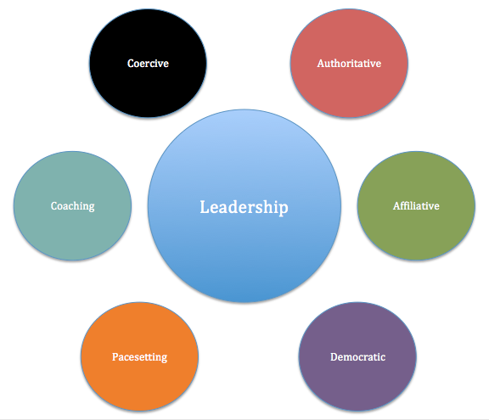
Bonus #1: Leadership Style
Know your leadership style
What works for you may not be the same as other PDs before you or around you

Slide 17
Bonus #2: The Bad Guy
You have to be the bad guy sometimes
Leverage CCC and other fellowship leadership,
be objective,
And don’t take criticism personally

Slide 18
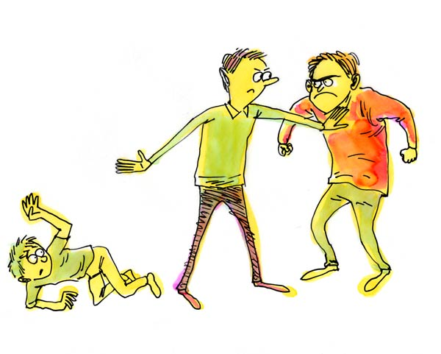
Bonus #3: The Good Guy
Stand up for the fellows and for education, especially with administration
It's important that the fellows know that you're on their side

Slide 19
Bonus #4: Promises
Don't promise things in the fellowship that you can't deliver
Talk with all stakeholders before communicating changes to fellows

Slide 20
Bonus #5: Innovation
Try new things and be innovative!
Know that some won’t work (and be ok with that), but that some will

Slide 21
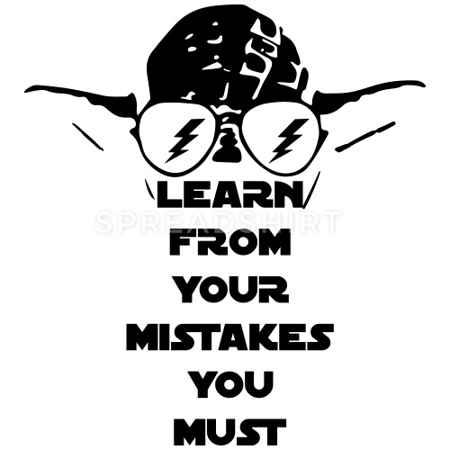
Bonus #6: The Mistakes
Turn every misstep into a lesson
Mistakes are common early, they will only help you quickly become an older and wiser PD

Slide 22
Additional Pearls from the Audience?

