Slide 1
Manali Patel, MD, MPH
56th ASH Annual Meeting Disclosure Statement
Nothing to disclose
Discussion of off-label drug use: not applicable

Slide 2
Overview
Background
Achieving the Triple Aim in Cancer Fellow
A3 Thinking
Questions
Workshop
Mock A3 Thinking Projects

Slide 3
Achieving the Triple Aim In Cancer
Manali I. Patel, MD MSPH
Instructor, Division of Oncology
Clinical Excellence Research Center
Stanford University School of Medicine
Health Services Research, Palo Alto Veterans Administration

Slide 4
Overview
Care delivery
“Triple Aim”
Value Improvement Options
Clinical Excellence Research Center
Innovations in care delivery
User-centered design methodologies
Achieving the “Triple Aim” in Cancer Care
Pilot test partners
Payment Reform

Slide 5
Annual Percent Increase GDP, Healthcare, Cancer costs
National Cancer Institute 2012
Notes:
This slide depicts further depicts the annual percent increase of cancer costs as compared to health care expenditures and GDP. The rate of rise of direct cancer costs is significantly outpacing the rate of inflation and is unsustainable.

Slide 6
Annual Percent Increase GDP, Healthcare, Cancer costs
National Cancer Institute 2012
Notes:
This slide depicts further depicts the annual percent increase of cancer costs as compared to health care expenditures and GDP. The rate of rise of direct cancer costs is significantly outpacing the rate of inflation and is unsustainable.

Slide 7
Annual Percent Increase GDP, Healthcare, Cancer costs
National Cancer Institute 2012
Notes:
This slide depicts further depicts the annual percent increase of cancer costs as compared to health care expenditures and GDP. The rate of rise of direct cancer costs is significantly outpacing the rate of inflation and is unsustainable.

Slide 8
The “Triple Aim”
Population Health
Experience of Care
Better Health
Better Care
Per Capita Cost
Lower Cost
Berwick D Health Affairs 2008

Slide 9
Value Improvement Options
Sum
=
Care Delivery Innovations
+
Focused Improvement Bursts
+
Manage for Daily Improvement
Health Care Professionalism
+
Adapted from W.E. Deming
Notes:
There have been many efforts in the healthcare space over the past several years that have improved value to society. Health care professionalism, daily improvement efforts and focused improvement bursts like LEAN which is a toyota manufacturing improvement effort designed to quickly develop improvement efforts have created some improvements in healthcare value.
slide which is adapted from W E Deming demonstrates that while there are many efforts targeted at health care professionalism like the list of 5 by consumer reports in ASCO and daily improvement efforts through quality improvement targets like LEAN the best way to improve value is through care delivery innovations that are disruptive to the current healthcare system.

Slide 10
Value Improvement Options
Sum
=
Care Delivery Innovations
+
Focused Improvement Bursts
+
Manage for Daily Improvement
Health Care Professionalism
+
Adapted from W.E. Deming

Slide 11
Value Improvement Options
Sum
=
Care Delivery Innovations
+
Focused Improvement Bursts
+
Manage for Daily Improvement
Health Care Professionalism
+
Adapted from W.E. Deming
Notes:
However, some would argue that these small efforts are only a bandaid solution.

Slide 12
Clinical Excellence Research Center
Better Health, Less Spending

Slide 13
Clinical Excellence Research Center: A Care Model Accelerator

Slide 14
CERC Innovation Process
Unreasonable value improvement targets
Immersion or Boot Camp
Needs findings
Literature Review, Clinical Observations, Diverse panel of subject matter experts
d.school and Bio-design methodologies
Design
Team Based Brainstorming
Cost-modeling
Partnerships
Implementation
Evaluation
Spread
Patel MI 2013 Transdisciplinary Approaches to Improving Cancer Care, JOP, July 2013;
Patel MI 2013 The Process Behind the Design, In progress

Slide 15
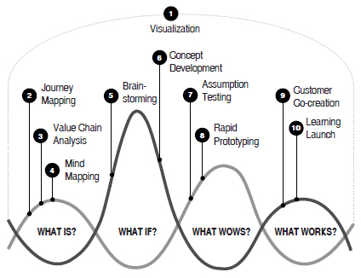
Design-Thinking: Process
Liedtka, J; Oglivie, T. Designing for Growth

Slide 16
Design-thinking in Cancer?
Patel MI 2013 Journal Oncology Practice.
Patel MI 2013 The Process Behind the Design, Under Review

Slide 17
Design-Thinking: Through the Patient’s Journey

Slide 18
Design-Thinking: Un-Met Needs
Patient Caregiver Provider Staff Payer
Wait times Burn-out Timeliness Wait times Claims
Respect Communication Quality care Scheduling Data
Comfort Distractions Administrative Authorizations Costs
Anxiety Space Communication Follow-up plans Satisfaction
Goals Anxiety Follow-up plans Comfort Scheduling

Slide 19
Design-Thinking: Opportunities
Wait Times Communication Support
Inform, engage patients Improve workflow, Engage families and patient
and caregivers fewer tasks, delegation, Websites and videos
Comfortable environment “Lean” clinics Educational activities

Slide 20
Design-Thinking: Opportunities
↑ Underused, preventive services | ↓ Low Value, Unwanted Services | ↓ Inefficient production | ↓ Noncompetitive prices
Inform, engage patients, caregivers | Engage providers, patients, caregivers | Improve workflow, fewer tasks, delegation | Competition, Innovation
Comfortable environment | Financial incentives | “Lean” clinics | Partners

Slide 21
Design-Thinking Analysis
Patel MI 2013 The Process Behind the Design, Under Review

Slide 22
Design-Thinking
Patel MI 2013 The Process Behind the Design, Under Review

Slide 23
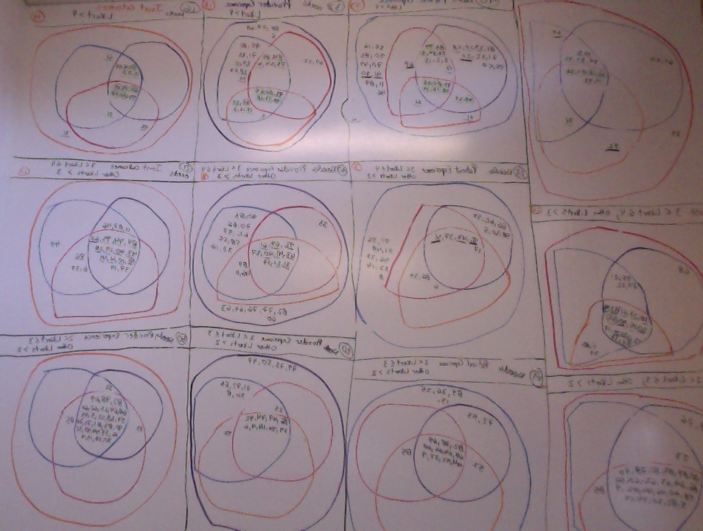
Team-Based Brainstorm

Slide 24
CERC Design Product: Advanced Cancer Care
Respect patient and family goals
1:1 Care Guides
Immediately relieve symptoms
Protocol-driven symptom control
Optimize care at and near home
Appointments, chemotherapy closer to home
~30% Net Reduction in Annual US Spending
Patel MI 2013 Bending the Spending Trend in Advanced Cancer, Under review

Slide 26
PROCESS FOR CARE MODEL IMPLEMENTATION SUPPORT
Organize
Plan
Test and iterate
Implement
Spread & publish (CERC)
Sustain & rollout (IO)
CERC
Identify team
Align goals¹
Set aims
Establish metrics
Select model
Confirm business case
Advise
Workflows
Value stream mapping
Technology
Physical space
Training
Data collection
Develop research plan²
Prepare for testing¹
Advise site small scale tests PDSA cycles¹
Advise modifications
Facilitate implementation prep
Light touch support (~1 day per week)
Facilitate debriefing session
Support research plan, as agreed
Spread model
Disseminate pilot outcomes
Plan for iterative testing
Beta site identification
Implementing organization (IO)
Identify project leadership
Define project governance
Agree project scale/scope
Internally lead budget, plan
Mobilize resources
Lead internal communications
Run small scale tests using PDSA cycles
Modify project plan, budget
-- Leadership
resources for
successful
translation of
tests into data
Sustain model and rollout
Provide feedback on model to CERC
Deliverables
Project charter
Business case and resource requirements
Project budget
Baseline data
Plan for test
Timeframe
-- Revised
implementation
plan and budget
-- Revised
operational
plan
-- Data set
Validated
model
Published
outcomes
1 Based on IHI’s Model for Improvement
2 Includes trial design, measures at baseline and project end, statistical techniques used, and roles of IO and CERC.

Slide 27
Implementation Summary
Prelaunch
Pilot Launch
Pilot Completion
Data Analysis
Project Completion
Organization/Planning
Charter Document
Resources
First patient enrolled
Last Patient
Data Analysis
Continuation
Dissemination
Merge utlization/cost
Data organized
IRB
Train Health Care Coaches

Slide 28
Pilot Test Partners
Notes:
And, the final slide shows the partners that I am implementing the cancer care model with. For the VA, I have received a ½ million dollar innovation grant to roll it out in the Palo Alto system. I have also received grant funding from Intermountain for the evaluation at their center along with Jack Ruckdeschel. We are working with Blue Shield of California in several ACOs and IPAs and we have several corporate partners we are working with.

Slide 29
Pilot Site: Palo Alto Veterans Administration Engagement of Patients with Advanced Cancer

Slide 30
Pilot Site: Palo Alto Veterans Administration
R
A
N
D
O
M
I
Z
E
Evaluate
Feasibility 4-6 weeks;
Satisfaction 3, 6 months;
Utilization/Cost,
Patient/Family reported outcomes
EPAC
1:1 Guide
Sx access
Chemo CBOC
New Diagnosis
Recurrent Cancer
Oncology
Care
EPAC as
Oncology Care
Baseline
Intake Surveyi;
Usual Care
Oncology
Care
Exclude:
Localized Disease
No Capacity;
Evaluate
Satisfaction 3, 6 months
Utilization/Cost
Patient/Family Reported Outcome
Primary Endpoint: Feasibility;
Stratified 1:1
Cancer Type, Stage, Histology;

Slide 31
EPAC
Screened-441
# Unstaged
#Early stage
# Psych/ Co-Morbidity
Re-screened/scheduled
# out of VA
# Inpt or hospitalized
Excluded* 254
Enrolled-187
Randomized
Intervention - 92
Control – 95
Feasibility
Process Metrics
Qualitative Interviews
Patient Satisfaction
Health care utilization

Slide 32
Pilot Site: CareMore-CERC Higher Value Cancer Care
Evaluate
Satisfaction 3, 6 months
Utilization/Cost
Patient/Family Reported Outcome
Program
Participants
Pretest
INTERVENTION
Posttest
Comparison Group
Pretest
Posttest
Evaluate
Satisfaction 3, 6 months
Utilization/Cost
Patient/Family Reported Outcome

Slide 33
CareMore-CERC
Screened-220
Excluded* 25
# Unstaged
# Refused
Enrolled-193
Feasibility
Process Metrics
Qualitative Interviews
Patient Satisfaction
Health care utilization

Slide 34
Next Steps
Other pilot test sites
Similar model of co-design at Unite Here and Presence
Demonstration/Evaluation
Spread
Translate research into practice
Reform payment models on point estimates
Translate into policy

Slide 35
Summary
Rapid growth of health expenditures
Expenditures largely borne by society
Addressing targets bends spending trends
Satisfaction and clinical outcomes important
Value improvement options are needed
Can innovative care delivery models succeed?

Slide 36
Questions?

