Slide 1
Jennifer Kesselheim, MD
56th ASH Annual Meeting
Disclosure Statement
Nothing to disclose
Discussion of off-label drug use: not applicable

Slide 2

Milestone-based Assessment:
The Pediatric Hematology-Oncology Approach
Jennifer Kesselheim, MD, EdM
ASH Program Directors’ Workshop
December 5, 2014

Slide 3
The Next Accreditation System (NAS)
51 sub competencies in pediatrics
15 EPAs
Clinical Competency Committees
Requirement to report to ACGME on 21 milestones every 6 months for every fellow starting in this academic year
How do we optimally support program directors???
Notes:
Summarizing previous information from the perspective of task force; could be deleted if thought redundant.
I think having one summary slide like this makes sense but you could remove the bullet on EPAs

Slide 4
ASPHO EPA/Milestones Task Force
Formed to provide guidance and resources to pediatric hematology-oncology (PHO) program directors
  Subgroup of the Program Directors’ Committee
  Approximately 10 members, 1 fellow
Notes:
So far I have not seen a slide on the task force…would check with Mark to see if he is presenting but it is not within the intro presentation he is giving. Would mention that we met via monthly conf call, sometimes even more frequent, and have had 2 in-person meetings. Maybe that we were formed in spring 2013?

Slide 5
ASPHO EPA/Milestones Task Force
Tasks
  Work on subspecialty-specific EPAs
  Develop assessment instruments to measure the milestones
    Available to any program
    Avoid reinventing the wheel
  Determine how the sub competencies and EPAs relate to one another
  Gather data to measure outcomes of transition
Notes:
So far I have not seen a slide on the task force…would check with Mark to see if he is presenting but it is not within the intro presentation he is giving. Would mention that we met via monthly conf call, sometimes even more frequent, and have had 2 in-person meetings. Maybe that we were formed in spring 2013?

Slide 6
ASPHO EPA/Milestones Task Force
No current plans to require reporting on EPAs
Discussion about EPAs tabled for now
  Entrustment is the subject of a research study happening in pediatric subspecialties
  More on that below…

Slide 7
21 Sub competencies for Reporting
Patient Care: 13→5
Medical knowledge: 2→1
Interpersonal Communication: 6 →3
Practice-based Learning and Improvement:10 →4
Professionalism: 5 →1
Systems based Practice: 7 →5
Personal and Professional Development: 8 →3

Slide 8
The Task force identified 5 additional competencies (red) we believed essential to the training of a PHO, raising total number to 26.
PC-3 | Transfers in care
PC6 | Exhibits good clinical judgment
PC7 | Construct a management plan
PC8 | Procedures
PC12 | Role modeling
PC13 | Supervision
MK2 | Applied knowledge
PBLI1 | Self-identify deficiencies
PLBI4 | QI, improve practice mgmt
PBLI7 | Information technology
PBLI9 | Educate patients
ICS-1 | Communicate to patients
ICS3 | Communicate in profession
ICS4 | Lead team
ICS5 | Consult
P-conduct | Professional conduct
P-humanism | Humanism in medicine
SBP1 | Health care setting
SBP2 | Med home
SBp3 | Cost/risk-benefit
SBP5 | Team safety/qi
SBP6 | System errors/soln
PPD2 | Coping mechanisms
PPD5 | Trustworthiness
PPD6 | Leadership
PPD8 | Ambiguity

Slide 9
The Challenge of Implementation
No one wants to fill out an assessment form with 26 items!
Variable relevance of sub competencies
  Inpatient vs. outpatient settings
  Different PGY levels
Conducted survey of PHO program directors
  Significant overlap in rotations and curricula

Slide 10
Spreading the Wealth
Distribute competencies among different rotations/ fellowship activities
  Inpatient
  Outpatient/Consults
  Continuity clinic
  Teaching conferences
  Research
  Procedures
  360 evaluations
Allow more advanced competencies to be assessed later
Allow crucial competencies to be assessed frequently
Notes:
Bullet on the fact that we did a survey and know that we all do basically the same rotations?

Slide 11
First-Year Evaluation Forms
Inpatient |  |  |  |  |  |  | Consult/Outpt
A | B | C | D | E | F |  | PC6
PC6 | PC6 | PC6 | PC6 | PC6 | PC6 |  | PBLI7
PC7 | PC7 | PC7 | PC7 | PC7 | PC7 |  | ICS5
PC3 | MK2 | PC12 | PBLI7 | PC13 | PC12 |  | P-con
ICS1 | PBLI1 | PC13 | PLBI9 | P-con | ICS4 |  | P-hum
 |  |  |  |  | PPD6
Continuity Clinic |  |  |  |  | 360 |  | Conferences
A | B | C | D |  | SBP1 |  | MK2
MK2 | MK2 | MK2 | MK2 |  | SBP5 |  | PLBI4
ICS1 | PBLI1 | ICS1 | P-hum |  | SPB6 |  | PBLI9
ICS3 | PBLI9 | ICS3 | SBP2 |  | PPD2 |  | ICS3
P-con | P-hum | P-con | PPD5 |  | PPD5
 |  | SBP3 | PPD8 |  | PPD6 |  | Procedures
 |  |  |  |  | PPD8 |  | PC8

Slide 12
Upper-Level Evaluation Forms
Continuity |  |  | 360 |  | Inpatient/Outpatient/Consult
A | B |  | ICS1 |  | PC3
PC6 | PC6 |  | ICS3 |  | PC8
PC7 | PC12 |  | SBP1 |  | ICS4
PC13 | MK2 |  | SBP5 |  | ICS5
P-con | P-hum |  | SPB6
SBP2 | SBP3 |  | PPD2
PPD6 | PPD8 |  | PPD5
 |  |  | PPD6
Research |  |  | PPD8
PLB1
PLBI7 |  |  | Conferences
PBLI9 |  |  | MK2
ICS3 |  |  | PLBI4
P-con |  |  | PBLI9
PPD2 |  |  | ICS3

Slide 13
First-Year Evaluation Matrix
 | Evaluation Source: | Inpatient | Continuity | Consult/Outpt | Procedures | Conferences | 360 | Research | CCC
 | Frequency: | qRotation | q3 month | qRotation | q6 mo | As appropriate | q6 mo | q6 mo | q6 mo
 | Minimum | q2 mo | q3 mo | q6 mo
Competency
PC3 | Transfer of care | A
PC6 | Clinical judgment | All |  | X
PC7 | Management plans | All
PC8* | Procedures |  |  |  | X
PC12 | Role modeling | C,F
PC13* | Supervision | C,E
MK2 | EBM | B | All |  |  | X
PBLI1 | Self -knowledge | B | B
PLBI4 | QI |  |  |  |  | X
PBLI7 | Information technology | D |  | X
PBLI9 | Educate others | D | B |  |  | X
ICS1* | Communication: pts/public | A | A.C
ICS3 | Communication:professional |  | A,C |  |  | X
ICS4 | Team leadership | F
ICS5 | Consultant role |  |  | X
P-con | Professional Conduct | E | A,C | X
P-hum* | Humanism |  | B.D | X
SBP1 | Work in health care system |  |  |  |  |  | X
SBP2 | Coordinate care |  | D
SBP3 | Cost/risk-benefit analysis |  | C
SBP5 | Interprofessional teams |  |  |  |  |  | X
SBP6 | ID and solve system errors |  |  |  |  |  | X
PPD2* | Healthy coping mechanisms |  |  |  |  |  | X
PPD5 | Trustworthiness in pt care |  | D |  |  |  | X
PPD6 | Leadership skills | F |  |  |  |  | X
PPD8 | Tolerance of ambiguity |  | D |  |  |  | X
* Not yet required for ACGME reporting
Notes:
They are not likely about to see this….might ask them to look at it in their packets as you discuss it.

Slide 14
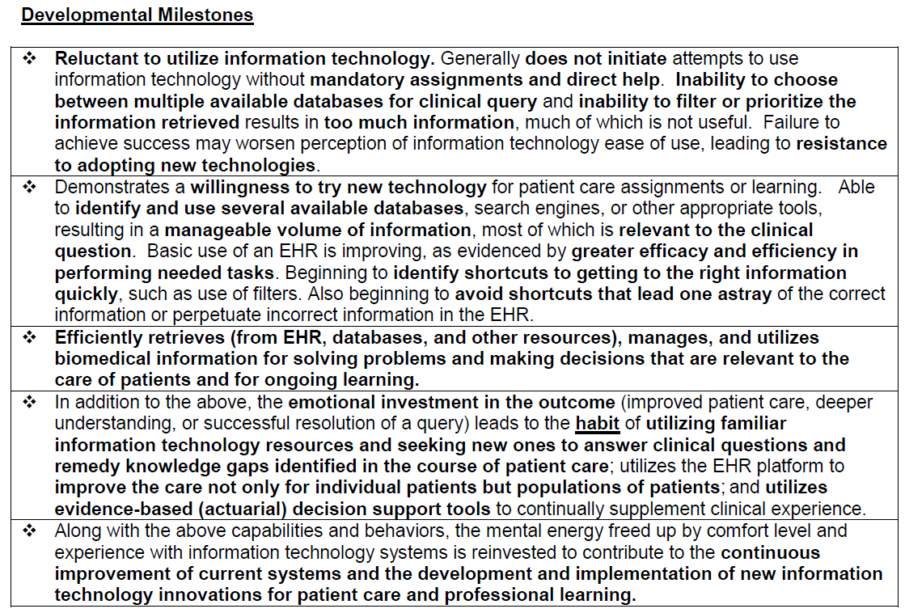
Distilling Down to Essentials
Uses information technology to optimize learning and care delivery (PBLI 7)
Is reluctant to use information technology. Is unable to prioritize information retrieved.
Has basic EBM and EHR skills but is not able to use them with ease and facility.
Efficiently retrieves and utilizes information for medical decision making.
Habitually uses information for medical decision making for patients and populations.
Contributes to development and improvement of information technology for patient care and/or professional learning.
Notes:
Because ASPHO already serves as the primary resource for pediatric hematoogy-oncology educators working to implement CBME, the ASPHO annual meeting was identified as a natural venue to provide education on this topic.

Slide 15
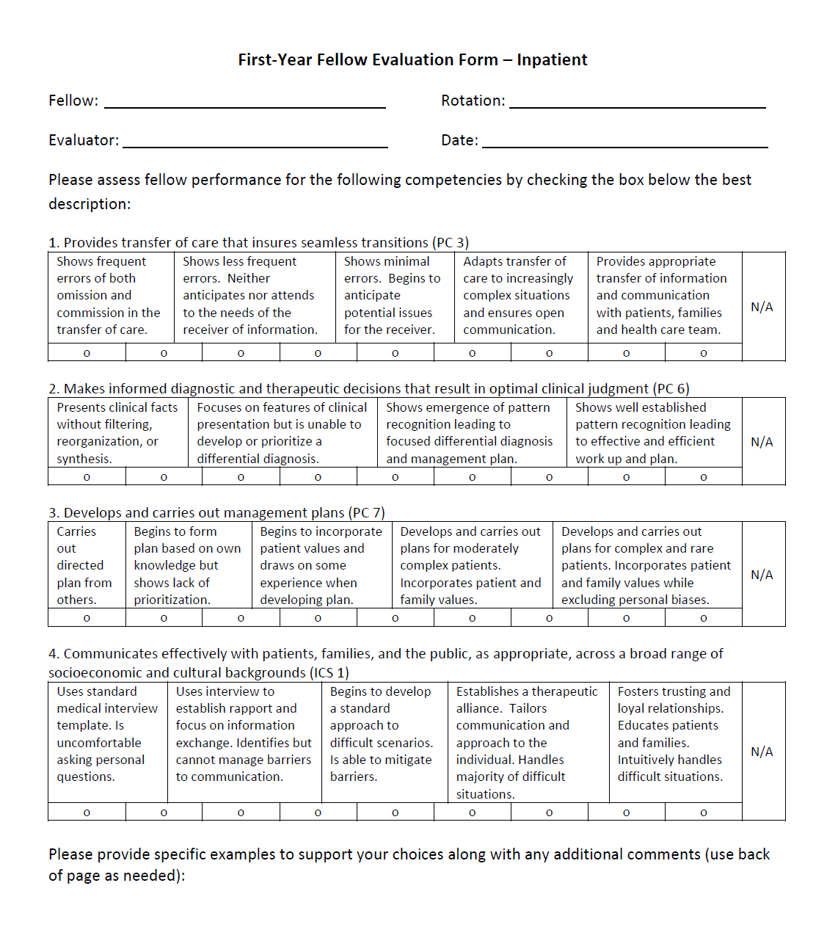
First-year
Fellow
Evaluation Form:
Inpatient

Slide 16
Small Group Exercise
How could you use the Heme-Onc Milestones as an “item bank” to create meaningful evaluations aligned with the purpose of the curricular experience?

Slide 17
Faculty Development
At 2014 ASPHO annual meeting, we led a workshop open to program directors, associate program directors, and teaching faculty
Notes:
Because ASPHO already serves as the primary resource for pediatric hematoogy-oncology educators working to implement CBME, the ASPHO annual meeting was identified as a natural venue to provide education on this topic.

Slide 18
Workshop Objectives
Describe the theory behind EPAs and CBME and the assessment instruments developed by the task force
Plan their own program’s implementation of CBME with guidance from a worksheet and task force members
Become facile with faculty development modules, disseminated during the workshop, for use at home institution

Slide 19
Workshop Format
Hour 1: Didactic presentation
  Principles of the Next Accreditation System
  Structure and function of the CCC
  Orientation to new assessment instruments created by task force
Hour 2: Small group work
  How will you implement new assessments in your program?
Hour 3: Training the trainer
  Strategies for faculty development at home
  Review of PowerPoint module created by task force
Notes:
Principles of NAS included a discussion of milestones and entrustable professional activities
The hour-long didactic was punctuated by short interactive exercise such as assessing a ficticious fellows’ performance using a milestone-based scale after reviewing both video and written case vignettes.
During the small group exercise, participants were guided by use of a handout and by facilitation for task force members.
Because the participants were also likely to be responsible for faculty development in their home institutions, a large portion of the workshop was dedicated to “training the trainer”

Slide 20
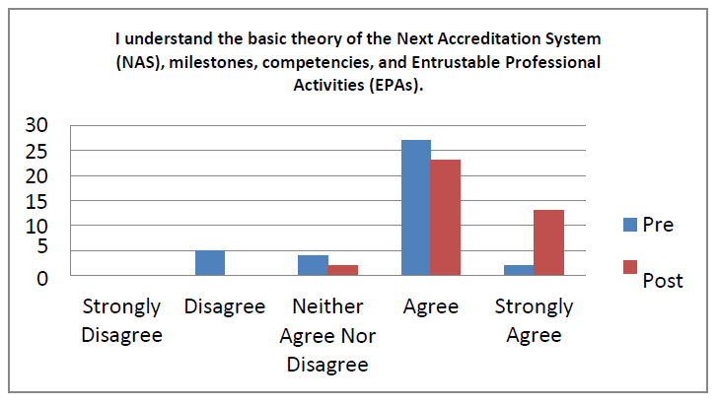
Evaluation Data
Pre-test administered to registrants (N=37)
Repeated as post-test (N=38)
Rate agreement with 6 different item stems

Slide 21
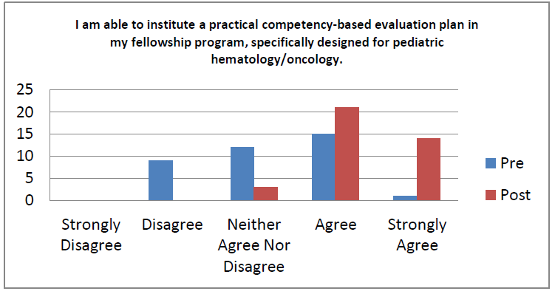
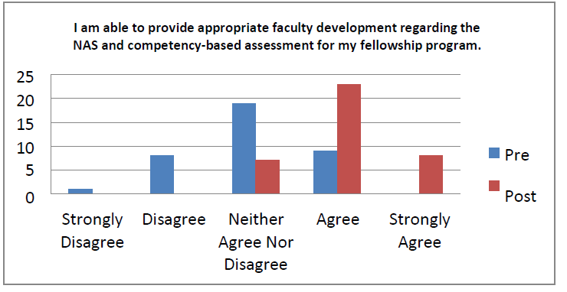

Slide 22
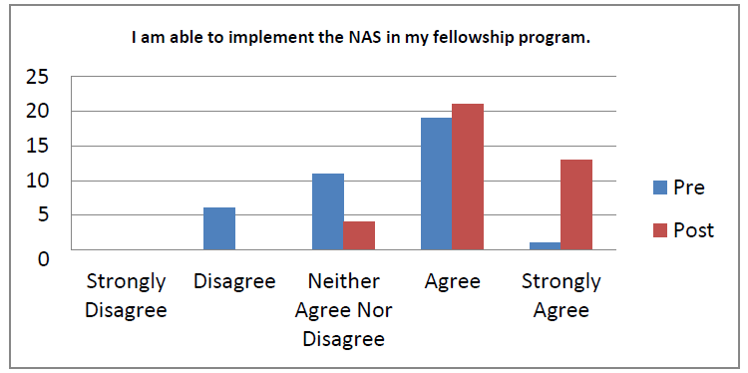

Slide 23

Collaborative Research
Council of Pediatric Subspecialties
How are entrustment decisions being made?
  Measure program directors’ assessments of entrustment on each EPA (standard)
  Compare to CCC entrustment decisions derived from sub competencies and milestones
  Determine which sub competencies most influential
Participation
  8 subspecialties, 15 PHO programs, ~500 fellows
  IRB approval at hospital level
  Data collection in progress

Slide 24

Acknowledgments
Mark Atlas, MD
Task Force members
ASPHO leadership and staff
  Funded 2 in-person meetings
  Allocated time and space during annual meetings
  Conveyed fellowship training as major priority

