Slide 1
Use of Anticoagulation in Patients with COVID-19
An Educational Slide Set
American Society of Hematology 2021 Guidelines on Use of Anticoagulation in Patients with COVID-19
Slide set authors:
Erik Klok, MD, PhD, Leiden University Medical Center
Deborah Siegal, MD, MSc, University of Ottawa
Robby Nieuwlaat, PhD, MSc, McMaster University
Adam Cuker, MD, MS, University of Pennsylvania

Slide 2
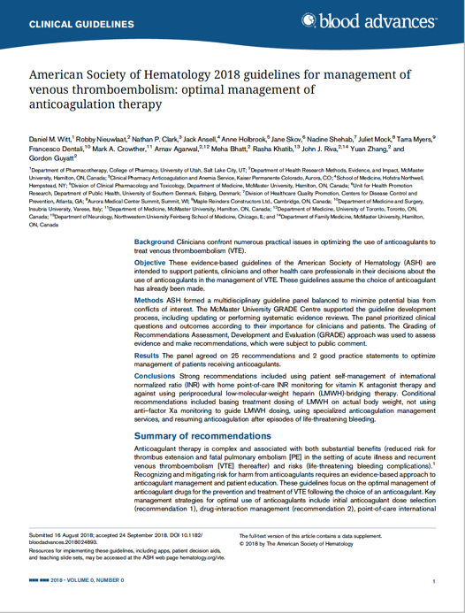
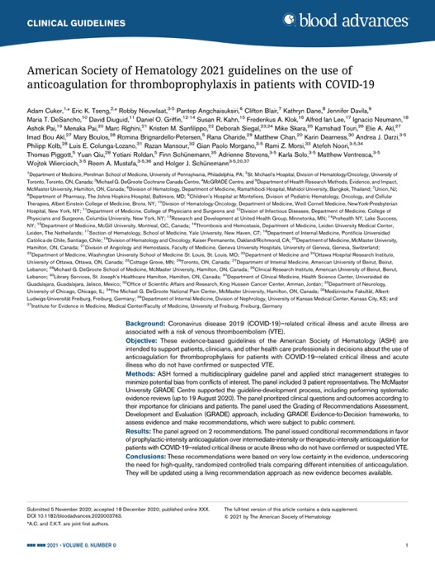
Clinical Guidelines
American Society of Hematology 2021 Guidelines on the Use of Anticoagulation for Thromboprophylaxis in Patients with COVID-19
Adam Cuker, Eric K. Tseng, Robby Nieuwlaat, Pantep Angchaisuksiri, Clifton Blair, Kathryn Dane, Jennifer Davila, Maria T. DeSancho, David Diuguid, Daniel O. Griffin, Susan R. Kahn, Frederikus A. Klok, Alfred Ian Lee, Ignacio Neumann, Ashok Pai, Menaka Pai, Marc Righini, Kristen M. Sanfilippo, Deborah Siegal, Mike Skara, Kamshad Touri, Elie A. Akl, Imad Bou Akl, Mary Boulos, Romina Brignardello-Petersen, Rana Charide, Matthew Chan, Karin Dearness, Andrea J. Darzi, Philipp Kolb, Luis E. Colunga-Lozano, Razan Mansour, Gian Paolo Morgano, Rami Z. Morsi, Atefeh Noori, Thomas Piggott, Yuan Qiu, Yetiani Roldan, Finn Schunemann, Adrienne Stevens, Karla Solo, Matthew Ventresca, Wojtek Wiercioch, Reem A. Mustafa, Holger J. Schunemann

Slide 3
ASH Clinical Practice Guidelines on VTE
Prevention of VTE in Surgical Hospitalized Patients
Prophylaxis in Hospitalized and Non-Hospitalized Medical Patients
Treatment of Acute VTE (DVT and PE)
Optimal Management of Anticoagulation Therapy
Prevention and Treatment of VTE in Patients with Cancer
Heparin-Induced Thrombocytopenia (HIT)
Thrombophilia
Pediatric VTE
VTE in the Context of Pregnancy
Diagnosis of VTE
Use of Anticoagulation in Patients with COVID-19

Slide 4
How were these ASH guidelines developed?
PANEL FORMATION
Each guideline panel was formed following these key criteria:
Balance of expertise (including disciplines beyond hematology, and patients)
Close attention to minimization and management of COI
CLINICAL QUESTIONS
2 clinically-relevant questions generated in PICO format (population, intervention, comparison, outcome)
EVIDENCE SYNTHESIS
Evidence summary generated for each PICO question via systematic review of health effects plus:
Resource use
Feasibility
Acceptability
Equity
Patient values and preferences
MAKING RECOMMENDATIONS
Recommendations made by guideline panel members based on evidence for all factors.
The guidelines will be updated using a living recommendation approach as new evidence becomes available.
Example: PICO question
“In patients with COVID-19 related critical illness who do not have suspected or confirmed VTE, should intermediate- or therapeutic intensity anticoagulation versus prophylactic-intensity anticoagulation be used for thromboprophylaxis?”

Slide 5
How patients and clinicians should use these recommendations
 | STRONG Recommendation (“The panel recommends…”) | CONDITIONAL Recommendation (“The panel suggests…”)
For patients | Most individuals would want the intervention. | A majority would want the intervention, but many would not.
For clinicians | Most individuals should receive the intervention. | Different choices will be appropriate for different patients, depending on their values and preferences. Use shared decision making.

Slide 6
Patient groups addressed in this chapter
Acutely Ill
Medical Patient
Patients hospitalized for medical illness
Critically Ill Patient
Patients suffering from immediately life-threatening illness requiring admission to intensive care unit

Slide 7
What these guidelines are about
Anticoagulants
carry benefits
(reducing venous thromboembolism)
and risks (life-threatening bleeding)
Recognizing and mitigating risk for harm from anticoagulants requires evidence-based approach
to management
This guideline focuses on anticoagulant dose intensity for critically ill and acutely ill hospitalized patients with COVID-19 who do not have suspected or confirmed venous thromboembolism

Slide 8
Objectives
By the end of this session you will be able to:
Describe VTE prophylaxis recommendations for hospitalized patients with COVID-19 related critical illness who do not have suspected or confirmed VTE
  Intermediate- or therapeutic-intensity versus prophylactic intensity anticoagulation
Describe VTE prophylaxis recommendations for hospitalized patients with COVID-19 related acute illness who do not have suspected or confirmed VTE
  Intermediate- or therapeutic-intensity versus prophylactic intensity anticoagulation

Slide 9
Methods
Overall
  GRADE methodology for guideline recommendation development
  Cochrane methodology for systematic reviews
Initial Phase
  PICO question generation and prioritization
  Selection of critical outcomes
  Systematic review for baseline risk estimates
  Systematic review for effect of different anticoagulation intensities
Living Phase
  Monthly updated searches for baseline risk estimates and prognostic factors
  Monthly updated searches for effect of different anticoagulation strategies
  Revisiting guideline recommendations if new evidence meets pre-specified criteria

Slide 10
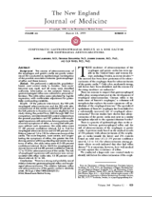
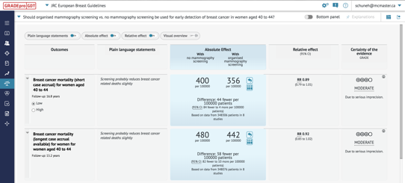
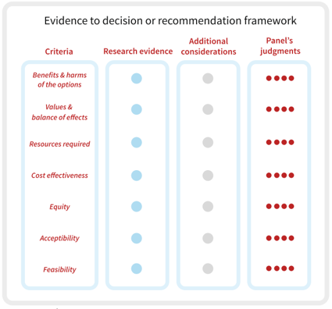
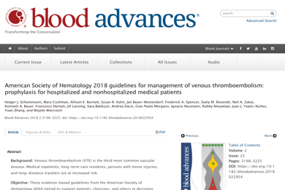
Formulate question
Assess single studies
Synthesize and Create
evidence profile & Evidence to Decision Table with GRADEpro
Rate certainty
of evidence for each outcome and other criteria
P
I
C
O
Outcome
Critical
Outcome
Critical
Outcome
Important
Outcome
Not
important
Recommendation/Decision
Grade recommendations
(Evidence to Recommendation)
For or against (direction)
Strong or conditional/weak (strength)
Guideline/coverage decision
Evidence synthesis
(systematic
review/HTA)
Panel
© GRADE Working Group/EP 2008 - 2021
Notes:
The Grading of Recommendations Assessment, Development and Evaluation approach, in short GRADE, is a systematic and transparent approach to developing guideline recommendations. The ASH guideline panel was at the heart of the whole process. They prioritized well-defined PICO questions that represent important questions in practice. With that, the panel selected which patient-important outcomes were critical, or important but not critical, for decision-making. The evidence synthesis team then searched, screened, extracted and synthesized the best available studies in Evidence Profiles to answer these questions. The certainty of this evidence was assessed using the GRADE criteria, per outcome as well as for the overall body of evidence. Evidence-to-Decision (EtD) tables were then used to summarize the evidence for all relevant domains to generate a recommendation, including required resources, cost-effectiveness, equity, acceptability and feasibility. Using the EtD judgments the panel then went from evidence to a recommendation, specifying the direction and strength of the recommendation.

Slide 11
PICO Question Generation & Prioritization
Brainstorming: inclusive list of potential PICO questions to address
Importance rating: selecting the PICO questions with the most critical importance
Critically ill COVID-19
Acutely ill COVID-19
Prophylactic
intensity
Prophylactic
intensity
Intermediate
intensity
Therapeutic
intensity
Intermediate
intensity
Therapeutic
intensity
Notes:
Illustrations:
The panel judged that in both critically and acutely ill COVID-19 patients the standard of care will be prophylactic intensity anticoagulation, based on previous ASH recommendations for all critically and acutely ill patients.(Schünemann 2018) As intermediate and therapeutic intensities were being used in practice for COVID-19 patients, both were selected for comparison with prophylactic intensity. The ASH guideline panel created specific definitions for prophylactic, intermediate, and therapeutic intensity anticoagulation.

Slide 12
Outcome Selection
Brainstorming: inclusive list of potential outcomes to address
Importance rating: selecting the most critical outcomes for key stakeholders
  Using Health Outcome Descriptors (marker states) - https://ms.gradepro.org/
Critical Outcomes
All-cause mortality
Pulmonary embolism
Deep venous thrombosis
Major bleeding
Multi-organ failure
Ischemic stroke
Intracranial hemorrhage/hemorrhagic stroke
Invasive mechanical ventilation
Limb amputation
ICU admission
ST-elevation myocardial infarction
Notes:
List of ‘Critical Outcomes’:
All listed outcomes were prioritized as being Critical for anticoagulation decision-making. The outcomes in orange were considered of highest importance for decision-making, and carried the most weight when judgments about the available evidence.

Slide 13
Evidence for Effect of the Intervention
Baseline Risk
Relative Effect
Absolute Effect
RR = 0.40
5 per 1,000
3 per 1,000 fewer
Notes:
Guideline development methodologists emphasized the importance of focusing on absolute effects rather than relative effects only. If a population has a baseline risk for an outcome of 5 in 1000, a relative risk of 0.40 when applying an intervention would mean that the intervention reduced the risk for the event by 3 per 1000 in absolute terms.

Slide 14
GRADE Certainty of Evidence
Table: Grade’s approach to rating quality of evidence (aka confidence in effect estimates)
For each outcome based on a systematic review and across outcomes (lowest quality across the outcomes critical for decision making)
1. Establish initial level of
confidence
2. Consider lowering or raising
level of confidence
3. Final level of confidence rating
Study design | Initial confidence in an estimate of effect
Randomized trials ► | High Confidence
Observational studies ► | Low confidence
Reasons for considering lowering or raising confidence | Initial confidence in an estimate of effect
▼Lower if | ▲Higher if*
Risk of Bias Inconsistency Indirectness Imprecision Publication bias | Large effect Dose Response All plausible confounding & bias Would reduce a demonstrated effect or Would suggest spurious effect if no effect was observed
Confidence in an estimate of effect across these considerations
High ●●●●
Moderate ●●●●
Low ●●●●
Very Low ●●●●
*upgrading criteria are usually applicable to observational studies only.
Notes:
The GRADE approach to rating the quality, or certainty, of the evidence helped to determine the panel’s confidence in the effect estimates for the anticoagulation intensities. Depending on the study design, the initial level of confidence can be low or high. Five factors can then potentially lead to lowering the certainty, including risk of bias, inconsistency, indirectness, imprecision, and publication bias. There are three other factors that may increase confidence, primarily for evidence from observational studies, including a large effect, dose-response, and plausible residual confounding. Following these ratings, the final level of confidence in the effect was determined.

Slide 15
Baseline Risk – Systematic Review
Incidence rate of selected outcomes:
  In the two populations of interest
  Among patients receiving prophylactic intensity anticoagulation
Required:
  Not high risk of bias (according to simplified QUIPS)
  Reporting duration of follow-up
Initial search date: 23-JUL-2020
Screened: 14,816 citations
Included: 51 Studies
Analysis:
  Pooled estimates using generalized linear mixed model
  Descriptive, if only one study identified, or when pooling was considered inappropriate

Slide 16
Effect of Anticoagulation – Systematic Review
Comparison of two or more anticoagulation intensities for prevention of VTE:
  In the two populations of interest
  Primarily addressing Prophylactic vs. Intermediate/Therapeutic intensity
Required:
  Pre-defined definitions for Prophylactic, Intermediate, Therapeutic intensity
  Risk of bias assessed with ROBINS-I
Initial search date: 20-AUG-2020
Screened: 3,118 citations
Included: 12 Studies
Analysis:
  Descriptive analysis of adjusted relative effect estimates
  Pooling unadjusted relative effect estimates in meta-analysis

Slide 17
Evidence for Other Domains
The panel considered additional Evidence-to-Decision domains to generate the recommendations:
  Resource use
  Cost-effectiveness
  Health equity
  Acceptability
  Feasibility
  Evidence for these domains was also sought in the two reviews
  COVID-19 specific evidence not yet identified – the panel mainly relied on evidence from the ASH guidelines for the management of hospitalized medically ill patients, and their expertise

Slide 18
Living Phase – Systematic Reviews
Overall
  Monthly search updates
  Using explicit criteria for updating analyses and publication with new important information
Baseline risk
  Add evidence on prognostic factors
  Search strategy & eligibility criteria may become narrower as quantity and quality of evidence increases
  Use of machine learning to make regular screening manageable
Effect of anticoagulation intensity
  Search strategy & eligibility criteria may focus on RCTs as they become available
  Update analyses with new important data (explicit criteria)

Slide 19
Living Phase – Recommendations
Continue to work closely with panel and systematic review team
Reconsider recommendations when important new evidence is identified
Using explicit criteria for reconsidering recommendations
  Changes in the evidence of effects (certainty, direction, magnitude)
  Changes in the evidence for other Evidence-to-Decision domains (cost-effectiveness, equity, others)
Publish updated recommendations and supporting documents
Timely advice for decision-makers
Notes:
When practice changing evidence is identified

Slide 20
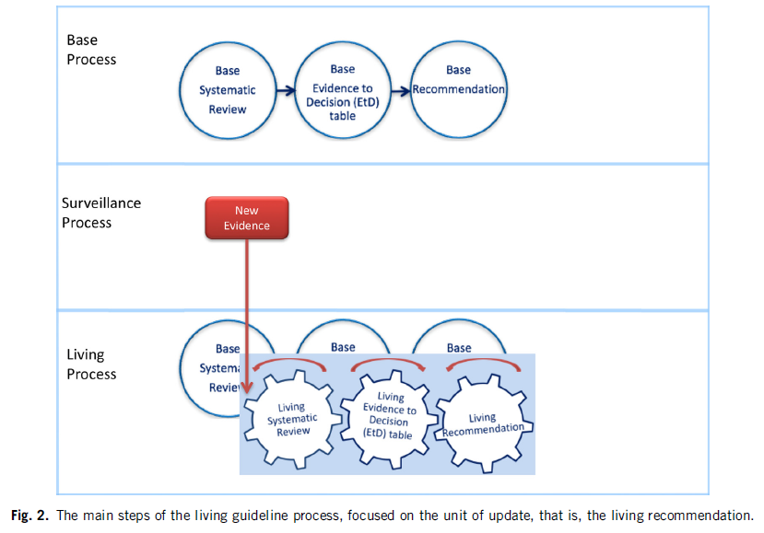
Living Recommendations Process
Akl EA, et al. Living systematic reviews: 4. Living guideline recommendations. J Clin Epidemiol. 2017;91:47-53.

Slide 21
Main Challenges
Evidence
  Large number of citations
  Incomplete reporting
  Risk of bias
  Imprecision
  Evolving field in Living phase
Recommendation formulation process
  Very low certainty evidence
  Not relying on non-COVID-19 evidence
  Criteria to reconsider recommendations with important new evidence in Living phase
  Provide timely and stable guidance

Slide 22
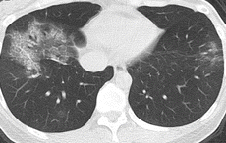
Case Presentations
Patient T | Patient K
♂, Chinese, 73 years | ♂, Caucasian, 52 years
BMI 34 kg/m², DM, hypertension | BMI 23 kg/m², Asthma
COVID-19 day 10 | COVID-19 day 6
High fever, dyspneic at rest | Anosmia, shortness of breath with exercise
HR 123/min, RR 42/min, Sat 83% at 15L O2 | HR 95/min, RR 20/min, sat 90% at room air
Notes:
Patient T: extensive bilateral patchy ground-glass opacities and consolidations in predominantly peripheral distribution
Patient K: ground-glass opacity with intralobular septal thickening (crazy-paving pattern) in right lower lobe.

Slide 23
Million Dollar Question
What would be the optimal anticoagulant strategy in these 2 patients?

Slide 24
Which ONE of the following options would you suggest for thromboprophylaxis during this medical inpatient’s hospital admission?
Subcutaneous low molecular weight heparin (LMWH)
Direct oral anticoagulant (Rivaroxaban, or Apixaban)
Graduated compression stockings
No prophylaxis because patient is low thrombosis risk

Slide 25
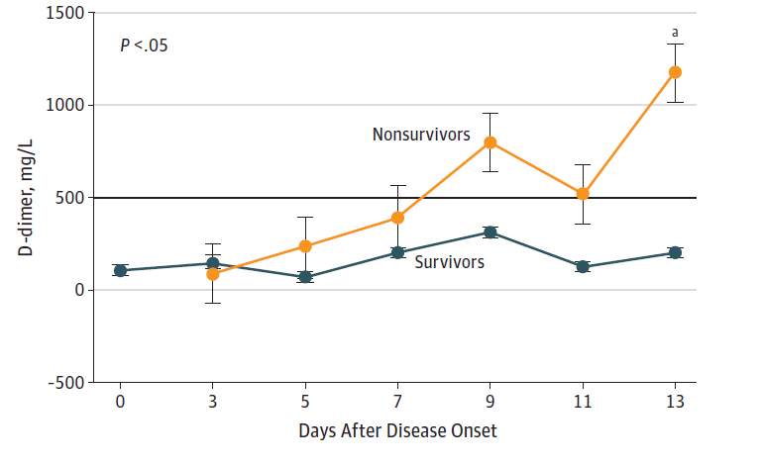
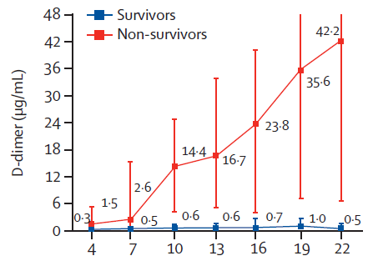
COVID-19 coagulopathy: initial reports (China)
Wang D et al, JAMA 2020
Zhou F et al, Lancet 2020

Slide 26
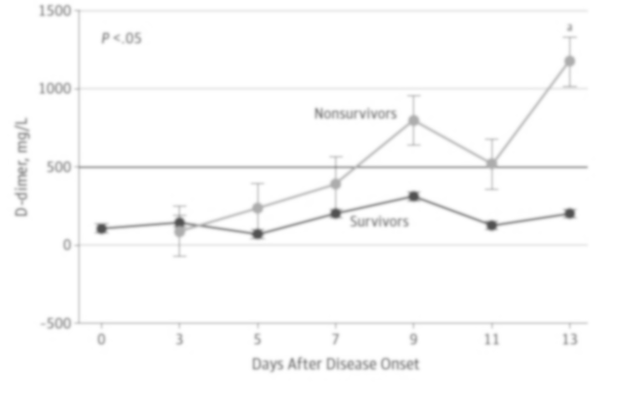
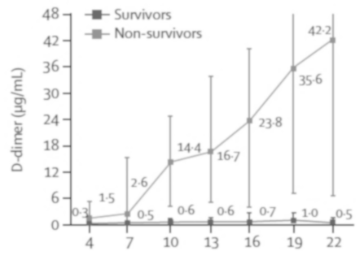
COVID-19 coagulopathy: initial reports (China)
Occurrence of VTE not mentioned
Wang D et al, JAMA 2020
Zhou F et al, Lancet 2020

Slide 27
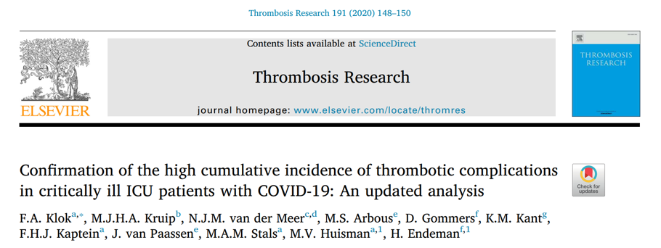
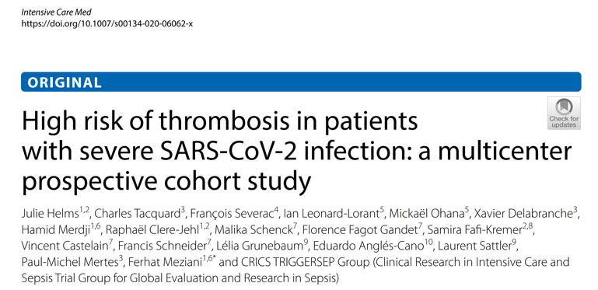
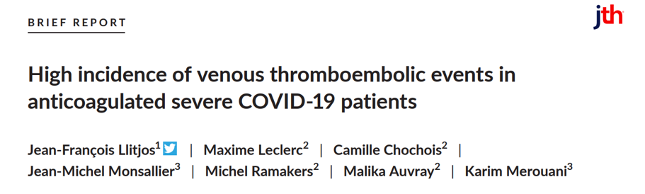
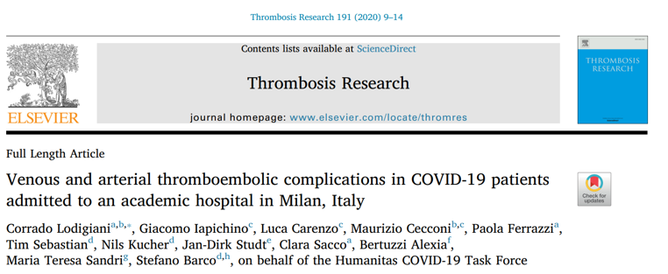
COVID-19 coagulopathy: initial reports (Europe)

Slide 28
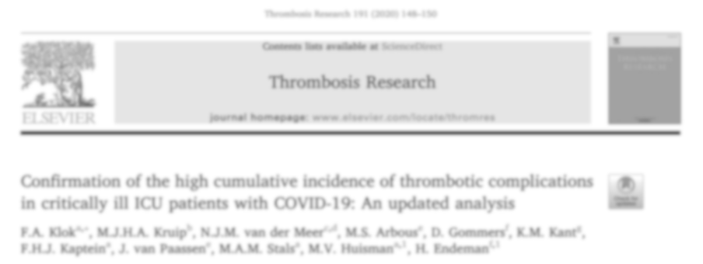
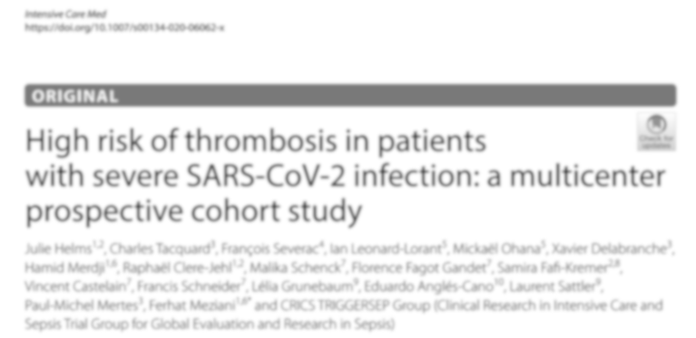

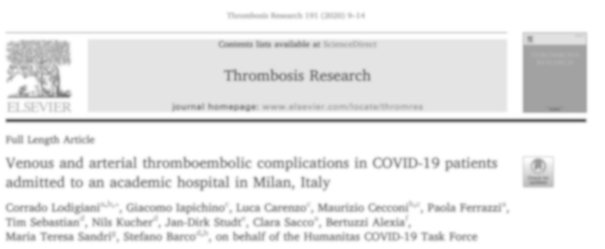
COVID-19 coagulopathy: initial reports (Europe)
Incidence of VTE in ICU 17-70%

Slide 29
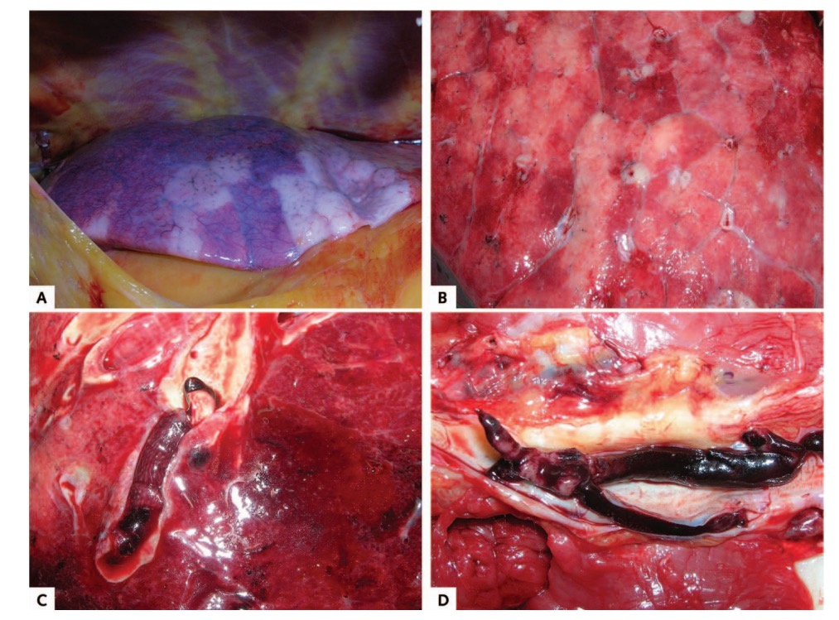
COVID-19 coagulopathy: autopsy studies
Macroscopic autopsy findings
Patchy aspect of the lung surface (case1).
Cutting surface in (case 4).
Pulmonary embolism (case 3).
Deep venous thrombosis (case 5).
Wichmann D et al, Ann Int Med 2020

Slide 30
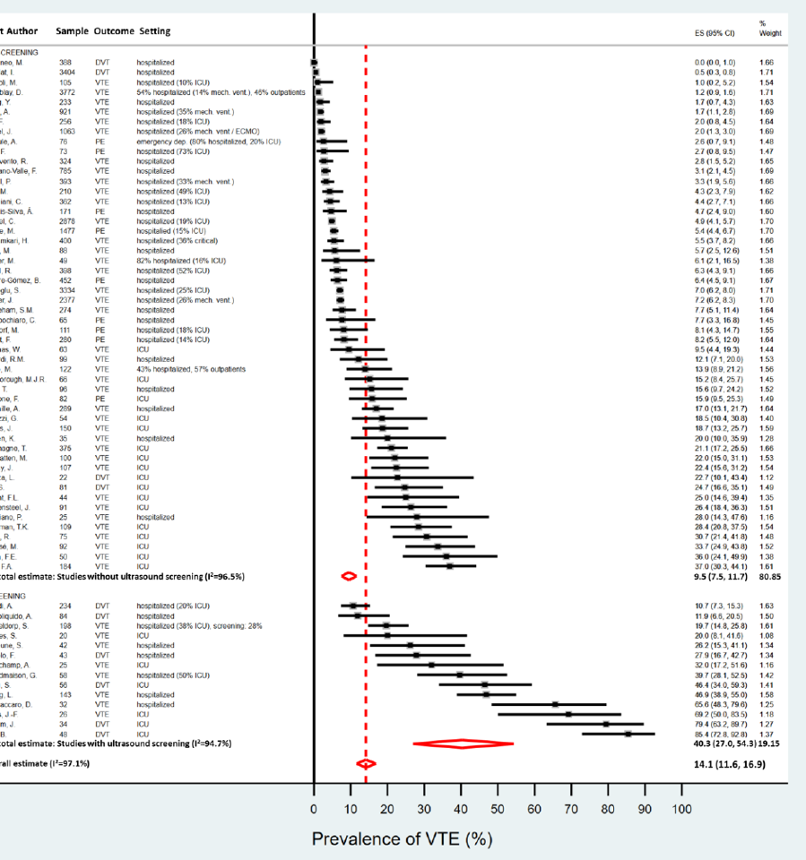
COVID-19: incidence of VTE
9.5% (95%CI 7.5-12)
40% (95%CI 27-54)
Nopp S et al, RPTH 2020

Slide 31
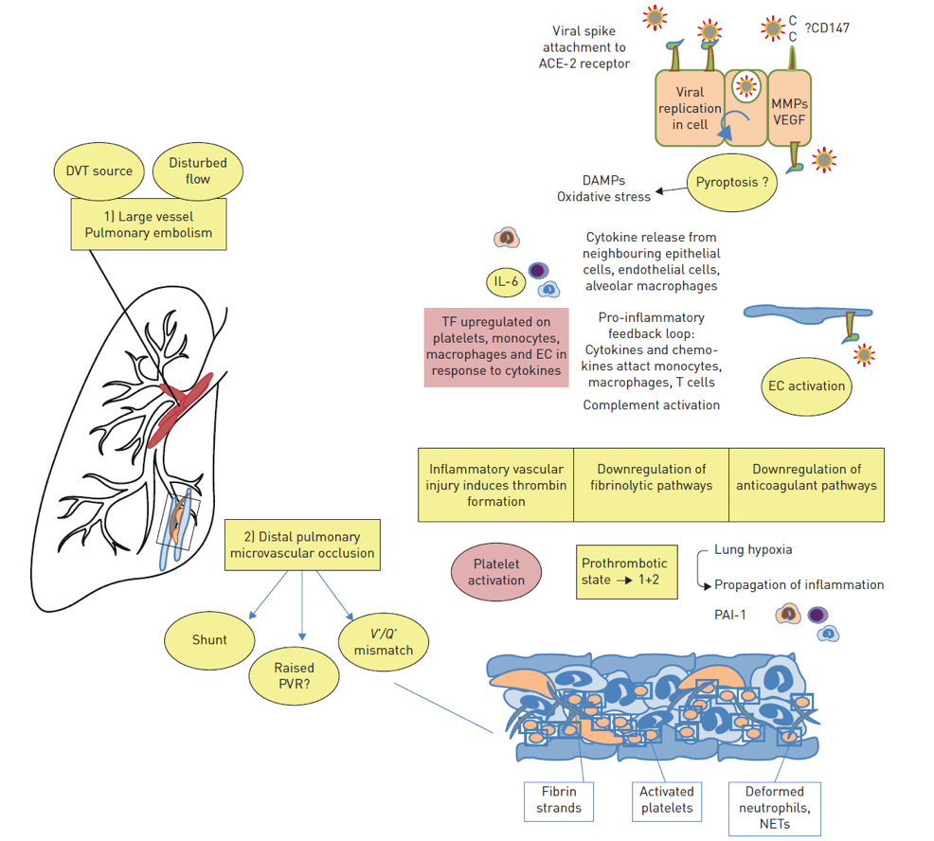
Pathophysiology of increased VTE risk
Price LC et al, Eur Respir J 2020

Slide 32



Beneficial non-anticoagulant mechanisms?
X
Reduces viral entry to host cells
Reduces NET formation
Inhibits heparanase

Slide 33


Intensive anticoagulant therapy beneficial?
High incidence of VTE
Beneficial non-anticoagulant mechanisms (?)
Immunothrombosis
Overdiagnosis of VTE (?)

Slide 34
Case 1: COVID-19 Related Critical Illness
Patient T
♂, Chinese, 73 years
BMI 34 kg/m², DM, hypertension
COVID-19 day 10
High fever, dyspneic at rest
HR 123/min, RR 42/min, Sat 83% at 15L O2

Slide 35
Question #1
Should DOACs, LMWH, UFH, fondaparinux, argatroban, or bivalirudin at intermediate- or therapeutic-intensity vs. prophylactic-intensity be used for patients with COVID-19 related critical illness who do not have suspected or confirmed VTE?

Slide 36
Which ONE of the following options would you suggest for thromboprophylaxis in a hospitalized patient with COVID-19 related critical illness who does not have suspected or confirmed VTE?
Intermediate- or therapeutic-intensity anticoagulation
Prophylactic-intensity anticoagulation
Graduated compression stockings
No prophylaxis because patient is at low thrombosis risk

Slide 37
Should DOACs, LMWH, UFH, fondaparinux, argatroban, or bivalirudin at intermediate-intensity or therapeutic-intensity vs. prophylactic intensity be used for patients with COVID-19 related critical illness who do not have suspected or confirmed VTE?
Population: | Patients with COVID-19 related critical illness who do not have suspected or confirmed VTE
Intervention: | DOACs, LMWH, UFH, fondaparinux, argatroban, or bivalirudin at intermediate-intensity or therapeutic-intensity
Comparison: | Prophylactic-intensity
Main outcomes: | Mortality; Pulmonary embolism; Proximal lower extremity DVT; Venous thromboembolism; Major bleeding; Multiple Organ Failure; Ischemic stroke; Intracranial hemorrhage; Invasive ventilation; Limb amputation; ICU hospitalization; ST-elevation myocardial infarction;

Slide 38
Outcomes | № of participants (studies) | Certainty of the evidence (GRADE) | Relative effect (95% CI) | Anticipated absolute effects (95% CI)
 |  |  |  | Risk with prophylactic intensity | Risk difference with anticoagulation at intermediate or therapeutic-intensity
MORTALITY follow up: range 14 days to 22 days | 141 (1 study) | ●●●● VERY LOW | OR 0.73 (0.33 to 1.76) | 236 per 1,000 | 52 fewer per 1,000 (143 fewer to 116 more)
PE follow up: range 14 days to 20 days | 82 (1 study) | ●●●● VERY LOW | OR 0.09 (0.02 to 0.57) | 98 per 1,000 | 88 fewer per 1,000 (96 fewer to 40 fewer)
PROXIMAL LOWER EXTREMITY DVT follow up: range 14 days to 20 days | 41 (1 study) | ●●●● VERY LOW | OR 0.35 (0.06 to 2.02) | 106 per 1,000 | 66 fewer per 1,000 (99 fewer to 87 more)
VTE (DVT or PE) follow up: range 18 days to 28 days | 118 (2 studies) | ●●●● VERY LOW | OR 0.87 (0.45 to 1.67) | 130 per 1,000 | 15 fewer per 1,000 (67 fewer to 70 more)
MAJOR BLEEDING follow up: mean 16 days | 141 (1 study) | ●●●● VERY LOW | OR 3.84 (1.44 to 10.21) | 84 per 1,000 | 176 more per 1,000 (33 more to 400 more)
Notes:
Observational studies
Mean across studies

Slide 39
Outcomes | № of participants (studies) | Certainty of the evidence (GRADE) | Relative effect (95% CI) | Anticipated absolute effects (95% CI)
 |  |  |  | Risk with prophylactic intensity | Risk difference with anticoagulation at intermediate or therapeutic-intensity
MORTALITY follow up: range 14 days to 22 days | 141 (1 study) | ●●●● VERY LOW | OR 0.73 (0.33 to 1.76) | 236 per 1,000 | 52 fewer per 1,000 (143 fewer to 116 more)
PE follow up: range 14 days to 20 days | 82 (1 study) | ●●●● VERY LOW | OR 0.09 (0.02 to 0.57) | 98 per 1,000 | 88 fewer per 1,000 (96 fewer to 40 fewer)
PROXIMAL LOWER EXTREMITY DVT follow up: range 14 days to 20 days | 41 (1 study) | ●●●● VERY LOW | OR 0.35 (0.06 to 2.02) | 106 per 1,000 | 66 fewer per 1,000 (99 fewer to 87 more)
VTE (DVT or PE) follow up: range 18 days to 28 days | 118 (2 studies) | ●●●● VERY LOW | OR 0.87 (0.45 to 1.67) | 130 per 1,000 | 15 fewer per 1,000 (67 fewer to 70 more)
MAJOR BLEEDING follow up: mean 16 days | 141 (1 study) | ●●●● VERY LOW | OR 3.84 (1.44 to 10.21) | 84 per 1,000 | 176 more per 1,000 (33 more to 400 more)
Notes:
Observational studies
Mean across studies

Slide 40
Outcomes | № of participants (studies) | Certainty of the evidence (GRADE) | Relative effect (95% CI) | Anticipated absolute effects (95% CI)
 |  |  |  | Risk with prophylactic intensity | Risk difference with anticoagulation at intermediate or therapeutic-intensity
MORTALITY follow up: range 14 days to 22 days | 141 (1 study) | ●●●● VERY LOW | OR 0.73 (0.33 to 1.76) | 236 per 1,000 | 52 fewer per 1,000 (143 fewer to 116 more)
PE follow up: range 14 days to 20 days | 82 (1 study) | ●●●● VERY LOW | OR 0.09 (0.02 to 0.57) | 98 per 1,000 | 88 fewer per 1,000 (96 fewer to 40 fewer)
PROXIMAL LOWER EXTREMITY DVT follow up: range 14 days to 20 days | 41 (1 study) | ●●●● VERY LOW | OR 0.35 (0.06 to 2.02) | 106 per 1,000 | 66 fewer per 1,000 (99 fewer to 87 more)
VTE (DVT or PE) follow up: range 18 days to 28 days | 118 (2 studies) | ●●●● VERY LOW | OR 0.87 (0.45 to 1.67) | 130 per 1,000 | 15 fewer per 1,000 (67 fewer to 70 more)
MAJOR BLEEDING follow up: mean 16 days | 141 (1 study) | ●●●● VERY LOW | OR 3.84 (1.44 to 10.21) | 84 per 1,000 | 176 more per 1,000 (33 more to 400 more)
Notes:
Observational studies
Mean across studies

Slide 41
Outcomes | № of participants (studies) | Certainty of the evidence (GRADE) | Relative effect (95% CI) | Anticipated absolute effects (95% CI)
 |  |  |  | Risk with prophylactic intensity | Risk difference with anticoagulation at intermediate or therapeutic-intensity
MORTALITY follow up: range 14 days to 22 days | 141 (1 study) | ●●●● VERY LOW | OR 0.73 (0.33 to 1.76) | 236 per 1,000 | 52 fewer per 1,000 (143 fewer to 116 more)
PE follow up: range 14 days to 20 days | 82 (1 study) | ●●●● VERY LOW | OR 0.09 (0.02 to 0.57) | 98 per 1,000 | 88 fewer per 1,000 (96 fewer to 40 fewer)
PROXIMAL LOWER EXTREMITY DVT follow up: range 14 days to 20 days | 41 (1 study) | ●●●● VERY LOW | OR 0.35 (0.06 to 2.02) | 106 per 1,000 | 66 fewer per 1,000 (99 fewer to 87 more)
VTE (DVT or PE) follow up: range 18 days to 28 days | 118 (2 studies) | ●●●● VERY LOW | OR 0.87 (0.45 to 1.67) | 130 per 1,000 | 15 fewer per 1,000 (67 fewer to 70 more)
MAJOR BLEEDING follow up: mean 16 days | 141 (1 study) | ●●●● VERY LOW | OR 3.84 (1.44 to 10.21) | 84 per 1,000 | 176 more per 1,000 (33 more to 400 more)
Notes:
Observational studies
Mean across studies

Slide 42
Recommendation
The ASH guideline panel suggests using prophylactic-intensity over intermediate-intensity or therapeutic-intensity anticoagulation in patients with COVID-19 related critical illness who do not have suspected or confirmed VTE (Conditional recommendation based on very low certainty in the evidence about effects)
The panel agreed that there was less uncertainty regarding the influence on undesirable effects (bleeding) compared with desirable effects (mortality and VTE). This was driven by extensive indirect evidence of dose-dependent effects of anticoagulation on bleeding.
Individualized assessment
No validated risk assessment models for in patients with COVID-19
No direct high-quality evidence comparing different anticoagulants
Notes:
Overall justification
Although the panel judged the certainty of evidence to be very low for both desirable and undesirable effects, the panel considered the plethora of indirect evidence supporting a dose-dependent increase in major bleeding reported with anticoagulation. Hence, the panel agreed that there was less uncertainty regarding the increase in undesirable effects (bleeding) compared with the influence on desirable effects (i.e., reduction in mortality and VTE) reported with intermediate-intensity or therapeutic-intensity anticoagulation. Without compelling evidence for benefit, the usual practice of prophylactic-intensity anticoagulation in critically ill medical patients without COVID-19 was suggested while acknowledging that individualized decision-making is required. This recommendation will be updated based on a living review of evolving evidence.

Slide 43
Case 2: COVID-19 related acute illness
Patient K
♂, Caucasian, 52 years
BMI 23 kg/m², Asthma
COVID-19 day 6
Anosmia, shortness of breath with exercise
HR 95/min, RR 20/min, sat 90% at room air

Slide 44
Question #2
Should DOACs, LMWH, UFH, fondaparinux, argatroban, or bivalirudin at intermediate-intensity or therapeutic-intensity vs. prophylactic-intensity be used for patients with COVID-19 related acute illness who do not have suspected or confirmed VTE?

Slide 45
Which ONE of the following options would you suggest for thromboprophylaxis in a hospitalized patient with COVID-19 related acute illness who does not have suspected or confirmed VTE?
Intermediate- or therapeutic-intensity anticoagulation
Prophylactic-intensity anticoagulation
Graduated compression stockings
No prophylaxis because patient is at low thrombosis risk

Slide 46
Should DOACs, LMWH, UFH, fondaparinux, argatroban, or bivalirudin at intermediate-intensity or therapeutic-intensity vs. prophylactic-intensity be used for patients with COVID-19 related acute illness who do not have suspected or confirmed VTE?
Population: | Patients with COVID-19 related acute illness who do not have suspected or confirmed VTE
Intervention: | DOACs, LMWH, UFH, fondaparinux, argatroban, or bivalirudin at intermediate-intensity or therapeutic-intensity
Comparison: | Prophylactic-intensity
Main outcomes: | All-cause mortality; Pulmonary embolism; Proximal lower extremity DVT; Venous thromboembolism; Major bleeding; Multiple organ failure; Ischemic stroke; Intracranial hemorrhage; Invasive ventilation; Limb amputation; ICU hospitalization; ST-elevation myocardial infarction;

Slide 47
Outcomes | № of participants (studies) | Certainty of the evidence (GRADE) | Relative effect (95% CI) | Anticipated absolute effects (95% CI)
 |  |  |  | Risk with prophylactic-intensity | Risk difference with anticoagulation at intermediate- or therapeutic-intensity
ALL-CAUSE MORTALITY follow up: 14 days | 2626 (1 study) | ●●●● VERY LOW | HR 0.86 (0.73 to 1.02) | 148 per 1,000 | 19 fewer per 1,000 (38 fewer to 3 more)
PE follow up: range 4 days to 28 days | 82 (1 study) | ●●●● VERY LOW | OR 0.09 (0.02 to 0.57) | 16 per 1,000 | 15 fewer per 1,000 (16 fewer to 7 fewer)
PROXIMAL LOWER EXTREMITY DVT follow up: 28 days | 41 (1 study) | ●●●● VERY LOW | OR 0.35 (0.06 to 2.02) | 20 per 1,000 | 13 fewer per 1,000 (18 fewer to 19 more)
VTE follow up: range 6 days to 28 days | 0 (1 study) | - | - | Baseline (2 studies, range 2.0% to 3.1%); 0/19 (0%) on therapeutic (other indications) vs. 39/179 (22%) on proph/intermediate (1 study).
MAJOR BLEEDING follow up: 14 days | 0 (2 studies) | ●●●● VERY LOW | - | Pooled baseline risk of 1.7% (5 studies); Follow-up 4 to 12 days: lowest OR 1.42 and highest adjusted HR 3.89 (7 more to 46 more major bleeds per 1000 patients)
Notes:
VTE
Study by Middeldorp et al. 2020 showed 0/19 patients (0%) who continued therapeutic anticoagulation for other indications during admission developed VTE compared with 39/179 of the remaining patients who received Prophylactic or Intermediate intensity anticoagulation (22%)

Slide 48
Outcomes | № of participants (studies) | Certainty of the evidence (GRADE) | Relative effect (95% CI) | Anticipated absolute effects* (95% CI)
 |  |  |  | Risk with prophylactic-intensity | Risk difference with anticoagulation at intermediate- or therapeutic-intensity
ALL-CAUSE MORTALITY follow up: 14 days | 2626 (1 study) | ●●●● VERY LOW | HR 0.86 (0.73 to 1.02) | 148 per 1,000 | 19 fewer per 1,000 (38 fewer to 3 more)
PE follow up: range 4 days to 28 days | 82 (1 study) | ●●●● VERY LOW | OR 0.09 (0.02 to 0.57) | 16 per 1,000 | 15 fewer per 1,000 (16 fewer to 7 fewer)
PROXIMAL LOWER EXTREMITY DVT follow up: 28 days | 41 (1 study) | ●●●● VERY LOW | OR 0.35 (0.06 to 2.02) | 20 per 1,000 | 13 fewer per 1,000 (18 fewer to 19 more)
VTE follow up: range 6 days to 28 days | 0 (1 study) | - | - | Baseline risk (2 studies, range 2.0% to 3.1%).
MAJOR BLEEDING follow up: 14 days | 0 (2 studies) | ●●●● VERY LOW | - | Pooled baseline risk of 1.7% (5 studies); Follow-up 4 to 12 days: lowest OR 1.42 and highest adjusted HR 3.89 (7 more per 1000 to 46 more major bleeds per 1000 patients)
Notes:
VTE: Study by Middeldorp et al. 2020 showed 0/19 patients (0%) who continued therapeutic anticoagulation for other indications during admission developed VTE compared with 39/179 of the remaining patients who received Prophylactic or Intermediate intensity anticoagulation (22%)

Slide 49
Outcomes | № of participants (studies) | Certainty of the evidence (GRADE) | Relative effect (95% CI) | Anticipated absolute effects* (95% CI)
 |  |  |  | Risk with prophylactic-intensity | Risk difference with anticoagulation at intermediate- or therapeutic-intensity
ALL-CAUSE MORTALITY follow up: 14 days | 2626 (1 study) | ●●●● VERY LOW | HR 0.86 (0.73 to 1.02) | 148 per 1,000 | 19 fewer per 1,000 (38 fewer to 3 more)
PE follow up: range 4 days to 28 days | 82 (1 study) | ●●●● VERY LOW | OR 0.09 (0.02 to 0.57) | 16 per 1,000 | 15 fewer per 1,000 (16 fewer to 7 fewer)
PROXIMAL LOWER EXTREMITY DVT follow up: 28 days | 41 (1 study) | ●●●● VERY LOW | OR 0.35 (0.06 to 2.02) | 20 per 1,000 | 13 fewer per 1,000 (18 fewer to 19 more)
VTE follow up: range 6 days to 28 days | 0 (1 study) | - | - | Baseline risk (2 studies, range 2.0% to 3.1%).
MAJOR BLEEDING follow up: 14 days | 0 (2 studies) | ●●●● VERY LOW | - | Pooled baseline risk of 1.7% (5 studies); Follow-up 4 to 12 days: lowest OR 1.42 and highest adjusted HR 3.89 (7 more to 46 more major bleeds per 1000 patients)
Notes:
VTE: Study by Middeldorp et al. 2020 showed 0/19 patients (0%) who continued therapeutic anticoagulation for other indications during admission developed VTE compared with 39/179 of the remaining patients who received Prophylactic or Intermediate intensity anticoagulation (22%)

Slide 50
Outcomes | № of participants (studies) | Certainty of the evidence (GRADE) | Relative effect (95% CI) | Anticipated absolute effects (95% CI)
 |  |  |  | Risk with prophylactic-intensity | Risk difference with anticoagulation at intermediate- or therapeutic-intensity
ALL-CAUSE MORTALITY follow up: 14 days | 2626 (1 study) | ●●●● VERY LOW | HR 0.86 (0.73 to 1.02) | 148 per 1,000 | 19 fewer per 1,000 (38 fewer to 3 more)
PE follow up: range 4 days to 28 days | 82 (1 study) | ●●●● VERY LOW | OR 0.09 (0.02 to 0.57) | 16 per 1,000 | 15 fewer per 1,000 (16 fewer to 7 fewer)
PROXIMAL LOWER EXTREMITY DVT follow up: 28 days | 41 (1 study) | ●●●● VERY LOW | OR 0.35 (0.06 to 2.02) | 20 per 1,000 | 13 fewer per 1,000 (18 fewer to 19 more)
VTE follow up: range 6 days to 28 days | 0 (1 study) | - | - | Baseline (2 studies, range 2.0% to 3.1%); 0/19 (0%) on therapeutic (other indications) vs. 39/179 (22%) on proph/intermediate (1 study).
MAJOR BLEEDING follow up: 14 days | 0 (2 studies) | ●●●● VERY LOW | - | Pooled baseline risk of 1.7% (5 studies); Follow-up 4 to 12 days: lowest OR 1.42 and highest adjusted HR 3.89 (7 more to 46 more major bleeds per 1000 patients)
Notes:
VTE: Study by Middeldorp et al. 2020 showed 0/19 patients (0%) who continued therapeutic anticoagulation for other indications during admission developed VTE compared with 39/179 of the remaining patients who received Prophylactic or Intermediate intensity anticoagulation (22%)

Slide 51
Recommendation
The ASH guideline panel suggests using prophylactic-intensity over intermediate-intensity or therapeutic-intensity anticoagulation in patients with COVID-19 related acute illness who do not have suspected or confirmed VTE. (Conditional recommendation based on very low certainty in the evidence about effects)
The panel agreed that there was less uncertainty regarding the influence on undesirable effects (bleeding) compared with desirable effects (mortality and VTE). This was driven by extensive indirect evidence of dose-dependent effects of anticoagulation on bleeding.
Individualized assessment
No validated risk assessment models for in patients with COVID-19
No direct high-quality evidence comparing different anticoagulants
Notes:
Overall justification
Although the panel judged the certainty of evidence to be very low for both desirable and undesirable effects, the panel considered the plethora of indirect evidence supporting a dose-dependent increase in major bleeding with anticoagulation. Hence, the panel agreed that there was less uncertainty regarding the increase in undesirable effects (bleeding) compared with the influence on desirable effects (i.e., reduction in mortality, VTE) reported with intermediate-intensity or therapeutic-intensity anticoagulation. Without compelling evidence for benefit, the usual practice of prophylactic-intensity anticoagulation in acutely ill medical patients without COVID-19 was suggested while acknowledging that individualized decision-making is required. This recommendation will be updated based on living reviews of evolving evidence.

Slide 52
Very low certainty of evidence
Baseline risk studies
Effect of
anticoagulation studies
Lack of definitions and/or descriptions of outcome measurement
Incomplete/missing follow-up
Incidence rates not reported (i.e. events per unit of follow-up)
Confounding with use of higher intensities in selected patients
Lack of details regarding reported anticoagulant intensities
Notes:
Incomplete/missing follow-up: typically due to a large proportion still in hospital at end of study without specifying the duration of follow-up.

Slide 53
In Summary: Back to our Objectives
Describe VTE prophylaxis recommendations for hospitalized patients with COVID-19 related critical illness who do not have suspected or confirmed VTE
  Intermediate- or therapeutic-intensity versus prophylactic intensity anticoagulation
Describe VTE prophylaxis recommendations for hospitalized patients with COVID-19 related acute illness who do not have suspected or confirmed VTE
  Intermediate- or therapeutic-intensity versus prophylactic intensity anticoagulation

Slide 54
Acknowledgements
ASH Guideline Panel team members
Knowledge Synthesis team members
McMaster University GRADE Centre
Author of ASH VTE Slide Sets: Erik Klok, MD, PhD, Deborah Siegal, MD, MSc, Robby Nieuwlaat, PhD, MSc, Adam Cuker, MD, MS
See more about the ASH VTE guidelines at www.hematology.org/COVIDguidelines

