Slide 1
ASH Guidelines on Use of Anticoagulation in Patients with COVID-19
October 8, 2020
* This session is being recorded *

Slide 2
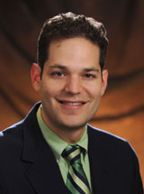

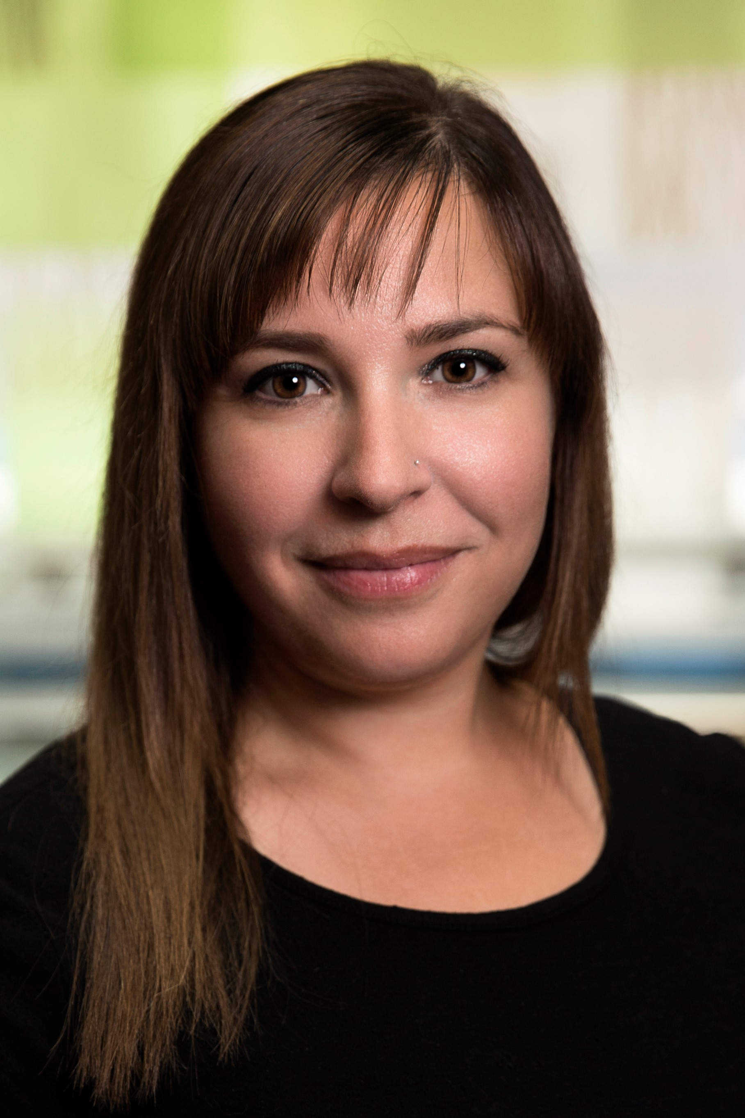
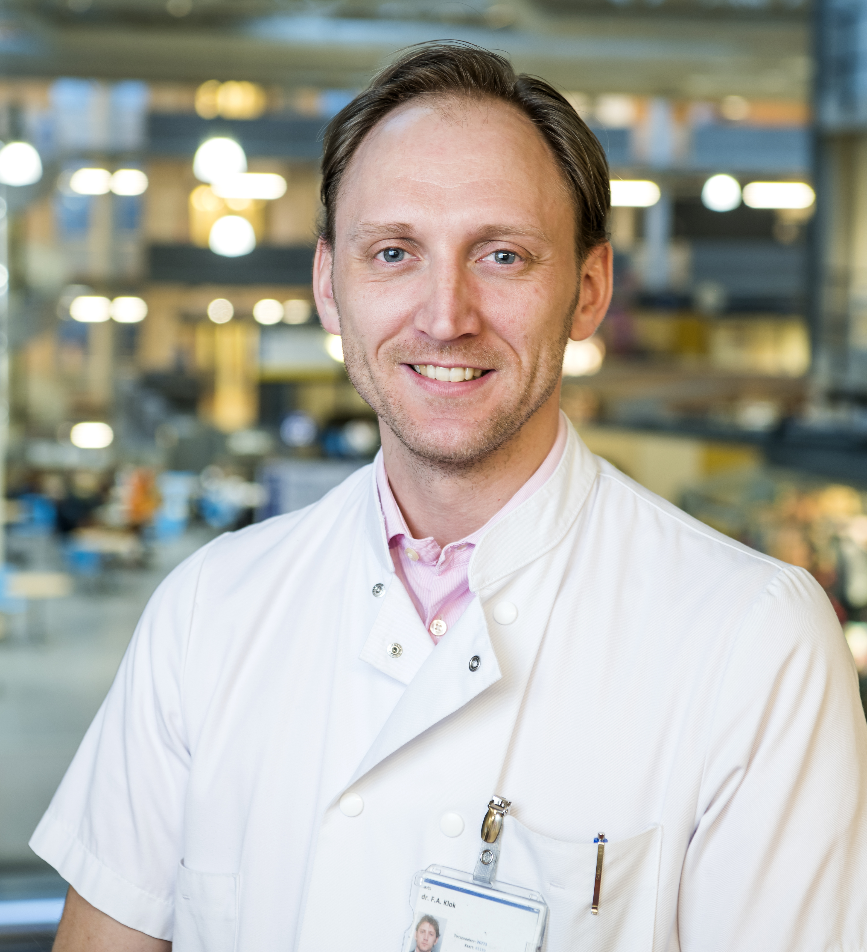
Speaker
Moderator
Speaker
Speaker
Adam Cuker, MD, MS
University of Pennsylvania
Robby Nieuwlaat,
PhD, MSc
McMaster University
Deborah Siegal, MD, MSc
University of Ottawa
Erik Klok, MD, PhD
Leiden University Medical Center

Slide 3
Disclosures
Frederikus A Klok reports research grants from Bayer, Bristol-Myers Squibb, Boehringer Ingelheim, Daiichi-Sankyo, MSD and Actelion, the Dutch Heart foundation, the Netherlands Organisation for Health Research and Development and the Dutch Thrombosis association, all outside this work.
Dr. Siegal reports payments from BMS-Pfizer, Leo Pharma, and Portola for consulting, all concluding in April 2020. She also reports ongoing research funding from Novartis and is an unpaid member of board of directors for Thrombosis Canada.
Dr. Nieuwlaat and Dr. Cuker have no conflicts to disclose.

Slide 4
Housekeeping
Submitting questions
Please use the chat in the tool bar on your screen to send in questions about the webinar.
Please submit questions as they arise. You do not have to wait for the end of a session to pose a question.
Technical difficulties
If you experience technical problems during the webinar, notify us via the chat box, and staff will assist.
If you get disconnected, please use the link sent to you via e-mail to reconnect.
Recording
A recording of this webinar will be made available on ASH On Demand (www.ashondemand.org), ASH’s multimedia platform for on-demand viewing of its educational meetings and webinars.

Slide 5
ASH Guidelines on Use of Anticoagulation in Patients with COVID-19
Robby Nieuwlaat, PhD, MSc
McMaster University

Slide 6
Methods
Overall
GRADE methodology for guideline recommendation development
Cochrane methodology for systematic reviews
Initial Phase
PICO question generation and prioritization
Selection of critical outcomes
Systematic review for baseline risk estimates
Systematic review for effect of different anticoagulation intensities
Living Phase
Monthly updated searches for baseline risk estimates and prognostic factors
Monthly updated searches for effect of different anticoagulation strategies
Revisiting guideline recommendations if new evidence meets pre-specified criteria

Slide 7
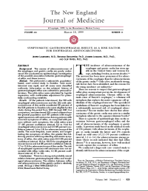
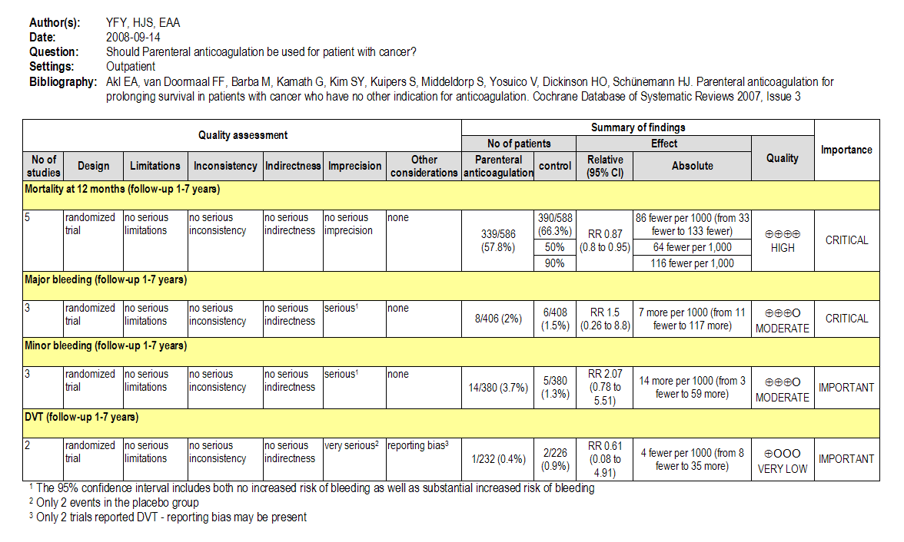
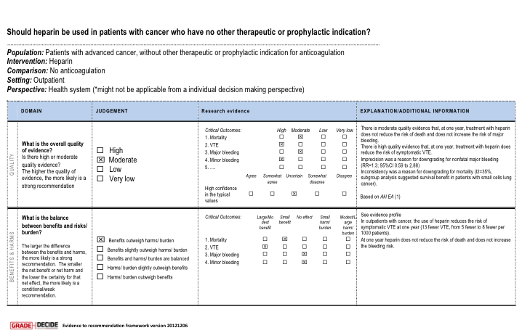
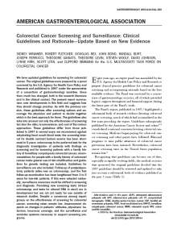
Outcomes across studies
Create
evidence profile with GRADEpro
Rate quality of evidence for each outcome
Randomization raises initial quality
RCTs: high
Observational: low
Formulate question
Rate importance
Select outcomes
Risk of bias
Inconsistency
Indirectness
Imprecision
Publication bias
P
I
C
O
Outcome
Critical
High
Outcome
Critical
Moderate
Grade down
Outcome
Important
Low
Very low
Outcome
Not
important
Summary of findings & estimate of effect for each outcome
Large effect
Dose response
Opposing bias & Confounders
Input?
Grade up
Evidence synthesis
Recommendation
Panel
Grade recommendations
(Evidence to Recommendation)
For or against (direction) ↓↑
Strong or conditional/weak (strength)
By considering balance of consequences (evidence to recommendations):
  Quality of evidence
  Balance benefits/harms
  Values and preferences
  Feasibility, equity and acceptability
Resource use (if applicable)
Grade overall
quality of evidence
across outcomes based on lowest quality
of critical outcomes
EtD framework
GRADEpro
Guideline
Formulate Recommendations (↓↑ | ⊕…)
“The panel recommends that ….should...”
“The panel suggests that ….should...”
“The panel suggests to not ...”
“The panel recommends to not...”
Transparency, clear, actionable
Research?
Notes:
New slide-Not animated

Slide 8
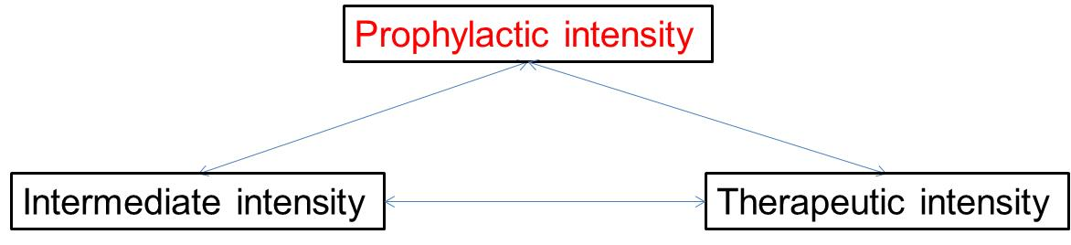
PICO Question Generation & Prioritization
Brainstorming: inclusive list of potential PICO questions to address
Importance rating: selecting the PICO questions with the most critical importance
Critically ill COVID-19
Acutely ill COVID-19

Slide 9
Outcome Selection
Brainstorming: inclusive list of potential outcomes to address
Importance rating: selecting the most critical outcomes for key stakeholders
  Using Health Outcome Descriptors (marker states) - https://ms.gradepro.org/
Critical Outcomes
All-cause mortality
Pulmonary embolism
Deep venous thrombosis
Major bleeding
Multi-organ failure
Ischemic stroke
Intracranial hemorrhage/hemorrhagic stroke
Invasive mechanical ventilation
Limb amputation
ICU admission
ST-elevation myocardial infarction

Slide 10
Evidence for Effect of the Intervention
Baseline Risk
Relative Effect
Absolute Effect
RR = 0.40
5 per 1,000
3 per 1,000 fewer

Slide 11
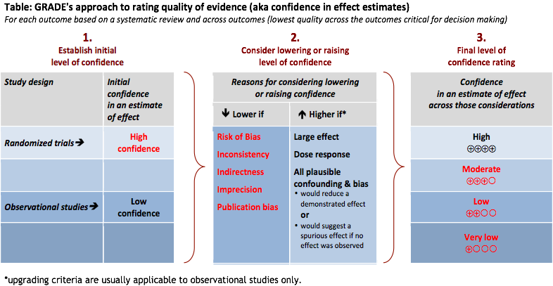
GRADE Certainty of Evidence
Notes:
Date missing

Slide 12
Baseline Risk – Systematic Review
Incidence rate of selected outcomes:
  In the two populations of interest
  Among patients receiving prophylactic intensity anticoagulation
Required:
  Not high risk of bias (according to simplified QUIPS)
  Reporting duration of follow-up
Initial search date: 23-JUL-2020
Screened: 14,816 citations
Included: 51 Studies
Analysis:
  Pooled estimates using generalized linear mixed model
  Descriptive, if only one study identified, or when pooling was considered in appropriate
Notes:
Date missing

Slide 13
Effect of Anticoagulation – Systematic Review
Comparison of two or more anticoagulation intensities for prevention of VTE:
  In the two populations of interest
  Primarily addressing Prophylactic vs. Intermediate/Therapeutic intensity
Required:
  Pre-defined definitions for Prophylactic, Intermediate, Therapeutic intensity
  Risk of bias assessed with ROBINS-I
Initial search date: 20-AUG-2020
Screened: 3,118 citations
Included: 12 Studies
Analysis:
  Descriptive analysis of adjusted relative effect estimates
  Pooling unadjusted relative effect estimates in meta-analysis
Notes:
Date missing

Slide 14
Evidence for Other Domains
The panel considered additional Evidence-to-Decision domains to generate the recommendations:
  Resource use
  Cost-effectiveness
  Health equity
  Acceptability
  Feasibility
  Evidence for these domains was also sought in the two reviews
  COVID-19 specific evidence not yet identified – the panel mainly relied on evidence from the ASH guidelines for the management of hospitalized medically ill patients, and their expertise

Slide 15
Living Phase – Systematic Reviews
Overall
Monthly search updates
Using explicit criteria for updating analyses and publication with new important information
Baseline risk
Add evidence on prognostic factors
Search strategy & eligibility criteria may become narrower as quantity and quality of evidence increases
Use of machine learning to make regular screening manageable
Effect of anticoagulation intensity
Search strategy & eligibility criteria may focus on RCTs as they become available
Update analyses with new important data (explicit criteria)

Slide 16
Living Phase – Recommendations
Continue to work closely with panel and systematic review team
Reconsider recommendations when important new evidence is identified
Using explicit criteria for reconsidering recommendations
  Changes in the evidence of effects (certainty, direction, magnitude)
  Changes in the evidence for other Evidence-to-Decision domains (cost-effectiveness, equity, others)
Publish updated recommendations and supporting documents
Timely advice for decision-makers
Notes:
When practice changing evidence is identified

Slide 17
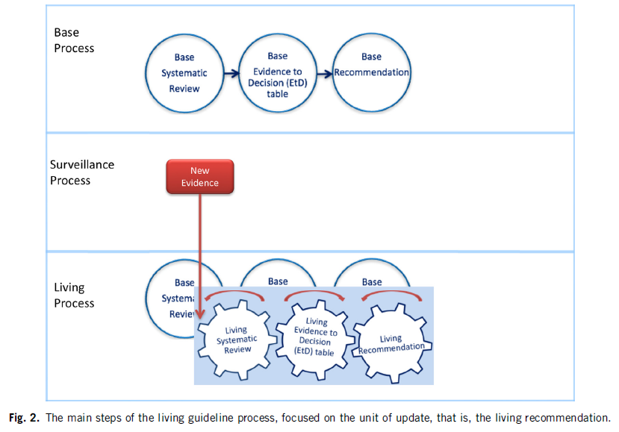
Living Recommendations Process
Akl EA, et al. Living systematic reviews: 4. Living guideline recommendations. J Clin Epidemiol. 2017;91:47-53.

Slide 18
Main Challenges
Evidence
Large number of citations
Incomplete reporting
Risk of bias
Imprecision
Evolving field in Living phase
Recommendation formulation process
Very low certainty evidence
Not relying on non-COVID-19 evidence
Criteria to reconsider recommendations with important new evidence in Living phase
Provide timely and stable guidance

Slide 19
Acknowledgements
Guideline Panel
Pantep Angchaisuksiri, MD (Ramathibodi Hospital, Mahidol University, Bangkok, Thailand)
Clifton Blair (Union, New Jersey) / Patient Representative
Adam Cuker, MD, MS (University of Pennsylvania) / Clinical Co-chair
Kathryn E. Dane, PharmD (Johns Hopkins Hospital)
Jennifer Davila, MD (Children's Hospital at Montefiore)
Maria DeSancho, MD, MSc (Weill Cornell Medicine)
David L. Diuguid, MD (Columbia University)
Daniel Griffin, MD, PhD (Columbia University and ProHealth Care, New Hyde Park, NY)
Susan R. Kahn, MD, MSc (McGill University)
Frederikus A. Klok, MD, PhD (Leiden University Medical Center Einthoven Laboratory)
Alfred Ian Lee, MD, PhD (Yale School of Medicine)
Reem Mustafa, MBBS, PhD, MPH (University of Kansas) / Methodology Co-chair
Ignacio Neumann, MD, MS (Pontifica Universidad Católica de Chile, Santiago, Chile)
Ashok Pai, MD (Kaiser Permanente, Oakland Medical Center)
Menaka Pai, MD, MSc (McMaster University) / Ex Officio, Guideline Oversight Subcommittee
Marc Righini, MD (University of Geneva, Switzerland)
Kristen M. Sanfilippo, MD, MPHS (Washington University in St. Louis)
Holger Schünemann, MD, PhD (McMaster University) / Methodology Co-chair
Deborah Siegal, MD, MSc (McMaster University)
Mike Skara (Cottage Grove, Indiana) / Patient Representative
Kamshad Touri (Ontario, Canada) / Patient Representative
Eric K. Tseng, MD, MSc (St. Michael's Hospital, Toronto) / Writer

Slide 20
Acknowledgements
Methods Team
Reem Mustafa, Robby Nieuwlaat, Holger Schünemann, Elie Akl, Kendall Alexander, Romina Brignardello-Petersen, Adam Cuker, Karin Dearness, Rob Kunkle, Ignacio Neumann, Eddrika Russell, Karla Solo, Adrienne Stevens, Wojtek Wiercioch
Systematic Review Team
Reyad Al Jabiri, Yazan Al Jabiri, Kendall Alexander, Antonio Bognanni, Imad Bouakl, Mary Boulos, Emma Cain, Matthew Chan, Rana Charide, Andrea Darzi, Samer Karam, Philipp Kolb, Claudia Li, Luis Enrique Colunga Lozano, Razan Mansour, Gian Paolo Morgano, Rami Morsi, Atefeh Noori, Thomas Piggott, Yuan Qiu, Yetiani Roldan, Finn Schünemann, Giovanna Schünemann, Holger Schünemann, Matthew Ventresca, Wojtek Wiercioch, Robby Nieuwlaat, Karla Solo

Slide 21
ASH Guidelines on Use of Anticoagulation in Patients with COVID-19
Erik Klok, MD, PhD
Leiden University Medical Center

Slide 22
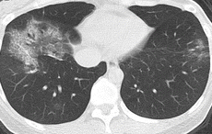
Case Presentations
Patient T | Patient K
♂, Chinese, 73 years | ♂, Caucasian, 52 years
BMI 34 kg/m², DM, hypertension | BMI 23 kg/m², Asthma
COVID-19 day 10 | COVID-19 day 6
High fever, dyspneic at rest | Anosmia, shortness of breath with exercise
HR 123/min, RR 42/min, Sat 83% at 15L O2 | HR 95/min, RR 20/min, sat 90% at room air
Notes:
Patient T: extensive bilateral patchy ground-glass opacities and consolidations in predominantly peripheral distribution
Patient K: ground-glass opacity with intralobular septal thickening (crazy-paving pattern) in right lower lobe.

Slide 23
Million Dollar Question
What would be the optimal anticoagulant strategy in these 2 patients?

Slide 24
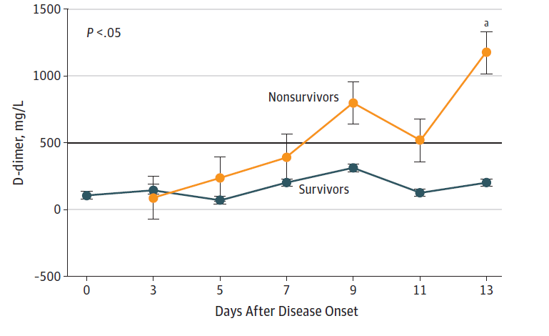
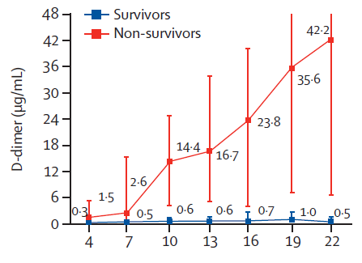
COVID-19 coagulopathy: initial reports (China)
Wang D et al, JAMA 2020
Zhou F et al, Lancet 2020

Slide 25
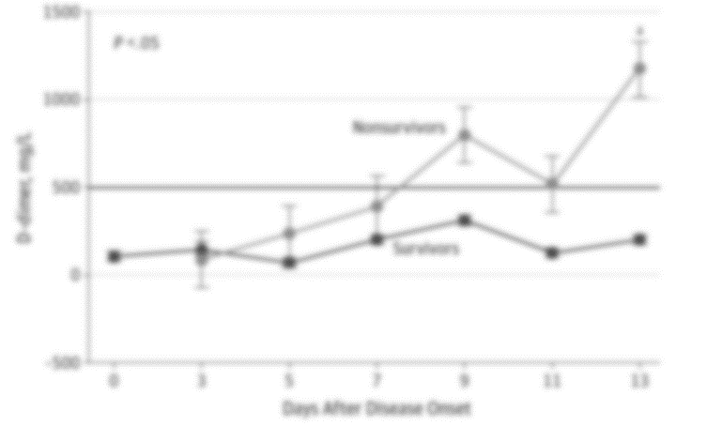
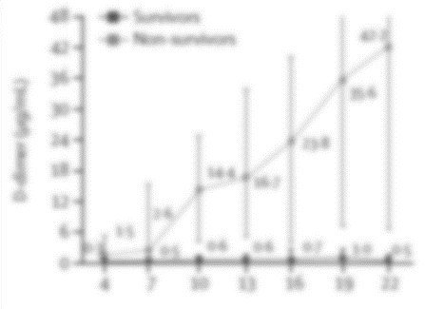
COVID-19 coagulopathy: initial reports (China)
Occurrence of VTE not mentioned
Wang D et al, JAMA 2020
Zhou F et al, Lancet 2020

Slide 26
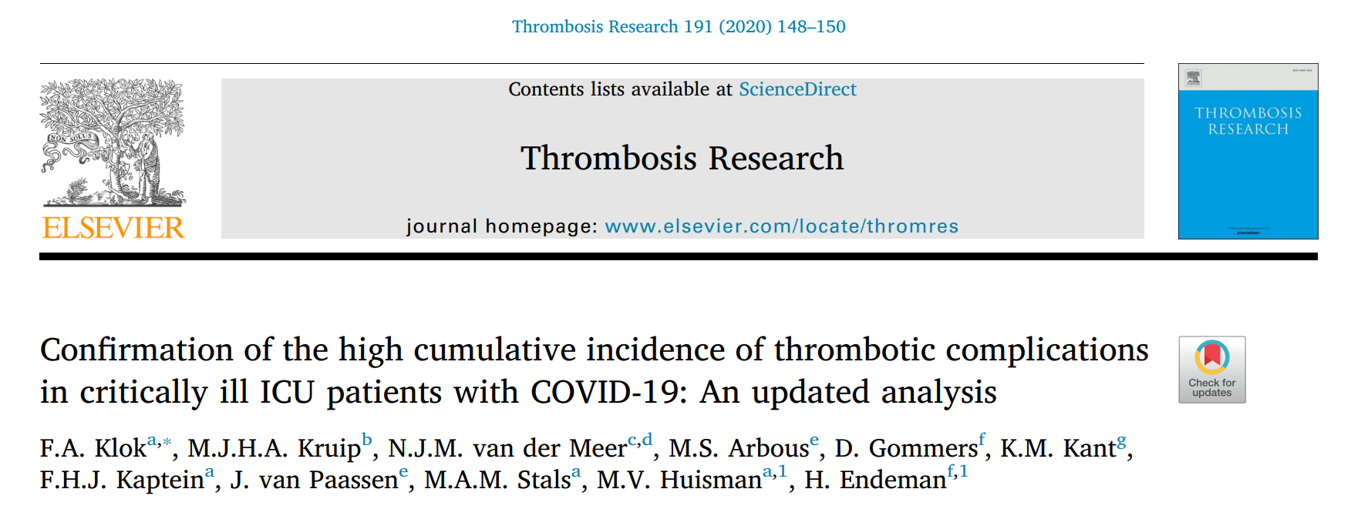
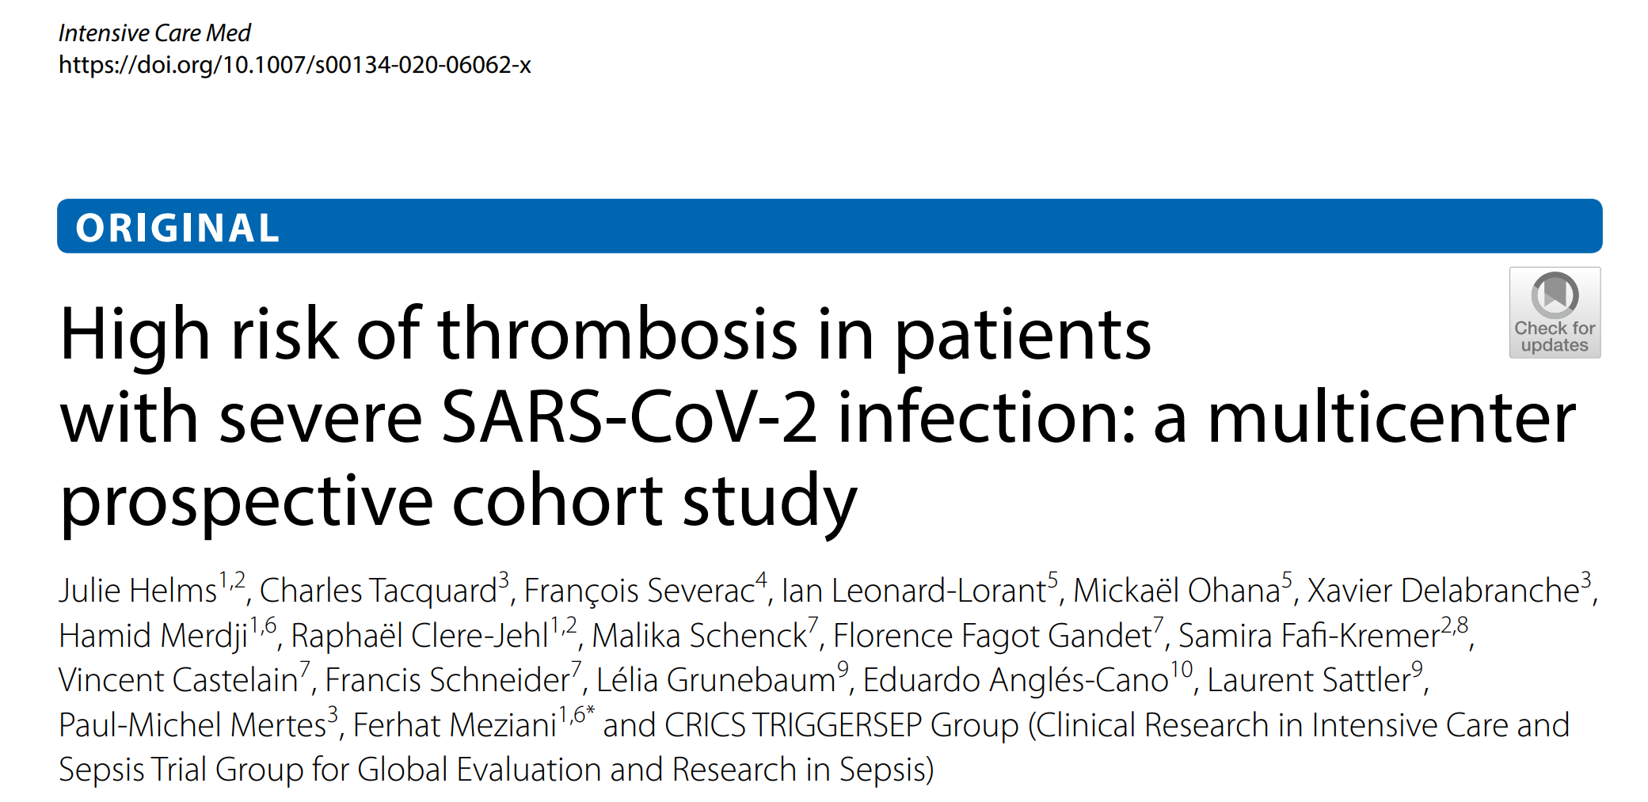
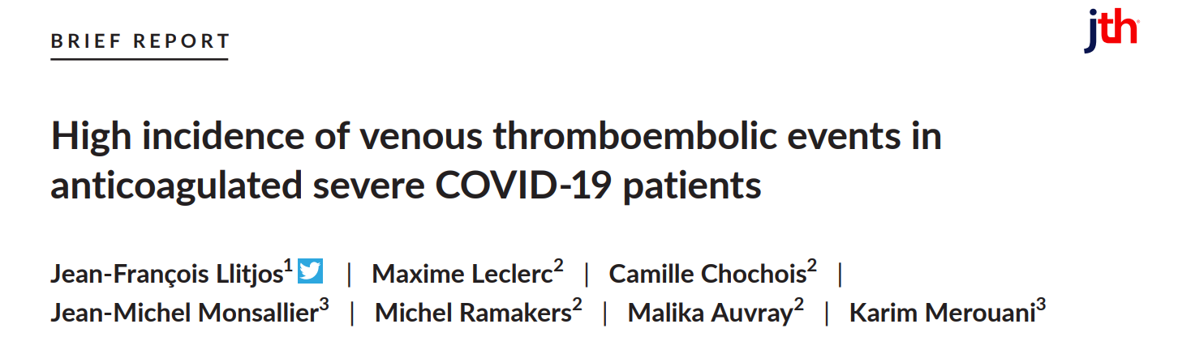
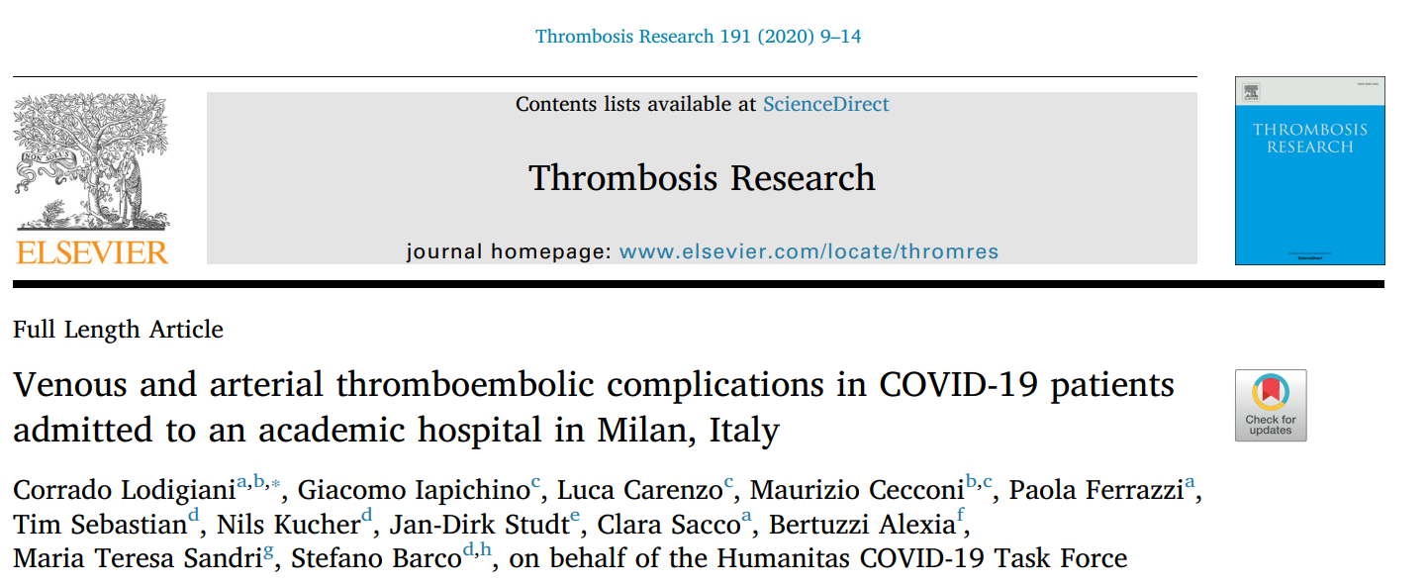
COVID-19 coagulopathy: initial reports (Europe)

Slide 27
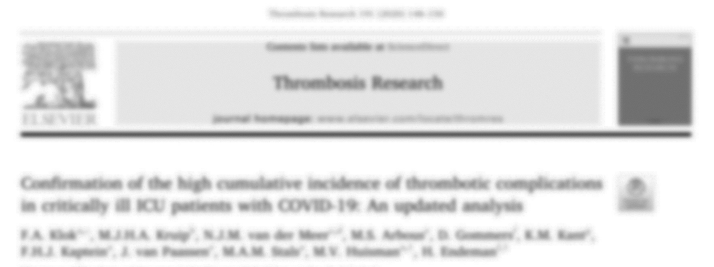
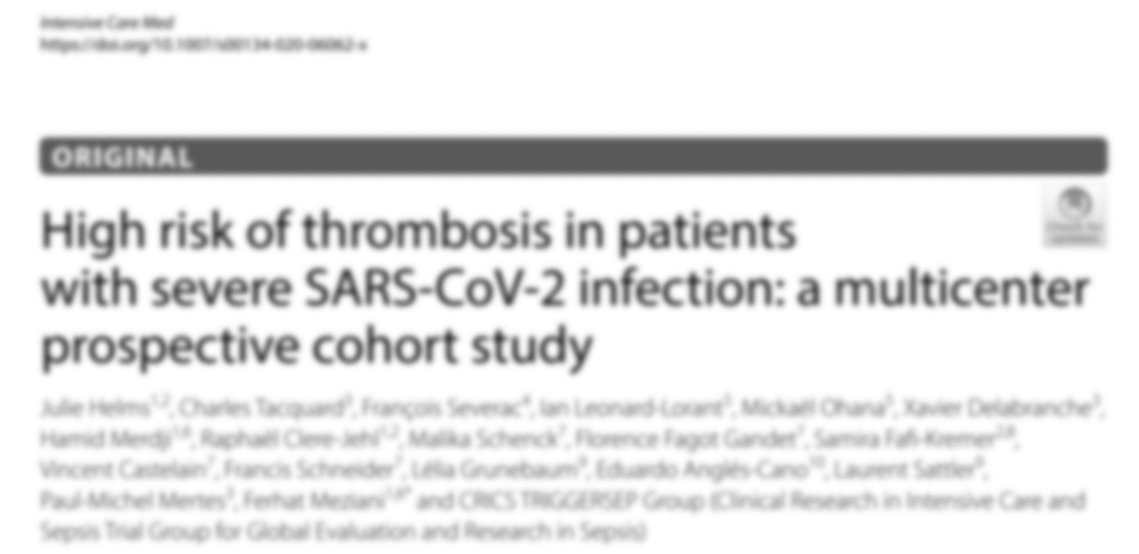
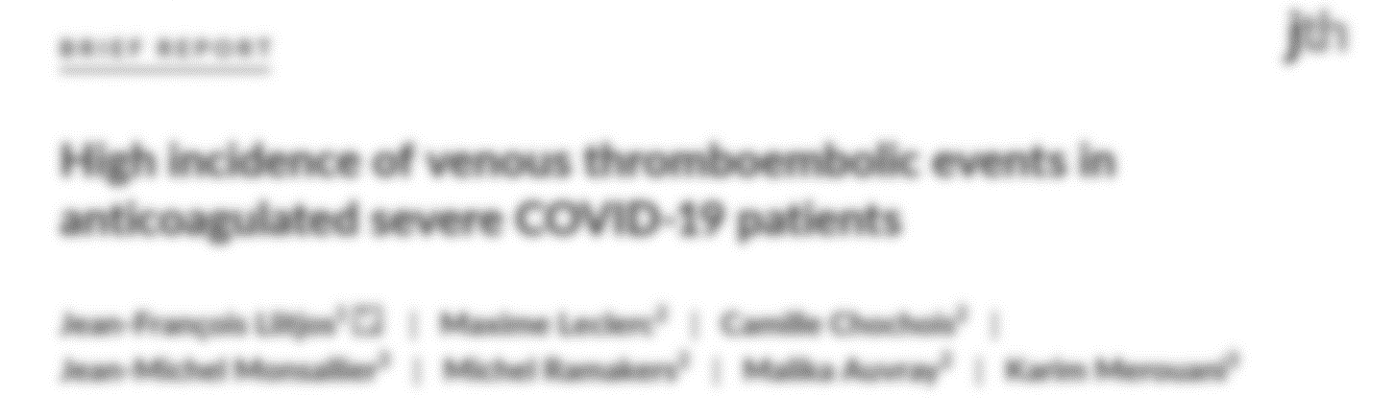
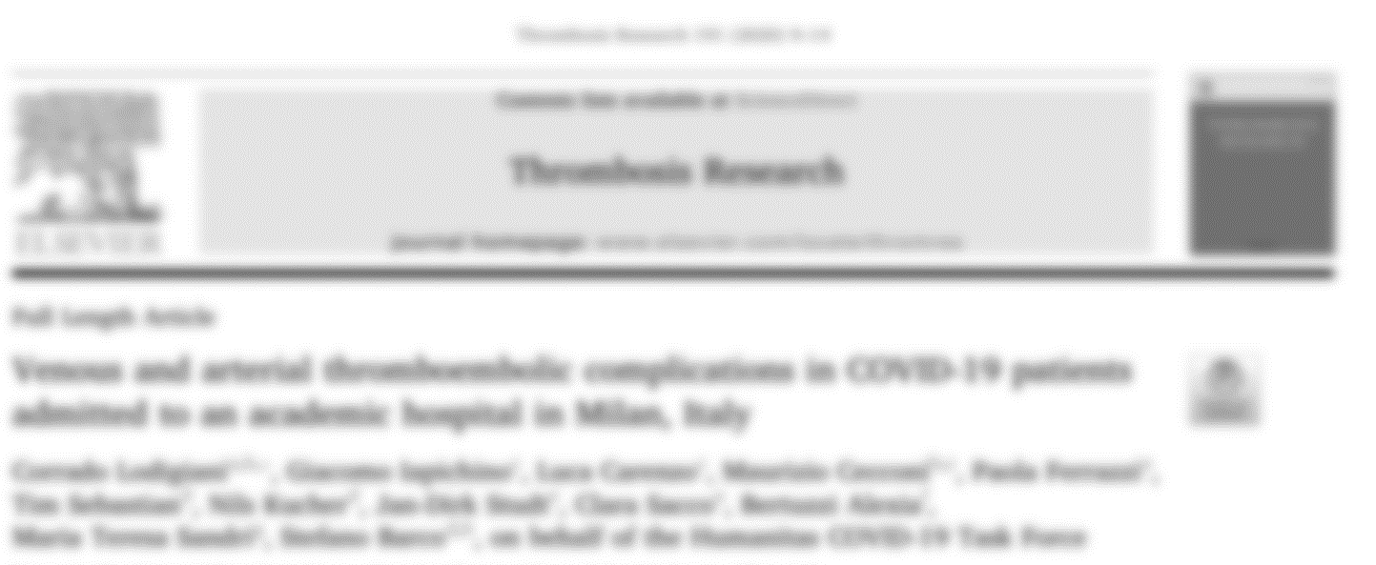
COVID-19 coagulopathy: initial reports (Europe)
Incidence of VTE on ICU 17-70%

Slide 28
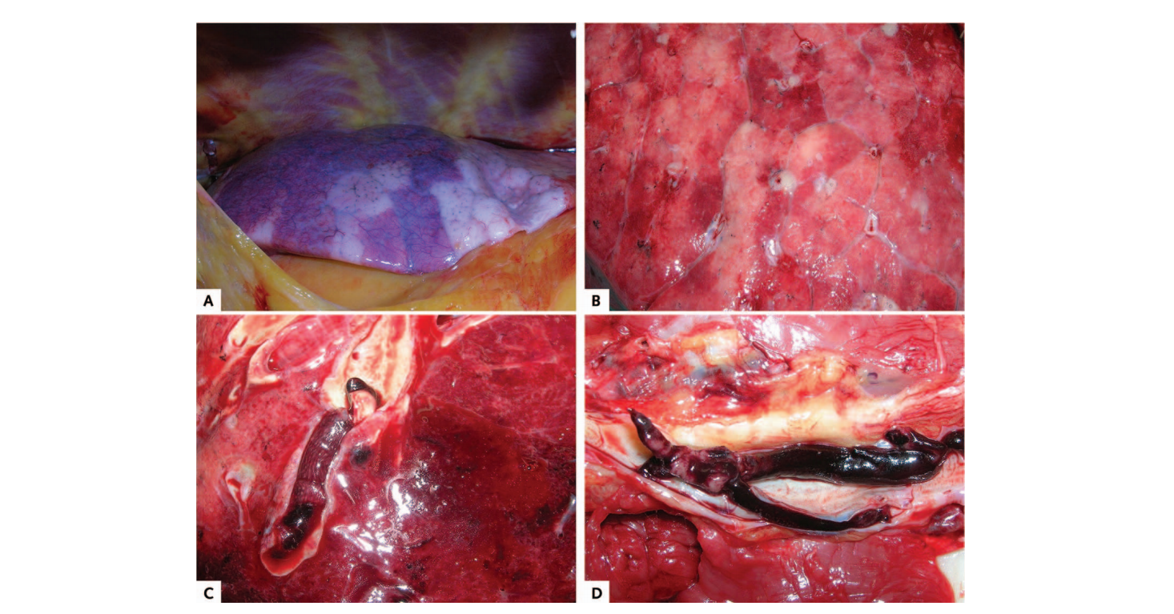
COVID-19 coagulopathy: autopsy studies
Wichmann D et al, Ann Int Med 2020

Slide 29
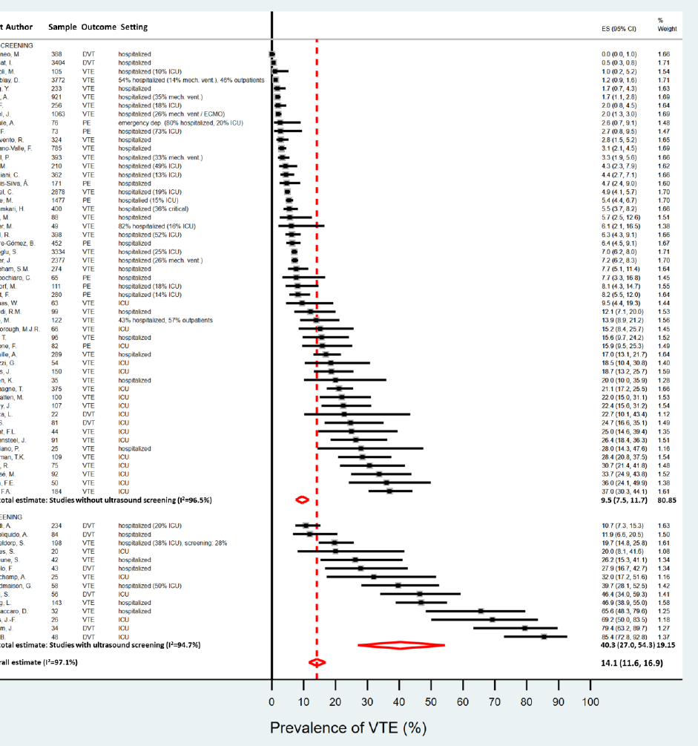
COVID-19: incidence of VTE
9.5% (95%CI 7.5-12)
40% (95%CI 27-54)
Nopp S et al, RPTH 2020

Slide 30
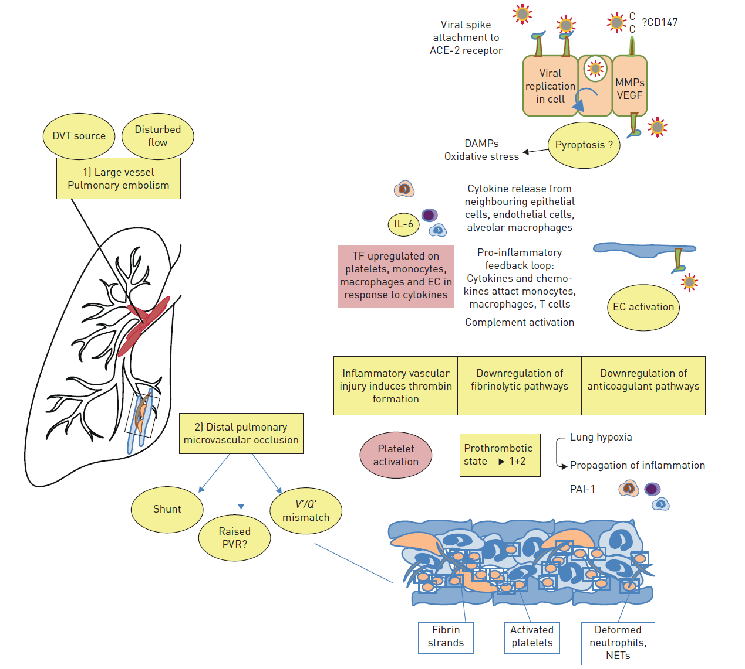
Pathophysiology of increased VTE risk
Price LC et al, Eur Respir J 2020

Slide 31



Beneficial non-anticoagulant mechanisms?
X
Reduces viral entry to host cells
Reduces NET formation
Inhibits heparanase

Slide 32

Intensive anticoagulant therapy beneficial?
High incidence of VTE
Beneficial non-anticoagulant mechanisms (?)
Immunothrombosis
Overdiagnosis of VTE (?)

Slide 33
ASH Guidelines on Use of Anticoagulation in Patients with COVID-19
Deborah Siegal, MD, MSc
University of Ottawa

Slide 34

Recommendations for anticoagulant dose intensity in patients with COVID-19 who do not have suspected or confirmed venous thromboembolism
Critically ill patients
Acutely ill patients
Photograph by: Nate Ptacek
Notes:
Dawn Wall, a seemingly impossible 3,000 foot rock face in Yosemite National Park, California which was conquered in January 2015 as a reminder that even the most challenging goals are achievable including improving outcomes for people with COVID-19.
In January 2015, Caldwell and Kevin Jorgesen completed the first free climb of the Dawn Wall of El Capitan in Yosemite National Park. Their 19-day ascent of the Dawn Wall was considered by some as the hardest successful rock climb in history. Caldwell and his partner Jorgeson spend six years meticulously plotting and practicing their route.

Slide 35
How patients and clinicians should use these recommendations
 | STRONG Recommendation (“The panel recommends…”) | CONDITIONAL Recommendation (“The panel suggests…”)
For patients | Most individuals would want the intervention. | A majority would want the intervention, but many would not.
For clinicians | Most individuals should receive the intervention. | Different choices will be appropriate for different patients, depending on their values and preferences. Use shared decision making.

Slide 36
What these guidelines are about
Anticoagulants carry benefits (reducing venous thromboembolism) and risks (life-threatening bleeding)
Recognizing and mitigating risk for harm from anticoagulants requires evidence-based approach to management
This guideline focuses on anticoagulant dose intensity for critically ill and acutely ill hospitalized patients with COVID-19 who do not have suspected or confirmed venous thromboembolism

Slide 37
Case 1: COVID-19 Related Critical Illness
Patient T
♂, Chinese, 73 years
BMI 34 kg/m², DM, hypertension
COVID-19 day 10
High fever, dyspneic at rest
HR 123/min, RR 42/min, Sat 83% at 15L O2

Slide 38
Question #1
Should DOACs, LMWH, UFH, fondaparinux, argatroban, or bivalirudin at intermediate- or therapeutic-intensity vs. prophylactic-intensity be used for patients with COVID-19 related critical illness who do not have suspected or confirmed VTE?

Slide 39
Should DOACs, LMWH, UFH, fondaparinux, argatroban, or bivalirudin at intermediate-intensity or therapeutic-intensity vs. prophylactic intensity be used for patients with COVID-19 related critical illness who do not have suspected or confirmed VTE?
Population: | Patients with COVID-19 related critical illness who do not have suspected or confirmed VTE
Intervention: | DOACs, LMWH, UFH, fondaparinux, argatroban, or bivalirudin at intermediate-intensity or therapeutic-intensity
Comparison: | Prophylactic-intensity
Main outcomes: | Mortality; Pulmonary embolism; Proximal lower extremity DVT; Venous thromboembolism; Major bleeding; Multiple Organ Failure; Ischemic stroke; Intracranial hemorrhage; Invasive ventilation; Limb amputation; ICU hospitalization; ST-elevation myocardial infarction;

Slide 40
OUTCOMES | № of participants (studies) | Certainty of the evidence (GRADE) | Relative effect (95% CI) | Anticipated absolute effects (95% CI)
 |  |  |  | Risk with prophylactic intensity | Risk difference with anticoagulation at intermediate or therapeutic-intensity
MORTALITY follow up: range 14 days to 22 days | 141 (1 study) | ⨁◯◯◯ VERY LOW | OR 0.73 (0.33 to 1.76) | 236 per 1,000 | 52 fewer per 1,000 (143 fewer to 116 more)
PE follow up: range 14 days to 20 days | 82 (1 study) | ⨁◯◯◯ VERY LOW | OR 0.09 (0.02 to 0.57) | 98 per 1,000 | 88 fewer per 1,000 (96 fewer to 40 fewer)
PROXIMAL LOWER EXTREMITY DVT follow up: range 14 days to 20 days | 41 (1 study) | ⨁◯◯◯ VERY LOW | OR 0.35 (0.06 to 2.02) | 106 per 1,000 | 66 fewer per 1,000 (99 fewer to 87 more)
VTE (DVT or PE) follow up: range 18 days to 28 days | 118 (2 studies) | ⨁◯◯◯ VERY LOW | OR 0.87 (0.45 to 1.67) | 130 per 1,000 | 15 fewer per 1,000 (67 fewer to 70 more)
MAJOR BLEEDING follow up: mean 16 days | 141 (1 study) | ⨁◯◯◯ VERY LOW | OR 3.84 (1.44 to 10.21) | 84 per 1,000 | 176 more per 1,000 (33 more to 400 more)
Notes:
Observational studies
Mean across studies

Slide 41
OUTCOMES | № of participants (studies) | Certainty of the evidence (GRADE) | Relative effect (95% CI) | Anticipated absolute effects (95% CI)
 |  |  |  | Risk with prophylactic intensity | Risk difference with anticoagulation at intermediate or therapeutic-intensity
MORTALITY follow up: range 14 days to 22 days | 141 (1 study) | ⨁◯◯◯ VERY LOW | OR 0.73 (0.33 to 1.76) | 236 per 1,000 | 52 fewer per 1,000 (143 fewer to 116 more)
PE follow up: range 14 days to 20 days | 82 (1 study) | ⨁◯◯◯ VERY LOW | OR 0.09 (0.02 to 0.57) | 98 per 1,000 | 88 fewer per 1,000 (96 fewer to 40 fewer)
PROXIMAL LOWER EXTREMITY DVT follow up: range 14 days to 20 days | 41 (1 study) | ⨁◯◯◯ VERY LOW | OR 0.35 (0.06 to 2.02) | 106 per 1,000 | 66 fewer per 1,000 (99 fewer to 87 more)
VTE (DVT or PE) follow up: range 18 days to 28 days | 118 (2 studies) | ⨁◯◯◯ VERY LOW | OR 0.87 (0.45 to 1.67) | 130 per 1,000 | 15 fewer per 1,000 (67 fewer to 70 more)
MAJOR BLEEDING follow up: mean 16 days | 141 (1 study) | ⨁◯◯◯ VERY LOW | OR 3.84 (1.44 to 10.21) | 84 per 1,000 | 176 more per 1,000 (33 more to 400 more)
Notes:
Observational studies
Mean across studies

Slide 42
OUTCOMES | № of participants (studies) | Certainty of the evidence (GRADE) | Relative effect (95% CI) | Anticipated absolute effects (95% CI)
 |  |  |  | Risk with prophylactic intensity | Risk difference with anticoagulation at intermediate or therapeutic-intensity
MORTALITY follow up: range 14 days to 22 days | 141 (1 study) | ⨁◯◯◯ VERY LOW | OR 0.73 (0.33 to 1.76) | 236 per 1,000 | 52 fewer per 1,000 (143 fewer to 116 more)
PE follow up: range 14 days to 20 days | 82 (1 study) | ⨁◯◯◯ VERY LOW | OR 0.09 (0.02 to 0.57) | 98 per 1,000 | 88 fewer per 1,000 (96 fewer to 40 fewer)
PROXIMAL LOWER EXTREMITY DVT follow up: range 14 days to 20 days | 41 (1 study) | ⨁◯◯◯ VERY LOW | OR 0.35 (0.06 to 2.02) | 106 per 1,000 | 66 fewer per 1,000 (99 fewer to 87 more)
VTE (DVT or PE) follow up: range 18 days to 28 days | 118 (2 studies) | ⨁◯◯◯ VERY LOW | OR 0.87 (0.45 to 1.67) | 130 per 1,000 | 15 fewer per 1,000 (67 fewer to 70 more)
MAJOR BLEEDING follow up: mean 16 days | 141 (1 study) | ⨁◯◯◯ VERY LOW | OR 3.84 (1.44 to 10.21) | 84 per 1,000 | 176 more per 1,000 (33 more to 400 more)
Notes:
Observational studies
Mean across studies

Slide 43
OUTCOMES | № of participants (studies) | Certainty of the evidence (GRADE) | Relative effect (95% CI) | Anticipated absolute effects (95% CI)
 |  |  |  | Risk with prophylactic intensity | Risk difference with anticoagulation at intermediate or therapeutic-intensity
MORTALITY follow up: range 14 days to 22 days | 141 (1 study) | ⨁◯◯◯ VERY LOW | OR 0.73 (0.33 to 1.76) | 236 per 1,000 | 52 fewer per 1,000 (143 fewer to 116 more)
PE follow up: range 14 days to 20 days | 82 (1 study) | ⨁◯◯◯ VERY LOW | OR 0.09 (0.02 to 0.57) | 98 per 1,000 | 88 fewer per 1,000 (96 fewer to 40 fewer)
PROXIMAL LOWER EXTREMITY DVT follow up: range 14 days to 20 days | 41 (1 study) | ⨁◯◯◯ VERY LOW | OR 0.35 (0.06 to 2.02) | 106 per 1,000 | 66 fewer per 1,000 (99 fewer to 87 more)
VTE (DVT or PE) follow up: range 18 days to 28 days | 118 (2 studies) | ⨁◯◯◯ VERY LOW | OR 0.87 (0.45 to 1.67) | 130 per 1,000 | 15 fewer per 1,000 (67 fewer to 70 more)
MAJOR BLEEDING follow up: mean 16 days | 141 (1 study) | ⨁◯◯◯ VERY LOW | OR 3.84 (1.44 to 10.21) | 84 per 1,000 | 176 more per 1,000 (33 more to 400 more)
Notes:
Observational studies
Mean across studies

Slide 44
Recommendation
The ASH guideline panel suggests using prophylactic-intensity over intermediate-intensity or therapeutic-intensity anticoagulation in patients with COVID-19 related critical illness who do not have suspected or confirmed VTE
Conditional recommendation based on very low certainty in the evidence about effects
The panel agreed that there was less uncertainty regarding the influence on undesirable effects (bleeding) compared with desirable effects (mortality and VTE). This was driven by extensive indirect evidence of dose-dependent effects of anticoagulation on bleeding.
Individualized assessment
No validated risk assessment models for in patients with COVID-19
No direct high-quality evidence comparing different anticoagulants
Notes:
Overall justification
Although the panel judged the certainty of evidence to be very low for both desirable and undesirable effects, the panel considered the plethora of indirect evidence supporting a dose-dependent increase in major bleeding reported with anticoagulation. Hence, the panel agreed that there was less uncertainty regarding the increase in undesirable effects (bleeding) compared with the influence on desirable effects (i.e., reduction in mortality and VTE) reported with intermediate-intensity or therapeutic-intensity anticoagulation. Without compelling evidence for benefit, the usual practice of prophylactic-intensity anticoagulation in critically ill medical patients without COVID-19 was suggested while acknowledging that individualized decision-making is required. This recommendation will be updated based on a living review of evolving evidence.

Slide 45
Case 2: COVID-19 related acute illness
Patient K
♂, Caucasian, 52 years
BMI 23 kg/m², Asthma
COVID-19 day 6
Anosmia, shortness of breath with exercise
HR 95/min, RR 20/min, sat 90% at room air

Slide 46
Question #2
Should DOACs, LMWH, UFH, fondaparinux, argatroban, or bivalirudin at intermediate-intensity or therapeutic-intensity vs. prophylactic-intensity be used for patients with COVID-19 related acute illness who do not have suspected or confirmed VTE?

Slide 47
Should DOACs, LMWH, UFH, fondaparinux, argatroban, or bivalirudin at intermediate-intensity or therapeutic-intensity vs. prophylactic-intensity be used for patients with COVID-19 related acute illness who do not have suspected or confirmed VTE?
Population: | Patients with COVID-19 related acute illness who do not have suspected or confirmed VTE
Intervention: | DOACs, LMWH, UFH, fondaparinux, argatroban, or bivalirudin at intermediate-intensity or therapeutic-intensity
Comparison: | Prophylactic-intensity
Main outcomes: | All-cause mortality; Pulmonary embolism; Proximal lower extremity DVT; Venous thromboembolism; Major bleeding; Multiple organ failure; Ischemic stroke; Intracranial hemorrhage; Invasive ventilation; Limb amputation; ICU hospitalization; ST-elevation myocardial infarction;

Slide 48
Outcomes | № of participants (studies) | Certainty of the evidence (GRADE) | Relative effect (95% CI) | Anticipated absolute effects (95% CI)
 |  |  |  | Risk with prophylactic-intensity | Risk difference with anticoagulation at intermediate- or therapeutic-intensity
ALL-CAUSE MORTALITY follow up: 14 days | 2626 (1 study) | ⨁◯◯◯ VERY LOW | HR 0.86 (0.73 to 1.02) | 148 per 1,000 | 19 fewer per 1,000 (38 fewer to 3 more)
PE follow up: range 4 days to 28 days | 82 (1 study) | ⨁◯◯◯ VERY LOW | OR 0.09 (0.02 to 0.57) | 16 per 1,000 | 15 fewer per 1,000 (16 fewer to 7 fewer)
PROXIMAL LOWER EXTREMITY DVT follow up: 28 days | 41 (1 study) | ⨁◯◯◯ VERY LOW | OR 0.35 (0.06 to 2.02) | 20 per 1,000 | 13 fewer per 1,000 (18 fewer to 19 more)
VTE follow up: range 6 days to 28 days | 0 (1 study) | - | - | Baseline (2 studies, range 2.0% to 3.1%); 0/19 (0%) on therapeutic (other indications) vs. 39/179 (22%) on proph/intermediate (1 study).
MAJOR BLEEDING follow up: 14 days | 0 (2 studies) | ⨁◯◯◯ VERY LOW | - | Pooled baseline risk of 1.7% (5 studies); Follow-up 4 to 12 days: lowest OR 1.42 and highest adjusted HR 3.89 (7 more to 46 more major bleeds per 1000 patients)
Notes:
VTE
Study by Middeldorp et al. 2020 showed 0/19 patients (0%) who continued therapeutic anticoagulation for other indications during admission developed VTE compared with 39/179 of the remaining patients who received Prophylactic or Intermediate intensity anticoagulation (22%)

Slide 49
Outcomes | № of participants (studies) | Certainty of the evidence (GRADE) | Relative effect (95% CI) | Anticipated absolute effects* (95% CI)
 |  |  |  | Risk with prophylactic-intensity | Risk difference with anticoagulation at intermediate- or therapeutic-intensity
ALL-CAUSE MORTALITY follow up: 14 days | 2626 (1 study) | ⨁◯◯◯ VERY LOW | HR 0.86 (0.73 to 1.02) | 148 per 1,000 | 19 fewer per 1,000 (38 fewer to 3 more)
PE follow up: range 4 days to 28 days | 82 (1 study) | ⨁◯◯◯ VERY LOW | OR 0.09 (0.02 to 0.57) | 16 per 1,000 | 15 fewer per 1,000 (16 fewer to 7 fewer)
PROXIMAL LOWER EXTREMITY DVT follow up: 28 days | 41 (1 study) | ⨁◯◯◯ VERY LOW | OR 0.35 (0.06 to 2.02) | 20 per 1,000 | 13 fewer per 1,000 (18 fewer to 19 more)
VTE follow up: range 6 days to 28 days | 0 (1 study) | - | - | Baseline risk (2 studies, range 2.0% to 3.1%).
MAJOR BLEEDING follow up: 14 days | 0 (2 studies) | ⨁◯◯◯ VERY LOW | - | Pooled baseline risk of 1.7% (5 studies); Follow-up 4 to 12 days: lowest OR 1.42 and highest adjusted HR 3.89 (7 more per 1000 to 46 more major bleeds per 1000 patients)
Notes:
VTE
Study by Middeldorp et al. 2020 showed 0/19 patients (0%) who continued therapeutic anticoagulation for other indications during admission developed VTE compared with 39/179 of the remaining patients who received Prophylactic or Intermediate intensity anticoagulation (22%)

Slide 50
Outcomes | № of participants (studies) | Certainty of the evidence (GRADE) | Relative effect (95% CI) | Anticipated absolute effects* (95% CI)
 |  |  |  | Risk with prophylactic-intensity | Risk difference with anticoagulation at intermediate- or therapeutic-intensity
ALL-CAUSE MORTALITY follow up: 14 days | 2626 (1 study) | ⨁◯◯◯ VERY LOW | HR 0.86 (0.73 to 1.02) | 148 per 1,000 | 19 fewer per 1,000 (38 fewer to 3 more)
PE follow up: range 4 days to 28 days | 82 (1 study) | ⨁◯◯◯ VERY LOW | OR 0.09 (0.02 to 0.57) | 16 per 1,000 | 15 fewer per 1,000 (16 fewer to 7 fewer)
PROXIMAL LOWER EXTREMITY DVT follow up: 28 days | 41 (1 study) | ⨁◯◯◯ VERY LOW | OR 0.35 (0.06 to 2.02) | 20 per 1,000 | 13 fewer per 1,000 (18 fewer to 19 more)
VTE follow up: range 6 days to 28 days | 0 (1 study) | - | - | Baseline risk (2 studies, range 2.0% to 3.1%).
MAJOR BLEEDING follow up: 14 days | 0 (2 studies) | ⨁◯◯◯ VERY LOW | - | Pooled baseline risk of 1.7% (5 studies); Follow-up 4 to 12 days: lowest OR 1.42 and highest adjusted HR 3.89 (7 more to 46 more major bleeds per 1000 patients)
Notes:
VTE
Study by Middeldorp et al. 2020 showed 0/19 patients (0%) who continued therapeutic anticoagulation for other indications during admission developed VTE compared with 39/179 of the remaining patients who received Prophylactic or Intermediate intensity anticoagulation (22%)

Slide 51
Outcomes | № of participants (studies) | Certainty of the evidence (GRADE) | Relative effect (95% CI) | Anticipated absolute effects (95% CI)
 |  |  |  | Risk with prophylactic-intensity | Risk difference with anticoagulation at intermediate- or therapeutic-intensity
ALL-CAUSE MORTALITY follow up: 14 days | 2626 (1 study) | ⨁◯◯◯ VERY LOW | HR 0.86 (0.73 to 1.02) | 148 per 1,000 | 19 fewer per 1,000 (38 fewer to 3 more)
PE follow up: range 4 days to 28 days | 82 (1 study) | ⨁◯◯◯ VERY LOW | OR 0.09 (0.02 to 0.57) | 16 per 1,000 | 15 fewer per 1,000 (16 fewer to 7 fewer)
PROXIMAL LOWER EXTREMITY DVT follow up: 28 days | 41 (1 study) | ⨁◯◯◯ VERY LOW | OR 0.35 (0.06 to 2.02) | 20 per 1,000 | 13 fewer per 1,000 (18 fewer to 19 more)
VTE follow up: range 6 days to 28 days | 0 (1 study) | - | - | Baseline (2 studies, range 2.0% to 3.1%); 0/19 (0%) on therapeutic (other indications) vs. 39/179 (22%) on proph/intermediate (1 study).
MAJOR BLEEDING follow up: 14 days | 0 (2 studies) | ⨁◯◯◯ VERY LOW | - | Pooled baseline risk of 1.7% (5 studies); Follow-up 4 to 12 days: lowest OR 1.42 and highest adjusted HR 3.89 (7 more to 46 more major bleeds per 1000 patients)
Notes:
VTE
Study by Middeldorp et al. 2020 showed 0/19 patients (0%) who continued therapeutic anticoagulation for other indications during admission developed VTE compared with 39/179 of the remaining patients who received Prophylactic or Intermediate intensity anticoagulation (22%)

Slide 52
Recommendation
The ASH guideline panel suggests using prophylactic-intensity over intermediate-intensity or therapeutic-intensity anticoagulation in patients with COVID-19 related acute illness who do not have suspected or confirmed VTE
Conditional recommendation based on very low certainty in the evidence about effects
The panel agreed that there was less uncertainty regarding the influence on undesirable effects (bleeding) compared with desirable effects (mortality and VTE). This was driven by extensive indirect evidence of dose-dependent effects of anticoagulation on bleeding.
Individualized assessment
No validated risk assessment models for in patients with COVID-19
No direct high-quality evidence comparing different anticoagulants
Notes:
Overall justification
Although the panel judged the certainty of evidence to be very low for both desirable and undesirable effects, the panel considered the plethora of indirect evidence supporting a dose-dependent increase in major bleeding with anticoagulation. Hence, the panel agreed that there was less uncertainty regarding the increase in undesirable effects (bleeding) compared with the influence on desirable effects (i.e., reduction in mortality, VTE) reported with intermediate-intensity or therapeutic-intensity anticoagulation. Without compelling evidence for benefit, the usual practice of prophylactic-intensity anticoagulation in acutely ill medical patients without COVID-19 was suggested while acknowledging that individualized decision-making is required. This recommendation will be updated based on living reviews of evolving evidence.

Slide 53
Very low certainty of evidence
Baseline risk studies
Effect of anticoagulation studies
Lack of definitions and/or descriptions of outcome measurement
Incomplete/missing follow-up
Incidence rates not reported (i.e. events per unit of follow-up)
Confounding with use of higher intensities in selected patients
Lack of details regarding reported anticoagulant intensities
Notes:
typically due to a large proportion still in hospital at end of study without specifying the duration of follow-up.

Slide 54
Thank you for joining today’s webinar!
Visit www.hematology.org/COVIDguidelines for access to:
  Recommendations for anticoagulation in critically and acutely ill patients
  Public comment open until October 16th
  Links to full evidence profiles and evidence to decision tables
Visit www.hematology.org/covid-19 for access to:
  FAQs about COVID-19 and clinical hematology topics
  Data summaries from the ASH RC COVID-19 registry for hematology
  Resources for clinicians, researchers, and trainees
Visit www.ashondemand.org to view this webinar recording on ASH On Demand.
If you have questions or feedback, please contact quality@hematology.org

Slide 55

Question & Answer Panel
Use the Q&A box to send in questions to the presenters.

