Slide 1
Prophylaxis for Hospitalized and Non-Hospitalized Medical Patients
An Educational Slide Set
American Society of Hematology 2018 Guidelines for Management of Venous Thromboembolism
Slide set authors: Eric Tseng MD MScCH, University of Toronto Mary Cushman MD MSc, University of Vermont

Slide 2
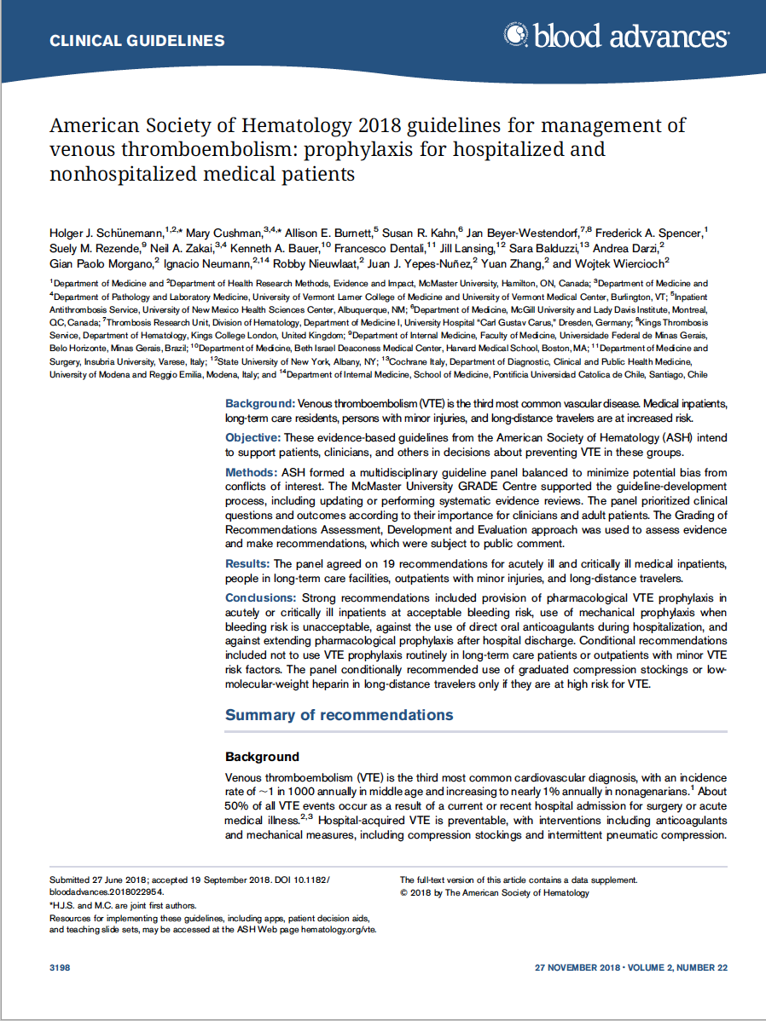
American Society of Hematology 2018 guidelines for management of venous thromboembolism: prophylaxis for hospitalized and non-hospitalized medical patients
Holger J. Schünemann, Mary Cushman, Allison E. Burnett, Susan R. Kahn, Jan Beyer-Westendorf, Frederick A. Spencer, Suely M. Rezende, Neil A. Zakai, Kenneth A. Bauer, Francesco Dentali, Jill Lansing, Sara Balduzzi, Andrea Darzi, Gian Paolo Morgano, Ignacio Neumann, Robby Nieuwlaat, Juan J. Yepes-Nuñez, Yuan Zhang, and Wojtek Wiercioch

Slide 3
ASH Clinical Practice Guidelines on VTE
Prevention of VTE in Surgical Hospitalized Patients
Prophylaxis in Hospitalized and Non-Hospitalized Medical Patients
Treatment of Acute VTE (DVT and PE)
Optimal Management of Anticoagulation Therapy
Prevention and Treatment of VTE in Patients with Cancer
Heparin-Induced Thrombocytopenia (HIT)
Thrombophilia
Pediatric VTE
VTE in the Context of Pregnancy
Diagnosis of VTE

Slide 4
How were these ASH guidelines developed?
PANEL FORMATION
Each guideline panel was formed following these key criteria:
Balance of expertise (including disciplines beyond hematology, and patients)
Close attention to minimization and management of COI
CLINICAL QUESTIONS
10 to 20 clinically-relevant questions generated in PICO format (population, intervention, comparison, outcome)
EVIDENCE SYNTHESIS
Evidence summary generated for each PICO question via systematic review of health effects plus:
Resource use
Feasibility
Acceptability
Equity
Patient values and preferences
MAKING RECOMMENDATIONS
Recommendations made by guideline panel members based on evidence for all factors.
Example: PICO question
“Should LMWH versus UFH be used for VTE prophylaxis in critically ill patients?”

Slide 5
How patients and clinicians should use these recommendations
 | STRONG Recommendation (“The panel recommends…”) | CONDITIONAL Recommendation (“The panel suggests…”)
For patients | Most individuals would want the intervention. | A majority would want the intervention, but many would not.
For clinicians | Most individuals should receive the intervention. | Different choices will be appropriate for different patients, depending on their values and preferences. Use shared decision making.

Slide 6
VTE in medical inpatients is common
Half of VTE events occur due to hospital admission for surgery (24%) or medical illness (22%)
Risk factors for VTE in hospital include cancer, older age, prior VTE, central lines, immobility
40% of hospitalized patients have 3 or more risk factors for VTE
Increase in thrombosis risk in medical inpatients persists 45 to 60 days after discharge

Slide 7
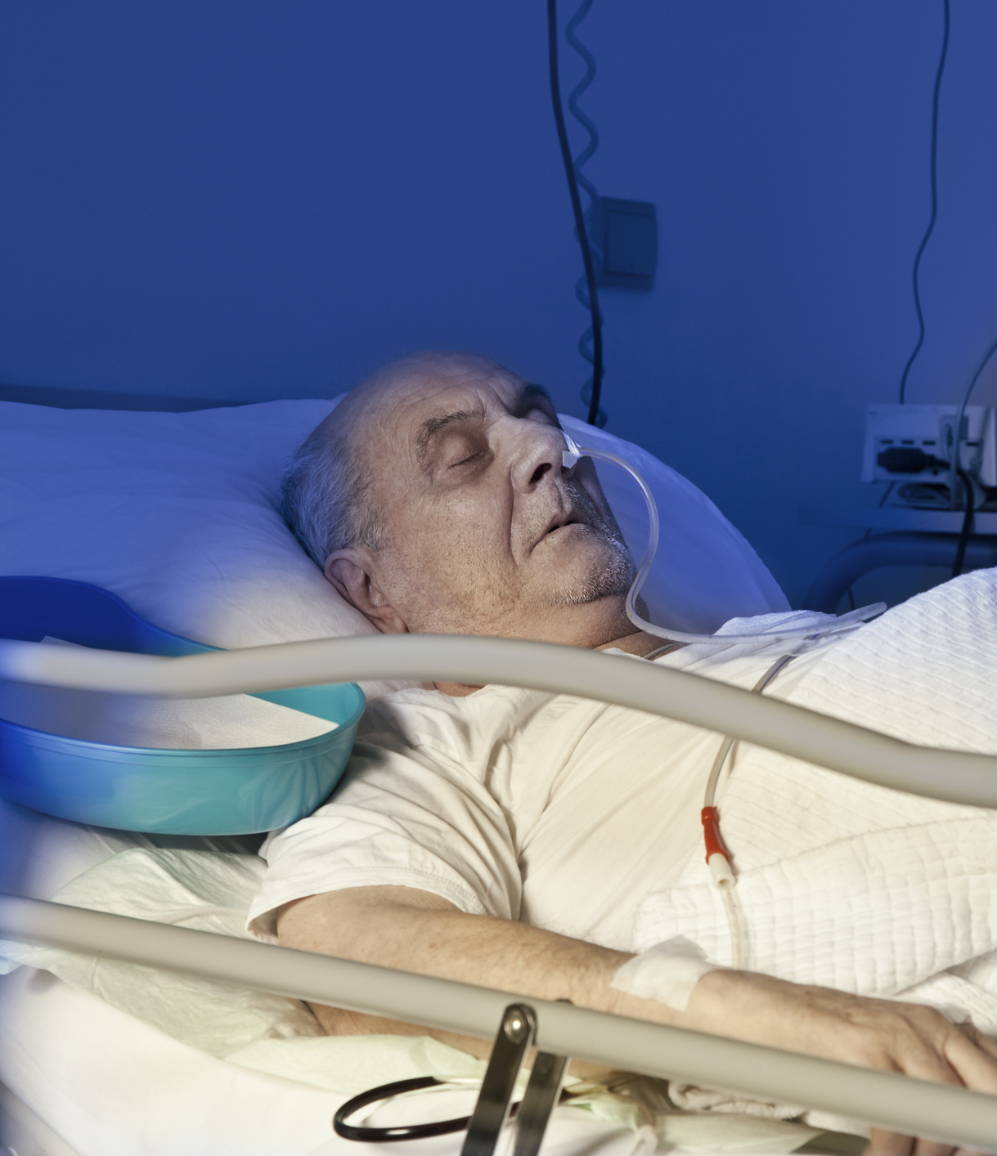
Patient groups addressed in this chapter
Acutely Ill Medical Patient
Patients hospitalized for medical illness
Critically Ill Patient
Patients suffering from immediately life-threatening illness requiring admission to intensive care unit
Chronically Ill Medical Patient
Those with medical conditions who may be cared for in long-term care facilities
Long-distance Traveler
Those traveling by air for ≥ 4 hours

Slide 8
Who is at risk for VTE in hospital?
Risk Assessment Models (RAMs) can identify inpatients at high risk
Examples: Padua, IMPROVE-VTE Scores
These RAMs are not extensively validated for guiding decisions about prophylaxis
Padua RAM: Factors
Previous VTE Thrombophilia Active cancer Age > 70 years Reduced mobility Recent trauma/surgery Heart or respiratory failure Acute MI or stroke Hormonal treatment Obesity (BMI > 30) Infection/rheumatologic
IMPROVE-VTE RAM: Factors
Previous VTE Thrombophilia Active cancer Age > 60 years Immobilization of ≥ 7 days Lower limb paralysis ICU/CCU stay
Spyropoulos Chest 2011
Leizorovicz Circulation 2004
Notes:
NOTES:
Over the last decade, several quantitative VTE risk assessment models (RAMs) were developed for medical inpatients
The two most extensively studied are the empirically-derived Padua score and the database-derived IMPROVE score.
Both have been externally validated and showed fair discrimination in identifying medical inpatients who are and are not at increased risk of VTE
However, they have not been extensively validated for guiding decisions about who should receive thromboprophylaxis in hospital

Slide 9
The following outcomes were rated by the panel as critical to decision-making:
High value was placed on avoiding these outcomes
Asymptomatic VTE were not considered critical outcomes
Mortality
Pulmonary Embolism (PE)
Moderate to Severe Deep Vein Thrombosis (DVT)
Major Bleeding

Slide 10
Case: Medical Inpatient Admission
82 year old male
Past Medical History: Emphysema, type 2 diabetes, obesity (body mass index [BMI] of 42 kg/m²), provoked DVT 15 years ago (after appendectomy)
Medications: Tiotropium, metformin, amlodipine, ramipril
Admitted to: Internal Medicine Ward with pneumonia
Treated with: antibiotics, supplemental oxygen
He is not ambulating on the ward due to dyspnea and generalized weakness.

Slide 11
Which ONE of the following options would you suggest for thromboprophylaxis during this medical inpatient’s hospital admission?
Subcutaneous low molecular weight heparin (LMWH)
Direct oral anticoagulant (Betrixaban, Rivaroxaban, or Apixaban)
Graduated compression stockings
No prophylaxis because patient is low thrombosis risk

Slide 12
Our patient’s risk factors for VTE
Padua RAM: Factors
Previous VTE Thrombophilia Active cancer Age > 70 years Reduced mobility Recent trauma/surgery Heart or respiratory failure Acute MI or stroke Hormonal treatment Obesity (BMI > 30) Infection/rheumatologic
IMPROVE-VTE RAM: Factors
Previous VTE Thrombophilia Active cancer Age > 60 years Immobilization of ≥ 7 days Lower limb paralysis ICU/CCU stay

Slide 13
Recommendation
In acutely ill medical patients, the panel suggests using UFH, LMWH, or fondaparinux rather than no parenteral anticoagulant (conditional recommendation, low certainty)
The panel suggests using LMWH (low certainty) or fondaparinux (very low certainty) rather than UFH (conditional recommendation)
Parenteral anticoagulant compared with no parenteral anticoagulant:
Outcomes | Relative effect: RR (95% CI) | Anticipated absolute effects (95% CI)
 |  | Risk with no parenteral anticoagulant | Risk difference with parenteral anticoagulant
Mortality | 0.97 (0.91 to 1.04) | 69 per 1,000 | 2 fewer deaths per 1,000 (6 fewer to 3 more)
PE | 0.59 (0.45 to 0.78) | 10 per 1,000 | 4 fewer PE per 1,000 (6 fewer to 2 fewer)
Symptomatic proximal DVT | 0.28 (0.06 to 1.37) | 4 per 1,000 | 3 fewer DVT per 1,000 (4 fewer to 1 more)
Major bleeding | 1.48 (0.81 to 2.71) | 7 per 1,000 | 3 more bleeds per 1,000 (1 fewer to 12 more)
Quality of Evidence (GRADE): Low Moderate Strong
Notes:
Recommendations 1, 2, and 3
NOTES:
Parenteral agents (LMWH, UFH, Fondaparinux) reduce the risk of PE (RR 0.59) and symptomatic DVT (RR 0.28) compared with no prophylaxis
LMWH and Fondaparinux are recommended over UFH due to once-daily dosing, lower risk of heparin-induced thrombocytopenia (HIT), and may be more effective for VTE prevention (imprecise estimates)
Link to Evidence-to-Decision framework: https://dbep.gradepro.org/profile/54B577E9-7F80-3A78-B3EA-3850E9A1D432

Slide 14
Recommendation
In acutely or critically ill medical patients, the panel suggests using pharmacological VTE prophylaxis over mechanical prophylaxis (conditional recommendation, very low certainty)
Pharmacologic prophylaxis compared with mechanical prophylaxis (graduated compression stockings or pneumatic compression devices):
Outcomes | Relative effect: RR (95% CI) | Anticipated absolute effects (95% CI)
 |  | Risk with pharmacologic prophylaxis | Risk difference with mechanical prophylaxis
Mortality | 0.95 (0.42 to 1.13) | 18 per 1,000 | 1 fewer death per 1,000 (11 fewer to 21 more)
PE | 1.54 (0.48 to 4.93) | 1 per 1,000 | 1 more PE per 1,000 (1 fewer to 4 more)
Symptomatic proximal DVT | 2.20 (0.22 to 22.09) | 2 per 1,000 | 2 more DVT per 1,000 (1 fewer to 38 more)
Major bleeding | 0.87 (0.25 to 3.08) | 28 per 1,000 | 4 fewer bleeds per 1,000 (21 fewer to 58 more)
Quality of Evidence (GRADE): Low Moderate Strong
Notes:
Recommendation 6
NOTES:
Mechanical methods include graduated compression stockings and pneumatic compression devices
Uncommon adverse effects: risk of falls, ischemia and limb ulceration in patients with peripheral vascular disease
Mechanical methods are associated with higher risk of PE (RR 1.54) and symptomatic DVT (RR 2.20) compared with pharmacologic prophylaxis (although imprecise estimates)
Link to Evidence-to-Decision framework: https://guidelines.gradepro.org/profile/95794127-BD67-D33B-BCDA-3FF49A76A6F2

Slide 15
Recommendation
In acutely ill hospitalized medical patients, the panel recommends using LMWH over DOACs for VTE prophylaxis (strong recommendation, moderate certainty)
Any DOAC compared with prophylactic LMWH:
Outcomes | Relative effect: RR (95% CI) | Anticipated absolute effects (95% CI)
 |  | Risk with prophylactic LMWH | Risk difference with any DOAC
Mortality | 0.64 (0.21 to 1.98) | 1 per 1,000 | 0 fewer deaths per 1,000 (1 fewer to 1 more)
PE | 1.01 (0.29 to 3.53) | 1 per 1,000 | 0 fewer PE per 1,000 (1 fewer to 3 more)
Symptomatic proximal DVT | 1.03 (0.34 to 3.08) | 2 per 1,000 | 0 fewer DVT per 1,000 (1 fewer to 4 more)
Major bleeding | 1.70 (1.02 to 2.82) | 2 per 1,000 | 2 more bleeds per 1,000 (0 fewer to 4 more)*
*these estimates apply to low baseline bleeding risk
Quality of Evidence (GRADE): Low Moderate Strong
Notes:
Recommendation 11
DOACs are associated with a higher rate of major bleeding than prophylactic LMWH.
For patients at high risk of bleeding, risk difference would be 8 more bleeds per 1,000 (2 more to 22 more)
NOTES:
The guideline panel determined that there is moderate certainty of the evidence for net health harm given the increased bleeding risk from using a DOAC compared with LMWH in acutely ill medical inpatients, both for inpatient use and extended use
While the panel judged that extending prophylaxis with a DOAC was probably both acceptable and feasible, it could increase inequity due to access and cost of extended out of hospital use.
Link to Evidence-to-Decision framework: https://guidelines.gradepro.org/profile/684ECAB2-2D90-B610-94A8-00BED6FC63FE

Slide 16
You start VTE prophylaxis with prophylactic LMWH for this internal medicine admission
Two days into the hospital admission, your patient is admitted to the critical care unit with respiratory failure and septic shock
He is intubated and started on vasopressors
His labs:
Labs on Transfer to ICU
Hemoglobin | 12.0 g/dL
Platelets | 103 x 10^{9/}L
Leukocytes | 15.6 x 10^{9/}L
Creatinine | 1.47 mg/dL (eGFR 49 mL/min/1.73 m²)

Slide 17
Your patient has been transferred to the intensive care unit (ICU), and has mild thrombocytopenia and acute kidney injury.
Which ONE of the following options would you recommend for thromboprophylaxis now?
Subcutaneous LMWH
Subcutaneous Unfractionated Heparin (UFH)
Graduated Compression Stockings
Graduated Compression Stockings combined with LMWH

Slide 18
Recommendation
In critically ill medical patients, the panel suggests using LMWH over UFH (conditional recommendation, moderate certainty)
LMWH compared with UFH in critically ill patients:
Outcomes | Relative effect: RR (95% CI) | Anticipated absolute effects (95% CI)
 |  | Risk with UFH | Risk difference with LMWH
Mortality | 0.90 (0.75 to 1.08) | 243 per 1,000 | 24 fewer deaths per 1,000 (61 fewer to 19 more)
PE | 0.80 (0.44 to 1.46) | 11 per 1,000 | 2 fewer PE per 1,000 (6 fewer to 5 more)
Symptomatic proximal DVT | 0.87 (0.60 to 1.25) | 25 per 1,000 | 3 fewer DVT per 1,000 (10 fewer to 6 more)
Major bleeding | 0.98 (0.76 to 1.27) | 53 per 1,000 | 1 fewer bleeds per 1,000 (13 fewer to 14 more)
Heparin-induced thrombocytopenia | 0.42 (0.15 to 1.18) | 6 per 1,000 | 4 fewer episodes per 1,000 (5 fewer to 1 more)
Critically ill patients may require other prophylaxis options due to hepatic or renal dysfunction.
Quality of Evidence (GRADE): Low Moderate Strong
Notes:
Recommendation 5
NOTES:
Compared with UFH, LMWH demonstrates:
Moderate reduction in mortality (RR 0.90), PE (0.80), and DVT (RR 0.87)
No difference in major bleeding
Reduction in heparin-induced thrombocytopenia
The panel made a conditional recommendation because of remaining uncertainty about the exact magnitude of the effect and because critically ill medical patients with renal failure and hepatic failure may require alternative options
Link to Evidence-to-Decision framework: https://guidelines.gradepro.org/profile/FDD22673-C5BB-8A63-A715-5D225B808EA2

Slide 19
Recommendation
In acutely and critically ill medical patients, the panel suggests pharmacological VTE prophylaxis alone over mechanical combined with pharmacological VTE prophylaxis (conditional recommendation, very low certainty)
Mechanical combined with pharmacologic compared with pharmacologic alone:
Outcomes | Relative effect: RR (95% CI) | Anticipated absolute effects (95% CI)
 |  | Risk with pharmacologic prophylaxis alone | Risk difference with combined prophylaxis
Mortality | 0.50 (0.05 to 5.30) | 8 per 1,000 | 4 fewer deaths per 1,000 (8 fewer to 34 more)
PE | 0.35 (0.05 to 2.22) | 1 per 1,000 | 1 fewer PE per 1,000 (1 fewer to 1 more)
Symptomatic proximal DVT | 0.13 (0.04 to 0.40) | 2 per 1,000 | 2 fewer DVT per 1,000 (2 fewer to 1 fewer)
Major bleeding | 2.83 (0.30 to 26.70) | 28 per 1,000 | 51 more bleeds per 1,000 (20 fewer to 720 more)
Quality of Evidence (GRADE): Low Moderate Strong
Notes:
Recommendation 9
There is no clear evidence that adding mechanical to pharmacologic prophylaxis in high-risk patients is helpful
NOTES:
Data extrapolated from trauma and stroke patients: adding mechanical prophylaxis may reduce PE (RR 0.35) and proximal DVT (RR 0.13), but very serious imprecision
Benefit of combined pharmacologic and mechanical prophylaxis is very uncertain, so undesirable effects of combined prophylaxis (including cost-effectiveness) were felt to outweigh possible benefits
Link to Evidence-to-Decision framework: https://guidelines.gradepro.org/profile/DBB3AAE6-C0E9-1F2D-947D-4ED4A2B15E33

Slide 20
Case: Back to our patient
You decide to continue prophylactic LMWH without mechanical prophylaxis after your patient’s transfer to the ICU
Three days into his ICU admission, he develops upper GI bleeding
Gastroscopy reveals a small gastric ulcer with a visible bleeding vessel; this vessel is clipped
Hemoglobin | 7.5 g/dL
Platelets | 88 x 10^{9/}L
Leukocytes | 13.0 x 10^{9/}L
Creatinine | 1.47 mg/dL (eGFR 49 mL/min/1.73 m²)

Slide 21
Your patient has had recent upper GI bleeding. You decide to withhold pharmacologic prophylaxis to ensure hemostasis.
Which of the following options for thromboprophylaxis would you suggest at this time?
Graduated Compression Stockings
Pneumatic Compression Devices
Calf exercises
No mechanical prophylaxis is needed

Slide 22
Recommendation
In acutely and critically ill medical patients who are not receiving pharmacological VTE prophylaxis, the panel suggests either pneumatic compression devices or graduated compression stockings for VTE prophylaxis (conditional recommendation, very low certainty)
Pneumatic compression devices compared with graduated compression stockings:
Outcomes | Relative effect: RR (95% CI) | Anticipated absolute effects (95% CI)
 |  | Risk with graduated compression stockings | Risk difference with pneumatic compression
Mortality | 3.43 (0.15 to 79.74) | 0 per 1,000 | 0 fewer deaths per 1,000 (0 fewer to 0 fewer)
PE | 0.38 (0.02 to 8.86) | 43 per 1,000 | 27 fewer PE per 1,000 (43 fewer to 342 more)
Symptomatic proximal DVT | 0.16 (0.01 to 2.98) | 130 per 1,000 | 110 fewer DVT per 1,000 (129 fewer to 258 more)
Quality of Evidence (GRADE): Low Moderate Strong
Notes:
Recommendation 10
There is scarce data addressing which mechanical method is more effective (1 RCT).
NOTES:
Paucity of evidence concerning which mechanical method is more effective for preventing VTE
Either option can be used for those with contraindications to pharmacological prophylaxis, including those at high bleeding risk
Link to Evidence-to-Decision framework: https://guidelines.gradepro.org/profile/481D40D6-31CD-153A-BB3F-1CF50F1A7B23

Slide 23
Case continued: Discharge from hospital
Your patient recovers from his upper GI bleed and septic shock, and is transferred back to the internal medicine ward.
Within a few days he is started back on LMWH for pharmacologic VTE prophylaxis.
He has been in hospital for a total of 9 days and is being discharged back to his home, as his pneumonia has resolved.

Slide 24
You are discharging your patient after an acute medical illness. He has received prophylaxis with LMWH in hospital for 9 days. He is ambulatory and back on his usual medications.
What would you recommend on discharge for VTE prophylaxis?
Stop LMWH on the day of discharge
Extend LMWH for 3 weeks post-discharge
Switch LMWH on discharge to a DOAC, and continue the DOAC for 3 weeks post-discharge
Graduated compression stockings for 3 weeks post-discharge

Slide 25
What is the rationale for extending VTE prophylaxis beyond hospital discharge?
Most hospital-related VTE events occur out of hospital, in the first month after discharge
VTE risk in medical patients is elevated for 45-60 days post-discharge
Duration of inpatient prophylaxis is shortening as the average hospital length of stay decreases
Huang Am J Med 2014
Cohen NEJM 2016
Cohen NEJM 2014
Goldhaber NEJM 2011

Slide 26
Recommendation
In acutely ill hospitalized medical patients, the panel recommends inpatient over inpatient plus extended duration outpatient VTE prophylaxis (strong recommendation, moderate certainty).
Extended prophylaxis (30-40 days) compared with in-hospital prophylaxis (any agent):
Outcomes | Relative effect: RR (95% CI) | Anticipated absolute effects (95% CI)
 |  | Risk difference with extended prophylaxis
Mortality | 1.00 (0.89 to 1.12) | 0 fewer deaths per 1,000 (5 fewer to 5 fewer)
PE | 0.63 (0.39 to 1.03) | 1 fewer PE per 1,000 (3 fewer to 0 fewer)
Symptomatic proximal DVT | 0.54 (0.32 to 0.91) | 3 fewer DVT per 1,000 (4 fewer to 1 fewer)
Major bleeding | 2.09 (1.33 to 3.27) | 4 more bleeds per 1,000 (1 more to 8 more)
Quality of Evidence (GRADE): Low Moderate Strong
Notes:
Recommendation 13
NOTES:
In a systematic review of four studies (1 LMWH, 3 DOAC) comparing inpatient-only versus extended pharmacologic prophylaxis:
Extended prophylaxis led to relative reduction in PE (RR 0.63) and DVT (RR 0.54), but absolute effects were small (0 to 3 fewer per 1,000)
Extended prophylaxis led to increase in risk of major bleeding (RR 2.09
While there was reduction in PE and DVT, absolute effects were very small.
Link to Evidence-to-Decision framework: https://guidelines.gradepro.org/profile/B7E7908E-FFD0-19C4-862E-16561BEC51FE

Slide 27
Recommendation
In acutely ill hospitalized medical patients, the panel recommends inpatient VTE prophylaxis with LMWH only, rather than inpatient and extended duration outpatient VTE prophylaxis with DOACs (strong recommendation, moderate certainty)
Extended DOAC prophylaxis (30-40 days) compared with shorter LMWH prophylaxis:
Outcomes | Relative effect: RR (95% CI) | Anticipated absolute effects (95% CI)
 |  | Risk with shorter duration non-DOAC inpatient prophylaxis | Risk difference with extended prophylaxis with DOAC
Mortality | 1.01 (0.89 to 1.14) | 49 per 1,000 | 0 fewer deaths per 1,000 (5 fewer to 7 more)
PE | 0.67 (0.41 to 1.09) | 4 per 1,000 | 1 fewer PE per 1,000 (2 fewer to 0 fewer)
Symptomatic proximal DVT | 0.62 (0.36 to 1.05) | 6 per 1,000 | 2 fewer DVT per 1,000 (4 fewer to 0 fewer)
Major bleeding | 1.99 (1.08 to 3.65) | 4 per 1,000 | 4 more bleeds per 1,000 (0 more to 10 more)
Quality of Evidence (GRADE): Low Moderate Strong
Notes:
Recommendation 12
NOTES:
Extended prophylaxis with DOACs also led to more bleeding, compared with LMWH in-hospital only
When comparing DOACs extended beyond discharge versus non-DOACs given in-hospital only, patients receiving DOACs:
Had lower risk of PE (RR 0.67) and symptomatic DVT (RR 0.62), but very low absolute risk reduction
Had higher risk of major bleeding (RR 1.99)
Link to Evidence-to-Decision framework: https://guidelines.gradepro.org/profile/200AE04A-D3F5-16AC-BEFE-A9E99C2A3900

Slide 28
In summary, why is routine post-discharge extended prophylaxis currently not recommended?
Extended prophylaxis may reduce PE and DVT, but absolute impact on VTE reduction is very small (1 to 3 fewer VTE per 1,000 patients treated), and is similar to number of bleeding events caused
Extended prophylaxis does not impact mortality
Possible that the three included RCTs (APEX, MAGELLAN, ADOPT) did not select patients at sufficiently high risk for VTE
However, the recent MARINER trial (Spyropoulos NEJM 2018) also did not show significant reduction in VTE despite use of a modified IMPROVE VTE risk score to select high-risk medical inpatients for extended prophylaxis with rivaroxaban

Slide 29
Case Conclusion and a Visitor
On discharge you stop LMWH, and he does not receive extended VTE prophylaxis out of hospital. He recovers and does not develop VTE.
Two months later, the patient’s 50 year old niece decides to visit him from England (7 hour flight to Baltimore).
She is has a history of unprovoked DVT 4 years ago, and her BMI is 38 kg/m². She is currently not on anticoagulant or antiplatelet therapy.

Slide 30
This patient’s niece has a history of unprovoked VTE, and her BMI is 38. She is boarding a long-distance flight (> 4 hours).
What would you suggest for VTE prophylaxis during her flight?
LMWH
Graduated compression stockings
Aspirin
No prophylaxis is needed

Slide 31
Air Travel and VTE
Long-distance travelers: 4-hour flight or longer
Air travel associated with 2.8-fold increase in risk of VTE; risk increases with flight duration
Several risk factors increase risk of VTE multiplicatively with risk of prolonged air travel
Pregnancy, cancer, plaster casts, hormonal therapy, oral contraception

Slide 32
Recommendation
In people at increased VTE risk the panel suggests using graduated compression stockings or prophylactic LMWH for long-distance travel (conditional recommendation, very low certainty)
If compression stockings or LMWH are not used, aspirin should be used instead of no prophylaxis (conditional recommendation, very low certainty)
Who is at increased risk?
Recent surgery Prior VTE Postpartum women Active malignancy 2+ risk factors including combinations of the above with hormonal replacement therapy, obesity, or pregnancy
LMWH, stockings, and ASA have small, uncertain benefit
There is no evidence regarding use of DOACs for prophylaxis during air travel
Notes:
Recommendations 18 and 19
Patients at increased VTE risk include: recent surgery, prior VTE, postpartum women, active malignancy, or two or more risk factors including combinations of the above with hormone replacement therapy, obesity, or pregnancy
Links to Evidence-to-Decision frameworks:
Compared with no intervention:
Graduated compression stockings: https://dbep.gradepro.org/profile/C18330E4-93EB-5807-ABAB-5F926CD54CCF
LMWH: https://dbep.gradepro.org/profile/916AAFBA-F72C-2CBE-BD33-8EA86A031824
Aspirin: https://dbep.gradepro.org/profile/7E083128-12E4-1EB2-9567-2E37334ECB8D

Slide 33
Stockings, LMWH, and aspirin have small, very uncertain effects on VTE prevention – and the estimated absolute benefits are very small
Intervention | Relative Effects (RR, 95% CI) on VTE Prevention (compared with no intervention) | Absolute Risk Difference with each intervention (compared with no prophylaxis)
Graduated Compression Stockings | 0.10 (0.04 to 0.25) | 3 fewer PE per 1,000,000 (3 fewer to 3 fewer) 1.8 fewer asymptomatic DVT per 10,000 (1.9 fewer to 1.5 fewer)
LMWH | 0.10 (0.10 to 2.11) | 3 fewer PE per 1,000,000 (3 fewer to 4 more) 17.8 fewer asymptomatic DVT per 10,000 (1.9 fewer to 2.2 more)
Aspirin | 0.75 (0.13 to 4.32) | 1 fewer PE per 1,000,000 (3 fewer to 12 more) 0.5 fewer asymptomatic DVT per 10,000 (1.7 fewer to 6.5 more)
Quality of Evidence (GRADE): Low Moderate Strong
Notes:
Recommendations 18 and 19
NOTES:
Given the extremely small absolute effect sizes, clinicians must take into account patient-centered factors including acceptability, ease of use, and cost
Links to Evidence-to-Decision frameworks:
Compared with no intervention:
Graduated compression stockings: https://guidelines.gradepro.org/profile/C18330E4-93EB-5807-ABAB-5F926CD54CCF
LMWH: https://guidelines.gradepro.org/profile/916AAFBA-F72C-2CBE-BD33-8EA86A031824
Aspirin: https://guidelines.gradepro.org/profile/7E083128-12E4-1EB2-9567-2E37334ECB8D

Slide 34
Applying these guidelines to our patient: why are these recommendations “conditional?”
There is very low certainty and small absolute effect size in these estimates
Physicians must take patient-centered factors into account
50 year old female with prior unprovoked VTE and obesity
What is her approximate risk of VTE in association with her flight?
Baseline annual risk ≈ 1 in 1,000 (age) x 2 (obesity) x 5 (prior VTE) ≈ 1 in 100 per year
Daily VTE risk ≈ 1 in 100 x 1 in 365 days per year ≈ 1 in 3,650
VTE risk per flight ≈ 1 in 3,650 (daily risk) x 30 days of risk x 3 (RR with flight) ≈ 3%
What is the benefit of LMWH prophylaxis?
RR 0.10 (95% CI 0.01-2.11) compared with no intervention
Approximate VTE risk per flight with LMWH = 3% x 0.10 = 0.3% (high uncertainty, 95% CI 0.03% to 6.3%)
Eichinger Arch Int Med 2008
Silverstein Arch Int Med 1998

Slide 35
However, patients without VTE risk factors do not merit prophylaxis for air travel
Recommendation
In long-distance travelers without risk factors for VTE, the panel suggests not using graduated compression stockings, LMWH, or aspirin for VTE prophylaxis (conditional recommendation, very low certainty)
Notes:
Recommendation 17

Slide 36
Case: Conclusion
Given her history of previous VTE and obesity, you feel that she merits VTE prophylaxis either with graduated compression stockings or LMWH during her flight.
She receives prophylactic LMWH on the morning of her 7-hour flight, and does not develop VTE.

Slide 37
Other guideline recommendations that were not covered in this presentation
For these topics, conditional recommendations were made based on weak or very weak quality of evidence
Medical outpatients with minor provoking risk factors for VTE (immobility, minor injury, illness, infection)
Chronically ill medical patients or nursing home patients

Slide 38
Some of the 29 identified future priorities for research
Optimal prophylaxis dosing for obese, underweight, renal patients
Utility of mechanical prophylaxis in medical outpatients at high risk
Bleeding and thrombosis risk estimation in medical and critically ill patients
More study of post discharge measures to prevent VTE
Comparison of different forms of mechanical prophylaxis to each other
Comparison of combined approaches (mechanical plus pharmacologic) versus pharmacologic prophylaxis alone
Utility of prophylaxis in high-risk chronically ill/nursing home patients
Effectiveness and safety of DOACs for prophylaxis during air travel
Notes:
29 areas for further research were identified based on gaps in evidence identified during the guideline development process

Slide 39
In Summary: Back to our Objectives
Describe VTE prophylaxis recommendations for patients hospitalized with a medical illness or critical illness
Risk assessment models, LMWH compared with DOACs
Describe VTE prophylaxis recommendations for patients discharged from hospital after an acute medical illness
Extended versus in-hospital prophylaxis, LMWH compared with DOACs
Identify when long-distance travelers may benefit from receiving VTE prophylaxis
Graduated compression stockings or LMWH for those with strong VTE risk factors

Slide 40
Acknowledgements
ASH Guideline Panel team members
Knowledge Synthesis team members
McMaster University GRADE Centre
Author of ASH VTE Slide Sets: Eric Tseng MD MScCH, University of Toronto and Mary Cushman MD MSc, University of Vermont
See more about the ASH VTE guidelines at www.hematology.org/vte

