Slide 1
Diagnosis & Management of Heparin-Induced Thrombocytopenia
An Educational Slide Set
American Society of Hematology 2018 Guidelines for Management of Venous Thromboembolism
Slide set authors:
Eric Tseng MD MScCH, University of Toronto
Adam Cuker MD MS, University of Pennsylvania

Slide 2
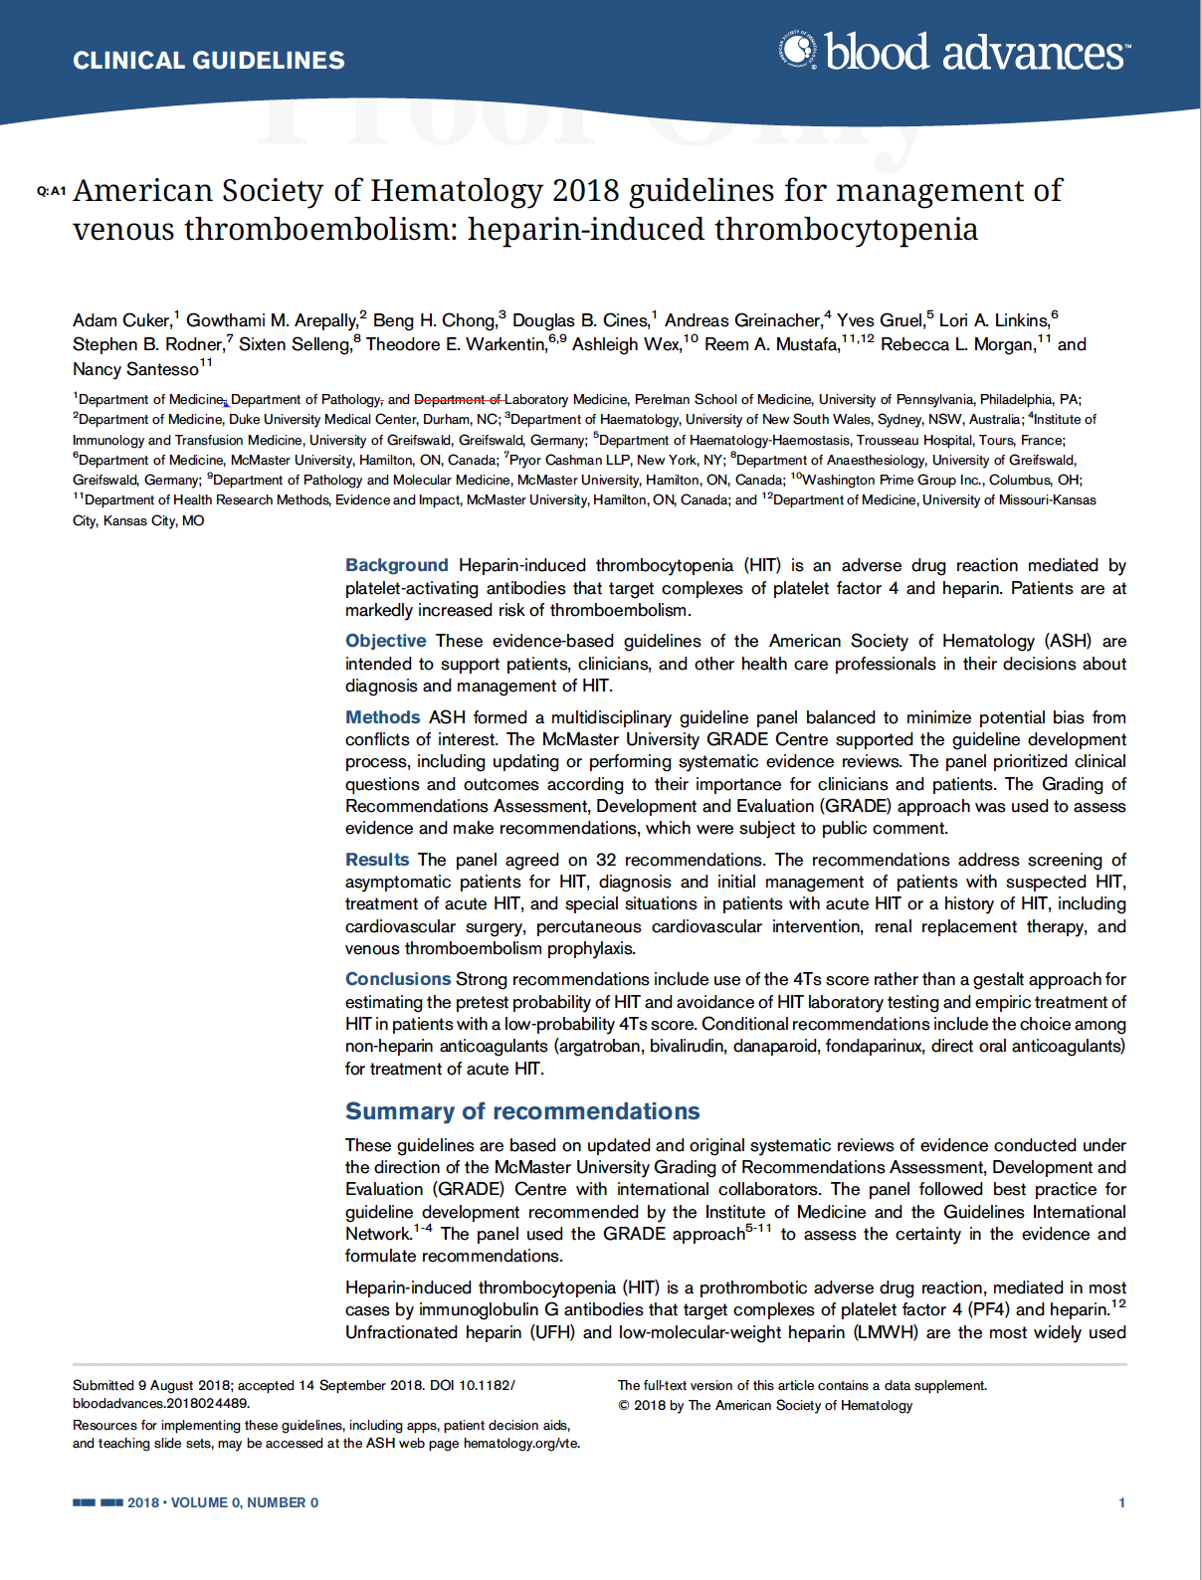
Clinical Guidelines
American Society of Hematology 2018 guidelines for management of venous thromboembolism: heparin-induced thrombocytopenia
Adam Cuker, Gowthami M. Arepally, Beng H. Chong, Douglas B. Cines, Andreas Greinacher, Yves Gruel, Lori A. Linkins, Stephen B. Rodner, Sixten Selleng, Theodore E. Warkentin, Ashleigh Wex, Reem A. Mustafa, Rebecca L. Morgan, and Nancy Santesso

Slide 3
ASH Clinical Practice Guidelines on VTE
Prevention of VTE in Surgical Hospitalized Patients
Prevention of VTE in Medical Hospitalized Patients
Treatment of Acute VTE (DVT and PE)
Optimal Management of Anticoagulation Therapy
Prevention and Treatment of VTE in Patients with Cancer
Heparin-Induced Thrombocytopenia (HIT)
Thrombophilia
Pediatric VTE
VTE in the Context of Pregnancy
Diagnosis of VTE

Slide 4
How were these ASH guidelines developed?
PANEL FORMATION
Each guideline panel was formed following these key criteria:
Balance of expertise (including disciplines beyond hematology, and patients)
Close attention to minimization and management of conflicts of interest
CLINICAL QUESTIONS
10 to 20 clinically-relevant questions generated in PICO format (population, intervention, comparison, outcome)
EVIDENCE SYNTHESIS
Evidence summary generated for each PICO question via systematic review of health effects plus:
Resource use
Feasibility
Acceptability
Equity
Patient values and preferences
MAKING RECOMMENDATIONS
Recommendations made by guideline panel members based on evidence for all factors.
Example: PICO question
“In patients with suspected HIT and an intermediate probability 4Ts score, should non-heparin anticoagulants be provided at therapeutic or prophylactic intensity?”

Slide 5
How patients and clinicians should use these recommendations
 | STRONG Recommendation (“The panel recommends…”) | CONDITIONAL Recommendation (“The panel suggests…”)
For patients | Most individuals would want the intervention. | A majority would want the intervention, but many would not.
For clinicians | Most individuals should receive the intervention. | Different choices will be appropriate for different patients, depending on their values and preferences. Use shared decision making.

Slide 6
Objectives
By the end of this module, you should be able to
Describe a diagnostic algorithm for patients with suspected heparin-induced thrombocytopenia (HIT)
Compare non-heparin anticoagulants for the treatment of acute HIT
Describe recommendations for managing anticoagulation for cardiac surgery in patients with a previous history of HIT

Slide 7
HIT is a profoundly hypercoagulable state
HIT is an iatrogenic disorder usually mediated by IgG antibodies that bind PF4-heparin complexes
These antibodies cause a hypercoagulable state by activating platelets and procoagulant microparticles
One-third to one-half of patients with HIT develop venous, arterial, or microvascular thrombosis
Unfractionated heparin (UFH) associated with 10-fold increase in risk of HIT compared with LMWH
Notes:
NOTES:
12 million inpatients in US exposed to heparin annually
Incidence of HIT ranges from <0.1% to 7% depending on type of heparin, duration of exposure, patient population
Untreated HIT carries 5% to 10% daily risk of thrombosis, amputation, or death

Slide 8
Case 1: Medical Inpatient Admission
82 year old male
Past Medical History: Diabetes, hypertension, congestive heart failure
Medications: Metformin, ramipril, aspirin, furosemide
Admitted to: Internal Medicine ward with exacerbation of congestive heart failure, secondary to poor compliance with diet and diuretics
Treated with:
Intravenous furosemide, nitroglycerin patch
Subcutaneous unfractionated heparin (UFH) 5,000 IU Q12H started on admission date for DVT prophylaxis

Slide 9
Case 1: Medical Inpatient Admission
Bloodwork: Day 0 is admission date
No fever, no other new medications. Normal blood pressure and heart rate. No signs or symptoms of venous thromboembolism.
No bleeding or bruising
No exposure to heparin in the 3 months prior to this admission
Date
Platelets (x 10⁹)
Day 0
200
+1
220
+2
206
+3
210
+4
220
+5
230
+6
150
+7
67

Slide 10
Considering your patient’s progressive thrombocytopenia and heparin exposure, you are concerned about the possibility of HIT.
Which of the following most accurately describes his clinical probability of HIT?
Probably low probability, given overall clinical context
Probably high probability, given overall clinical context
Low probability, based on 4Ts score
Intermediate probability, based on 4Ts score
High probability, based on 4Ts score

Slide 11
Recommendation
In patients with suspected HIT, the panel recommends using the 4Ts score to estimate the probability of HIT rather than a gestalt approach (strong recommendation, moderate certainty)
Remarks:
Missing or inaccurate information may lead to a faulty 4Ts score and inappropriate management
Every effort should be made to obtain accurate and complete information necessary to calculate the 4Ts score. If key information is missing it may be prudent to err on the side of a higher 4Ts score.
Reassess frequently. If there is a change in clinical picture, the 4Ts score should be recalculated.
Notes:
Recommendation 2.1
NOTES:
The recommendation encompasses an entire diagnostic algorithm that incorporates standardized clinical probability model (4Ts score), immunoassay, and functional testing
Link to Evidence-to-Decision framework: https://dbep.gradepro.org/profile/883a6eac-0bee-42b7-a788-f5998a4191d7

Slide 12
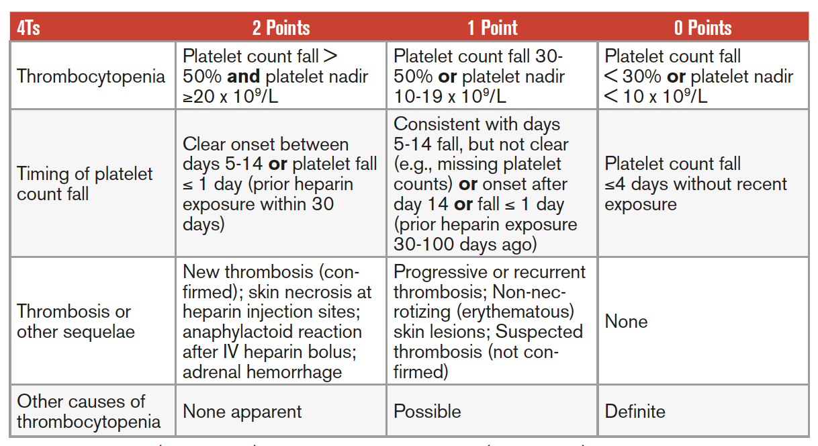
The 4Ts Score: Clinical Probability Model
Our patient:
Platelets 67, > 50% drop.
Onset of drop on day +6.
No thrombosis.
No other cause for thrombocytopenia.
HIGH probability: 6-8 points
INTERMEDIATE probability: 4-5 points
LOW probability: ≤ 3 points
Lo J Thromb Haemost 2006
ASH 2009 Clinical Guide

Slide 13
Your patient’s 4Ts score indicates a high clinical probability for HIT.
What diagnostic tests would you recommend at this point to confirm or exclude a diagnosis of HIT?
None; patient is high probability and diagnosis is confirmed
Immunoassay only (ex. HIT PF4/heparin ELISA)
Functional test only (ex. serotonin release assay)
Immunoassay, and if positive then perform functional test

Slide 14
Laboratory Diagnostic Testing for HIT
HIT Immunoassay Tests Detect the presence of anti-PF4/heparin antibodies | Functional HIT Assays Assays that detect antibodies capable of binding and activating platelets
ELISA (detect IgG) ELISA (detect polyspecific antibodies) IgG-specific chemiluminescent assay Particle gel immunoassay (PaGIA) Latex agglutination assay | Serotonin release assay (SRA) Heparin-induced platelet activation test (HIPA) Platelet aggregation test (PAT) Flow cytometry-based assays
Notes:
NOTES:
Functional assays are technically more challenging and not routinely performed at most medical centres
Different immunoassays and functional assays are available. The choice of assay may be influenced by diagnostic accuracy, availability, cost, feasibility, and turnaround time

Slide 15
Recommendation
If there is an intermediate- or high-probability 4Ts score, the panel recommends an immunoassay (strong recommendation, moderate certainty)
If the immunoassay is positive and a functional assay is available (locally or as a send-out test to a reference laboratory), the panel suggests a functional assay (conditional recommendation, moderate certainty)
Remark:
Likelihood of HIT increases with a higher 4Ts score and a higher ELISA OD (Optical Density)
Notes:
Recommendation 2.1
NOTES:
The recommendation encompasses an entire diagnostic algorithm that incorporates standardized clinical probability model (4Ts score), immunoassay, and functional testing
Link to Evidence-to-Decision framework: https://dbep.gradepro.org/profile/883a6eac-0bee-42b7-a788-f5998a4191d7

Slide 16
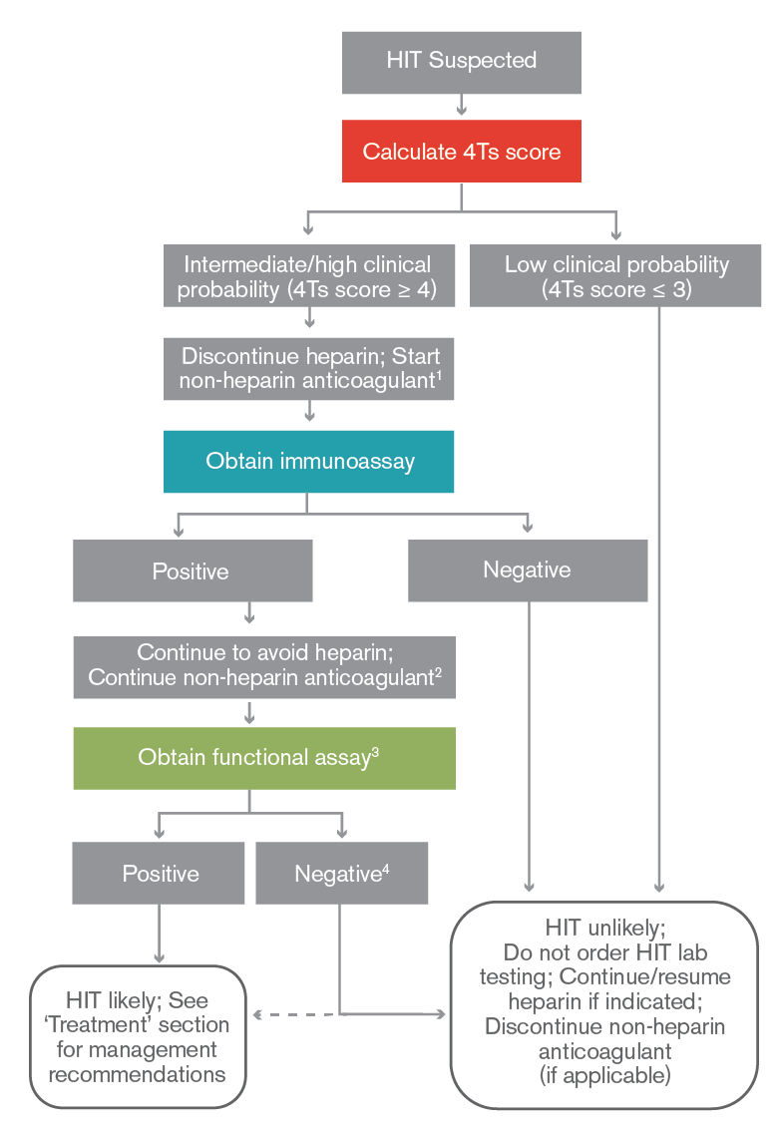
A diagnostic algorithm of intermediate/high 4Ts score, followed by immunoassay, followed by functional testing results in:
Few false negatives (missed HIT diagnoses), and
Few or no false positives (incorrect diagnoses of HIT)
A functional assay may not be necessary for patients with high probability 4Ts score and very strongly positive immunoassay (ELISA value of > 2.0 OD units)
Notes:
Recommendation 2.1
NOTES:
In the ASH guidelines, this diagnostic algorithm was tested based on expected population prevalence of HIT in patients with suspected HIT (11%)
It was compared with other diagnostic algorithms, and found to optimize the number of false negatives and false positives
If one applies this diagnostic algorithm to 1000 patients, would see
100 correct HIT diagnosis (true positive)
890 correctly identified as not having HIT (true negative)
10 missed diagnoses of HIT (false negatives)
0 incorrect diagnoses of HIT (false positives)
Link to Evidence-to-Decision framework: https://dbep.gradepro.org/profile/883a6eac-0bee-42b7-a788-f5998a4191d7

Slide 17
Your patient’s 4Ts score indicates high probability for HIT, and you have sent off the HIT ELISA (result is pending). Currently, your patient is receiving subcutaneous UFH 5,000 units twice daily.
What management strategy would you recommend while awaiting the HIT ELISA test results?
Continue heparin as the diagnosis of HIT is not confirmed
Stop heparin, wait for ELISA result
Stop heparin, start non-heparin anticoagulant at prophylactic intensity
Stop heparin, start non-heparin anticoagulant at therapeutic intensity
Stop heparin, transfuse platelets

Slide 18
Recommendation
In patients with suspected HIT and HIGH PROBABILITY 4Ts score:
The panel recommends discontinuation of heparin and initiation of a non-heparin anticoagulant at therapeutic intensity (strong recommendation, moderate certainty)
In patients with suspected HIT and INTERMEDIATE PROBABILITY 4Ts score:
The panel recommends discontinuation of heparin (strong recommendation, moderate certainty)
The panel suggests initiation of non-heparin anticoagulant at prophylactic intensity if patient is at high bleeding risk, therapeutic intensity if patient not at high bleeding risk
In patients with INTERMEDIATE-risk 4Ts score who have high bleeding risk, there could be greater harm with therapeutic-intensity treatment (bleeding) with less potential benefit, because fewer such patients will have HIT
Notes:
Recommendation 2.4, 2.5, 2.6
Links to Evidence-to-Decision frameworks: https://dbep.gradepro.org/profile/15d951fb-5481-492e-9518-bd44091b4198

Slide 19
Therapeutic versus Prophylactic Intensity
Non-heparin anticoagulant at therapeutic intensity is recommended over prophylactic intensity based on very low certainty of evidence
3 small studies comparing therapeutic versus prophylactic anticoagulation with Danaparoid, Lepirudin, or Fondaparinux
Danaparoid showed 50% reduction in thrombosis with therapeutic dosing
No difference in outcomes with Lepirudin and Fondaprainux
However, strong recommendation based on likely large magnitude of benefit (prevention of thrombosis)
Schindewolf Thromb Res 2012
Greinacher A Circulation 1999
Farner Thromb Haemost 2001
Notes:
Recommendation 3.2
Link to Evidence-to-Decision framework: https://dbep.gradepro.org/profile/D1230F84-C07C-BBF8-9214-2AB5D71750A3

Slide 20
Recommendation
In patients with HIT who are at average bleeding risk, the panel suggests against routine platelet transfusion (conditional recommendation, low certainty)
Remark:
Platelet transfusion may be an option for patients with active bleeding or at high bleeding risk
Low certainty for beneficial or adverse effects of platelet transfusions in HIT
Mixed results from observational studies
One large database study (n = 6,332) suggested increase in arterial thrombotic events (adjusted odds ratio 3.4, 95% CI 1.2 to 9.5); other small cohort studies suggest no difference
Goel Blood 2015
Refaai J Thromb Haemost 2010
Notes:
Recommendation 3.6
Link to Evidence-to-Decision framework: https://dbep.gradepro.org/profile/0B5351AD-4CFF-7A8F-8E7E-F9B9307A1441

Slide 21
Case 1: HIT Laboratory Test Results
Your HIT immunoassay (ELISA) results are reported back that afternoon as optical density (OD) = 1.8 (NORMAL OD is < 0.4 at your lab).
You ask your lab to send a sample to your local reference lab for a confirmatory functional assay (serotonin release assay).
Your patient continues to be clinically stable with no symptoms or signs of pulmonary embolism, deep vein thrombosis, or arterial thrombosis.

Slide 22
Your patient has acute isolated HIT (without thrombosis), and platelet count is currently 67.
Which of the following non-heparin anticoagulants would NOT be appropriate at this point?
Argatroban
Warfarin (vitamin K antagonist)
Rivaroxaban
Fondaparinux
Danaparoid

Slide 23
Recommendation
In patients with acute HITT or acute isolated HIT, the panel recommends against initiation of a VKA prior to platelet count recovery (platelets ≥ 150 x 10⁹/L) (strong recommendation, moderate certainty)
Remarks:
Also applies to those taking VKA at onset of acute HITT or acute isolated HIT
In these patients, VKA would be discontinued and intravenous Vitamin K administered concomitant with initiation of a non-heparin anticoagulant
In case series, early initiation of VKA associated: | Warfarin-induced skin necrosis | Venous limb gangrene | Recurrent thrombosis | Limb amputation
Notes:
Recommendation 3.5
NOTES:
Platelet count recovery occurs within 7 days in 90% of cases, though it may take weeks in a minority of patients
Initiation of VKA prior to platelet count recovery is associated with trivial benefit and large harm
Link to Evidence-to-Decision framework: https://dbep.gradepro.org/profile/2EDAF7FC-665F-302A-97CA-ED3B70A9A133

Slide 24
Recommendation
In patients with acute HIT complicated by thrombosis (HITT) or acute HIT without thrombosis (isolated HIT), the panel recommends discontinuation of heparin and initiation of a non-heparin anticoagulant (strong recommendation, moderate certainty)
The panel suggests argatroban, bivalirudin, danaparoid, fondaparinux or a direct oral anticoagulant (DOAC)
Notes:
Recommendation 3.1
Link to Evidence-to-Decision Frameworks:
https://dbep.gradepro.org/profile/86423A6B-5963-B7EC-ABE9-EC0124002ED0
and
https://dbep.gradepro.org/profile/5CBFE061-894E-B073-A792-28DC54FA7F25

Slide 25
Rationale for Anticoagulant Selection
Using a non-heparin anticoagulant (compared with stopping heparin +/- starting VKA) associated with:
Fewer thrombotic events
BUT probably increase in risk of major bleeding
No direct comparisons of DOACs vs. parenteral anticoagulants in HIT
Small numbers of patients treated with DOACs in case series
Few thrombotic events (rivaroxaban 1/46, apixaban 0/12, dabigatran 1/11)
Benefits and harms of DOACs compare favorably to parenteral agents
Notes:
Recommendation 3.1
NOTES:
The benefits of discontinuing heparin and starting a non-heparin anticoagulant (compared to discontinuing heparin alone or discontinuing heparin and starting VKA) may result in large reductions in death and thrombotic events; however, harms (such as major bleeding) may be moderate.
Harms (such as major bleeding) may be greater in critically ill patients and patients with certain comorbidities.
The benefits and harms of the effects of DOACs compare favorably to those associated with the use of parenteral non-heparin anticoagulants
The oral medications are probably acceptable to patients and may become increasingly acceptable to clinicians as the evidence base and experience grow.
Link to Evidence-to-Decision Frameworks:
https://dbep.gradepro.org/profile/86423A6B-5963-B7EC-ABE9-EC0124002ED0
and
https://dbep.gradepro.org/profile/5CBFE061-894E-B073-A792-28DC54FA7F25

Slide 26
Rationale for Anticoagulant Selection
Clinical Context | Implications for Anticoagulant Selection
Critical illness Increased bleeding risk Possible urgent procedures | Argatroban or Bivalirudin (shorter duration of effect) If moderate or severe hepatic dysfunction (Childs-Pugh B or C), may be advisable to avoid argatroban or use a reduced dose
Life- or limb-threatening VTE (massive PE or venous limb gangrene) | Parenteral non-heparin anticoagulant preferred (Argatroban, Bivalirudin, Danaparoid, Fondaparinux) Few such patients treated with DOACs
Clinically stable patients at average bleeding risk | Fondaparinux or DOACs reasonable Most published DOAC experience with Rivaroxaban

Slide 27
Anticoagulant (mechanism, route) | Dosing | Clearance & Monitoring
Argatroban (direct thrombin inhibitor) IV | Bolus: None Infusion: STANDARD (2 mcg/kg/min), REDUCED DOSE for liver dysfunction, CHF, post-cardiac surgery (0.5-1.2 mcg/kg/min) | Hepatobiliary clearance Adjusted to aPTT 1.5-3.0 times baseline
Bivalirudin (direct thrombin inhibitor) IV | Bolus: None Infusion: STANDARD (0.15 mg/kg/hr); consider REDUCED DOSE for renal or liver dysfunction | Enzymatic clearance Adjusted to aPTT 1.5-2.5 times baseline
Danaparoid (indirect Xa inhibitor) IV | Bolus: Weight-based (1500-3750 units) Infusion: INITIAL ACCELERATED (400 units/hr x 4 hr, then 300 units/hr x 4 hr), then MAINTENANCE (150-200 units/hr) | Renal clearance Adjusted to anti-Xa activity 0.5-0.8 units/mL
Fondaparinux (indirect Xa inhibitor) SC | < 50 kg → 5 kg daily 50-100 kg → 7.5 mg daily > 100 kg → 10 mg daily | Renal clearance No monitoring
Rivaroxaban (direct Xa inhibitor) PO | HITT: 15 mg twice daily x 3 weeks, then 20 mg daily Isolated HIT: 15 mg twice daily until platelet count recovery (≥ 150) | Renal clearance No monitoring
Notes:
NOTES:
Danaparoid bolus dosing:
<60 kg, 1,500 units
60–75 kg, 2,250 units
75–90 kg, 3,000 units
>90 kg, 3,750 units
Various dosing regimens for the DOACs, including Rivaroxaban, have been reported

Slide 28
Case 1: Treatment
You decide to start your patient on rivaroxaban 15 mg PO BID and discontinue subcutaneous UFH.
Over the next 8 days, your patient’s platelet count gradually rises from 67 to 165, and there is no evidence of bleeding.

Slide 29
Your patient has no symptoms of deep vein thrombosis or pulmonary embolism.
Which of the following tests would you suggest to screen for asymptomatic VTE?
There are no symptoms, so imaging is not indicated
Bilateral upper extremity compression ultrasound (US)
Bilateral lower extremity compression ultrasound (US)
CT pulmonary angiogram
Choices C & D

Slide 30
Recommendation
In patients with acute isolated HIT, the panel suggests:
Bilateral lower extremity compression US to screen for asymptomatic proximal DVT (conditional recommendation, very low certainty)
Upper-extremity US in patients with an upper extremity central venous catheter, in the limb with the catheter, to screen for asymptomatic DVT (conditional recommendation, very low certainty)
Ultrasound studies have identified silent lower extremity DVT in 12-44% of asymptomatic patients with HIT
Notes:
Recommendation 3.7
NOTES:
There may be benefits of screening for silent DVTs when the findings would change clinical practice; however, this is uncertain. Ultrasound studies identified silent lower extremity DVT in 12-44% of asymptomatic HIT patients
While no study reported on the prevalence of silent upper extremity DVT among persons with HIT, symptomatic upper extremity DVT is common in HIT patients with a CVC (14/145) and uncommon in those without a CVC (0/115)(65). The panel agreed that there may be benefit to screening patients with CVC for upper extremity DVT in the limb where the CVC has been placed due to the high baseline prevalence of CVC-associated upper extremity DVT and the moderate risk of PE associated with upper extremity DVT.
Link to Evidence-to-Decision framework: https://dbep.gradepro.org/profile/52FE6F09-0233-F65B-BA7A-5ADB96E1007D

Slide 31
Case 1: HITT
He is found to have an occlusive left popliteal vein DVT. He continues rivaroxaban 15 mg BID for 3 weeks, then takes rivaroxaban 20 mg daily for a total of 3 months.
At 3 months, his platelet count is normal (205 x 10⁹/L) and he is at his baseline health status. You ask him to stop rivaroxaban.
15 months later, he returns to hospital with CHF again and is found to have severe aortic stenosis, with an aortic valve area of 0.6 cm². He requires a valve replacement.

Slide 32
Your patient with a history of HITT requires open heart surgery, with intraoperative anticoagulation while on pump. His platelet count is normal. You repeat his HIT ELISA and OD is 0.2 (NORMAL < 0.4).
What would you suggest that your patient receive for intraoperative anticoagulation?
Preoperative plasma exchange and intraoperative heparin
Intraoperative heparin only
Intraoperative heparin with an antiplatelet agent
Intraoperative bivalirudin only
Intraoperative bivalirudin with an antiplatelet agent

Slide 33
Five Phases of HIT
Phase | Platelet count | Immunoassay | Functional assay
Suspected HIT | Decreased | ? | ?
Acute HIT | Decreased | + | +
Subacute HIT A | Normal | + | +
Subacute HIT B | Normal | + | –
Remote HIT | Normal | – | –
Notes:
NOTES:
Patients with suspected HIT are those who are thought to have HIT on clinical grounds but for whom confirmatory laboratory test results are not yet available.
Once the diagnosis is confirmed, the patient is labeled as having acute HIT, a highly prothrombotic phase which persists until platelet count recovery.
Subacute HIT A is the phase following platelet count recovery but before the functional assay becomes negative.
Subacute HIT B is the interval after the functional assay becomes negative but before the immunoassay becomes negative.
Finally, once anti-PF4/heparin antibodies are no longer detectable by immunoassay, the patient is said to have remote HIT.

Slide 34
Recommendation
In patients with subacute HIT B or remote HIT who require cardiovascular surgery, the panel suggests intraoperative anticoagulation with heparin rather than treatment with a non-heparin anticoagulant, plasma exchange and heparin, or heparin combined with antiplatelet agent (conditional recommendation, very low certainty)
Remarks:
Treatment with heparin would be limited to the intraoperative setting, and avoided before and after surgery
Postoperative platelet count monitoring for HIT may be necessary, even when postoperative heparin is not given, because “delayed-onset (autoimmune) HIT” beginning 5 to 10 days after intraoperative heparin exposure has been reported
Notes:
Recommendation 4.2
Link to Evidence-to-Decision framework: https://dbep.gradepro.org/profile/DA1DC8AA-C703-3D20-8DEC-32208503CEED

Slide 35
Case 2: Medical Inpatient Admission
82 year old male
Past Medical History: Diabetes, hypertension, congestive heart failure
Medications: Metformin, ramipril, aspirin, furosemide
Admitted to: Internal Medicine ward with exacerbation of congestive heart failure, secondary to poor compliance with diet and diuretics
Treated with:
Intravenous furosemide, nitroglycerin patch
Subcutaneous unfractionated heparin (UFH) 5,000 IU Q12H started on admission date for DVT prophylaxis

Slide 36
Case 2: Medical Inpatient Admission
Bloodwork: Day 0 is admission date
No fever, no other new medications. Normal blood pressure and heart rate. No signs or symptoms of venous thromboembolism
No bruising or bleeding
No exposures to heparin in the 3 months prior to this admission
Date
Platelets (x 10⁹)
Day 0
200
+1
220
+2
206
+3
145
+4
140
+5
145
+6
130
+7
125

Slide 37
Considering your patient’s progressive thrombocytopenia and heparin exposure, you are concerned about the possibility of HIT.
Which of the following most accurately describes his clinical probability of HIT?
Probably low probability, given overall clinical context
Probably high probability, given overall clinical context
Low probability, based on 4Ts score
Intermediate probability, based on 4Ts score
High probability, based on 4Ts score

Slide 38
The 4Ts Score: Clinical Probability Model
Our patient:
Platelets 125, 30-50% drop
Drop at Day +2
No thrombosis
No other cause for thrombocytopenia
HIGH probability: 6-8 points
INTERMEDIATE probability: 4-5 points
LOW probability: ≤ 3 points
Lo J Thromb Haemost 2006
ASH 2009 Clinical Guide

Slide 39
Your patient’s 4Ts score (3) indicates a low clinical probability for HIT.
What diagnostic tests would you recommend at this point to confirm or exclude a diagnosis of HIT?
None; patient is low probability and HIT is highly unlikely
Immunoassay only (ex. HIT PF4/heparin ELISA)
Functional test only (ex. serotonin release assay)
Immunoassay, and if positive then perform functional test

Slide 40
Recommendation
In patients with suspected HIT and low probability 4Ts score, the panel recommends against HIT laboratory testing (strong recommendation, moderate certainty)
Remark:
HIT laboratory testing may be appropriate for patients with a low probability 4Ts score if there is uncertainty about the 4Ts score (for example, due to missing data)
Notes:
Recommendation 2.2
NOTES:
The recommendation encompasses an entire diagnostic algorithm that incorporates standardized clinical probability model (4Ts score), immunoassay, and functional testing
Link to Evidence-to-Decision framework: https://dbep.gradepro.org/profile/883a6eac-0bee-42b7-a788-f5998a4191d7

Slide 41
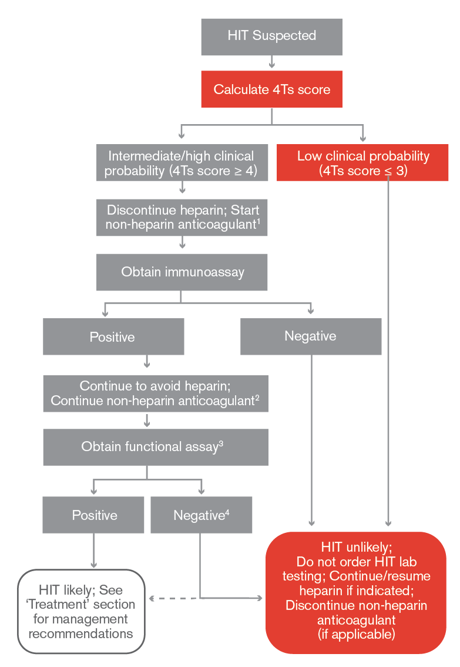
Notes:
Recommendation 2.1
In the ASH guidelines, this diagnostic algorithm was tested based on expected population prevalence of HIT in patients with suspected HIT (11%)
It was compared with other diagnostic algorithms, and found to optimize the number of false negatives and false positives
If one applies this diagnostic algorithm to 1000 patients, would see
100 correct HIT diagnosis (true positive)
890 correctly identified as not having HIT (true negative)
10 missed diagnoses of HIT (false negatives)
0 incorrect diagnoses of HIT (false positives)
Link to Evidence-to-Decision framework: https://dbep.gradepro.org/profile/883a6eac-0bee-42b7-a788-f5998a4191d7

Slide 42
Case 2: Resolution
Given his low clinical probability, you elect not to send his HIT ELISA assay or functional assay. He continues to receive SC heparin.
With treatment for CHF, his thrombocytopenia improves. He is discharged with a follow-up outpatient CBC to ensure resolution of thrombocytopenia
Date
Platelets (x 10⁹)
Day 0
200
+1
220
+2
206
+3
145
+4
140
+5
145
+6
130
+7
125
Date
Platelets (x 10⁹)
+8
145
+9
160
+20
165

Slide 43
Additional Topics in these Guidelines
Platelet count monitoring in patients receiving heparin
Prophylactic IVC filter insertion in the setting of acute HIT
Duration of non-heparin anticoagulant therapy in acute isolated HIT
Anticoagulant management for percutaneous coronary intervention in patients with acute HIT or previous history of HIT
Anticoagulant therapy for HIT in renal replacement therapy

Slide 44
Areas of Future Investigation
Development of novel HIT immunoassays and functional assays
Outcomes from treatment of acute HIT with DOACs
Comparisons of DOACs and parenteral non-heparin anticoagulants
Role of concomitant antiplatelet and anticoagulant therapy in HIT
Impact of screening for asymptomatic DVT in acute isolated HIT
Optimal duration of anticoagulation in acute isolated HIT
Intraoperative anticoagulant management for cardiovascular surgery

Slide 45
In Summary: Back to our Objectives
Describe a diagnostic algorithm for patients with suspected heparin-induced thrombocytopenia (HIT)
4Ts score, immunoassay, functional assay
Compare non-heparin anticoagulants for treatment of acute HIT
DOACs or parenteral options (Argatroban, Fondaparinux, Danaparoid, Bivalirudin)
Describe recommendations for managing anticoagulation for cardiac surgery in patients with a previous history of HIT
Determination of HIT clinical status with ELISA and/or functional assay helps to determine intraoperative anticoagulation plan

Slide 46
Acknowledgements
ASH Guideline Panel team members
Knowledge Synthesis team members
McMaster University GRADE Centre
Author of ASH VTE Slide Sets: Eric Tseng MD MScCH, University of Toronto and Adam Cuker MD MS, University of Pennsylvania
See more about the ASH VTE guidelines at http://www.hematology.org/VTEguidelines
Don’t miss our updated HIT Pocket Guide!

