Slide 1
Managing Acute and Chronic Pain
An Educational Slide Set
American Society of Hematology 2020 Guidelines for Management of Venous Thromboembolism
Slide set authors:
Ahmar U. Zaidi, MD, Children’s Hospital Of Michigan
Amanda M. Brandow, DO, MS Medical College Of Wisconsin

Slide 2
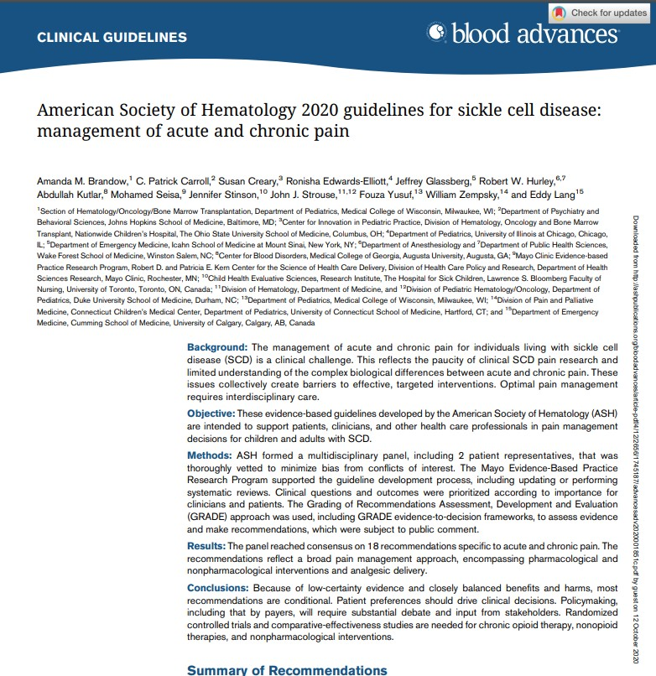
Clinical Guidelines
American Society of Hematology 2020 guidelines for sickle cell disease: management of acute and chronic pain
Amanda M. Brandow, C. Patrick Carroll, Susan Creary, Ronisha Edwards-Elliott, Jeffrey Glassberg, Robert W. Hurley, Abdullah Kutlar, Mohamed Seisa, Jennifer Stinson, John J. Strouse, Fouza Yusuf, William Zempsky, and Eddy Lang
https://doi.org/10.1182/bloodadvances.2020001851

Slide 3
ASH Clinical Practice Guidelines on SCD
Cardiopulmonary and Kidney Disease
Transfusion Support
Cerebrovascular Disease
Acute and Chronic Pain
Stem Cell Transplantation

Slide 4
How were these ASH guidelines developed?
PANEL FORMATION
Each guideline panel was formed following these key criteria:
Balance of expertise (including disciplines beyond hematology, and patients)
Close attention to minimization and management of conflicts of interest
CLINICAL QUESTIONS
10 clinically-relevant questions generated in PICO format (population, intervention, comparison, outcome)
EVIDENCE SYNTHESIS
Evidence summary generated for each PICO question via systematic review of health effects plus:
Resource use
Feasibility
Acceptability
Equity
Patient values and preferences
MAKING
RECOMMENDATIONS
Recommendations made by guideline panel members based on evidence for all factors.
Example: PICO question “Should automated red cell exchange vs simple transfusion or manual red cell exchange be used for patients with SCD receiving chronic transfusions?”
ASH guidelines are reviewed annually by expert work groups convened by ASH. Resources, such as this slide set, derived from guidelines that require updating are removed from the ASH website.

Slide 5
How to use these recommendations
 | STRONG Recommendation (“The panel recommends…”) | CONDITIONAL Recommendation (“The panel suggests…”)
For patients | Most individuals would want the intervention. | A majority would want the intervention, but many would not.
For clinicians | Most individuals should receive the intervention. | Different choices will be appropriate for different patients, depending on their values and preferences. Use shared decision making.

Slide 6
Good Practice Statements
It is good practice to provide patient-centered education and surveillance related to NSAID toxicity, especially in patients with end-organ comorbidities, because long- term safety data are lacking for SCD, but vascular, bleeding, and renal risks may be elevated.
Given the prevalence of psychological comorbidities that are present in the context of pain, it is good practice to routinely screen for depression and anxiety and to perform targeted screening for other psychological comorbidities.

Slide 7
Objectives
To understand non-opioid pharmacologic therapy for acute pain and non-opioid pharmacological therapies either in addition to or instead of opioids or other usual care interventions for the treatment of acute pain in children and adults with SCD.
To understand non-pharmacologic therapies for acute pain and if nonpharmacological therapies in addition to pharmacological therapies should be used for the treatment of acute pain in children and adults with SCD.
To understand non-opioid pharmacologic therapy for chronic pain and if non-opioid pharmacological therapy should be used for children and adults with SCD and chronic pain with no identifiable cause beyond SCD.
To understand non-pharmacologic therapy for chronic pain and if nonpharmacological therapies be used in addition to pharmacological therapies be used for the treatment of chronic pain in children and adults with SCD.

Slide 8
BACKGROUND

Slide 9
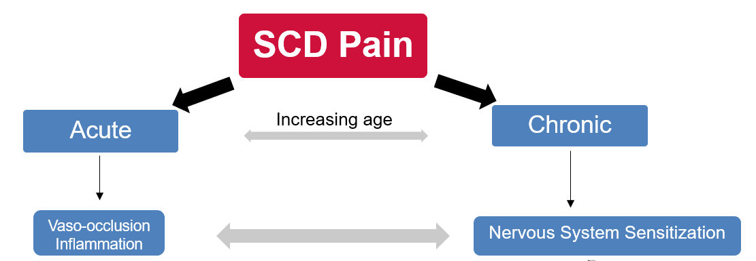
Abnormalities in peripheral nerves, brain and spinal cord initiate, transmit and sustain pain signals resulting in complex, pathological pain

Slide 10
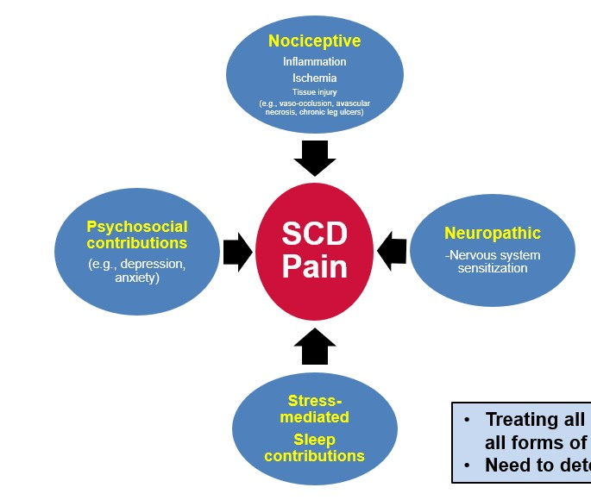
Treating all pain the same is like treating all forms of anemia with same approach
Need to determine etiology of pain

Slide 11
negative provider attitudes
stigma
environmental stressors
traumatic life events
disparities in care
Sociological
hematological factors
inflammation
nervous system sensitization
chronic organ damage
Biological
Acute and Chronic Pain
depression
anxiety
learned helplessness
sleep disorders
Psychological
adapted from Brandow AM, DeBaun MR. Hematol Oncol Clin North Am. 2018

Slide 12
Hematologist and
Primary Care Provider

Slide 13
Clinical scope of guideline panel questions
Acute Pain (5 questions)
Delivery of analgesia (location and protocol)
Role of non-opioid pharmacologic therapy
Role of non-pharmacologic therapy
Chronic Pain (5 questions)
Role of non-opioid pharmacologic therapy
Role of non-pharmacologic therapy
Using chronic opioid therapy
Using chronic transfusion therapy

Slide 14
SCD Pain Guidelines Timeline
Panel met in person second time to draft recs November 2018
Panel met in person to draft PICO
questions June 2017
Panel met in person to develop draft recs April 2018
Guidelines published in Blood Advances June 2020
Chair and Co-chair appointed Aug 2016
All public Comments reviewed
All panelists appointed March 2017
Methods
team conducted literature searches July 2017-March 2018
Methods team conducted additional literature searches
Public comment period April through May 2019
Final recs
approved by Guideline Oversight Committee and ASH Executive Committee February 2020

Slide 15
Composition of Panel
Hematology
Pain medicine
Nursing
Psychology/psychiatry
Emergency medicine
Patient and parent of young adult with SCD
Methodologist (GRADE working group)
*Pediatric and adult providers

Slide 16
Data sources
Direct evidence
Minimal available
Indirect evidence
Pain conditions other than SCD
Enrich evidence on which to base guidelines
Mayo Clinic Evidence Based Practice Research Center
Conducted and assimilated systematic evidence reviews

Slide 17
Indirect evidence
Consensus reached via independent online survey and panel discussion about:
Questions to be addressed by indirect evidence
Pain conditions that most closely parallel acute and chronic SCD pain
Based on similarities to the biology or experience of individuals with SCD
Searched for systematic reviews/meta-analyses
Must include ≥5 studies
Single studies not used
Evidence downgraded as per GRADE for population indirectness

Slide 18
Major Challenges in Guideline Development
Lack of direct evidence
Minimal (if any) high quality evidence
Lack of randomized-controlled trials
Harnessing indirect data
Differentiating acute and chronic pain in literature
Pediatric and adult data not always available in parallel

Slide 19
Overview of pain guielines
SCD Pain
Acute Pain
Chronic Pain
-Identifiable cause
-Non-identifiable cause beyond SCD
Analgesic delivery (location/protocol) (3)
Non-opioid pharmacologic therapy (4)*
Non-opioid pharmacologic therapy (5)*
Chronic opioid
therapy (3)
Chronic transfusion therapy (1)
Non-pharmacologic therapy (1)
Non-pharmacologic therapy (2)*
Chronic transfusion therapy (NR)
*Recommendations that utilized indirect evidence; NR: No Recommendation

Slide 20
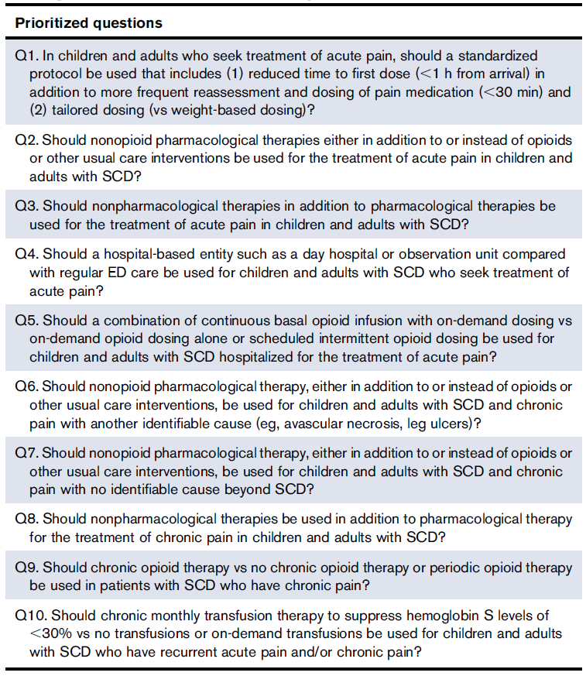
Selected Guidelines
in this Presentation
non-opioid pharmacologic therapy for acute pain
non-pharmacologic therapy for acute pain
non-opioid pharmacologic therapy for chronic pain
non-pharmacologic therapies for chronic pain
chronic opioid therapy for chronic pain

Slide 21
NON-OPIOID PHARMACOLOGIC
THERAPY FOR ACUTE PAIN

Slide 22
Should non-opioid pharmacological therapies either in addition to or instead of opioids or other usual care interventions be used for the treatment of acute pain in children and adults with SCD?

Slide 23
Opioids have been the mainstay for the treatment of acute pain related to SCD
Some patients do not respond to opioid therapy alone
– the tenets of appropriate management of acute pain include multimodal analgesia
Pathways to reduce the opioid burden would provide nonopioid analgesics to treat acute pain with the goal of reducing the total dose and duration of exposure while maintaining or improving analgesia
There has been a greater understanding of the complex nature of pain in SCD such that better definitions of acute pain, chronic pain, and acute-on-chronic pain have emerged

Slide 24
Non-opioid pharmacologic interventions
for acute pain refractory to opioids
Recommendation 2c. For adults and children presenting with acute pain related to SCD who are hospitalized, the ASH guideline panel suggests a sub-anesthetic (analgesic) ketamine infusion as adjunctive treatment for pain that is refractory or not effectively treated with opioids alone (conditional recommendation based on very low certainty in the evidence about effects ⨁◯◯◯).
Remarks:
This recommendation assumes safe administration of sub-anesthetic ketamine infusions in the hospital inpatient unit in centers that have appropriate expertise to administer the drug.
Recommended dose for sub-anesthetic (analgesic) infusion for acute exacerbation of SCD pain starts at 0.1 to 0.3 mg/kg/h with a maximum of 1 mg/kg/h.
Currently, there is no standardized, widely accepted definition for the word “refractory”; thus, whether pain is considered refractory is determined at the clinician’s discretion.

Slide 25
Subanesthetic ketamine for treatment of acute pain
The balance of effects favors the intervention
Subanesthetic ketamine should be used cautiously in this population and in patients for whom first-line treatment (ie, opioids) has failed or in patients who wish to avoid opioid analgesia
Because of the absence of high-quality data and overall low to moderate certainty in
the evidence about effects, the recommendation is conditional

Slide 26
Acute pain refractory to opioid therapy: Non-opioid pharmacologic interventions
Recommendation 2d. For adults and children presenting with acute pain related to SCD, the ASH guideline panel suggests regional anesthesia treatment approaches for localized pain that is refractory or not effectively treated with opioids alone (conditional recommendation based on very low certainty in the evidence about effects ⨁◯◯◯).
Remarks:
Regional anesthesia in this context is defined as epidural or peripheral nerve catheter-delivered analgesia for abdominal, hip or leg pain.
The procedure needs to be technically feasible based on the anatomic location of the pain.
A thorough explanation of the procedure as well as risks, benefits and alternative options should be provided to patients and
families prior to the procedure.
The recommendation assumes administration of procedure in a center that has appropriate resources and expertise.
There is considerable uncertainty around optimal timing and indications for regional anesthesia interventions; however, the panel emphasized the importance of shared decision-making based on the patient’s knowledge of their own disease and course of pain-related complications and strategies that promote reduced opioid requirements, improved function, pain management and reduced duration of hospitalization.

Slide 27
Regional anesthesia for treatment of acute pain
The balance of effects favors the intervention
The absence of high-quality data for patients with SCD, regional anesthesia should be
used only in centers with the appropriate expertise, in inpatients with:
localized pain that is amenable to a regional approach or
in patients for whom first-line treatment (ie, opioids) has failed or
those who wish to avoid opioid analgesia

Slide 28
NON-PHARMACOLOGIC THERAPIES
FOR ACUTE PAIN

Slide 29
Should nonpharmacological therapies in addition to pharmacological therapies be used for the treatment of acute pain in children and adults with SCD?

Slide 30
Non-pharmacological therapies for acute pain
The first line of treatment of SCD pain is pharmacological therapies, such as NSAIDs and opioids, but may not always be enough
Nonpharmacological interventions have the potential to ease pain and reduce the need for opioids or other pharmacological treatments
massage, yoga, transcutaneous electrical nerve stimulation (TENS), Virtual Reality (VR), guided audiovisual (AV) relaxation, acupuncture, biofeedback, mindfulness, spirituality, cognitive behavioral therapy (CBT), meditation
Panel examined impact of nonpharmacological therapies on patient-centered outcomes
improved pain intensity, pain coping strategies, and health related quality of life, reduction in total opioid consumption, length of stay, and return to baseline pain

Slide 31
Non-pharmacologic therapy for acute pain
Recommendation 3. For adults and children who seek treatment for acute pain, the ASH guideline panel suggests massage, yoga, transcutaneous electrical nerve stimulation (TENS), virtual reality (VR) and guided audiovisual (AV) relaxation in addition to standard pharmacological management (conditional recommendation based on very low certainty in the evidence about effects ⨁◯◯◯).
Remarks:
This recommendation is based on direct evidence from patients with SCD and indirect evidence largely from postoperative adult mixed surgical populations.
Despite the evidence primarily based on adult populations, there is low risk of harm in children. However, a tailored approach should be used that matches feasibility and acceptability for a given patient. Some interventions may not apply to younger children; thus, the age of the patient should be considered, especially for interventions such as yoga and guided AV relaxation.
Time requirements, financial costs, availability and training of therapists for these types of treatments are important factors in treatment selection and should be discussed with patients in the course of shared decision-making.

Slide 32
NON-OPIOID PHARMACOLOGIC
THERAPY FOR CHRONIC PAIN

Slide 33
Should non-opioid pharmacological therapy, either in addition to or instead of opioids or other usual care interventions, be used for children and adults with SCD and chronic pain with no identifiable cause beyond SCD?

Slide 34
Individuals living with SCD experience chronic pain
The prevalence of chronic pain increases with age and may not be associated with an identifiable cause
Chronic pain in individuals with SCD is often treated with opioid and nonopioid
analgesic medications
There is a lack of evidence-based guidelines comparing chronic nonopioid therapy
with chronic opioid therapy for chronic SCD pain

Slide 35
Non-opioid pharmacologic therapy for chronic pain
Recommendation 7a. For adults who have SCD-related chronic pain with no identifiable cause beyond SCD, the ASH guideline panel suggests SNRIs (e.g., duloxetine and milnacipran) as options for pain management (conditional recommendation based on very low certainty in the evidence about effects ⨁◯◯◯).
Remarks:
This recommendation is based largely on indirect evidence from adult patients without SCD affected with fibromyalgia. Fibromyalgia was selected by panel consensus as the entity most closely aligned with chronic pain in SCD (with no identifiable cause beyond SCD).
Antidepressants may increase the risk of suicidal ideation and behavior in children and adolescents with major depression
disorder and other psychiatric disorders.
The significant lack of pediatric data for the use of SNRIs for pain management could not support a recommendation for this age group.

Slide 36
Non-opioid pharmacologic therapy for chronic pain
Recommendation 7b. For adults who have SCD-related chronic pain with no identifiable cause beyond SCD, the ASH guideline panel suggests tricyclic antidepressants (e.g., amitriptyline) as an option for pain management (conditional recommendation based on very low certainty in the evidence about effects ⨁◯◯◯).
Remarks:
This recommendation is based largely on indirect evidence from adult patients without SCD affected with fibromyalgia. Fibromyalgia was selected by panel consensus as the entity most closely aligned with chronic pain in SCD with no identifiable cause.
Antidepressants may increase the risk of suicidal ideation and behavior in children and adolescents with major depression
disorder and other psychiatric disorders.
The significant lack of pediatric data for the use of tricyclic antidepressants for pain management could not support a recommendation for this age group.
The increased side effect profile for this drug includes, but is not limited to, prolonged QT, orthostasis, cognitive impairment, dry mouth, and anticholinergic effects. These side effects should be considered and discussed with patients.

Slide 37
Non-opioid pharmacologic therapy for chronic pain
Recommendation 7c. For adults who have SCD-related chronic pain with no identifiable cause beyond SCD, the ASH guideline panel suggests gabapentinoids (e.g., pregabalin) as options for pain management (conditional recommendation based on very low certainty in the evidence about effects ⨁◯◯◯).
Remarks:
This recommendation is based largely on indirect evidence from adult patients without SCD affected with fibromyalgia. Fibromyalgia was selected by panel consensus as the entity most closely aligned with chronic pain in SCD with no identifiable cause.
The significant lack of pediatric data for the use of gabapentinoids for pain management could not support a recommendation
for this age group.

Slide 38
An individualized treatment approach is required for the management of chronic pain
Considering the available indirect data and the lack of direct data, the decision to initiate and continue chronic nonopioid therapy for chronic SCD pain without an identifiable cause beyond SCD should be individualized.
Management should be based on a balance of benefits for that individual patient, harms, risk assessment, and shared decision making between the patient and provider.

Slide 39
NON-PHARMACOLOGIC THERAPY
FOR CHRONIC PAIN

Slide 40
Should nonpharmacological therapies be used in addition to pharmacological therapies be used for the treatment of chronic pain in children and adults with SCD?

Slide 41
Many children and adults with SCD also experience ongoing chronic pain
The first line of treatment of SCD pain is standard medical therapy
Pharmacotherapy alone has limited effectiveness in reducing the burden of chronic pain and associated psychosocial co-morbidities that commonly occur with chronic pain
Nonpharmacological strategies include psychological techniques (CBT, mindfulness, ACT, coping skills training), physical therapies (e.g., exercise, physical activities, yoga), and integrative medicine approaches (e.g., massage, acupuncture, complementary and alternative therapies), which are being used by patients with SCD

Slide 42
Treatment of Chronic Pain: Non-pharmacologic or Integrative Health Interventions
Recommendation 8a. For adults and children with SCD who have chronic pain related to SCD, the ASH guideline panel suggests cognitive and behavioral pain management strategies in the context of a comprehensive disease and pain management plan (conditional recommendation based on very low certainty in the evidence about effects ⨁◯◯◯).
Remarks:
The cognitive or behavioral pain management strategy with the broadest evidence base is cognitive behavioral therapy (CBT). Other strategies considered by the panel with lower certainty evidence include acceptance and commitment therapy (ACT), mindfulness-based treatments, coping skills training and operant therapy.
This recommendation is based mainly on indirect evidence. The treatments that have been tested in SCD are in children with acute pain without establishing the presence of chronic pain or the intervention’s effects on chronic pain. The outcomes assessed in SCD have not typically included pain intensity. The greater body of indirect evidence was drawn from the literature on individuals with fibromyalgia and nonspecific low back pain.
No standardized, manualized universally accepted version of CBT is available for SCD in either adults or children. This is a significant clinical and translational research need. Nonetheless, such strategies have shown broad applicability in pediatric and adult chronic non-cancer pain.
Interventions based on CBT, coping skills training and guided imagery have some evidence base for SCD, though mainly in children and for episodic pain.
In other conditions, these methods are believed to have low risks and are portable in that patients can utilize the skills learned on their own after treatment, possibly with intermittent "booster" sessions.
Time, financial costs, availability and training of therapists (i.e., in chronic pain and SCD) and patient burden can be barriers to these types of psychological treatments that are being recommended.
Cognitive and behavioral pain management strategies should be used in conjunction with other modalities as part of a comprehensive and multimodal pain management plan.
Behavior and cognitive strategies are optimal in a setting where patient is motivated and there is access to appropriately trained personnel.

Slide 43
Treatment of Chronic Pain: Non-pharmacologic or Integrative Health
Interventions
Balance of benefits vs harms likely favors this intervention.
There are few undesirable effects of the intervention except for the time commitment and cost of these therapies.

Slide 44
Should chronic opioid therapy versus no chronic opioid therapy or periodic opioid therapy be used in patients with SCD who have chronic pain?

Slide 45
Chronic opioid therapy: General comments
Individualized approach to initiating or discontinuing COT:
Based on balance between risks/harms and benefits
Consider functional outcomes and durability of benefit over time
Recommendations are divided based on 3 distinct patient populations
Clear presence of chronic rather than episodic pain

Slide 46
Chronic Opioid Therapy (COT)
Recommendation 9a. For adults and children with SCD and emerging and/or recently developed chronic pain, the ASH guideline panel suggests against the initiation of COT unless pain is refractory to multiple other treatment modalities (conditional recommendation based on very low certainty in the evidence about effects
⨁◯◯◯).
Recommendation 9b. For adults and children with chronic pain from SCD who are receiving COT, are functioning well and have perceived benefit, the ASH guideline panel suggests shared decision-making for continuation of COT (conditional recommendation based on very low certainty in the evidence about effects ⨁◯◯◯).
Recommendation 9c. For adults and children with chronic pain from SCD who are receiving COT, are functioning poorly or are at high risk for aberrant opioid use or toxicity, the ASH guideline panel suggests against continuation of COT (conditional recommendation based on very low certainty in the evidence about effects
⨁◯◯◯).
*See important Remarks in full guideline manuscript

Slide 47
Remarks
•
•
Optimization of SCD management is a priority.
In those whose pain has been refractory to multiple other interventions, COT should be considered after risk stratification using a validated tool, based on how well patients’ SCD is managed, comprehensive assessment of behavioral risks (eg, risk factors for opioid misuse), implications of tolerance on the management of acute pain episodes, and other known adverse effects of opioids. Adverse events noted in other non-SCD patient populations are dose dependent and include increased risk of poor surgical outcomes, increased risk of motor vehicle collisions, myocardial infarction, bone fracture, and mortality. Patients on doses of >120 mg of morphine milligram equivalents (MME) are at risk for hormonal alterations, which can lead to sexual dysfunction. Doses >100 mg of MME are associated with a ninefold increase in risk of overdose compared with doses <20 mg of MME in general non-SCD pain populations.
•
Failure criteria for a trial of COT should be discussed in the shared decision-making process, and alternative treatments in the case of failure and a plan for opioid cessation should be developed before initiation. Documentation of this discussion and the goals of care should be included in the medical record.
•
•
•
The lowest effective opioid dose should be prescribed.
Patients on COT should avoid the use of benzodiazepines, sedating medications, and alcohol.
Providers should be aware that patients may inadvertently end up on COT if episodic pain is frequent enough that patients are receiving frequent opioid treatment of recurrent pain. Therefore, providers should make efforts to reduce or eliminate scheduled opioid doses between acute episodic pain events, which may reduce the likelihood of unintentional COT.

Slide 48
Further Remarks
•
•
Optimization of SCD management is a priority.
The benefit of COT in SCD is largely unknown, and the harms are established via indirect evidence (recommendation 9a, remark 2); therefore, shared decision making is essential and may lead to continuation once risks of COT and tapering are explained.
•
Function should be assessed from the shared patient/clinician perspective. The use of standardized patient-reported outcome tools that assess patient functioning is encouraged.
•
COT is discussed as a class of drugs. Individual opioid drugs have different specific toxicity profiles and interactions with end-organ injury. Therefore, a review of the individual profile of each drug under consideration for use should be performed for a given patient.
•
•
•
The lowest effective opioid dose should be prescribed.
Patients on COT should avoid the use of benzodiazepines, sedating medications, and alcohol.
Patients on COT require careful monitoring with regard to functional status and risk assessment for the development of aberrant opioid use and medical, social, behavioral, or psychological complications as a precursor to opioid dose reduction or weaning.
•
The risk of adverse events related to COT rises as the total dose increases. Therefore, patients on high doses of opioids need close monitoring for complications and adverse effects.

Slide 49
Further Remarks
•
•
•
Optimization of SCD management is a priority.
Collaboration with a pain specialist should be strongly considered for additional or alternative pain management strategies. Weaning and/or withdrawal from COT is potentially a higher-risk entity in patients with SCD (ie, risk of triggering vasoocclusive
events or other medical complications) and should be done carefully.
The other recommendations provided in this summary should be used for potential alternatives that could be part of a comprehensive pain management plan.
Patients on COT should avoid the use of benzodiazepines, sedating medications, and alcohol.
Acute pain events may still be treated with opioid analgesia if this serves the overall pain treatment plan, but this should be done in conjunction with the primary outpatient management team. Furthermore, nonopioid medications and integrative therapies should also be offered as outlined in prior recommendations.
•

Slide 50
Chronic Opioid Therapy (COT)
There are insufficient data to determine the efficacy and/or effectiveness of long- term opioid therapy for improving chronic pain and function in individuals living with SCD
Indirect evidence in chronic noncancer pain populations is also insufficient to determine long-term efficacy and/or effectiveness and supports risk for harms
The decision to initiate, continue, or taper COT should be individualized and based
on a balance of benefits and harms

Slide 51
Multidisciplinary approach
to pain treatment
Hematologist and
Primary Care
Provider

Slide 52
Dissemination and Implementation
Available tools for all guidelines
Clinical teaching slide sets
Infographics, podcasts
App-based version of the guidelines
ASH pocket guides (print and electronic)
Speaker engagements
Patient education, materials and tools
Lay language versions of key recommendations (e.g. CDC/ASH)
Stakeholder webinars
Patient decision aids
Physician Tools
Performance measures
Quality improvement and accountability
EDSC³/ACEP/ASH bedside tools for ED physicians
Furthering ASH’s policy agenda
Considering “living guideline model”
Advocacy
Updates

Slide 53
Conclusions
There is significant variability in the approach to pain management in individuals with SCD and a paucity of direct evidence.
There has been a lack of coordinated efforts to evaluate similar outcomes that are
patient focused and allow comparison of effectiveness of treatments across studies.
The hope is that these guidelines will provide structure around the management of
acute and chronic SCD pain and identify areas of research.
There is a need to provide individualized interdisciplinary pain management to individuals living with SCD who have acute and chronic pain, because there is no one-size-fits-all approach.

Slide 54
Acknowledgements
ASH guideline panel members
Mayo Clinic Evidence-Based Practice Research Program
ASH support team: Starr Webb, Robert Kunkle
See more about the ASH SCD guidelines: https://hematology.org/SCDguidelines

