Slide 1
Diagnosis of Iron Deficiency
An Educational Slide Set
American Society of Hematology 2026 guidelines for diagnosis of iron deficiency
Slide set authors:
Dr. Thomas DeLoughery; Dr. Layla Van Doren; Dr. Michelle P. Zeller

Slide 2
Objectives
By the end of this session, you should be able to
Understand the recommended ferritin threshold for the diagnosis of iron deficiency in children, adults, and menstruating persons.
Understand the need to use transferrin saturation (TSAT) and ferritin for the diagnosis of iron deficiency in those with inflammation.
Understand when TSAT should be drawn for the most accurate assessment.

Slide 3
American Society of Hematology 2026 guidelines for diagnosis of iron deficiency
Jacquelyn M. Powers, Ming Y. Lim, Maureen Okam Achebe, Imo J. Akpan, Michael Auerbach, Megan C. Brown, Maria Paula Cardenas, Caroline Cromwell, Thomas DeLoughery, Robert E. Fleming, Martina Fraga, George Goshua, Paula James, Adam Lewkowitz, Jori May, Grace Nnadozie, Frances Ogunnaya, Guillermo J. Ruiz-Arguelles, Michelle Sholzberg, Layla Van Doren, Angela C. Weyand, Michelle P. Zeller, Muayad Azzam, Ali Choaib, Qais Hamarsha, Hassan Kawatharany, Jana Khawandi, Reem A. Mustafa American Society of Hematology 2026 guidelines for diagnosis of iron deficiency. Blood Adv. 2026. doi: 10.1182/bloodadvances.2025015950

Slide 4
How were these guidelines generated?
PANEL FORMATION
Guideline panel was formed following these key criteria:
Balance of expertise (including disciplines beyond hematology)
Close attention to minimization and management of conflicts of interest
CLINICAL QUESTIONS
5 clinically-relevant questions generated in PICO format (population, intervention, comparison, outcome)
EVIDENCE SYNTHESIS
Evidence summary generated for each PICO question via systematic review of health effects plus:
Resource use
Feasibility
Acceptability
Equity
Patient values and preferences
MAKING RECOMMENDATIONS
Recommendations made by guideline panel members based on evidence for all factors
Example: PICO question
Should serum ferritin cutoffs of ≤12 ng/mL or ≤20 ng/mL be used to diagnose iron deficiency, with or without anemia, in children aged 9 months to 4 years of age?
ASH guidelines are reviewed annually by expert work groups convened by ASH. Resources, such as this slide set, derived from guidelines that require updating are removed from the ASH website.

Slide 5




How patients and clinicians should use these recommendations
 | STRONG Recommendation |  | CONDITIONAL Recommendation
 | “The panel recommends…” | “The panel recommends against…” | “The panel suggests…” | “The panel suggests against…”
For patients | Most individuals would want the intervention. |  | A majority would want the intervention, but many would not.
For clinicians | Most individuals should receive the intervention. |  | Different choices will be appropriate for different patients, depending on their values and preferences. Use shared decision making.

Slide 6
PURPOSE
Provide evidence-based recommendations on the diagnosis of ID
PRIMARY GOALS
Review, critically appraise, and implement evidence-based recommendations
Provide clinical decision support for shared decision-making better recognition of ID, identification and management of underlying etiology, improved counseling , and early initiation of iron therapy ​
Improve accurate identification of affected individuals & minimize harms of overdiagnosis
Notes:
The purpose of these guidelines is to provide evidence-based recommendations on the diagnosis of iron deficiency. The primary goals of these guidelines are to review, critically appraise, and implement evidence-based recommendations that will improve the accurate identification of affected individuals while minimizing harms of overdiagnosis. Through improved provider and patient education using the available evidence and evidence-based recommendations, these guidelines aim to provide clinical decision support for shared decision-making that will result in better recognition of iron deficiency, which will lead to identification and management of underlying etiology where applicable, improved counseling of affected individuals, and early initiation of iron therapy to improve iron status.

Slide 7
TARGET AUDIENCE
Hematologists, family physicians, pediatricians, obstetricians and gynecologists, internists, other clinicians and healthcare providers, decision-makers, and patients
IMPACT
Local, national, or international initiatives that seek to enhance guidance on screening at-risk populations for ID
Standardized clinical decision limits in laboratory reporting
Notes:
The target audience includes hematologists, family physicians, pediatricians, obstetricians and gynecologists, internists, other clinicians and healthcare providers, decision-makers, and patients. These guidelines may be relevant to policy makers engaged in developing local, national, or international initiatives that seek to enhance guidance on screening at-risk populations for iron deficiency and to implement standardized clinical decision limits in laboratory reporting. This document may also serve as the basis for adaptation by local, regional, or national guideline panels.

Slide 8
Background on iron deficiency (ID)
Iron is a critical micronutrient
Erythropoiesis
DNA replication
Mitochondrial energy production
Neurotransmitter synthesis
ID is common & widespread
Negative impact on quality of life
Underrecognized & untreated
Disproportionate impact on individuals of economically disadvantaged backgrounds and/or within certain racial and ethnic minority groups

Slide 9
Etiology of iron deficiency
Examples of Increased Need
BLOOD LOSS
Examples of Decreased Availability
$↓$ INTAKE
↓ INTAKE
Menstruation
GI blood loss
Hematuria
Pregnancy
Extreme exercise
Childhood growth
Blood donation
PHYSIOLOGIC NEEDS
__________________________
Dietary restriction
$↓$ ABSORPTION
↓ ABSORPTION
Inflammation
Proton pump inhibitors
Inflammatory bowel disease
Gastric bypass surgery
____________________

Slide 10
Pros & cons of serum ferritin testing in iron deficiency
Widely available
Accurate in populations without inflammation
Best indirect measure of total body iron stores in some populations
Inflammation impacts accuracy
Lack of standardization across platforms
Variability across assays, most pronounced a higher end of ferritin values
PROS
CONS
Notes:
The panel acknowledges several limitations of serum ferritin testing, which include variability across laboratory methods for testing serum ferritin and lack of harmonization across platforms. Testing methods have evolved and include nonradiometric immunoassays such as enzyme-linked immunoassay (ELISA), chemiluminescent microparticle immunoassay (CMIA), chemiluminescent assays (CLIA), and electrochemiluminescence immunoassay (ECLIA) as well as radiometric assays such as radioimmunoassays (RIA) and immunoradiometric assays (IRMA). As a result, different laboratory assays may obtain and report different serum ferritin values on the same serum sample. This -assay-to-assay variability occurs across the range of serum ferritin values but is most pronounced, and potentially clinically significant, at the higher end of serum ferritin values
12. Truong J, Naveed K, Beriault D, Lightfoot D, Fralick M, Sholzberg M. The origin of ferritin reference intervals: a systematic review. Lancet Haematol. Jul 2024;11(7):e530-e539. doi:10.1016/S2352-3026(24)00103-0
13. Garcia-Casal MN, Pena-Rosas JP, Urrechaga E, et al. Performance and comparability of laboratory methods for measuring ferritin concentrations in human serum or plasma: A systematic review and meta-analysis. PLoS One. 2018;13(5):e0196576. doi:10.1371/journal.pone.0196576
14. Karakochuk CD, Whitfield KC, Rappaport AI, et al. Comparison of four immunoassays to measure serum ferritin concentrations and iron deficiency prevalence among non-pregnant Cambodian women and Congolese children. Clin Chem Lab Med. Jan 1 2017;55(1):65-72. doi:10.1515/cclm-2016-0421
15. Majoni SW, Nelson J, Graham J, et al. Comparison of two ferritin assay platforms to assess their level of agreement in measuring serum and plasma ferritin levels in patients with chronic kidney disease. BMC Nephrol. Jun 30 2023;24(1):198. doi:10.1186/s12882-023-03255-6

Slide 11

Case 1: Child with iron deficiency
A 7-year-old child has been lethargic and complaining that he can't keep up with his friends at recess. He is known to be very picky about food and only eats pizza, pasta and paneer. He does not like vegetables or meat, including chicken. His mother is worried about iron deficiency and wants to try an oral iron supplement. Unfortunately, he does NOT like pills either.

Slide 12
Case 1: Child with iron deficiency
The child agrees to blood work (with bribery of a new toy dinosaur and spy book). Hemoglobin is 10.4 g/dL and Ferritin is 15 ng/mL. Which of the following best summarizes this child's laboratory investigations?
The child is non-anemic with adequate iron stores
The child is anemic with adequate iron stores
The child is anemic with iron deficiency
The child is non-anemic with iron deficiency

Slide 13
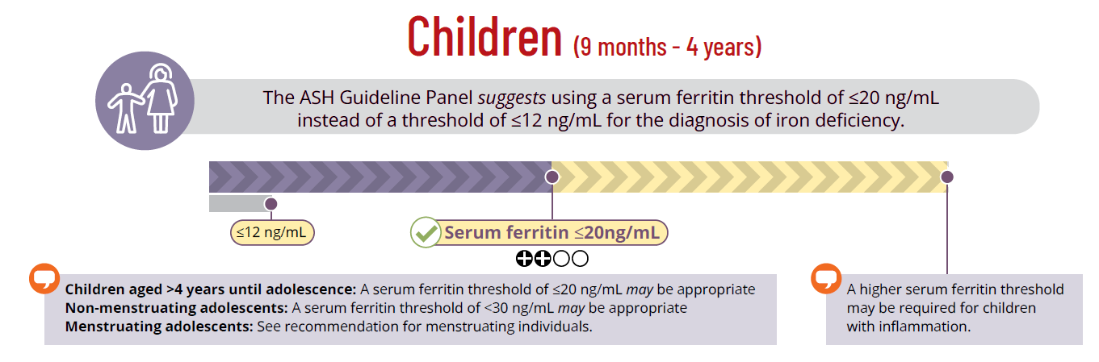
Recommendation
Image from guideline Visual Summary
Notes:
Recommendation #1 This threshold is for children without known or suspected inflammation, and a higher serum ferritin threshold may be required for children with inflammation.
Due to a lack of direct evidence, specific recommendations for children aged >4 years until adolescence (defined as age >11 years5) and non-menstruating adolescents were not developed. For children aged >4 years until adolescence, a serum ferritin threshold of ≤20 ng/mL is appropriate for the diagnosis of iron deficiency by indirectly applying evidence for young children. For non-menstruating adolescents, a serum ferritin threshold of <30 ng/mL is appropriate for the diagnosis of iron deficiency by indirectly applying evidence from menstruating adolescents and adult populations.

Slide 14
Summary of Evidence
Evidence for diagnostic test accuracy included one observational study (n=87) with a median age of 36.5 months (IQR 17.1 months).
The study compared a serum ferritin threshold of <12 ng/mL versus <18 ng/mL (which was utilized to inform the threshold of 20 ng/mL)
Excluded Populations
Children were excluded from this recommendation if they have:
Inflammation
Menstruation
Pregnancy
Systematic review
Prevalence of ID included 56 studies (n=121,394) with a pooled estimate for the global prevalence of iron deficiency in this population of 30%
Observational studies
Provided indirect evidence through estimation of physiologically based serum ferritin thresholds for this age group
Notes:
19. Mei Z, Addo OY, Jefferds ME, Sharma AJ, Flores-Ayala RC, Brittenham GM. Physiologically based serum ferritin thresholds for iron deficiency in children and non-pregnant women: a US National Health and Nutrition Examination Surveys (NHANES) serial cross-sectional study. Lancet Haematol. Aug 2021;8(8):e572-e582. doi:10.1016/S2352-3026(21)00168-X
37. Jonker FA, Boele van Hensbroek M, Leenstra T, et al. Conventional and novel peripheral blood iron markers compared against bone marrow in Malawian children. J Clin Pathol. Aug 2014;67(8):717-23. doi:10.1136/jclinpath-2014-202291
38. Sezgin G, Monagle P, Loh TP, et al. Clinical thresholds for diagnosing iron deficiency: comparison of functional assessment of serum ferritin to population based centiles. Sci Rep. Oct 26 2020;10(1):18233. doi:10.1038/s41598-020-75435-5
39. Mukhtarova N, Ha B, Diamond CA, Plumb AJ, Kling PJ. Serum Ferritin Threshold for Iron Deficiency Screening in One-Year-Old Children. J Pediatr. Jun 2022;245:217-221. doi:10.1016/j.jpeds.2022.01.050
40. Addo OY, Mei Z, Jefferds MED, et al. Physiologically based serum ferritin thresholds for iron deficiency among women and children from Africa, Asia, Europe, and central America: a multinational comparative study. Lancet Glob Health. May 2025;13(5):e831-e842. doi:10.1016/S2214-109X(25)00009-9

Slide 15
Rationale
The panel prioritized a serum ferritin threshold that maximized sensitivity, prioritizing detection of as many iron-deficient children as possible who could benefit from treatment.
BENEFITS
BENEFITS
Prompt treatment to prevent progression to IDA given high iron demand in childhood
Improvement in hematologic parameters, cognition, and neurodevelopment
RISKS
Incorrectly identified ID may lead to adverse effects from unnecessary iron supplementation
Intravenous iron, though less commonly used in this group, poses a small risk of infusion reactions
RISKS
HARMS
HARMS
Children in malaria endemic areas may be more vulnerable to harm with unnecessary iron supplementation
Notes:
The panel prioritized a serum ferritin threshold that maximized true positives and minimized false negatives based on the expected benefit of identification of a great number of patients with iron deficiency who may benefit from treatment.
The accurate diagnosis of iron deficiency in children allows for prompt intervention (dietary counseling, iron supplementation) to prevent the progression of iron deficiency to iron deficiency anemia or, in individuals with iron deficiency anemia, progression to more severe anemia. The benefits of identifying and treating iron deficiency in children are particularly significant due to the high iron demands in development and the demonstrated improvement in hematologic parameters⁴¹, cognition, and neurodevelopment⁴² with supplementation.
41. Powers JM, Buchanan GR, Adix L, Zhang S, Gao A, McCavit TL. Effect of Low-Dose Ferrous Sulfate vs Iron Polysaccharide Complex on Hemoglobin Concentration in Young Children With Nutritional Iron-Deficiency Anemia: A Randomized Clinical Trial. JAMA. Jun 13 2017;317(22):2297-2304. doi:10.1001/jama.2017.6846
42. Bahbah WA, Omar ZA, El-Shafie AM, Mahrous KS, El Zefzaf HMS. Interventional impact of liposomal iron on iron-deficient children developmental outcome: randomized, double-blind, placebo-controlled trial. Pediatr Res. Dec 2025;98(6):2228-2239. doi:10.1038/s41390-025-04204-9
43. Beard J. Iron deficiency alters brain development and functioning. J Nutr. May 2003;133(5 Suppl 1):1468S-72S. doi:10.1093/jn/133.5.1468S
44. Lukowski AF, Koss M, Burden MJ, et al. Iron deficiency in infancy and neurocognitive functioning at 19 years: evidence of long-term deficits in executive function and recognition memory. Nutr Neurosci. Apr 2010;13(2):54-70. doi:10.1179/147683010X12611460763689
45. Wang J, Huo JS, Sun J, Ning ZX. Physical performance of migrant schoolchildren with marginal and severe iron deficiency in the suburbs of Beijing. Biomed Environ Sci. Aug 2009;22(4):333-9. doi:10.1016/S0895-3988(09)60064-7
46. Nelson M, Bakaliou F, Trivedi A. Iron-deficiency anaemia and physical performance in adolescent girls from different ethnic backgrounds. Br J Nutr. Sep 1994;72(3):427-33. doi:10.1079/bjn19940044
47. Itzkovich M, Neuberger A, Harris I, Yahav D, Paul M, Gilboa M. Oral iron supplements for children in malaria-endemic areas. Cochrane Database Syst Rev. Jan 9 2026;1(1):CD006589. doi:10.1002/14651858.CD006589.pub5

Slide 16
Discussion & Caveats
Due to a lack of direct evidence, specific recommendations for children aged >4 years until adolescence (defined as age >11 years) and non-menstruating adolescents were not developed.
For children aged >4 years until adolescence
Serum ferritin threshold of ≤20 ng/mL is appropriate for the diagnosis of ID by indirectly applying evidence for young children.
For non-menstruating adolescents
Serum ferritin threshold of <30 ng/mL is appropriate for the diagnosis of ID by indirectly applying evidence from menstruating adolescents & adult populations.

Slide 17
Return to Case 1: Child with iron deficiency
The child agrees to blood work (with bribery of a new toy dinosaur and spy book). Hemoglobin is 10.4 g/dL and Ferritin is 15 ng/mL. Which of the following best summarizes this child's laboratory investigations?
The child is non-anemic with adequate iron stores
The child is anemic with adequate iron stores
The child is anemic with iron deficiency
The child is non-anemic with iron deficiency
Notes:
This child is 7 years of age, no history of inflammation and non-menstruating, therefore we can extrapolate that a serum ferritin threshold of ≤20 ng/mL is appropriate for the diagnosis of iron deficiency by indirectly applying evidence for young children. Furthermore, this child is anemic. Efforts at iron repletion are appropriate (and nutritional counselling).

Slide 18
FUTURE RESEARCH NEEDS
Prevalence of ID in children aged >4 years until adolescence and in non-menstruating adolescents
Assessment of changes in serum ferritin and TSAT across all pediatric groups
Evaluation of outcomes related to screening at various serum ferritin thresholds and impact of treatment on such outcomes
Stakeholder engagement
Randomized clinical trials comparing health outcomes in children treated using different serum ferritin thresholds
Cost effectiveness studies
Exploration of health equity implications
Notes:
The panel identified the following additional research needs and questions for children:
Prevalence of iron deficiency in children aged >4 years until adolescence and in non-menstruating adolescents
Assessment of changes in serum ferritin and TSAT values across all pediatric age groups from birth to adulthood
Evaluation of outcomes related to screening at various serum ferritin thresholds for iron deficiency in young children and impact of treatment on such outcomes
Stakeholder engagement to evaluate the acceptability, feasibility, and health state utility values of different serum ferritin thresholds. Stakeholders include patients, caregivers, physicians, and other pediatric healthcare providers
Randomized clinical trials comparing health outcomes in children when treated based on different serum ferritin thresholds
Cost effectiveness studies comparing the diagnosis and downstream implications of testing and treatment at different serum ferritin thresholds
Exploration of the health equity implications of different serum ferritin thresholds for pediatric individuals, including those living in malaria endemic areas

Slide 19

Case 2 : Adult with inflammatory bowel disease
A 21-year-old man with a history of inflammatory bowel disease is seen in follow-up. He is being treated with adalimumab but is now having more symptoms, including abdominal pain and an increasing number of stools. He also notes extreme fatigue. A complete blood count shows a hemoglobin of 9.5 g/dL. His MCV was 78 fL. The remainder of the blood count showed a WBC of 12,300 x 10³/μL and platelets of 585 x 10³/μL.

Slide 20
Case 2 : Adult with inflammatory bowel disease
For adults with anemia of inflammation what tests are suggested to evaluate for iron deficiency?
A. Serum ferritin
B. Transferrin saturation
C. Both serum ferritin and transferrin saturation

Slide 21
Case 2 : Adult with inflammatory bowel disease
In adults with the anemia of inflammation, when should the diagnosis of iron deficiency be considered?
A. Ferritin <100 ng/mL and TSAT <20%
B. Ferritin <200 ng/mL and TSAT <20%
C. Ferritin <100 ng/mL or TSAT <20%
D. Ferritin <200 ng/mL and TSAT <20%

Slide 22
Case 2 : Adult with inflammatory bowel disease
To be most accurate, when should a TSAT be drawn?
Any time; recent food consumption does not affect results
Wait one hour after supplements or an iron-containing meal
After fasting for 5-9 hours
Wait 12 hours after supplements or an iron-containing meal

Slide 23
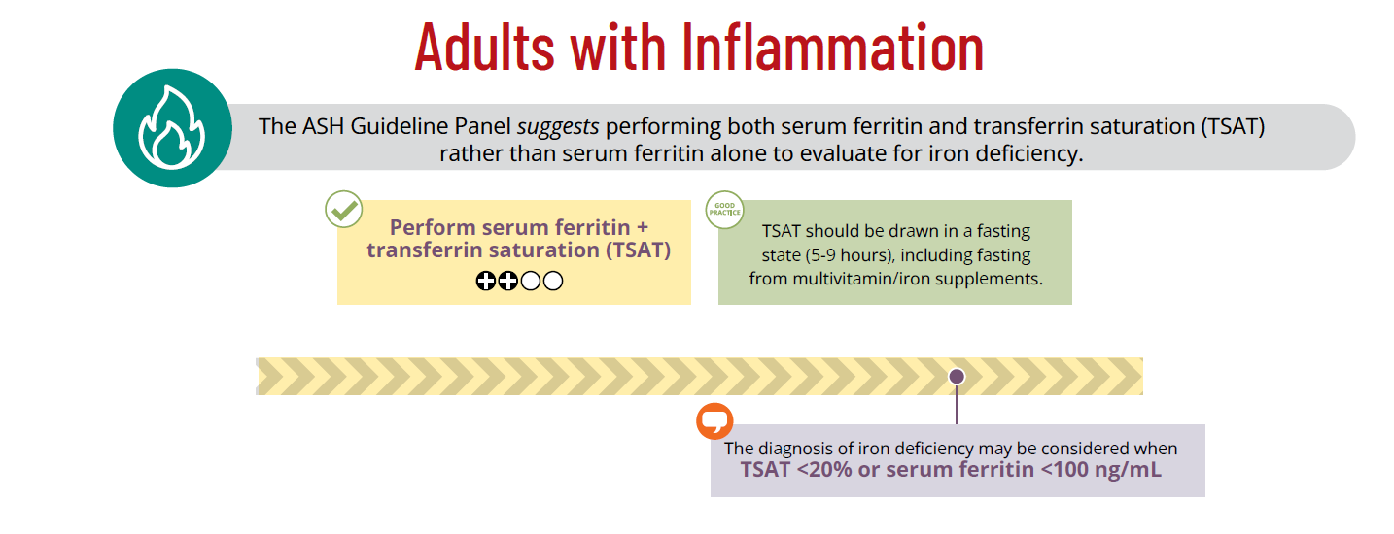
Recommendation
Image from guideline Visual Summary
Notes:
Recommendation 5. For adults with anemia of inflammation, the ASH Guideline Panel suggests performing both serum ferritin and transferrin saturation (TSAT) rather than serum ferritin alone to evaluate for iron deficiency (conditional recommendation based on very low certainty in the evidence about effects ⨁◯◯◯)
Remarks:
Inflammation is on a continuum, and establishing a serum ferritin threshold for the diagnosis of iron deficiency is challenging. However, in adults with anemia of inflammation, the diagnosis of iron deficiency may be considered when (A) TSAT <20% or (B) serum ferritin <100 ng/mL.
TSAT should be drawn in a fasting state (5-9 hours6, including fasting from multivitamin/iron supplements), as the test is susceptible to recent dietary intake.
Anemia of inflammation may occur in individuals with inflammatory bowel disease, infectious diseases, cancer, chronic kidney disease, heart failure, rheumatologic disorders, and other inflammatory disorders.
Due to a lack of data on the diagnosis of iron deficiency in children with inflammation, no recommendations were made for this population (see Recommendation 1).
Good practice statement: Anemia of inflammation may be present concurrently with other causes of anemia. Thus, in individuals with inflammation, the serum ferritin and TSAT should be analyzed in context of the full clinical picture including consideration of the history, physical exam, underlying disease process, and other existing management guidelines7,8 for chronic diseases. Such guidelines may consider higher serum ferritin and/or TSAT thresholds for the diagnosis of iron deficiency.

Slide 24
Summary of Evidence
Evidence for the diagnostic test accuracy included two comparative cross-sectional studies (n=67), one with heart failure patients & the other with chronic renal disease.
For serum ferritin threshold <100 ng/mL and/or TSAT <20%, the pooled sensitivity and specificity were 0.91 and 0.70 compared to a ferritin alone of <100 ng/nL (0.38 and 0.88, respectively)
Ferritin vs TSAT
Both studies presented data on the sensitivity and specificity of serum ferritin alone versus serum ferritin combined with TSAT
Adjunctive Tests
Adjunctive tests such as CRP lack sufficient data to use as standalone tests, but may be helpful in the context of the individual’s clinical condition and other laboratory values
Randomized Trials
The panel considered indirect evidence from 4 RCTs in individuals with ID and heart failure that defined iron deficiency as serum ferritin ≤100 ng/mL or TSAT <20%.
Notes:
113. Grote Beverborg N, Klip IT, Meijers WC, et al. Definition of Iron Deficiency Based on the Gold Standard of Bone Marrow Iron Staining in Heart Failure Patients. Circ Heart Fail. Feb 2018;11(2):e004519. doi:10.1161/CIRCHEARTFAILURE.117.004519
114. Kalantar-Zadeh K, Hoffken B, Wunsch H, Fink H, Kleiner M, Luft FC. Diagnosis of iron deficiency anemia in renal failure patients during the post-erythropoietin era. Am J Kidney Dis. Aug 1995;26(2):292-9. doi:10.1016/0272-6386(95)90649-5

Slide 25
Rationale
Panel members considered serum ferritin alone often insufficient to assess iron status in adults with inflammation and supported using multiple iron parameters to inform diagnosis. The panel also recognized that inflammation exists on a continuum, limiting the ability of dichotomous thresholds to fully characterize its spectrum.
BENEFITS
Accurate diagnosis of iron deficiency in the setting of inflammation enables timely treatment, mitigating negative consequences such as worsening anemia and poorer outcomes related to the underlying comorbid condition and primary cause of inflammation.
RISKS
Incorrectly identified ID may lead to adverse effects from unnecessary iron supplementation.
Intravenous iron poses a small risk reactions.
HARMS
The panel prioritized minimizing false negatives, considering the undesirable effects of serum ferritin ≤100 ng/mL alone as moderate, and the undesirable effects of serum ferritin ≤100 ng/mL or transferrin saturation <20% as likely small overall.

Slide 26
Discussion & Caveats
Due to low certainty in the evidence and very limited number of prospective trials providing indirect evidence, a recommendation regarding specific thresholds was not made.
Based on available evidence, a serum ferritin of <100 ng/mL or TSAT <20% may identify many individuals with concomitant iron deficiency in the setting of inflammation.
This will reduce untreated iron deficiency and its attendant negative health consequences.

Slide 27
Return to Case 2 : Adult with inflammatory bowel disease
For adults with anemia of inflammation what tests are suggested to evaluate for iron deficiency?
A. Serum ferritin
B. Transferrin saturation
C. Both serum ferritin and transferrin saturation
Notes:
ASH Guidelines state for anemia of inflammation both the serum ferritin and transferrin saturation offer diagnostic information

Slide 28
Return to Case 2 : Adult with inflammatory bowel disease
In adults with the anemia of inflammation, when should the diagnosis of iron deficiency be considered?
A. Ferritin <100 ng/mL and TSAT <20%
B. Ferritin <200 ng/mL and TSAT <20%
C. Ferritin <100 ng/mL or TSAT <20%
D. Ferritin <200 ng/mL and TSAT <20%
Notes:
Inflammation is on a continuum, and establishing a serum ferritin threshold for the diagnosis of iron deficiency is challenging. However, in adults with anemia of inflammation, the diagnosis of iron deficiency may be considered when (A) TSAT <20% or (B) serum ferritin <100 ng/mL.

Slide 29
Return to Case 2: Adult with inflammatory bowel disease
To be most accurate, when should a TSAT be drawn?
Any time; recent food consumption does not affect results
Wait one hour after supplements or an iron-containing meal
After fasting for 5-9 hours
Wait 12 hours after supplements or an iron-containing meal
Notes:
TSAT should be drawn in a fasting state (5-9 hours1, including fasting from multivitamin/iron supplements), as the test is susceptible to recent dietary intake and levels will start to rise again with prolonged fasting

Slide 30
FUTURE RESEARCH NEEDS
Studies on various iron parameters including diagnostic hepcidin assays to inform diagnosis of iron deficiency in the setting of anemia of inflammation
Evaluation of the relationship between serum ferritin and TSAT in pediatrics, including optimal threshold for diagnosing iron deficiency in children with concomitant inflammation
Randomized clinical trials that examine different iron parameters for diagnosis of iron deficiency in individuals with inflammation, to guide treatment and assess patient-important outcomes

Slide 31

Case 3: Adult with iron deficiency
A patient was started on vedolizumab therapy for inflammatory bowel disease with an excellent response. At follow-up, all markers of inflammation are negative, and gastroenterology studies show no evidence of inflammation. However, he again reports severe fatigue and exercise limitations.
His complete blood count showed a hemoglobin of 10.3 g/dL. His MCV was 75 fl. The remainder of the blood count showed a WBC of 3,500 x 10³/μL and platelets of 289 x 10³/μL.

Slide 32
Case 3: Adult with iron deficiency
In the adult population (excluding menstruating or pregnant individuals) what is the suggested ferritin threshold for diagnosis of iron deficiency?
15 ng/mL
30 ng/mL
50 ng/mL
100 ng/mL

Slide 33
Case 3: Adult with iron deficiency
Given that the patient is having symptoms, what is the suggested ferritin threshold for diagnosis of iron deficiency?
15 ng/mL
30 ng/mL
50 ng/mL
100 ng/mL

Slide 34
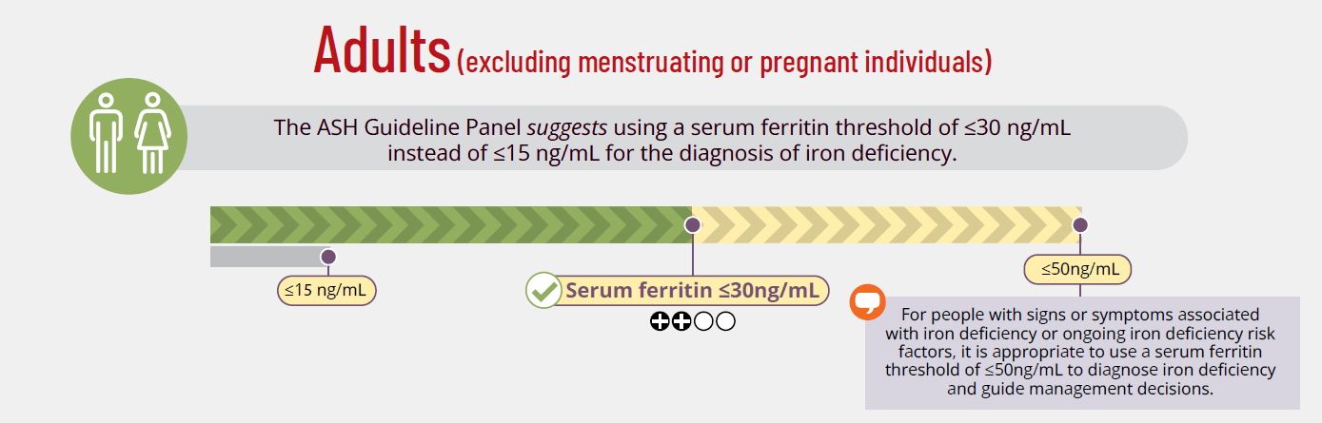
Recommendation
Image from guideline Visual Summary
Notes:
Recommendation #2: In the adult population (excluding menstruating or pregnant individuals), the ASH Guideline Panel suggests using a serum ferritin threshold of ≤30 ng/mL instead of ≤15 ng/mL for the diagnosis of iron deficiency (conditional recommendation based on low certainty in the evidence about effects ⨁⨁◯◯).
Remark:
For people with signs or symptoms associated with iron deficiency or ongoing iron deficiency risk factors (see Table 1), a serum ferritin threshold ≤50 ng/mL is appropriate to diagnose iron deficiency and guide management decisions.
This threshold is for adults without known or suspected inflammation. For adults with inflammation, please see Recommendation 5.

Slide 35
Summary of Evidence
Evidence for the diagnostic test accuracy included 19 cross-sectional studies.
Pooled sensitivity & specify based on serum ferritin cut-off:
  ≤15 ng/mL: 0.41 & 0.99, respectively
  ≤30 ng/mL: 0.67 & 0.96, respectively
  ≤50 ng/mL: 0.89 & 0.86, respectively
Exclusion Criteria
Adults were excluded from this recommendation if they have:
Menstruation
Pregnancy
Inflammation
Systematic Review
Prevalence of iron deficiency in adults included 52 studies (n=154,819 individuals). Pooled estimate for the global prevalence of iron deficiency in this population was 16%.
Bone Marrow Reference
All but one of the included studies used serum as the index test and bone marrow examination as a reference standard to confirm the diagnosis of iron deficiency.

Slide 36
Rationale
The panel prioritized a serum ferritin threshold that maximized sensitivity, prioritizing detection of as many iron-deficient individuals as possible who could benefit from treatment.
BENEFITS
Accurate diagnosis allows prompt iron supplementation, preventing progression to iron deficiency anemia or, in those already anemic, progression to more severe anemia.
RISKS
Incorrectly identified ID may lead to adverse effects from unnecessary iron supplementation.
Intravenous iron poses a small risk of reaction.
HARMS
The panel determined undesirable effects of the lowest serum ferritin threshold of ≤15 ng/mL were greater than those of the higher serum ferritin thresholds, given that a missed diagnosis of iron deficiency may result in prolongation of unaddressed negative health issues.

Slide 37
Discussion & Caveats
The guideline panel suggests a serum ferritin threshold of ≤30 ng/mL over a serum ferritin threshold of ≤15 ng/mL to diagnose iron deficiency in the general adult population (excluding menstruating or pregnant individuals), despite low certainty in the evidence.
The panel acknowledged a significant variation between patients with iron deficiency and their associated symptoms at different serum ferritin thresholds, which creates important certainty or variability in patient values.
This higher threshold will result in a higher proportion of adults with iron deficiency receiving a diagnosis and potentially benefitting from appropriate evaluation and management.

Slide 38
Return to Case 3: Adult with iron deficiency
In the adult population (excluding menstruating or pregnant individuals) what is the suggested ferritin threshold for diagnosis of iron deficiency?
15 ng/mL
30 ng/mL
50 ng/mL
100 ng/mL
Notes:
Given this is an adult who is not inflamed, menstruating or pregnant a ferritin of 30 ng/mL is an appropriate threshold

Slide 39
Return to Case 3: Adult with iron deficiency
Given the patient is having symptoms, what is the suggested ferritin threshold for diagnosis of iron deficiency?
15 ng/mL
30 ng/mL
50 ng/mL
100 ng/mL
Notes:
For people with signs or symptoms associated with iron deficiency, or ongoing iron deficiency risk factors (gastric bypass, heavy periods, etc), it may be appropriate to use a serum ferritin threshold of ≤50 ng/mL to diagnose iron deficiency and guide management decisions.

Slide 40
FUTURE RESEARCH NEEDS
Studies on an appropriate reference standard for iron deficiency and harmonization of serum ferritin laboratory testing
Randomized clinical trials comparing serum ferritin thresholds to guide iron treatment, using patient-important outcomes
Cost-effectiveness studies comparing diagnosis at different serum ferritin diagnostic thresholds
Stakeholder engagement to assess feasibility, acceptability, and health state utility implications of different serum ferritin thresholds
Exploration of health equity implications for different serum ferritin diagnostic thresholds in adults, including in individuals in malaria- endemic regions

Slide 41

Case 4: Menstruating individual with iron deficiency
A 34-year-old patient presents to their primary care physician for fatigue. They report fatigue for at least a year, but over the last several months have developed a craving for ice and a pins-and-needles sensation in their legs, specifically at night, with an inability to stop moving them (restless leg syndrome).

Slide 42
Case 4: Menstruating individual with iron deficiency
When asked about a change in menstruation pattern, they note an increase in menstrual flow over the past year. Menarche occurred at age 11, with periods lasting five days, and pad changes at most four times daily on the heaviest days. Over the last several months, pad changes have increased to every 1-1.5 hours with associated passage of clots, both of which are affecting their quality of life.

Slide 43
Case 4: Menstruating individual with iron deficiency
Lab notes indicate that hemoglobin is 9.1g/dL and ferritin is 4ng/mL. What ferritin threshold should be used to diagnose iron deficiency in menstruating individuals?
A. Ferritin ≤15 ng/mL
B. Ferritin ≤20 ng/mL
B. Ferritin ≤30 ng/mL
C. Ferritin ≤100 ng/mL

Slide 44
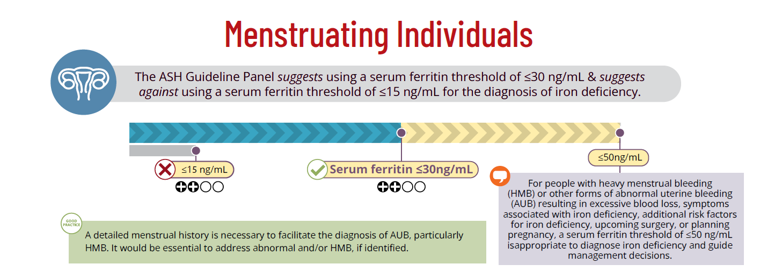
Recommendation
Image from guideline Visual Summary
Notes:
Recommendation 3. In menstruating individuals, the ASH Guideline Panel suggests using a serum ferritin threshold of ≤30 ng/mL and suggests against using a serum ferritin threshold of ≤15 ng/mL for the diagnosis of iron deficiency (conditional recommendation based on low certainty in the evidence about effects ⨁⨁◯◯).
Remark: For people with heavy menstrual bleeding (HMB) or other forms of abnormal uterine bleeding (AUB) resulting in excessive blood loss, symptoms associated with iron deficiency, additional risk factors for iron deficiency (Table 1), upcoming surgery, or planning pregnancy, a serum ferritin threshold ≤50 ng/mL is appropriate to diagnose iron deficiency and guide management decisions.
Good Practice Statement: A detailed menstrual history is necessary to facilitate the diagnosis of AUB, particularly HMB. It would be essential to address abnormal and/or HMB, if identified.

Slide 45
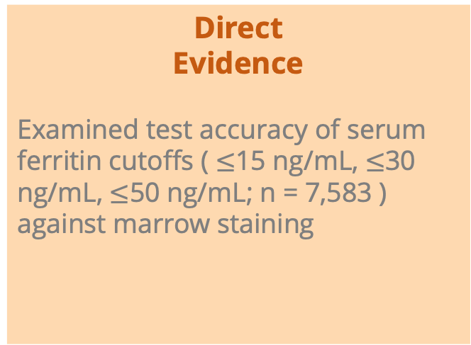
Summary of Evidence
Direct
Evidence
Examined test accuracy of serum ferritin cutoffs ( $≤$15 ng/mL, $≤$30 ng/mL, $≤$50 ng/mL; n = 7,583 ) against marrow staining
Physiologic &
Observational Evidence
Physiological effects of serum ferritin thresholds, recommendations from other organizations & the panel’s expert consensus
Functional & Patient-Important Outcomes
22 studies (5 observational, 12 RCTs, 2 meta-analyses, 2 SRs, 1 Cochrane review) informed impact & treatment decisions on patient-important outcomes
Notes:
Direct Evidence: The same diagnostic test accuracy data was used to inform recommendations for adults, menstruating, and pregnant populations.
An internal systematic review was conducted to inform test accuracy, all studies included females of reproductive age and/or persons who menstruate (7,583). The panel compared serum ferritin cutoffs against marrow staining to identify the most clinically useful thresholds. The panel discussed its limitations, such as bone marrow specimen sampling bias, subjectivity in grading, and unclear correlation with functionally available total body iron stores. Recognizing these limitations, the panel compared serum ferritin cutoffs against marrow staining to identify the most clinically useful thresholds given the lack of other available reference standards in the literature.
Physiologic & Observational Evidence: The panel considered indirect evidence that evaluated the physiological effects of serum ferritin thresholds, recommendations from other organizations as well as the panel’s expert consensus. For physiologic data, one study demonstrated that gastrointestinal absorption of iron returns to physiological baseline at a serum ferritin above 50 ng/mL. Another study found that sTfR/ hepcidin ratio, as a biomarker of early iron deficiency, correlates with serum ferritin when levels are below 50 ng/ml.
The cutoff of 15 ng/ml was considered by the panel predominantly based on the World Health Organization (WHO) recommended serum ferritin threshold of ≤ 15ug/L for the diagnosis of iron deficiency in apparently healthy individuals. The serum ferritin threshold of ≤ 30 ng/ml was assessed based on a systematic review of guideline recommendations on numerous pediatric and adult populations and a cross-sectional study from the US National Health and Nutrition Examination Surveys (NHANES) estimating the serum ferritin concentration at which the hemoglobin concentration plateaus and soluble transferrin receptor (sTfR) concentration begins to increase (sTfR minimum point).⁷ In this NHANES study, among non-pregnant women of reproductive age, a hemoglobin plateau occurred at a serum ferritin of 25.2 ng/ml (95% CI 24.2–26.2) and the soluble transferrin receptor (sTfR) minimum point occurred at a serum ferritin of 24.0 ng/ml (95% CI 23.3-24.6). The serum ferritin threshold of ≤ 50ug/L was evaluated based on a systematic review of guideline recommendations
Functional & Patient-Important Outcomes: data from 6 observational studies, 12 randomized controlled trials, 2 meta-analyses, 2 systematic reviews, and 1 Cochrane review were considered to inform the effect of using different serum ferritin diagnostic thresholds to inform treatment decisions and its impact on patient important outcomes

Slide 46
Rationale
The panel prioritized a serum ferritin threshold that maximized sensitivity, prioritizing detection of as many iron-deficient individuals as possible who could benefit from treatment.
BENEFITS
Appropriate diagnosis and treatment will prevent progression of iron deficiency to anemia and the need for blood transfusion, and will improve patient-important outcomes (fatigue, cognition, physical performance, and health-related quality of life). Implementing a threshold of <30 ng/mL is likely feasible across income settings.
RISKS
Incorrectly identified iron deficiency, using a serum ferritin threshold of <50 ng/mL, may lead to adverse effects from unnecessary iron supplementation, although most individuals with heavy menstrual bleeding will likely have a serum ferritin far lower than this threshold. Intravenous iron poses a small risk of reactions.
HARMS
The undesirable effects of a serum ferritin threshold of ≤15 ng/mL were highest, due to the high proportion of this population with HMB.
Notes:
Threshold of <15 ng/mL: The cutoff of 15 ng/ml was considered by the panel predominantly based on the World Health Organization (WHO) recommended serum ferritin threshold of ≤ 15ug/L for the diagnosis of iron deficiency in apparently healthy individuals. . The panel considered that existing laboratory serum ferritin reference intervals in adult populations appear at high risk of bias given that the majority of studies included “apparently healthy individuals” without consideration of iron deficiency risk factors nor additional laboratory findings in keeping with iron deficiency. Therefore, clinical use of methodologically flawed serum ferritin lower limits of normal has led to variations in the management of iron deficiency as well as likely contributing to its under-diagnosis.
Threshold of <30ng/mL: The panel judged that a serum ferritin threshold of $≤$30 ng/ml is probably favoured for the diagnosis of iron deficiency given consideration of desirable (true positives and true negatives) and undesirable (false positives and false negatives) effects (BALANCE OF EFFECTS) as well as the feasibility of implementing this threshold across low, middle and high income settings. A ferritin value of less than 30 μg/L is a sensitive (92%) and specific (98%) cutoff to diagnose iron deficiency, which correlates with the absence of iron stores in the bone marrow
Threshold <50ng/mL: The panel also judged a diagnostic threshold of $≤$50 ng/ml as probably favoured. However, there was concern regarding the higher number of false positives with this threshold. Also, it was discussed that most people with iron deficiency from menstrual blood loss have a serum ferritin far lower than 50 ng/ml at diagnosis, although the pathophysiological progression of iron deficiency across the lower spectrum of serum ferritin values was acknowledged. Furthermore, the challenges associated with implementing a diagnostic threshold of $≤$50ng/mL were discussed.
However, there was also discussion regarding the use of this diagnostic threshold to increase health equity. While there is no direct evidence on the impact of various serum ferritin thresholds on health equity, the panel discussed that higher thresholds could advance opportunity for identification and management of iron deficiency given that those who are medically underserved are generally at greater risk of iron deficiency. Taking all points into consideration, the panel supported the use of a serum ferritin threshold of $≤$50ng/mL in subgroups of menstruating people including– those with: symptoms of iron deficiency, heavy menstrual bleeding, upcoming surgery, planning pregnancy, or other risk factors

Slide 47
Discussion & Caveats
Laboratories should shift from shift from reference intervals based on population-derived normative values to clinical decision limits for ferritin thresholds.
Laboratories should flag ferritin $≤$30ng/mL as abnormal
Laboratories should flag ferritin ≤30ng/mL as abnormal
80% (123/155) of providers surveyed accepted $≤$30ng/mL as a practical diagnostic cutoff
80% (123/155) of providers surveyed accepted ≤30ng/mL as a practical diagnostic cutoff
Include a post-analytical comment that $≤$50ng/mL may be appropriate for high-risk subgroups (i.e. heavy menstrual bleeding)
Include a post-analytical comment that ≤50ng/mL may be appropriate for high-risk subgroups (i.e. heavy menstrual bleeding)
Notes:
To determine the feasibility of changing the LLN of serum ferritin to a clinical decision limit, an online acceptability survey was conducted among healthcare providers in 23 countries. 80% indicated 30 to be an accepted cutoff. Those who expressed concern 32% expressed that 30 was too low and would lead to underdiagnosis (Tange et al. British Journal of Haem. 2025)

Slide 48
Return to Case 4: Menstruating individual with iron deficiency
Upon checking labs, it is noted that the hemoglobin is 9.1g/dL and ferritin is 4ng/mL. What ferritin threshold should be used to diagnose iron deficiency in menstruating individuals?
A. Ferritin ≤15 ng/mL
B. Ferritin ≤20 ng/mL
C. Ferritin ≤30 ng/mL
D. Ferritin ≤100 ng/mL

Slide 49
FUTURE RESEARCH NEEDS
Studies focused on an appropriate reference standard for iron deficiency and harmonization of serum ferritin laboratory testing across platforms
Evaluation of outcomes related to various serum ferritin diagnostic thresholds and impact of treatment on such outcomes
Randomized clinical trials comparing patient-important outcomes using different serum ferritin diagnostic thresholds to guide management
Stakeholder engagement
Cost effectiveness studies
Exploration of the health equity implications of different serum ferritin diagnostic thresholds

Slide 50
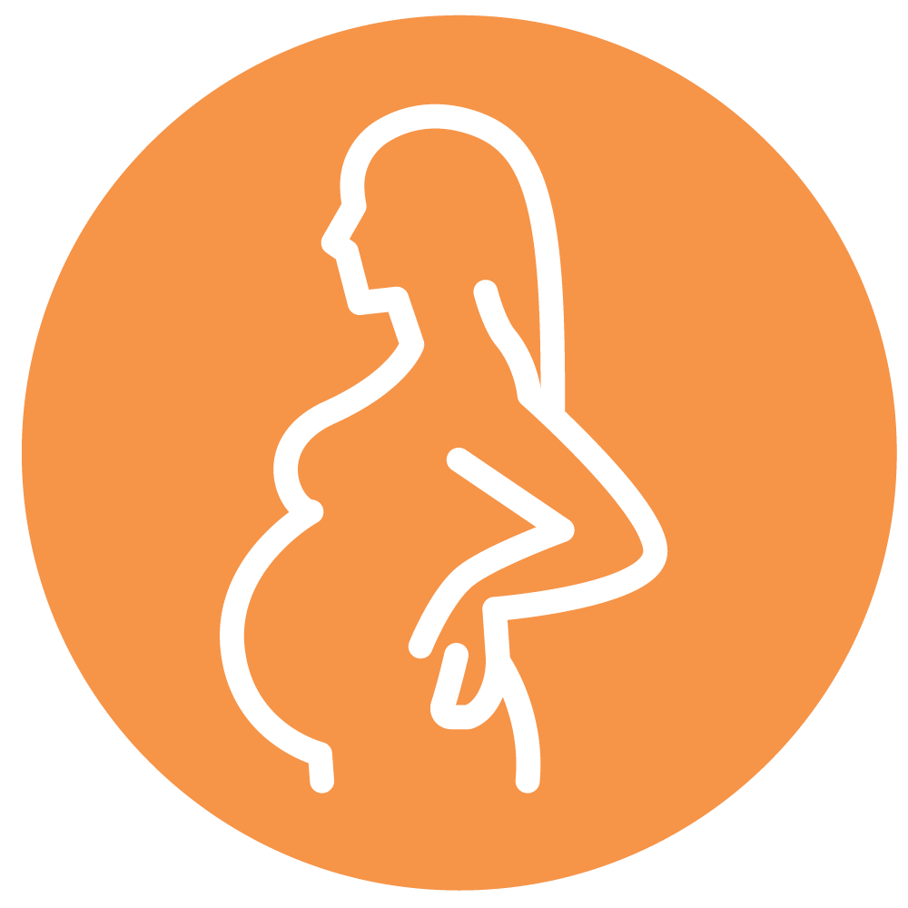
Case 5: Pregnant individual with iron deficiency
The patient in the preceding case becomes pregnant. They note fatigue, shortness of breath with exertion, worsening migraines, and PICA for ice. Labs show the following:
WBC 10,000/uL (normal 4-10,000)​
Hemoglobin 10.5 g/dL (normal 14-17)​
MCV 80 fL (normal 80-95)​
Platelets 439,000/uL (normal 150-350,000)​

Slide 51
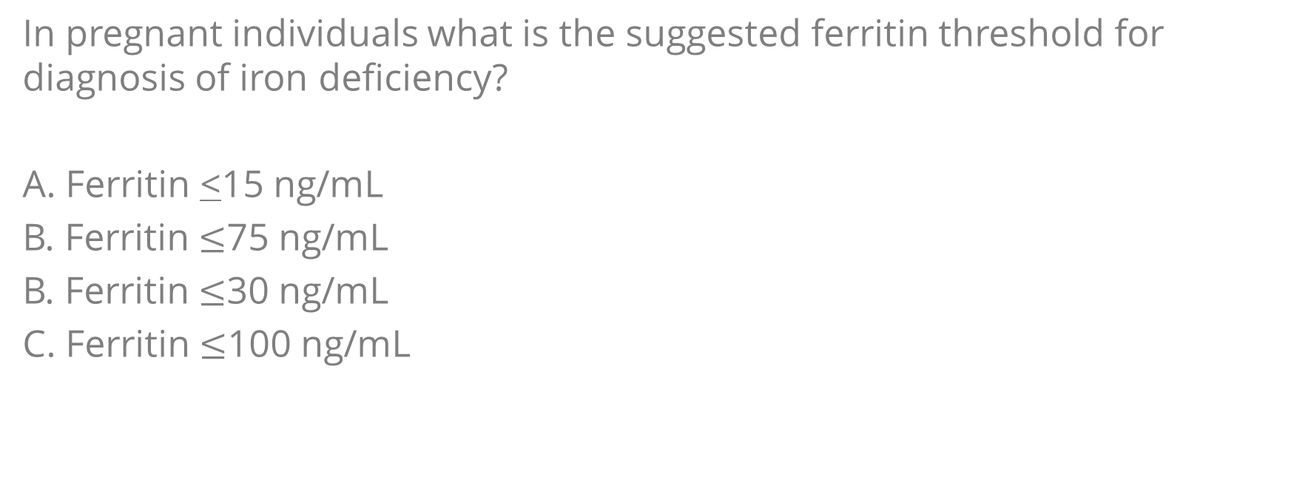
Case 5: Pregnant individual with iron deficiency
In pregnant individuals what is the suggested ferritin threshold for diagnosis of iron deficiency?
A. Ferritin <15 ng/mL
B. Ferritin $≤$75 ng/mL
B. Ferritin $≤$30 ng/mL
C. Ferritin $≤$100 ng/mL

Slide 52
Case 5: Pregnant individual with iron deficiency
Given that she is anemic and symptomatic, what might be an appropriate ferritin threshold to guide management in this patient?
15 ng/mL
50 ng/mL
75 ng/mL
100 ng/mL

Slide 53
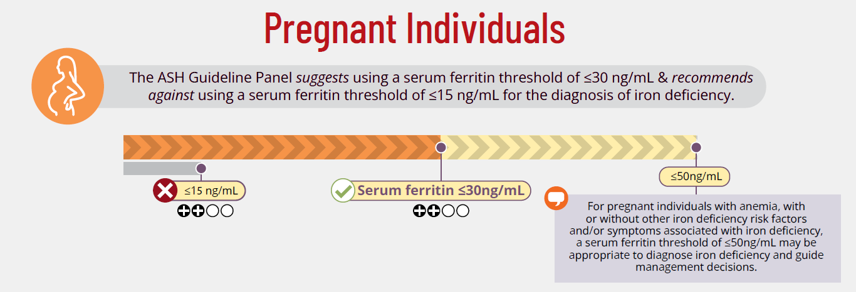
Recommendation
Image from guideline Visual Summary
Notes:
Recommendation 4. In pregnant individuals, the ASH Guideline Panel suggests using a serum ferritin threshold of ≤30 ng/mL (conditional recommendation based on low certainty in the evidence about effects ⨁⨁◯◯) and recommends against using a serum ferritin threshold of ≤15 ng/mL for the diagnosis of iron deficiency (strong recommendation based on low certainty in the evidence about effects ⨁⨁◯◯).
Remark: For pregnant individuals with anemia, with or without other iron deficiency risk factors and/or symptoms associated with iron deficiency (see Table 2), a serum ferritin threshold ≤50 ng/mL may be appropriate to diagnose iron deficiency and guide management decisions.
Risk Factors:
Preceding history of heavy menstrual bleeding
Teenage pregnancy
Hyperemesis gravidarum
Multiple gestation
Vaginal bleeding after the first trimester
Abnormal placentation (placenta previa, placenta accreta spectrum, placental abruption)
Short interpregnancy interval (<6 months between delivery and subsequent conception)
Multiparity

Slide 54
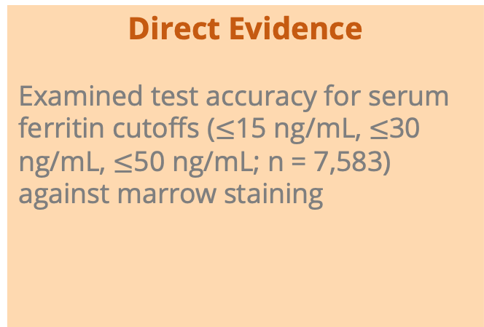
Summary of Evidence
The same data on diagnostic test accuracy were used to inform recommendations for adults, menstruating, and pregnant populations
Systematic review of the prevalence of iron deficiency in pregnancy was performed
Direct Evidence
Examined test accuracy for serum ferritin cutoffs ($≤$15 ng/mL, $≤$30 ng/mL, $≤$50 ng/mL; n = 7,583) against marrow staining
Physiologic & Observational Evidence
A systematic review on the prevalence of iron deficiency in pregnant individuals included 31 studies (n= 93,782 individuals)
Pooled estimate for global prevalence was 37%
Functional & Patient-Important Outcomes
Improvement in both maternal and neonatal outcomes with iron supplementation
Notes:
Direct Evidence: The same diagnostic test accuracy data was used to inform recommendations for adults, menstruating, and pregnant populations
Physiologic & Observational Data: The systematic review on the prevalence of iron deficiency in pregnant individuals included 31 studies (n=93,782 individuals), which were comprised of pregnant individuals across all trimesters. The panel selected to use the average pooled estimate from all trimesters rather than prevalence data at a specific time point in pregnancy. Thus, the pooled estimate for the global prevalence of iron deficiency in pregnant individuals was 37%.
Functional & Patient-Important Outcomes:
Abdulrehman J, Lausman A, Tang GH, et al. Development and implementation of a quality improvement toolkit, iron deficiency in pregnancy with maternal iron optimization (IRON MOM): A before-and-after study. PLoS Med. Aug 2019;16(8):e1002867. doi:10.1371/journal.pmed.1002867
104.Georgieff MK. Iron deficiency in pregnancy. Am J Obstet Gynecol. Oct 2020;223(4):516-524. doi:10.1016/j.ajog.2020.03.006
105.Shao J, Lou J, Rao R, et al. Maternal serum ferritin concentration is positively associated with newborn iron stores in women with low ferritin status in late pregnancy. J Nutr. Nov 2012;142(11):2004-9. doi:10.3945/jn.112.162362
106.Pasricha SR, Moya E, Ataide R, et al. Ferric carboxymaltose for anemia in late pregnancy: a randomized controlled trial. Nat Med. Jan 2025;31(1):197-206. doi:10.1038/s41591-024-03385-w
107.Ray JG, Davidson A, Berger H, Dayan N, Park AL. Haemoglobin levels in early pregnancy and severe maternal morbidity: population-based cohort study. BJOG. Aug 2020;127(9):1154-1164. doi:10.1111/1471-0528.16216

Slide 55
Rationale
Accurate diagnosis of iron deficiency during pregnancy allows prompt iron supplementation, preventing progression to iron deficiency anemia or, in those already anemic, progression to more severe anemia. The panel prioritized a serum ferritin threshold that maximized sensitivity, prioritizing detection of as many iron-deficient individuals as possible who could benefit from treatment.
BENEFITS
Identifying and treating iron deficiency is paramount in pregnant individuals given the high iron demands of pregnancy and delivery, and the associated improvement in maternal and neonatal outcomes with iron supplementation.
RISKS
Those incorrectly identified as iron deficient may experience adverse effects from unnecessary supplementation.
HARMS
The undesirable effects of a serum ferritin threshold of ≤15 ng/mL were highest, due to the high proportion of this population with HMB.
Intravenous iron poses a small risk of reactions.

Slide 56
Discussion & Caveats
The panel supported the use of this highest threshold, <50 ng/mL, in pregnant individuals with concomitant anemia, with the goal of minimizing progression of iron deficiency anemia in later trimesters and reducing fetal reliance on maternal iron stores.
There were concerns about the feasibility of implementing this threshold
There was not unanimous support for the threshold of 50 ng/mL for pregnant individuals without anemia due to uncertain benefits and uncertain potential harms of treatment at this threshold.

Slide 57
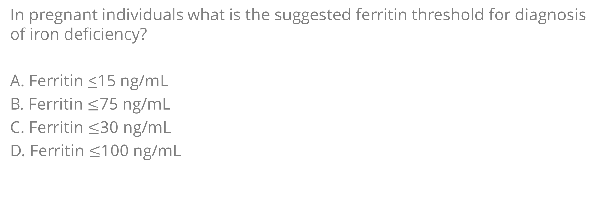
Return to Case 5: Pregnant individual with iron deficiency
In pregnant individuals what is the suggested ferritin threshold for diagnosis of iron deficiency?
A. Ferritin <15 ng/mL
B. Ferritin $≤$75 ng/mL
C. Ferritin $≤$30 ng/mL
D. Ferritin $≤$100 ng/mL

Slide 58
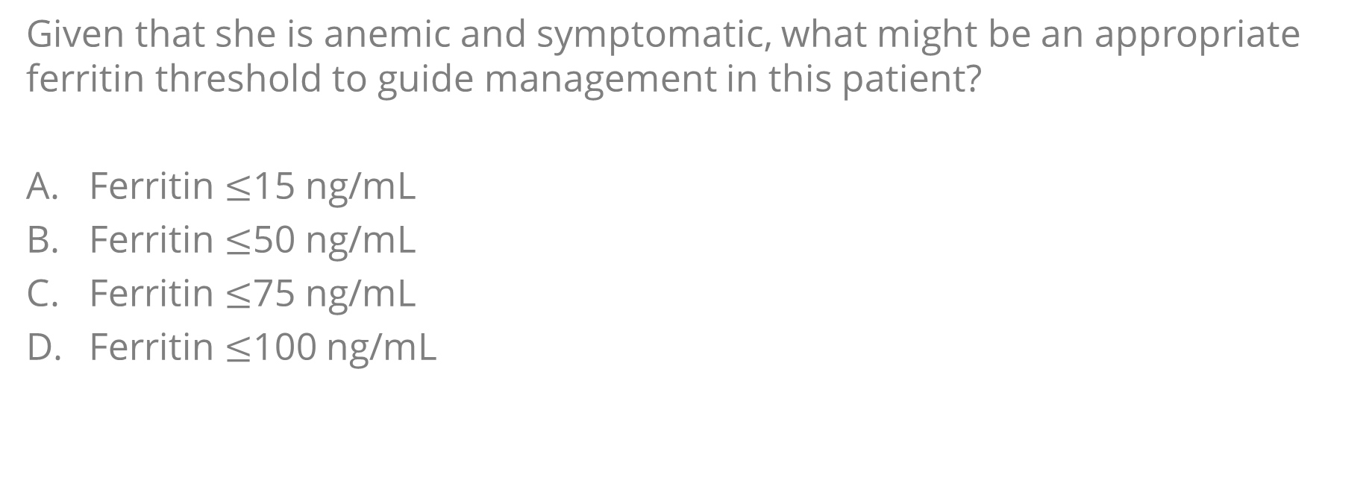
Return to Case 5: Pregnant individual with iron deficiency
Given that she is anemic and symptomatic, what might be an appropriate ferritin threshold to guide management in this patient?
Ferritin $≤$15 ng/mL
Ferritin $≤$50 ng/mL
Ferritin $≤$75 ng/mL
Ferritin $≤$100 ng/mL

Slide 59
FUTURE RESEARCH NEEDS
Examination of the relationship between serum ferritin and TSAT in pregnant individuals across trimesters
Evaluation of outcomes related to serum ferritin testing in pregnancy, including optimal timing (gestational age) for screening and treatment
Randomized clinical trials and prospective comparison of patient-important outcomes at various ferritin thresholds to guide iron therapy in pregnancy​
Stakeholder engagement
Cost effectiveness studies
Exploration of the health equity implications of different serum ferritin diagnostic thresholds

Slide 60
In Summary: Back to our objectives
Understand the recommended ferritin threshold for the diagnosis of iron deficiency in children, adults, and menstruating persons.
Understand the need to use transferrin saturation (TSAT) and ferritin for the diagnosis of iron deficiency in those with inflammation.
Understand when TSAT should be drawn for the most accurate assessment

Slide 61
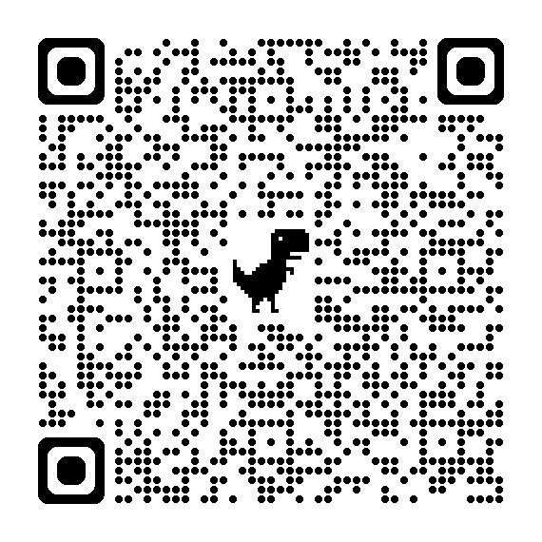
Acknowledgements
ASH Guideline Panel team members
Knowledge Synthesis team members
Evidence-Based Practice and Impact Center, Department of Internal Medicine, University of Kansas Medical Center
Authors of Diagnosis of Iron Deficiency slide set
See more about the ASH iron deficiency guidelines at hematology.org/IDA-guidelines

Slide 62
References: Children (9 months – 4 years)
1. Mei Z, Addo OY, Jefferds ME, Sharma AJ, Flores-Ayala RC, Brittenham GM. Physiologically based serum ferritin thresholds for iron deficiency in children and non-pregnant women: a US National Health and Nutrition Examination Surveys (NHANES) serial cross-sectional study. Lancet Haematol. Aug 2021;8(8):e572-e582. doi:10.1016/S2352-3026(21)00168-X
2. Jonker FA, Boele van Hensbroek M, Leenstra T, et al. Conventional and novel peripheral blood iron markers compared against bone marrow in Malawian children. J Clin Pathol. Aug 2014;67(8):717-23. doi:10.1136/jclinpath-2014-202291
3. Sezgin G, Monagle P, Loh TP, et al. Clinical thresholds for diagnosing iron deficiency: comparison of functional assessment of serum ferritin to population based centiles. Sci Rep. Oct 26 2020;10(1):18233. doi:10.1038/s41598-020-75435-5
4. Mukhtarova N, Ha B, Diamond CA, Plumb AJ, Kling PJ. Serum Ferritin Threshold for Iron Deficiency Screening in One-Year-Old Children. J Pediatr. Jun 2022;245:217-221. doi:10.1016/j.jpeds.2022.01.050
5. Addo OY, Mei Z, Jefferds MED, et al. Physiologically based serum ferritin thresholds for iron deficiency among women and children from Africa, Asia, Europe, and central America: a multinational comparative study. Lancet Glob Health. May 2025;13(5):e831-e842. doi:10.1016/S2214-109X(25)00009-9

Slide 63
References: Adults with inflammation
1. Nguyen LT, Buse JD, Baskin L, Sadrzadeh SMH, Naugler C. Influence of diurnal variation andfasting on serum iron concentrations in a community-based population. Clin Biochem. Dec 2017;50(18):1237-1242. doi:10.1016/j.clinbiochem.2017.09.018
2. Yancy CW, Jessup M, Bozkurt B, et al. 2017 ACC/AHA/HFSA Focused Update of the 2013 ACCF/AHA Guideline for the Management of Heart Failure: A Report of the American College of Cardiology/American Heart Association Task Force on Clinical Practice Guidelines and the Heart Failure Society of America. Circulation. Aug 8 2017;136(6):e137-e161. doi:10.1161/CIR.0000000000000509
3. Kidney Disease: Improving Global Outcomes Anemia Work G. KDIGO 2026 Clinical Practice Guideline for the Management of Anemia in Chronic Kidney Disease (CKD). Kidney Int. Jan 2026;109(1S):S1-S99. doi:10.1016/j.kint.2025.06.006
4. Grote Beverborg N, Klip IT, Meijers WC, et al. Definition of Iron Deficiency Based on the Gold Standard of Bone Marrow Iron Staining in Heart Failure Patients. Circ Heart Fail. Feb 2018;11(2):e004519. doi:10.1161/CIRCHEARTFAILURE.117.004519
5. Kalantar-Zadeh K, Hoffken B, Wunsch H, Fink H, Kleiner M, Luft FC. Diagnosis of iron deficiency anemia in renal failure patients during the post-erythropoietin era. Am J Kidney Dis. Aug 1995;26(2):292-9. doi:10.1016/0272-6386(95)90649-5
6. Anker SD, Comin Colet J, Filippatos G, et al. Ferric carboxymaltose in patients with heart failure and iron deficiency. N Engl J Med. Dec 17 2009;361(25):2436-48. doi:10.1056/NEJMoa0908355
7. Ponikowski P, van Veldhuisen DJ, Comin-Colet J, et al. Beneficial effects of long-term intravenous iron therapy with ferric carboxymaltose in patients with symptomatic heart failure and iron deficiencydagger. Eur Heart J. Mar 14 2015;36(11):657-68. doi:10.1093/eurheartj/ehu385
8. Kalra PR, Cleland JGF, Petrie MC, et al. Intravenous ferric derisomaltose in patients with heart failure and iron deficiency in the UK (IRONMAN): an investigator-initiated, prospective, randomised, open-label, blinded-endpoint trial. Lancet. Dec 17 2022;400(10369):2199-2209. doi:10.1016/S0140-6736(22)02083-9
9. Ezekowitz JA, Mulder H, Mentz RJ, et al. Prediction and Longer-Term Outcomes of All-cause and Cardiovascular Mortality in the HEART-FID Trial. J Card Fail. Dec 2025;31(12):1822-1833. doi:10.1016/j.cardfail.2025.01.009

Slide 64
References: Adults (excluding menstruating persons, pregnancy & inflammation)
1. Falkingham M, Abdelhamid A, Curtis P, Fairweather-Tait S, Dye L, Hooper L. The effects of oral iron supplementation on cognition in older children and adults: a systematic review and meta-analysis. Nutr J. Jan 25 2010;9:4. doi:10.1186/1475-2891-9-4
2. Delaney CB, Eddy KT, Hartmann AS, Becker AE, Murray HB, Thomas JJ. Pica and rumination behavior among individuals seeking treatment for eating disorders or obesity. Int J Eat Disord. Mar 2015;48(2):238-48. doi:10.1002/eat.22279
3. Kung WM, Yuan SP, Lin MS, et al. Anemia and the Risk of Cognitive Impairment: An Updated Systematic Review and Meta-Analysis. Brain Sci. Jun 11 2021;11(6)doi:10.3390/brainsci11060777
4. Horner RD, Lackey CJ, Kolasa K, Warren K. Pica practices of pregnant women. J Am Diet Assoc. Jan 1991;91(1):34-8.
5. Shah AA, Donovan K, Seeley C, et al. Risk of Infection Associated With Administration of Intravenous Iron: A Systematic Review and Meta-analysis. JAMA Netw Open. Nov 1 2021;4(11):e2133935. doi:10.1001/jamanetworkopen.2021.33935
6. Tobiasson M, Alyass B, Soderlund S, Birgegard G. High prevalence of restless legs syndrome among patients with polycytemia vera treated with venesectio. Med Oncol. Mar 2010;27(1):105-7. doi:10.1007/s12032-009-9180-5
7. Houston BL, Hurrie D, Graham J, et al. Efficacy of iron supplementation on fatigue and physical capacity in non-anaemic iron-deficient adults: a systematic review of randomised controlled trials. BMJ Open. Apr 5 2018;8(4):e019240. doi:10.1136/bmjopen-2017-019240
8. Avni T, Bieber A, Grossman A, Green H, Leibovici L, Gafter-Gvili A. The safety of intravenous iron preparations: systematic review and meta-analysis. Mayo Clin Proc. Jan 2015;90(1):12-23. doi:10.1016/j.mayocp.2014.10.007
9. Van Doren L, Auerbach M. IV iron formulations and use in adults. Hematology Am Soc Hematol Educ Program. Dec 8 2023;2023(1):622-629. doi:10.1182/hematology.2023000495
10. Malireddi A, Abera M, Suresh SB, et al. Safety and Efficacy of Ferric Carboxymaltose for Iron Deficiency Anemia in Inflammatory Bowel Disease: A Systematic Review. Cureus. Dec 2024;16(12):e76065. doi:10.7759/cureus.76065
11. Phillips Z, Tang G, Thillaye‐Kerr R, et al. Changing the serum ferritin lower limit of normal to a clinical decision limit: an acceptability survey. Blood. 2024;144(Supplement 1):7561.
12. Tang GH, Phillips Z, Poutanen S, et al. 'Raise the Bar', a Canadian intervention to combat disparities in the recognition and management of iron deficiency: Development of the intervention, feasibility and implementation. Br J Haematol. Nov 2025;207(5):2219-2223. doi:10.1111/bjh.70150

Slide 65
References: Menstruating persons
Bryant BJ, Yau YY, Arceo SM, Hopkins JA, Leitman SF. Ascertainment of iron deficiency and depletion in blood donors through screening questions for pica and restless legs syndrome. Transfusion (Paris). 2013;53(8):1637-1644. doi:10.1111/trf.12061
Fernandez-Jimenez MC, Moreno G, Wright I, Shih PC, Vaquero MP, Remacha AF. Iron Deficiency in Menstruating Adult Women: Much More than Anemia. Womens Health Rep New Rochelle N. 2020;1(1):26-35. doi:10.1089/whr.2019.0011
Barton JC, Barton JC, Bertoli LF. Pica associated with iron deficiency or depletion: clinical and laboratory correlates in 262 non-pregnant adult outpatients. BMC Blood Disord. 2010;10:9. doi:10.1186/1471-2326-10-9
Khair S, Saidenberg E, Jamil A, Chen I. RISK FACTORS FOR BLOOD TRANSFUSION IN WOMEN UNDERGOING GYNAECOLOGICAL SURGERY. J Obstet Gynaecol Can. 2019;41(5):721. doi:10.1016/j.jogc.2019.02.196
Patterson AJ, Brown WJ, Powers JR, Roberts DC. Iron deficiency, general health and fatigue: results from the Australian Longitudinal Study on Women’s Health. Qual Life Res Int J Qual Life Asp Treat Care Rehabil. 2000;9(5):491-497. doi:10.1023/a:1008978114650
Comín-Colet J, Enjuanes C, González G, et al. Iron deficiency is a key determinant of health-related quality of life in patients with chronic heart failure regardless of anaemia status. Eur J Heart Fail. 2013;15(10):1164-1172. doi:10.1093/eurjhf/hft083
Short V, Allen R, Earley CJ, et al. A randomized double-blind pilot study to evaluate the efficacy, safety, and tolerability of intravenous iron versus oral iron for the treatment of restless legs syndrome in patients with iron deficiency anemia. Am J Hematol. 2024;99(6):1077-1083. doi:10.1002/ajh.27290
Glynis A. A Double-blind, Placebo-controlled Study Evaluating the Efficacy of an Oral Supplement in Women with Self-perceived Thinning Hair. J Clin Aesthetic Dermatol. 2012;5(11):28-34.

Slide 66
References: Menstruating persons
9. DellaValle DM, Haas JD. Iron supplementation improves energetic efficiency in iron-depleted female rowers. Med Sci Sports Exerc. 2014;46(6):1204-1215. doi:10.1249/MSS.0000000000000208
10. Favrat B, Balck K, Breymann C, et al. Evaluation of a single dose of ferric carboxymaltose in fatigued, iron-deficient women--PREFER a randomized, placebo-controlled study. PloS One. 2014;9(4):e94217. doi:10.1371/journal.pone.0094217
11. Anker SD, Comin Colet J, Filippatos G, et al. Ferric carboxymaltose in patients with heart failure and iron deficiency. N Engl J Med. 2009;361(25):2436-2448. doi:10.1056/NEJMoa0908355
12. Toblli JE, Lombraña A, Duarte P, Di Gennaro F. Intravenous iron reduces NT-pro-brain natriuretic peptide in anemic patients with chronic heart failure and renal insufficiency. J Am Coll Cardiol. 2007;50(17):1657-1665. doi:10.1016/j.jacc.2007.07.029
13. Murray-Kolb LE, Beard JL. Iron treatment normalizes cognitive functioning in young women. Am J Clin Nutr. 2007;85(3):778-787. doi:10.1093/ajcn/85.3.778
14. Bruner AB, Joffe A, Duggan AK, Casella JF, Brandt J. Randomised study of cognitive effects of iron supplementation in non-anaemic iron-deficient adolescent girls. Lancet Lond Engl. 1996;348(9033):992-996. doi:10.1016/S0140-6736(96)02341-0
15. Krayenbuehl PA, Battegay E, Breymann C, Furrer J, Schulthess G. Intravenous iron for the treatment of fatigue in nonanemic, premenopausal women with low serum ferritin concentration. Blood. 2011;118(12):3222-3227. doi:10.1182/blood-2011-04-346304
16. Rezaeian A, Ghayour-Mobarhan M, Mazloum SR, Yavari M, Jafari SA. Effects of iron supplementation twice a week on attention score and haematologic measures in female high school students. Singapore Med J. 2014;55(11):587-592. doi:10.11622/smedj.2014156

Slide 67
References: Pregnant persons
1. Abdulrehman J, Lausman A, Tang GH, et al. Development and implementation of a quality improvement toolkit, iron deficiency in pregnancy with maternal iron optimization (IRON MOM): A before-and-after study. PLoS Med. Aug 2019;16(8):e1002867. doi:10.1371/journal.pmed.1002867
2. Georgieff MK. Iron deficiency in pregnancy. Am J Obstet Gynecol. Oct 2020;223(4):516-524. doi:10.1016/j.ajog.2020.03.006
3. Shao J, Lou J, Rao R, et al. Maternal serum ferritin concentration is positively associated with newborn iron stores in women with low ferritin status in late pregnancy. J Nutr. Nov 2012;142(11):2004-9. doi:10.3945/jn.112.162362
4. Pasricha SR, Moya E, Ataide R, et al. Ferric carboxymaltose for anemia in late pregnancy: a randomized controlled trial. Nat Med. Jan 2025;31(1):197-206. doi:10.1038/s41591-024-03385-w
5. .Ray JG, Davidson A, Berger H, Dayan N, Park AL. Haemoglobin levels in early pregnancy and severe maternal morbidity: population-based cohort study. BJOG. Aug 2020;127(9):1154-1164. doi:10.1111/1471-0528.16216

