Slide 1
Diagnosis and Management of von Willebrand Disease
An Educational Slide Set
ASH ISTH NHF WFH 2021 Guidelines for Diagnosis and Management
of von Willebrand Disease
Slide Set Authors:
Kristin Maher, MD, PhD, University of Michigan
Christopher Ng, MD, University of Colorado

Slide 2
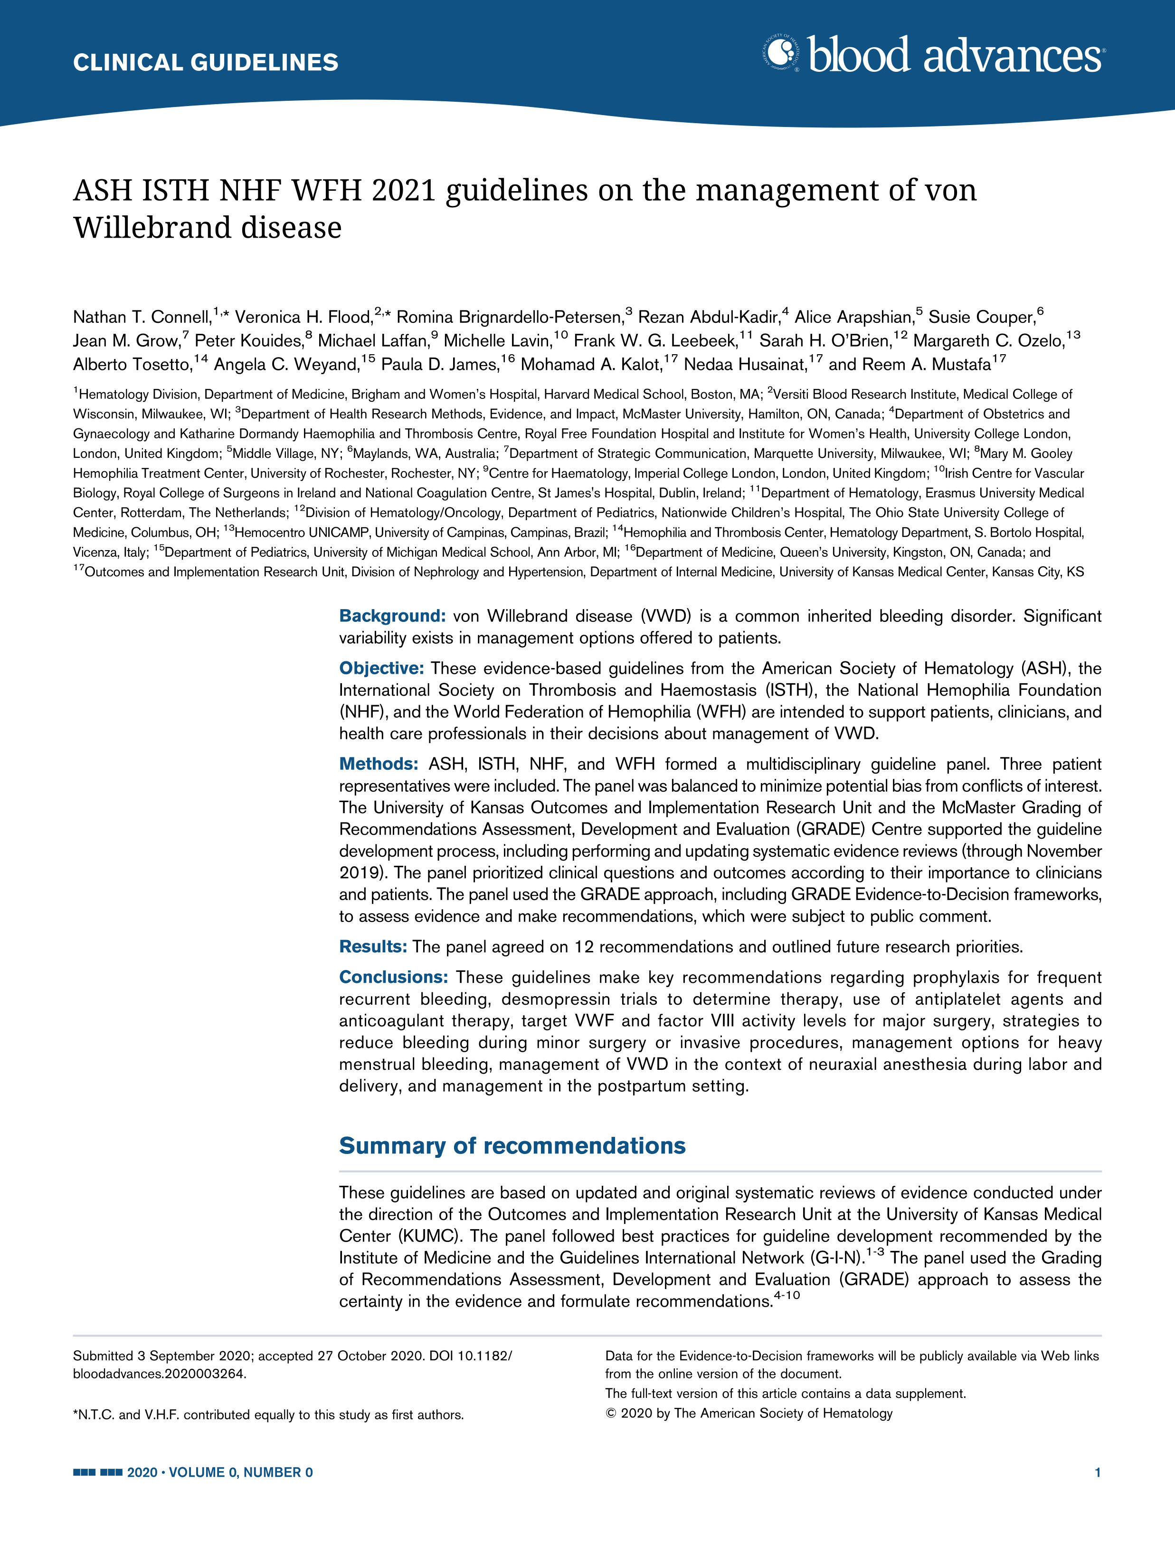
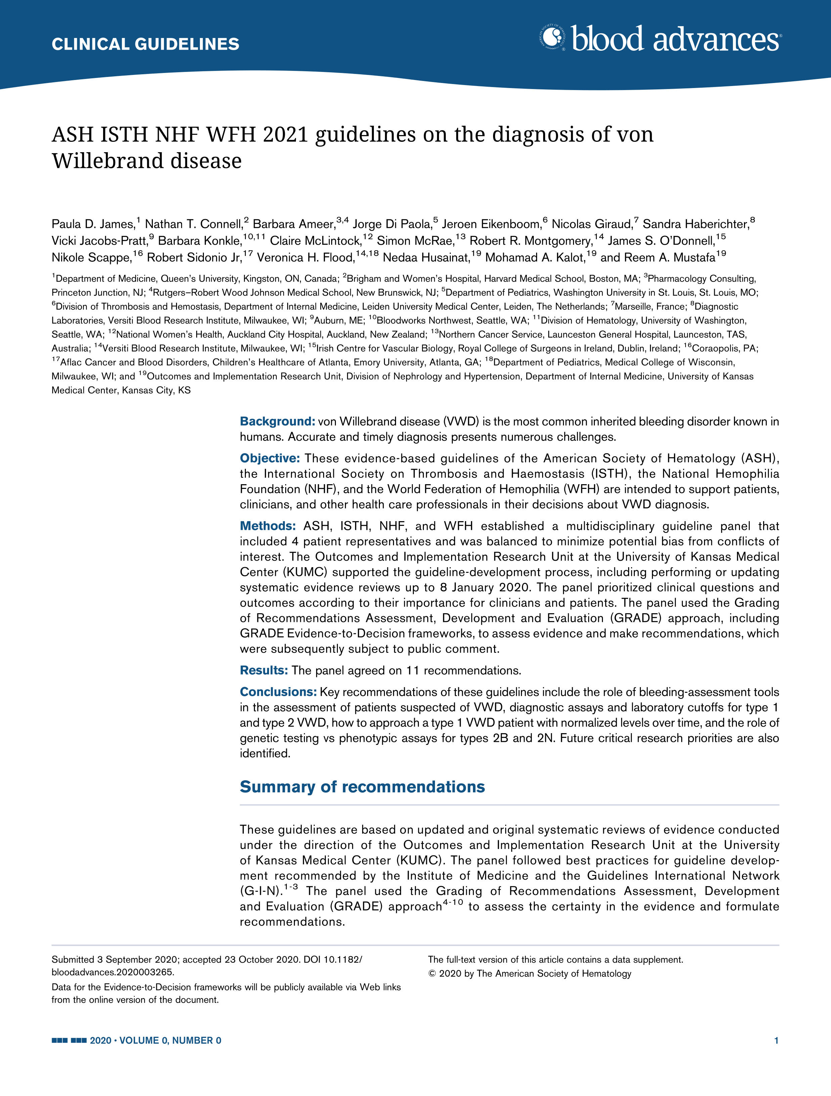
Where to find these guidelines:
ASH ISTH NHF WFH 2021 Guidelines on the Diagnosis of von Willebrand Disease
Paula D. James, Nathan T. Connell, Barbara Ameer, Jorge Di Paola, Jeroen Elkenboom, Nicolas Giraud, Sandra Haberichter, Vicki Jacobs-Pratt, Barbara Konkle, Claire McKlintock, Simon McRae, Robert Montgomery, James S. O’Donnell, Nikole Scappe, Robert Sidonio, Jr., Veronica H. Flood, Nedaa Husainat, Mohamad A. Kalot, and Reem A. Mustafa
James PD, Connell NT, Ameer B, et al. ASH ISTH NHF WFH 2021 guidelines on the diagnosis of von Willebrand disease. Blood Adv. 2021;5(1):280-300.
ASH ISTH NHF WFH 2021 Guidelines on the Management of von Willebrand Disease
Nathan T. Connell, Veronica H. Flood, Romina Brignardello-Petersen, Rezan Abdul-Kadir, Alice Arapshian, Susie Cooper, Jean M. Grow, Peter Kouides, Michael Laffan, Michelle Lavin, Frank W. G. Leebeek, Sarah H. O’Brien, Margareth C. Ozelo, Alberto Tosetto, Angela C. Weyand, Paula D. James, Mohamad Kalot, Nedaa Husainat, and Reem A. Mustafa
Connell NT, Flood VH, Brignardello-Petersen R, et al. ASH ISTH NHF WFH 2021 guidelines on the management of von Willebrand disease. Blood Adv. 2021;5(1):301-325.

Slide 3
How were these guidelines developed?
PANEL FORMATION
Each guideline panel was formed following these key criteria:
Balance of expertise (including disciplines beyond hematology, and patients)
Close attention to minimization and management of COI
CLINICAL QUESTIONS
10 to 20 clinically-relevant questions generated in PICO format (population, intervention, comparison, outcome)
EVIDENCE SYNTHESIS
Evidence summary generated for each PICO question via systematic review of health effects plus:
Resource use
Feasibility
Acceptability
Equity
Patient values and preferences
MAKING RECOMMENDATIONS
Recommendations made by guideline panel members based on evidence for all factors.
Example: Clinical Question
“In patients with VWD and history of severe and frequent bleeds, should routine prophylaxis with VWF concentrate or no routine prophylaxis be used?”
ASH guidelines are reviewed annually by expert work groups convened by ASH. Resources, such as this slide set, derived from guidelines that require updating are removed from the ASH website.

Slide 4
How should clinicians use these recommendations?
 | STRONG Recommendation (“The panel recommends…”) | CONDITIONAL Recommendation (“The panel suggests…”)
For patients | Most individuals would want the intervention. | A majority would want the intervention, but many would not.
For clinicians | Most individuals should receive the intervention. | Different choices will be appropriate for different patients, depending on their values and preferences. Use shared decision making.

Slide 5
What these guidelines cover:
DIAGNOSIS OF VWD:
Use of bleeding assessment tools (BATs)
Use of specific lab tests for VWD at initial diagnosis
How to approach patients with VWF levels that are initially abnormal and then normalize with age
Use of genetic testing in the diagnosis of VWD subtypes
MANAGEMENT OF VWD:
Use of prophylaxis
Use of the desmopressin challenge test
Patients undergoing major surgery
Patients undergoing minor surgery
Women with VWD with heavy menstrual bleeding
Women with VWD during labor and in the post-partum period

Slide 6
Objectives:
By the end of this session, you should be able to:
Demonstrate appropriate use of bleeding assessment tools (BATs) in patients with suspected VWD.
Describe a strategy for achieving accurate diagnosis in patients with an abnormal screening test for VWD.
Describe indications for prophylaxis for patients with VWD.
Formulate plans for prevention of bleeding in patients with VWD in the peripartum and perioperative settings.

Slide 7
VWD subtypes: Types with quantitative decrease in VWF
Type | Characteristics
1 | Quantitative decrease in VWF with preserved ratios between VWF antigen, activity and factor VIII. Normal multimer distribution.
1C | Quantitative decrease in VWF with preserved ratios between VWF antigen, activity and factor VIII. Increased clearance of VWF with increased propeptide compared to VWF antigen.
3 | Absence or near absence of VWF.

Slide 8
VWD subtypes: Types with abnormal VWF function
Type | Characteristics
2A | Decreased platelet-dependent VWF activity with loss of high-molecular-weight multimers.
2B | Increased binding to platelet GPIbα, often leading to thrombocytopenia.
2M | Decreased platelet-dependent VWF activity with preserved multimer pattern.
2N | Decreased binding of factor VIII.
Acquired von Willebrand syndrome* | Decreased VWF and particularly loss of high-molecular-weight multimers due to shearing from mechanical forces, adsorption on tumors or autoimmune inhibitor formation.
Platelet-type VWD* | Functional defect in platelet GPIbα, leading to excessive binding of platelets and VWF and subsequent thrombocytopenia and loss of high molecular weight multimers.
*Not addressed in these guidelines

Slide 9
Bleeding assessment tools (BATs)
Condensed MCDMCM
Developed in 2008
Administration time ~10 minutes
PBQ
(pediatric)
Developed in 2009
Administration time ~20 minutes
ISTH-BAT
Developed in 2010
Administration time ~20 minutes
SELF BAT
Developed in 2013
Administration time ~10 minutes

Slide 10
Specific laboratory tests used in the diagnosis of VWD
VWF antigen VWF:Ag
VWF ristocetin cofactor assay VWF:RCo
VWF binding to mutant GPIbα VWF:GPIbM
VWF binding to recombinant GPIbα VWF: GPIbR
VWF collagen binding assay VWF:CB
VWF propeptide VWFpp
Low dose ristocetin-induced platelet agglutination RIPA
Factor VIII clotting assay FVIII:C
VWF factor VIII binding assay VWF:FVIII binding

Slide 11
Specific laboratory tests used in the diagnosis of VWD
VWF antigen* VWF:Ag
VWF ristocetin cofactor assay* VWF:RCo
VWF binding to mutant GPIbα VWF:GPIbM
VWF binding to recombinant GPIbα VWF: GPIbR
VWF collagen binding assay VWF:CB
VWF propeptide VWFpp
Low dose ristocetin-induced platelet agglutination* RIPA
Factor VIII clotting assay* FVIII:C
VWF factor VIII binding assay VWF:FVIII binding
*Widely available

Slide 12
Case 1: Patient referred for heavy menstrual bleeding
An 18-year-old young woman is referred for hematology evaluation because of heavy menstrual bleeding. She reached menarche at age 13 and since then has missed one day of school each month because of her period. Periods lasts 8 days and she uses super plus tampons, which she changes every 1-2 hours on her heaviest days.
Surgical History: None.
Family History: Mom also with a history of heavy menstrual bleeding and postpartum hemorrhage requiring transfusion.
Prior Labs: Hemoglobin 11.0 g/dL (ref: 12.0 - 16.0 g/dL)
Ferritin 3.0 ng/mL (ref: 6.0 - 155.0 ng/mL)
Platelet count 250 K/μL (ref: 150 - 400 K/μL)
PT and PTT within normal limits.

Slide 13
Case 1: Question 1
Which one of the following is the most appropriate next step in evaluation of this patient?
Administer a bleeding assessment tool (BAT), then order specific laboratory testing for VWD only if the score is abnormal.
Obtain VWF:Ag and VWF:RCo assays.
Obtain VWF:Ag and VWF:GPIbM assays.
Obtain VWF:Ag and VWF:GPIbM assays and consider administering a BAT to document severity of bleeding.

Slide 14
Recommendation
The panel recommends against relying on a bleeding assessment tool (BAT) to decide whether to order specific blood testing in patients with intermediate or high probability of von Willebrand disease (Strong recommendation, moderate certainty).
Beyond their utility as a screening test in the primary care setting, BATs can be used in the referral setting to assess and document the severity of bleeding.

Slide 15
Recommendation
The panel suggests newer assays that measure the platelet-binding activity of VWF (e.g., VWF:GPIbM, VWF:GPIbR) over the VWF ristocetin cofactor assay. (Conditional recommendation, low certainty).
Newer activity assays have a lower coefficient of variation and higher reproducibility. In addition, there is a risk of overdiagnosis of VWD in patients of African descent due to higher prevalence of VWF variants that affect ristocetin binding but do not affect function.

Slide 16
Case 1 continued
The ISTH-BAT is administered to your patient and she has a total score of 7, with points for her heavy menstrual bleeding, extensive bruising and epistaxis. (Normal range is <4 in adult men, <6 in adult women and <3 in children.)
You obtain the following labs, which are reproducible on repeat testing:
VWF:Ag 0.53 IU/mL
VWF:GPIbM 0.42 IU/mL
VWF:GPIbM/VWF:Ag ratio 0.79
FVIII:C 0.70 IU/mL
FVIII:C/VWF:Ag ratio 1.32

Slide 17
Case 1: Question 2
Which one of the following is the most appropriate next step in evaluation of this patient?
Tell the patient she does not meet criteria for a diagnosis of VWD because her VWF levels are greater than 30 IU/mL.
Diagnose the patient with type 1 VWD and arrange for desmopressin trial with VWF levels 1- and 4-hours post administration.
Diagnose the patient with type 1 VWD and obtain a VWF propeptide level
Diagnose the patient with type 1 VWD and send targeted genetic testing.

Slide 18
Recommendation
The panel recommends a VWF level of <0.30 IU/mL regardless of bleeding, and in patients with abnormal bleeding, a VWF level of <0.50 IU/mL to confirm the diagnosis of type 1 VWD (Strong recommendation, low certainty).
High priority is placed on not missing the diagnosis of VWD in order to ensure treatment and prevention of bleeding is provided. Definitive diagnosis is required to ensure access to care for those with a bleeding phenotype.

Slide 19
Flow chart for diagnosis of VWD subtypes:

Slide 20
Recommendation
The panel suggests against using the VWFpp/VWF:Ag (ratio of propeptide to antigen) and rather using a desmopressin trial with 1- and 4-hour post-administration blood work be used to confirm increased clearance in patients with VWD suspected of type 1C (Conditional recommendation, low certainty).
Increased VWF clearance is now known to account for ~15-20% of cases of VWD. In general, a higher VWFpp/VWF:Ag ratio is associated with shorter VWF half life. However, it has been noted that in some patients, the ratio can be normal and the clearance of VWF rapid.

Slide 21
Flow chart for diagnosis of VWD subtypes

Slide 22
Case 1 continued
Your patient responds well to trial of intravenous desmopressin with post administration labs below:
1 hour post infusion: 4 hours post infusion:
VWF:Ag 1.40 IU/mL VWF:Ag 1.02 IU/mL
VWF:GPIbM 1.25 IU/mL VWF:GPIbM 0.93 IU/mL
FVIII:C 1.50 IU/mL FVIII:C 1.15 IU/mL
You explain to your patient that she does not have increased clearance of VWD and desmopressin may be useful in the future for bleeding symptoms or procedures.

Slide 23
Case 1: Question 4
What strategy could you use for management of your patient’s heavy menstrual bleeding?
Initiation of hormonal therapy, such as oral contraceptive pills or levonorgestrel IUD.
Use tranexamic acid, starting on the first day of menses and continuing for 3-5 days with each cycle.
Use desmopressin, starting on the first day of menses and given daily for 1-3 days with each cycle.
A or B

Slide 24
Recommendation
The panel suggests using either hormonal therapy (combined hormonal contraception or levonorgestrel-releasing IUD) or tranexamic acid over desmopressin to treat women with VWD with heavy menstrual bleeding who do not wish to conceive (Conditional recommendation, low certainty).
Quality of life may be most improved with hormonal contraception, but personal values and beliefs make this less acceptable to some women. The panel judged tranexamic acid to have the least harmful undesirable effects compared to desmopressin.

Slide 25
Case 1 continued
Your patient starts taking combined oral contraceptives and has significant improvement in her menstrual bleeding and resolution of her iron deficiency. She also continues to be free from any other bleeding symptoms.
The next time you see her she is 25 years old and wants to stop taking her oral contraceptives with the wish to become pregnant. She has many questions about management of VWD during labor and delivery.

Slide 26
Case 1: Question 5
What of the following is correct regarding the management of VWD during labor and delivery?
Neuraxial anesthesia is contraindicated in women with VWD.
VWF concentrate can be given to target a VWF activity level of 0.50-1.50 IU/mL to allow neuraxial anesthesia.
VWF concentrate can be given to target a VWF activity level of >1.50 IU/mL to allow neuraxial anesthesia.
Tranexamic acid should not be prescribed in the postpartum period because of increased risk for thrombosis.

Slide 27
Recommendation
In women with VWD for whom neuraxial anesthesia during labor is deemed suitable, the panel suggests targeting a VWF activity level of 0.50 to 1.50 IU/mL over targeting a level >1.50 IU/mL to allow neuraxial anesthesia (Conditional recommendation, very low certainty).
The panel advocates for a third trimester visit where factor VIII and VWF levels can be checked and a prospective plan formed for anesthesia and delivery. This recommendation does not assess suitability of neuraxial anesthesia itself for any given individual.

Slide 28
Recommendation
The panel suggests the use of tranexamic acid over not using it in women with type 1 VWD or low VWF levels (and this may also apply to type 2 and 3 VWD) in the postpartum period (Conditional recommendation, low certainty).
Tranexamic acid reduces the risk of secondary postpartum hemorrhage and may also reduce the risk of primary postpartum hemorrhage. The risk of adverse events, including thrombosis, were not estimable based on available studies but most likely to be small.

Slide 29
Case 1 summary – VWD diagnosis
BATs should be used as a screening tool for patients with low probability of VWD.
Newer assays of platelet-dependent VWF activity are preferred over the ristocetin cofactor assay.
A definitive diagnosis of VWD should be made in patients with abnormal bleeding and a VWF level of <0.50 IU/mL.
Desmopressin trial with 1- and 4-hour post-administration blood work should be used to confirm increased clearance in patients with VWD suspected of type 1C.

Slide 30
Case 1 summary – VWD treatment
Hormonal therapy or tranexamic acid are recommended over desmopressin in the treatment of heavy menstrual bleeding in women with VWD.
VWF activity level of 0.50 to 1.50 IU/mL should be targeted to allow neuraxial anesthesia in women with VWD.
Tranexamic acid is recommended for prevention of postpartum hemorrhage in women with VWD.

Slide 31
Case 2: Patient with severe epistaxis
A 7-year-old boy is seeing you for recurrent epistaxis and easy bruising. He has a history of moderate bruising with vaccines in the past, and mom has also occasionally noticed bruises the size of a quarter on his extremities. His nosebleeds have been much worse over the past month, and this is what prompted the referral. He has never had any surgery, but T&A has been recommended because of severe sleep apnea.
Labs (reproducible on repeat testing):
Platelet count 145 K/μL (ref: 150 – 400 K/μL)
PT and PTT within normal limits.
VWF:Ag 0.41 IU/mL
VWF:GPIbM 0.25 IU/mL
VWF:GPIbM/VWF:Ag ratio 0.61
FVIII:C 0.60 IU/mL
FVIII:C/VWF:Ag ratio 1.46

Slide 32
Case 1: Question 2.
Which one of the following is the most appropriate next step in evaluation of this patient?
Diagnose the patient with type 1 VWD and plan for desmopressin trial.
Diagnose the patient with type 1 VWD and send targeted genetic testing.
Diagnose the patient with type 2 VWD and send VWF multimer analysis.
Diagnose the patient with type 2 VWD and send targeted genetic testing.

Slide 33
Recommendation
The panel suggests against a platelet-dependent VWF activity/VWF:Ag ratio <0.5 cutoff , and rather using a higher cutoff of <0.7 be used to confirm type 2 VWD in patients with abnormal initial VWD screen (Conditional recommendation, very low certainty).
The false negative rate is much higher for the <0.5 cutoff than the <0.7 cutoff. False negatives in the determination of Type 2 VWD are of concern because of missing patients who would benefit from treatment.

Slide 34
Flow chart for diagnosis of VWD subtypes

Slide 35
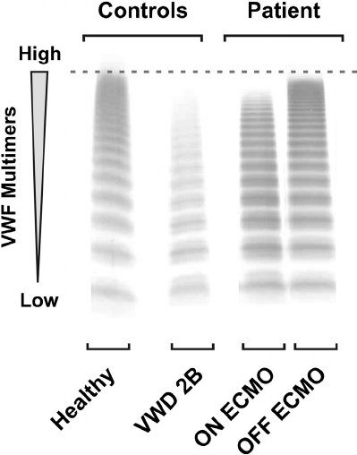
Case 1 continued
You explain to your patient’s family that his lab work is concerning for type 2 VWD, where the VWF protein does not function normally. Multimer analysis shows loss of high molecular weight multimers:
higher molecular weight
normal plasma
your patient

Slide 36
Case 1: Question 3
Which one of the following is the most appropriate next step in evaluation of this patient?
Arrange for a desmopressin trial.
Obtain a VWF collagen binding assay (VWF:CB).
Send low dose ristocetin-induced platelet agglutination testing.
Send targeted genetic testing.

Slide 37
Recommendation
The panel suggests targeted genetic testing over low-dose RIPA (ristocetin induced platelet agglutination) to diagnose type 2B VWD in patients of type 2A or 2B in need of additional testing (Conditional recommendation, low certainty).
The accurate identification of type 2B VWD is important because of relevance for prognosis and treatment, and so genetic testing is recommended when available. Patients with type 2B VWD typically have a more severe bleeding phenotype. In addition, desmopressin is relatively contraindicated because it can worsen thrombocytopenia.

Slide 38
Flow chart for diagnosis of Type 2B VWD

Slide 39
Case 1 continued
Genetic testing confirms a pathogenic variant in exon 28, known to cause type 2B VWD. You explain to the family that there are medications that can be used to treat and prevent bleeding in VWD, although some of them need to be used with caution in this subtype.
Despite preventative measures for his nosebleeds, they are recurrent and for one episode he has presented to the ED with a prolonged nosebleed and a drop in hemoglobin of 3 g/dL compared to his baseline. Otolaryngology evaluated him in the ED and does not think he will benefit from cauterization or any surgical intervention.

Slide 40
Case 2: Question 2
What is the most appropriate next step in management of this patient?
Start an oral antifibrinolytic to be taken for 3-5 days with each episode.
Increase preventative measures, including adding a humidifier in his bedroom.
Refer to otolaryngology for repeat evaluation.
Start weekly prophylaxis with intravenous VWF concentrate.

Slide 41
Recommendation
In patients with VWD with a history of severe and frequent bleeds, the guideline panel suggests using long-term prophylaxis rather than no prophylaxis (Conditional recommendation, low certainty).
Bleeding symptoms and the need for prophylaxis should be periodically assessed. Although long-term prophylaxis is not common in VWD as it is in hemophilia there are a substantial number of patients with a severe bleeding phenotype who could benefit from prophylaxis with VWF-containing concentrates.

Slide 42
Case 2 continued
After receiving prophylaxis for six months your patient has significant improvement in his nosebleeds. He stops his factor prophylaxis without return of significant bleeding. He continues to have severe sleep apnea however and is having trouble staying awake in school during the day. His parents want to know if there is a way to decrease the risk of excessive bleeding with tonsillectomy.

Slide 43
Case 2: Question 3
What of the following is the best approach to the management of your patient around the time of his tonsillectomy?
Give VWF factor concentrate to target trough VWF activity level ≥0.50 IU/ml for at least three days following surgery.
Give VWF factor concentrate to target trough factor VIII activity level ≥0.50 IU/ml for at least three days following surgery.
Give VWF factor concentrate to target both VWF and factor VIII activity levels ≥0.50 IU/ml for at least three days following surgery.
Give VWF factor concentrate prior to surgery, and then tranexamic acid alone for a week following surgery.

Slide 44
Recommendation
The panel suggests targeting both factor VIII and VWF activity levels of ≥0.50 IU/ml for at least three days following major surgery (Conditional recommendation, very low certainty).
When it is possible to keep both trough levels ≥0.50 IU/ml for at least three days, this should be the preferred option. The duration of intervention and specific trough levels can vary depending on the type of surgery.

Slide 45
Case 2 summary – VWD diagnosis
A cutoff of VWF activity/VWF:Ag ratio of <0.7 over <0.5 is suggested to confirm a diagnosis of type 2 VWD.
Genetic testing is recommended for diagnosis of type 2B VWD, when available.

Slide 46
Case 2 summary – VWD treatment
Long-term prophylaxis is recommended in patients with VWD and history of severe and frequent bleeds.
Both factor VIII and VWF activity levels of ≥0.50 IU/ml should be targeted for at least three days following major surgery.

Slide 47
Priorities for Future Research
Sensitivity and specificity of thresholds for VWD diagnostic tests.
Variability of the ristocetin cofactor assay in different ethnic groups.
Randomized clinical trial to determine whether maintaining VWF or FVIII activity levels at >0.50 IU/mL for at least 3 days after surgery leads to different outcomes.
Efficacy and safety of the combination of hormonal therapy with tranexamic acid in women with VWD and heavy menstrual bleeding.
Clinical trial on prevention of PPH in women with VWD, and basic science research on understanding fibrinolysis in women during the postpartum period.

Slide 48
Acknowledgements
ASH ISTH NHF WFH Guideline Panel team members
Knowledge Synthesis team members
Outcomes and Implementation Research Unity at the University of Kansas Medical Center
ASH ISTH NHF WFH von Willebrand Disease Guideline Scoping Group
Authors of ASH VWD Slide Set: Kristin Maher, MD, PhD and Christopher Ng, MD
See more about the ASH ISTH NHF WFH VWD diagnosis and treatment guidelines at:
www.hematology.org/VWDguidelines

