Slide 1
Managing Cerebrovascular Disease
An Educational Slide Set
American Society of Hematology 2020 Guidelines for Sickle Cell Disease
Slide Set Authors:
Ahmar U. Zaidi, MD, Children’s Hospital of Michigan and
Michael R. DeBaun, MD, Vanderbilt University School of Medicine

Slide 2
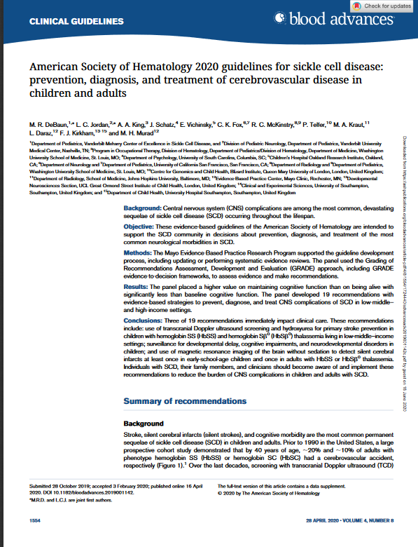
Clinical Guidelines
American Society of Hematology 2020 guidelines for sickle cell disease: cerebrovascular disease in children and adults
M. R. DeBaun, L. C. Jordan, A. A. King, J. Schatz, E. Vichinsky, C. K. Fox, R. C. McKinstry, P. Telfer, M. A. Kraut, L. Daraz, F. J. Kirkham, M. H. Murad
https://ashpublications.org/bloodadvances/article/4/8/1554/454384/American-Society-of-Hematology-2020-guidelines-for

Slide 3
ASH Clinical Practice Guidelines on SCD
1. Cardiopulmonary and Kidney Disease
2. Transfusion Support
3. Cerebrovascular Disease
4. Acute and Chronic Pain
5. Stem Cell Transplantation

Slide 4
How were these ASH guidelines developed?
PANEL FORMATION
Each guideline panel was formed following these key criteria:
Balance of expertise (including disciplines beyond hematology, and patients)
Close attention to minimization and management of conflicts of interest
CLINICAL QUESTIONS
10 clinically-relevant questions generated in PICO format (population, intervention, comparison, outcome)
EVIDENCE SYNTHESIS
Evidence summary generated for each PICO question via systematic review of health effects plus:
Resource use
Feasibility
Acceptability
Equity
Patient values and preferences
MAKING RECOMMENDATIONS
Recommendations made by guideline panel members based on evidence for all factors.
Example: PICO question
“Should automated red cell exchange vs simple transfusion or manual red cell exchange be used for patients with SCD receiving chronic transfusions?”

Slide 5
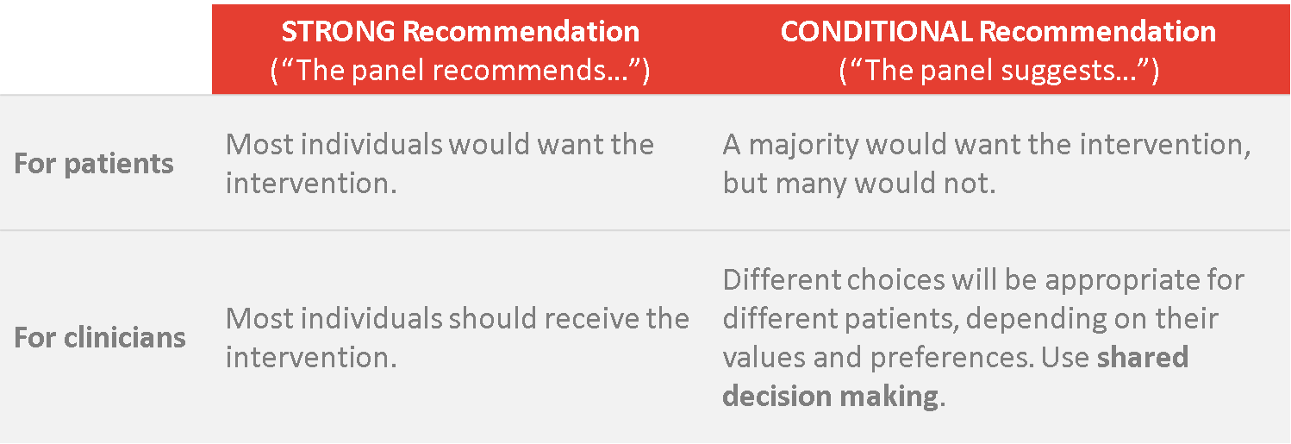
How to use these recommendations

Slide 6
Key terms in SCD stroke
Stroke
  acute neurologic injury of the brain, retina, or spinal cord that occurs as a result of ischemia or hemorrhage that last longer than 24 hours (World Health Organization Bull World Health Organ. 1980;58(1):113-130.)
Silent cerebral infarction (SCI)/silent stroke
  a lesion visible by magnetic resonance imaging (MRI) images with no associated findings on neurologic exam (American Heart Association/American Stroke Association, Stroke. 2019 Aug;50(8):e239.)
  can be correlated with neurocognitive and behavioral deficits
Transient ischemic attack
  transient episode of neurologic dysfunction caused by focal brain, spinal cord, or retinal ischemia, without acute infarction seen on neuroimaging

Slide 7
Key terms in SCD stroke management
Primary prevention
  interventions to reduce the risk of a first stroke
Secondary prevention
  interventions to reduce the risk of recurrence in individuals who have already had a first stroke or SCI
Transcranial Doppler (TCD)
  noninvasive ultrasound-based method of measuring the flow rate of blood in
    terminal internal carotid
    proximal middle cerebral and intracranial arteries

Slide 8
Objectives
By the end of this session, you should be able to:
Describe recommendations on primary stroke prevention for children with SCA in
  high-income settings
Describe recommendations on the acute and timely treatment of
  suspected or confirmed stroke
  transient ischemic attack
Describe recommendations secondary prevention of ischemic strokes in children and adults with HbSS or HbSβ⁰
Describe recommendations for screening silent cerebral infarcts for HbSS/HbSβ0 in children and adults

Slide 9
Objectives (cont’d)
  Describe recommendations on acute management of ischemic strokes using tissue plasminogen activator (tPA) for adults with SCD and stroke symptoms

Slide 10
Good Practice Statements
Good Practice Statement 1
  To adopt a health care system for tracking transcranial dopplers and their treatment
Good Practice Statement 2
  To consult with neurology/neuroradiology for all acute neurological events and timely and appropriate red blood cell transfusion
Good Practice Statement 3
  To discuss silent cerebral infarcts with patients/families, based on one non-sedation MRI and discussion about disease modifying therapy
Notes:
A 'good practice' statement is one where there is high level of certainty that the recommendation will do more good than harm, but where there is little direct evidence

Slide 11
Background

Slide 12
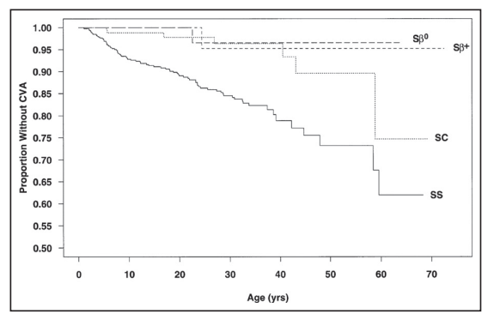
Stroke is the most common permanent sequalae of SCD
(Ohene-Frempong et al Blood (1998) 91 (1): 288–294)

Slide 13
Case 1
Primary stroke prevention for children with SCD living in low-middle– and high-income settings (Q 1, 2, 3)

Slide 14
Case 1: Screening and primary stroke prevention in a high-income country
A four-year-old male with HbSS living in the United States, presents to your clinic for an annual visit. In discussing plans for his disease surveillance, you note that the child has recently had two abnormal TCD measurements (high MCA velocity), what is the next best step?
repeat test in six months
repeat test in one year
start transfusion/apheresis to reduce sickle hemoglobin level
no further action is needed

Slide 15
TCD screening and initiation of transfusion is necessary for primary stroke prevention
Annual TCD screening should be performed for:
  children with HbSS or HbSβ⁰ thalassemia (ages 2-16 years) (strong recommendation)
For children with SCA or children who have compound heterozygous SCD, other than HbSC, who have evidence of hemolysis in the same range as those with HbSS, (ages 2-16 years) who have abnormal TCD velocities:
  blood transfusion therapy every 3-4 weeks is recommended
  blood transfusion for at least a year (vs no transfusion) with the goal of:
    maximum HbS levels below 30%
    hemoglobin levels at 9.0 g/dL (strong recommendation)

Slide 16
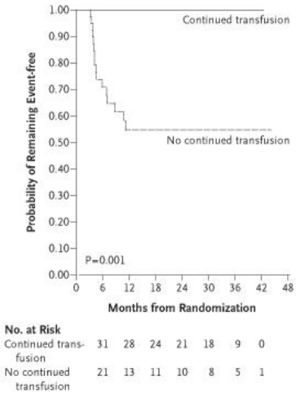
TCD screening with regular blood transfusions results in a reduction of stroke
(New England Journal of Medicine 353, no. 26 (2005): 2769-2778)

Slide 17
Case 1 (continued)
The patient has now been on transfusion therapy for 18 months. The family is discussing options for possibly discontinuing transfusion therapy. Which of the following answers describes the next best course of action:
  patient must continue transfusions indefinitely
  patient can be put on MTD hydroxyurea
  patient can be put on MTD hydroxyurea if he has a normal MRI/MRA
  patient can discontinue transfusions

Slide 18
Hydroxyurea can replace blood transfusions in select cases in children with abnormal TCD values transfused for at least a year
(Ware et al. Lancet 2016 Feb 13;387(10019):661-70)
Criteria for being able to stop indefinite monthly regular blood transfusion therapy for primary stroke prevention:
  Red blood cell transfusion therapy for at least 1 year
  No MRA defined vasculopathy
  No silent cerebral infarct
Alternative therapy to monthly blood transfusion: hydroxyurea
  Hydroxyurea treatment at the maximum tolerated dose can be considered to substitute for regular blood transfusions.

Slide 19
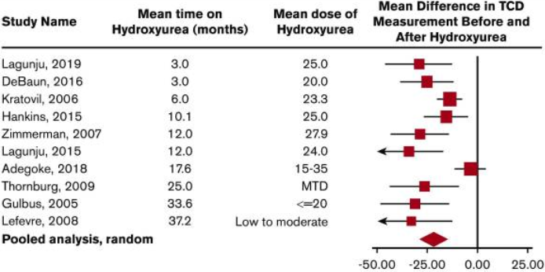
Pooled analysis of the 10 studies documenting TCD measurements decrease after starting hydroxyurea therapy in children with HbSS
(Blood Advances 2020 Apr 28; 4(8): 1554–1588)

Slide 20
Case 2
Acute and timely treatment of suspected or confirmed ischemic stroke or TIA

Slide 21
Case 2
A 9-year-old female with HbSβ⁰ thalassemia presents to the ER with new onset hemiparesis and aphasia. Her hemoglobin is 9g/dL on presentation, and her symptoms started 35 minutes ago. What is the next best course of action?
  admission to monitor for progression
  MRI/MRA
  simple transfusion
  exchange transfusion

Slide 22
SCD patients with neurological deficits should have prompt blood transfusion
Prompt blood transfusion should be given upon recognition of symptoms without delay beyond 2 hours of acute neurological symptom presentation
The type of transfusion (simple, modified exchange, or apheresis) is dependent on individual patient factors and local transfusion resources (strong recommendation)
Optimal timing of intervention with blood transfusion therapy and brain-imaging modality has not been rigorously studied
Exchange transfusion is preferred over simple transfusion

Slide 23
Management of acute neurological events
Optimal timing of therapy is to have prompt (within 2 hours of presentation to medical care) transfusion in children and adults with SCD presenting within 72 hours of symptom onset
An assessment for anemia and percentage of sickle hemoglobin with consideration of transfusion on a case-by-case basis is suggested
For individuals with hemoglobin levels >8.5 g/dL presenting with focal neurological deficits or TIA, exchange transfusion therapy to decrease the possibility of hyperviscosity syndrome is suggested

Slide 24
Multi-disciplinary management of acute ischemic stroke is recommended
Close consultative interaction between hematologists, neurologists, and acute-care providers because the diagnosis of an acute ischemic stroke can be challenging
If you do not work at a center capable of dealing with acute stroke, rapidly initiate low flow oxygen, IV fluids, complete blood count, and crossmatching and transfer to a facility that is adept at managing acute stroke

Slide 25
The final diagnosis of ischemic stroke or TIA is based on a complete neurological history, not MRI
An MRI of the brain may facilitate a diagnosis of acute cerebral ischemia, but cannot replace a history and examination
The absence of abnormality seen on the diffusion weighted image on MRI of the brain does not definitively exclude the diagnosis of an ischemic stroke.
If a patient with SCD presents with an acute-onset focal neurological deficit and the health care provider believes that the patient has had an ischemic stroke or TIA, intervention should be the same to minimize the potential risk of ongoing ischemic brain injury

Slide 26
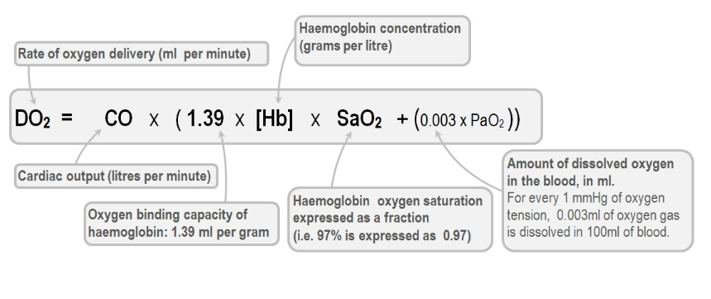
Increasing hemoglobin with a transfusion improves oxygen delivery to the brain

Slide 27
Oxygen delivery to the brain is also dependent on the HbS%
(Stroke, 19(12), pp.1466-1469)
Thresholds for postapheresis HbS percentage and hemoglobin level are typically set at 15% to 20% and 10g/dL, respectively
When the HbS level is 20%, the total hemoglobin level can generally be 10 g/dL, up to 12 to 13 g/dL, without concerns for viscosity related complications, and the optimal recommended range of hemoglobin level postapheresis is 10 to 12 g/dL
When the hemoglobin level is 5.0 g/dL, a simple transfusion to increase the total hemoglobin to 10.0 g/dL may be required

Slide 28
Case 3
Acute management of ischemic strokes and the use of tPA for adults with SCD presenting with stroke symptoms (Question 7)

Slide 29
Case 3
A 41-year-old female with HbSβ⁰ thalassemia presents with new aphasia and hemiparesis that started two hours ago. Her hemoglobin is 8.5 g/dL. Imaging confirms that there is no hemorrhage. What is the next best course of action:
  tPA only
  exchange transfusion only
  exchange transfusion and tPA if consistent with institutional guidelines
  no further management

Slide 30
Administration of tPA should never delay prompt blood transfusion
For adults with SCD presenting with symptoms of acute ischemic stroke and being considered for IV tPA (age ≥18 years, no hemorrhage on CT scan, within 4.5 hours of onset of signs, symptoms, and without contraindications for thrombolysis), the panel suggests management using a shared decision-making approach that follows these principles:
  For all patients, the administration of tPA should not delay prompt simple or exchange blood transfusion therapy
  Patients may be evaluated for IV tPA based on its established inclusion and exclusion criteria detailed in stroke management algorithms

Slide 31
tPA treatment in adults with SCD must be balanced with timely treatment with prompt transfusions
Evidence does not exist as to which treatment option should be provided first (tPA or blood transfusion)
Given the increased overall survival of adults with SCD into middle and old age with the cumulative effect of traditional cardiovascular risk factors leading to stroke
Offering emergent treatment with tPA to older adults with SCD presenting with acute ischemic strokes within 4.5 hours of symptom onset is advised

Slide 32
The evidence for the benefit of tPA in SCD is scant, and the potential harm associated with tPA is significant
One study of tPA for hyperacute stroke compared outcomes of adults with and without an SCD diagnosis using administrative data from a large US health provider
There was no difference in efficacy or safety outcomes between the 2 groups, but the study was limited by lack of confirmation of SCD phenotype and probable inclusion of individuals with sickle cell trait
the panel suggests that adults with SCD and acute ischemic stroke be considered for IV tPA following established guidelines because of the strong evidence for improved outcomes in the general population

Slide 33
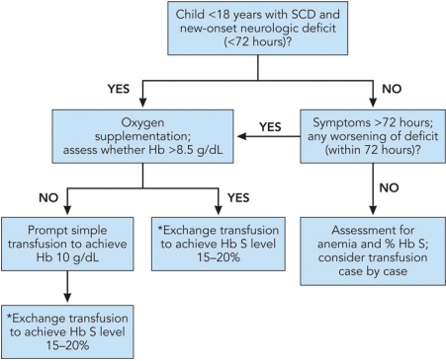
Acute presentation of neurological event in a children with SCA requires transfusion within 2 hours of presentation

Slide 34
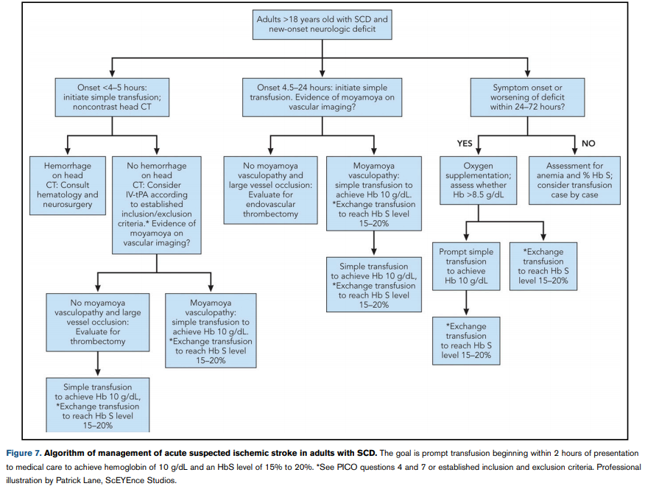
Acute presentation of neurological event in adults with SCD requires transfusion within 2 hours of presentation

Slide 35
Onset 4-5 hours; initiate simple transfusion; noncontrast head CT

Slide 36
Onset 4.5-24 hours: initiate simple transfusion. Evidence of moyamoya on vascular imaging?

Slide 37
Symptom onset or worsening of deficit within 24-72 hours?

Slide 38
Case 4
Screening for silent cerebral infarcts in children and adults with HbSS or HbSβ⁰ thalassemia (Question 10)

Slide 39
Case 4
A 6-year-old female with HbSS is evaluated with a non-sedation screening MRI and found to have a silent cerebral infarct. She is on hydroxyurea therapy. Which of the following is the best next action?
discussion about secondary prevention with regular blood transfusions and HSCT
cognitive screening assessment
MRI surveillance every 12 to 24 months
all of the above

Slide 40
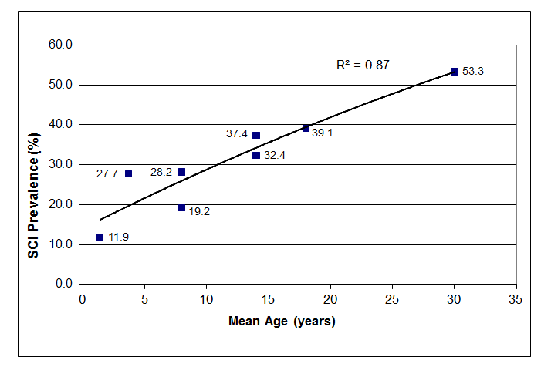
Silent cerebral infarcts are very common in sickle cell anemia
(Kassim et al. Blood. 2016 Apr 21;127(16):2038-40.)
Before completing high school 39% of the students with SCA will have silent cerebral infarcts and 53%
of young adults with SCA
Notes:
Prevalence of silent cerebral infarcts (SCI) in children and young adults with SCA based on 5 cross sectional studies and 1 longitudinal study.

Slide 41
Minimum of 6 reasons to screen at least once for silent cerebral infarcts in children and adults with HbSS or HbSß⁰ thalassemia
High pre-test probability of the disease
  Approximately 39% in students
  Approximately 50% in adults
Associated with decreased FSIQ of at least 5-point drop
May provide evidence for additional services (education and employment)
Is associated with higher infarct recurrence without any treatment
May include executive dysfunction which has specific evidence based cognitive strategies to overcome (American Congress of Rehabilitation Medicine)
Efficacious therapy demonstrated to decrease the rate of new cerebral infarcts in children with pre-existing cerebral infarcts

Slide 42
After a silent cerebral infarct is identified, panel recommends tangible steps to inform family
Neurological evaluation to assure that infarcts are classified as a silent cerebral infarct rather than overt stroke.
A discussion regarding:
  Secondary prevention options including regular blood transfusions and HSCT.
  Cognitive screening assessment
MRI surveillance every 12 to 24 months to assess for cerebral infarct progression.
  If new infarcts are present, then a discussion with the patient and family regarding the pros and cons of a step-up in therapy intensity to prevent cerebral infarct recurrence

Slide 43
Summary
The responses to the remaining PICO questions were based on review of all available observational studies, including cerebral hemodynamic studies in SCD (Only 3 RCTs)
The panel did not include the role of HSCT for primary and secondary stroke prevention, an emerging treatment strategy in high-income settings.

Slide 44
Recommendations that immediately impact clinical care in high-resource settings
  use of transcranial Doppler ultrasound screening in children with HbSS and HbSβ⁰ thalassemia (and hydroxyurea for primary stroke prevention living in low-middle–income settings)
  surveillance for developmental delay, cognitive impairments, and neurodevelopmental disorders in children
  use of magnetic resonance imaging of the brain without sedation to detect silent cerebral infarcts at least once in early-school-age children and once in adults with HbSS or HbSb0 thalassemia

Slide 45
Limitations of imaging definition of silent cerebral infarct
A definition of silent cerebral infarcts that requires a 5-mm size with corresponding T1-weighted hypointensity on MRI, instead of 3-mm only, will lead to a large misclassification bias with fewer children being identified with silent cerebral infarcts
A minimum size for silent cerebral infarct of 3 mm has been used in adult SCD studies and is predictive of infarct recurrence
The diagnosis of a silent cerebral infarct can be challenging if the radiologist is unfamiliar with the definition of silent cerebral infarct in SCD
The definition of silent cerebral infarct cannot be extrapolated
  to include the common definition of lacunar strokes in the general population, which includes a T1 hypointensity in addition to a 5-mm FLAIR hyperintensity

Slide 46
Acknowledgements
ASH guideline panel members
Mayo Clinic Evidence-Based Practice Research Program
ASH support team: Starr Webb, Kendall Alexander, Robert Kunkle
See more about the ASH SCD guidelines: https://hematology.org/SCDguidelines

