Slide 1
Advancing Your Career
Support for hematologists at all stages of their education and careers

Slide 2
What is Hematology?
Hematology is the study of blood in health and disease. It includes problems with the red blood cells, white blood cells, platelets, blood vessels, bone marrow, lymph nodes, spleen, and the proteins involved in bleeding and clotting (hemostasis and thrombosis).
Patients may be affected by many different types of blood conditions and blood cancers. Common blood disorders include anemia, bleeding disorders such as hemophilia, blood clots, and blood cancers such as leukemia, lymphoma, and myeloma.

Slide 3
Why is Hematology the “It” Specialty?
Hematology is on the forefront of the most exciting developments in the area of molecular medicine, including development of individualized targeted therapies as well as technological advancements such as genome editing, gene and cellular therapies as well as immune-based treatments.
Furthermore, mechanistic insights into hematologic diseases is helping to reframe modern research and identify cutting-edge therapeutic strategies that have implications beyond just hematologic diseases.

Slide 4
Hematology? Are You SURE???
“Hematologists need to be curious, they need to love puzzles and complex problems, because hematologists don’t stop at any one organ. Blood is everywhere and blood is life.”
“I get to both diagnose AND treat.”
“It makes me feel valued.”
“Its such a cerebral discipline.”
My sister had… My mother was… My Brother is…

Slide 5
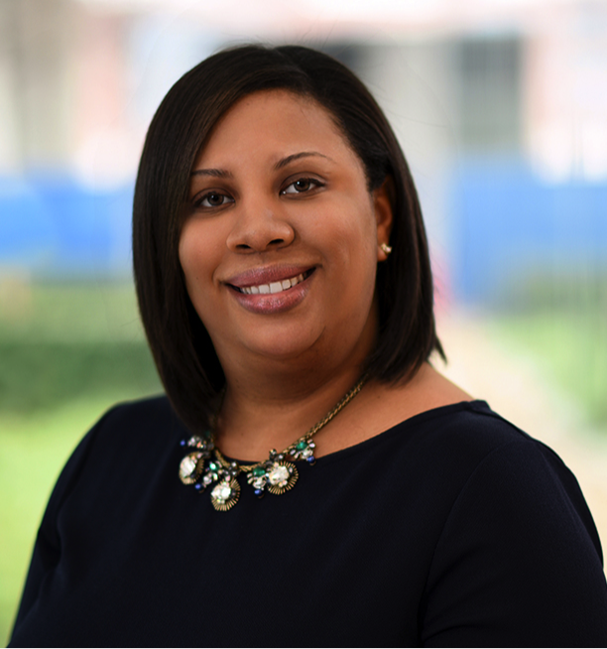
Why Hematology?
I have the best job in the world, and can’t imagine doing anything else. My initial interest in the field of pediatric hematology/oncology sparked from my experiences as a volunteer for The Rainbow Connection and The Periwinkle Foundation, both foundations dedicated to serving children and families affected by cancer and blood disorders.
Rayne Rouce, MD
Assistant Professor, Department of Pediatrics, Section of Hematology-Oncology
Baylor College of Medicine

Slide 6
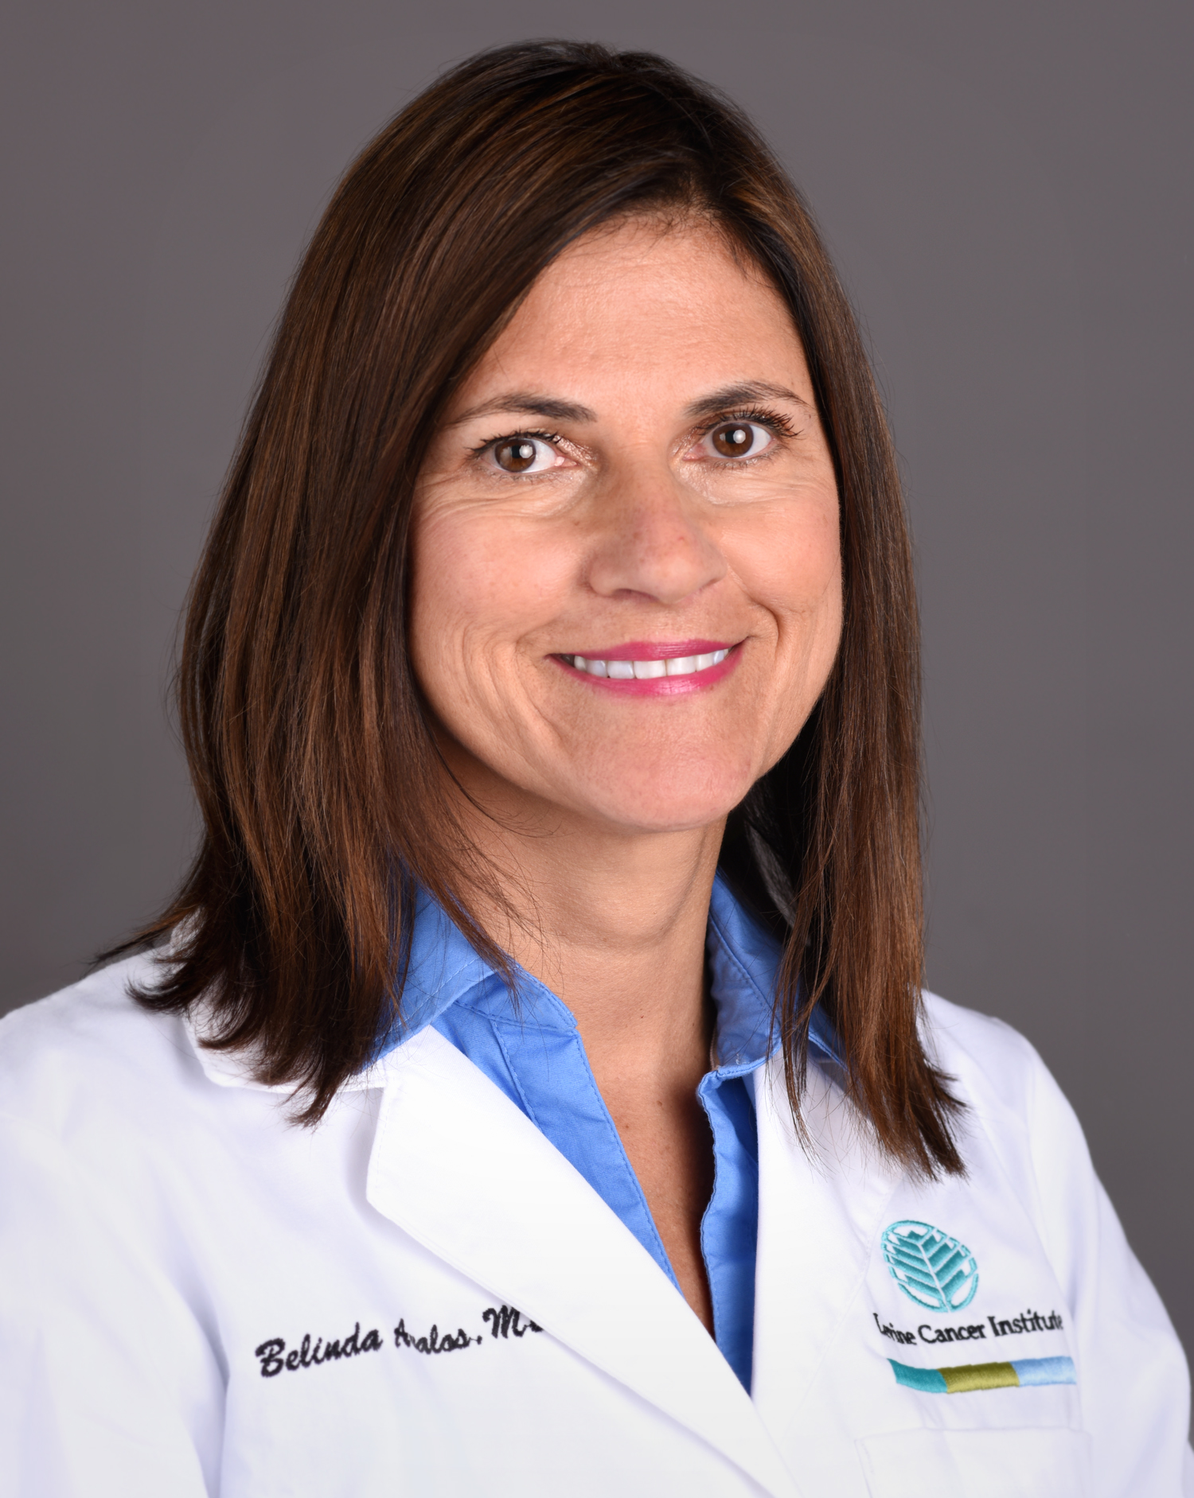
Why Hematology?
Dr. Bertha Bouroncle, a Peruvian hematologist with whom I worked as a third-year medical student, proved to be the most influential person in my decision to pursue a career in hematology.
She taught me the art and skill of morphologic examination and interpretation of peripheral blood smears and bone marrow aspirations. From these experiences, I came to recognize for the first time the importance of bench-to-bedside observations, which ultimately propelled me to pursue research studies on hematopoiesis.
Belinda Avalos, MD
Vice Chair, Hematologic Oncology & Blood Disorders
Director, Hematologic Oncology Translational Laboratory
Director, Stem Cell Processing Laboratory
Levine Cancer Institute
Carolinas HealthCare System

Slide 7
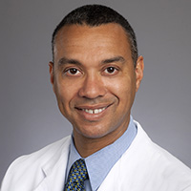
Why Hematology?
Academic hematology provides outstanding opportunities for a fulfilling lifelong career. I am constantly amazed by the numerous opportunities to continually learn from patients and colleagues, mentor and teach young scientists and clinicians, and use new technologies to make biological and clinical discoveries.
Chris Flowers, MD
Professor, Department of Hematology and Medical Oncology
  Emory University School of Medicine
Director of the Emory Lymphoma Program
  Winship Cancer Institute of Emory University
Scientific Director, Winship Research Informatics
  Winship Cancer Institute of Emory University

Slide 8
What is a Society?
A medical society or association is an organization representing a particular group of medical professionals. Medical societies perform a number of important functions for members, including education and advocacy. They also help set standards for excellence in the profession. In simpler terms, medical societies help inform members about new research and developments in the field, and they assist doctors and other professionals in protecting the interests of their patients. Societies keep their members informed through newsletters, Web sites, e-mail, and conferences.

Slide 9
American Society of Hematology (ASH)
The Society's mission is to further the understanding, diagnosis, treatment, and prevention of disorders affecting the blood, bone marrow, and the immunologic, hemostatic and vascular systems, by promoting research, clinical care, education, training, and advocacy in hematology.

Slide 10

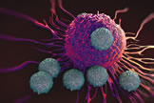
Innovation at ASH
Development of a patient registry.
Strengthened its role regarding precision medicine and immunotherapies.
Revitalized its recruitment and retention initiative.
Continued its commitment to conquering sickle cell disease.
Grew the global programs and services.
Implemented an educational roadmap.

Slide 11
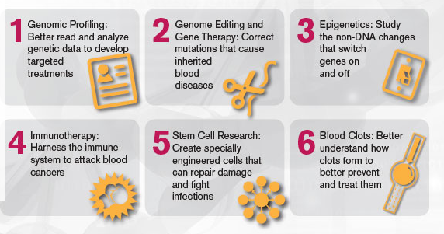
Pillars of ASH (Research)
The ASH Agenda for Hematology Research, developed by the Society's scientific committees, guides many of ASH's scientific initiatives.
  In 2017, ASH announced plans to develop a research-focused registry that will harness the power of big data to conquer blood diseases worldwide.

Slide 12


Pillars of ASH (Education)
ASH is the leading provider of hematology education.
  Offers free webinars on a wide range of hematology topics from “Coding for Sickle Cell Disease to “How to Develop a CV”.
Publish new guidelines, create new resources, and broaden existing initiatives.
280 new case based questions added to the ASH Self-Assessment Program
80,000 print pocket guides requested

Slide 13
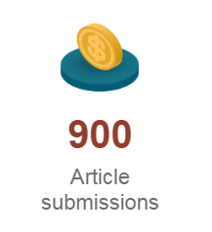
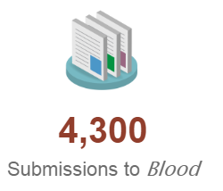
Pillars of ASH (Publications)
ASH continues to be an innovative and trusted resource for the latest clinical and scientific research and education in the field of hematology.
  Since its launch in 2016, Blood Advances has doubled its article submissions.
  The most cited peer-reviewed publication in hematology, Blood covers the full spectrum of the field through a diverse collection of article types and videos.
  Other publications include: The Hematologist and ASH Clinical News.

Slide 14


Pillars of ASH (Advocacy)
Continued to be a vocal advocate for federal support of biomedical research and funding for the NIH.
Launched a multifaceted initiative focused on improving outcomes for people with sickle cell disease.

Slide 15
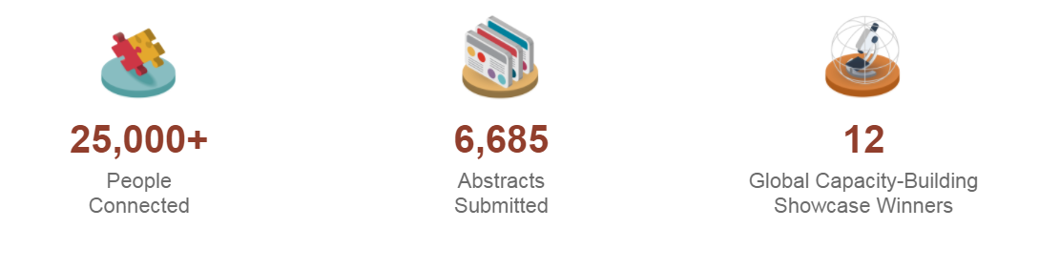
Pillars of ASH (Meetings)
ASH hosts multiple educational and scientific meetings around the world.
Provides platform for community to meet, interact, and discover latest updates.
At the ASH annual meeting,

Slide 16
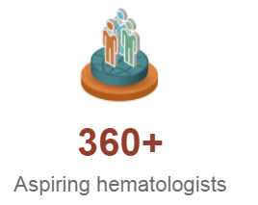
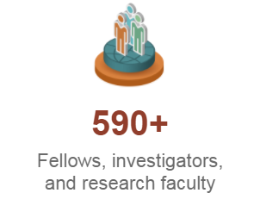
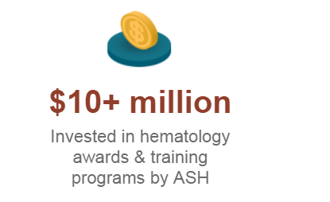
Pillars of ASH (Training/Awards)
ASH supports hematologists at all stages of their careers by offering research awards, training programs, and other resources designed to enhance knowledge and expertise.
  Offers short- and long-term opportunities that allow aspiring hematologists in medical school or residency to conduct hands-on research.
  Provides funding during critical times in the careers of junior and senior researchers, allows investigators to improve the quality of their research, and supports career advancement through mentor-guided training.

Slide 17
Diversity and Inclusion in Hematology

Slide 18
The Who, What, Why and How for Hematology
What is Diversity and Inclusion?
  Diversity and Inclusion are terms that have become so well-known that they are often used interchangeably — but they are two very different things.
  Diversity is the WHO and the WHAT: who’s sitting around that table, who's being recruited, who's being promoted, and who we’re tracking from characteristics and identities of gender and ethnicity.
  Inclusion, on the other hand, is the HOW: Inclusion is the behaviors that welcome and embrace diversity. How do we embrace and galvanize diverse voices and identities?

Slide 19
Science and the Hematology Workforce
Why is it important for science?
  Scientific progress relies on problem solving and collaboration. Groups composed of people with diverse experiences and areas of expertise tend to be more creative and innovative.
  Asking questions drives science forward, and scientists with different perspectives often ask different questions. Different questions can lead to new insights.
  The ways in which scientists seek answers to questions can be heavily influenced by their values, and new techniques often lead to new knowledge.

Slide 20
Science and the Hematology Workforce
Why is it important for the hematology workforce?
  The hematology workforce should reflect our diverse society and the many ethnic/racial minority groups afflicted by hematologic disorders.
  Minority physician scientists should be among the core researchers leading the field to find cures for hematologic diseases affecting their communities.
  Increasing the number of minority physician scientists and physicians in hematology will likely lead to an increase in the access to care and quality of the medical experience for minority patients afflicted by hematologic disorders.

Slide 21
The Current Landscape

Slide 22
The Current Landscape

Slide 23
The Current Landscape

Slide 24
Implicit Bias
“...attitudes or stereotypes that affect our understanding, decision making, and behavior, without our even realizing it.”
  “Implicit bias in the courtroom”, UCLA Law Review(2012) by Jerry Kang, et al.
How our minds work:
  Automatic associations,
  Messages from our culture, and
  First impressions are made quickly.
MDs, other providers show bias similar to others with doctoral degrees, others in society.
  Nosek, et al., 2007, Sabin et al., 2009, Hill et al., 2015

Slide 25
Implicit Bias
If there is an association that is faster for the concept of “good”.
70% of IAT test takers show stronger association of White rather than Black face and concept of “good”.
  Nosek et al., 2007.
Racial bias is contagious.

Slide 26
Challenges for Mid-Senior Level Faculty and Investigators:
Promotion and Research Grant Funding Issues.
The number of newly minted PhD holders from underrepresented groups grew by nine times, but the number of assistant professors from those groups grew by just 2.6 times.
There are mobility barriers for URM and female faculty within the academic promotional structure.
Notes:
Yong, E. (2016, November 22). Science's Minority Talent Pool Is Growing—but Draining Away. The Atlantic. Retrieved from https://www.theatlantic.com/science/archive/2016/11/the-minority-talent-pool-in-science-is-growing-and-draining-away/508481/

Slide 27
The Intervention
Institutional Hematology Connector for the Society, Trainees, and Mentors
  Increase awareness of hematology and hematology-related career opportunities.
  Help trainees navigate ASH’s career development award and training programs.
  Scout for and build relationships with new and established ASH mentors.
  Connect trainees with resources (human, financial, networks, etc.).
  Build a community of aspiring hematologists.
  Help inspire and support the next generation of hematologists.

Slide 28
Your Observations and Experiences
What diversity and/or inclusion experiences have been pivotal for you in your educational and/or professional career?
How can medical schools foster environments that are more supportive of underrepresented minority trainees?

Slide 29
ASH Award Programs

Slide 30
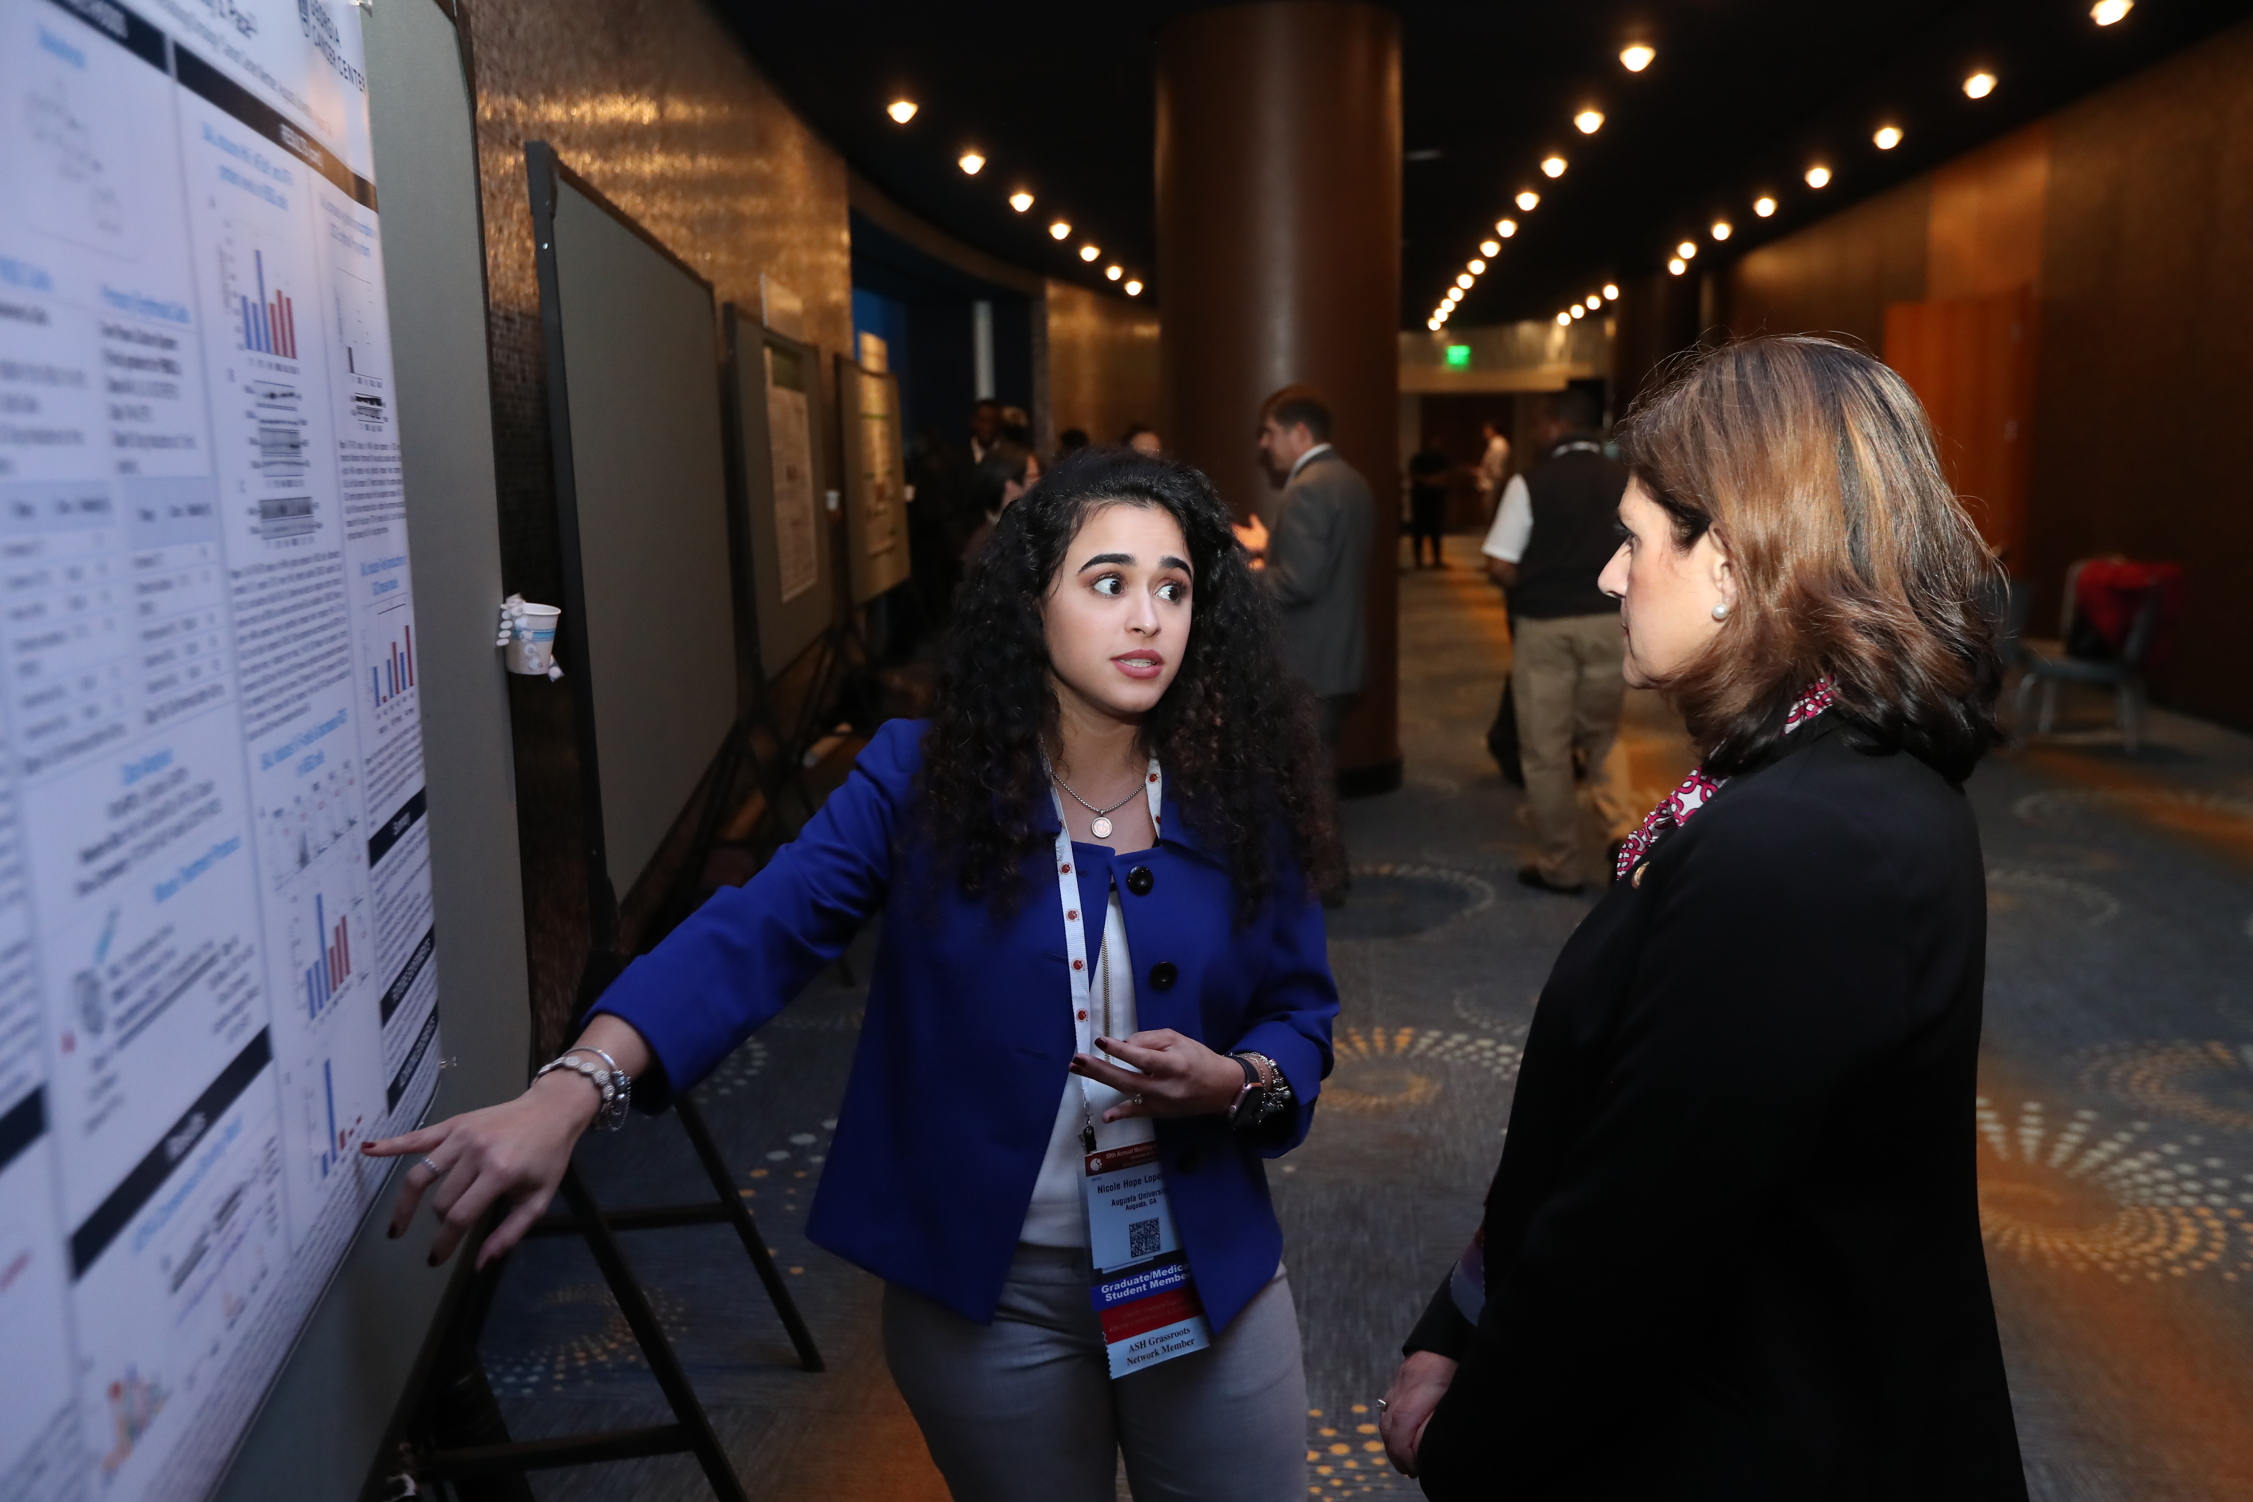
Interested in a Career in Hematology?
As the world's largest professional society of hematologists, ASH provides awards and programs to support hematologists in all stages of their careers and to honor those who have helped advance the field of hematology.
  Medical Student and Early Investigator Awards.
  Abstract Achievement Awards.
  Career-Enhancement Awards and Training Programs.
  Career Achievement Awards.
  ASH Minority Recruitment Initiative (MRI).

Slide 31
Minority Recruitment Initiative (MRI)
Goals:
  Increase the participation of URM training in hematology-related fields.
  Increase the number of minority hematologists with academic and research appointments.
Pathway of programs available for varying career stages.
Encouraged to apply for subsequent awards.

Slide 32
Minority Recruitment Initiative
Who is eligible?
  For the purposes of this program, minority is defined as a group of people from racial and ethnic groups that have been shown to be underrepresented in health-related sciences in the United States and Canada. This includes American Indians or Alaska Natives, Blacks or African Americans, Hispanics or Latinos, Native Hawaiians or other Pacific Islanders, African Canadians, Inuit, and First Nation Peoples.
MRI Programs:
  Minority Medical Student Award Program (MMSAP).
  Minority Resident Hematology Award Program (MRHAP).
  Minority Graduate Student Abstract Achievement Award (MGSAAA).
  Harold Amos Medical Faculty Development Program (ASH-AMFDP).

Slide 33
MRI Awards in Development (launch in 2019)
ASH Minority Hematology Graduate Student Award Program (MGSAP).
  The proposed program would be an expansion to the existing Minority Graduate Student Abstract Achievement Award (MGSAAA) and would support 2 graduate students pursuing a PhD degree to conduct hematology research.

Slide 34
MRI Awards in Development (launch in 2019)
ASH Minority Hematology Career Development Award
MD/DO Fellow Award: The program would be intended for 3 fellows in their first or second year of fellowship at the time of application.
PhD Postdoctoral Fellow Award: This award that would support postdoctoral fellows with a PhD degree and who have fewer than three years of research experience after completion of their degree and would provide additional exposure to hematology. The program would be intended for 3 fellows in their first or second year of fellowship at the time of application.

Slide 35
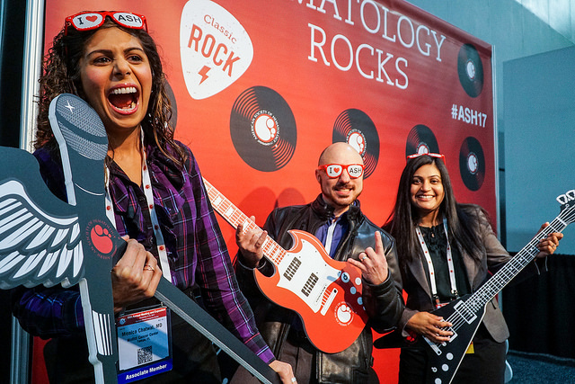
Medical Student & Early Investigator Awards
Minority Medical Student Award Program (MMSAP)
Physician-Scientist Career Development Award.
Hematology Opportunities for the Next Generation of Research Scientists (HONORS).
Minority Resident Hematology Award Program (MRHAP).

Slide 36
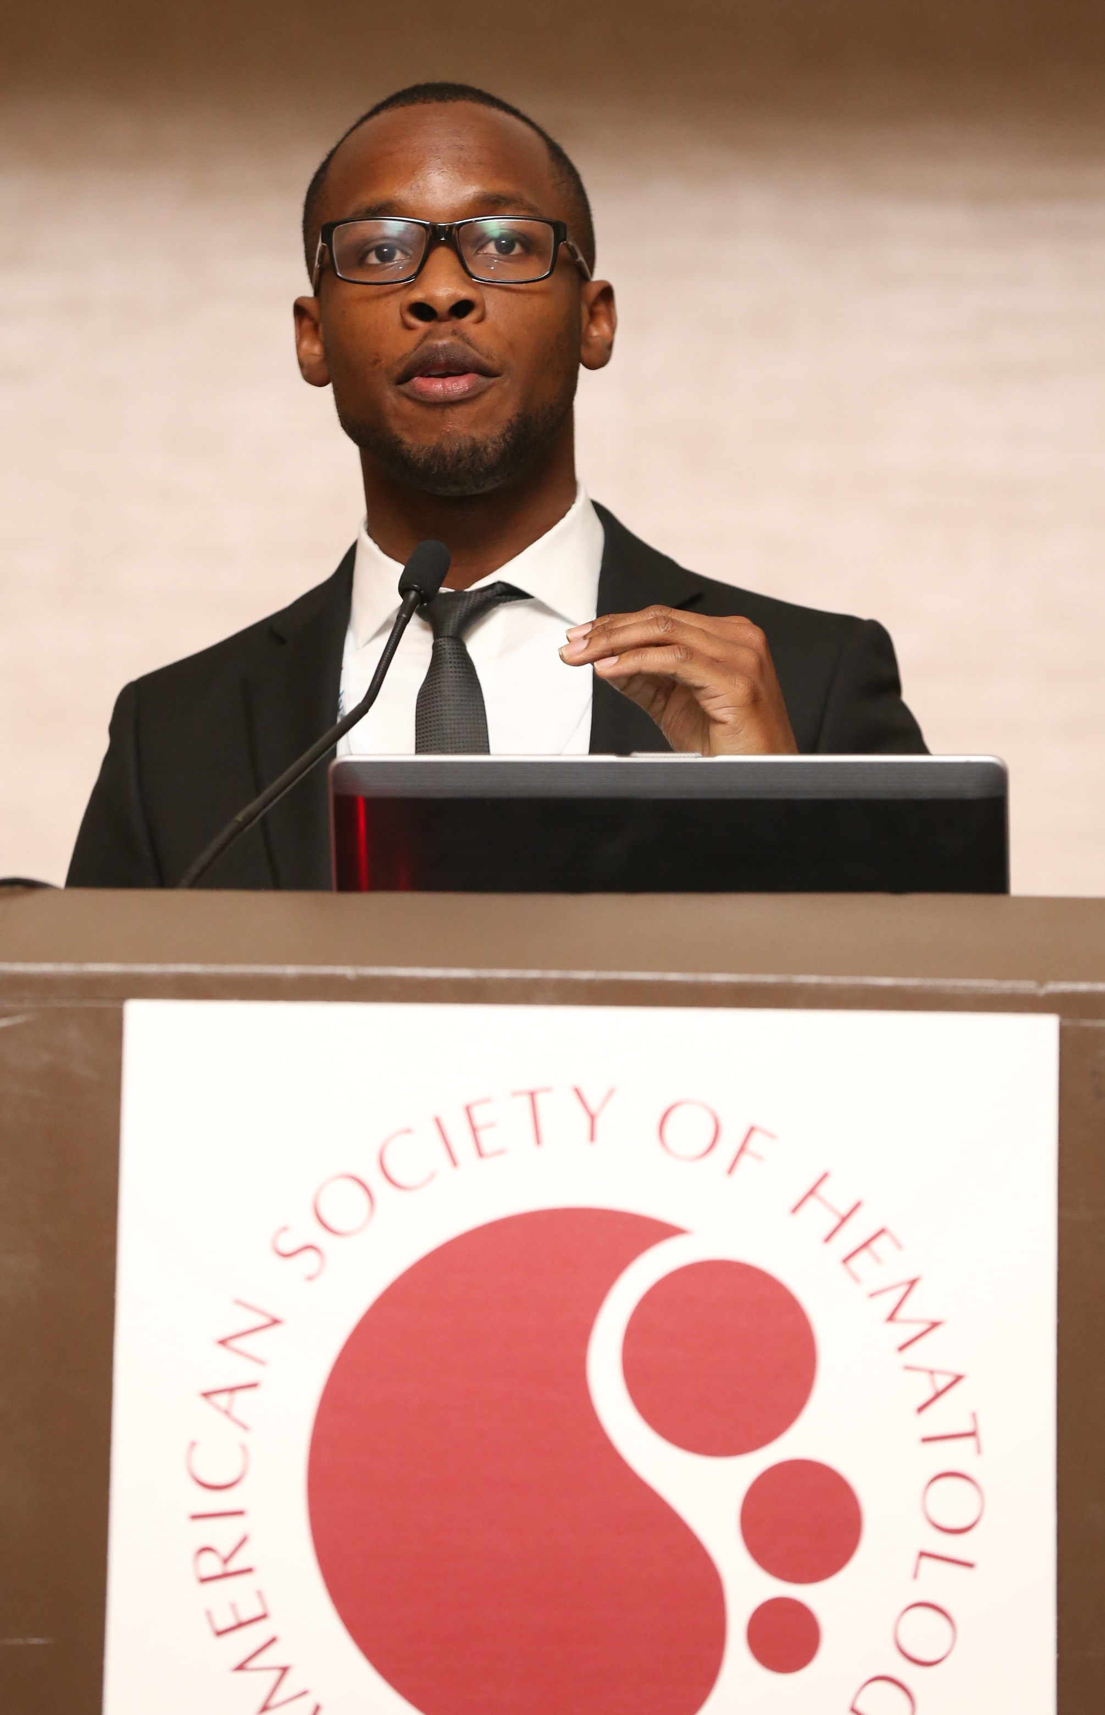
Minority Medical Student Award Program (MMSAP)
Designed to introduce underrepresented minority medical students to hematology with an opportunity to:
Conduct a research project under the supervision of an ASH member.
Receive guidance from a research mentor and a career-development mentor.
Gain valuable knowledge of hematology which helps awardees advance their careers.
Three project options:
  Summer- part time, to be conducted during the summer break. ($5,000 stipend).
  Flexible- part time, to be completed over the course of a year. ($5,000 stipend).
  Yearlong- full time, students take off a year from medical school to complete research. ($42,000 award).
The award provides complimentary ASH membership throughout medical school and residency as well as other benefits.
Recipients are encouraged to apply for subsequent awards.
Application opens in August and closes in January

Slide 37

Meet Anjelica, a Medical Student and
Two-Time ASH Award Recipient of the MMSAP
Research project: Exploring the Relationship Between Self­-Management and Disease Knowledge Among Adolescents with Sickle Cell Disease.
“Most important to me is that my research addresses care for patients with sickle cell disease, a population that experiences disparity in healthcare…I see my research as a contribution to a larger body of work to help sickle cell patients live longer, more fulfilled lives as adults.”
Anjelica C. Saulsberry
University of Tennessee Health Science Center College of Medicine

Slide 38
ASH Physician-Scientist Career Development Award
Provides an opportunity for first-, second-, and third-year medical students to gain experience in hematology research under the mentorship of an ASH member and to learn more about the specialty.
Awardees spend more than 80 percent of their time during the immersive, year-long project conducting laboratory, translational, or clinical hematology research.
The award provides $42,000 of funding for a one-year period.
Students can apply for a second year of funding.
Awardees attend the annual meeting and have opportunities to network with committee members and fellow trainees.
Award opens in August and closes in January

Slide 39
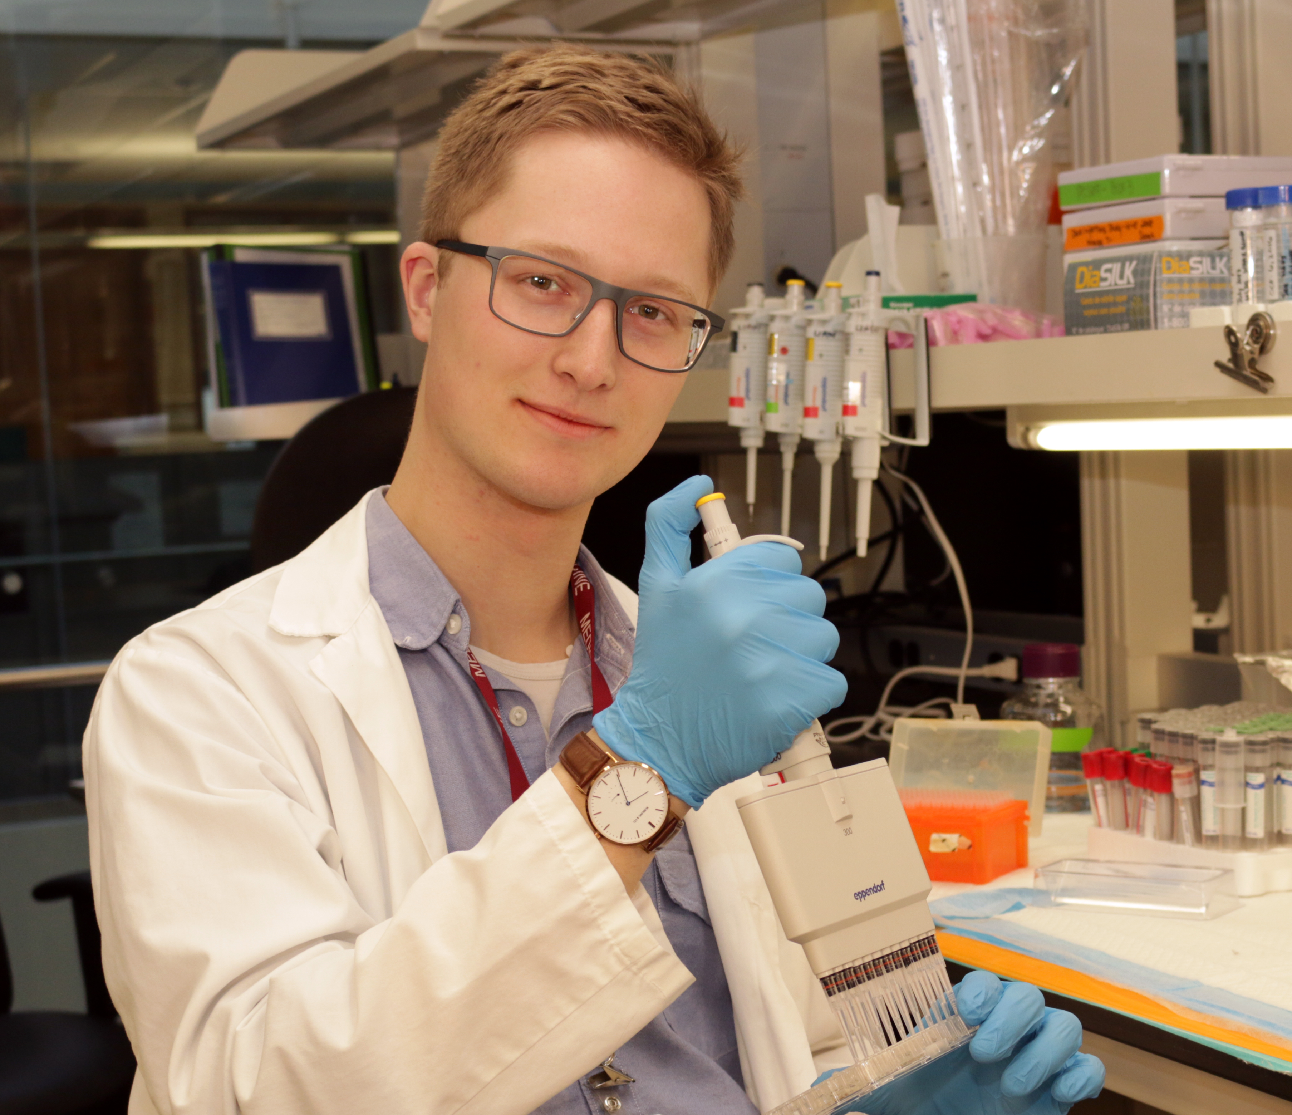
Meet Nicholas, a Medical Student and Two-Time ASH Award Recipient,
Physician-Scientist and HONORS
Research project: Translational studies of disseminated intravascular coagulation in sepsis and trauma.
"As someone interested in pursuing an academic career, [this award] is huge. There’s a lot that can be accomplished in a year with regards to research productivity. I really feel like I’ve gotten a sense of how academic medicine works.
In addition to my research project on Disseminated Intravascular Coagulation, my supervisor tries to involve me in other aspects of academia – like how to peer review a manuscript and write a grant."
Nicholas Jackson Chornenki
McMaster University

Slide 40
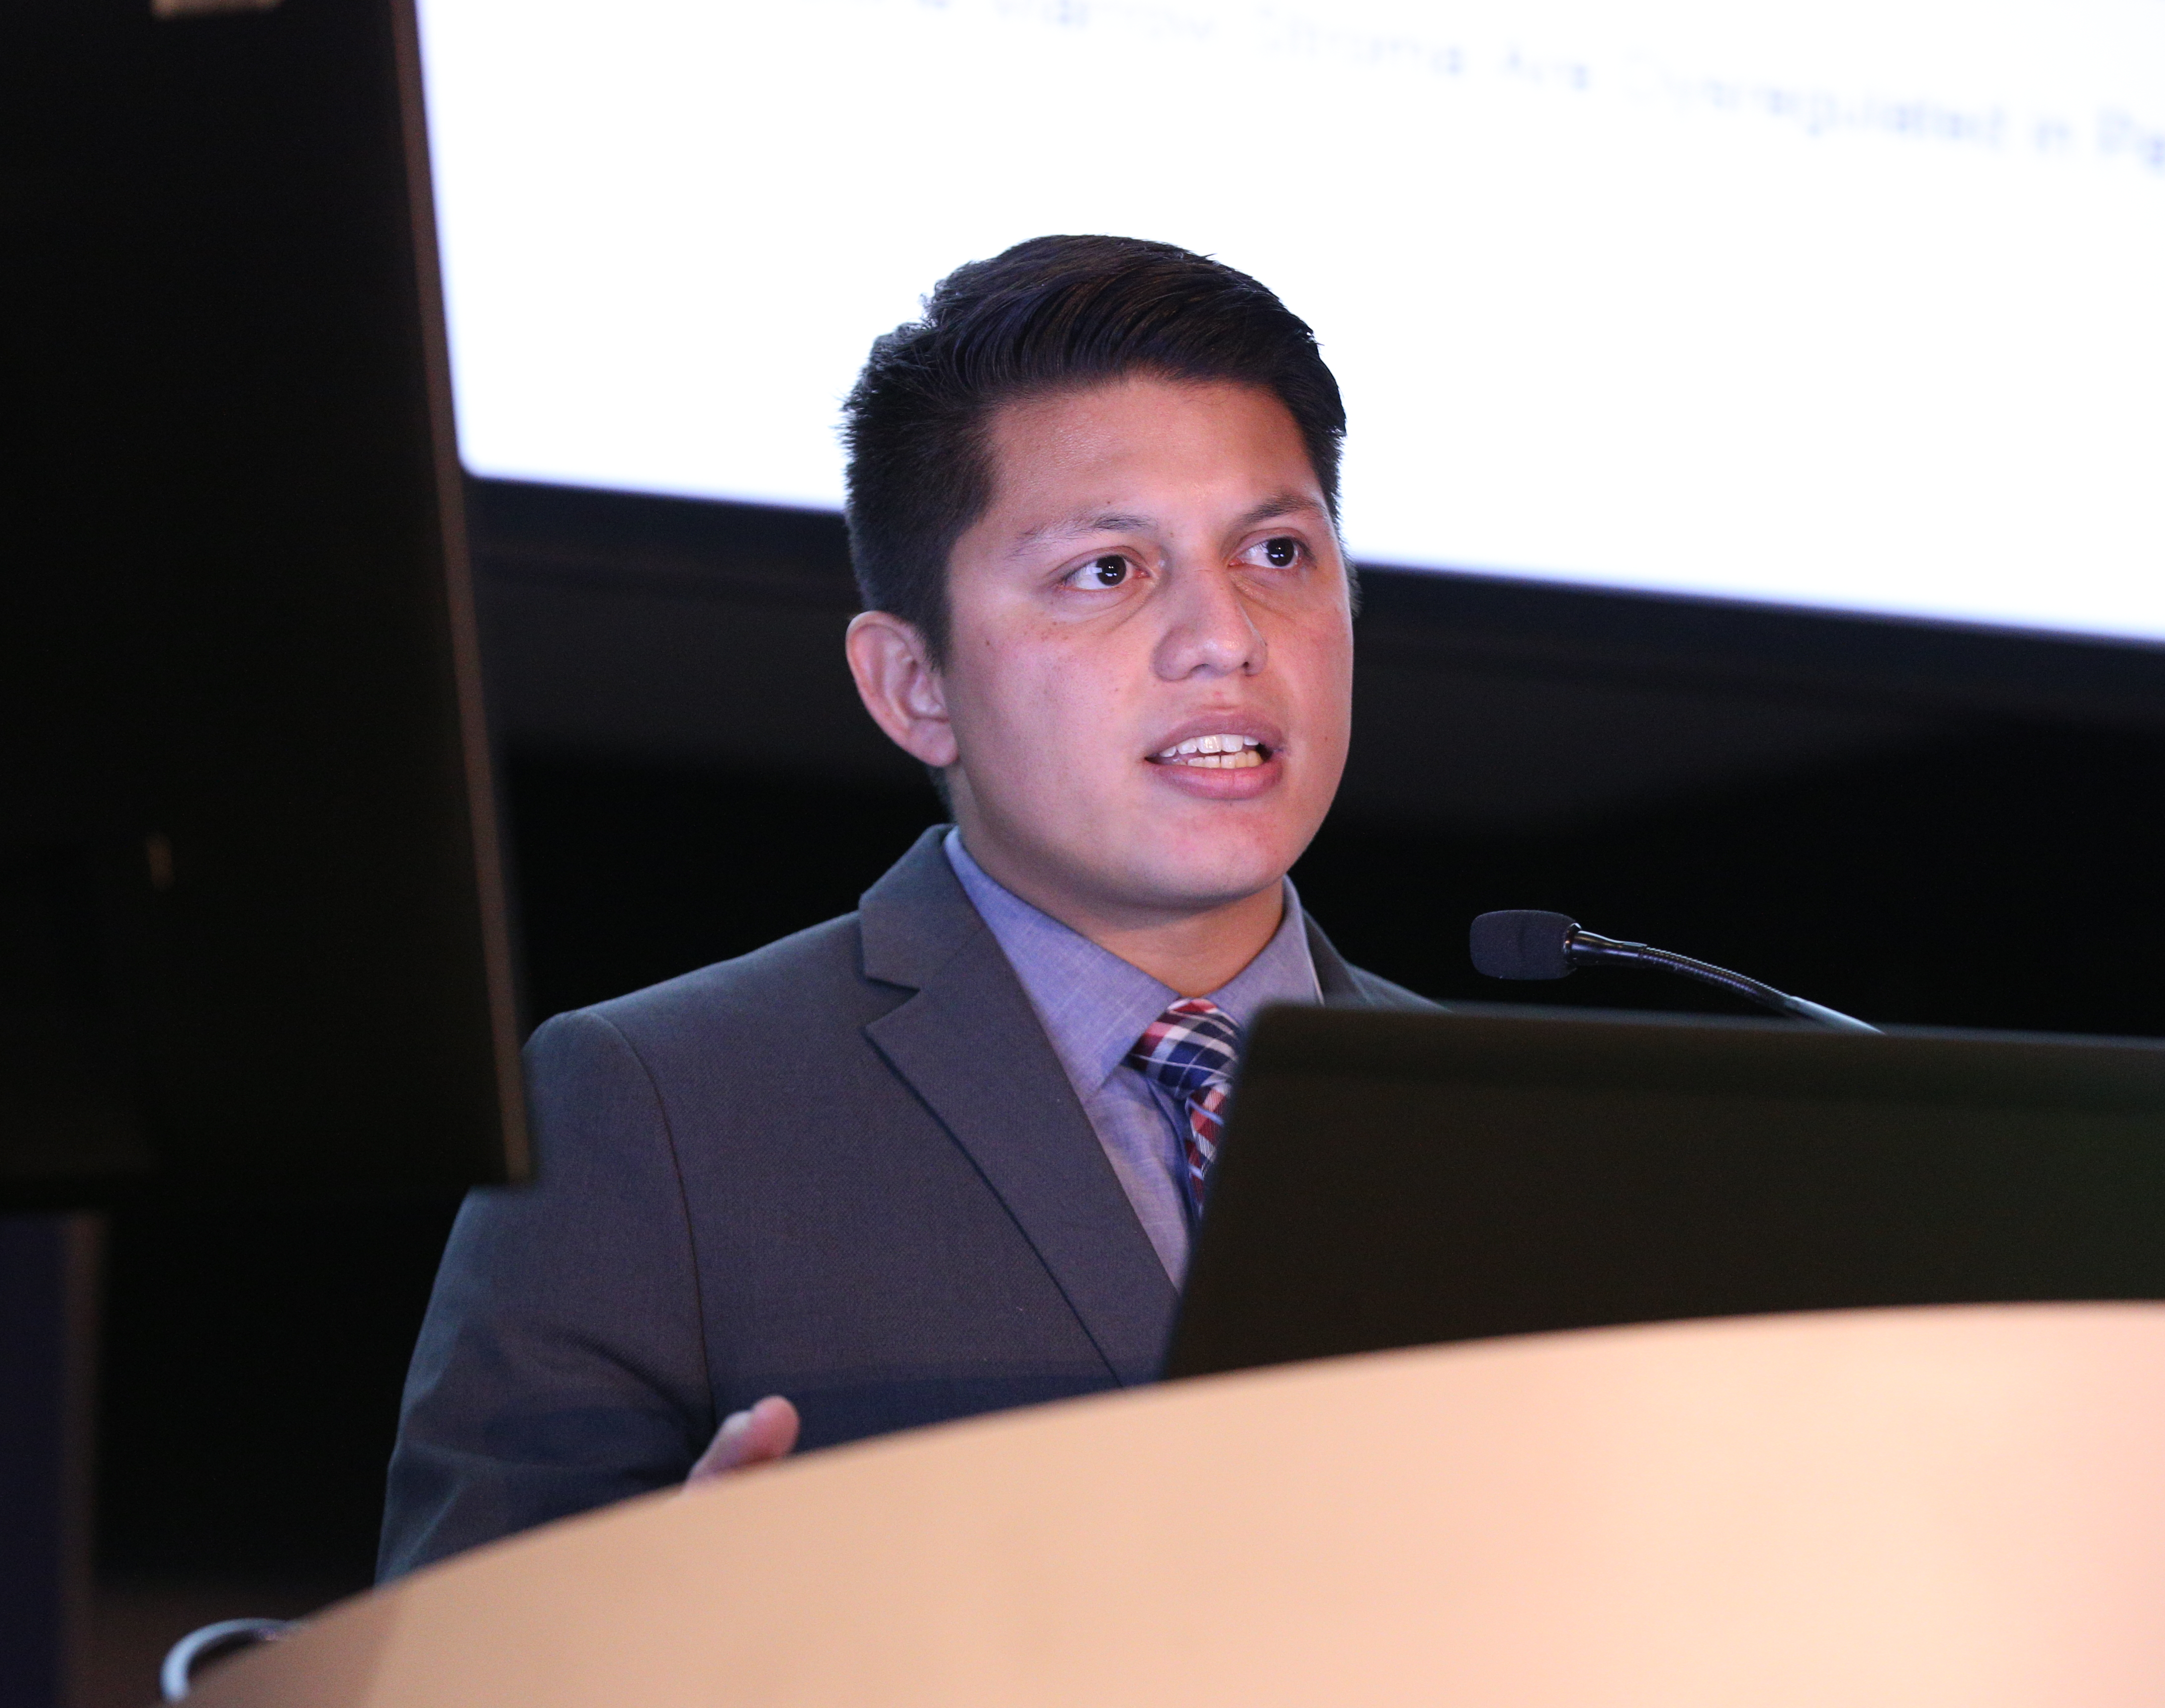
Hematology Opportunities for the Next Generation of Research Scientists (HONORS) Award
Contributes to the development of the next generation of hematologists by providing research funding for first, second, and third-year medical students as well as first- and second-year medical residents.
Two project options:
  Summer- part time, to be conducted during the summer break.
  Flexible- part time, to be completed over the course of a year.
The award provides a $5,000 stipend to support work on a hematology-related research project.
Awardees can apply for a subsequent experience.
Award opens in August and
Closes in February

Slide 41
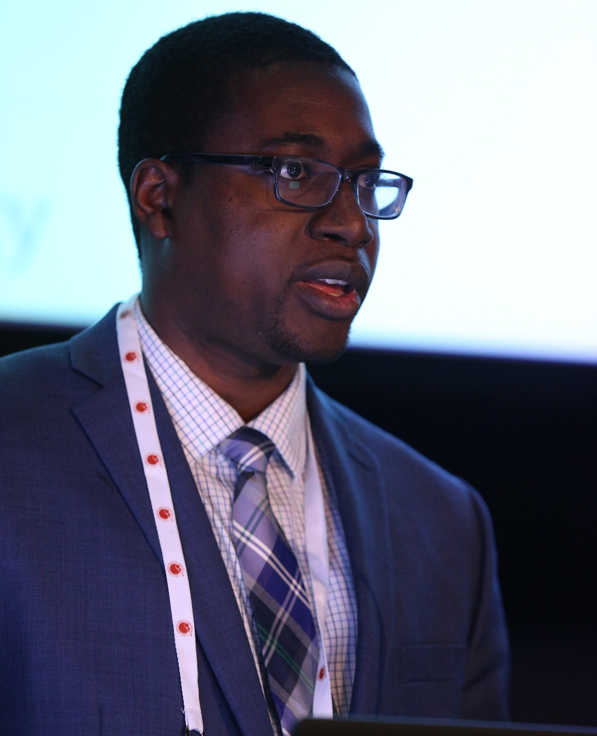
Minority Resident Hematology Award Program (MRHAP)
Offers a unique opportunity for first- and second-year underrepresented minority resident physicians to get exposure to the field of hematology and conduct hands-on research under the guidance of an ASH member and research mentor.
The award provides:
The guidance of a research and career-development mentor.
$5,000 stipend to support their research project.
Complimentary ASH membership throughout residency.
Award opens in August and closes in January

Slide 42

Meet Elisa, a medical resident and two-time ASH award recipient of MMSAP and MRHAP
Research project: Acute Lymphoblastic Leukemia in the Latino Population.
"What I have learned and continue to learn from my mentor through our conversations about research, academic life, working as a clinician, and even work-life balance, has far exceeded my expectations.“
Elisa is one of 24 individuals who have successfully navigated the longitudinal pathway of ASH MRI programs, competing for and receiving funding for multiple supported research projects.
Elisa K. Quiroz, MD
Beaumont Health

Slide 43
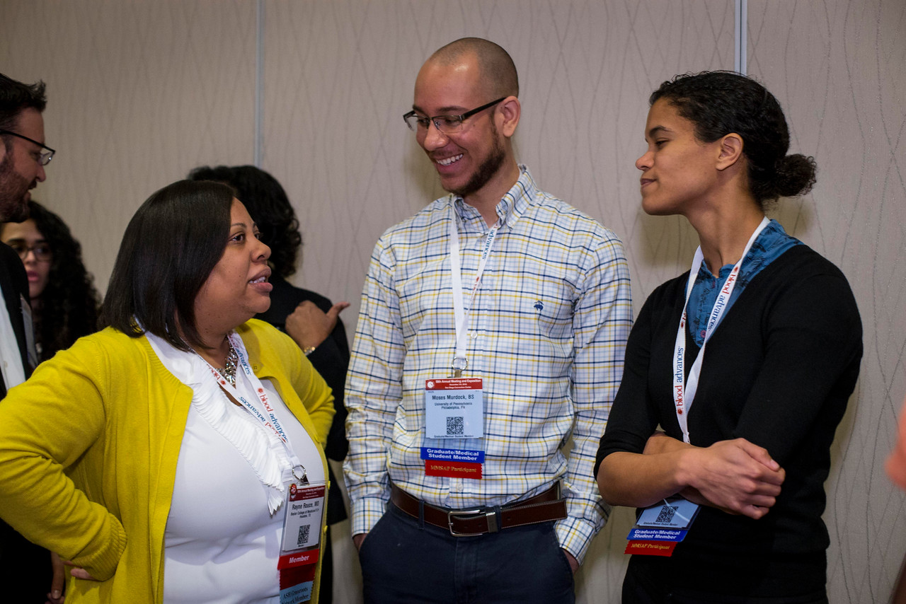
Career-Enhancement Awards and Training Programs
Minority Graduate Student Abstract Achievement Award (MGSAAA).
Abstract Achievement Awards.
Harold Amos Medical Faculty Development Program (ASH-AMFDP).
ASH Research Training Award for Fellows (RTAF).
Clinical Research Training Institute (CRTI).
Translational Research Training in Hematology (TRTH).
ASH Scholar Award.
ASH Medical Educators Institute (ASH MEI).
Awardees networking at the ASH-AMFDP event.

Slide 44
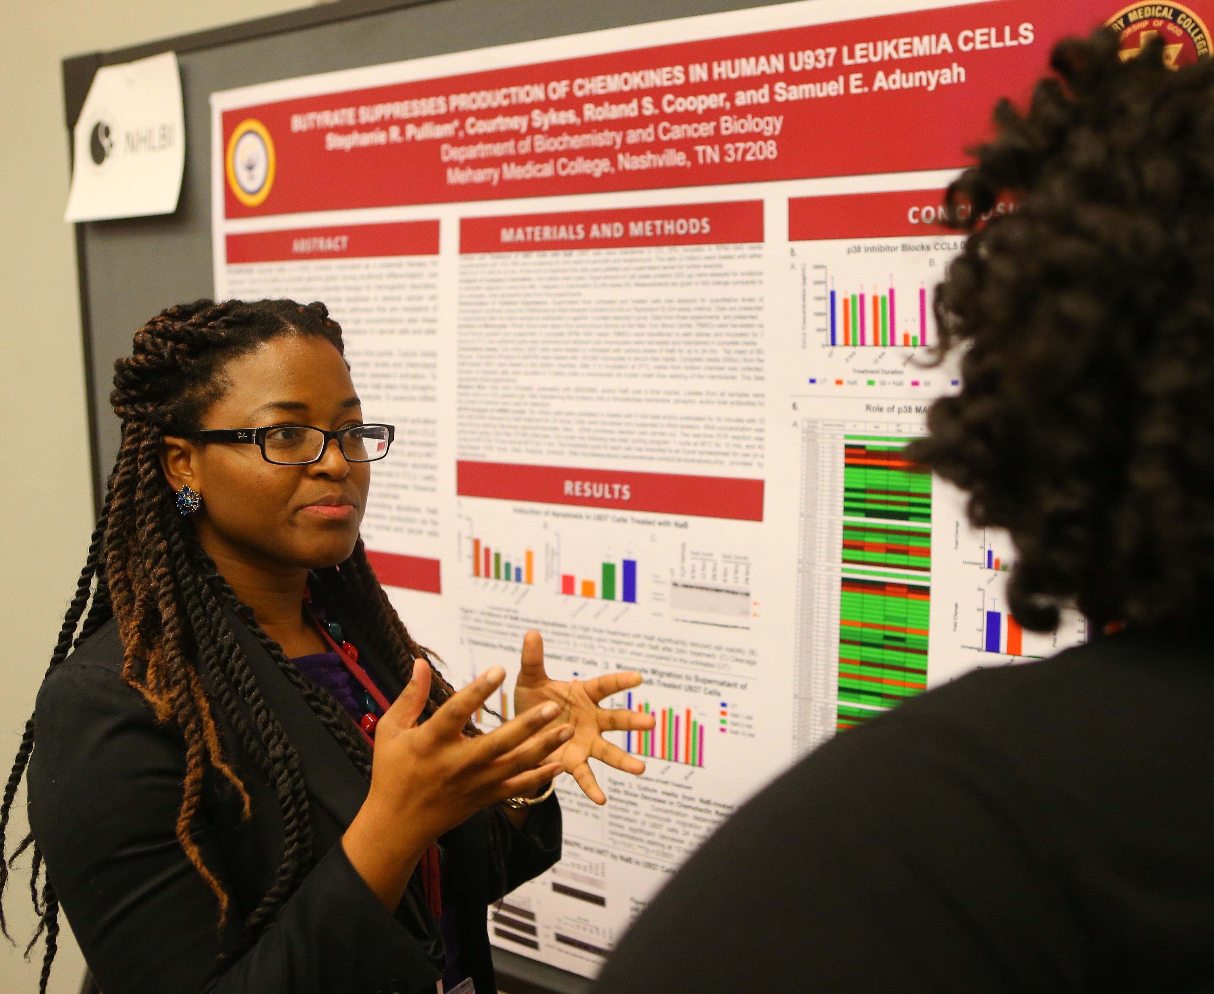
Minority Graduate Student Abstract Achievement Award (MGSAAA)
Designed to attract and/or retain underrepresented minority PhD students to the field of hematology through the ASH annual meeting.
At the meeting, students have the opportunity to hear the latest advances in hematology research, and interact with ASH leadership, senior researchers, minority physicians, scientists, and students.
The award provides:
  $1,500 stipend.
  Complimentary ASH membership.
  Online subscription to ASH journal, Blood®.
  Subscription to The Hematologist.
Awards opens in June and closes in August

Slide 45
Abstract Awards
Abstract Achievement Awards (formerly Travel Awards): for trainees who are chosen to present an abstract, of which they are the first or senior author and presenter, at the ASH annual meeting.
Outstanding Abstract Achievement Awards (formerly Merit Awards): provided to abstract presenters with the highest scoring abstracts of which they are the first author in each of the following categories: undergraduate student, medical student, graduate student, resident physician, and post-doctoral fellow (MD or PhD).

Slide 46
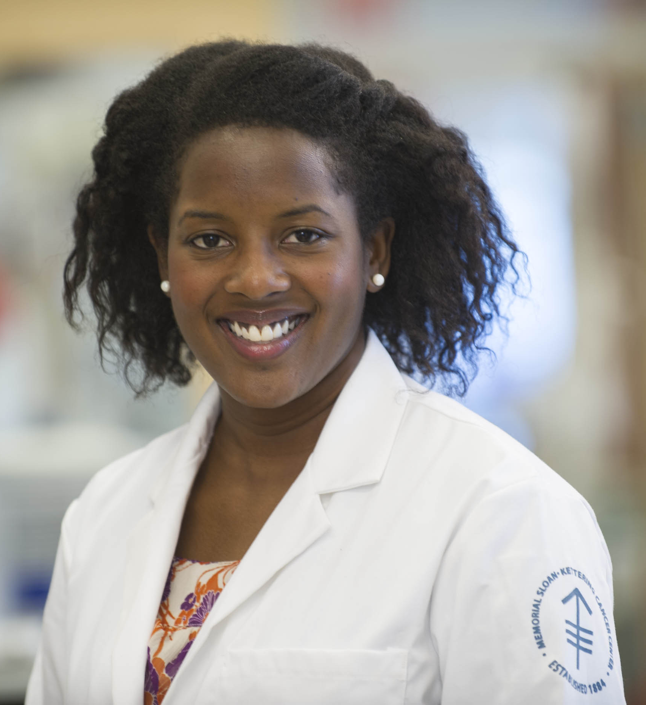
ASH-Harold Amos Medical Faculty Development Program Award (ASH-AMFDP)
Designed to increase the number of underrepresented minority scholars in the field of hematology with academic and research appointments.
Program benefits include:
Four years of postdoctoral research support, $420,000 over four years.
Complimentary ASH membership.
Subscription to ASH journal, blood®.
The opportunity to attend the ASH annual meeting for the four years of the award, with all travel, lodging, and meal costs covered by ASH.
3 NIH directors are AMFDP alums!
Application opens in February, closes in March

Slide 47
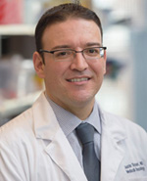
Meet Justin, ASH-AMFDP Recipient
Research project: Biological and Mechanistic Effects of XPO1 Alterations in Hematopoietic Malignancies.
“My first and foremost goal has always been to help patients with cancer, and I think I can make the biggest impact by performing translational research that will bring science to the bedside.
The ASH-AMFDP Award will help immensely as it is my first significant career development award and spans a four-year period. During this time, I will develop my independent research program and lay the foundation for future scientific inquiry into the molecular mechanisms of leukemia.”
Justin Taylor, MD
Memorial Sloan Kettering Cancer Center

Slide 48
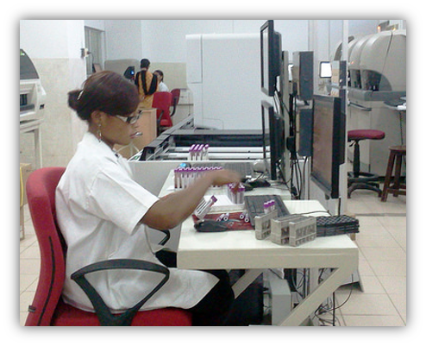
ASH Research Training Award for Fellows
Designed to encourage junior researchers in hematology, hematology/oncology, and other hematology-related training programs to pursue careers in academic hematology.
Program benefits:
$70,000 for a one-year period to guarantee protected time for clinical, basic, or translational research.
  Funding is available each year for up to four RTAF recipients to apply for a second year of support.
The RTAF is open to both MD and MD-PhD researchers between their second and fifth year of fellowship.
Application opens in August, closes in January

Slide 49
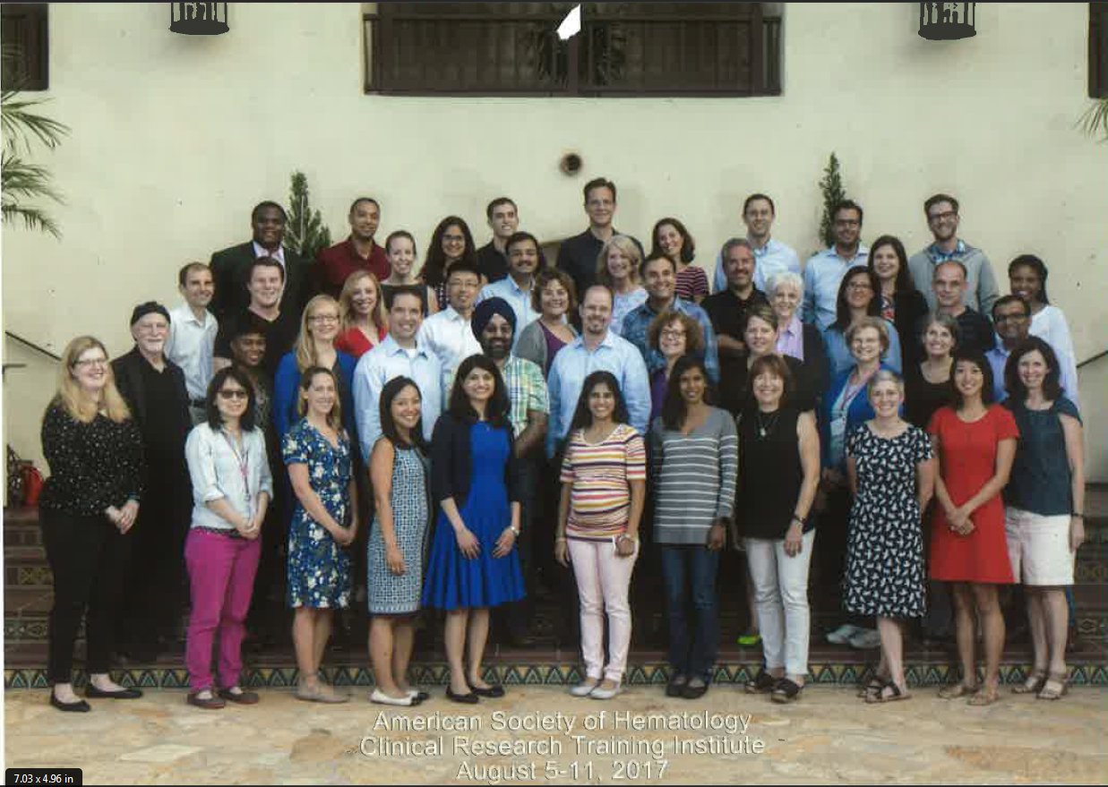
Clinical Research Training Institute
The ASH Clinical Research Training Institute (CRTI) is a unique year-long education and mentoring program for hematology and hematology/oncology fellows-in-training, as well as junior faculty physicians at academic medical centers. The goal of ASH’s Clinical Research Training Institute is to prepare hematologists for careers in patient-oriented clinical research.
CRTI consists of four mandatory components:
A week-long workshop in August in La Jolla, California, which focuses on the foundation, methodologies, and application of patient-oriented clinical research.
A follow-up meeting at the ASH annual meeting in December.
A final meeting in May at ASH Headquarters in Washington, DC where the participants share the status of their research.
Networking and mentorship through distance learning, which takes place between the in-person meetings.
Application opens in October, closes in March

Slide 50
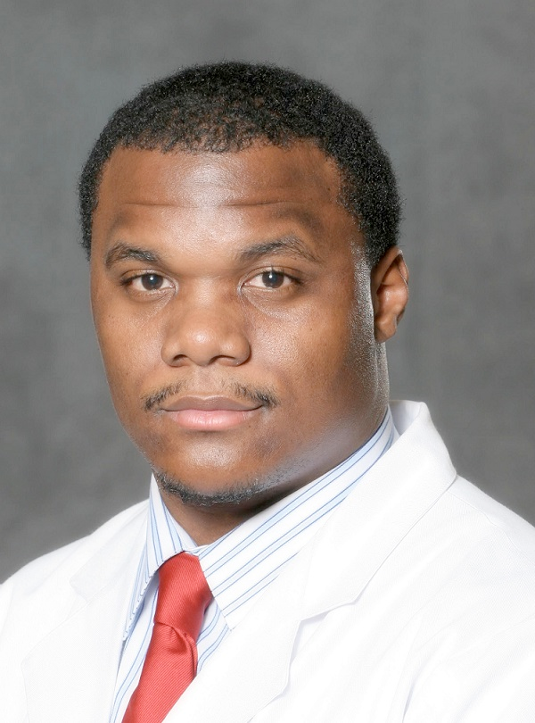
Meet Brandon, CRTI Participant
Research project: STAT Trial: Sickle cell cognitive assessment in adults.
“Of all the different programs that are available, I would say CRTI is probably one of the most special because in research for any trainees or any faculty, one major thing that helps propel you to the next level is mentorship. Mentorship, career development, and actually having a plan. Throughout CRTI, basically the whole goal is once you have this research project it puts you on the pathway to success.
The one thing that I would say mean the most to me is the relationships and networking I was able to obtain through CRTI. There are people who we call the giants in the field who are actually there at CRTI…developing a professional and personal relationship with trainees who otherwise wouldn’t have access.”
Brandon Blue, MD
Saint Louis University School of Medicine

Slide 51
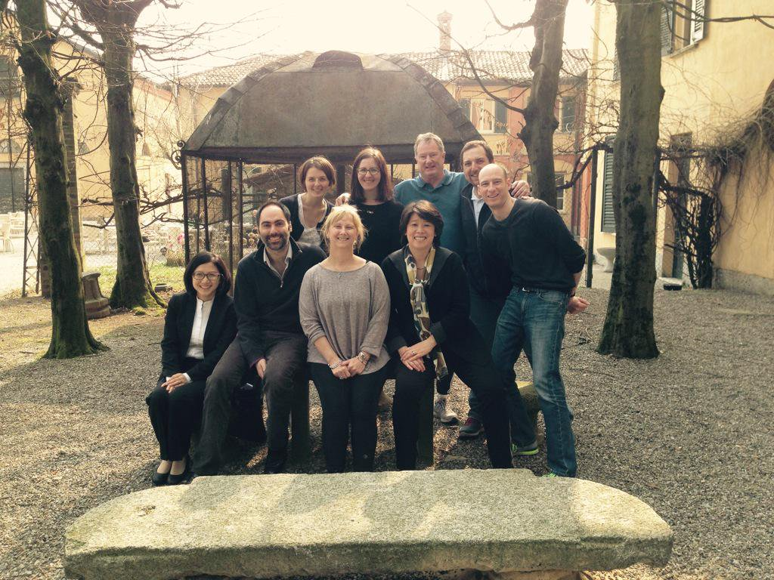
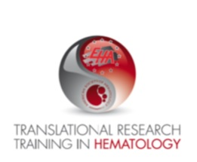
Translational Research Training in Hematology
ASH-EHA Translational Research Training in Hematology (TRTH) is a unique, year-long training and mentoring program focused on helping junior researchers build successful careers in hematologic translational research.
TRTH includes three mandatory components:
An intensive, week-long course held in Europe in the spring.
A follow-up meeting, which takes place during the Annual Congress of EHA in June.
A final meeting at the ASH annual meeting in December where the participants share the status of their research project.
LOI opens in March, closes in June

Slide 52
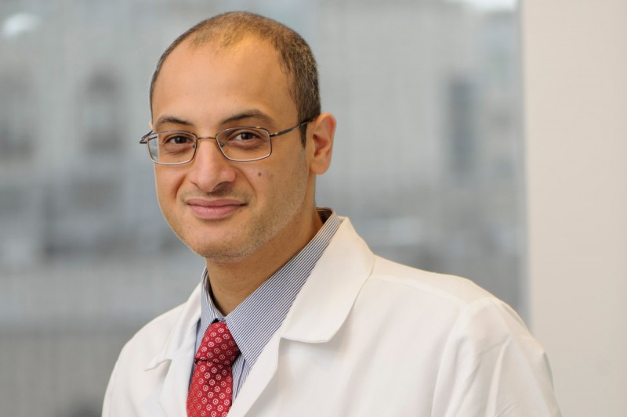
ASH Scholar Award
Designed to help ease the transition between completion of training and the establishment of independent career by providing partial salary or other support.
Recipients may receive up to $100,000 for fellow scholars and $150,000 for junior faculty scholars over a two- to three-year period.
29.4% of RTAF awardees have gone on to receive future ASH awards including 12 Scholar Awards.
ASH has spent over $41 million dollars on Scholar Awards since the program’s inception.
Application opens March, closes August

Slide 53
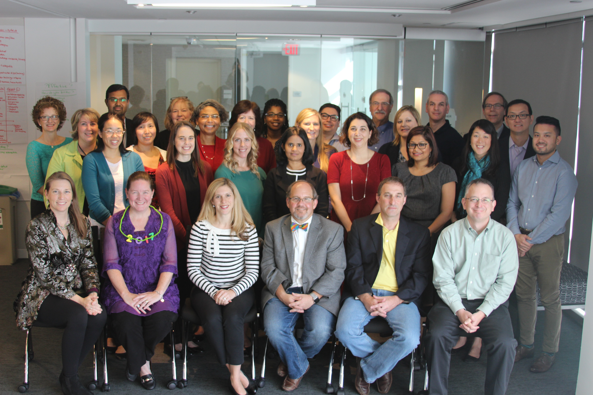
ASH Medical Educators Institute
The ASH Medical Educators Institute (MEI) develops future
leaders in hematology education by providing a "boot camp“ in teaching techniques, medical education scholarship, and career development for hematologists and fellows who are new to or in the early phases of medical education careers. The training is designed to build skills and position junior faculty and senior fellows for successful careers as clinician educators and mentors to future generations of hematologists.
ASH MEI includes three components:
A three-day, in-person workshop at ASH Headquarters in Washington, DC.
A six-part webinar series covering the medical educator core competencies not addressed in the workshop, hosted over the six months following the workshop.
Mentorship from MEI Faculty over the year of the program.
Application opens in February, closes in April.

Slide 54
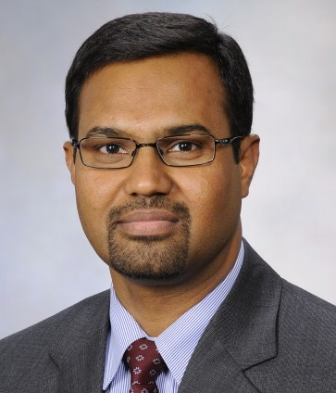
Meet Prakash, ASH MEI Participant
Research project: Managing Direct Oral Anticoagulants: A Team-Based Learning Workshop for Hematology Trainees.
“The program was a perfect boot camp to boost my knowledge in hematology education research, and it provided a fantastic launch-pad for career advancement.”
Prakash Vishnu, MD, FACP
Mayo Clinic College of Medicine

Slide 55
Additional Awards
Bridge Grant: Each year, approximately 20 to 30 one-year awards of $150,000 are granted to ASH members who applied for an NIH R01 grant or equivalent but were denied funding due to budget cutbacks. ASH Bridge Grants are intended to help sustain recipients' research and contribute to their retention in hematology investigation.
Honorific and Mentor Awards: The Honorific and Mentor Awards are the Society's most prestigious awards, recognizing significant contributions to the field of hematology made by hematologists. Each year, the Society honors outstanding hematologists through a number of different awards.

Slide 56

Annual Meeting Benefits for Awardees
At the ASH annual meeting, participants have outstanding opportunities to meet prominent hematology leaders, network with other program participants, and discover breaking news in the field. Benefits vary by award:
Travel stipends to help cover travel cost.
Stipends to support opportunities to present research.
Invitations to exclusive gatherings.
Invitations to network with committees and mentors.

Slide 57
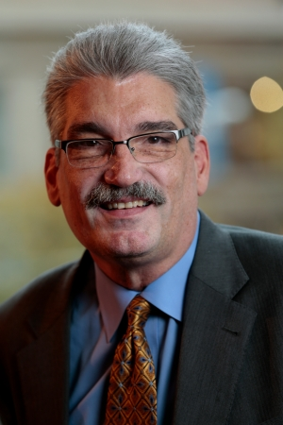
Final Thought…
The (award) resources give you a chance to do things you might not have otherwise. They enable creativity and innovation and confidence that somebody thought that I could do something to make a difference.
D. Gary Gilliland, MD
Fred Hutchinson Cancer Research Center

Slide 58
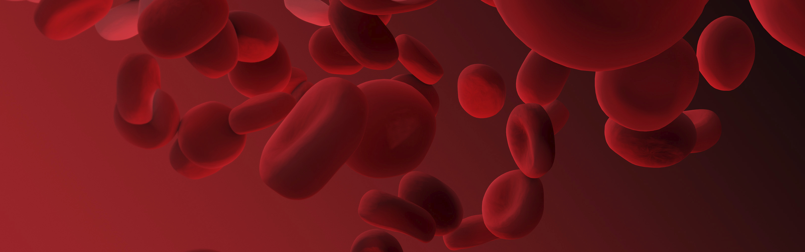
Learn More about ASH Awards
To learn more about The American Society of Hematology and their various awards, please visit www.hematology.org/awards
or email awards@hematology.org

