Slide 1
New Approaches to Old Diseases
Press Briefing
Moderator: Aaron Gerds, MD, Cleveland Clinic Taussig Cancer Center
Saturday, December 9, 2023: 7:15 a.m. – 8:15 a.m. Pacific time
Embargoed until Saturday, Dec. 9, 2023, at 7:15 a.m. Pacific time

Slide 2
Panelists
Contact ASH press staff at
ashmedia@fleishman.com
Andrew Srisuwananukorn, MD, The Ohio State University
901: Interpretable Artificial Intelligence (AI) Differentiates Prefibrotic Primary Myelofibrosis (prePMF) from Essential Thrombocythemia (ET): A Multi-Center Study of a New Clinical Decision Support Tool
Oliver Shastri, MBBS MRCS, Pfizer UK Ltd
1057: Understanding the experiences of patients with sickle cell disease and their caregivers by social media listening in the UK
Harinder Gill, MD, University of Hong Kong
157: An Entirely Oral Regimen of Oral-Arsenic Trioxide/All-Trans Retinoic Acid/Ascorbic Acid in Newly- Diagnosed Acute Promyelocytic Leukaemia (APL): Updated Results of an Ongoing Multicentre Trial
Fabian Müller, MD, of Bavarian Cancer Research Institute
220: CD19-Targeted CAR-T Cells in Refractory Systemic Autoimmune Diseases: A Monocentric Experience from the First Fifteen Patients
Embargoed until Saturday, Dec. 9, 2023, at 7:15 a.m. Pacific time

Slide 3
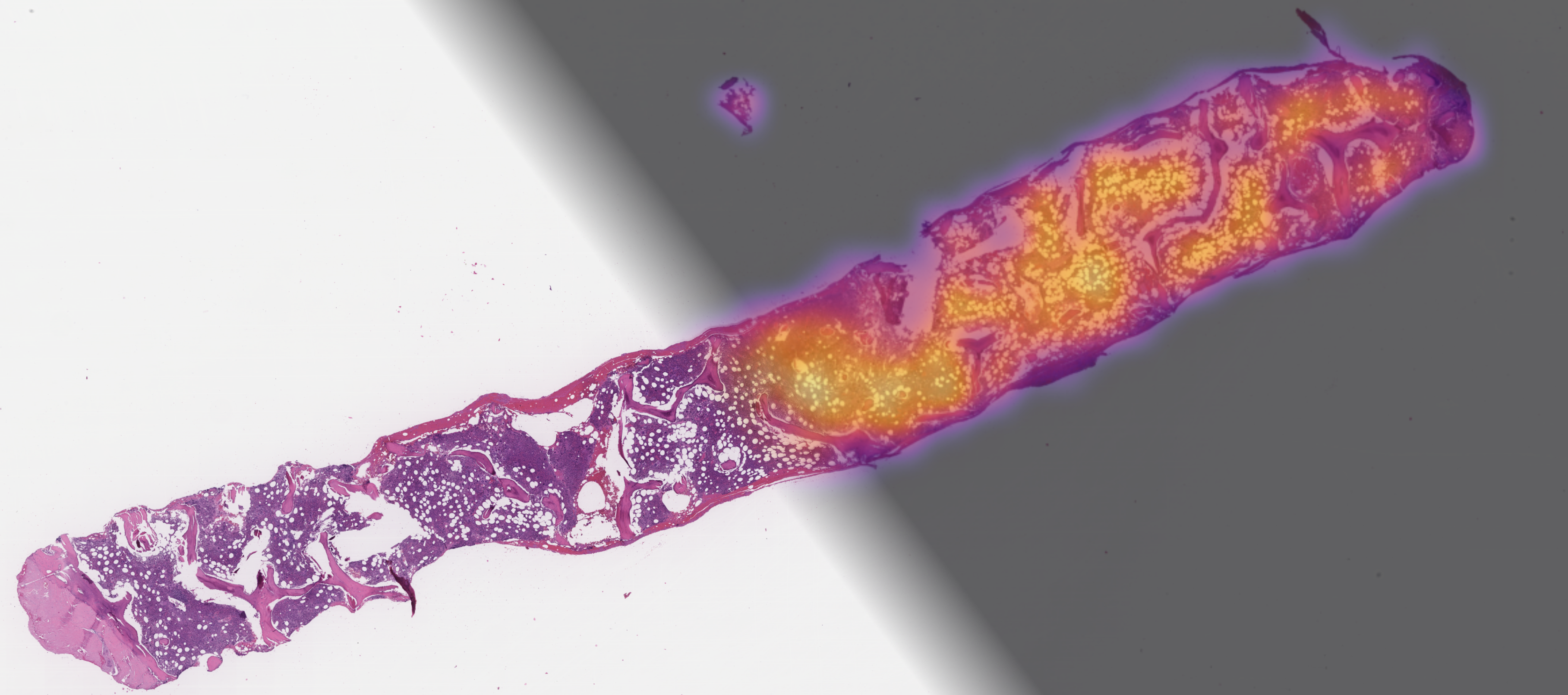

Interpretable Artificial Intelligence Differentiates Prefibrotic Primary Myelofibrosis from
Essential Thrombocythemia
Andrew Srisuwananukorn
ASH Annual Meeting 2023
@andrewsris1
Embargoed until Saturday, Dec. 9, 2023, at 7:15 a.m. Pacific time

Slide 4
Overview of Myeloproliferative Neoplasms (MPNs)
MPNs are a family of hematological myeloid neoplasms
More common diagnoses include polycythemia vera (PV), essential thrombocythemia (ET), and primary myelofibrosis (PMF)
Share common activated
JAK-STAT pathway due to
JAK2, CALR, or MPL mutations
Boissinot, et al. Cancers (2014)
Embargoed until Saturday, Dec. 9, 2023, at 7:15 a.m. Pacific time

Slide 5
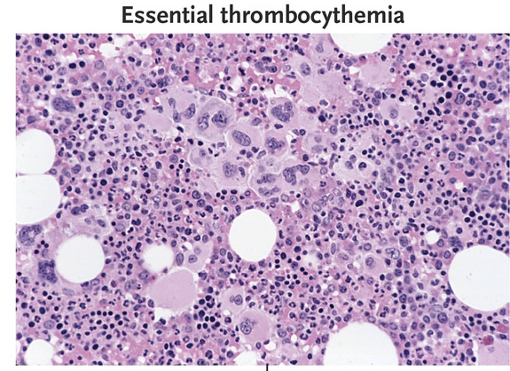
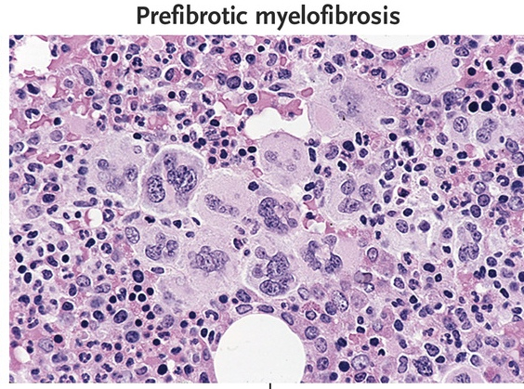
Prefibrotic Primary Myelofibrosis as a separate entity
In 2016, World Health Organization differentiates ET from a newly-defined prefibrotic/early primary myelofibrosis (prePMF).
Compared to ET, prePMF patients have higher risk for
    constitutional symptoms^{1,2}
    major hemorrhage³
    progression to overt MF and leukemia^{4,5}
1. Guglielmelli, et al. Blood (2017)
2. Gisslinger, et al. Leukemia (2016)
3. Finazzi, et al. Leukemia (2012)
4. Rumi, et al. Oncotarget (2017)
5. Barbui, et al. J Clin Oncol (2011)
6. Passamonti, et al. Haematologica (2008)
Embargoed until Saturday, Dec. 9, 2023, at 7:15 a.m. Pacific time

Slide 6
Challenges in differentiating prePMF from ET
Diagnosis of ET and prePMF rely on similar clinical analysis, mutational profiling, morphological analysis of megakaryocytic proliferation and atypia, and the subjective assignment of a fibrosis grade by a hematopathologist.
High interobserver variability in bone marrow assessment with consensus varying between 49% and 100%^{1,2}
There is a pressing need for improved diagnostics to differentiate among prePMF and ET
1. Alvarez-Larrán, et al. Br J Haematol (2014)
2. Barbui, et al. Blood Cancer Journal (2018)
3. Thiele, et al. Blood (2011)
Embargoed until Saturday, Dec. 9, 2023, at 7:15 a.m. Pacific time

Slide 7
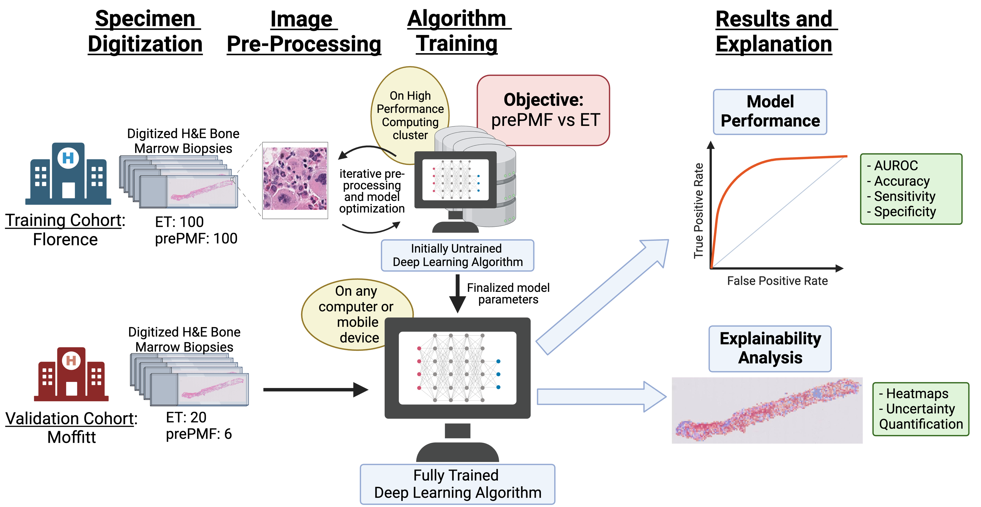


Training Cohort:
University of Florence
200 Patients
Prediction in
6 seconds
per slide
Validation Cohort:
Moffitt Cancer Center
26 Patients
Embargoed until Saturday, Dec. 9, 2023, at 7:15 a.m. Pacific time

Slide 8
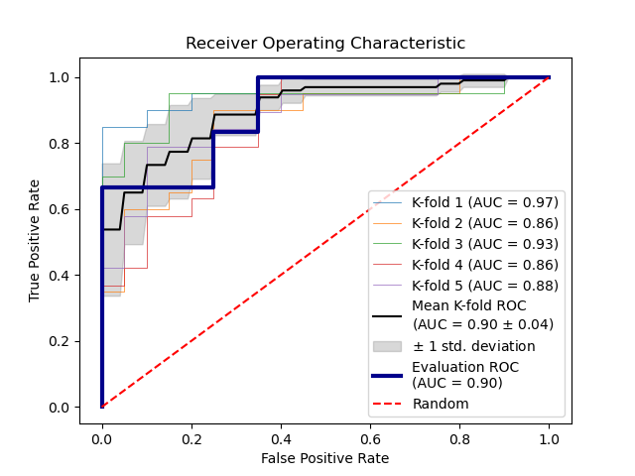
Results: Area Under Receiver Operator Curve
External Validation:
  AUROC 0.90
After Threshold for Diagnosis Classification:
    Sensitivity: 66.6%
    Specificity: 100%
    PPV: 100%
    NPV: 90.9%
    Accuracy: 92.3%
Florence
Moffitt
Embargoed until Saturday, Dec. 9, 2023, at 7:15 a.m. Pacific time

Slide 9
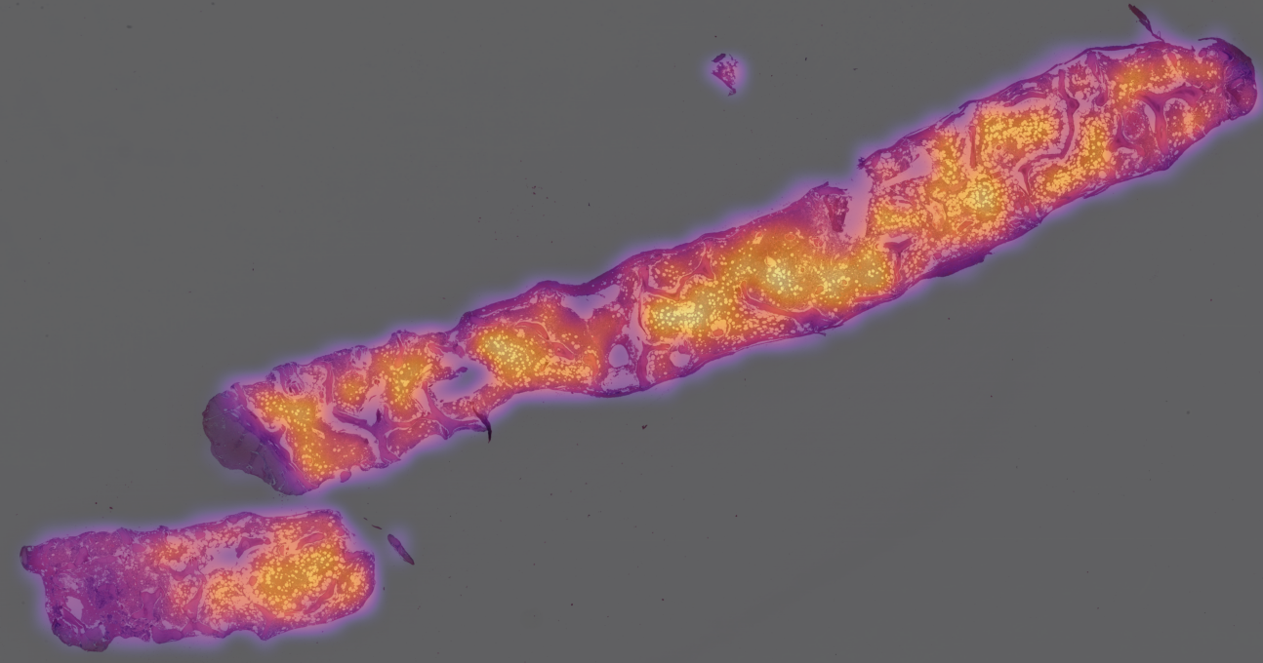
Explainability: Attention Heatmap on Bone Marrow Image
Embargoed until Saturday, Dec. 9, 2023, at 7:15 a.m. Pacific time

Slide 10






Project Team Funding
Ohio State University
Andrew Srisuwananukorn
Icahn School of Medicine at Mount Sinai
Ronald Hoffman
Douglas Tremblay
University of Florence
Alessandro Vannucchi
Giuseppe Loscocco
Raffaella Santi
Paola Guglielmelli
Moffitt Comprehensive
Cancer Center
Andrew Kuykendall
Ling Zhang
Avani Singh
University of Chicago
Alexander Pearson
James Dolezal
Sonic Healthcare USA
Mohamed Salama
2022 Paul Carbone, MD Fellowship Award
2023 Young
Investigator Award
Mildred Early Career
Research Fellow
Embargoed until Saturday, Dec. 9, 2023, at 7:15 a.m. Pacific time

Slide 11
Understanding the Experiences of Patients with Sickle Cell Disease and Their Caregivers by Social Media Listening in the UK
PP-UNP-GBR-7443 DoP November 2023
Embargoed until Saturday, Dec. 9, 2023, at 7:15 a.m. Pacific time
Oliver Shastri, BSc (Hons), MBBS, MRCS¹; Orlando Agrippa, MBA²; Laura Galimam, MSc³; Seraj Sharif, MSc¹; Marzieh Araghi, PhD¹
¹Pfizer Ltd, Tadworth, UK; ²Sanius Health, London, UK; ³Lumanity, London, UK
This study was initiated and funded by Pfizer Ltd.
Presentation for the 65th American Society of Hematology Annual Meeting and Exposition, San Diego, California, December 9–12, 2023
Notes:
Notes:
Oral presentation slots are 18 minutes per paper (including changing time of presenters).
The general rule is to use 15 minutes for each presentation and 3 minutes for questions and discussion at the end of each session.

Slide 12





Sickle Cell Disease in the UK
Introduction
A life-long hereditary condition¹ with an unpredictable disease course²
Affects ~20,000 people in the UK³
Associated with reduced life expectancy and quality of life¹
Long-term complications include:^{1,4,5}
High infection rate
Severe anemia
Organ damage
Stroke
Vaso-occlusive crises*
Embargoed until Saturday, Dec. 9, 2023, at 7:15 a.m. Pacific time

Slide 13








Social Media Listening: Gathering Sickle Cell Disease Insights
Introduction
Using AI-powered analytic tools, we can explore online conversations surrounding SCD to gain valuable information regarding real-world experiences in this under-researched population,¹ including:
  Patient experience with the health system²
  Health-related concerns²
  Patient perspective on challenges^{3,4}
  Caregiver experiences⁴
  Patient perspective on treatments and
  their accessibility^{1,4}
  Other potential stakeholder perspectives
Objective:
To analyze online conversations about SCD for insights into patients’ and caregivers’ real-world experiences and unmet needs
AI, artificial intelligence; SCD, sickle cell disease.
1. Jonassaint C, et al. Blood. 2016;128(22)5921; 2. Healthline Media. Engage and Empower: Pharma’s Social Opportunity. April 2023. https://healthlinemedia.com/assets/files/HealthlineMedia_Social_Health_
Trends_Report_2023.pdf (Accessed October 2023); 3. Schmidt AL, et al. Drug Discov Today. 2022;27(5):1523–30; 4. Syntosi A, et al. Ophthalmol Ther. 2022;11(6):2183–2196
Embargoed until Saturday, Dec. 9, 2023, at 7:15 a.m. Pacific time

Slide 14






A Qualitative Netnographic Social Media Listening Study¹
Embargoed until Saturday, Dec. 9, 2023, at 7:15 a.m. Pacific time
Methods
Search design and data collection
Data segmentation and sifting
Analysis and consolidation
Search term syntax including:
Hashtags, e.g., #SickleCellDisease
Terms anchored to SCD/SCT/SCC,
e.g., Transfusions
Sickle Cell UK Facebook group
    Patient involvement in search term syntax development
Data were sifted through keyword filtering and manual reading to isolate posts referencing the patient or caregiver experience
Human-led qualitative analysis and further manual trawling contextualized and validated findings
AI-powered NLP was used to analyze and measure the topics
12-month historical search
The syntax and a third-party SML tool (TalkWalker) captured all SCD-related conversations across publicly accessible social media channels in the UK
Topics were explored manually to group into broader common themes and quantified for prevalence and sentiment
(Jun 1, 2022–Jun 1, 2023)
Natural language processing (NLP) is a form of AI that can automatically process human language²
AI, artificial intelligence; NLP, natural language processing; SCC, sickle cell crisis; SCD, sickle cell disease; SCT, sickle cell trait; SML, social media listening; UK, United Kingdom.
1. Shastri O, et al. Abstract #1057. ASH 2023 Annual Meeting. https://ash.confex.com/ash/2023/webprogram/Paper179151.html (Accessed November 2023); 2. Crema C, et al. Front Psychiatry. 2022;13:946387.

Slide 15




Overview of Online Posts¹
Results
Embargoed until Saturday, Dec. 9, 2023, at 7:15 a.m. Pacific time
A total of 45,864 posts with 687,302 engagements (i.e., likes, shares, comments, etc.) were captured
The sickle cell conversation volume by mentions mapped out over the year of analysis has four notable peaks
From the sifted results*, 513 posts (1.1%) were obtained:
93% were from patients with SCD
7% were from caregivers and other sources
Mentions of SCD online in the UK
Stakeholder breakdown by channel
SCD awareness
campaign
NHS calling for
blood donors
Fundraising
for SCD
Genomic research
and NHS reports
*Data were sifted through keyword filtering and manual reading to isolate posts referencing the patient or caregiver experience.
NHS, National Health Service; SCD, sickle cell disease; UK, United Kingdom.
1. Shastri O, et al. Abstract #1057. ASH 2023 Annual Meeting. https://ash.confex.com/ash/2023/webprogram/Paper179151.html (Accessed November 2023)
Notes:
Notes:
Patients and caregivers were differentiated due to it being implicit in the language by use of first person pronouns (vs other types)
We ensured it was UK through use of geolocation operators at data capture

Slide 16



Emergent Themes and Sentiment Breakdown¹
Results
Embargoed until Saturday, Dec. 9, 2023, at 7:15 a.m. Pacific time
72.5%*
70.8%*
60.6%*
45.4%*
40.9%*
27.1%*
Positive
Negative
Neutral
*Proportion of posts for the respective theme out of a total of 513 posts.
NHS, National Health Service; SCD, sickle cell disease.
1. Shastri O, et al. Abstract #1057. ASH 2023 Annual Meeting. https://ash.confex.com/ash/2023/webprogram/Paper179151.html (Accessed November 2023)
Notes:
Notes:
Sentiment analysis is an in-built function within the NLP tool. The NLP tool we have utilized in this research claims they use AI algorithms to capture the opinions expressed and spot patterns and commonalities across them. So, it assigns sentiment to each topic even though there may be multiple topics within the one post. Using such a tool can give a sense of consistency and robustness to such analysis but sentiment is inherently subjective.

Slide 17
Health Inequity in Sickle Cell Disease
Embargoed until Saturday, Dec. 9, 2023, at 7:15 a.m. Pacific time
Results
  Example quotes:
  Experience with management
  Limited access to emergency care
  Perceived lack of
  empathy from HCPs
  Lack of development and access to treatment
Barriers and unmet needs
“I am hoping and praying that we will experience a future where there is a greater level of sickle cell awareness and that this number starts to drop.”
6.3%
31.3%
6.1%
36.4%
  Living with SCD
  Treatment
  Pain is often dismissed
“I've learned that the best strategy is to educate others as I've matured with this sickness. Each person's experience with sickle cell disease is unique, thus we rarely share the same circumstances.”
  Need to raise awareness through campaigns
2.0%
88.0%
  Importance of community
13.0%
7.0%
“I just turned 40, and having sickle cell anemia, getting here hasn't been simple: the suffering, the hospital stays, the operations, the tears, the difficulties, and the close calls with death.”
  Lack of awareness
Struggle to find a place
in society
Support of community through blood donations
  Life-long disease
  with a constant and
  repetitive nature
8.5%
34.0%
  Burden over lifetime
33.0%
0.9%
Note. Positive and negative sentiments, depicted by happy and sad faces respectively, are relevant only to the corresponding underlined text.
HCP, healthcare professional; SCD, sickle cell disease.

Slide 18







Conclusions
Conclusions
Embargoed until Saturday, Dec. 9, 2023, at 7:15 a.m. Pacific time
SML is a valuable, novel, and quantifiable method for adding insights to the evidence base in this under-researched area, and can identify challenges, unmet needs, and capture the patient’s digital voice in SCD¹
The insights gained here may help inform where resources should be focused, for example:
Limitations
Posts were gathered from the
UK only, identifying the specific needs in this region
Some popular social media sites (e.g., Facebook), were not included in the NLP analysis due to technical limitations
The vast majority of social media users are within the younger demographic, so results may not fully reflect the SCD population
                Proactive education around SCD pain crises to non-SCD healthcare professionals
          Tailored materials to educate and support patients
            Support and empowerment of patient advocacy groups
By identifying and overcoming health inequity, improvements to the quality of life of patients and their caregivers can be achieved
NLP, natural language processing; SCD, sickle cell disease; SML, social media listening; UK, United Kingdom.
1. Shastri O, et al. Abstract #1057. ASH 2023 Annual Meeting. https://ash.confex.com/ash/2023/webprogram/Paper179151.html (Accessed November 2023)

Slide 19



An entirely oral regimen of oral-arsenic trioxide/all-trans retinoic acid/ascorbic acid in newly-diagnosed acute promyelocytic leukaemia (APL): updated results of an ongoing multicentre trial
Harinder Gill¹, Rita Yim¹, Lynn Chin¹, Paul Lee¹, Vivian W.K. Li¹, Lester Au¹, Garret M.K. Leung¹, Daniel K.L. Cheuk^{2,3}, Shau-Yin Ha^{2,3}, Chi-Kong Li^{3,4}, Melissa Ooi^{5,6}, Wee-Joo Chng^{5,6}, Patrick C.M. Chu⁷, Cyrus R. Kumana¹, Yok-Lam Kwong¹
1.Department of Medicine, School of Clinical Medicine, LKS Faculty of Medicine, the University of Hong Kong, Hong Kong; 2. Department of Paediatric and Adolescent Medicine, School of Clinical Medicine, LKS Faculty of Medicine, the University of Hong Kong, Hong Kong; 3. Department of Haematology and Oncology, the Hong Kong Children’s Hospital, Hong Kong; 4. Department of Paediatrics, Faculty of Medicine, the Chinese University of Hong Kong, Hong Kong; 5. Department of Haematology Oncology, National University Cancer Institute Singapore, National University Health System, Singapore; 6. Department of Medicine, Yong Loo Lin School of Medicine, National University Singapore; 7. Department of Medicine, the University of Hong Kong-Shenzhen Hospital, Shenzhen, China
Embargoed until Saturday, Dec. 9, 2023, at 7:15 a.m. Pacific time

Slide 20
Acute promyelocytic leukaemia
A distinct subtype of AML characterized by t(15;17)(q24;q12) / PML::RARA
Remission in excess of 90% with ATRA + i.v. ATO+ chemotherapy or ATRA + chemo
Relapse in 5-10% of patients (up to 20% with conventional ATRA/chemo)
Long-term overall survival ~ 80-90%, worse in places without access to ATO
Early death is still a major problem and real-world outcomes are much worse than those in clinical trial/academic settings.
Access to IV ATO limited in resource-constrained countries
There is need to reduce chemotherapy to reduce short term and long-term toxicities
Embargoed until Saturday, Dec. 9, 2023, at 7:15 a.m. Pacific time

Slide 21
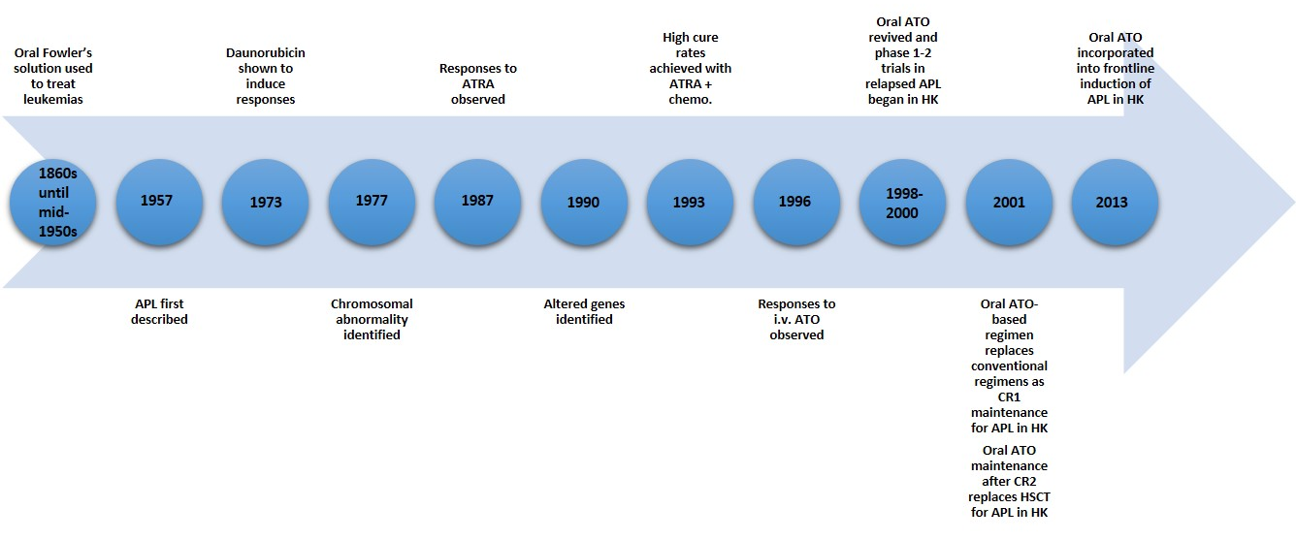
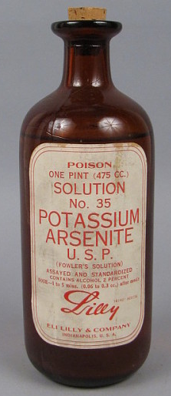
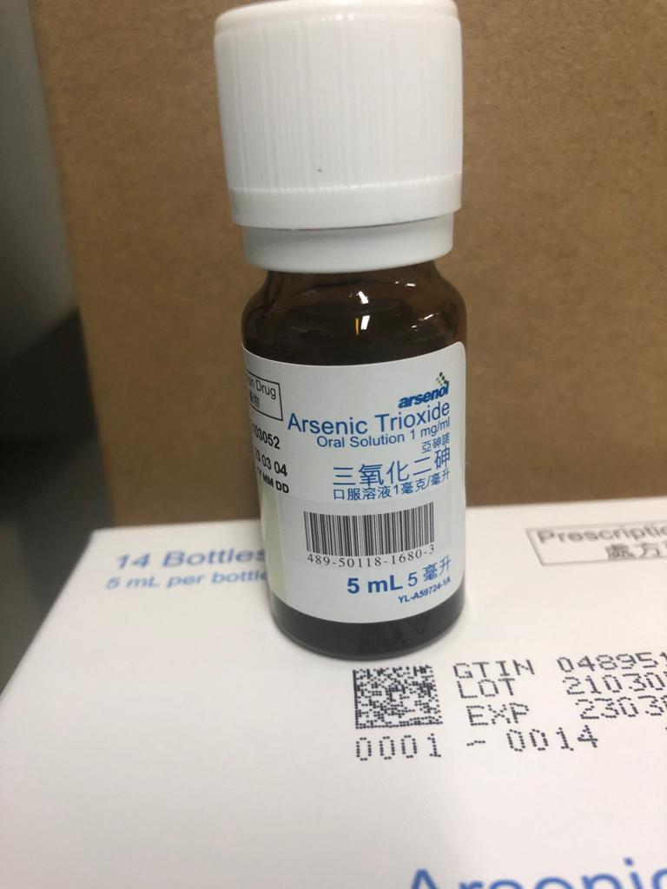
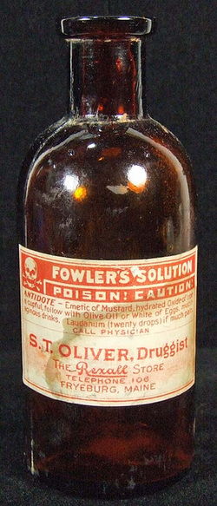
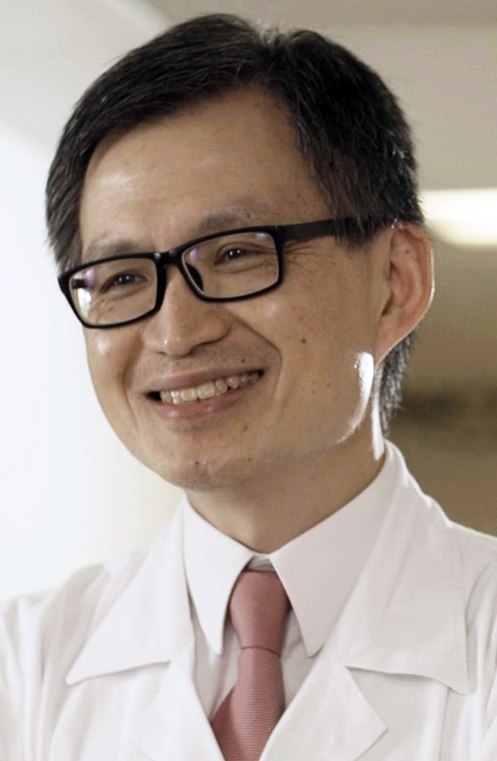
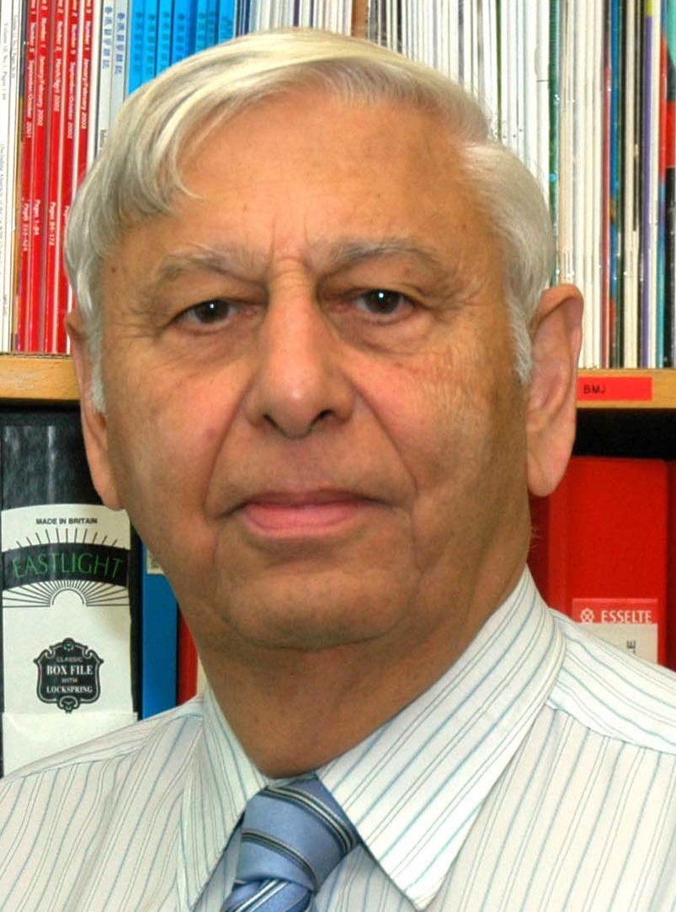
History of oral-ATO
Oral-AAA-based reinduction in APL obviates need for HSCT in CR2
Gill H et al. Cancer 2018; 124:2316-26.
Gill H et al. Blood 2013; 122: 2678
Oral-AAA + chemo results in 100% 3-year OS and LFS
Gill H et al. Cancer 2019; 125: 3001-3012.
In 1786, Thomas Fowler reported the effects of arsenic in the cure of agues, remittent fevers, and periodic headaches. Used extensively as a tonic in treating nutritional disturbances, neuralgia, rheumatism, arthritis, asthma, chorea, malaria, syphilis, tuberculosis, diabetes, skin disease, and every kind of blood disturbance.
Kumana C et al. European journal of clinical pharmacology. 2002 Nov 1;58(8):521-6.
Embargoed until Saturday, Dec. 9, 2023, at 7:15 a.m. Pacific time

Slide 22
Objectives
To evaluate the efficacy and safety of an entirely oral AAA-induction in a risk-adapted strategy with no chemotherapy and minimal chemotherapy in low-risk and high-risk (presentation leucocyte ≤ 10 x 10⁹/L and > 10 x 10⁹/L) cases
To evaluate the molecular responses during treatment with oral-AAA-based induction/consolidation/maintenance.
Embargoed until Saturday, Dec. 9, 2023, at 7:15 a.m. Pacific time

Slide 23
Results – baseline characteristics
Between January 1, 2018 to September 30, 2023, 51 men and 74 women (Total, N=125) with a median age of 49 years (range: 3-91 years) patients were identified
5 patients were < 18 years-old
93 patients (74.4%) and 32 patients (25.6%) belonging to the standard-risk and high-risk groups respectively.
8 patients (6.4%) had early deaths (ICH, N=6; APL-DS, N=2) – Moribund at presentation and were treated off protocol with oral-AAA
117 patients received oral-AAA-based induction on protocol (AAA alone, N=92, 78.6%; AAA+daunorubicin, N=25, 21.4%).
Embargoed until Saturday, Dec. 9, 2023, at 7:15 a.m. Pacific time

Slide 24
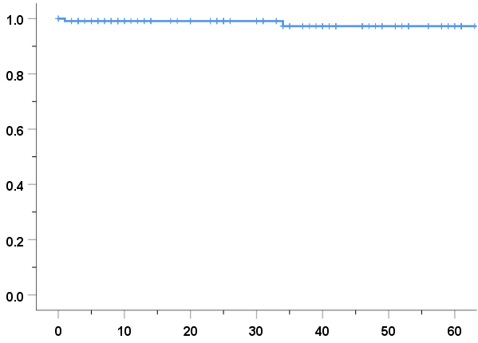
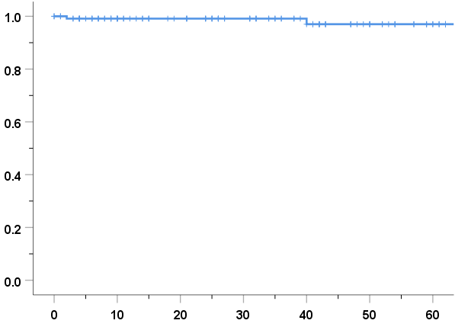
Results – outcome
All patients on oral-AAA protocol achieved CR
The median duration of follow-up was 31 months
63 patients completed 2 years of AAA maintenance at data censoring.
1 relapse and resultant death from refractory APL
1 death in CR1 due to unrelated cause
3-years OS – 97%
3-years RFS – 97%
Cumulative survival
Cumulative survival
No. at risk 117 93 77 62 47 30 16
No. at risk 117 88 77 62 45 27 14
Overall survival (months)
Relapse-free survival (months)
Embargoed until Saturday, Dec. 9, 2023, at 7:15 a.m. Pacific time

Slide 25
Results - toxicities
Commonest non-haematological toxicity was transaminitis (49.6%) and headache (36%)
Cardiotoxicity and grade 3-4 hepatotoxicity related to oral-ATO were not observed.
There were no treatment discontinuations due to oral-ATO
Treatment-related deaths were not observed
In AAA-treated patients, APL-DS occurred in 68 patients (58%) after initiation of AAA (all within the first 14 days), all responding fully to dexamethasone.
Embargoed until Saturday, Dec. 9, 2023, at 7:15 a.m. Pacific time

Slide 26
Conclusions
Use of an entirely oral AAA-based induction in a risk-adapted strategy that minimized chemotherapy was highly effective and safe in newly-diagnosed APL of all risk categories and all ages
Recruitment in a multi-centre setting in Asia is going (ClinicalTrials.gov Identifier: NCT04687176)
A pivotal trial is being planned
Embargoed until Saturday, Dec. 9, 2023, at 7:15 a.m. Pacific time

Slide 27
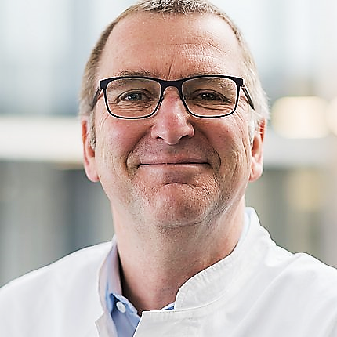
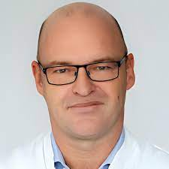
#220
CD19.CAR-T Cells in Refractory Systemic Autoimmune Diseases: A Monocentric Experience from the First 15 Patients
Embargoed until Saturday, Dec. 9, 2023, at 7:15 a.m. Pacific time
Fabian Müller, MD
Max Eder Research Group Leader, Head of CAR T Cell Unit
Dept. of Hematology & Oncology, University Hospital of Erlangen
Prof. Andreas Mackensen, MD Prof. Georg Schett, MD
Head, Dept. of Hematology&Oncology Head, Dept. of Rhematology
&

Slide 28
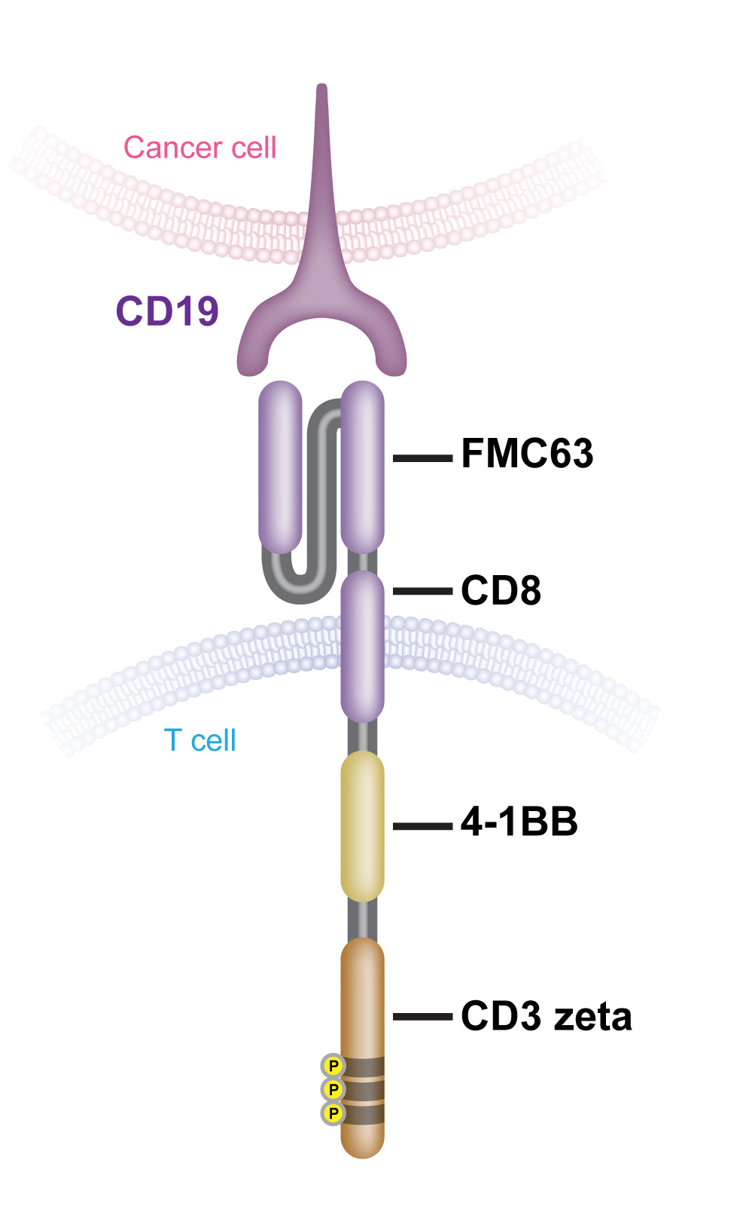
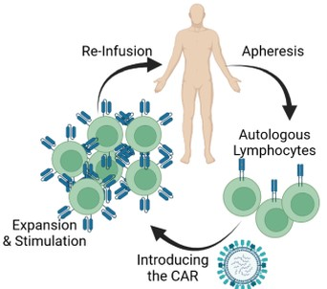
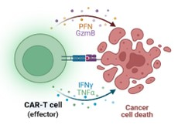
The Concept of CAR T in a nut shell
Embargoed until Saturday, Dec. 9, 2023, at 7:15 a.m. Pacific time
Chimeric Antigen
Receptor (CAR)
CAR-Cycle
Redirecting the physiologic function of T cells
Fv
Hinge
Co-stim.
Stim.
Question: Are CAR T cells active against
B cell-driven auto-immune diseases?

Slide 29
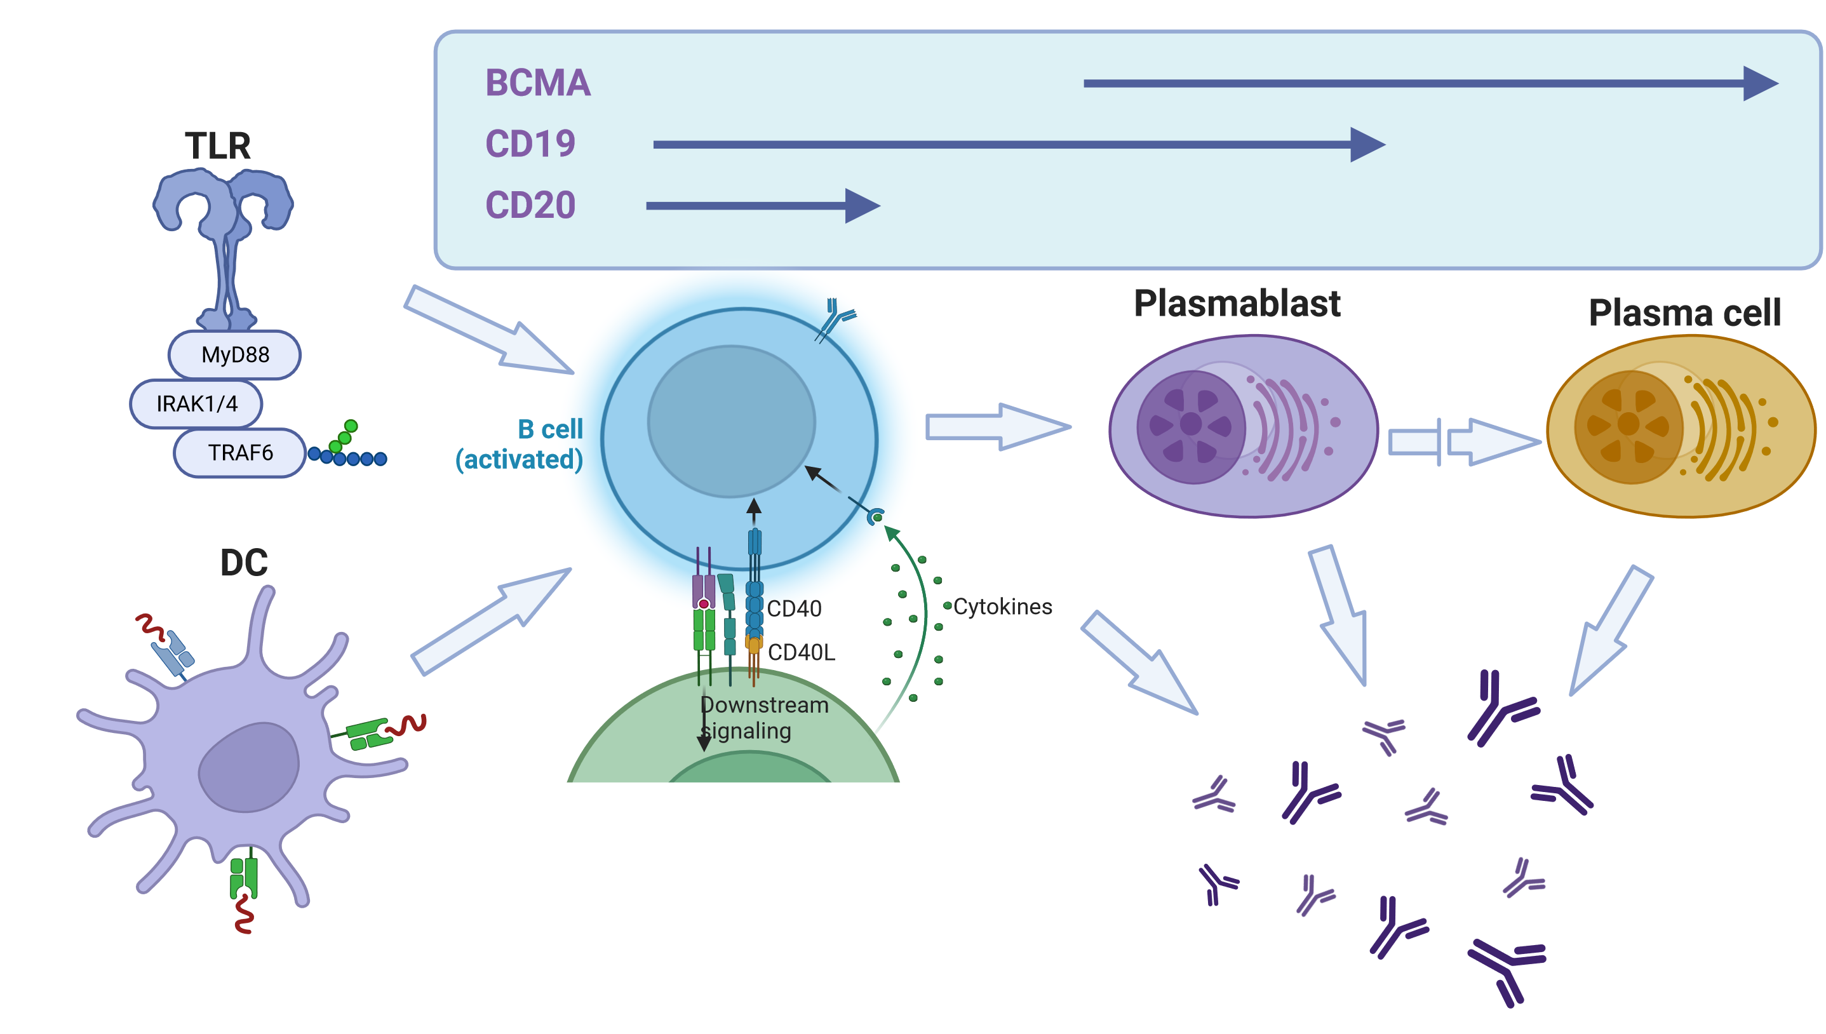
Auto-antibodies in Autoimmune Diseases
Embargoed until Saturday, Dec. 9, 2023, at 7:15 a.m. Pacific time
Loss of Self-Tolerance
?
?
?
Rubin et al. Nat. Rev. Rheumatol. 2019; Parodis et al. Front. Med. 2022; Lee et al. Nat Rev Drug Discov. 2021; Created in BioRender

Slide 30
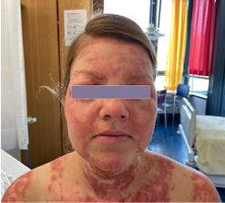
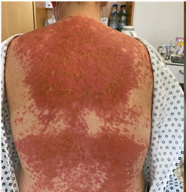
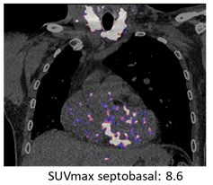
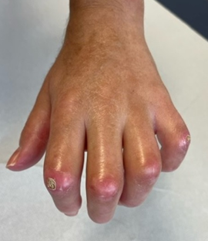
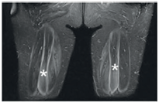
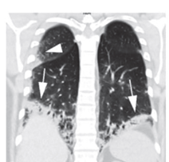
The three diseases treated at our center
Systemic Lupus Erythematosus (SLE)
Systemic Sclerosis (SSc)
Myositis (IIM)
Kidney, Skin, Lung, Heart, Brain
Skin, Lung, Heart, Kidney
Mougiakakos et al. NEJM, 2021
Mackensen et al. Nat Med. 2022
Bergmann et al. Annals Rheum. Dis. 2023
This year in talk #220, we report on:
The first 15 patients with longer follow-up
Growing understanding of B cell biology
Muscle, Lung, Heart
Müller et al. Lancet 2023
Embargoed until Saturday, Dec. 9, 2023, at 7:15 a.m. Pacific time

Slide 31
Patient Characteristics at Baseline
Total of 15 Patients
Disease Type: 8x SLE, 3x IIM, 4x SSc
Median Age (y): 36 (18-60)
Median Disease Duration: 4 years (1-20)
Median Follow-Up (mo): 15 months (4-29)
Auto-antibodies present: 15/15
For all at least 2 organs: 13 skin, 11 lung, 9 kidney, 9 joints,
4 heart, 3 muscle, others
➔ Heavily Pretreated, active & progressive disease at time of indication
Embargoed until Saturday, Dec. 9, 2023, at 7:15 a.m. Pacific time

Slide 32
Patient Safety
Only low grade inflammatory (CAR-T-related) side effects
Few patients with B cell-derived immune deficiency in need of substitution
Several infectious complications up to year 1
  1 hospitalization due to pneumonia in the
  first three months
  2 herpes zoster reactivations at 6 months and at 12 months after CAR T
➔ CD19 CAR T cells are very well tolerated
Embargoed until Saturday, Dec. 9, 2023, at 7:15 a.m. Pacific time

Slide 33
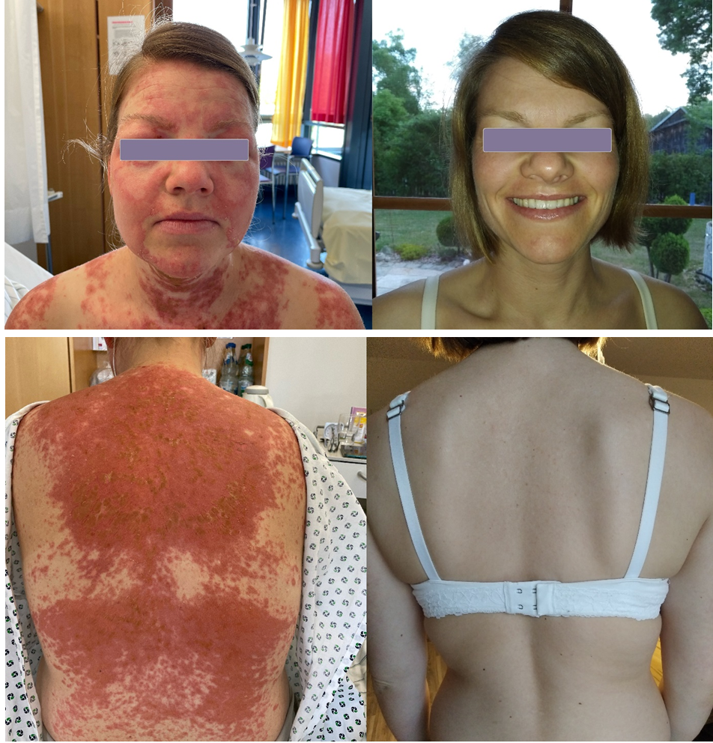
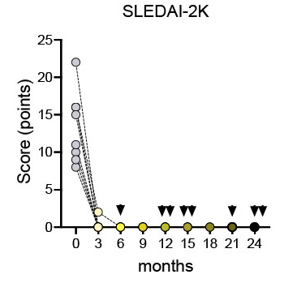
Clinical responses - SLE
Embargoed until Saturday, Dec. 9, 2023, at 7:15 a.m. Pacific time
Length
of follow-up
Disease-activity rapidly abrogated
Patients remain in complete remission
No disease-specific therapy since CAR T
CD19 CAR T achieves lasting remission in SLE
More data on efficacy in SSc and IIM this afternoon
Effects of the treatment on B cells

Slide 34
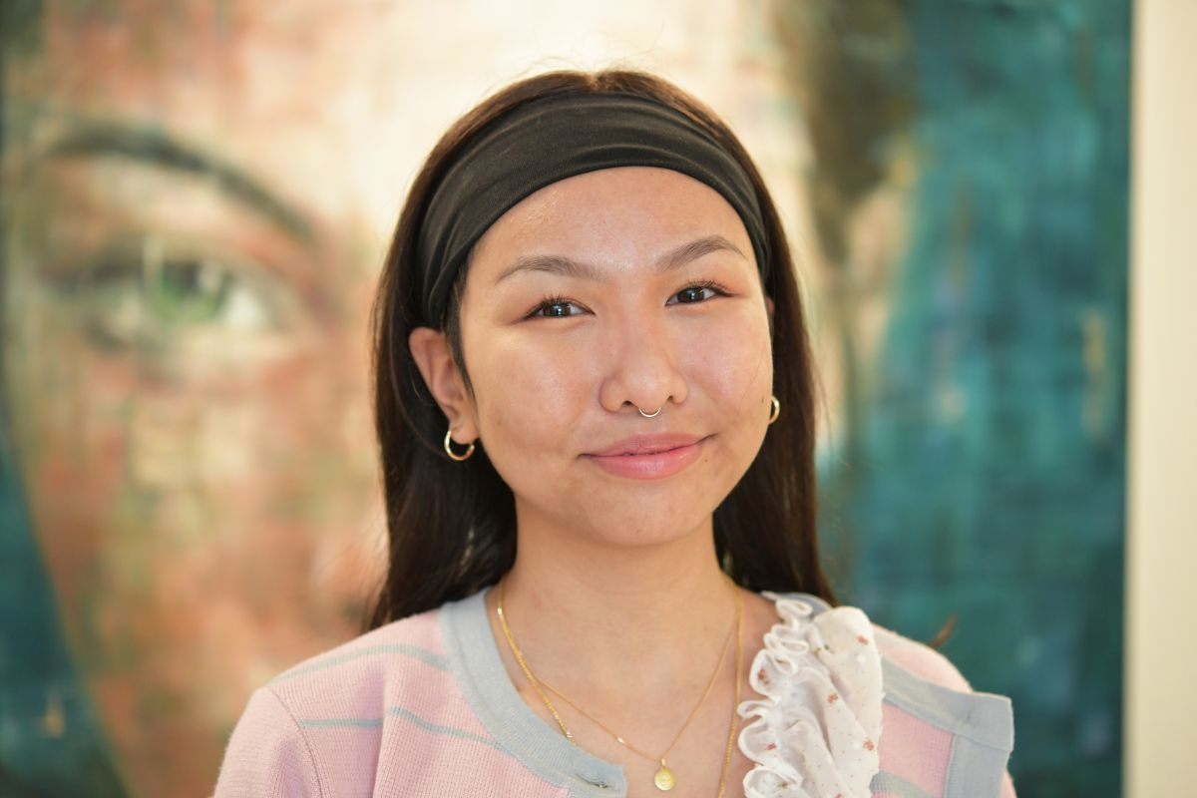
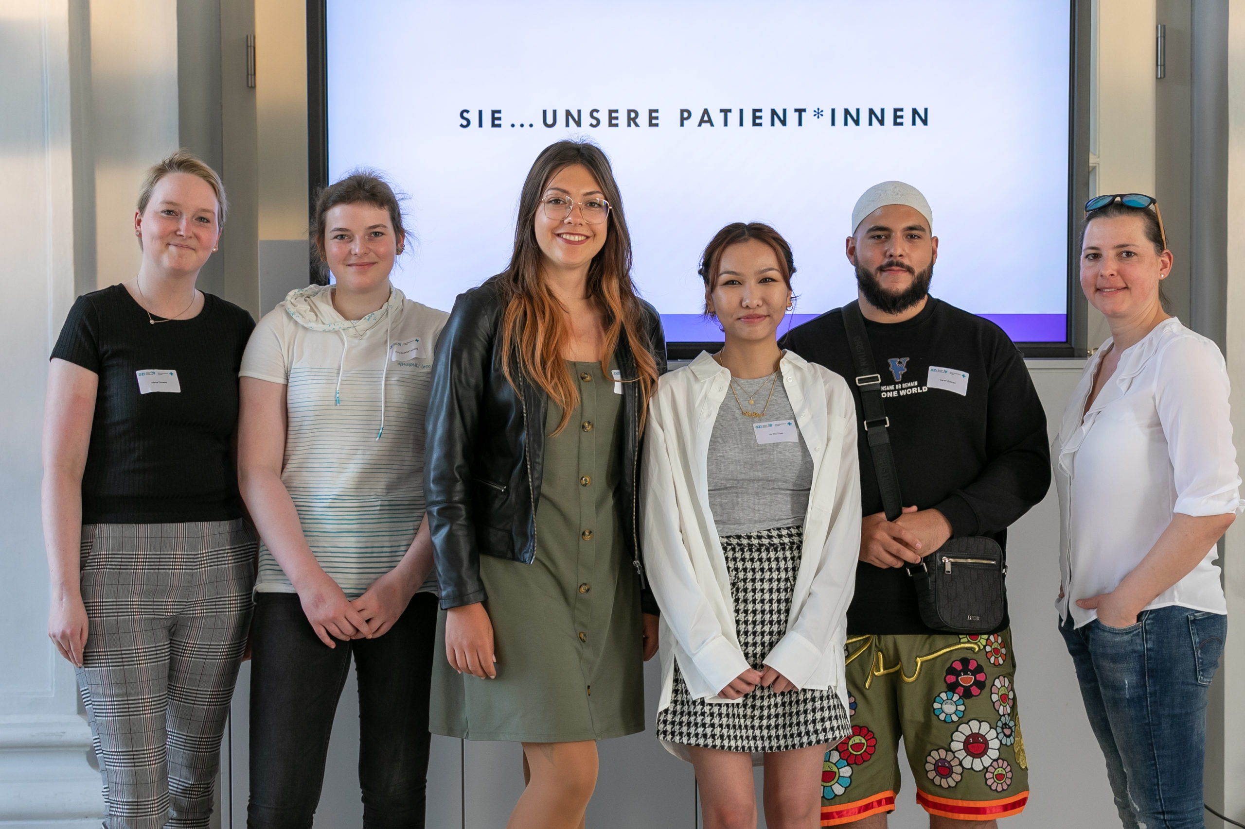
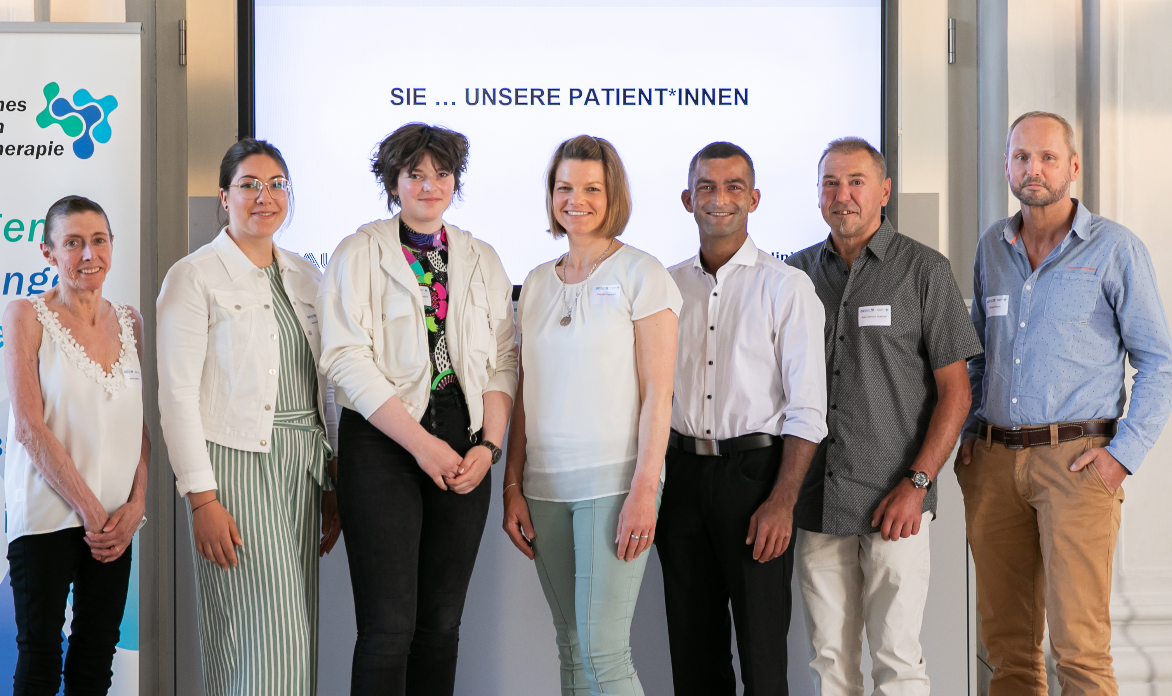
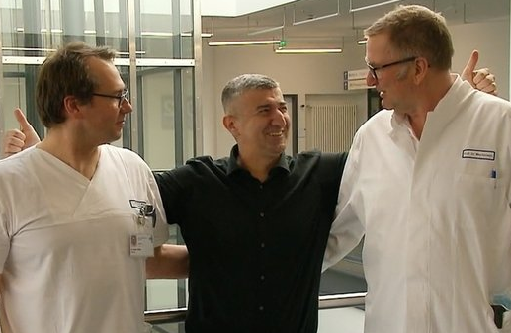
Thanks to all the courageous patients!
Embargoed until Saturday, Dec. 9, 2023, at 7:15 a.m. Pacific time
June 2022
June 2023

Slide 35






Acknowledgements
Embargoed until Saturday, Dec. 9, 2023, at 7:15 a.m. Pacific time
GMP CAR T-Cell Team
M. Aigner
S. Völkl
S. Kretschmann
H. Reimann
S. Moi
S. Schaffer
L. Albert
H. Spreitzer
Clinical CAR T-Cell Team
A. Mackensen
F. Müller
B. Ferstl
S. Kharboutli
B. Jacobs
S. Krause
D. Mougiakakos (Magdeburg)
Dept. of Medicine 3
G. Schett
D. Bohr
G. Krönke
S. Böltz
J. Taubmann
J. Knitza
Ch. Bergmann
Miltenyi Biotec/Biomedicine
S. Miltenyi
L. Hanssens
M. Assenmacher
J. Theelen
M. Apel
Outpatient & D2/BMT Unit
N. Meidenbauer & Team
S. Krause/B. Spriewald & Team
W. Rösler/I. Vasova & Team
Biobank/Core Unit Immunomonitoring
S. Völkl
A. Kämpf
L. Meretuk
D. Gebhardt
F. Schonath
L. Albert
CAR-T Coordination/QM
D. Bene
S. Spanl
A. Wagner
G. Lutzny-Geyer

Slide 36

Embargoed until Saturday, Dec. 9, 2023, at 7:00 a.m. Pacific time

