Slide 1
Focusing on Health Equity in Hematology
Press Briefing
Moderator: Alison Walker, MD, Moffitt Cancer Center
Wednesday, December 9, 2023: 10:00 a.m. – 11:00 a.m. Pacific time
Embargoed until Saturday, Dec. 9, 2023, at 7:00 a.m. Pacific time

Slide 2
Panelists
Contact ASH press staff at
ashmedia@fleishman.com
Jatinder Lamba, PhD, University of Florida
386: Intensification of Therapy and Pharmacogenetic Personalization Mitigate Racial Disparities in Pediatric Acute Myeloid Leukemia Outcomes
Sara Khan, DO, HCA Florida Bayonet Point
5113: A 10 Year Analysis of Gender Distribution in National Institutes of Health Funding for Non- Malignant Hematology
Alissa Visram, MD, MPH, Ottawa Hospital Research Institute
541: Comparison of the Efficacy in Clinical Trials Versus Effectiveness in the Real-World of Treatments for Multiple Myeloma: A Population-Based Cohort Study
Michelle Lee, MD, Massachusetts General Hospital
388: Psychiatric and Substance Use Disorders Are Independent Predictors of Treatment Response and Outcomes in United States Veterans with Newly Diagnosed Acute Myeloid Leukemia Treated with Venetoclax Combinations
Embargoed until Saturday, Dec. 9, 2023, at 7:00 a.m. Pacific time

Slide 3
Intensification of Therapy and Pharmacogenetic Personalization Mitigate Racial Disparities in Pediatric Acute Myeloid Leukemia Outcomes
Jatinder K. Lamba, Richard Marrero, Huiyun Wu, Xueyuan Cao, Phani Krishna Parcha, Seth Karol, Hiroto Inaba, Dennis John Kuo, Barbara A. Degar, Kenneth Heym, Jeffrey W. Taub, Norman Lacayo, Ching-Hon Pui, Raul C. Ribeiro, Stanley B. Pounds, Jeffrey E. Rubnitz
Embargoed until Saturday, Dec. 9, 2023, at 7:00 a.m. Pacific time

Slide 4
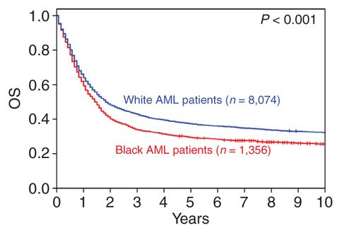
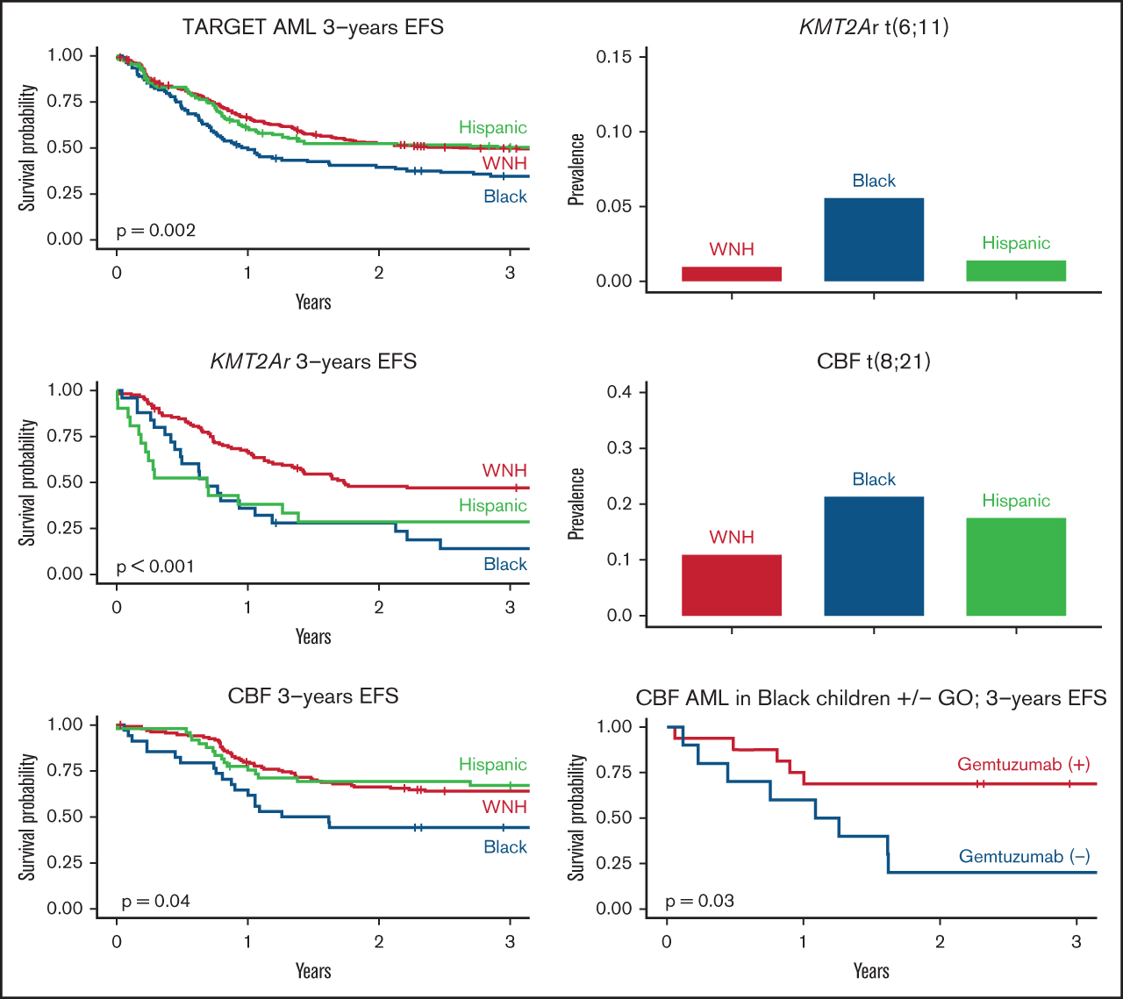
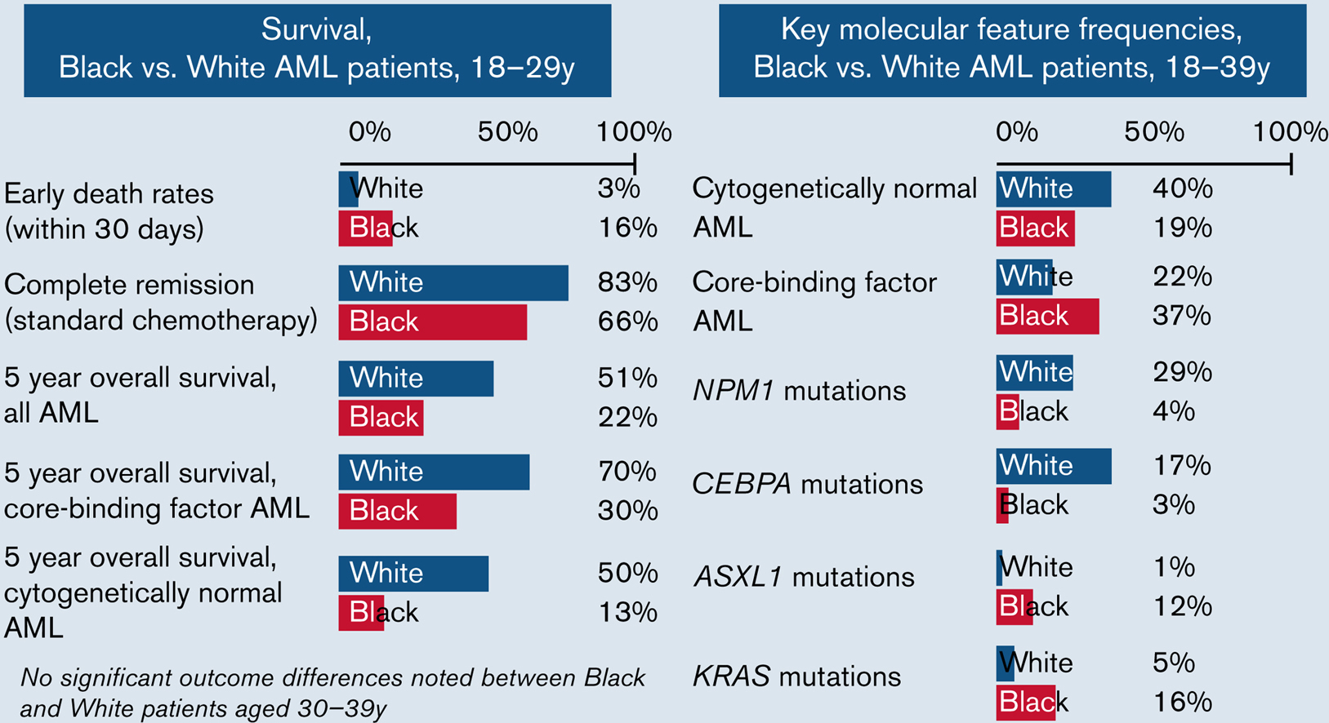
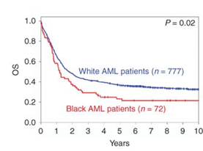
Racial Disparity in AML Outcome
Black patients historically have poor outcome as compared to White patients.
Adult AML
Pediatric AML
AYA AML
Larkin et al, 2022
Bhatnagar et al, 2022
Conneely et al, 2021
Embargoed until Saturday, Dec. 9, 2023, at 7:00 a.m. Pacific time

Slide 5
AML02 cohort (N=161 White, 44 Black)
AML08 cohort
(N=99 White, 43 Black)
AML02: Standard Arm
Low dose Ara-C (100 mg/m2/dose every 12 hrs days 1-10) with daunorubicin and eto
AML02: HDAC Arm
High dose Ara-C (3g/m2/dose every 12 hrs days 1,3 and 5) with daunorubicin and etoposide
AML08: HDAC Arm
High dose Ara-C with daunorubicin and etoposide
AML08: Clofarabine/Ara-C
Clo 52 mg/m² and cytarabine (1 g/m² on days 1 to 5)
Compare the outcome of Black and White pediatric patients with AML treated on the multi-site St. Jude AML02 and AML08 clinical trials
Compare pharmacogenomic differences between Black and White patients and its contribution to disparities in outcome
Rubnitz et al, Lancet Oncology 2010; Rubnitz et al, JCO 2019
Embargoed until Saturday, Dec. 9, 2023, at 7:00 a.m. Pacific time

Slide 6
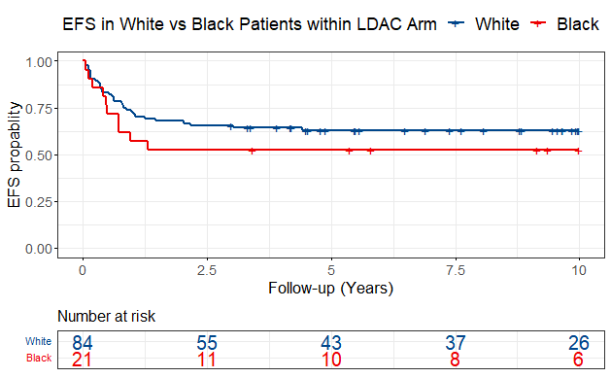
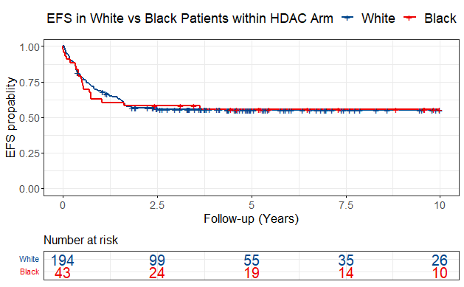
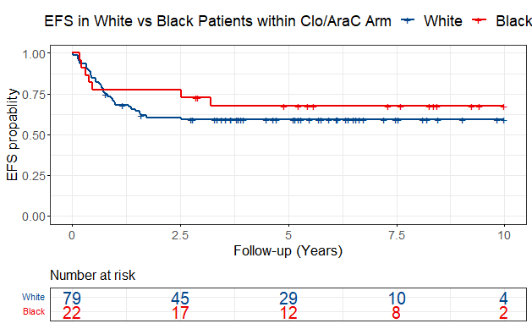
Survival outcomes did not differ by race
by treatment arms
EFS by race in standard Arm
EFS by race in HDAC Arm
EFS by race in Clo/Ara-C Arm
Black: HR:1.44 (0.71-2.94); p=0.32
White: REF
Black: HR:1.02 (0.62-1.67); p=0.95
White: REF
Black: HR:0.75 (0.33-1.69); p=0.49
White: REF
Embargoed until Saturday, Dec. 9, 2023, at 7:00 a.m. Pacific time

Slide 7
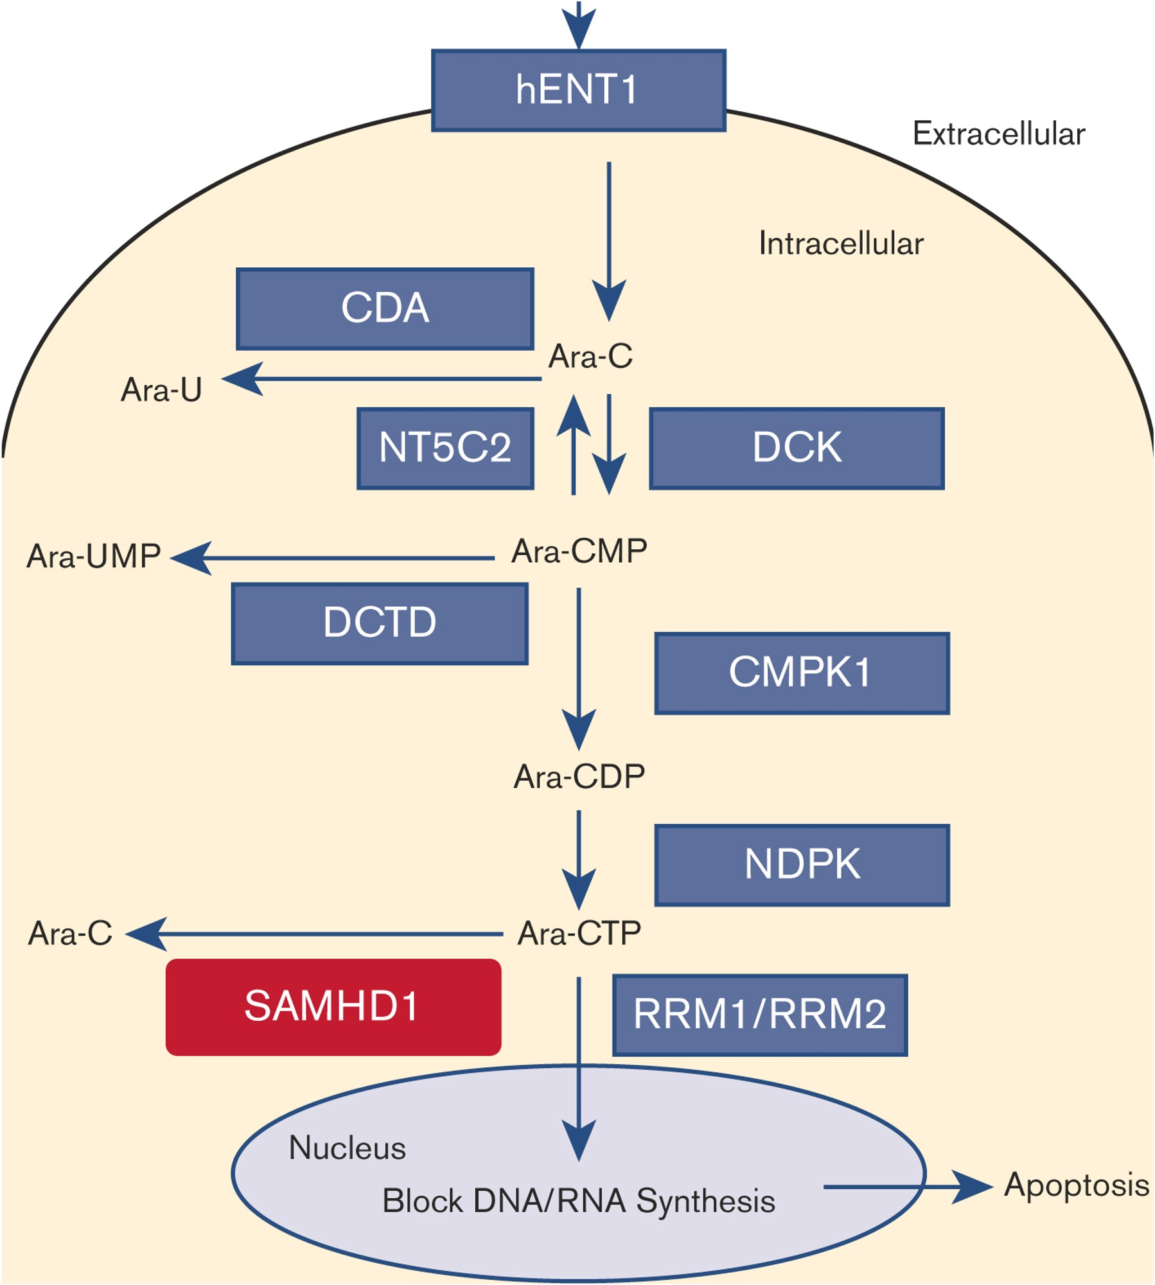
Pharmacogenomics based ACS10 score
Cytarabine/Ara-C
ACS10 distribution by race
Elsayed et al, JCO 2022
Embargoed until Saturday, Dec. 9, 2023, at 7:00 a.m. Pacific time

Slide 8
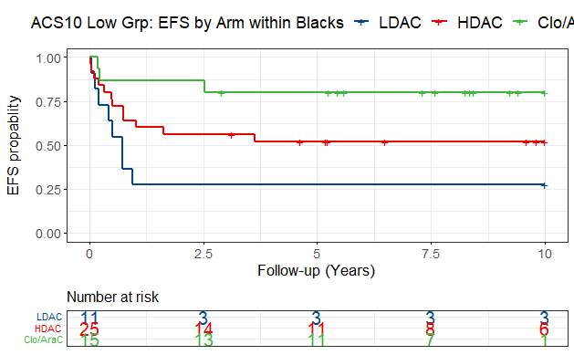
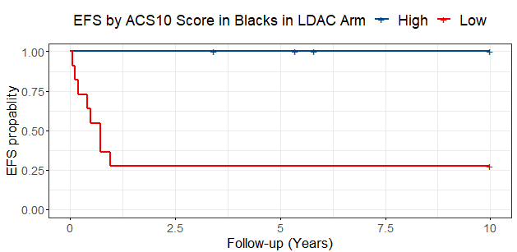
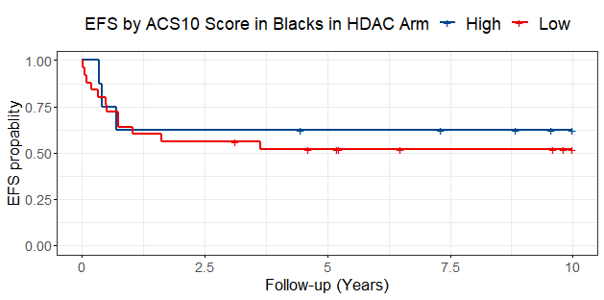
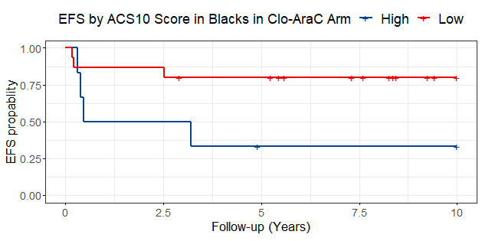
Black patients with low ACS10 have poor outcome with standard therapy BUT benefit from Augmented therapy
LDAC
HDAC
Clo/Ara-C
High ACS10 (n=6)
Clo/Ara-C N=15
LowACS10 (n11)
HDAC N=25
LDAC N=11
LDAC: ref
HDAC: HR: 0.49; 95%CI (0.20-1.22); p=0.13
Clo/AraC: HR: 0.17; 95%CI (0.05-0.66); p=0.01
High ACS10 (n=8)
LowACS10 (n=25)
In Low ACS10 group ranking for therapy choice
  1. Best Option Clo+Ara-C
  2. High dose-Ara-C (HDAC)
  3. Worst Option Low dose Ara-C (LDAC)
LowACS10 (n=15)
High ACS10 (n=5)
Embargoed until Saturday, Dec. 9, 2023, at 7:00 a.m. Pacific time

Slide 9
World-wide distribution of ACS10 score
Impact of Cytarabine Pharmacogenomics on Survival of Adolescent and Young Adults with AML and Its Clinical Relevance in Black Patients Number: 2954, December 10
ACS10- Cytarabine Pharmacogenomics Score Impacts Survival in Pediatric AML Patients Treated on AAML1031 Trial and Associates with Outcome Differences in Black AML Patients Number: 4314, December 11
Embargoed until Saturday, Dec. 9, 2023, at 7:00 a.m. Pacific time

Slide 10
A 10 Year Analysis of Gender Distribution in the National Institutes of Health Funding for Non Malignant Hematology
Sara Khan, DO¹; Faraz Eshaghi, DO¹, Aruba Sohail², Kainat Khan³, Taha Huda, MD¹; Evan Lindbergh, DO¹; Kapisthalam S. Kumar, MD ⁴
HCA Healthcare/USF Morsani College of Medicine GME: Bayonet Point, Hudson, FL¹; Dow University of Health Sciences, Karachi, Pakistan²; Edward Via College of Medicine, Auburn, AL³; Florida Cancer Specialists, Trinity FL⁴
Embargoed until Saturday, Dec. 9, 2023, at 7:00 a.m. Pacific time

Slide 11
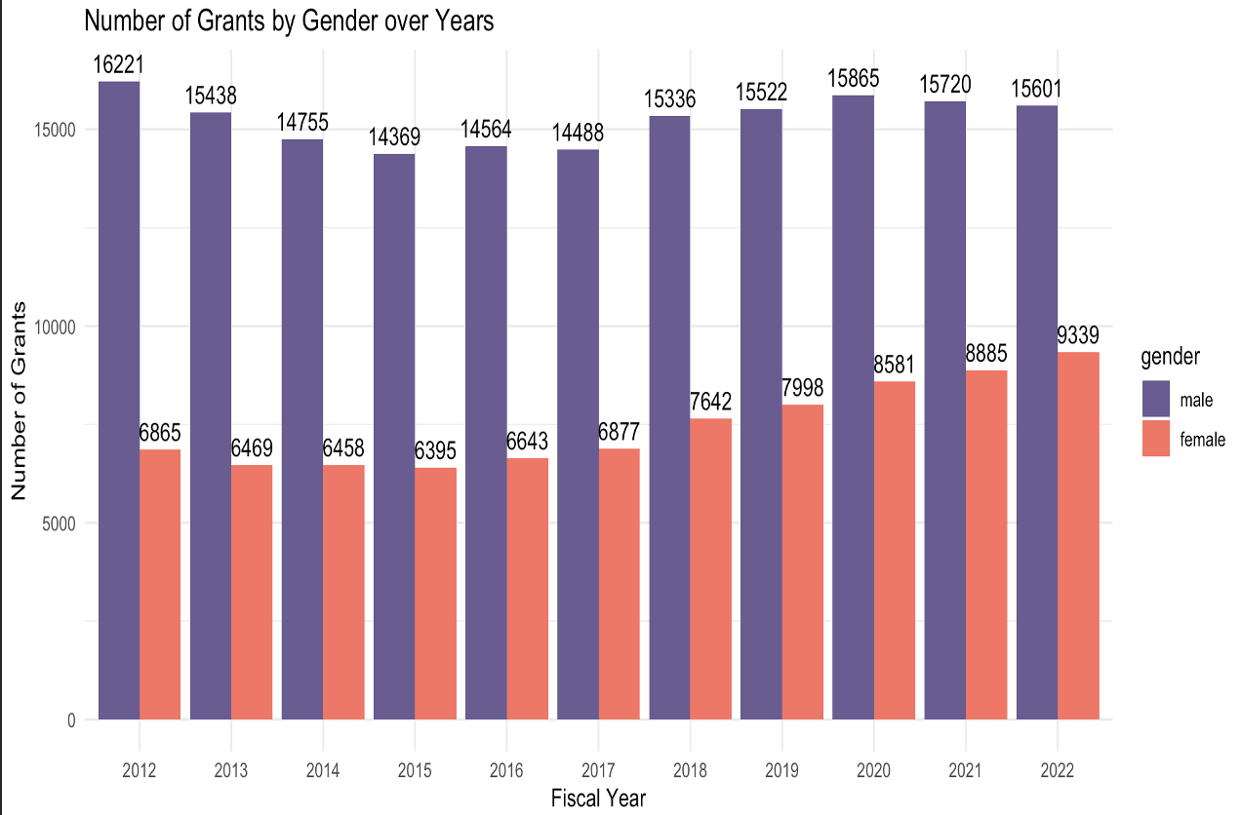
Embargoed until Saturday, Dec. 9, 2023, at 7:00 a.m. Pacific time

Slide 12
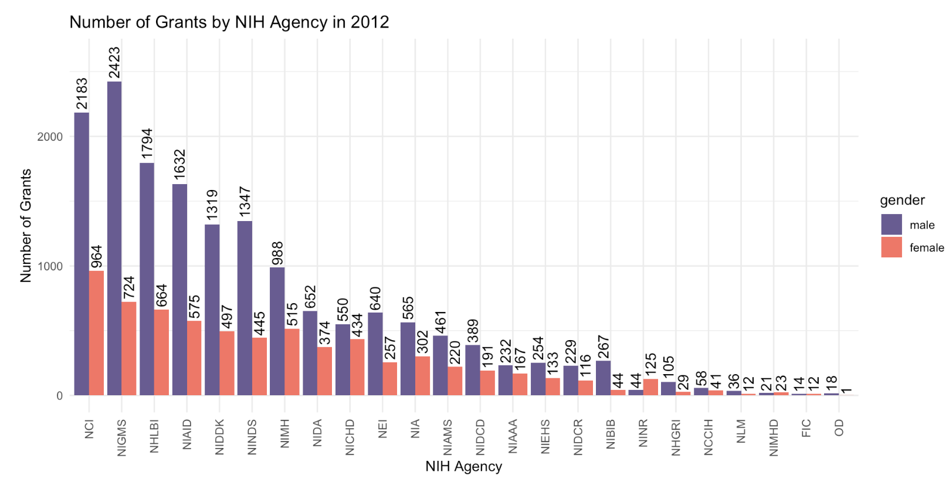
Embargoed until Saturday, Dec. 9, 2023, at 7:00 a.m. Pacific time

Slide 13
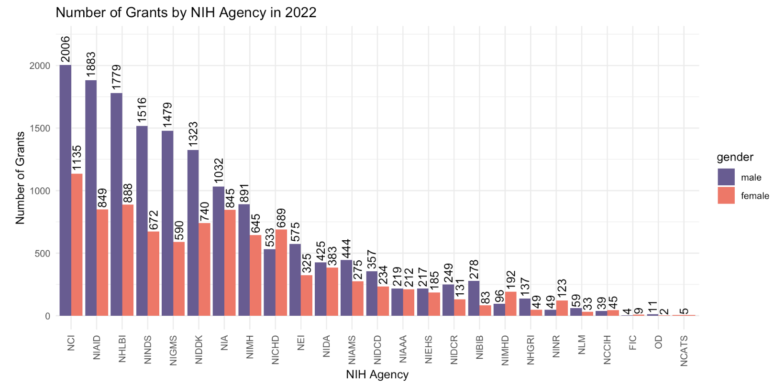
Embargoed until Saturday, Dec. 9, 2023, at 7:00 a.m. Pacific time

Slide 14
National Heart, Lung, and Blood Institute (NHLBI)
2012
  -Females: 664 grants awarded in non-malignant hematology
  -Males: 1794 grants awarded in non-malignant hematology
  2022
    -Females: 888 grants awarded in non-malignant hematology
    -Males: 1779 grants awarded in non-malignant hematology
Embargoed until Saturday, Dec. 9, 2023, at 7:00 a.m. Pacific time

Slide 15
Conclusion
This analysis highlights continued gender disparity as only 33% of total R01 NIH grants were awarded to females during the fiscal years 2012-2022 in non-malignant hematologic research. Although, it is noted that while some agencies have made strides towards gender parity, others continue to have a significant gap. While this remains a systemic and multifaceted issue, identifying these areas of gender disparity will enable targeted efforts to bridge this gap and advance gender equality.
NEXT STEPS…
Embargoed until Saturday, Dec. 9, 2023, at 7:00 a.m. Pacific time

Slide 16


Comparison of the efficacy in clinical trials versus effectiveness in the real-world of treatments for multiple myeloma: A population-based cohort study
A. Visram, K. Chan, H. Seow, G. Pond, A. Gayowsky, A. McCurdy, I. Sandhu, C. Venner, G. Lancman, A. Balitsky, R. Bruins, S. Kumar, R. Fonseca, H. Mian
Embargoed until Saturday, Dec. 9, 2023, at 7:00 a.m. Pacific time

Slide 17
Introduction
Randomized control trials (RCT) are the “gold standard” for regulatory approval and treatment guidelines, and informing patients about expected outcomes
“Efficacy” – outcomes in an ideal RCT setting
?
“Effectiveness” –
outcomes in the
real world setting
How much does the RCT “efficacy” differ from the real-world “effectiveness” for multiple myeloma therapies?
(Visram et al. ASH 2023 Abstract #541)
Embargoed until Saturday, Dec. 9, 2023, at 7:00 a.m. Pacific time

Slide 18
Study Aims
In patients with newly diagnosed MM (NDMM) and relapsed-refractory MM (RRMM) treated with standard-of-care regimens in Ontario, Canada:
Primary aim: compare the RCT efficacy versus real-world effectiveness in Ontario, Canada, with respect to progression free survival (PFS) and overall survival (OS)
Secondary aim: compare the rates of serious adverse events in the RCT versus real-world setting
Embargoed until Saturday, Dec. 9, 2023, at 7:00 a.m. Pacific time
(Visram et al. ASH 2023 Abstract #541)

Slide 19
Methods – Study Population
Reimbursed Standard of Care (SoC) regimens in Ontario, Canada as of Dec. 31, 2020 | Phase 3 RCT
Transplant eligible NDMM
CyBorD-ASCT-R maintenance (cyclophosphamide & bortezomib & dex – autologous transplant - lenalidomide) | none
Transplant ineligible NDMM
RD (n=824) | FIRST (Rd continuous; n=535)
VRD (n=282) | SWOG0777 (VRD; n=242)
RRMM
KD (n=498) | ENDEAVOR (KD; n=464)
KRD (n=287) | ASPIRE (KRD; n=396)
DVD (n=627) | CASTOR (DVD; n=251)
DRD (n=785) | POLLUX (DPD; n=286)
PD (n=648) | MM-003 (PD; n=302)
Real-world cohort
Clinical-trial cohort
IC/ES database
Administrative healthcare claims for all Ontario residents (13 million)
Loss to follow-up rate 0.25%¹
Retrospectively included patients diagnosed with multiple myeloma between Jan 2007- Dec 2020²
Published Kaplan-Meier curves for SoC regimens were digitized to provide individual patient-level PFS and OS data
¹Silver et al. JASN 2018
²Fiala et al. JCO Clin. Informatics 2017
(Visram et al. ASH 2023 Abstract #541)
Embargoed until Saturday, Dec. 9, 2023, at 7:00 a.m. Pacific time

Slide 20
Results – Crude comparison of RCT and RW outcomes
Median PFS
Median OS
Added benefit in RCT
patients (months)
Added benefit in RCT
patients (months)
With the exception of the pom-dex regimen, the absolute
mPFS was 3-18.3 months and mOS >19 months longer in RCT compared to real world patients
(Visram et al. ASH 2023 Abstract #541)
Embargoed until Saturday, Dec. 9, 2023, at 7:00 a.m. Pacific time

Slide 21
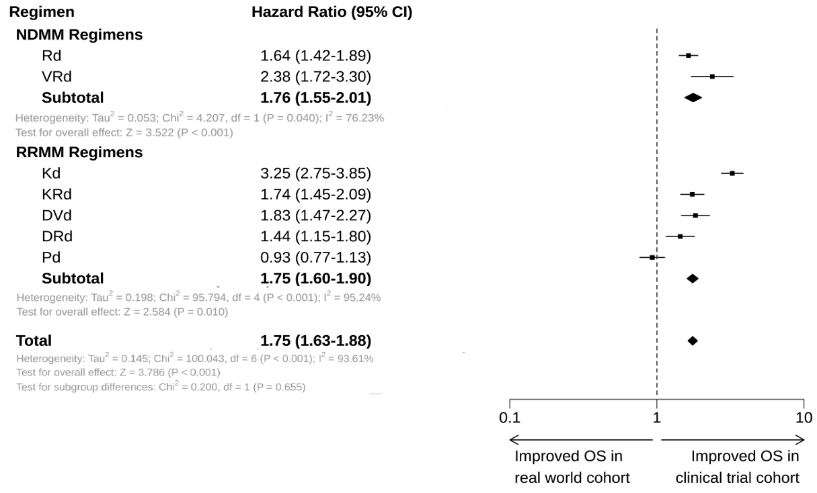
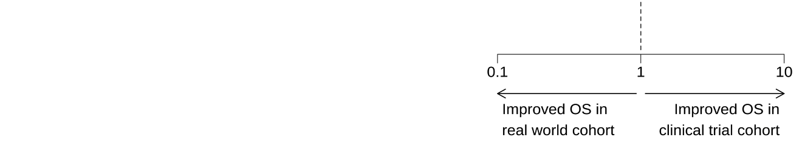
Results – Forest plot (overall survival)
Overall, the risk of death was 75% higher in real-world compared to RCT patients treated with the same SoC regimens
Embargoed until Saturday, Dec. 9, 2023, at 7:00 a.m. Pacific time
(Visram et al. ASH 2023 Abstract #541)

Slide 22
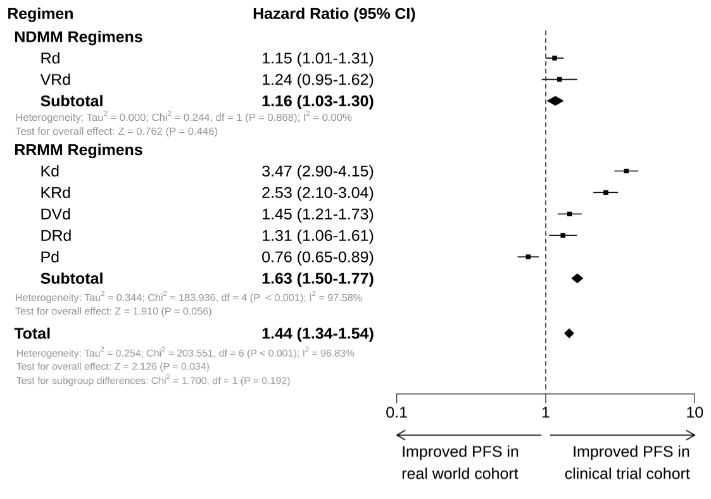
Results – Forest plot (progression free survival)
Overall, the risk of progression or death was 44% higher in real-world compared to RCT patients treated with the same regimen
(Visram et al. ASH 2023 Abstract #541)
Embargoed until Saturday, Dec. 9, 2023, at 7:00 a.m. Pacific time

Slide 23
Conclusion
This is one of the largest population-level studies highlighting the significant efficacy-effectiveness gap with multiple standard of care regimens for multiple myeloma
  Real-world patients experienced a 44% worse PFS and a 75% worse OS compared to RCT patients.
Underscores the importance of real-world data to understand whether RCT outcomes are generalizable to our real-world patients
  Our results will better inform both clinicians and patients to allow for shared treatment decision making
(Visram et al. ASH 2023 Abstract #541)
Embargoed until Saturday, Dec. 9, 2023, at 7:00 a.m. Pacific time

Slide 24
Psychiatric and Substance Use Disorders are Independent Predictors of Treatment Response and Outcomes in U.S. Veterans with Newly Diagnosed Acute Myeloid Leukemia Treated with Venetoclax Combinations
Michelle H. Lee MD^{1,2}, Jennifer La PhD³, Mary T. Brophy MD³⁻⁵, Nhan V. Do MD^{3,6}, Camille V. Edwards MD^{5,6}, Clark Dumontier MD, MPH^{2,7-9}, Gabriela Hobbs MD^{1,2}, Nathanael R. Fillmore PhD²⁻⁴
¹Department of Medical Oncology, Massachusetts General Hospital, Boston, MA, ²Havard Medical School, Boston MA, ³Cooperative Studies Program Informatics Center, VA Boston Healthcare System, Boston, MA, ⁴VA Boston Healthcare System, Department of Medicine, Boston, MA, ⁵Section of Hematology and Medical Oncology, Boston Medical Center, Boston, MA, ⁶Boston University School of Medicine, Boston, MA, ⁷New England Geriatric Research, Education and Clinical Center, VA Boston Healthcare System, Boston, MA, ⁸Dana Farber Cancer Institute, Boston, MA, ⁹Division of Aging, Brigham and Women’s Hospital, Boston, MA
Embargoed until Saturday, Dec. 9, 2023, at 7:00 a.m. Pacific time

Slide 25
Background
With a median age of 69 years at diagnosis, older adults represent the majority of patients with acute myeloid leukemia (AML).
Venetoclax (VEN) combinations are now a frontline option for patients with newly diagnosed AML who are ≥75 years or <75 but deemed unable to tolerate intensive chemotherapy induction.
Prior to the U.S. Food and Drug Administration (FDA) approval of VEN in 2018, AML treatment was extremely limited; over 50% of adults ≥65 years were not treated.
Older adults carry multiple comorbidities and we do not know how they affect treatment outcomes.
Veterans represent an aging population of varying wartime eras with distinct health issues.
Disparities in outcomes exist between veterans with AML and clinical trial populations.
AIM: To determine the prevalence and impact of psychiatric and SUDs on treatment response and outcomes of veterans with AML induced upfront with VEN.
Embargoed until Saturday, Dec. 9, 2023, at 7:00 a.m. Pacific time

Slide 26
Results: Psychiatric and SUDs are prevalent among veterans with AML
Comorbidity | N (% of 452)
Psychiatric Disorders
At least one diagnosis | 206 (46)
Anxiety | 150 (33.2)
Bipolar Disorder | 47 (10.4)
Depression | 144 (31.9)
Other depressive/mood disorders | 139 (30.8)
Personality disorders | 13 (2.9)
Schizophrenia | 5 (1.1)
Schizophrenia/related psychotic disorders | 9 (2.0)
Post-traumatic stress disorder | 91 (20.1)
SUDs
At least one diagnosis | 84 (19)
Alcohol use disorder | 49 (10.8)
Drug use disorder* | 52 (11.5)
Median age of cohort: 74
98.5% male
76% White race
ccwdata.org
*includes opioid, anxiolytic, hypnotic, hallucinogen, and other non-opioid substance abuse
Embargoed until Saturday, Dec. 9, 2023, at 7:00 a.m. Pacific time

Slide 27
Results: Psychiatric and SUDs are more prevalent in younger veterans with AML
Embargoed until Saturday, Dec. 9, 2023, at 7:00 a.m. Pacific time

Slide 28
Results: VEN treatment response by Psych and SUD
Veterans with SUD had lower rates of remission (p=0.003)
No significant difference in rates of progressive AML (p=0.154)
Within the entire cohort, 12 (3%) veterans underwent HSCT
Zero veterans with SUD were transplanted
CCR = composite complete remission, CR = complete remission, CRi = complete remission with incomplete count recovery, PD = progressive disease, HSCT = allogeneic stem cell transplantation
Embargoed until Saturday, Dec. 9, 2023, at 7:00 a.m. Pacific time

Slide 29
Results: Incidence of ICU utilization post-induction significantly higher in SUD
Relative Risk = 2.26 (1.56-3.2)
p<0.001
Embargoed until Saturday, Dec. 9, 2023, at 7:00 a.m. Pacific time

Slide 30
Results: Early mortality (EM) rate highest among veterans with SUD
Within 60 days of VEN initiation, 87 (19%) veterans died
Only 8 veterans had refractory/progressive AML
EM rates lowest with neither psych/SUD; veterans with SUD had significantly higher rates (35%) of early mortality (p=0.006)
Embargoed until Saturday, Dec. 9, 2023, at 7:00 a.m. Pacific time

Slide 31
Results: Psychiatric and SUDs are independent predictors of negative AML outcomes
 | N | Venetoclax Response, OR (95% CI) | Early Mortality, OR (95% CI) | Overall Mortality, HR (95% CI)
Substance use disorders | 83 | 0.47 (0.25-0.87) | 1.6 (0.83-3.03) | 1.34 (0.98-1.85)
Psychiatric disorders | 206 | 0.52 (0.32-0.84) | 1.97 (1.16-3.39) | 1.28 (1-1.64)
Median overall survival (OS) of entire cohort = 216 days
Psychiatric and SUDs are associated with lower odds of complete remission or venetoclax response
Veterans with psychiatric disorders are 2x more likely to die within 60 days of AML treatment initiation and 28% more likely to die overall
*VEN response = CR+CRi, CR = complete remission, CRi = complete remission with incomplete count recovery, EM = early mortality, OS = overall survival, OR = odds ratio, HR = hazards ratio. Multivariable analysis, adjusted for age, gender, race/ethnicity, rurality, AML risk by ELN 2017, molecular mutations, bone marrow blast %, AML type (de novo vs secondary), prior treatment with HMA, and type of VEN combination.
Embargoed until Saturday, Dec. 9, 2023, at 7:00 a.m. Pacific time

Slide 32
Conclusions
Psychiatric and SUDs are prevalent among veterans with AML, and associated with lower likelihood of achieving remission, higher incidence of ICU admission post-VEN initiation, and higher hazard of early and overall mortality
Potential mechanisms of worse outcomes in veterans with psychiatric and SUDs:
  Difficulty with treatment adherence
  Re-emergence of their mental instability and illnesses with a cancer diagnosis
  Distinct biologic mechanisms associated with these comorbidities
Future studies to better understand and target these potentially intervenable comorbidities alongside AML-specific therapy may improve outcomes
Embargoed until Saturday, Dec. 9, 2023, at 7:00 a.m. Pacific time

Slide 33

Embargoed until Saturday, Dec. 9, 2023, at 7:00 a.m. Pacific time

