Slide 1
Is More or Less Better? Reviewing Therapies in Hematologic Cancers Press Briefing
Moderator: Mikkael Sekeres, MD, Sylvester Comprehensive Cancer Center, University of Miami Miller School of Medicine
Sunday, December 10, 2023: 7:30 a.m. – 8:30 a.m. Pacific time
Embargoed until Sunday, Dec. 10, 2023, at 7:30 a.m. Pacific time

Slide 2
Panelists
Contact ASH press staff at
ashmedia@fleishman.com
Naveen Pemmaraju, MD, MD Anderson Cancer Center
620: Transform-1: A Randomized, Double-Blind, Placebo-Controlled, Multicenter, International Phase 3 Study of Navitoclax in Combination with Ruxolitinib Versus Ruxolitinib Plus Placebo in Patients with Untreated
Peter Hillmen, MB ChB, PhD, Leeds Institute of Medical Research
631: Ibrutinib Plus Venetoclax with MRD-Directed Duration of Treatment Is Superior to FCR and Is a New Standard of Care for Previously Untreated CLL: Report of the Phase III UK NCRI FLAIR
Jad Othman, MBBS, King’s College London
425:The Benefit of Allogeneic Transplant in 1st Complete Remission in NPM1 Mutated AML with or without FLT3 ITD Is Restricted to Those Testing MRD Positive after Induction – an Analysis of the UK NCRI AML17 and AML19 Studies
Mazyar Shadman, MD, MPH, Fred Hutchinson Cancer Center
781: Autologous Transplant (auto-HCT) Is Associated with Improved Clinical Outcomes Compared to CAR-T Therapy in Patients (pts) with Large B-Cell Lymphoma (LBCL) Achieving a Complete Remission
Embargoed until Sunday, Dec. 10, 2023, at 7:30 a.m. Pacific time

Slide 3
Title of Presentation, Title Case
 | TRANSFORM-1: A Randomized, Double-Blind, Placebo-Controlled, Multicenter, International Phase 3 Study of Navitoclax in Combination With Ruxolitinib Versus Ruxolitinib Plus Placebo in Patients With Untreated Myelofibrosis
Naveen Pemmaraju¹, Adam J. Mead², Tim CP Somervaille³, James McCloskey⁴, Francesca Palandri⁵, Steffen Koschmieder⁶, David Lavie⁷, Brian Leber⁸, Su-Peng Yeh⁹, Maria Teresa Gomez Casares¹⁰, Emanuele Ammatuna¹¹, Ho-Jin Shin¹², Keita Kirito¹³, Eric Jourdan¹⁴, Timothy Devos¹⁵, Hun S. Chuah¹⁶, Atanas Radinoff¹⁷, Andrija Bogdanovic¹⁸, Rastislav Moskal¹⁹, Qi Jiang¹⁹, Avijeet S Chopra¹⁹, Elektra J Papadopoulos¹⁹, Jalaja Potluri¹⁹, Francesco Passamonti²⁰
¹Department of Leukemia, MD Anderson Cancer Center, Houston, TX, USA; ²Medical Research Council (MRC) Molecular Haematology Unit, MRC Weatherall Institute of Molecular Medicine, NIHR, Biomedical Research Centre, University of Oxford, Oxford, United Kingdom; Cancer and Haematology Centre, Churchill Hospital, Oxford University Hospitals NHS Foundation Trust, Oxford, United Kingdom; ³Cancer Research UK Manchester Institute, The University of Manchester and The Christie NHS Foundation Trust, Manchester, United Kingdom; ⁴Department of Leukemia, John Theurer Cancer Center at Hackensack Meridian Health, Hackensack, NJ, USA; ⁵Istituto di Ematologia "Seràgnoli", IRCCS Azienda Ospedaliero-Universitaria di Bologna, Italy; ⁶Department of Hematology, Oncology, Hemostaseology, and Stem Cell Transplantation, Faculty of Medicine, RWTH Aachen University, Aachen, Germany, and Center of Integrated Oncology Aachen Bonn Cologne Düsseldorf (CIO ABCD), Aachen, Germany; ⁷Hadassah Medical Center, Jerusalem, Israel; ⁸Division of Hematology, Juravinski Cancer Center, Hamilton, ON, Canada; ⁹China Medical University Hospital, Taichung, Taiwan; ¹⁰Hospital Universitario de Gran Canaria Dr. Negrín, Las Palmas de Gran Canaria, Spain; ¹¹Department of Hematology, University of Groningen, University Medical Center Groningen, Groningen, The Netherlands; ¹²Department of Hematology-Oncology, Pusan National University Hospital, Pusan National University School of Medicine, Busan, Korea; ¹³Department of Hematology and Oncology, University of Yamanashi, Japan; ¹⁴Hematologie Clinique, CHU de Nimes, Nimes; ¹⁵Department of Hematology, University Hospitals Leuven and Department of Microbiology and Immunology, Laboratory of Molecular Immunology (Rega Institute), KU Leuven, Leuven, Belgium; ¹⁶Department of Haematology, Royal Perth Hospital, Perth, Australia; ¹⁷Clinic of Haematology, St.Ivan Rilski University Multidisciplinary Hospital, Bulgaria; ¹⁸Clinic of Hematology, University Clinical Center of Serbia, and Faculty of Medicine, University of Belgrade, Serbia; ¹⁹AbbVie Inc., North Chicago, IL, USA; ²⁰Dipartimento di Oncologia ed Ematologia, Università degli Studi di Milano, Policlinico di Milano, Ospedale Maggiore, Fondazione I.R.C.C.S. Ca Granda, Milano, Italy.
Embargoed until Sunday, Dec. 10, 2023, at 7:30 a.m. Pacific time
ASH 2023; San Diego, USA

Slide 4
Introduction
There is a substantial unmet need for therapies that alter disease trajectory, improve outcomes, and enhance survival in patients with MF¹
JAKis, like ruxolitinib, are standard-of-care in MF, and have rates of SVR_{35W24} and SVR_{35W48} of 29–42% and 29%, respectively^{2,3}
Although JAKis have demonstrated symptom improvement and spleen volume reduction in patients with MF, they provide limited benefit to the key outcomes mentioned above¹
Study objective: To evaluate the safety and efficacy of navitoclax plus ruxolitinib (NAV + RUX) compared with placebo plus ruxolitinib (PBO + RUX) in JAK2i-naïve adults with MF
1. Pemmaraju N, et al. Cancer. 2022, 128; 2420–2432; 2. Verstovsek S, et al. N Engl J Med. 2012;366(9):799–807. 3. Mesa RA, et al. J Clin Oncol. 2017;35(34):3844–3850. JAKi, Janus kinase inhibitor; MF, myelofibrosis; NAV, navitoclax; PBO, placebo; RUX, ruxolitinib; SVR_{35W24}, spleen volume reduction of ≥35% at Week 24; SVR_{35W48}, spleen volume reduction of ≥35% at Week 48.
Embargoed until Sunday, Dec. 10, 2023, at 7:30 a.m. Pacific time

Slide 5
TRANSFORM-1 Is a Phase 3, Double-Blind, Multicenter Study (NCT04472598)
Inclusion criteria (N~230)
Aged ≥18 years with ECOG ≤2
Intermediate-2 or high-risk MF with measurable splenomegaly (as defined by the DIPSS+)
Evidence of MF-related symptoms
No prior JAKi treatment
Experimental arm
Ruxolitinib 15/20 mg BIDª
Navitoclax 100/200 mg QD^{b}
1:1 Randomization
Stratification factors:
Int-2 vs high-risk
PLT ≤200 × 10⁹/L vs >200 × 10⁹/L
Control arm
Ruxolitinib 15/20 mg twice dailyª
Placebo
Endpoints
Primary endpoint: SVR_{35W24} (assessed for superiority) as measured by MRI or CT scan, per IWG criteria
Secondary endpoints:
Change in TSS^{c} from baseline at Week 24 as measured by MFSAF v4.0
SVR₃₅ at any time
Duration of SVR₃₅
Anemia response per IWG criteria
Safety endpoints: AEs
ªPLT >200×10⁹/L: 20 mg BID, PLT 100 × 10⁹/L to 200 × 10⁹/L: 15 mg BID; ^{b}PLT >150 × 10⁹/L: 200 mg QD, PLT ≤150 × 10⁹/L: 100 mg QD and escalate to 200 mg after ≥7 days, if tolerable (platelets ≥75 x 10⁹/L). ^{c}TSS includes patient assessed fatigue, concentration, early satiety, inactivity, night sweats, itching, bone pain, abdominal discomfort, weight loss, and fevers. AEs, adverse events; BID, twice daily; CT, computed tomography; DIPSS+, Dynamic International Prognostic Scoring System Plus; ECOG, Eastern Cooperative Oncology Group; Int-2, intermediate-2; IWG, International Working Group, JAKi, Janus kinase inhibitor; MF, myelofibrosis; MFSAF, Myelofibrosis Symptom Assessment Form; MRI, magnetic resonance imaging; PLT, platelet; QD, once daily; SVR₃₅, spleen volume reduction of ≥35%; SVR_{35W24}, SVR of ≥35% at Week 24; TSS, total symptom score.
Embargoed until Sunday, Dec. 10, 2023, at 7:30 a.m. Pacific time

Slide 6
Embargoed until Sunday, Dec. 10, 2023, at 7:30 a.m. Pacific time
Demographics and Disease Characteristics Were Similar Between Groups
 | NAV + RUX (N=125) | PBO + RUX (N=127)
Age, median (range), years | 70 (42–87) | 69 (37–85)
Sex, male | 63 (50) | 81 (64)
Time from last MF diagnosis to study entry, median (range), months | 8 (0.3–181.6) | 6 (0.3–198.8)
Type of MF Primary Post-PV-MF or Post-ET-MF | 63 (50) 62 (50) | 72 (57) 55 (43)
Number of prior lines of therapy, median (range) | 1 (1–3) | 1 (1–4)
Spleen volume, median (range), cm³ | 1441 (419–8020) | 1639 (219–5664)
TSS score, median (range) | 21 (0.1–60.6) | 24 (6.7–61.6)
Transfusion dependent at BL | 5 (4) | 4 (3)
Calculated DIPSS+ risk at study entryª Intermediate-1 Intermediate-2 High | 8 (6) 104 (83) 13 (10) | 5 (4) 110 (87) 12 (9)
Driver mutations JAK2 V617F CALR MPL W515 | 81 (65) 22 (18) 14 (11) | 79 (62) 26 (20) 10 (8)
HMR mutations, n/N (%) | 57/120 (48) | 50/117 (43)
Median (range) follow-up was 14.9 (0.0–29.5) months
Data cutoff: 13 Apr 2023. Data are n (%) unless otherwise stated. ªDIPSS+ risk was calculated based on all available screening data. BL, baseline; CALR, calreticulin; DIPSS+, Dynamic International Prognostic Scoring System Plus; ET, essential thrombocythemia; HMR, high molecular risk; JAK2, Janus kinase 2; MF, myelofibrosis; MPL, gene encoding the thrombopoietin receptor; NAV, navitoclax; PBO, placebo; PV, polycythemia vera; RUX, ruxolitinib.

Slide 7
NAV + RUX Led to an SVR_{35W24} Rate That Was Twice as High as PBO + RUX
A significantly higher number of patients achieved SVR_{35W24} in NAV + RUX arm compared with PBO + RUX [79 (63.2%) vs 40 (31.5%); P<0.0001]
80
SVR at Week 24 (ITT)
70
60
50
Worsening
P<0.0001
40
30
20
63.2% (n=79)
31.5% (n=40)
10
% change from baseline at Week 24
0
-10
-20
-30
Improvement
-35%
-40
-50
-60
-70
NAV + RUX (Nª=114)
PBO + RUX (Nª=106)
-80
ªNumber of patients with available percent change in SVR_{35W24.} ITT, intention-to-treat; NAV, navitoclax; PBO, placebo; RUX, ruxolitinib; SVR, spleen volume reduction; SVR_{35W24}, SVR of ≥35% at Week 24.
Embargoed until Sunday, Dec. 10, 2023, at 7:30 a.m. Pacific time

Slide 8
Embargoed until Sunday, Dec. 10, 2023, at 7:30 a.m. Pacific time
SVR₃₅ Rate at Any Time Was Also Substantially Greater With NAV + RUX Than PBO + RUX
Time to first SVR₃₅ response was similar in NAV + RUX arm compared with PBO + RUX [median (range): 12.3 (10.1–48.3) vs 12.4 (11.3–72.3) weeks]
 | NAV + RUX (N=125) | PBO + RUX (N=127) | Response rate difference (95% CI; P-value)
Duration of study follow-up; median (range) months | 14.8 (1.0–29.5) | 14.9 (0.0–28.8)
SVR₃₅ at Week 24; n (%) | 79 (63.2) | 40 (31.5) | 31.0 (19.5–42.5); P<0.0001
SVR₃₅ at any time on-study; n (%) | 96 (76.8) | 53 (41.7) | 34.6 (23.6–45.6); P<0.0001*
Time to first SVR₃₅ response; median (range) weeks | 12.3 (10.1–48.3) | 12.4 (11.3–72.3)
Subjects who lost SVR₃₅ response; n/N (%) | 18/96 (18.8) | 14/53 (26.4)
12-month duration of SVR₃₅ rate; % (95% CI) | 76.7 (64.7, 85.0) | 76.9 (59.8, 87.4)
*Nominal P-value. ªDuration of SVR35 is the time from the first date of SVR35 to the first assessment where SVR35 is not maintained and the spleen volume is ≥25% increased from nadir (the lowest spleen volume in the previous assessments), confirmed relapse, or leukemic transformation per IWG criteria, whichever is earlier. CI, confidence interval; IWG, International Working Group; NAV, navitoclax; PBO, placebo; RUX, ruxolitinib; SVR₃₅, spleen volume reduction of ≥35%.

Slide 9
Embargoed until Sunday, Dec. 10, 2023, at 7:30 a.m. Pacific time
TSS Responses Were Not Significantly Different Between Groups
At Week 24, the mean change in TSS from baseline was -9.7 (95% CI: -11.8, -7.6) with NAV + RUX compared with -11.1 (95% CI: -13.2, -9.1) with PBO + RUX arm in ITT population (P=0.2852)
Change in TSS from baseline at Week 24 (ITT)ª
% patients with TSS≥-10 or TSS₅₀ reduction from baseline at Week 24^{c}
30
Worsening
20
10
0
-10
-10ª
Change in TSS from baseline at Week 24
-20
Improvement
n=47
n=45
n=54
n=50
-30
-40
-50
n=47
n=54
n=45
n=50
-60
NAV + RUX
(N^{d}=113)
PBO + RUX
(N^{d}=117)
NAV + RUX
(N^{d}=113)
PBO + RUX
(N^{d}=117)
-70
NAV + RUX (N^{b}=107)
PBO + RUX (N^{b}=107)
TSS improvement ≥-10
TSS₅₀
ªTSS was calculated based on reporting on the Myelofibrosis Symptom Assessment Form v4.0. A 10-point improvement (scale: 0–70) was estimated to be the level of change in TSS that patients would perceive to be meaningful improvement in MF-related symptoms; ^{b}Number of patients with available data for change in TSS at Week 24; ^{c}Error bars represent 95% CI. ^{d}Includes patients with baseline TSS ≥12 or at least 2 symptoms with a baseline symptom score ≥3 with TSS available at baseline and week 24. CI, confidence interval; ITT, intention-to-treat; NAV, navitoclax; RUX, ruxolitinib; TSS, total symptom score

Slide 10
Embargoed until Sunday, Dec. 10, 2023, at 7:30 a.m. Pacific time
AEs of Thrombocytopenia, Anemia, and Neutropenia Were Common But Manageable
 | NAV + RUX (N=124)ª N (%) |  | PBO + RUX (N=125)ª N (%)
Any AE | 124 (100) |  | 121 (97)
Any AE grade ≥3 | 105 (85) |  | 87 (70)
Most common AEs (>30% patients receiving NAV) Thrombocytopenia Anemia Neutropenia Diarrhea Bleeding/hemorrhagic events COVID-19 Contusion Abdominal pain Abdominal pain upper Bone pain | Any grade 112 (90) 74 (60) 56 (45) 42 (34) 30 (24) 26 (21) 13 (10) 11 (9) 9 (7) 9 (7) | Grade ≥3 63 (51) 57 (46) 47 (38) 6 (5) 2 (2) 1 (1) 0 1 (1) 1 (1) 0 | Any grade 62 (50) 61 (49) 7 (6) 17 (14) 27 (22) 23 (18) 7 (6) 8 (6) 10 (8) 6 (5) | Grade ≥3 19 (15) 49 (39) 5 (4) 0 7 (6) 7 (6) 0 1 (1) 1 (1) 0
Any serious AE | 32 (26) |  | 40 (32)
AEs leading to dose reduction Navitoclax/placebo Ruxolitinib | 101 (81) 112 (90) |  | 39 (31) 76 (61)
AE leading to dose interruption Navitoclax/placebo Ruxolitinib | 87 (70) 78 (63) |  | 44 (35) 41 (33)
All deaths Deaths ≤30 days following last dose of study drug | 13 (10) 6 (5) |  | 13 (10) 5 (4)
Most commons AEs were thrombocytopenia, anemia, neutropenia, and diarrhea
Most common serious AEs reported were
COVID-19 pneumonia and pneumonia in 3 patients each with NAV + RUX and 2 each with PBO + RUX
Dose reductions and interruptions were mostly due to thrombocytopenia, none were due to bleeding
ªAll AEs are presented as n (%). AEs, adverse events, NAV, navitoclax; PBO, placebo; RUX, ruxolitinib.

Slide 11
Embargoed until Sunday, Dec. 10, 2023, at 7:30 a.m. Pacific time
Conclusions
This first randomized trial in JAKi-naïve MF with a NAV + RUX combination, which led to an SVR_{35W24} rate twice as high as PBO + RUX (P<0.0001), with similar symptom response despite a lower average dose of RUX
AEs of thrombocytopenia, anemia, and neutropenia were common but manageable with dose modification without any clinically significant sequelae
Preliminary data are encouraging, and additional evaluations are ongoing to assess additional outcomes of overall survival and responses in subgroups
Scan QR code or use the following link to download an electronic version of this presentation and other AbbVie ASH 2023 scientific presentations: https://abbvie1.outsystemsenterprise.com/GMAEventPublications/Assets.aspx?ConferenceId=694
To submit a medical question, please visit www.abbviemedinfo.com
AEs, adverse events; JAKi, janus kinase inhibitor; MF, myelofibrosis; NAV, navitoclax; PBO, placebo; RUX, ruxolitinib; SVR_{35W24}, spleen volume reduction of ≥35% at Week 24.

Slide 12
Ibrutinib Plus Venetoclax with MRD-Directed Duration of Treatment Is Superior to FCR and Is a New Standard of Care for Previously Untreated CLL: Report of the Phase III UK NCRI Study
Embargoed until Sunday, Dec. 10, 2023, at 7:30 a.m. Pacific time
Peter Hillmen, David Cairns, Adrian Bloor, David Allsup, Kate Cwynarski, Andrew Pettitt,
Shankara Paneesha, Christopher Fox, Toby Eyre, Francesco Forconi, Nagah Elmusharaf, Ben Kennedy,
John Gribben, Nicholas Pemberton, Oonagh Sheehy, Gavin Preston, Anna Schuh, Dena Howard,
Anna Hockaday, Sharon Jackson, Natasha Greatorex, Sean Girvan, Sue Bell, Julia M Brown, Nichola Webster, Surita Dalal, Ruth de Tute, Andrew Rawstron, Piers EM Patten, Talha Munir
on behalf of the NCRI CLL Subgroup.
Abstract No: 631, Oral Presentation, ASH Annual Meeting
Sunday, December 10th, 2023

Slide 13
Embargoed until Sunday, Dec. 10, 2023, at 7:30 a.m. Pacific time

Slide 14
FCR vs I+V: Trial design
Embargoed until Sunday, Dec. 10, 2023, at 7:30 a.m. Pacific time
F
C
R
Oral Fludarabine (24mg/m²/day x 5 days; C1-6)
Oral Cyclophosphamide (150mg/m²/days x 5 days; C1-6)
Intravenous Rituximab (375mg/m² C1; 500mg/m²; C2-6)
Primary end-point:
To assess whether I+V is superior to FCR in terms of PFS
Key secondary end-points:
Overall survival
Response incl. MRD
Safety and toxicity
Patients with CLL
(n=523)
R
I+V given for 2 to 6 years
96 UK Centres
July 2017-March 2021
Venetoclax (400mg/day)*
Ibrutinib (420mg/day)
*, weekly escalation 20mg → 50mg → 100mg → 200mg → 400mg
Key Inclusion Criteria:
Previously untreated CLL requiring therapy by IWCLL criteria
Considered fit for FCR
≤75 years old
Key Exclusion Criteria:
Prior therapy for CLL; History of Richter’s transformation;
>20% TP53 deletion by FISH; Concomitant warfarin (or equivalent)
Symptomatic cardiac failure or angina

Slide 15
Stopping rules for ibrutinib + venetoclax in
Embargoed until Sunday, Dec. 10, 2023, at 7:30 a.m. Pacific time
10¹²
IWCLL CR
10¹⁰
MRD-negative
10⁸
MRD-negative CR (<0.01%)
Total body CLL
cell numbers
Stop ibrutinib
10⁶
10⁴
Potential cure
10²
10⁰
0
1
2
3
4
5
6
Years
7
BM
Testing schedule
(Central lab, MRD flow, MRD negative <1 CLL cell in 10⁴)
PB
FCR
Ibrutinib + ven
If PB MRD negative repeat after 3 months and then PB and BM at 6 months – if all MRD negative then first PB MRD negative result is time to MRD negativity
Defining treatment duration
2 to 6 years Ibrutinib
or both ibr+venetoclax
Double time after MRD negative
Restart ibrutinib + venetoclax if becomes MRD positive prior to Year 6

Slide 16
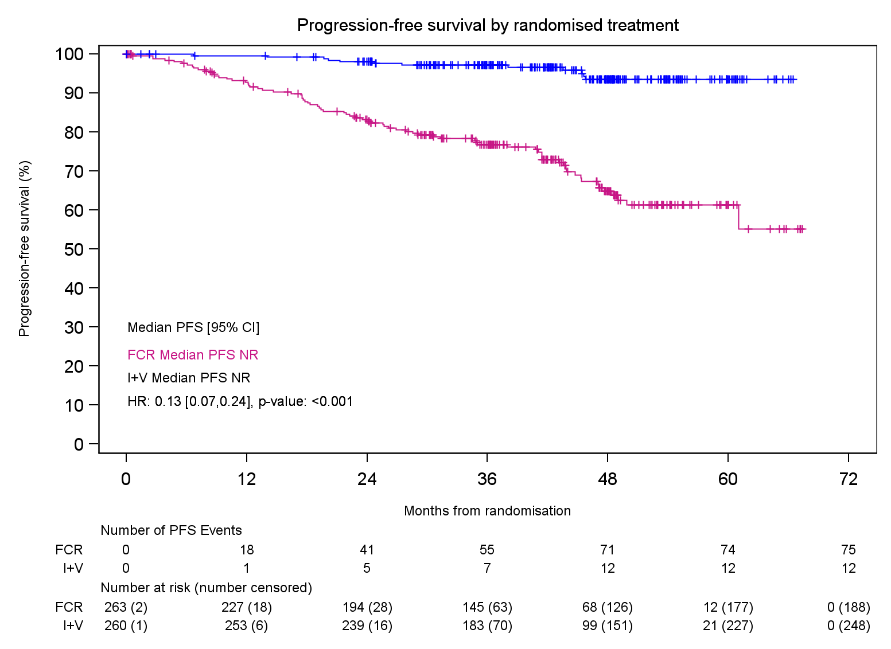
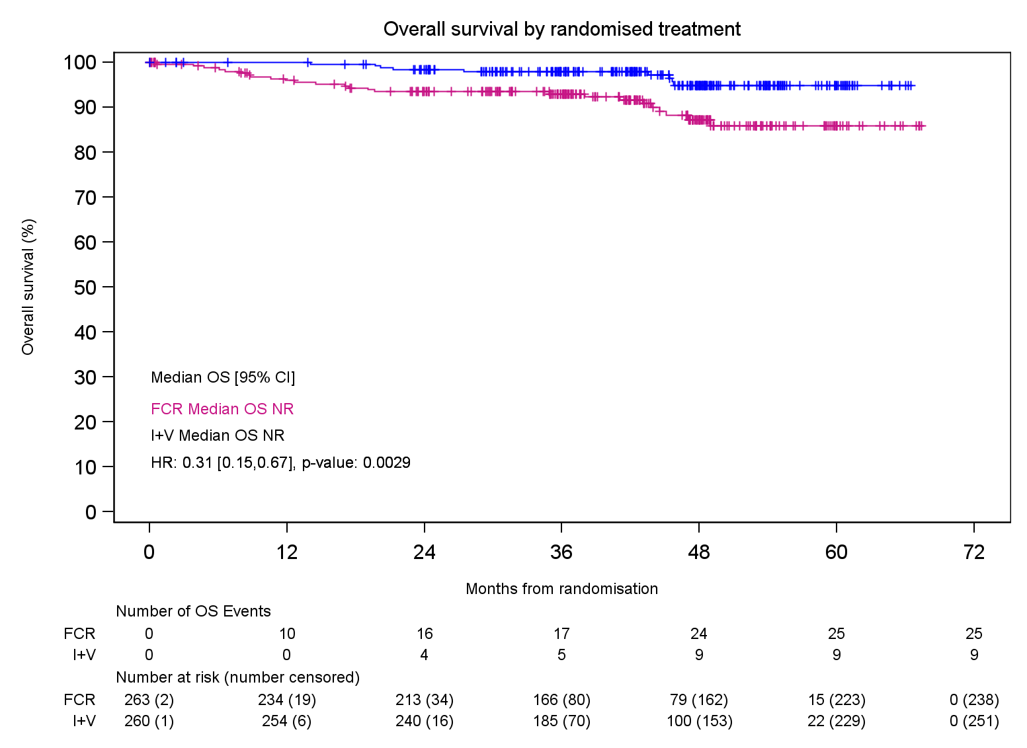
Embargoed until Sunday, Dec. 10, 2023, at 7:30 a.m. Pacific time
Progression Free and Overall Survival
Progression Free Survival (Primary end-point)
Overall Survival
I+V
I+V
FCR
Median follow-up: 43.0 months
Median follow-up: 43.7 months
Progression-free and alive (%)
Surviving (%)
FCR
 | Number of deaths | % died at 3 years*
I+V (n=260) | 9 | 2.0%
FCR (n=263) | 25 | 7.0%
HR: 0.31 [0.15, 0.67], p-value: <0.005
Progression free at 3 years
I+V (n=260) 97.2% (95% CI, 94.1-98.6)
FCR (N=263) 76.8% (95% CI, 70.8-81.7)
HR: 0.13 [0.07, 0.24], p-value: <0.0001
*, cumulative incidence per KM estimate
Months
Months

Slide 17
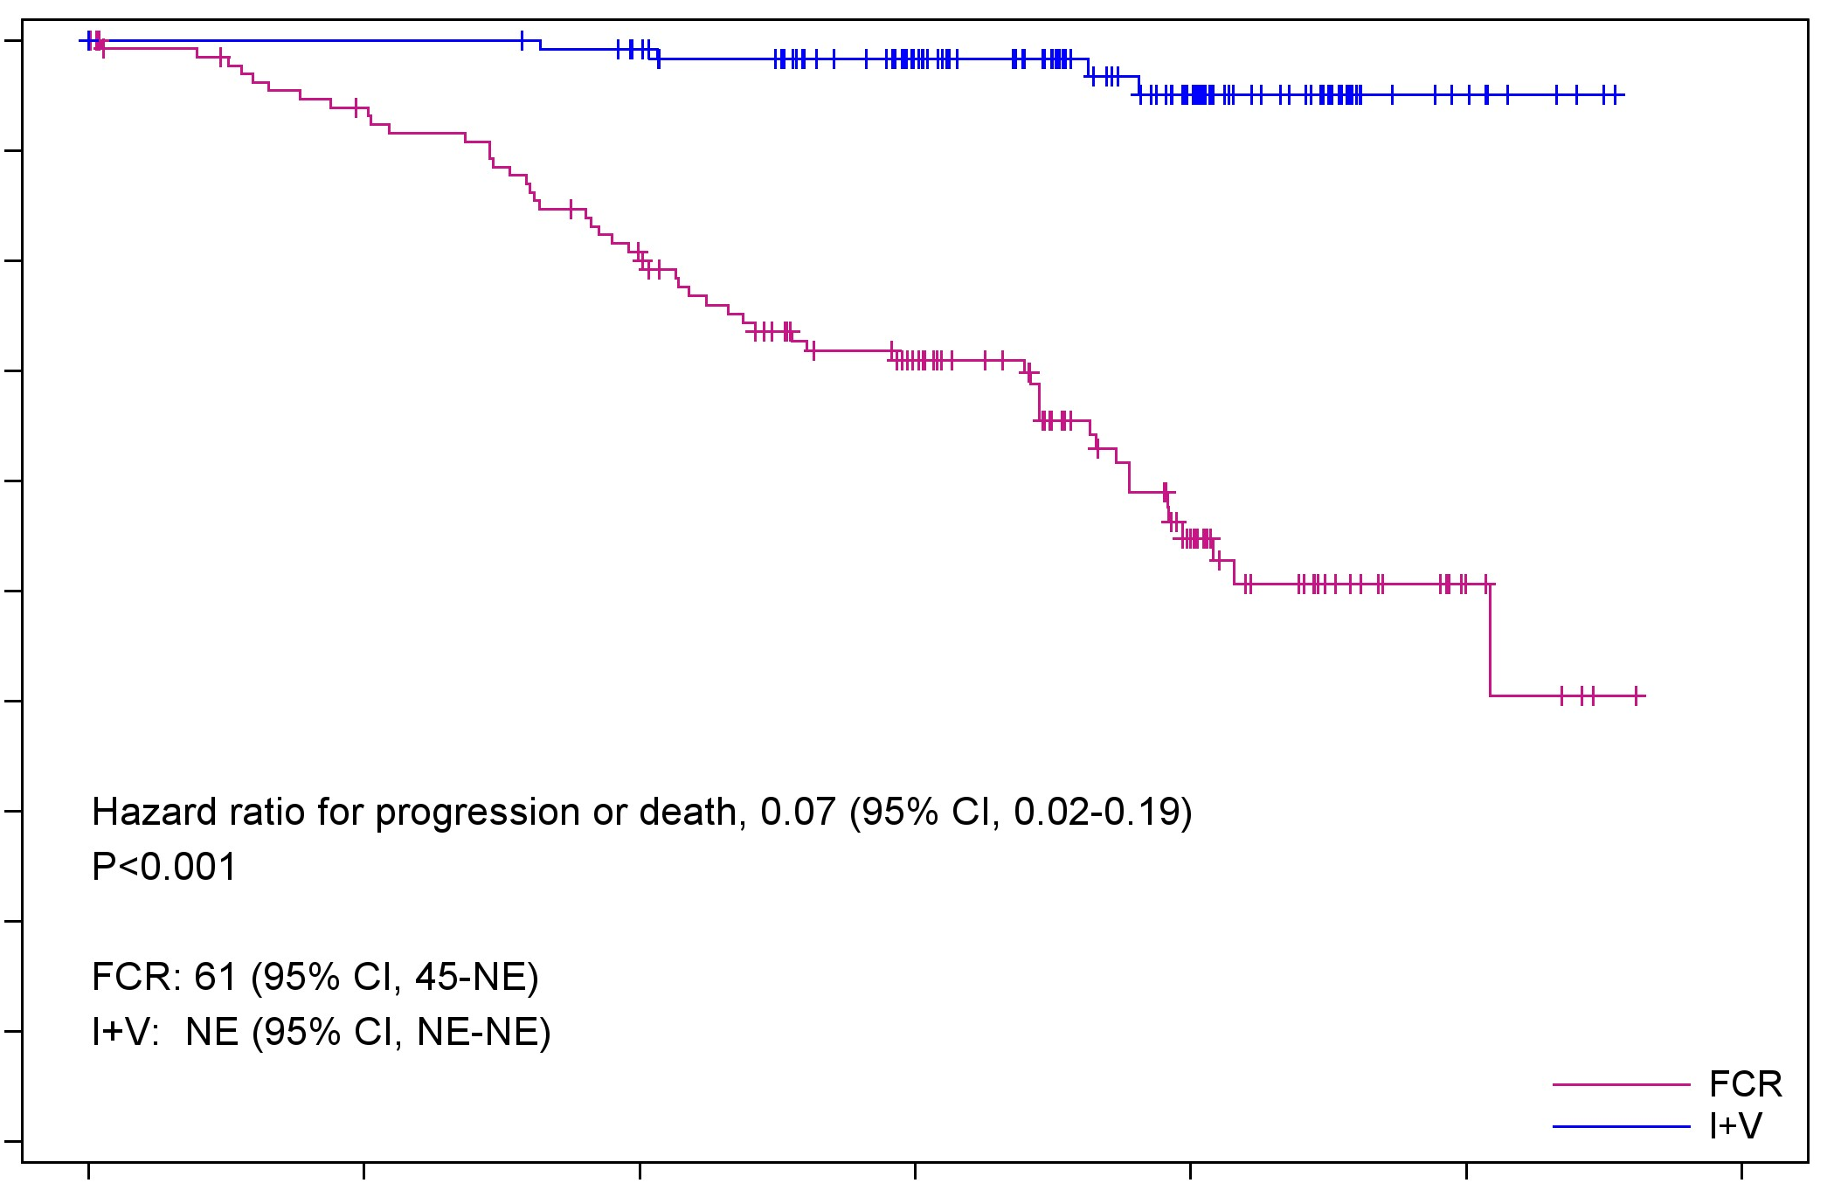
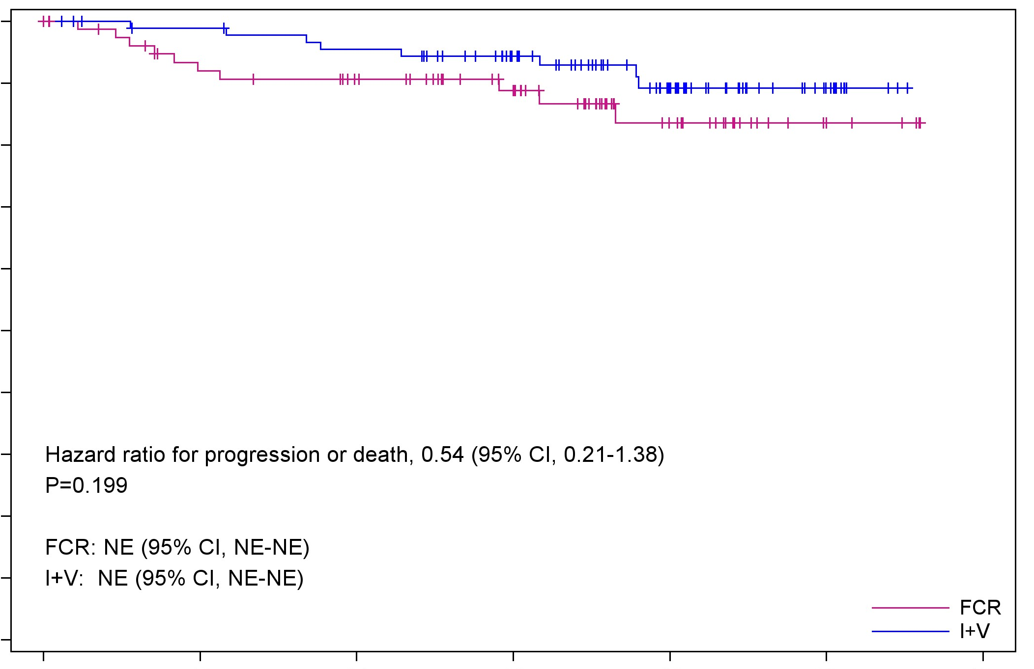
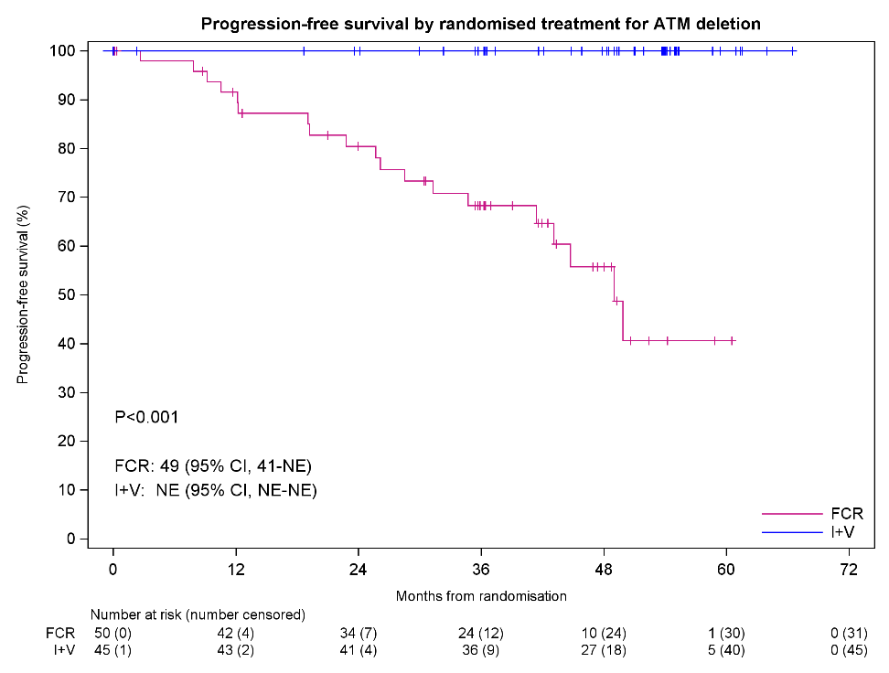
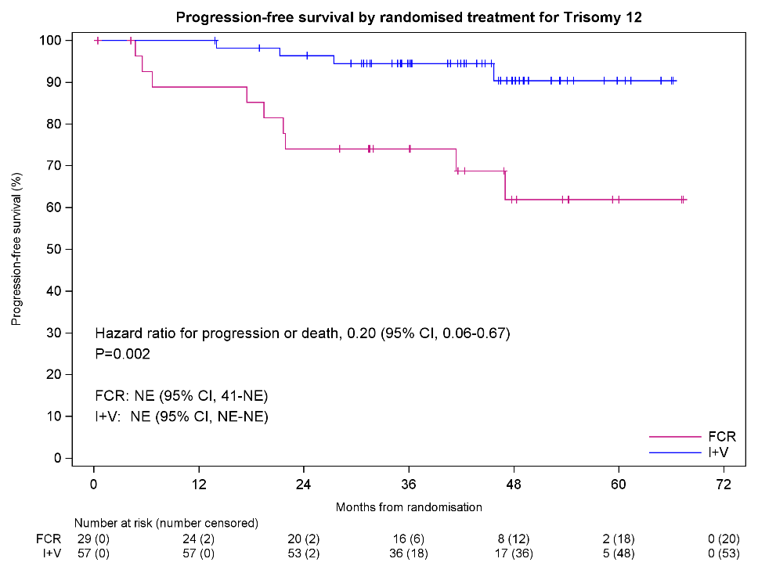
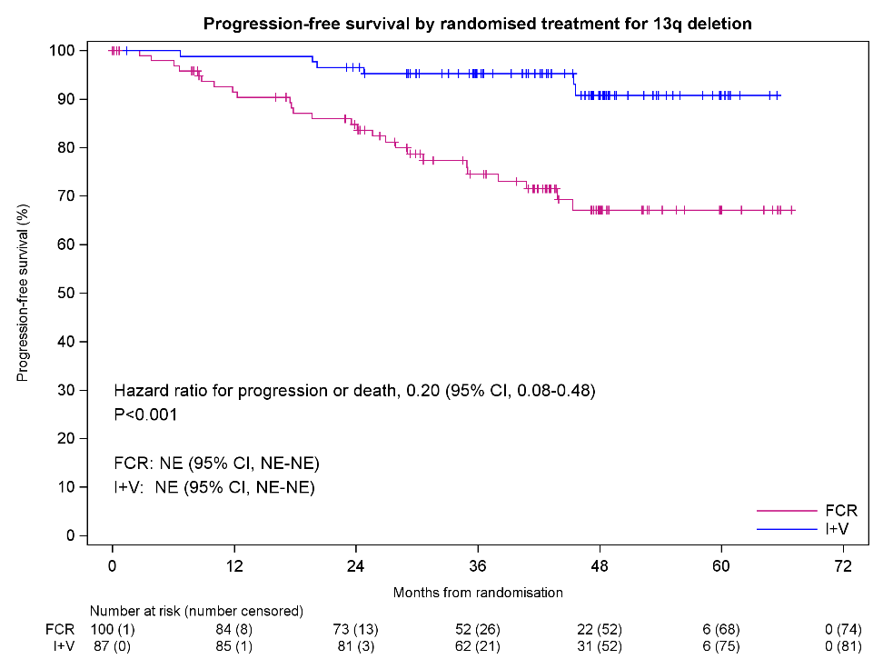
Improved outcomes seen across biological subgroups
Embargoed until Sunday, Dec. 10, 2023, at 7:30 a.m. Pacific time
IGHV unmutated (excl. Subset 2)
IGHV mutated (excl. Subset 2)
I+V
100
90
80
70
60
50
40
30
20
10
0
I+V
100
90
80
70
60
50
40
30
20
10
0
FCR
IGHV
Progression-free (%)
Progression-free (%)
FCR
Progression free at 3 years
I+V (n=92): 94.3%
FCR (n=79): 88.8%
HR: 0.54 [0.21, 1.38], p=0.199
Progression free at 3 years
I+V (n=124): 98.3%
FCR (n=139): 70.9%
HR: 0.07 [0.02, 0.19], p-value: <0.001
0 12 24 36 48 60 72
0 12 24 36 48 60 72
Months
Months
ATM (11q) deletion
Trisomy 12
13q deletion
100
90
80
70
60
50
40
30
20
10
0
I+V
100
90
80
70
60
50
40
30
20
10
0
100
90
80
70
60
50
40
30
20
10
0
I+V
FISH
I+V
FCR
FCR
Hazard ratio: 0.2
(95% CI: 0.06-0.67)
P=0.002
Hazard ratio: 0.2 (95% CI: 0.08-0.48)
P<0.001
Progression-free (%)
Progression-free (%)
Progression-free (%)
FCR
3 year PFS:
I+V (n=45): 100%
FCR (n=50): 68.3%
3 year PFS:
I+V (n=57): 94.5%
FCR (n=29): 74.1%
3 year PFS:
I+V (n=87): 95.3%
FCR (n=100): 74.5%
P <0.001
0 12 24 36 48 60 72
0 12 24 36 48 60 72
0 12 24 36 48 60 72
Months
Months
Months

Slide 18
SAEs, by MedDRA System organ class
Embargoed until Sunday, Dec. 10, 2023, at 7:30 a.m. Pacific time
Serious Adverse Events & Malignancies
Secondary malignancies (SM)
 | Number of participants reporting ≥1 SAE
 | FCR (n=239) | I+V (n=252)
Infections and infestations | 45 (18.8%) | 56 (22.2%)
Blood and lymphatic system disorders | 74 (31%) | 13 (5.2%)
Cardiac disorders | 1 (0.4%) | 27 (10.7%)
Gastrointestinal disorders | 19 (7.9%) | 9 (3.6%)
General disorders and administration site conditions | 12 (5%) | 4 (1.6%)
Neoplasms benign, malignant and unspecified (including cysts and polyps) | 5 (2.1%) | 6 (2.4%)
Metabolism and nutrition disorders | 0 (0%) | 10 (4%)
Respiratory, thoracic and mediastinal disorders | 6 (2.5%) | 4 (1.6%)
Musculoskeletal and connective tissue disorders | 3 (1.3%) | 6 (2.4%)
Skin and subcutaneous tissue disorders | 5 (2.1%) | 4 (1.6%)
Nervous system disorders | 2 (0.8%) | 5 (2%)
Eye disorders | 0 (0%) | 6 (2.4%)
 | FCR | I+V
Incidence rate of cancers per 100 person-years (95% CIs) | 5.4 (5.11, 5.68) | 2.6 (2.40, 2.79)
 | FCR | I+V
BCC/SCC | 16 | 13
MDS/AML | 8 | 1
Lymphoma | 5 | 3
Prostate/urological | 5 | 1
Lung | 3 | 0
GI | 3 | 1
Breast | 1 | 1
Melanoma | 1 | 1
Myeloma | 1 | 0
Endocrine | 0 | 1
Other | 5 | 2
Total patients* | 39 | 17
*, some patients had more than one SM

Slide 19
Conclusion: MRD guided I+V versus FCR
Embargoed until Sunday, Dec. 10, 2023, at 7:30 a.m. Pacific time
Ibrutinib plus venetoclax (I+V) significantly improved responses, progression free and overall survival compared to FCR in fit patients with previously untreated CLL
More patients achieve an MRD negative remission with I+V than FCR
the majority of I+V patients achieve the MRD stopping criteria
PFS better in IGHV unmutated, 11q deleted, Trisomy 12 and 13q deleted CLL amongst other sub-groups
I+V was well tolerated with no unexpected toxicities
The excellent results seen with I+V indicate that directing the duration of therapy according to individual MRD response maximizes outcomes

Slide 20
The benefit of allogeneic transplant in 1st complete remission in NPM1 mutated AML with or without FLT3 ITD is restricted to those testing MRD positive after induction – an analysis of the UK NCRI AML17 and AML19 studies
J Othman*, N Potter*, A Ivey, J Jovanovic, SD Freeman, A Gilkes, I Thomas, S Johnson, J Canham, J Cavenagh, P Kottaridis, C Arnold, UM Overgaard, M Dennis, C Wilhelm-Benartzi, R Dillon*, NH Russell*
On behalf of the UK NCRI AML working group
*equal contribution
Embargoed until Sunday, Dec. 10, 2023, at 7:30 a.m. Pacific time

Slide 21
Background
In ELN 2022, NPM1 mutated (NPM1^{mut}) AML is:
Generally favorable risk
Intermediate risk if co-mutated FLT3 ITD
Adverse risk if adverse karyotype
The role of allogeneic transplant in first remission (CR1-allo) in NPM1^{mut} AML remains controversial, with significant variation in practice worldwide
Embargoed until Sunday, Dec. 10, 2023, at 7:30 a.m. Pacific time

Slide 22
Background
Early studies suggested CR1-allo is beneficial in NPM1^{mut} AML only if FLT3 ITD was also present at a high level
However these did not take into account the impact of MRD, which is known to strongly associate with survival
To address this issue, we combined data from two large UK NCRI randomised studies – AML17 (2009-2014) and AML19 (2015-2020)
Ivey et al. N Engl J Med. 2016;374(5)
Embargoed until Sunday, Dec. 10, 2023, at 7:30 a.m. Pacific time

Slide 23
Methods
NPM1 MRD performed by RT-qPCR at the same reference laboratory in both trials
Selection of NPM1^{mut} patients for CR1-allo differed between trials:
AML17 – based on validated risk score*
AML19 – based on MRD. Recommended for CR1-allo only if MRD+ in PB post course 2
*age, sex, secondary disease, cytogenetics, WCC, response after course 1
Embargoed until Sunday, Dec. 10, 2023, at 7:30 a.m. Pacific time

Slide 24
All patients enrolled in AML17
N = 3215
All patients enrolled in AML19
N = 1853
NPM1 mutation
N = 888 (28%)
NPM1 mutation
N = 469 (25%)
CR/CRi after 2 courses
N = 821 (92%)
CR/CRi after 2 courses
N = 443 (94%)
Study population (N = 737)
Adequate PC2 PB MRD sample
N = 348 (42%)
Adequate PC2 PB MRD sample
N = 389 (88%)
MRD negative
N = 288 (83%)
MRD positive
N = 60 (17%)
MRD negative
N = 306 (79%)
MRD positive
N = 83 (21%)
CR1 alloSCT
N = 52 (18%)
CR1 alloSCT
N = 16 (27%)
CR1 alloSCT
N = 49 (16%)
CR1 alloSCT
N = 50 (60%)
Embargoed until Sunday, Dec. 10, 2023, at 7:30 a.m. Pacific time

Slide 25
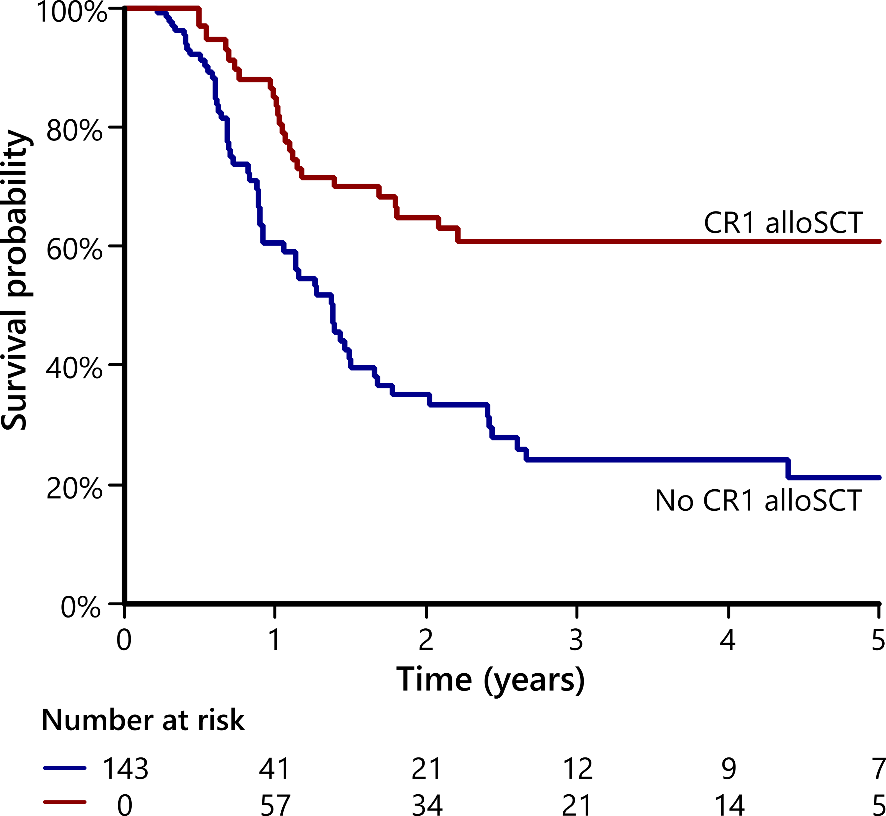
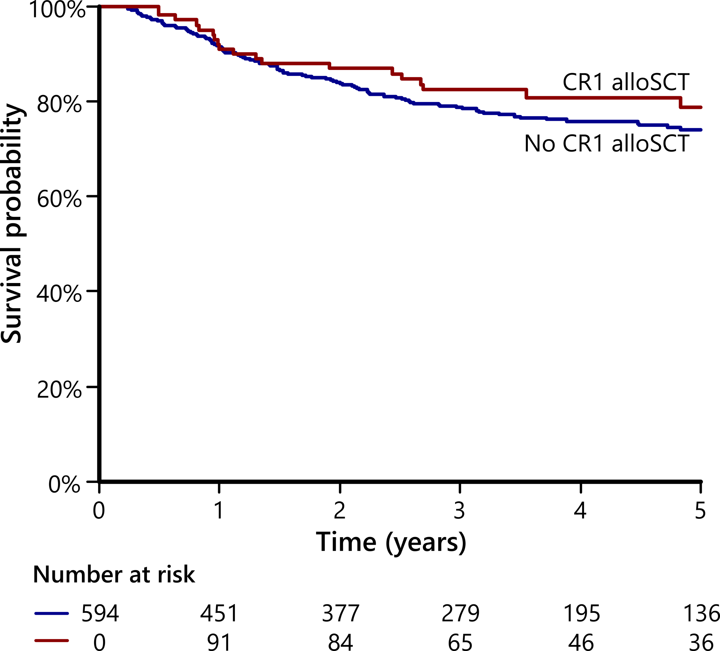
Impact of CR1-allo on survival is determined by MRD status after induction
MRD positive
MRD negative
HR 0.39, 95%CI 0.24-0.64
HR 0.82, 95%CI 0.50-1.33
Embargoed until Sunday, Dec. 10, 2023, at 7:30 a.m. Pacific time

Slide 26
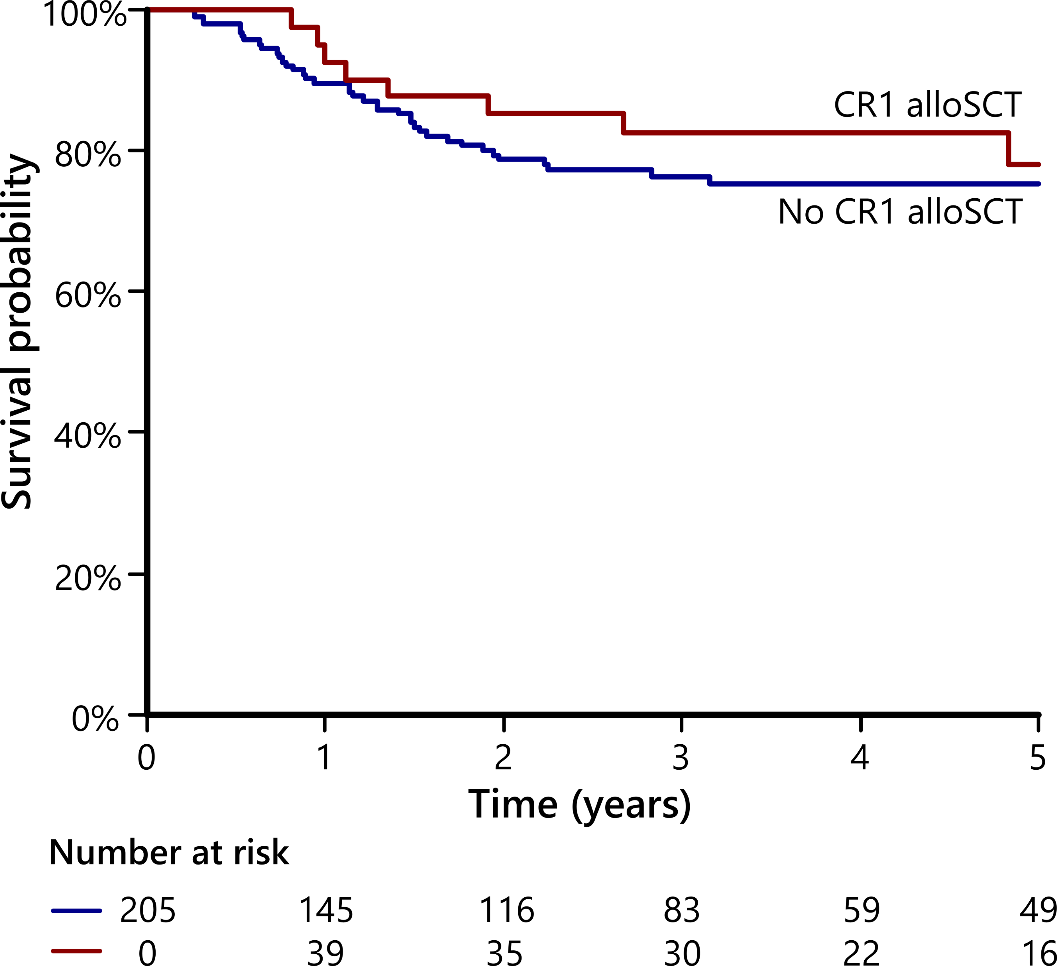
MRD also predicts CR1-allo benefit in patients with NPM1 + FLT3 ITD
MRD positive
MRD negative
HR 0.52, 95%CI 0.29-0.93
HR 0.80, 95%CI 0.37-1.72
Embargoed until Sunday, Dec. 10, 2023, at 7:30 a.m. Pacific time

Slide 27
Conclusions
Molecular MRD after induction chemotherapy identifies patients with NPM1^{mut} AML who benefit from allogeneic transplant in first remission
Patients achieving MRD negativity in blood after second induction show no survival benefit from CR1 transplant, even if FLT3 ITD co-mutated
Embargoed until Sunday, Dec. 10, 2023, at 7:30 a.m. Pacific time

Slide 28
Autologous Transplant is Associated with Improved Clinical Outcomes Compared to CAR-T Therapy in Patients with Large B-Cell Lymphoma Achieving a Complete Remission
Embargoed until Sunday, Dec. 10, 2023, at 7:30 a.m. Pacific time

Slide 29
Presentation Writing Committee
Authors
Mazyar Shadman, MD, MPH | Alex F. Herrera, MD
Kwang Woo Ahn, PhD | Craig S. Sauter, MD
Manmeet Kaur, MPH | Mehdi Hamadani, MD
Mohamed A. Kharfan-Dabaja, MD, MBA
On behalf of the CIBMTR® Lymphoma Working Committee; CIBMTR® is a research collaboration between National Marrow Donor Program®/Be The Match® and Medical College of Wisconsin.
Embargoed until Sunday, Dec. 10, 2023, at 7:30 a.m. Pacific time

Slide 30
Background
Embargoed until Sunday, Dec. 10, 2023, at 7:30 a.m. Pacific time
CAR-T therapy is the SOC for relapsed LBCL as early as 2nd line based on the results of the ZUMA-7 and TRANSOFRM studies
In practice, access to CAR-T is sometimes delayed due to logistical issues and patients may received interim (bridging) chemotherapy and some achieve a PR or CR
A number of reports indicate efficacy and feasibility of CAR-T in patients who achieve a CR
Using the CIBMTR registry, we compared the outcome of patients with LBCL who received auto-HCT vs. CAR-T while in a CR
We have previously shown superior efficacy of auto-HCT over CAR-T in LBCL patients in a PR

Slide 31
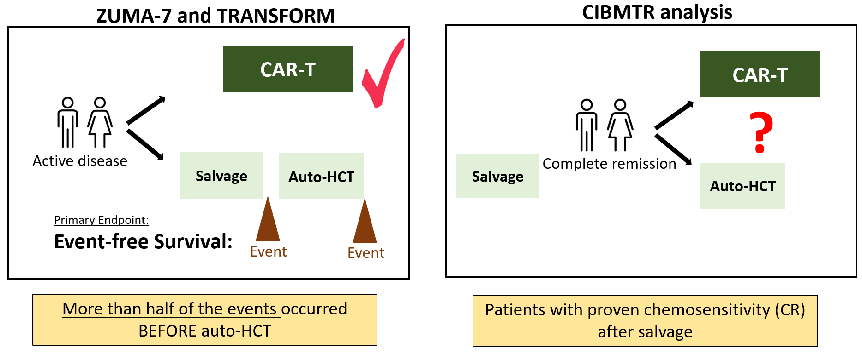
Background
Embargoed until Sunday, Dec. 10, 2023, at 7:30 a.m. Pacific time
This analysis asks a different question from what ZUMA-7 and TRANSFORM answered
Both trials compared CAR-T with (salvage chemo ➔ auto-HCT) and most patients had an “event” before receiving auto-HCT
We hypothesized that auto-HCT is superior to CAR-T in CR patients

Slide 32
Methods
Embargoed until Sunday, Dec. 10, 2023, at 7:30 a.m. Pacific time
A retrospective real-world analysis using the CIBMTR registry
Patients who received auto-HCT or CAR-T while in a CR by PET or PET/CT
Age range: 18-75
Endpoints
Primary: PFS and OS
Secondary: Relapse/progression rate, NRM, Causse of death
Subgroup analysis: Patients with progressive disease 12 months after finishing first line treatment
Patients with previous CAR-T or auto-HCT were excluded

Slide 33
Results: Baseline Characteristics
Characteristic | Auto-HCT (n=281) N (%) | CAR-T (n=79) N (%) | P-Value N (%)
Age, median (range) | 59.4 (18.2-75.6) | 64.1 (20.1-76.0) | 0.14
Female Sex | 103 (36.7) | 32 (40.5) | 0.53
Karnofsky score prior 90-100 | 161 (57.3) | 31 (39.2) | <.01
High-grade B-cell lymphoma, with MYC and BCL2 and/or BCL6 rearrangements | 31 (27.0) | 11 (13.9) | 0.03
Refractory to first line therapy | 56 (19.9) | 23 (29.1) | 0.22
Early therapy failure in 12 months | 181 (64.4) | 63 (79.7) | < 0.1
Total lines of therapies, median (range) | 2.0 (2.0-8.0) | 3.0 (2.0-8.0) | <.01
PET or PET/CT performed prior to treatment | 280 (99.6) | 71 (89.9) | <.01
Median follow-up, months (range) | 49.7 (3.0-95.4) | 24.7 (3.3-49.4)
CAR-T Product | N (%)
tisagenlecleucel | 42 (53.2)
axicabtagene ciloleucel | 36 (45.6)
lisocabtagene maraleucel | 1 (1.3)
Embargoed until Sunday, Dec. 10, 2023, at 7:30 a.m. Pacific time

Slide 34
Results: Progression-Free Survival
Embargoed until Sunday, Dec. 10, 2023, at 7:30 a.m. Pacific time
100
Auto-HCT
80
CAR-T
60
Probability, %
40
2-year PFS:
Auto-HCT: 66.2% (60.4-71.8)
CAR-T: 47.8% (26.4-59.4)
p<0.001
20
0
Months
0
6
12
18
24
N at Risk
Auto-HCT | 277 |  |  | 229 | 195 | 175 | 159
CAR-T | 76 |  |  | 46 | 40 | 34 | 26

Slide 35
Results: Progression / Relapse
Embargoed until Sunday, Dec. 10, 2023, at 7:30 a.m. Pacific time
100
2-year Progression/Relapse:
Auto-HCT: 27.8% (22.6-33.4)
CAR-T: 48% (36.4-59.7)
p<0.001
80
60
Cumulative Incidence, %
40
CAR-T
Auto-HCT
20
0
Months
0
6
12
18
24
N at Risk
Auto-HCT | 277 |  |  | 229 | 195 | 175 | 159
CAR-T | 76 |  |  | 46 | 40 | 34 | 26

Slide 36
Results: Overall Survival
Embargoed until Sunday, Dec. 10, 2023, at 7:30 a.m. Pacific time
100
Auto-HCT
80
CAR-T
60
Probability, %
2-year OS:
Auto-HCT: 78.9% (73.9-83.6)
CAR-T: 65.6% (53.6-76.6)
p=0.037
40
20
0
Months
0
6
12
18
24
N at Risk
Auto-HCT | 281 |  |  | 256 | 233 | 211 | 196
CAR-T | 77 |  |  | 64 | 54 | 43 | 33

Slide 37
Univariable Analyses for 2-year Outcomes
Embargoed until Sunday, Dec. 10, 2023, at 7:30 a.m. Pacific time
Entire Cohort
 | Auto-HCT |  | CAR-T |  | P-value
 | N | Prob (95%CI) | N | Prob (95%CI)
Non-relapse mortality | 277 | 5.9% (3.4-9.1) | 76 | 4.1 % (0.8-10) | 0.673
Relapse/progression | 277 | 27.8% (22.6-33.4) | 76 | 48% (36.4-59.7) | <0.001
Progression-free survival | 277 | 66.2% (60.4-71.8) | 76 | 47.8% (36.4-59.4) | <0.001
Overall survival | 281 | 78.9% (73.9-83.6) | 77 | 65.6% (53.6-76.6) | 0.037
Patients with Early (12 month) Relapse After First Line
 | Auto-HCT |  | CAR-T |  | P-value
 | N | Prob (95%CI) | N | Prob (95%CI)
Non-relapse mortality | 179 | 6.8% (3.6-11) | 60 | 5.3% (1-12.7) | 0.771
Relapse/progression | 179 | 25% (18.8-31.7) | 60 | 46.3% (33.5-59.3) | <0.001
Progression-free survival | 179 | 68.2% (61.1-74.9) | 60 | 48.4% (35.7-61.3) | 0.001
Overall survival | 181 | 79.6 % (73.3-85.2) | 61 | 66.3% (53-78.4) | 0.131

Slide 38
Multivariable Analysis
Embargoed until Sunday, Dec. 10, 2023, at 7:30 a.m. Pacific time
In multivariable analysis, treatment was auto-HCT vs. CAR-T was associated with:
Lower risk of relapse/progression: HR 2.18 (95% CI: 1.48-3.20); p<0.0001
Improved PFS: HR 1.83 (95% CI: 1.27-2.63); p=0.0011
There was no difference in:
No difference in TRM: HR 0.59 (95% CI: 0.19-1.83); p=0.3632
No difference in OS: HR 1.44 (95% CI: 0.91-2.28); p=0.123

Slide 39
Most Common Causes of Death
Embargoed until Sunday, Dec. 10, 2023, at 7:30 a.m. Pacific time
Auto-HCT Cohort
CAR-T Cohort
 | N of deaths = 85
Lymphoma | 51 (60%)
Infections | 14 (16.5%)
Second malignancy | 3 (3.5%)
Cardiac failure | 3 (3.5%)
 | N of deaths = 25
Lymphoma | 17 (68%)
Infections | 3 (12%)
Pulmonary failure | 2 (8%)

Slide 40
Limitations
Embargoed until Sunday, Dec. 10, 2023, at 7:30 a.m. Pacific time
As a retrospective analysis, investigators were limited in eliminating potential confounders that may influence the association between the treatment modality and outcomes.
Ideally, a randomized clinical trial comparing auto-HCT with CAR-T for patients in a CR would inform the practice in this setting
More than half of the patients in the CAR-T cohort received tisa-cel, which may have a lower efficacy than other approved CAR-T products and can underestimate the efficacy of CAR-T in this analysis. A repeat analysis by including more patients treated with axi-cel or liso-cel may address this issue in the future

Slide 41
Conclusion
Embargoed until Sunday, Dec. 10, 2023, at 7:30 a.m. Pacific time
In patients with relapsed DLBCL in a CR treatment auto-HCT is associated with a lower rate of relapse/progression, a longer PFS, and a superior OS
These findings are consistent with our previous findings, indicating higher efficacy of auto-HCT compared to CAR-T in patients in partial remission
These results may inform or confirm clinical practices in select settings:
In patients with late relapses (after 12 months), auto-HCT should remain SOC
In patients with primary refractory disease or early relapse, CAR-T should be the goal of therapy and improving access to CAR-T should remain a priority
In the subset of patients who achieve a CR with interim treatment, a discussion about the possibility of utilizing auto-HCT seems reasonable and can provide another curative option for some patients while keeping CAR-T as a backup treatment plan in case of auto-HCT failure.
Notes:
Treatment with auto-HCT remained independently associated with a lower relapse rate and an improved PFS in the multivariable analysis.

Slide 42
Acknowledgment
Embargoed until Sunday, Dec. 10, 2023, at 7:30 a.m. Pacific time
CIBMTR Lymphoma Committee
Scientific Director: Dr. Mehdi Hamadani
Co-chairs: Dr. Craig Sauter, Dr. Alex Herrera
Writing committee members
Patients and investigators

