Slide 1
Fight for Hematology
Join the #Fight4Hematology to protect federal investment in life-saving research and support access to care.

Slide 2




ASH is fighting for hematology in the face of executive orders and other federal actions that threaten research and, ultimately, the care of patients.
Join the #Fight4Hematology by taking 4 critical actions.
Visit:
HEMATOLOGY.ORG/FIGHT4HEMATOLOGY
Contact Congress to protect access to care, support research funding, and protect the critical federal health care workforce.
Share how executive orders and federal cuts have impacted hematology research, patient care, and treatment.
Use your voice on social media to spread awareness and support for the #Fight4Hematology!
Contribute to the ASH Foundation to support additional ASH Awards to help ensure that hematologists can continue their vital research without interruption.
Together, we can drive meaningful change!

Slide 3
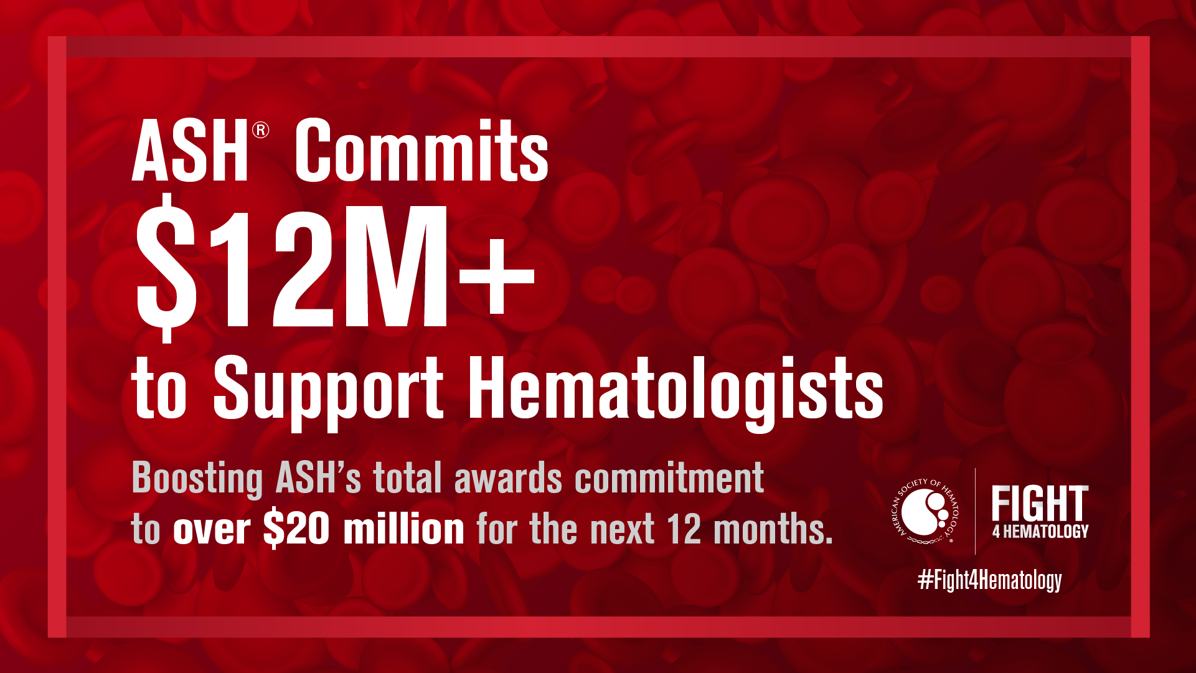
ASH's Commitment
ASH is investing $12M+, which includes a $9M increase in award support, bringing total commitments to $20M for the next year and funding 600+ additional awardees across all career stages.

Slide 4
Toolkits to Advocate
Advocacy Toolkit and NIH Facts by State - ASH’s advocacy toolkit and fact sheets for each of the 50 states and the District of Columbia, detailing the importance of NIH funding for each state.
Letter to the Editor Toolkit - Letter-to-the editor toolkit to help you communicate with the community and lawmakers on the critical importance of NIH research and funding.
Social Media Toolkit - Suite of social media graphics and posts you can use to share your involvement with the #Fight4Hematology. Join the fight and help ASH spread the word!
ASH Advocacy Training Webinar - Webinar recording with strategies to engage elected officials, ASH policy priorities, and tools to drive change.
Fight4Hematology PowerPoint Slide Deck - Create presentations to strengthen your advocacy for advancing hematology research and care.
#Fight4Hematology Research Saves Lives Webpage and Video - Highlight the importance of NIH-funded hematology research, connect the public with lawmakers, and create urgency around protecting NIH funding.

Slide 5

Follow ASH on Social Media
@ASH_Hematology
@American Society of Hematology
Use the Hashtag
#Fight4Hematology
@ash_hematology
@American Society of Hematology
@ash.hematology.org

Slide 6

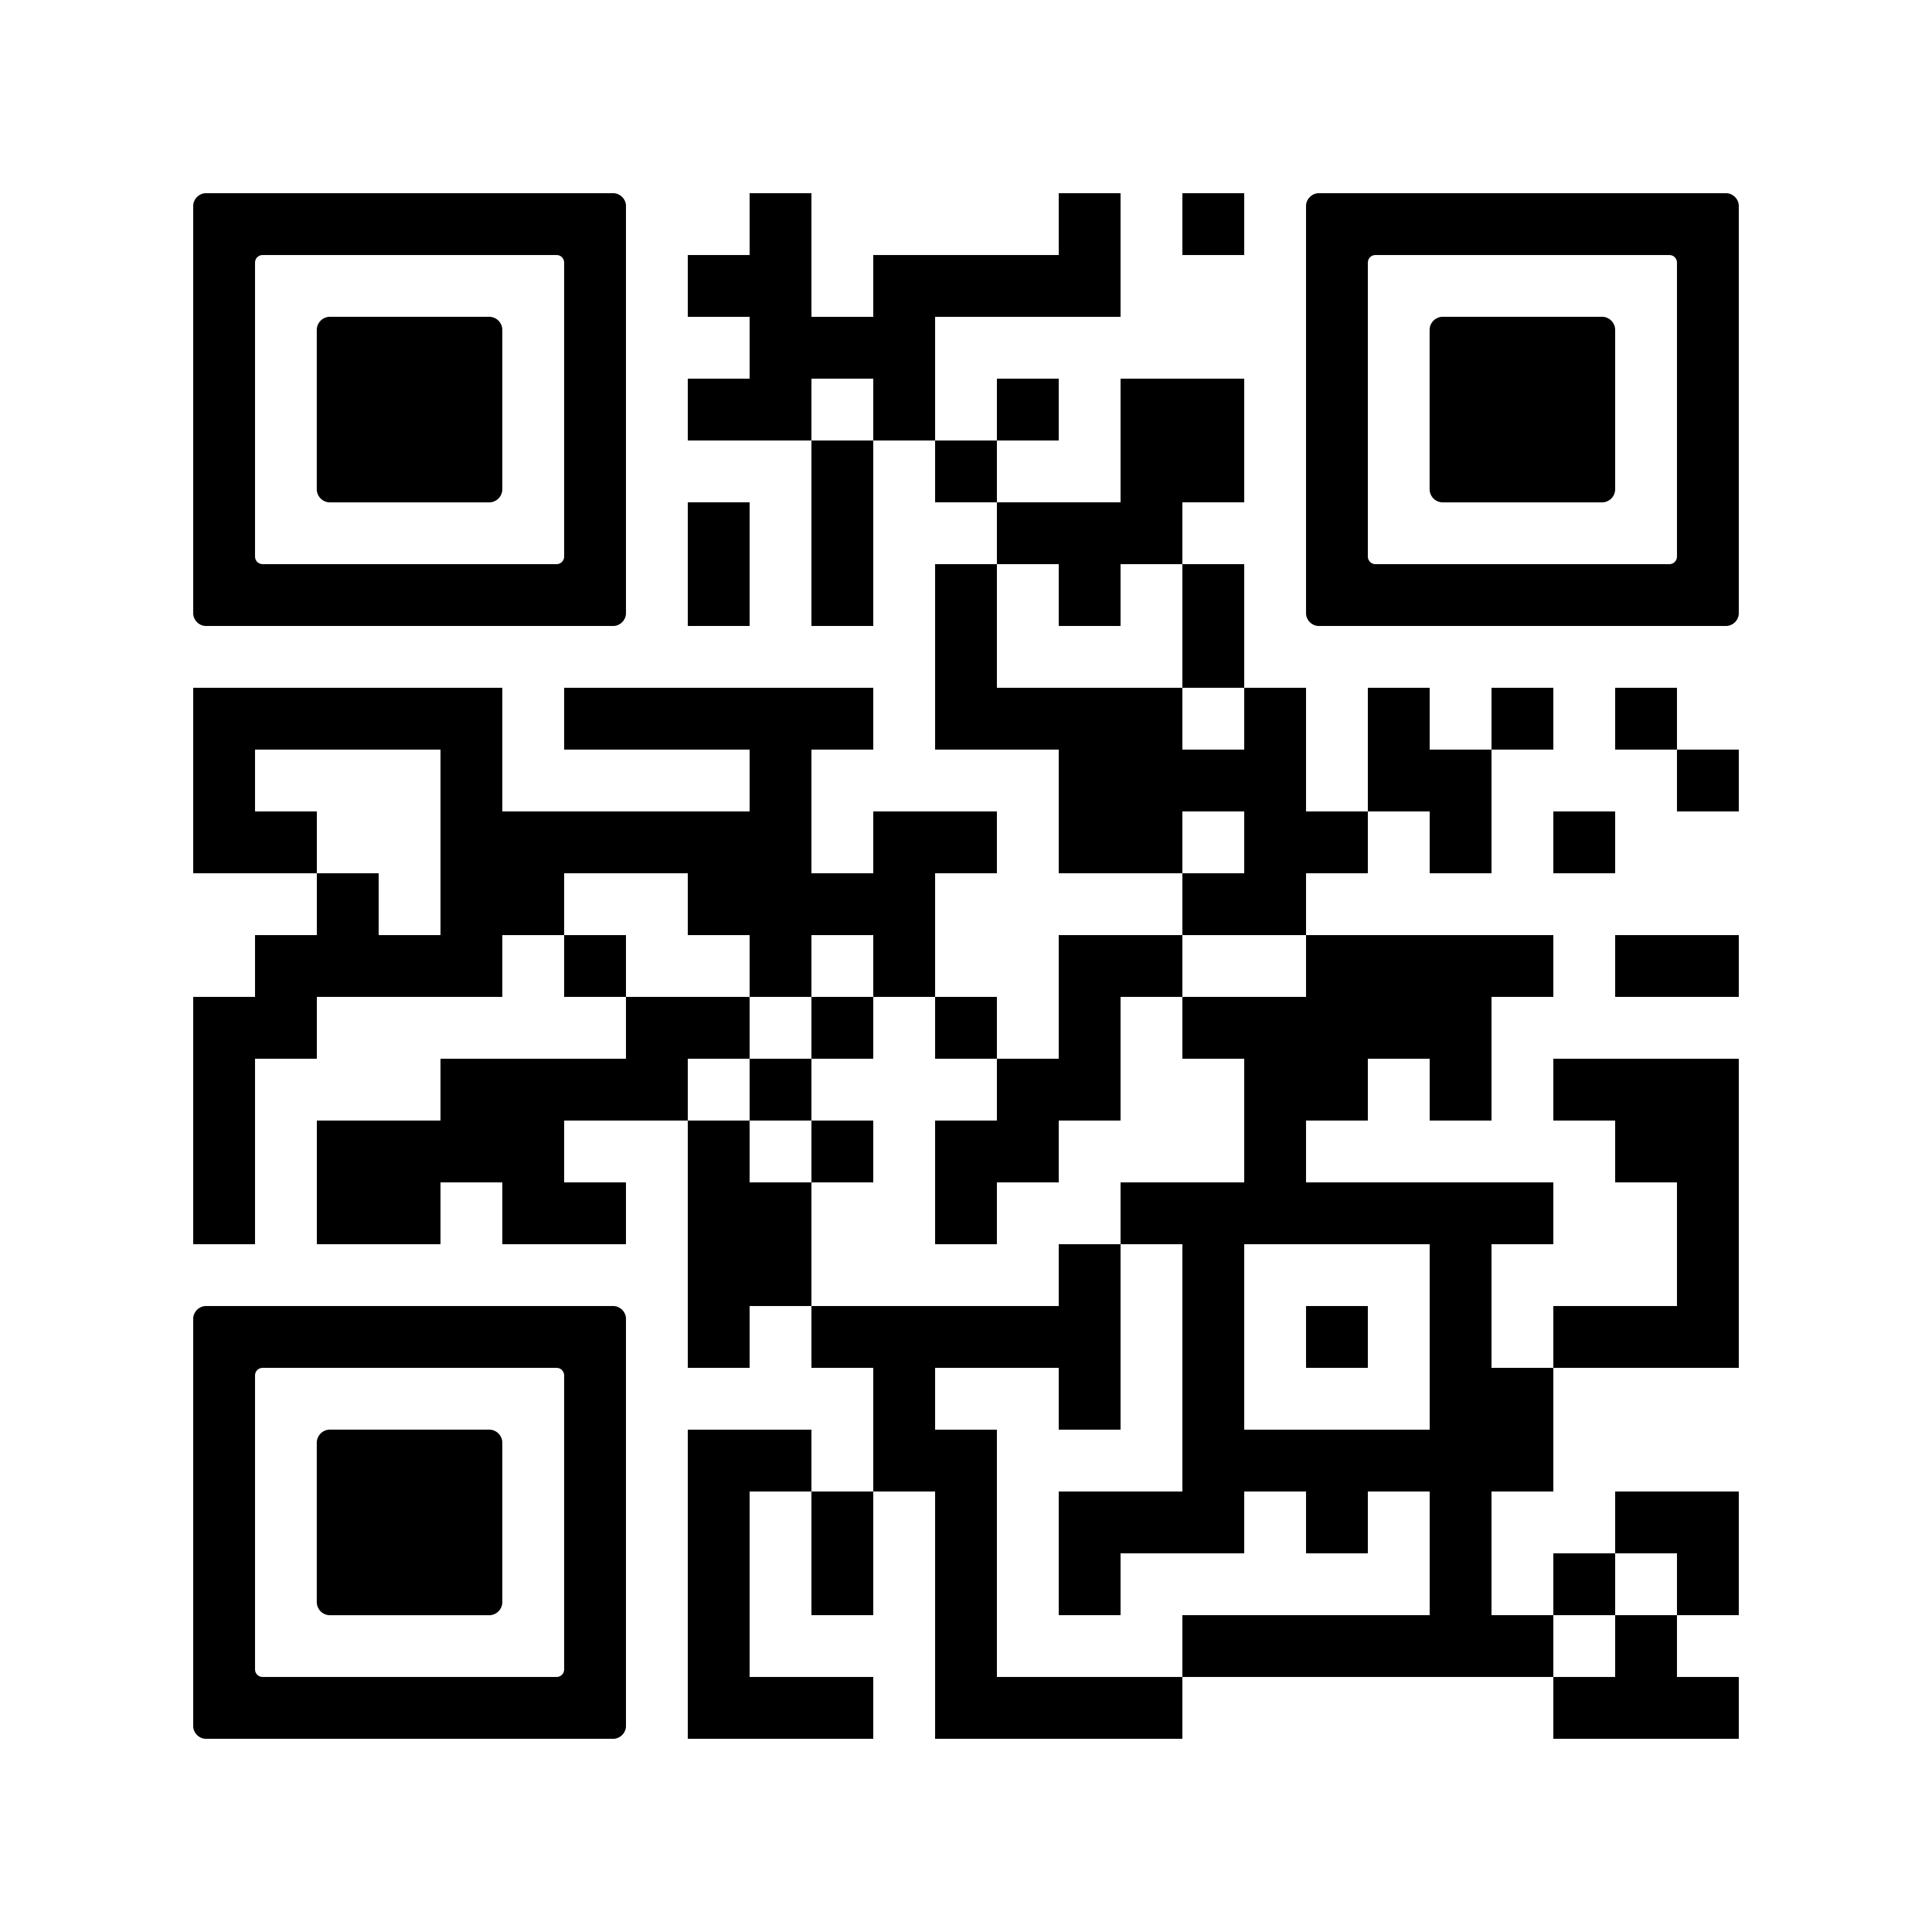
Contact your members of Congress to protect access to care, federal research funding, and the critical federal health workforce and infrastructure.
#Fight4Hematology

Slide 7

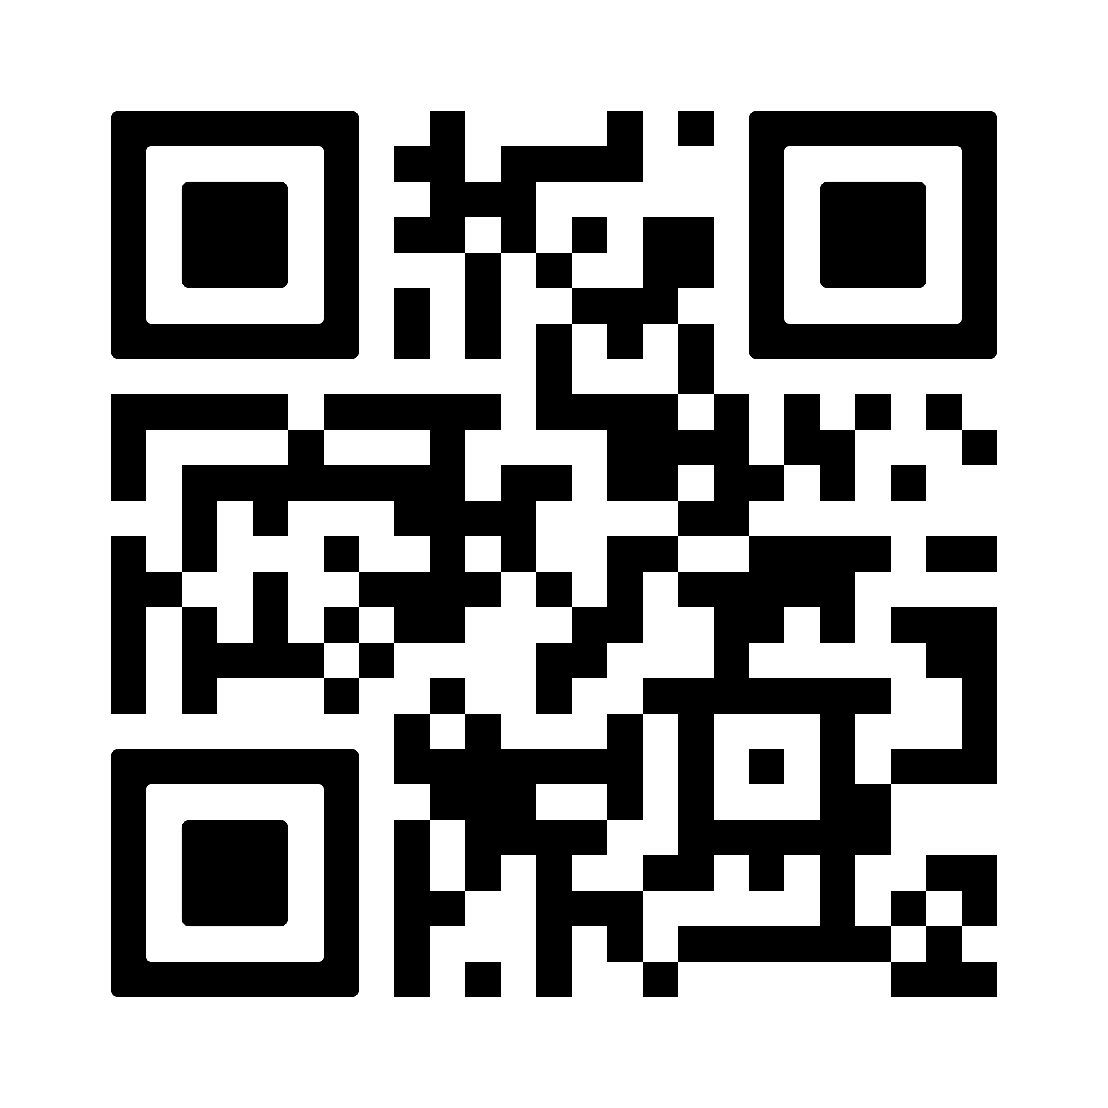
Share how executive orders and federal cuts have impacted hematology research, patient care, and treatment through anonymous surveys and social media posts, and encourage patients to participate in an advocacy campaign.
#Fight4Hematology

Slide 8

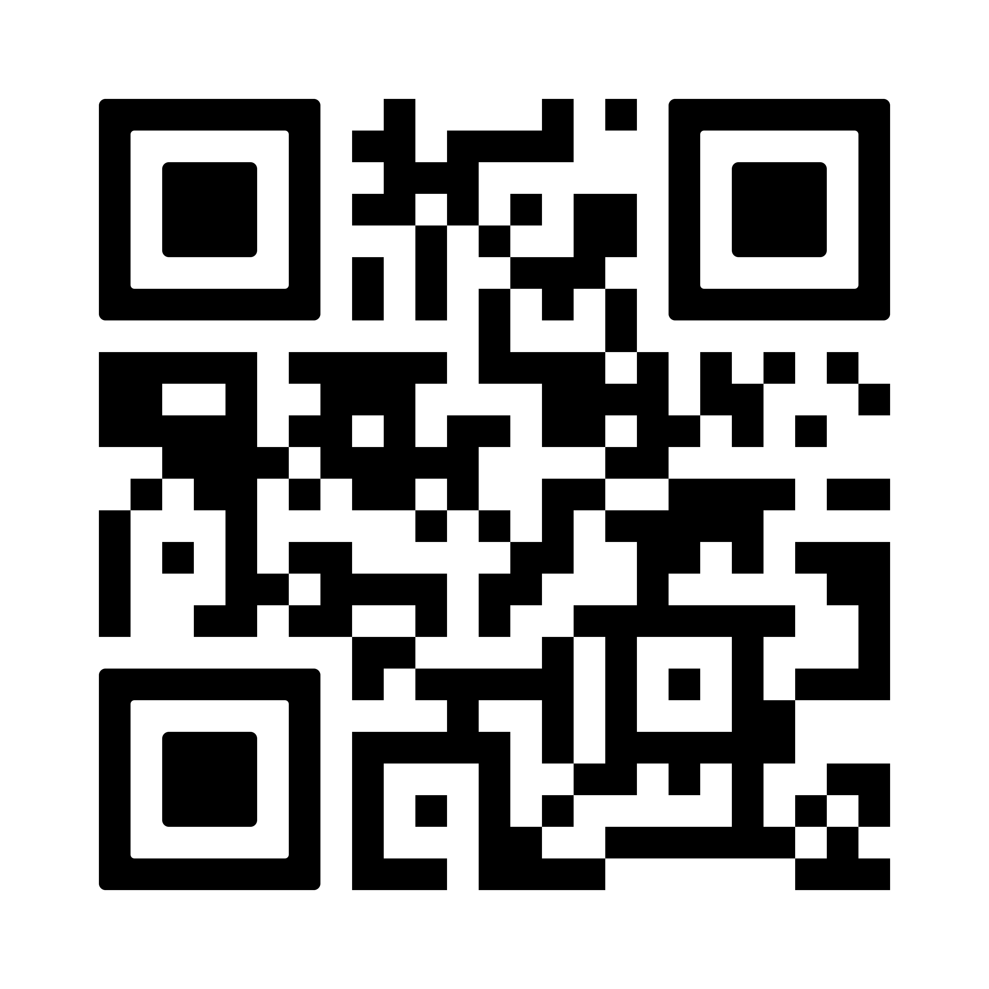
Use social media to join the #Fight4Hematology campaign, follow ASH's accounts, and amplify ASH's messages.
#Fight4Hematology

Slide 9

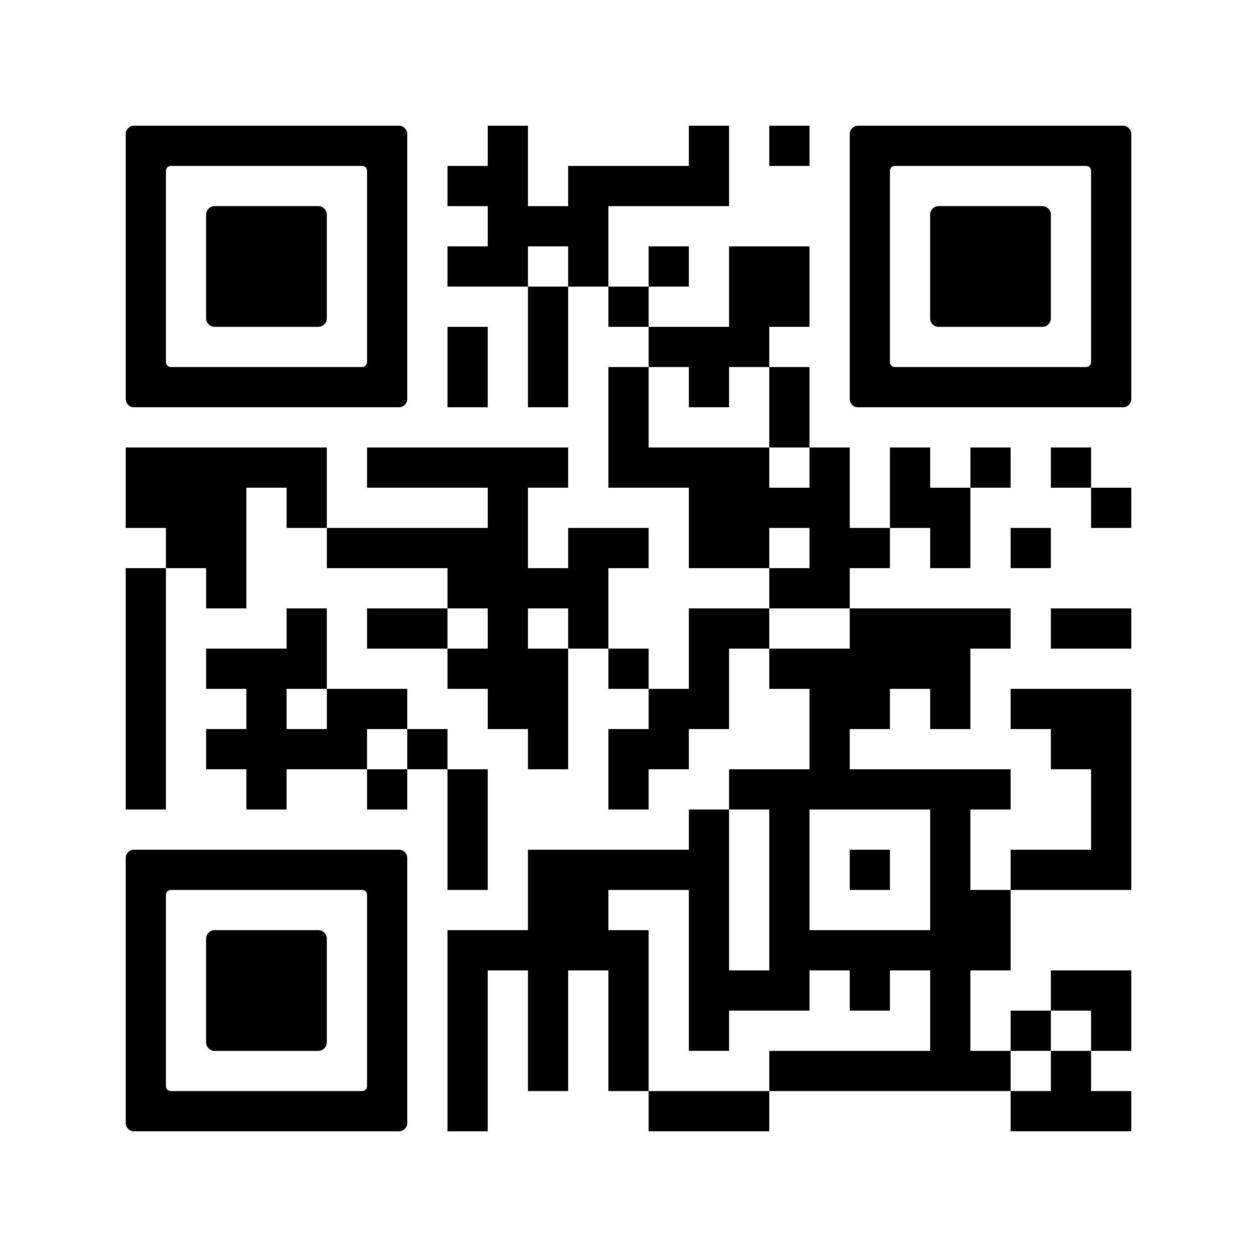
All donations to the Greatest Needs fund will support ASH awards and sustain important hematology research.
#Fight4Hematology

