Slide 1
2018 ASH Training Program Director’s Workshop
Resiliency in Fellowship
Michael Linenberger, MD
Program Director, Adult Hematology/Oncology Fellowship
University of Washington/Fred Hutchinson Cancer Rsrch Ctr
November 30, 2018

Slide 2
Disclosures
Recent past-member, ABIM Hematology Exam Writing Committee

Slide 3

A Summer Day
“…Tell me, what is it you plan to do with your one wild and precious life?”
- Mary Oliver, 1992

Slide 4
– Family Medicine, Internal Medicine, Cardiology, Orthopedics –
How Do We Keep Up & Not Burn Out?

Slide 5
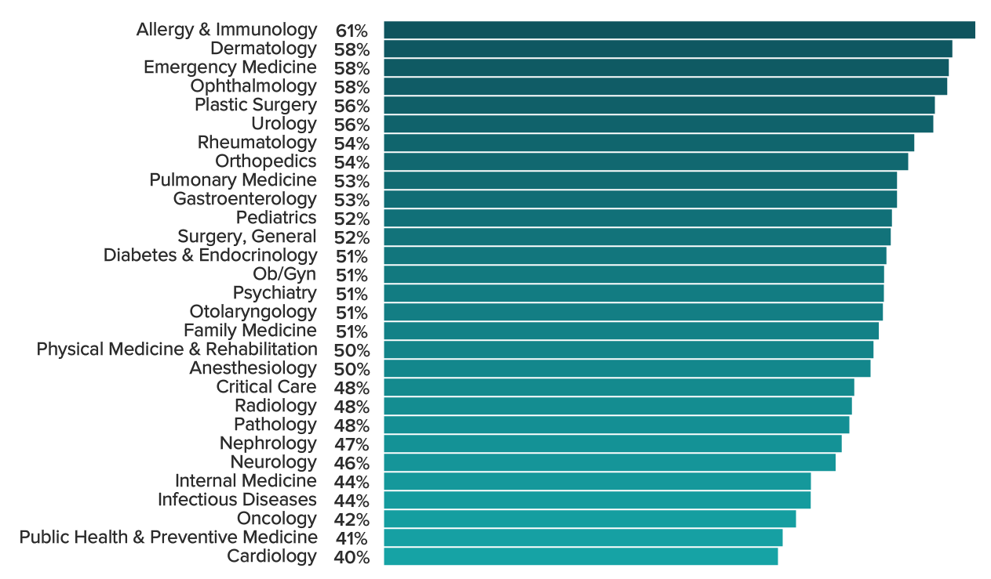

2018 Medscape Physician Lifestyle & Happiness Survey/Report (N=15,543): Happiest outside work?
Oncology 42%
(N ≈ 470)
https://www.medscape.com/slideshow/2018-lifestyle-happiness-6009320#3: Accessed 11/13/2018
Notes:
CM updated

Slide 6
Objectives
What is the problem?
  Awareness & acknowledgment
How do we recognize it?
  Break-out discussion #1
How might we intervene?
  Break-out discussion #2

Slide 7
Work-Life Balance Among Oncologists
Only 33% of oncologists are satisfied with work-life balance; Lower than satisfaction rate of other medical specialties [note: work-life balance is not the same as “burnout”]
Female oncologists are less likely to be satisfied with work-life balance than their male colleagues (26% vs 42%)
Among oncologists with children, those with non-adult children (< 22 yo) are less likely to be satisfied with work-life balance than those with older children (38% vs 51%)
Lower satisfaction & work-life balance among oncologists who…
  Are in private practice – Treat only one type of cancer
  Work more hours and spent more time in the hospital
Dyrbye LN et al. National Academy of Medicine Discussion Paper. July 5, 2017
Shanafelt TD et al. J Clin Oncol 2014;32:678. Shanafelt TD et al. J Clin Oncol 2014;32:1127
Shanafelt TD et al. J Clin Oncol 2014;32:2991 Shanafelt TD, Dyrbye LN, West CP. JAMA 2017;317:901
Notes:
CM updated

Slide 8
Shruti J et al.
Physician recipients of NIH K08 or K23 awards, 2006 & 2009 with active
academic affiliation at time of survey
Among married or partnered respondents with children, after adjustment
for work hours, spousal employment & other factors, women spent 8.5
more hours per week on domestic activities & less time doing research

Slide 9
Burnout: Definitions & Causes
Definition: A syndrome of depersonalization, emotional exhaustion, and low personal accomplishment leading to decreased effectiveness at work
Causes
  High workload (EHR) – Inefficiency in practice environment
  Credential burdens (MOC) – Clerical burdens (EHR)
  Inadequate support – Loss of autonomy/flexibility/control
  Erosion of meaning at work
  Inability to maintain work-life balance
Dyrbye LN et al. National Academy of Medicine Discussion Paper. July 5, 2017
Shanafelt TD et al. J Clin Oncol 2014;32:678. Shanafelt TD et al. J Clin Oncol 2014;32:1127
Shanafelt TD et al. J Clin Oncol 2014;32:2991 Shanafelt TD, Dyrbye LN, West CP. JAMA 2017;317:901
Notes:
CM updated

Slide 10
Drivers of Burnout & Low Engagement
Shanafelt T & Noseworthy JH. Nine organizational experiences to promote engagement and reduce burnout.
Mayo Clin Proc 2017;92:129

Slide 11
Influences of Drivers of Burnout & Engagement: Work Unit Factors
Shanafelt T & Noseworthy JH. Nine organizational experiences to promote engagement and reduce burnout. Mayo Clin Proc 2017;92:129

Slide 12
Influences of Drivers of Burnout & Engagement: Organizational Factors
Shanafelt T & Noseworthy JH. Nine organizational experiences to promote engagement and reduce burnout. Mayo Clin Proc 2017;92:129

Slide 13
Burnout: Statistics
Physician rates of depression remain quite high at 39%
The prevalence of emotional exhaustion among primary care nurses ranges from 23 – 31%
Approximately 45% of physicians work > 60 hrs/week, compared with < 10% of US workers in other fields
National studies indicate that at least 50% of US physicians are experiencing professional burnout
The overall burnout rate among US oncologists is 45%
  Emotional exhaustion occurs in 38%
  Depersonalization occurs in 25%
Dyrbye LN et al. National Academy of Medicine Discussion Paper. July 5, 2017
Shanafelt TD et al. J Clin Oncol 2014;32:678. Shanafelt TD et al. J Clin Oncol 2014;32:1127
Shanafelt TD et al. J Clin Oncol 2014;32:2991 Shanafelt TD, Dyrbye LN, West CP. JAMA 2017;317:901
Notes:
CM updated

Slide 14
Burnout, Moral Distress & Work/Life Balance in HCT Professionals*
APPs
(N = 255)
Nurses
(N = 763)
Physicians
(N = 330)
Pharmacists
(N = 95)
Social Workers
(N = 98)
No Burnout
Burnout
*Neuman JL et al. Biol Blood Marrow Transplant 2018;24:849

Slide 15
Burnout Among Oncology Fellows
The frequency of burnout among oncology fellows in the US ranges from 43% in year 1 to 28% in year 3 of training
The overall rate of burnout among oncology fellows is 34% - which was equivalent to simultaneously surveyed practicing oncologists (34%)
Higher levels of fellow burnout are correlated with lower performance on the Med Oncol In-Training Examination
Fellows’ expectations regarding future work hours under-estimate the true environment in practice and this may contribute to future professional dissatisfaction, burnout and challenges with work-life balance
Shanafelt TD et al. J Clin Oncol 2014;32:2991
Notes:
CM updated

Slide 16
Burnout Among IM Residency & Fellowship PDs – National Survey*
IM Program Directors
Medical Students
IM Residents
Practicing Physicians
IM Clerkship Directors
Med School Deans
Emotional Exhaustion Depersonalization Overall Burnout
*West CP et al. J Gen Intern Med 2013;28:1036

Slide 17
IM PD Survey: How was a recent conflict between work & personal responsibilities resolved? – Was it settled in favor of work, in favor of home or by balance of both?
In favor of work
In favor of home
Balance of work & home
*West CP et al. J Gen Intern Med 2013;28:1036

Slide 18
Physician Burnout: Personal & Professional Repercussions
Shanafelt T & Noseworthy JH Nine organizational experiences to promote engagementand reduce burnout. Mayo Clin Proc 2017;92:129

Slide 19
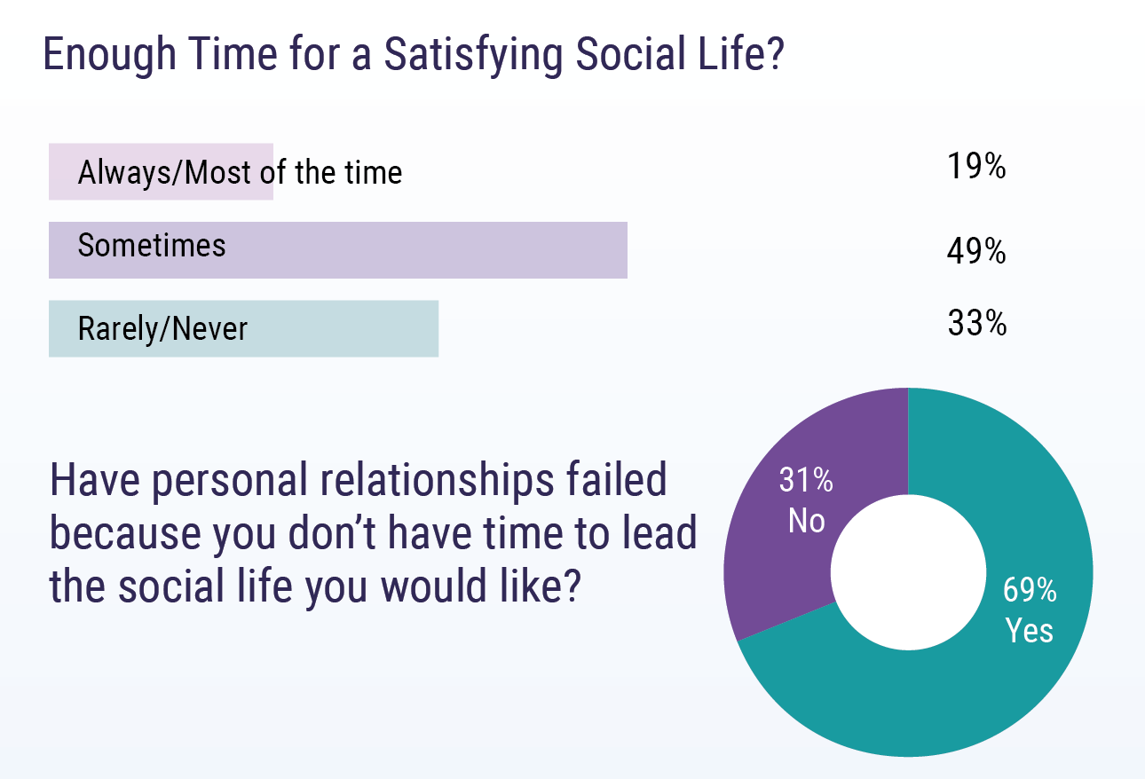
2018 Medscape Residents Lifestyle & Happiness Report (N=1916): Time for Satisfying Social Life?
https://www.medscape.com/slideshow/2018-residents-lifestyle-report-6010110#3: Accessed 11/13/2018
Notes:
CM updated

Slide 20
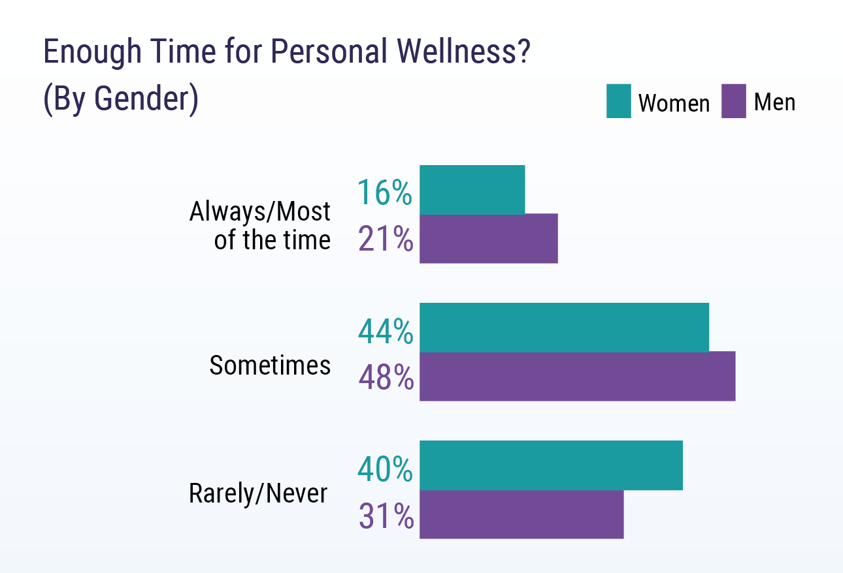
2018 Medscape Residents Lifestyle & Happiness Report (N=1916): Time for Personal Wellness?
https://www.medscape.com/slideshow/2018-residents-lifestyle-report-6010110#3: Accessed 11/13/2018
Notes:
CM updated

Slide 21
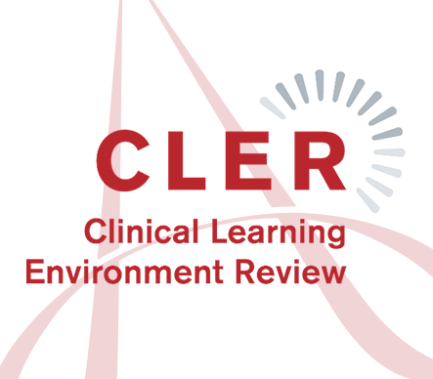
ACGME – Clinical Learning Environment Review (CLER)
Patient Safety
Health Care Quality
Care Transitions
Supervision & Workload
Professionalism
Well-being
CLER Evaluation Committee. CLER Pathways to Excellence: Expectations for an Optimal Clinical Learning Environment to Achieve Safe and High Quality Patient Care, Version 1.1. Chicago, IL: Accreditation Council for Graduation Medical Education; 2017.
Notes:
CM updated

Slide 22
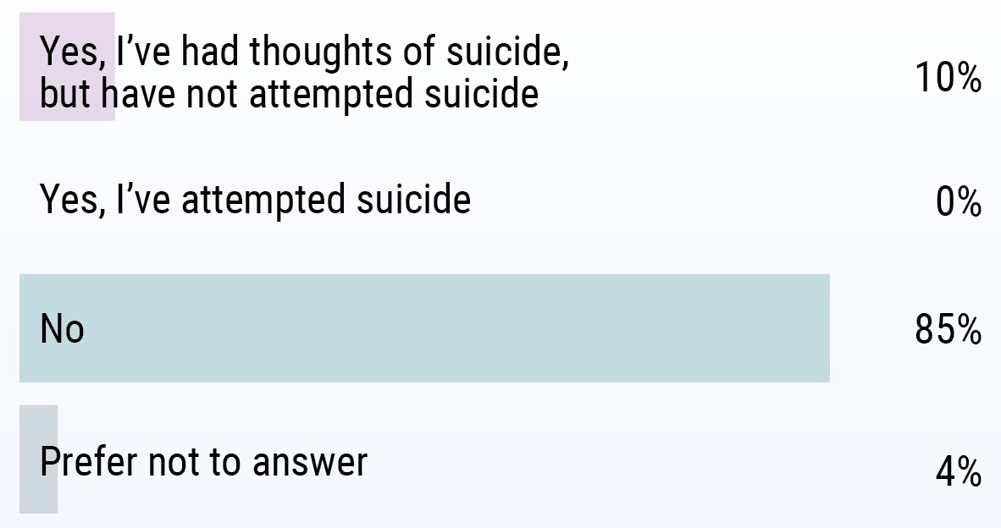
2018 Medscape Residents Lifestyle & Happiness Report (N=1916): Ever Considered Suicide?
https://www.medscape.com/slideshow/2018-residents-lifestyle-report-6010110#3: Accessed 11/13/2018
Notes:
CM updated

Slide 23
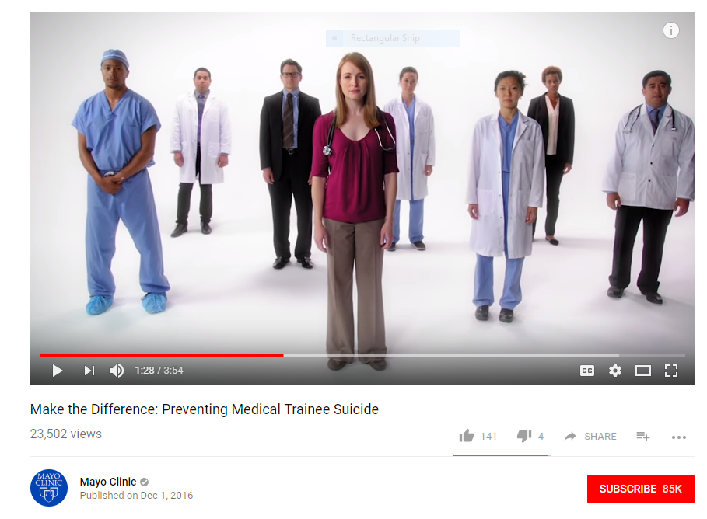
Suicide Awareness for Our Trainees
Suicide: #2 causes of resident death (behind cancer)*
Male > Female • Firearms ≈ drug OD > leaping, others
Greatest risk of death by suicide: 1st & 2nd yr & winter time
*Yaghmour NA et al. Acad Med 2017;92:976: ACGME Data; 2000-2014; N=381,614; incl. subspecialties
Notes:
CM updated

Slide 24
Monitoring Fellow Perspectives

Slide 25
2017-18 ACGME Fellow Survey: Well-Being
Never (1)
Rarely (2)
Sometimes (3)
Often (4)
Very Often (5)
Notes:
CM updated

Slide 26
2017-18 ACGME Faculty Survey: Well-Being
Never (1)
Rarely (2)
Sometimes (3)
Often (4)
Very Often (5)
Notes:
CM updated

Slide 27
How to Screen for Burnout & Well-Being?
Resident Physician Well-Being Index (PWBI)*
During the past month:
Have you felt burned out from your work?
Have you worried that your work is hardening you emotionally?
Have you often been bothered by feeling down, depressed, or hopeless?
Have you fallen asleep while stopped in traffic or driving?
Have you felt that all the things you had to do were piling up so high that
you could not overcome them?
Have you been bothered by emotional problems (such as feeling anxious,
depressed, or irritable)?
Has your physical health interfered with your ability to do your daily work
at home and/or away from home?
Predicts: Low mental QOL; high fatigue; suicide ideation & self-
perceived recent medical error
*Dyrbye LN et al. J Grad Med Educ 2014;6:78

Slide 28
Quick Screen for Burnout in Medical Professionals (students, residents, faculty)
Highest value item for emotional exhaustion:
“I feel burned out from my work”
Highest value item for depersonalization:
“I have become more callous toward people
since I took this job”
7-point Likert Scale
Never
A few times
a yr or less
Once a mo
or less
A few times
a mo or less
Once
a wk
A few times
a wk or less
Every
day
Responses to these items provide meaningful information on burnout – relative to the Maslach Burnout Inventory (MBI)
West CP et al. J Genl Intern Med 2009;24:1318

Slide 29
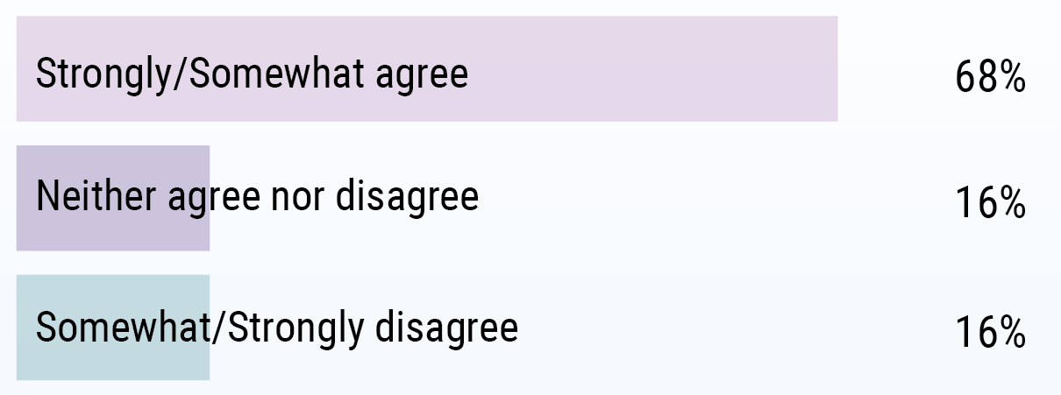
2018 Medscape Residents Lifestyle & Happiness Report (N=1916): Stigma Against Seeking Help?
https://www.medscape.com/slideshow/2018-residents-lifestyle-report-6010110#3: Accessed 11/13/2018
Notes:
CM updated

Slide 30
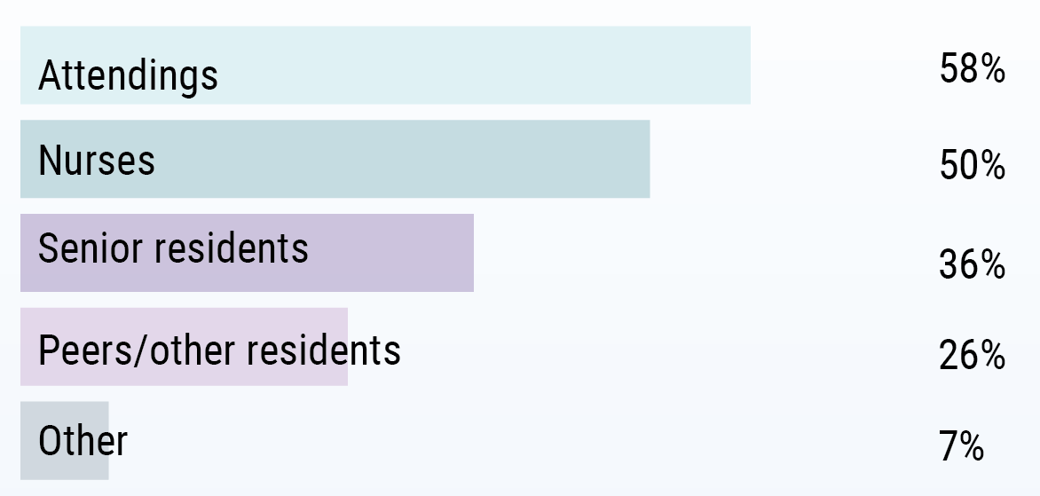
2018 Medscape Residents Lifestyle & Happiness Survey/Report (N=1916): Who Are the Bullies?
Bullying occurs: Often (4%); Occasionally (21%), Rarely (40%)
https://www.medscape.com/slideshow/2018-residents-lifestyle-report-6010110#3: Accessed 11/13/2018
Notes:
CM updated

Slide 31

Break-Out Session #1 – Acknowledgment & Awareness
Approaches, aids
& resources to identify
stress, fatigue, conflicting
priorities & burnout…
Among trainees
Among teaching faculty
You, individually
“Team-Based Learning”
Discuss in small groups…
Institutional approaches & resources
Personal approaches & resources
What you consider best practices

Slide 32
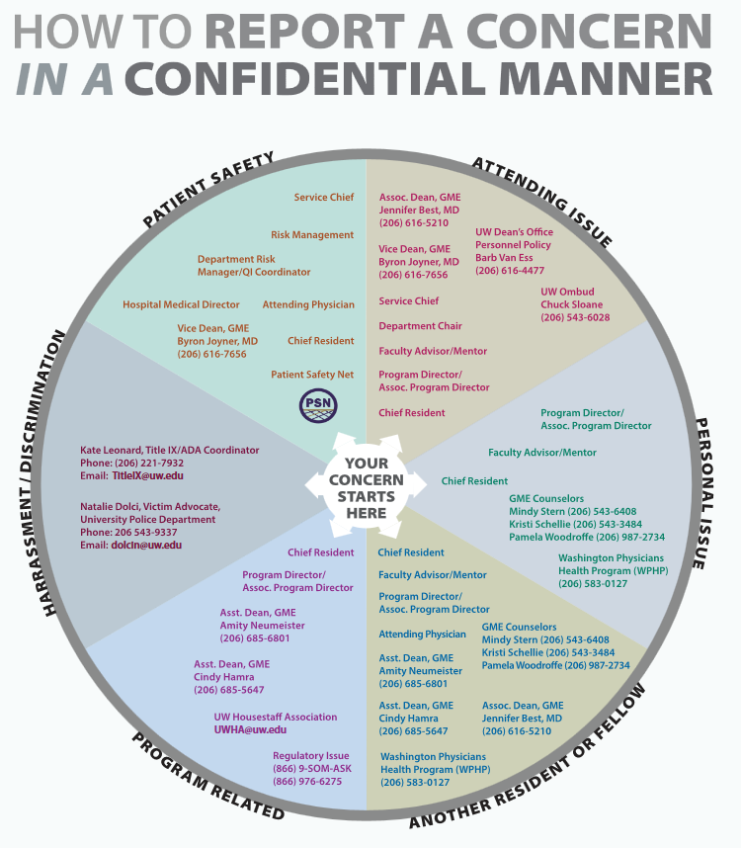
Fellow Well-Being – Who to Call
How to Report a Concern in a Confidential Manner
UW GME Wellness
UW CareLink
Notes:
CM updated

Slide 33
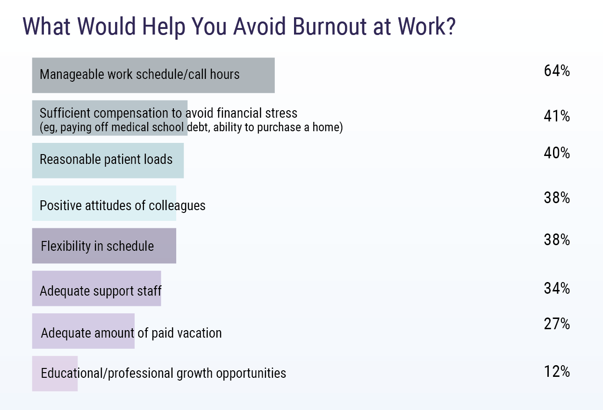
2018 Medscape Residents Lifestyle & Happiness Report (N=1916): Help to Avoid Burnout at Work?
https://www.medscape.com/slideshow/2018-residents-lifestyle-report-6010110#3: Accessed 11/13/2018
Notes:
CM updated

Slide 34
Nine Organizational Strategies to Reduce Burnout & Promote Physician Engagement
Provide options to adjust work effort – tailor work hrs
Greater flexibility on when & how work happens – days of week & hours of the day/night
Vacation, maternity time, LOA benefits
Couple individual strategies for resilience/wellness with organizational/systemic programs
Tools/training for self-calibration, self-care, resilience
Coaches, mindfulness-based stress reduction course
Shanafelt T & Noseworthy JH Nine organizational experiences to promote engagementand reduce burnout. Mayo Clin Proc 2017;92:129

Slide 35
Post-Fellowship Career Choices: Survey
Mayo H/O Grads (1998-2016); N=86; 69% academic; ~11 yrs post-grad
Clinical time: 61% • Solid tumor 58%; Malign Heme 38%; Heme 10%
Factors promoting focus in
current clinical practice area
Clinical experience during fellowship
Intellectual stimulation
Supportive mentor
Research focus
Clinical experience prior to fellowship
Career growth potential
Job choices when applying
Personal factors
Financial rewards
Adapted from: Marshall AL et al. Blood Adv 2018;2(4):361

Slide 36
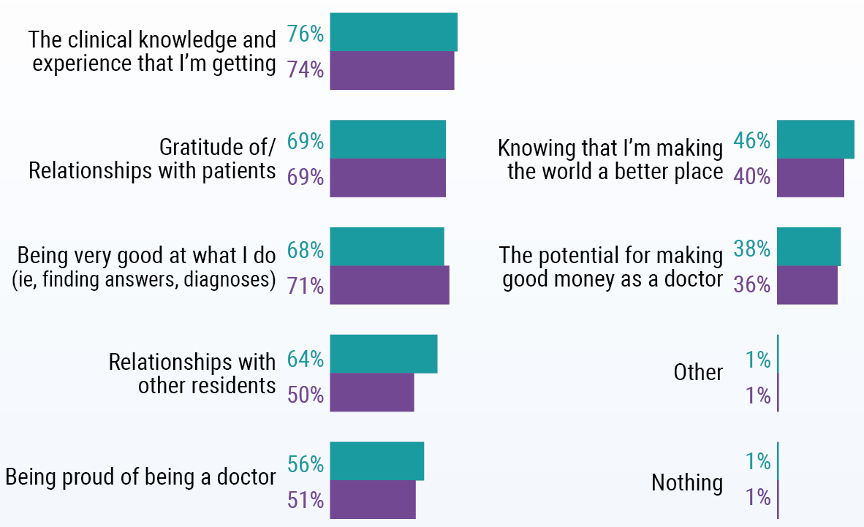
2018 Medscape Residents Lifestyle & Happiness Report (N=1916): Most Rewarding Part of Job?
https://www.medscape.com/slideshow/2018-residents-lifestyle-report-6010110#3: Accessed 11/13/2018
Notes:
CM updated

Slide 37
Finding Meaning in Our Profession
Notes:
CM updated

Slide 38
Fellow Well-Being – 2018 ASCO Resilience Skills Training Pilot
ASCO Director: Tony Back, MD
UW Program Facilitator: Martha Dimmers, MDiv, MSW, BCC
Topics (8 sessions)
Identifying Strengths and Utilizing Them
Your Resilience Zone – Activation
Recognizing Cognitive Distortions
Mindfulness
Self-compassion
Setting Healthy Boundaries
Finding Meaning in Your Everyday Work
Building Self-Care and Resilience into Your Life
Back AL et al. J Oncol Pract 2017;13(6):348
Notes:
CM updated

Slide 39
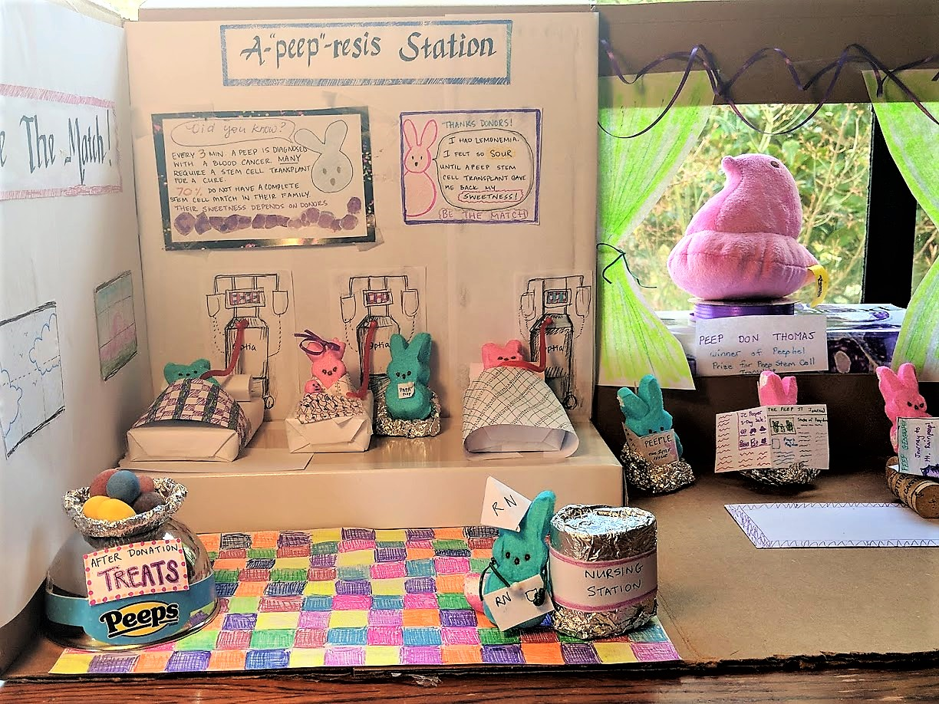
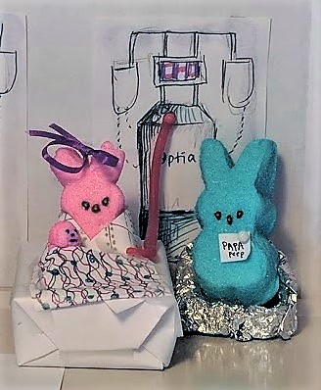
Community & Meaning Outside of Work
Comradery – Structured, unstructured & mutual support
Fellow events – Potlucks, bowling, picnics, movie night (w/babysitting)
Program events – Journal club at faculty homes; quarterly “Blood Club”
GME events – PEEPs diorama, free events, reduced tickets outside of work
Notes:
CM updated

Slide 40
Cope w/Burnout: Individual Strategies
Recognition of distress: Honest & regular self-calibration (take responsibility to care for yourself)
Identify Values: Debunk myth of delayed gratification; proactively identify personal & professional priorities; integrate personal & professional life (build community; connect with colleagues)
Optimize meaning in work: Create “flow” – ↑ time spent on meaningful & enriching activities & less time on draining & depleting activities (delegate/train/trade/outsource [scribe])
Nurture personal wellness activities: Mindfulness; resilience; practice self-care (exercise; sleep; medical care); religious/spiritual practice; personal interest/hobby; narrative medicine; relationships
Shanafelt T & Noseworthy JH.Mayo Clin Proc 2017;92:129
Rosenberg AR. Pediatrics 2018; 141(3):e20172388
Notes:
CM updated

Slide 41
External Resilience Resources
“Who supports me?” “Whom do I call when I need help?”
  Church groups – Extracurricular clubs – Professional peer support
Factors that inhibit outreach, social & relationship building
  Young MDs adopt a “survival” strategy
  Competition, scrutiny & fear of criticism
  Perfectionism, submissiveness & excessive devotion to work
  Indecisiveness & restricted ability to express warm emotions
  Guilt, doubt & exaggerated sense of responsibility
Build external resilience resources by:
  Cultivating professional relationships
  Sharing common experiences & challenges
  Nurture a culture where peer support is systematically modeled
Rosenberg AR. Pediatrics 2018; 141(3):e20172388
Notes:
CM updated

Slide 42
Internal Resilience Resources
“What are my strengths & skills?” “How can I develop them?”
  Personal traits (e.g., grit, optimism, sense of humor)
  Processes of adaptation (e.g., coping styles, mindfulness)
  Learned skills (e.g., goal-setting, stress-management, constructively responding to criticism, cognitive-reframing, intentional efforts to achieve work-life balance)
  Early career professionals may need help identifying other forward-looking goals or motivational factors to sustain themselves
Build internal resilience resources by:
  Acknowledging adaptive personal traits while making deliberate efforts to develop skills like stress- or time-management
Rosenberg AR. Pediatrics 2018; 141(3):e20172388
Notes:
CM updated

Slide 43
Existential Resilience Resources
“What should I learn from this?” “What am I grateful for?”
  Involves the process of meaning-making
  Finding gratitude through self-reflection, self-care & time
  Concepts of spirituality, including the non-faith based exploration of personal meaning & purpose
  Develop existential resilience resources such as self-awareness, reflective writing & communication-skills (to teach empathy & emotional connection with patients)
Build existential resources by:
  Finding time to create our own meaningful professional narratives
  Asking oneself, “what do I find most meaningful in my work?”
Rosenberg AR. Pediatrics 2018; 141(3):e20172388
Notes:
CM updated

Slide 44
Circumstantial vs Existential Burnout
Subjects (N=25)
- PGY-2, -3 & recent grads
- Experienced burnout &
recovered successfully
Structured interviews
- Saturation of themes →
consensus themes
“Circumstantial” burnout
- Environmental triggers
- Self-limited
“Existential” burnout
- Loss of meaning
- Uncertain professional role
Abedini NC et al. J Grad Med Educ 2018;10:26
Notes:
CM updated

Slide 45
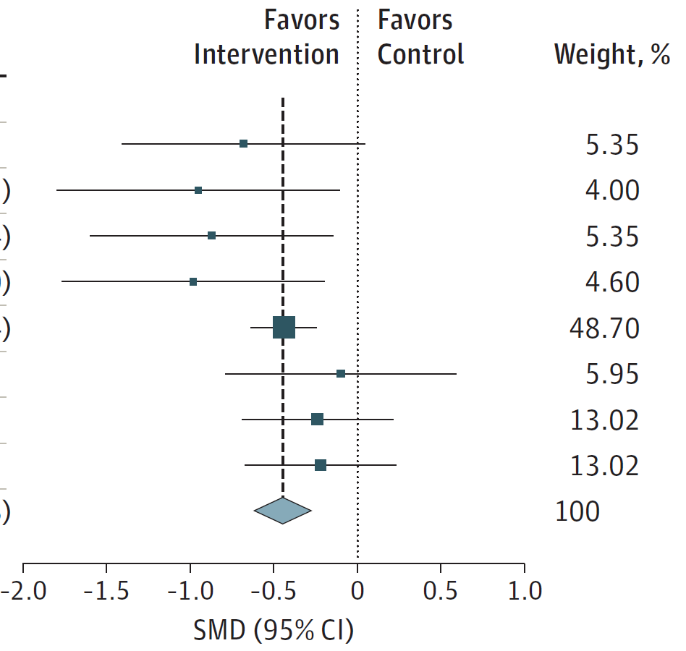
Which Interventions Best Reduce Burnout? Systematic Review & Meta-analysis*
Benefits: Organization-directed >> Individual-directed
Organization-directed Interventions
(Standardized mean difference -0.45)
Individual-directed (SMD -0.18)
→ Greatest source of burnout = Organizational factors (> individual)
*Panagioti M et al. JAMA Intern Med 2017;177:195

Slide 46
Break-Out Session #2 – Interventions Against Burnout & Building Resilience
Identify strategies for…
Mitigating stress
Navigating prioritization
Finding meaning
Instilling self-compassion
Promoting mindfulness
“Team-Based Learning”
Discuss in small groups…
Interventions at your institution/program
Your personal interventions, activities, practices
The barriers to achieving well-being & resilience?

Slide 47
Summary
Training in Hematology/Oncology & post-graduate careers incur major challenges to work-life balance → burnout
Causes of burnout may be “circumstantial” or “existential” with minor or more serious consequences & outcomes
PDs & faculty must be knowledgeable & vigilant for signs of distress, depersonalization & exhaustion (stigmatization)
Formal programs & institutional support must be available to implement & maintain a culture of personal well-being
Wellness & resilience skills training are essential to satisfaction during fellowship & for sustainable work-life balance in future clinical/academic careers

Slide 48
Thank you

Slide 49
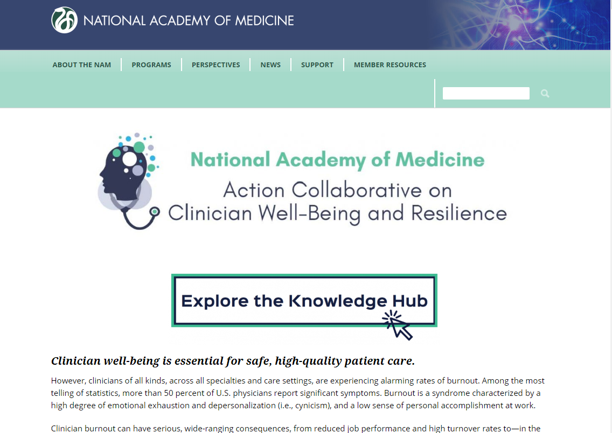
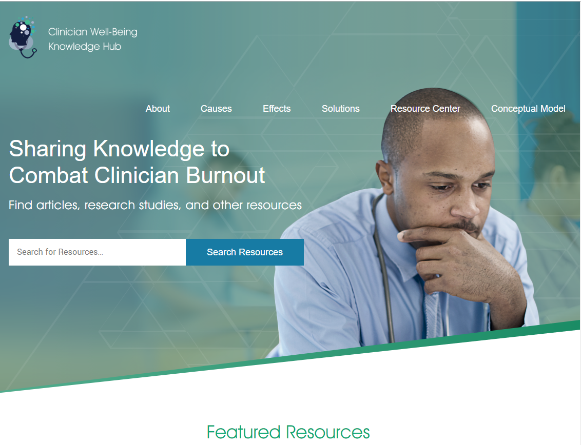
NAM – Action Collaborative on Clinician Well-Being and Resilience & Knowledge Hub
https://nam.edu/initiatives/clinician-resilience-and-well-being
https://nam.edu/clinicianwellbeing//
Notes:
CM updated

Slide 50
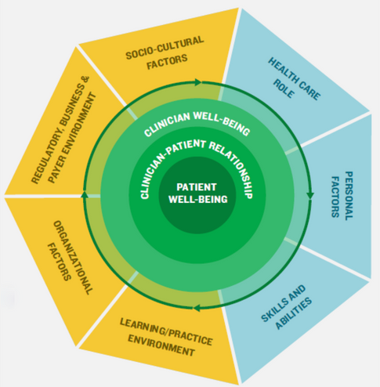
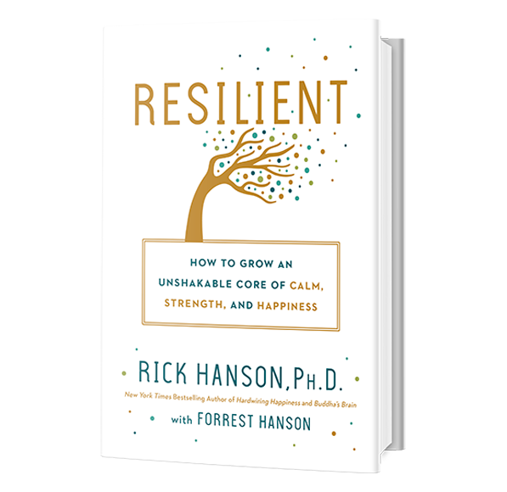
Well-Being & Resilience – NAM Construct & Lay Resource
Brigham T et al. NAM Action Collaborative on Clinician Well-Being and Resilience; Jan 2018. https://nam.edu/journey-construct-encompassing-conceptual-model-factors-affecting-clinician-well-resilience/
Notes:
CM updated

Slide 51
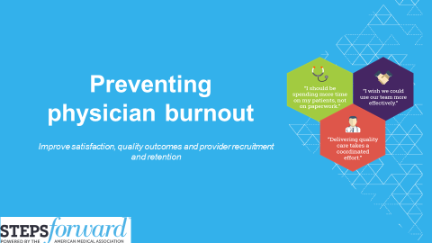
Wellbeing for Postgraduates – AMA Steps Forward Program
Notes:
CM updated

